Slide 1
Microbiology
Chapter 4
Microscopy, Staining and Classification

Slide 2
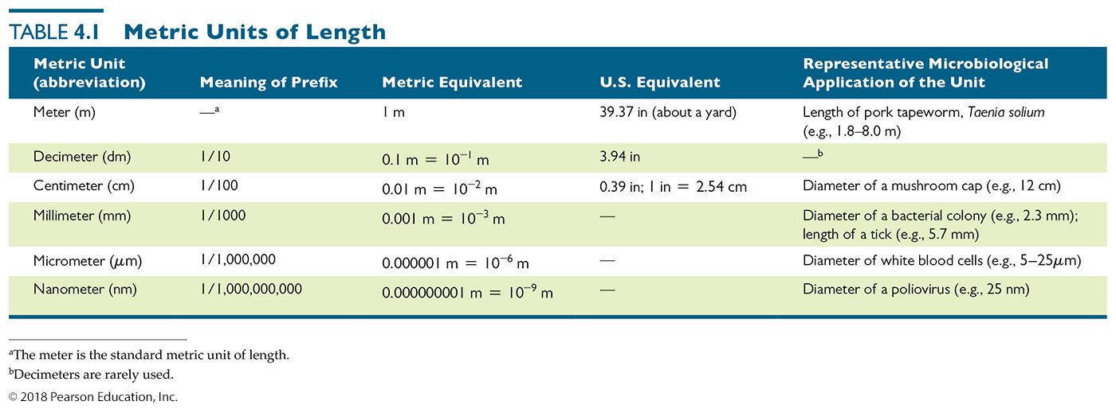
Table 4.1 Metric Units of Length
a.k.a micron
Factors of 1000
Factors of 10³
How many microns in a millimeter?
How many millimeters in a nanometer?
Notes:
2

Slide 3
SUMMARY SLIDE
General Principles of Microscopy
Wavelength of radiation
Determines ultimate resolution of region of interest
Sets limits on what we can easily see
Magnification
Results when a beam of radiation is refracted (bent)
Degree of magnification – thickness of lens, curvature, the speed of light through substance
Resolution
Ability to distinguish objects that are close together
Blue filter allows shorter wavelengths to pass which increases resolution
Contrast
Intensity between an object and its background
Notes:
3

Slide 4
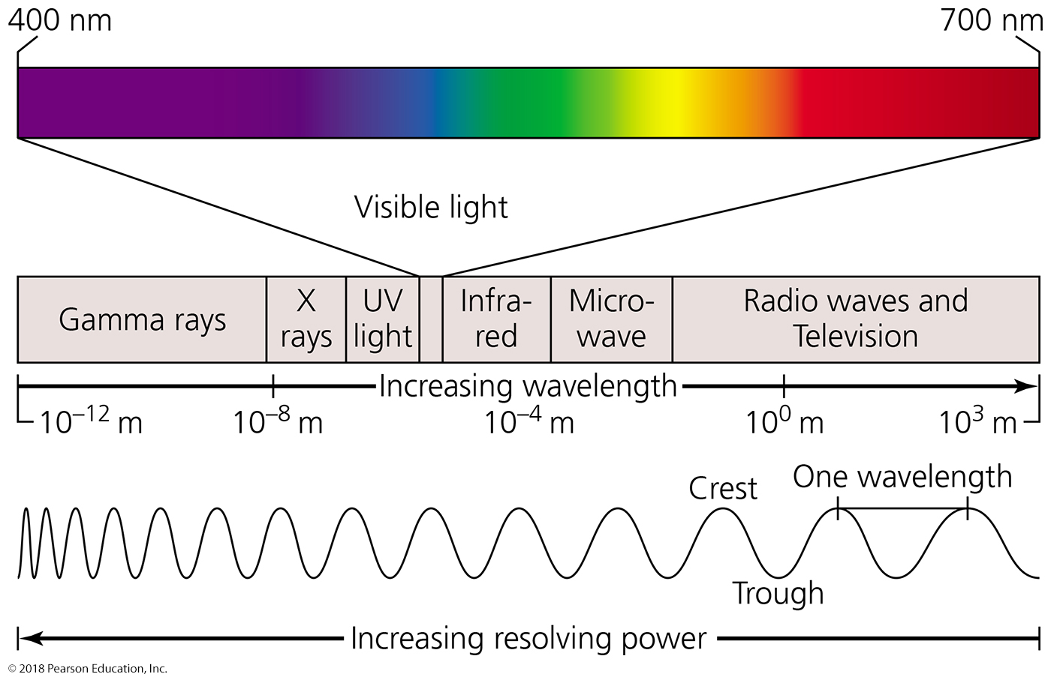
WAVELENGTH OF LIGHT - The electromagnetic spectrum.
Notes:
4

Slide 5
Why wavelength matters
An object is seen ONLY IF a “light” wave crest and trough
pass through an object at the same time (all things vibrate)
virus
bacterium
critical distance at short wavelength
critical distance at long wavelength
virus seen
virus too small to be seen
bacterium seen (in more detail)
bacterium seen
Which wavelengths would you prefer to use to see stuff???
Notes:
5

Slide 6
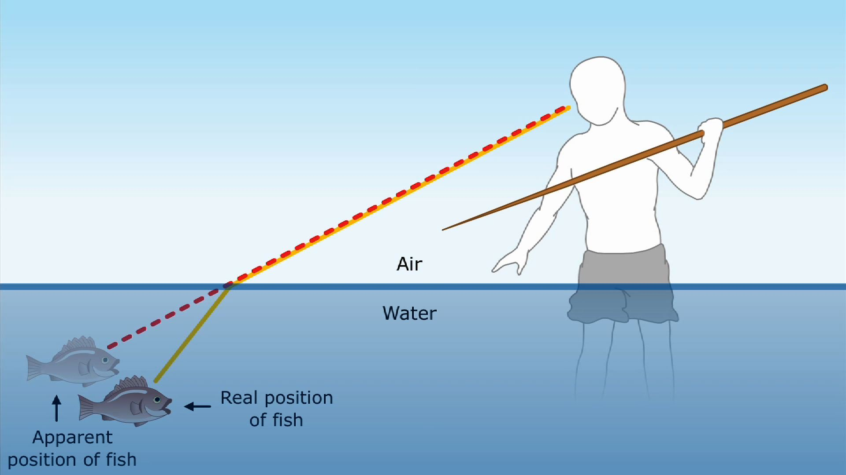
Light refraction and image magnification by a convex glass lens.
Light bends when it interacts with matter - refraction
Flat surface
Notes:
6

Slide 7
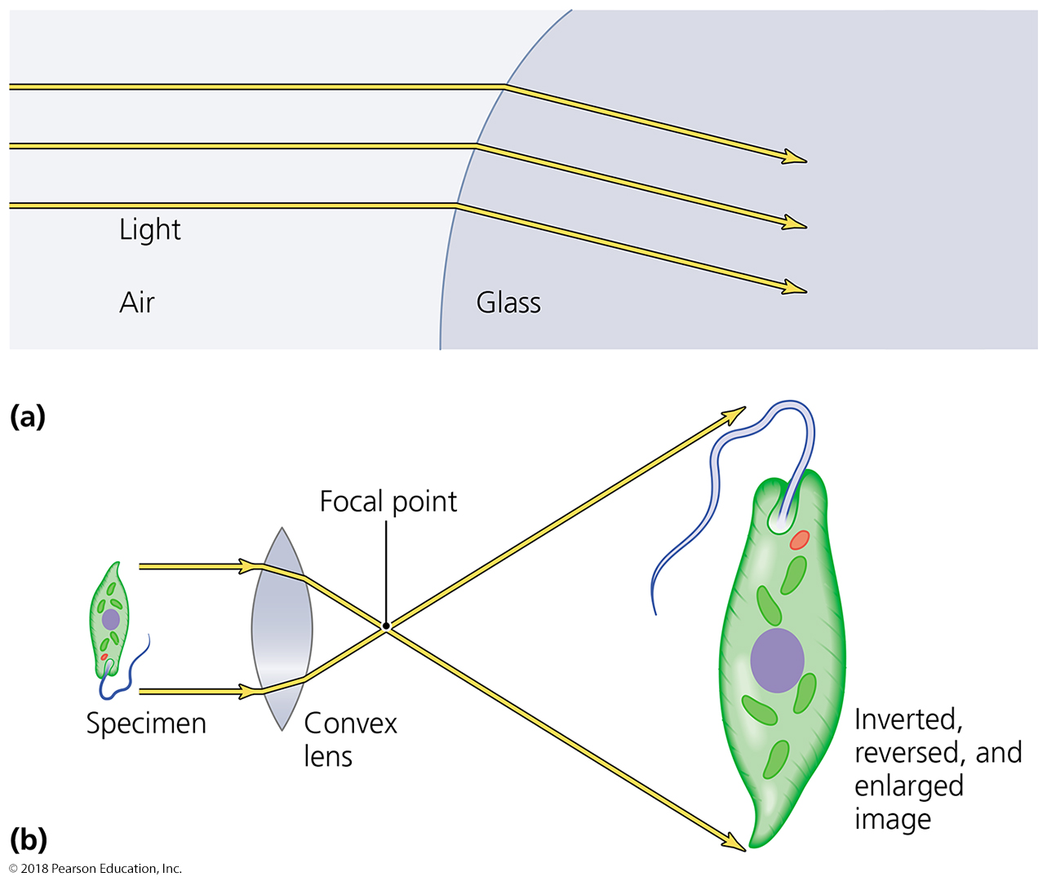
Figure 4.2 Light refraction and image magnification by a convex glass lens.
Light bends when it interacts with matter - refraction
What happens to intense light as it is spread out to magnify an image??
curved surface
Notes:
7

Slide 8
Microscopy
General Principles of Microscopy
Resolution
Ability to distinguish two points that are close together
The better the resolution, the better two nearby objects are distinguished from one another

Slide 9
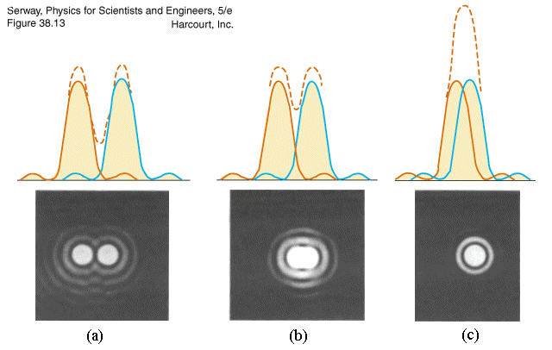
Microscopy
General Principles of Microscopy
Resolution
Ability to distinguish two points that are close together
The better the resolution, the better two nearby objects are distinguished from one another when they are really close

Slide 10
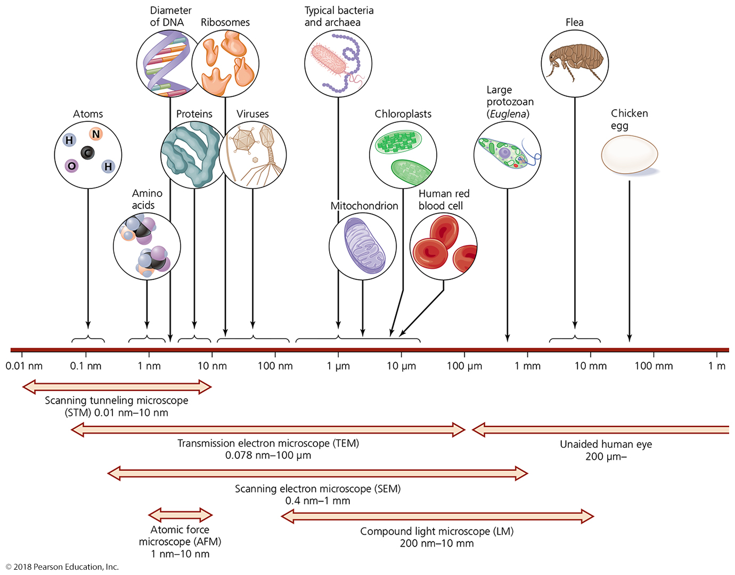
Figure 4.3 The limits of resolution (and some representative objects within those ranges) of the human eye and of various types of microscopes.
Notes:
10

Slide 11
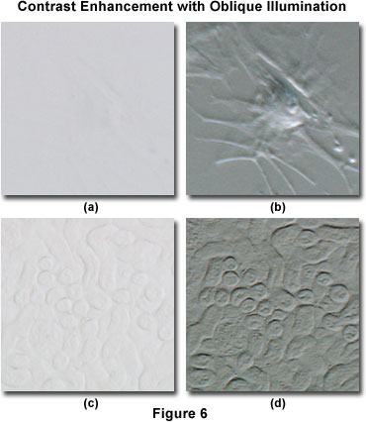
General Principles of Microscopy
Contrast
The presence of differences in intensity between two objects or between an object and its background
Is it the object or the background?
Important in determining resolution
Need to know there are two “things” in order to know resolution
Staining increases contrast
Use of light that is in phase also increases contrast

Slide 12
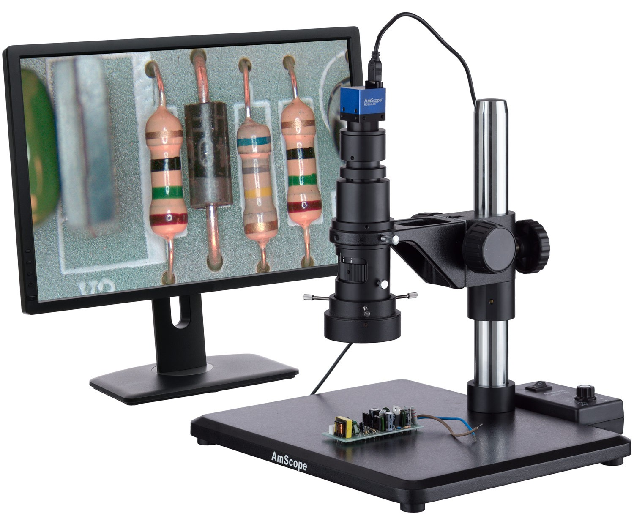
Microscopy
Light Microscopy
Bright-Field Microscopes
Uses visible light to “see” objects
We use visible light to see objects, thus we can see objects directly through light microscopy
Simple microscope
Contains a single magnifying lens
(USB microscopes)
Similar to magnifying glass
von Leeuwenhoek built simple microscopes to observe microorganisms

Slide 13
Microscopy
Light Microscopy
Bright-Field Microscopes
Compound microscope
Series of lenses (usually 2) for magnification
Light passes through specimen into objective lens
Oil immersion lens increases resolution by concentrating light, improving brightness and focal depth
Have one or two ocular lenses
Total magnification = magnification of objective lens × magnification of ocular lens
Most have condenser lens (concentrates and directs light into specimen) – does NOT magnify samples

Slide 14
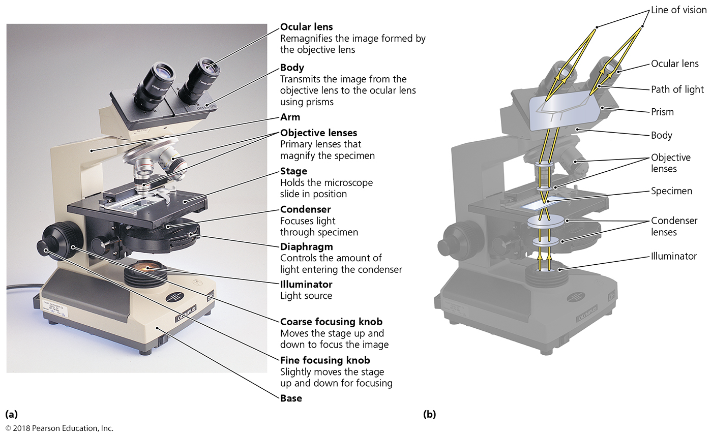
Figure 4.4 A bright-field compound light microscope.
Notes:
14

Slide 15
Figure 4.5 The effect of immersion oil on resolution.
Microscope
objective
Microscope
objective
Notes:
15

Slide 16
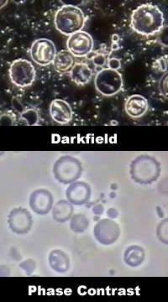
Microscopy
Light Microscopy
Dark-Field Microscopes
Best for observing pale objects and external features
Only light rays scattered by specimen enter objective lens
Specimen appears light against dark background
Increases contrast and enables observation of more details
Useful for examining small or colorless cells

Slide 17
Microscopy
Light Microscopy
Phase Microscopes
Used to examine living organisms or specimens that would be damaged/altered by attaching them to slides or staining
Contrast is created because light waves are out of phase
Best for viewing internal structures

Slide 18
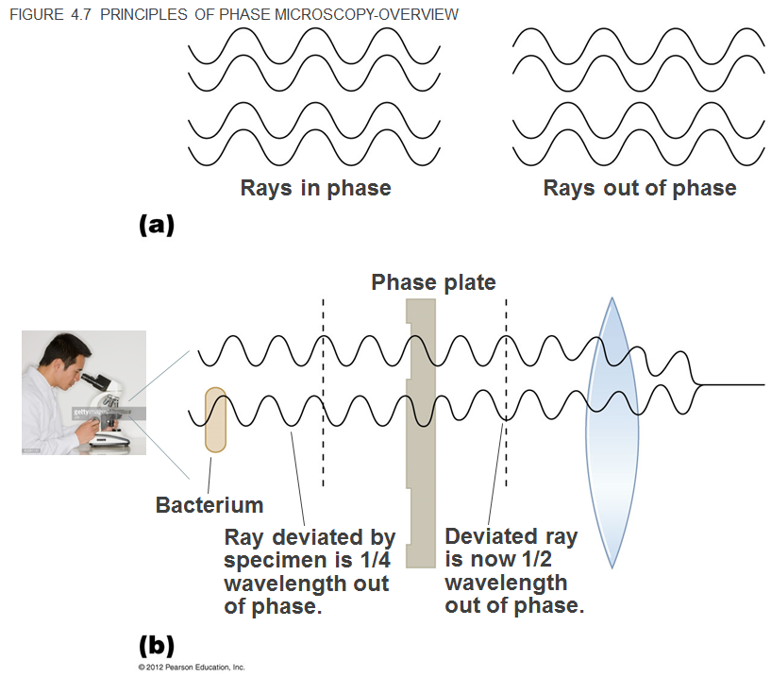
Light is doubled and thus still visible
Light cancels out and is invisible
Are objects that interact with matter, light or dark?
Notes:
18

Slide 19
Figure 4.6 Four kinds of light microscopy.
Notes:
19

Slide 20
Microscopy
Light Microscopy
Fluorescence Microscopes
Direct UV light source at specimen
Specimen radiates energy back as a longer, visible wavelength (UV light is blocked or is invisible)
UV light increases resolution and contrast
Some cells are naturally fluorescent; others must be stained with fluorescent dyes
Used in immunofluorescence to identify pathogens and to make visible a variety of proteins – increases specificity of staining
Fluorescence uses specific colors, allowing multi-labeling

Slide 21
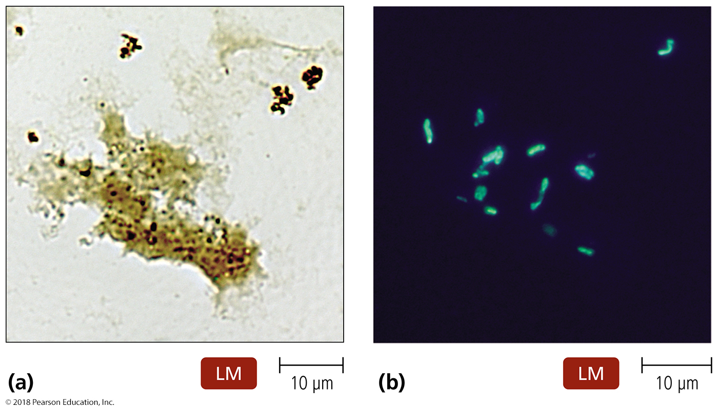
Figure 4.7 Fluorescence microscopy.
Notes:
21

Slide 22
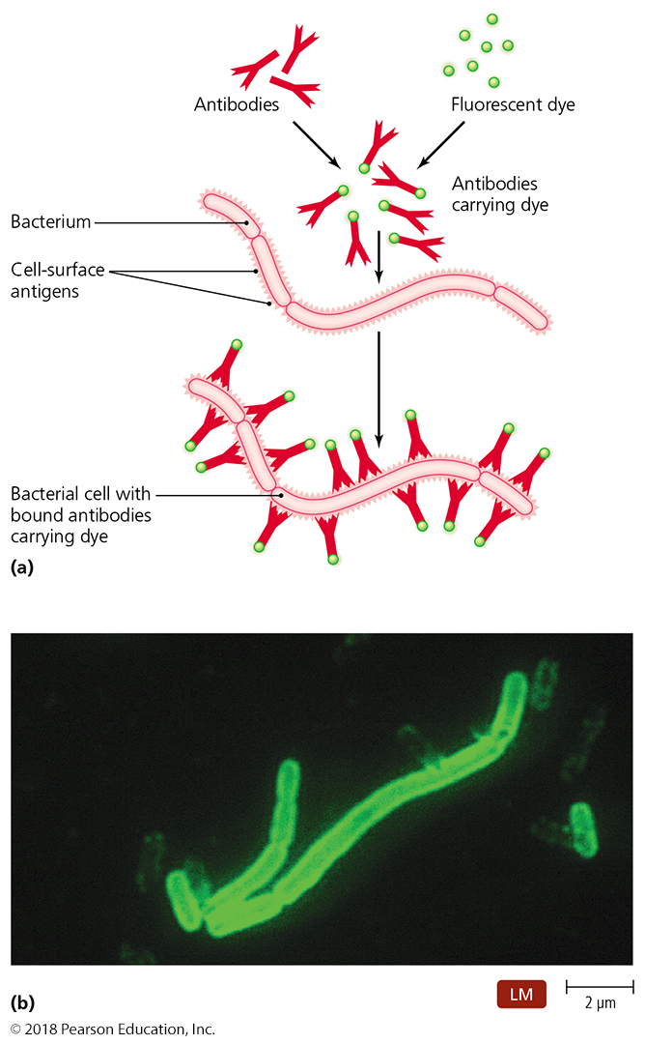
Figure 4.8 Immunofluorescence.
Notes:
22

Slide 23
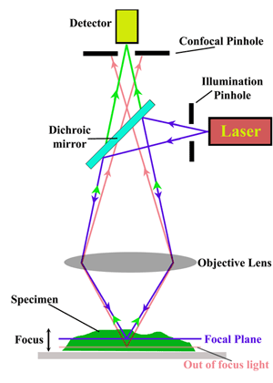
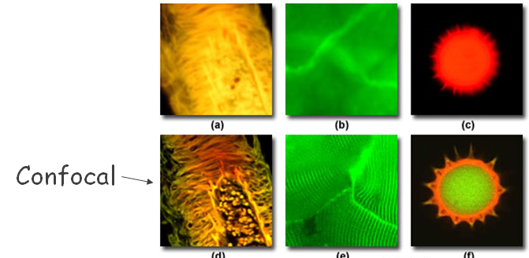
Confocal microscopy
Use fluorescent dyes
Use UV lasers to illuminate fluorescent chemicals in a single plane
Resolution increased because light passes through pinhole aperture; deepens focal depth
Computer assembles 2D image from tiny volumes, and constructs 3D images from 2D images
Notes:
23

Slide 24
Microscopy
Electron Microscopy
Light microscopes cannot resolve structures closer than 200 nm (lowest wavelength of visible light is 400 nm)
Electron microscopes have greater resolving power (< 0.05 nm; 4000x better!) and magnification
Magnify objects 10,000× to 100,000×
Cannot see directly; must use computers and mathematics to reconstruct image
Detailed views of bacteria, viruses, internal cellular structures, molecules, and large atoms
Two types:
Transmission electron microscopes (see through)
Scanning electron microscopes (bounce off)

Slide 25
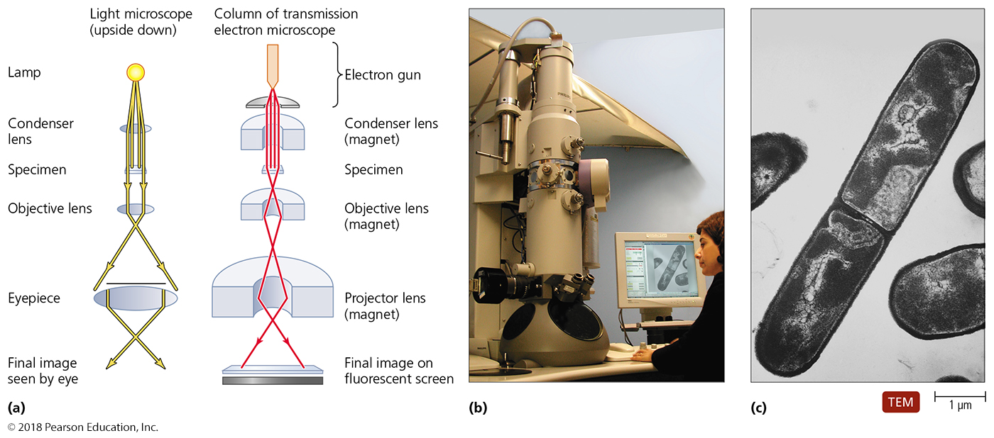
Figure 4.10 A transmission electron microscope (TEM).
Must see “through” sample, electrons that do not pass through are assumed to hit structure (dark parts)
Notes:
25

Slide 26
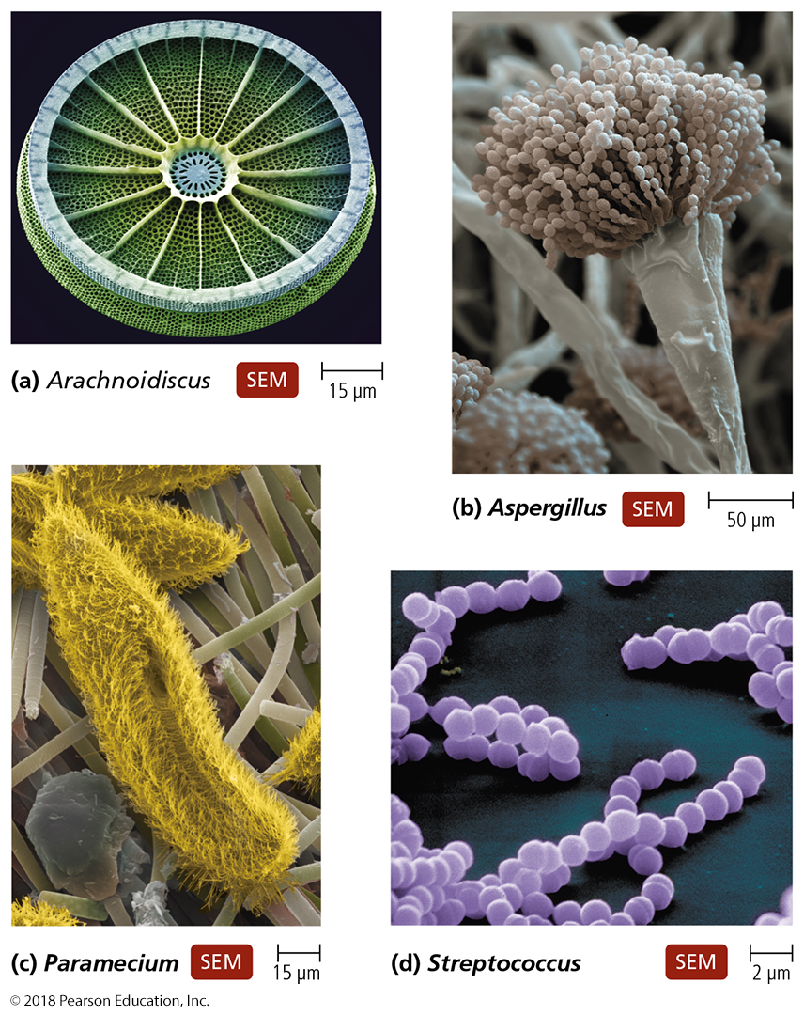
Figure 4.11 Scanning electron microscope (SEM) images.
Electrons reflect off of sample; reflection patterns used to reconstruct a 3D image
Notes:
26

Slide 27
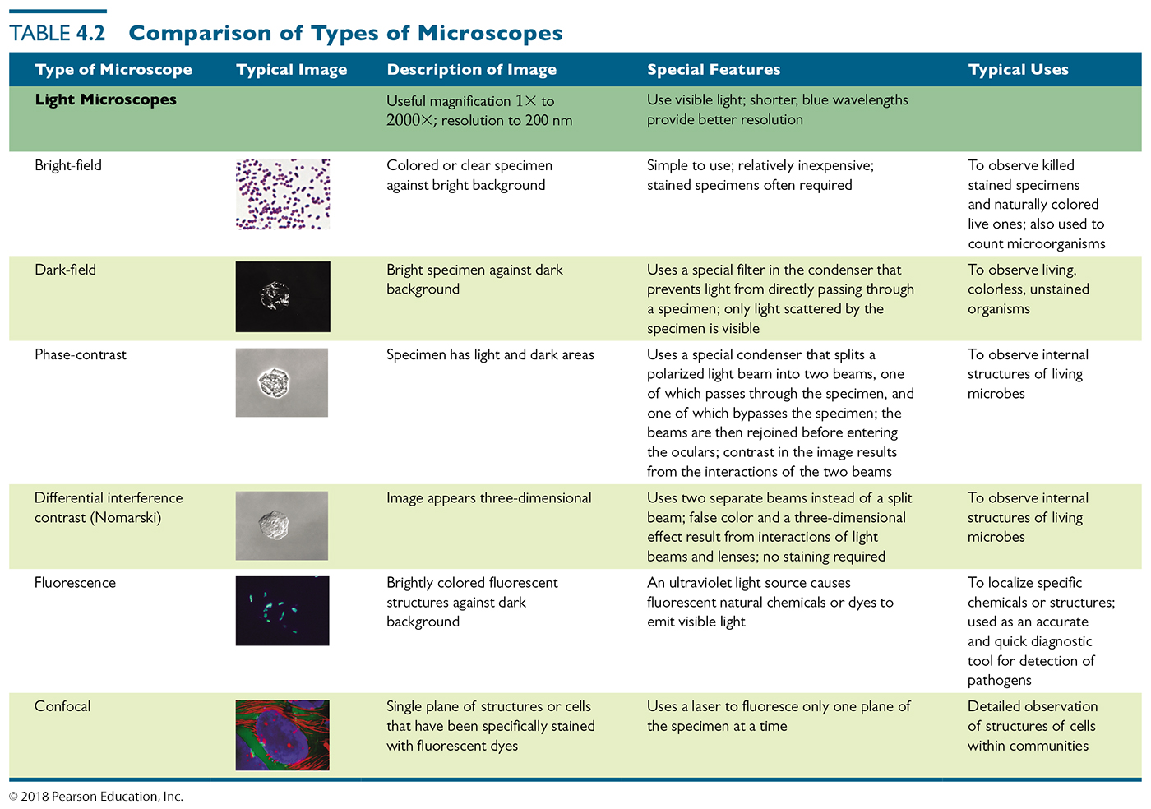
Table 4.2 Comparison of Types of Microscopes (1 of 3)
Notes:
27

Slide 28
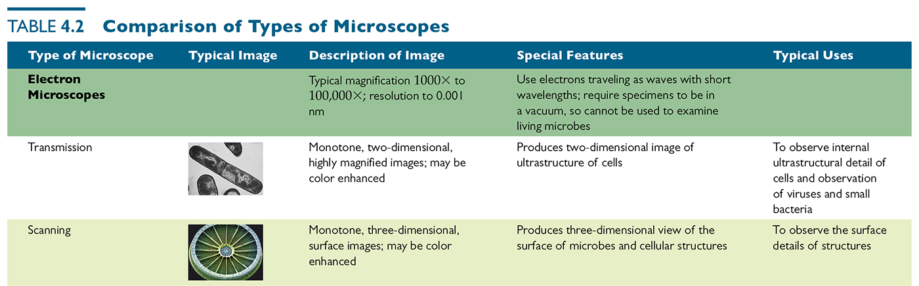
Table 4.2 Comparison of Types of Microscopes (2 of 3)
Notes:
28

Slide 29
Staining
Most microorganisms are difficult to view by bright-field microscopy
Coloring specimens with stain increases contrast and resolution
Specimens must be prepared for staining

Slide 30
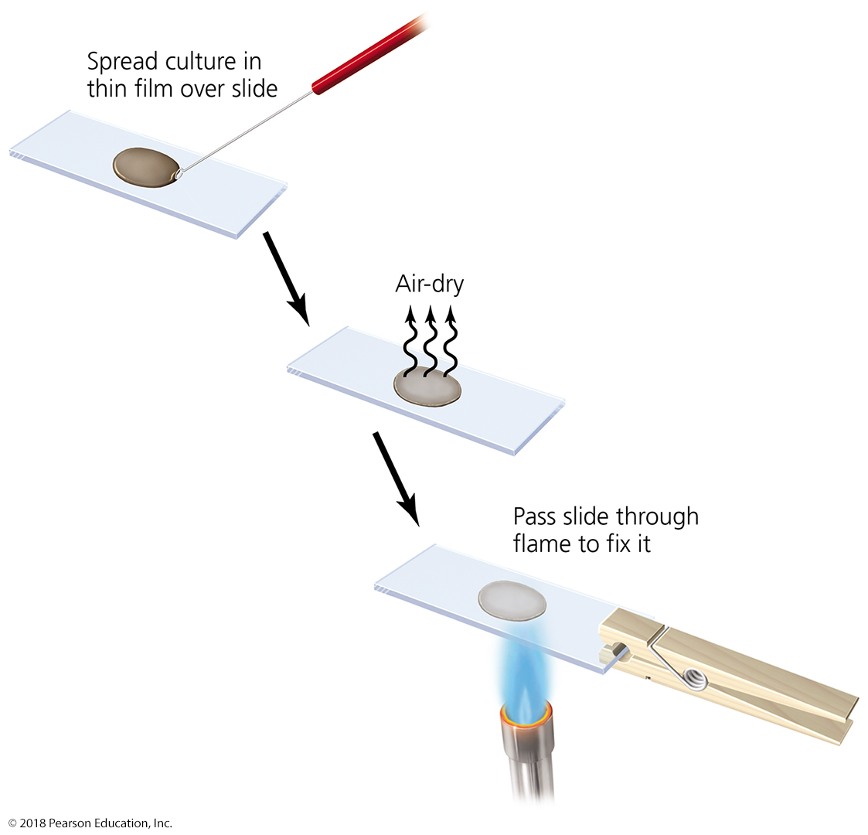
Figure 4.13 Preparing a specimen for staining.
Notes:
30

Slide 31
Staining
Principles of Staining
Dyes used as stains are usually salts (dissolve in water)
Chromophore is the colored portion of the dye
Acidic dyes
usually negatively charged
stains alkaline structures (histones)
Basic dyes
Often positively charged
stain acidic structures
More common since most cells are negatively charged and thus are acidic
What is the nature of the interaction of the stain with cells? Covalent or ionic?

Slide 32
Simple Staining
Composed of single basic dye
Crystal violet, safranin, methylene blue
Used to determine size, shape, arrangement, viability or the presence, of cells

Slide 33
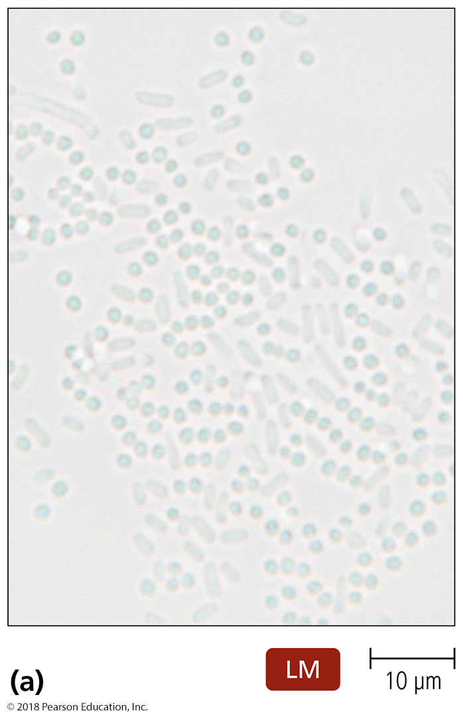
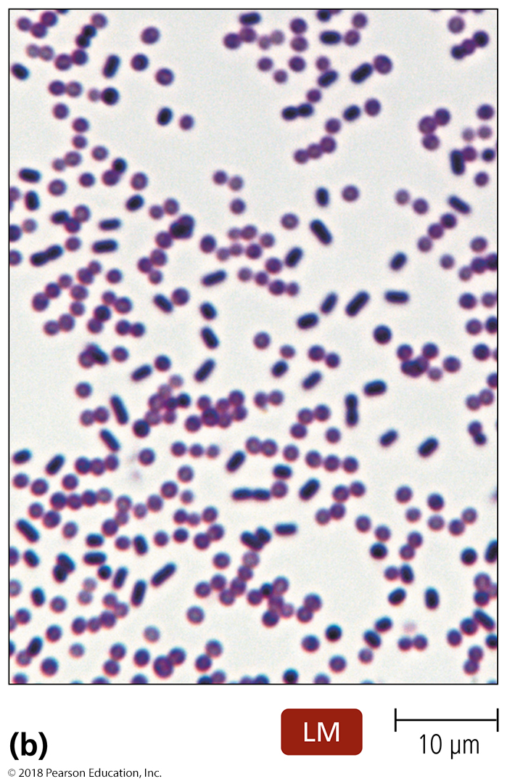
Figure 4.14 Simple stains.
Notes:
33

Slide 34
Differential Staining – SUMMARY SLIDE
Use more than one dye
Used to distinguish between different cells, chemicals, or structures
Common differential stains include:
Gram stain
Acid-fast stain
Endospore stain
Histological stains

Slide 35
Common staining vs. special staining
Simple Stains
Involve soaking the specimen in one stain
Differential Stains
Gram stain
Gram positive and Gram negative cells
Acid-fast stain
Stains genera Mycobacterium and Nocardia (waxy lipid in cell walls)
Endospore stain
Endospore wall are impermeable to many chemicals, stain uses heat to drive the staining agent into endospore
Histological stain
Used to visualize things like fungi and cancer cells in tissue samples
Special Stains
Negative (capsule) stain
Acidic dye – repelled by negative charges on surface of cell
Flagellar stain
Increase diameter of flagella to be seen
© 2012 Pearson Education Inc.
Notes:
35

Slide 36
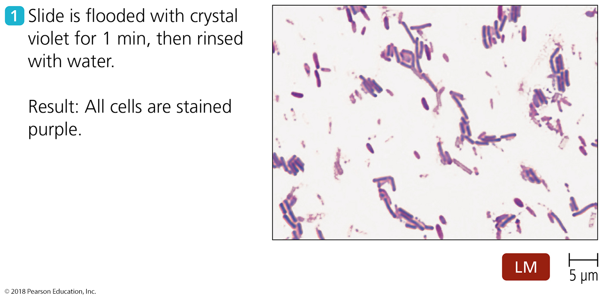
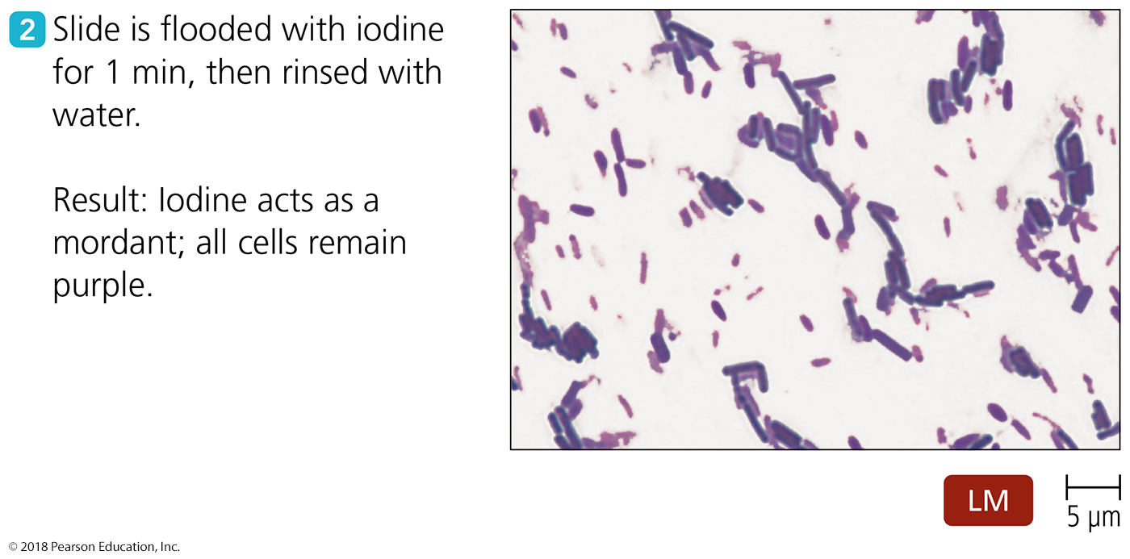
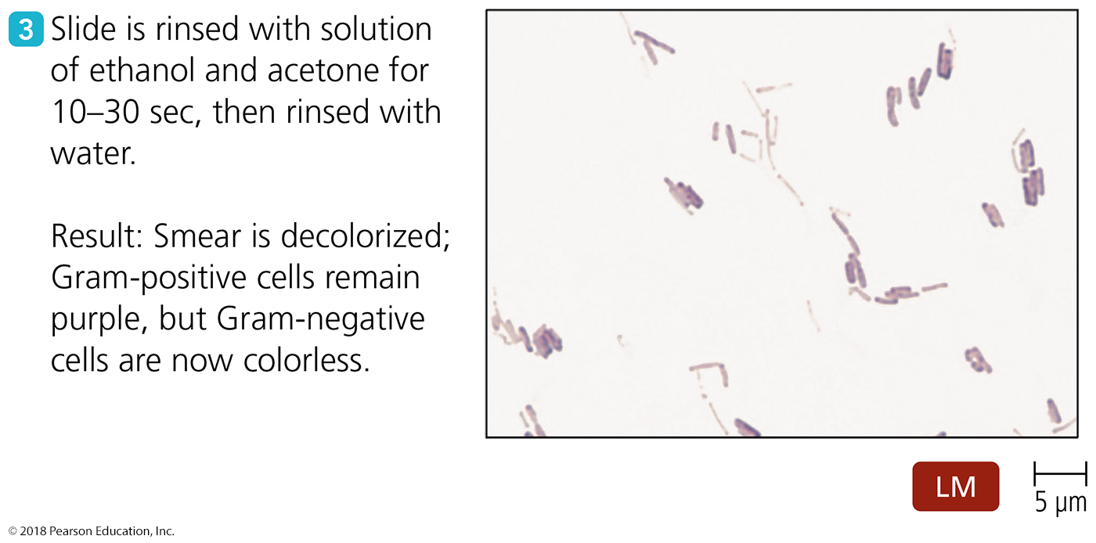
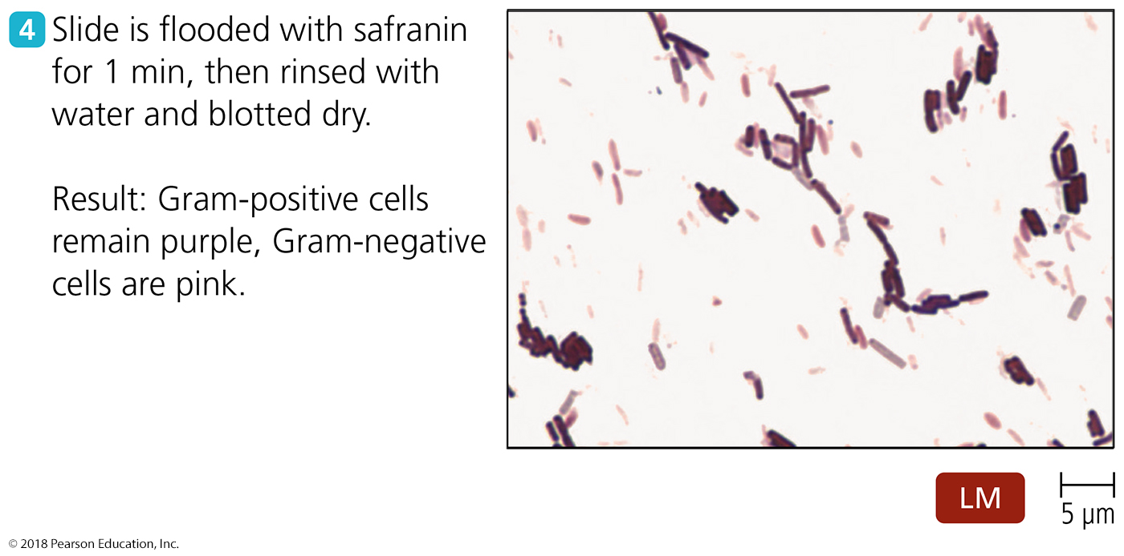
Figure 4.15 The Gram staining procedure.
Notes:
36

Slide 37
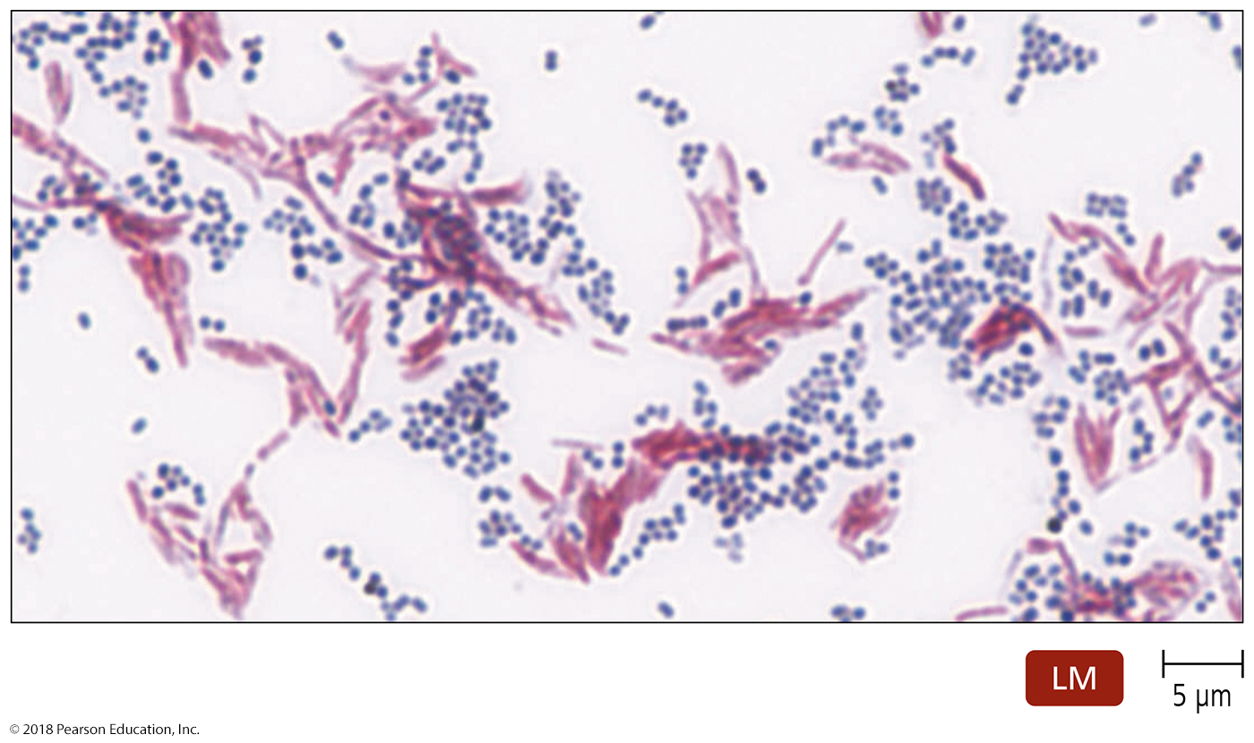
Figure 4.16 Ziehl-Neelsen acid-fast stain.
Notes:
37

Slide 38
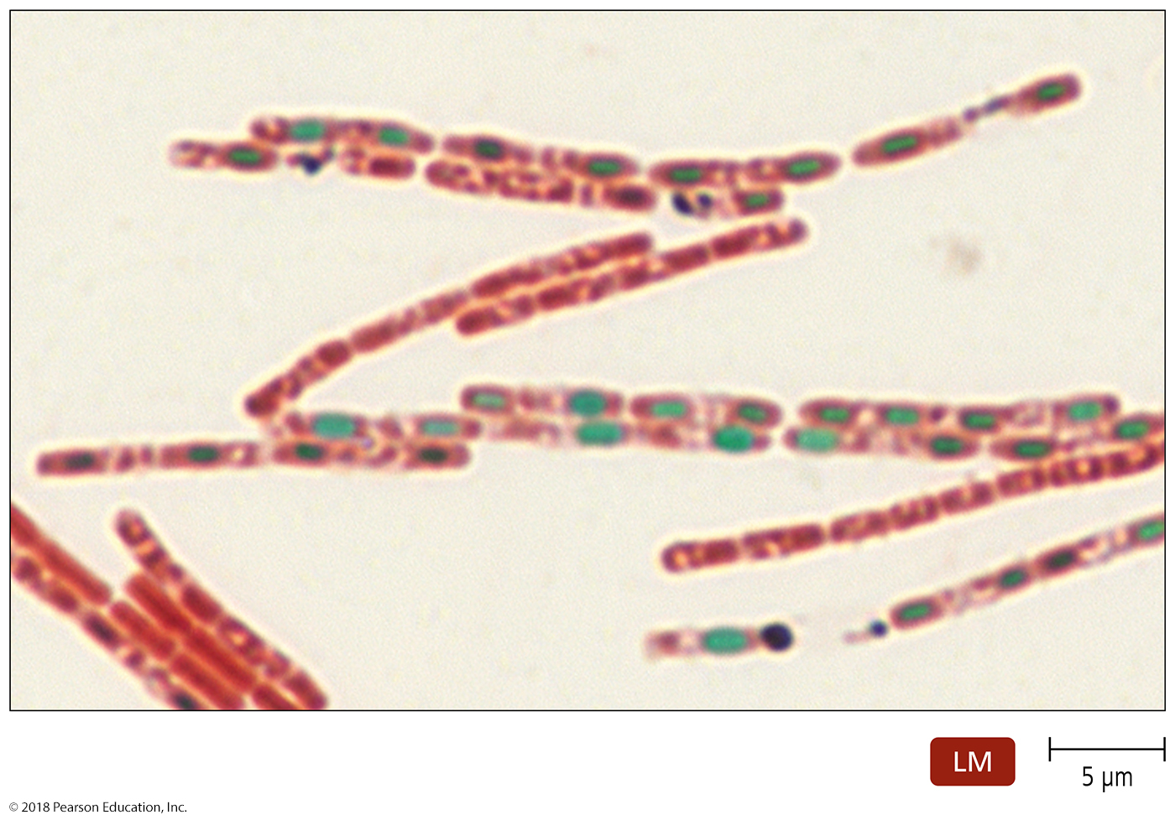
Figure 4.17 Schaeffer-Fulton endospore stain of Bacillus anthracis.
Notes:
38

Slide 39
Special staining
Simple stains used to identify specific microbial structures
Special stains include:
Negative stains
Flagellar stains
Fluorescent stains

Slide 40
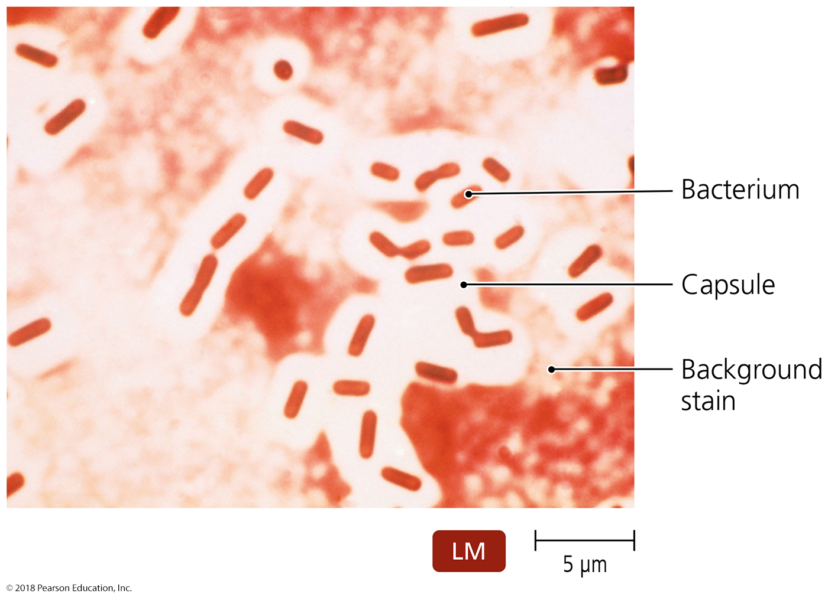
Figure 4.18 Negative (capsule) stain of Klebsiella pneumoniae.
Notes:
40

Slide 41
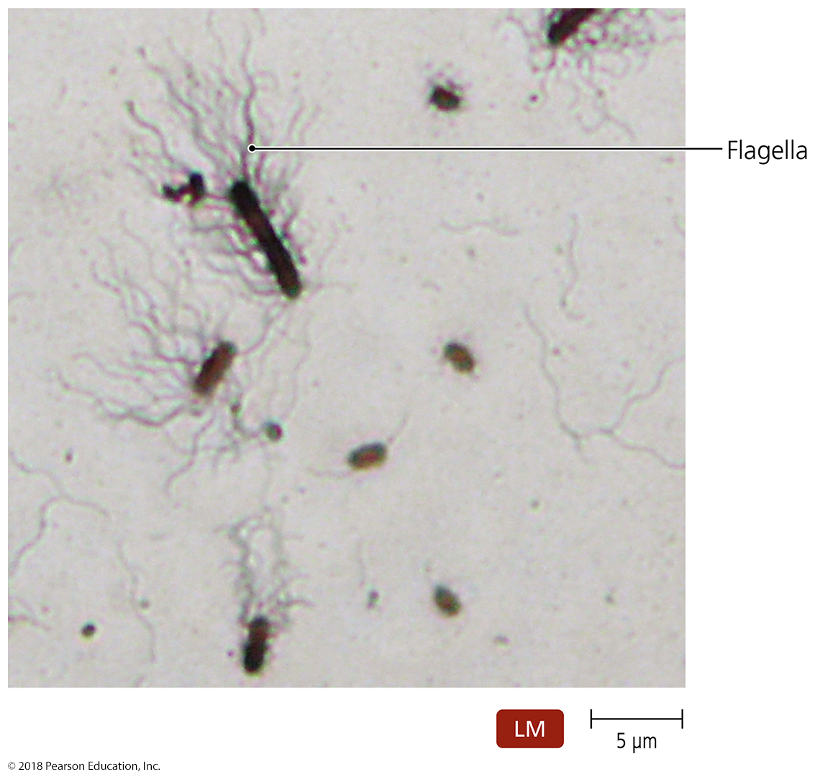
Figure 4.19 Flagellar stain of Proteus vulgaris.
Notes:
41

Slide 42
Table 4.3 Some Stains Used for Light Microscopy
Notes:
42

Slide 43
Differential Stains
Histological stain
Two popular stains for histological specimens
Gomori methenamine silver (GMS)
Presence of fungi and carbs in tissues
Hematoxylin and eosin (HE)
Presence of cancer cells
Notes:
43

Slide 44
Classification and Identification of Microorganisms
Taxonomy consists of classification, nomenclature, and identification
Organize large amounts of information about organisms
Make predictions based on knowledge of similar organisms
Help understand evolutionary connections

Slide 45
Classification and Identification of Microorganisms
Linnaeus and Taxonomic Categories
Carolus Linnaeus
His system classified organisms based on common characteristics
Grouped organisms that can successfully interbreed into categories called species
Used binomial nomenclature

Slide 46
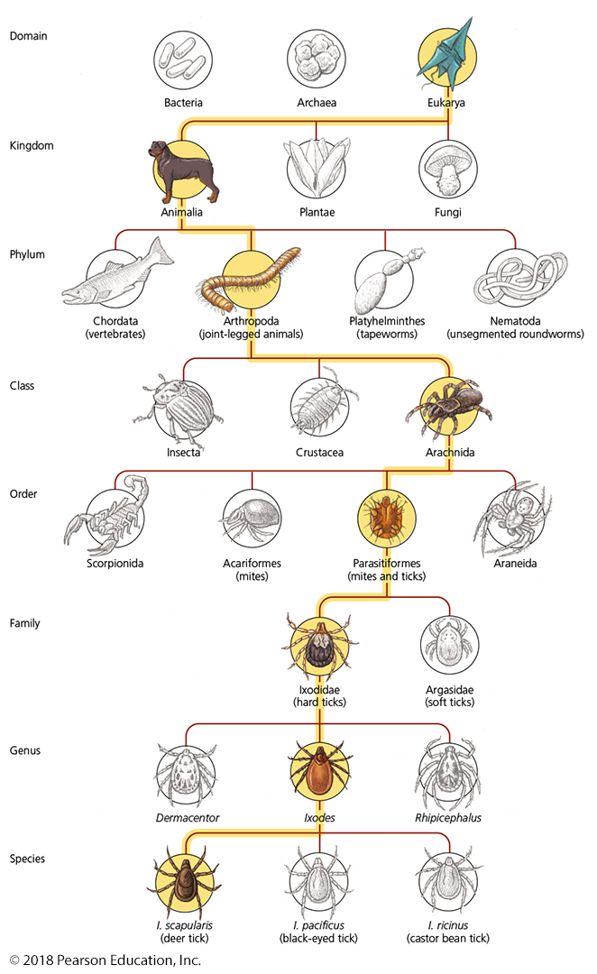
Figure 4.20 Levels in a taxonomic scheme.
Notes:
46

Slide 47
Classification and Identification of Microorganisms
Linnaeus and Taxonomic Categories
Linnaeus proposed only two kingdoms
Later taxonomic approach based on five kingdoms:
Animalia, Plantae, Fungi, Protista, and Prokaryotae
Linnaeus's goal was classifying organisms to catalog them
Modern goal is understanding relationships among organisms
Goal of modern taxonomy is to reflect phylogenetic hierarchy
Greater emphasis on comparisons of organisms' genetic material led to proposal to add domains

Slide 48
Classification and Identification of Microorganisms
Domains
Carl Woese compared nucleotide sequences of rRNA subunits
Proposal of three domains as determined by ribosomal nucleotide sequences:
Eukarya, Bacteria, and Archaea
Cells in the three domains also differ with respect to many other characteristics

Slide 49
SUMMARY SLIDE
How do we show relationships among different organisms?
Taxonomic and Identifying Characteristics
Physical characteristics
Biochemical tests
Serological tests
Phage typing
Analysis of nucleic acids

Slide 50
Classification and Identification of Microorganisms
Taxonomic and Identifying Characteristics
Physical Characteristics
Can often be used to identify microorganisms:
Protozoa, fungi, algae, and parasitic worms can often be identified based only on their morphology
Some bacterial colonies have distinct appearance used for identification

Slide 51
Classification and Identification of Microorganisms
Taxonomic and Identifying Characteristics
Biochemical Tests
Distinguish prokaryotes by their ability to utilize or produce certain chemicals
Laboratory scientists use biochemical tests to identify pathogens
Enteropleuri system used in labs later this semester!

Slide 52
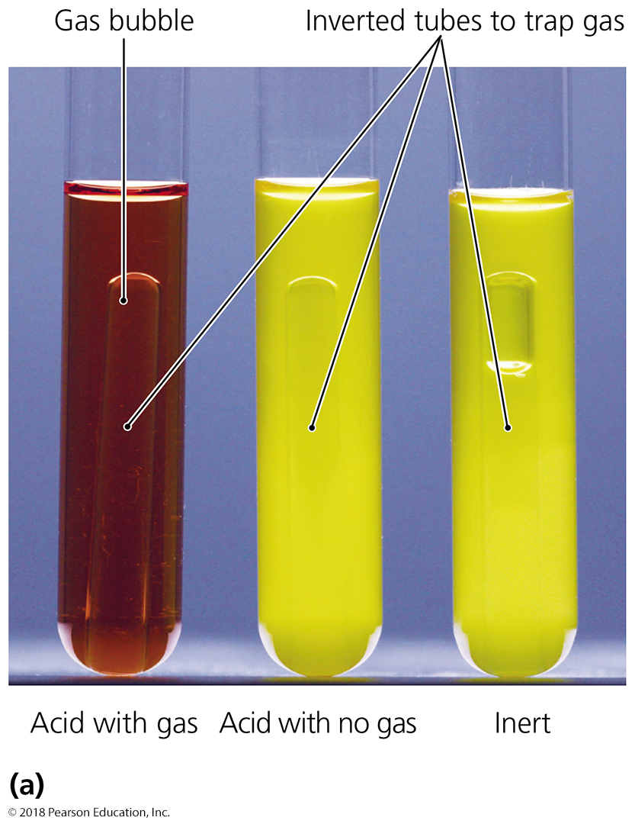
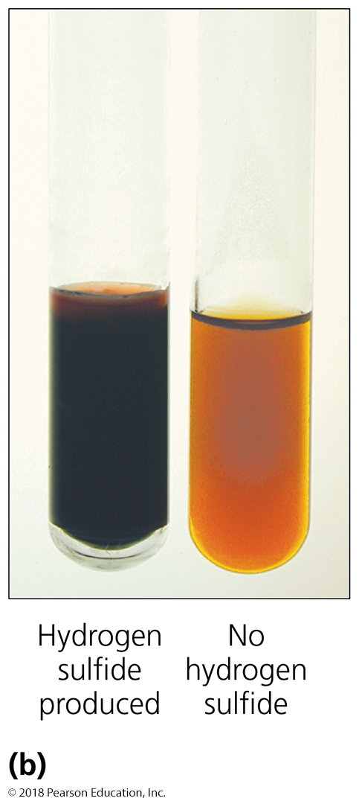
Figure 4.21 Two biochemical tests for identifying bacteria.
Notes:
52

Slide 53
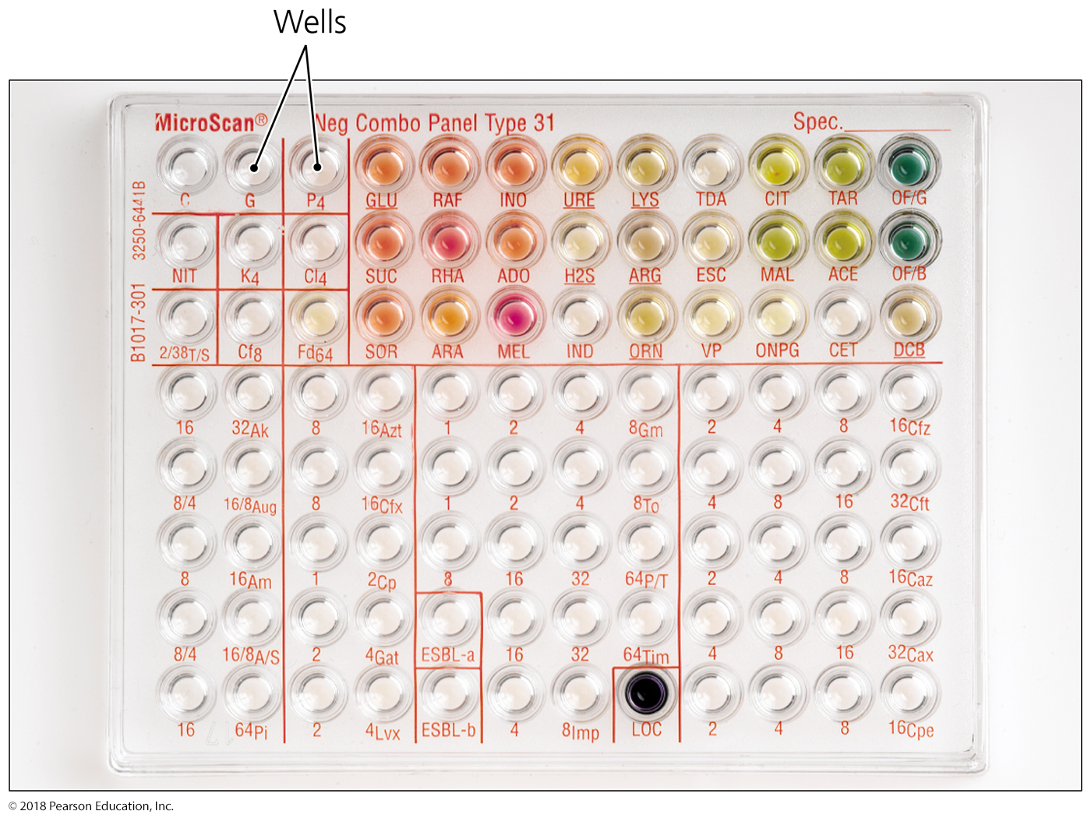
Figure 4.22 One tool for the rapid identification of bacteria, the automated MicroScan system. (DO NOT NEED TO KNOW THIS)
Notes:
53

Slide 54
Classification and Identification of Microorganisms
Taxonomic and Identifying Characteristics
Serological Tests
The study of antigen-antibody reactions in laboratory settings
Many microorganisms trigger an immune response that results in antibody production
Antibodies can be used to identify the organism that triggered their production
Used for Staph and Strept identification in labs this semester!

Slide 55
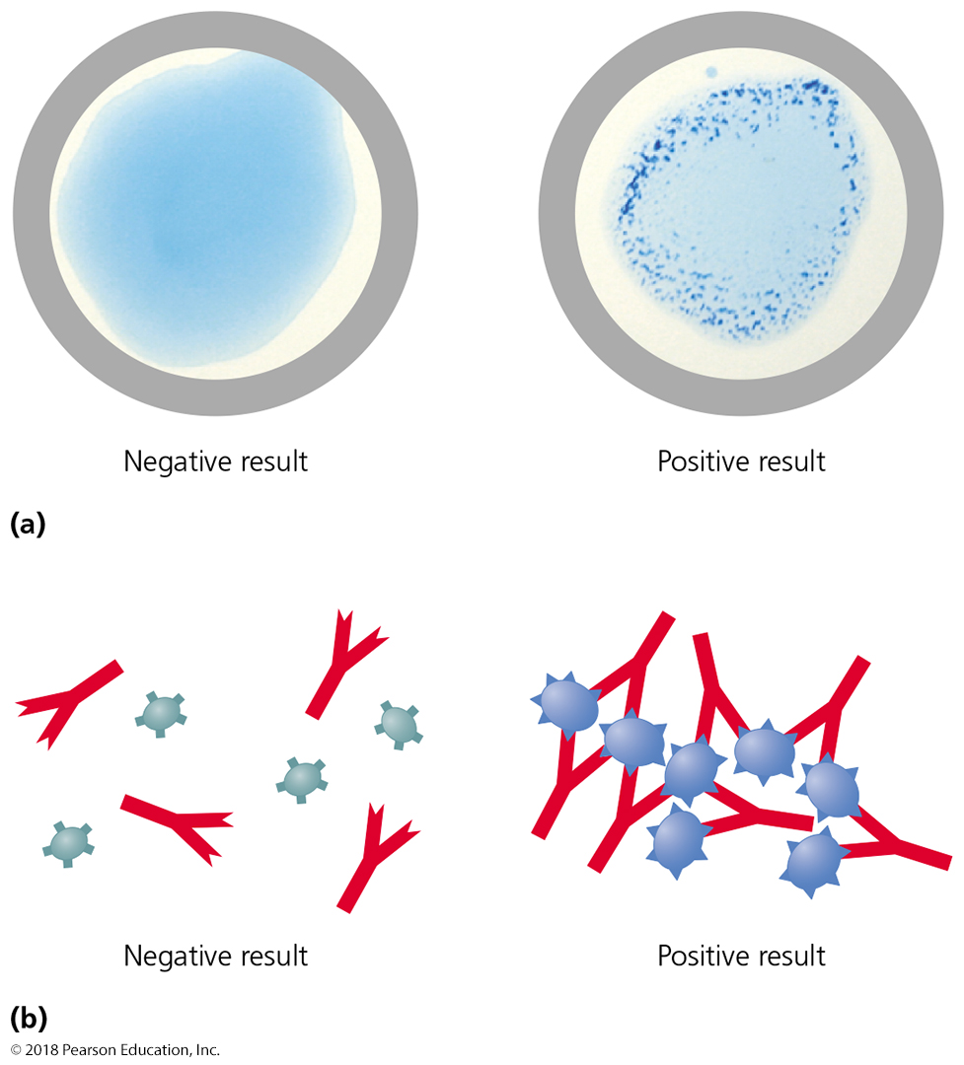
Figure 4.23 An agglutination test, one type of serological test.
Notes:
55

Slide 56
Classification and Identification of Microorganisms
Taxonomic and Identifying Characteristics
Phage Typing
Bacteriophages (phages) are viruses that infect bacterial cells
Phages are specific for the hosts they infect

Slide 57
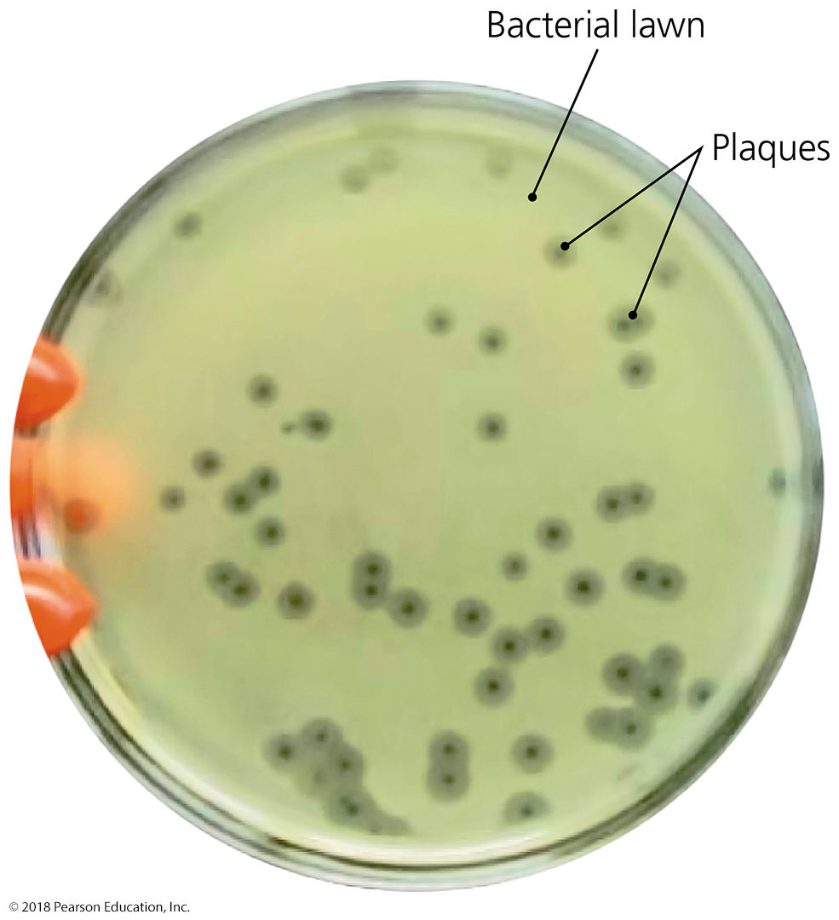
Figure 4.24 Phage typing.
Notes:
57

Slide 58
Classification and Identification of Microorganisms
Taxonomic and Identifying Characteristics
Analysis of Nucleic Acids
Nucleic acid sequence can be used to classify and identify microbes
Prokaryotic taxonomy now includes the G + C content of an organism's DNA

