Slide 1
Microbiology
Chapter 24
Diseases of the Urinary and Reproductive Systems

Slide 2
Structures of the Urinary and Reproductive Systems – SUMMARY
Females have distinct reproductive systems compared to men.
Women: vagina, uterus, oviducts, ovaries
Men: urethra, prostate, seminal ducts, testicles
In females, the urinary system and the reproductive system do not touch or mingle with each other
In 1:20000 births, they are fused without or without additional rectal fusion (more precisely, the three failed to separate), forming a persistent cloaca
Male urinary and reproductive systems share some components.
Immediately distal to the urethral sphincter at the bladder, the ductus deferens (seminal duct) and seminal vesicles both drain into the urethra at the prostate gland. Both systems share a long urethra to exit the body by passing through the penis

Slide 3
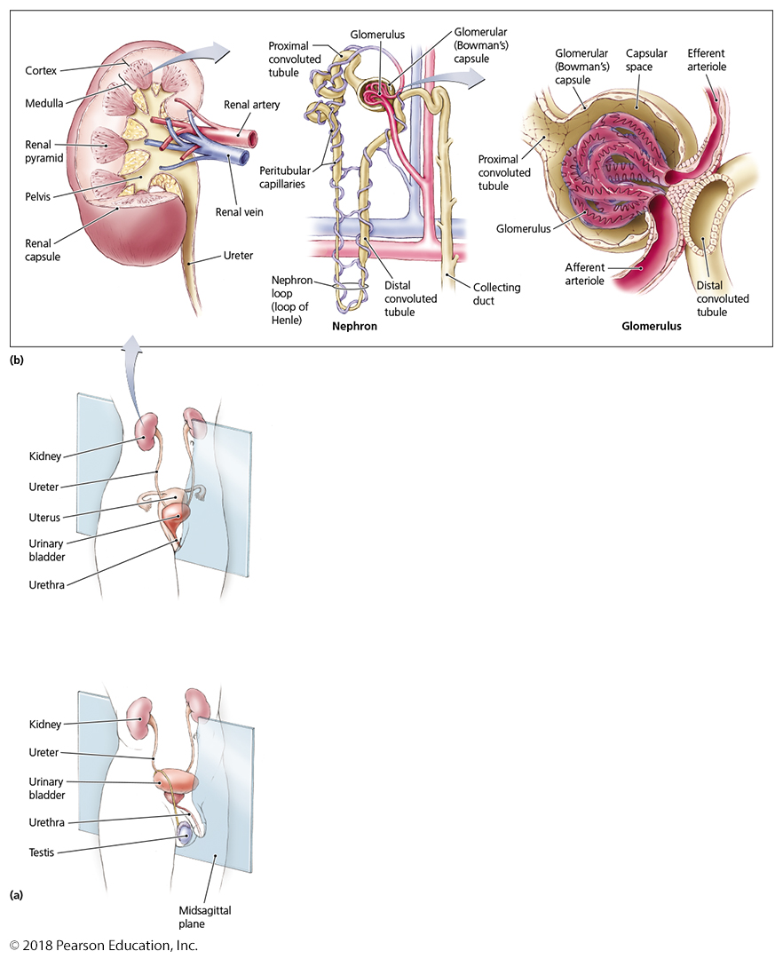
Figure 24.1a-b Urinary and reproductive systems.
Note the difference in urethral length between men and women!
Notes:
3

Slide 4
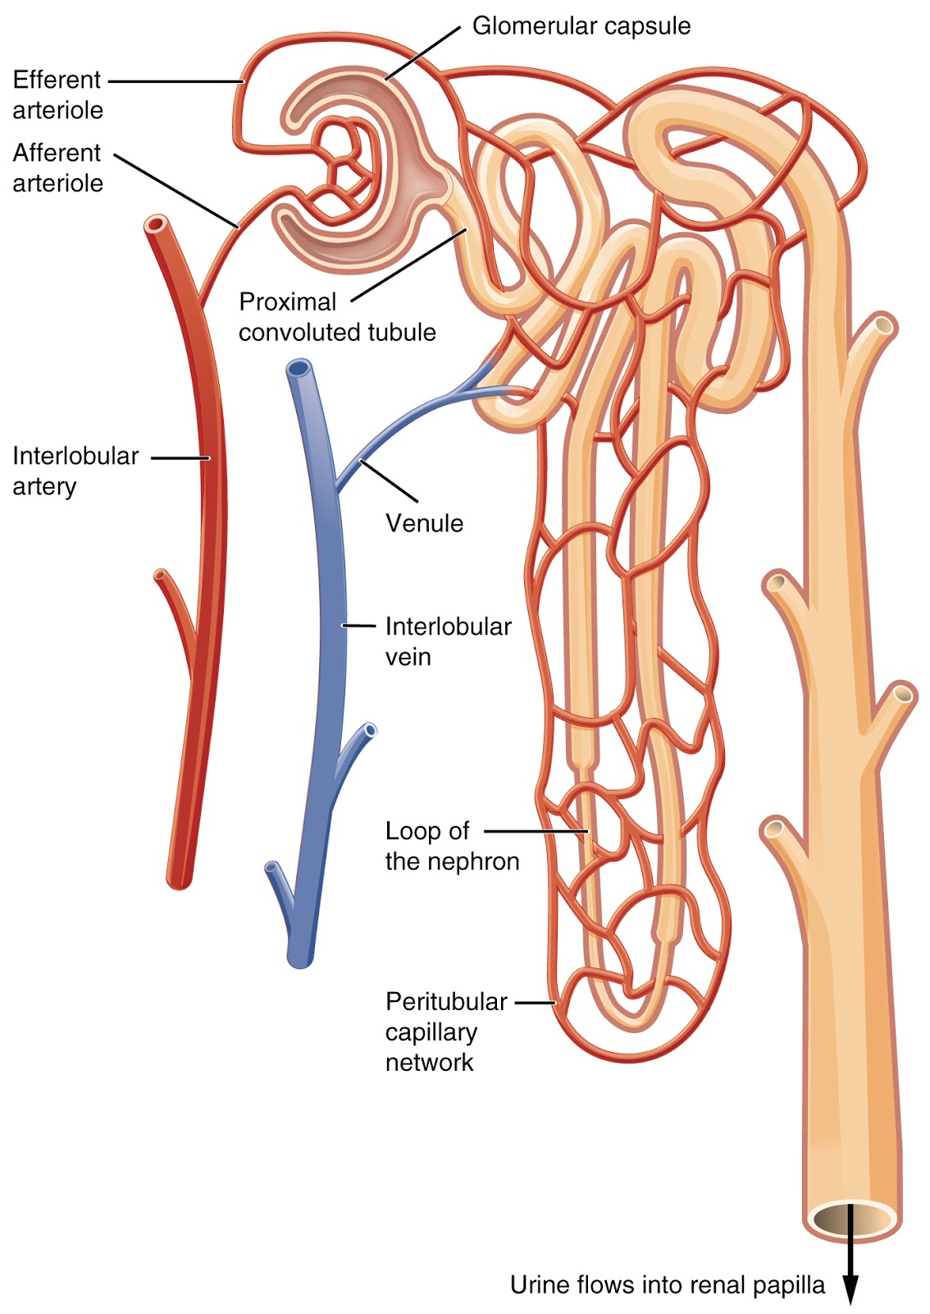
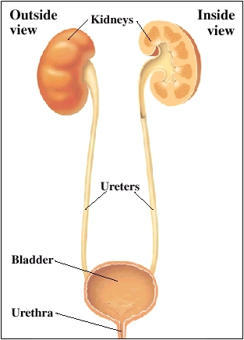
Structures of the Urinary System
Kidneys
Nephrons are the microscopic functional unit of the kidneys
~1,000,000 per kidney
“squeezes” plasma from the blood at the glomerulus
concentrates the waste ~100-400x by reabsorbing useful parts of the plasma
excretes the concentrated waste as urine
Ureters carry urine to the urinary bladder
The urinary bladder stores urine until it can be eliminated
Urine is released from the body through the urethra

Slide 5
Structures of the Urinary and Reproductive Systems
Structures of the female reproductive system
Ovaries
Uterine tubes (a.k.a., oviducts, Fallopian tubes)
Uterus
Vagina
Secretory glands (Skeen’s and Bartholin’s glands)
External genitalia
Microorganisms enter through the vagina or the urethra
A few blood-borne pathogens enter through the kidney at the glomerulus

Slide 6
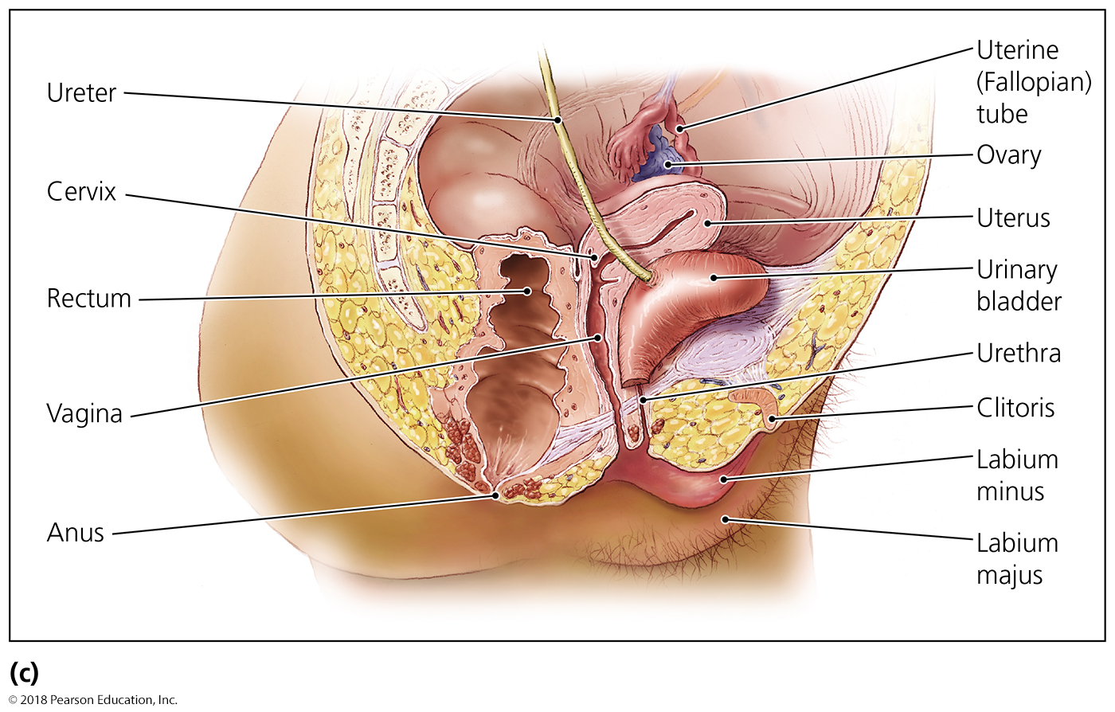
Figure 24.1c Urinary and reproductive systems.
Note the short distance between the anus, vagina, and urethra!
Notes:
6

Slide 7
Structures of the Urinary and Reproductive Systems
Structures of the male reproductive system
Testes
Scrotum
System of ducts (epididymis, vas deferens, urethra)
Accessory glands (seminal vesicles, prostate gland, and bulbourethral gland)
Penis
Microorganisms enter through the urethra and skin of the penis
A few blood-borne pathogens enter through the kidney at the glomerulus

Slide 8
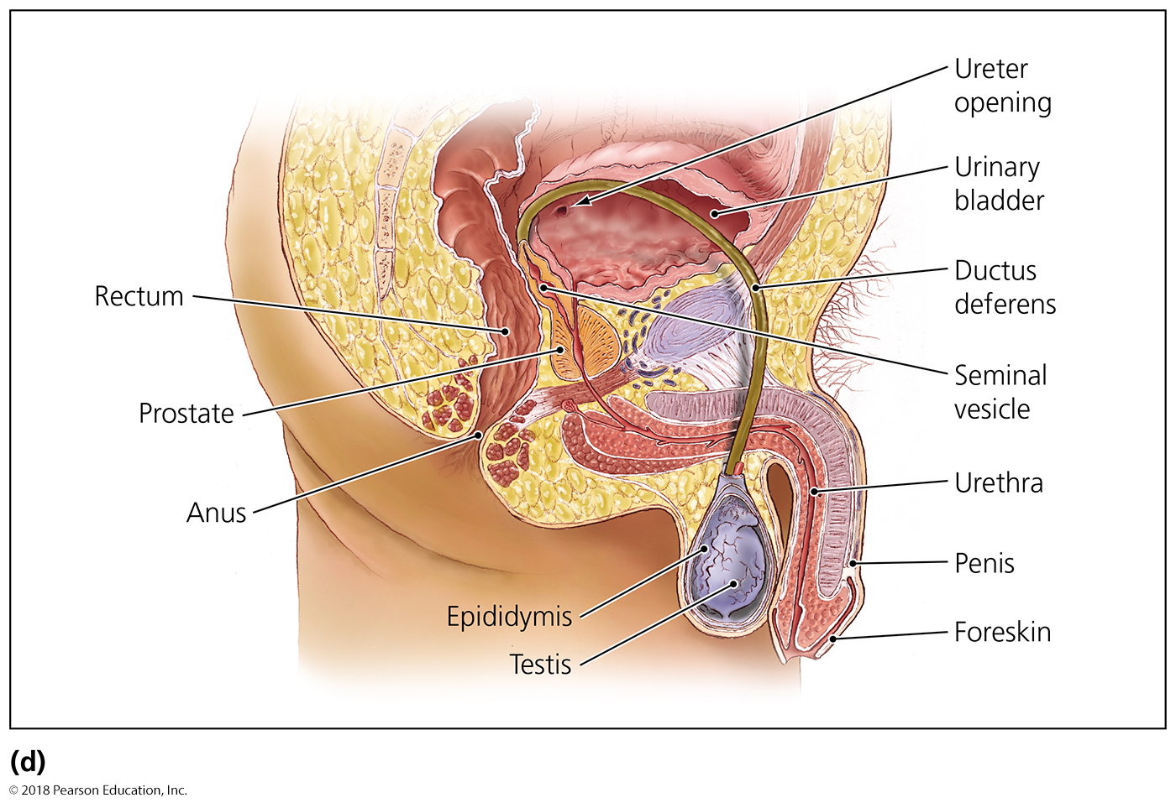
Figure 24.1d Urinary and reproductive systems.
Note the longer distance between the anus and the urethra!
Notes:
8

Slide 9
Microbiome of the Urinary and Reproductive Systems
Urinary system
Urethra supports colonization by some microorganisms
Include Lactobacillus and Staphylococcus
The other urinary organs (bladder, ureters, kidney) are sterile – too much fluid flow
Male reproductive system
Regions above the prostate are sterile
Female reproductive system
The vagina is colonized by various microorganisms, (esp. Lactobacillus) depending on hormone levels
Hormones promote glycogen release into mucus
Glycogen is fermented to generate acidic environment

Slide 10
Structures of the Urinary and Reproductive Systems
Microbiome of the Urinary and Reproductive Systems
UTI – urinary tract infection
Microorganisms in the urethra can move up to infect the kidneys.
Urination is the primary method of expelling pathogens and microbes from the kidney, ureters, bladder, and urethra
reduced water intake can promote UTIs
Opportunistic and sexually transmitted microbes can infect the reproductive system.

Slide 11
Bacterial Diseases of the Urinary Systems
Bacterial Urinary Tract Infections (UTIs)
Signs and symptoms
Frequent, urgent, painful urination
Urine may be cloudy with foul odor
Pathogens and virulence factors
Enteric bacteria are the most common cause
Escherichia coli causes most cases
Virulence factors include flagella and attachment fimbriae
Epidemiology
Often results when fecal bacteria are introduced into urethra
Proximity of rectum and urethra openings
More common in females than in males
shorter distance between openings

Slide 12
Bacterial Diseases of the Urinary Systems
Bacterial Urinary Tract Infections
Diagnosis, treatment, and prevention
Diagnosis is based on urinalysis
Many cases resolve without medicinal treatment
Frequent water drinking to induce frequent urination
Some treated with antimicrobial drugs
Prevented by limiting contamination by fecal microbes
Hygiene and safe practices
Clean clothes and bedding
Frequent healthy urination (drinking lots of water)

Slide 13
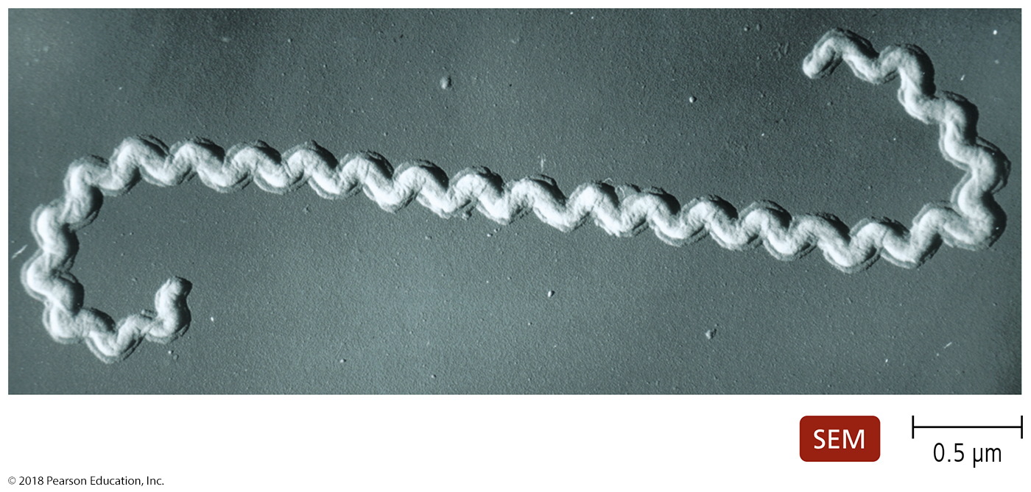
Bacterial Diseases of the Urinary Systems
Leptospirosis
Zoonotic disease seen primarily in animals
Signs and symptoms
Abrupt fever, myalgia, muscle stiffness, and headache
NOTE the resemblance to systemic infection vs. UTI
Rarely fatal
Pathogen
Caused by Leptospira interrogans
Normally lives in many wild and domestic animals
Virulent strains make adhesins, are motile, and can evade complement activity

Slide 14
Bacterial Diseases of the Urinary Systems
Leptospirosis
Pathogenesis
Transmitted by contact with urine of infected animal or urine-contaminated water (floods)
Spirochete enters through skin or mucosal breaks
Spirochete travels via the bloodstream through the body
Can cause kidney failure, liver failure, or meningitis
Epidemiology
Occurs throughout world but rare in the United States
Diagnosis, treatment, and prevention
Diagnosis is based on antibody test
Treated with antimicrobial drugs
Prevented by avoiding or sanitizing urine-contaminated water

Slide 15
Bacterial Diseases of the Urinary Systems
Streptococcal Acute Glomerulonephritis
Some antibody-antigen complexes against group A streptococci in the blood are not removed from the body
Complexes are deposited in the glomeruli of the kidneys
Clog the filipodia that function as sieve in glomerulus
Circulating immune cells bind immune complexes at the clog and initiate an inflammatory reaction of the glomeruli and nephrons
Can trigger hypertension (up to 25% of systemic blood flow goes through the kidneys and can be blocked) and low urine output
Irreversible kidney damage can occur in adults
Regenerative potential of kidneys decrease with age
Filipodia are notoriously resistant to regeneration

Slide 16
Nonvenereal Diseases of the Reproductive Systems
Staphylococcal Toxic Shock Syndrome (TSS)
Signs and symptoms
Sudden-onset fever, chills, vomiting, diarrhea, low blood pressure, confusion, and severe red rash
Individuals go into shock if untreated
Pathogen and virulence factors
Caused by some strains of S. aureus
These strains produce superantigen toxin
Toxin activates too many TCRs, almost none of which recognize S. aureus epitopes
Cause excessive cytokine production by too many activated T cells
Body believes it has a massive infection and shuts down blood flow to stop “rapid spread”

Slide 17
Nonvenereal Diseases of the Reproductive Systems
Staphylococcal Toxic Shock Syndrome
Pathogenesis and epidemiology
Absorption of toxin into blood triggers toxic shock syndrome
Most cases occur in menstruating females
Incomplete blood vessel clotting during menstruation, and preventing menstrual flow from uterine region, allows resident staphylococcus and their toxins to enter blood
Diagnosis, treatment, and prevention
Diagnosis is based on signs and symptoms
Considered medical emergency
Requires removal of foreign material and antimicrobial drugs
Risk can be lessened by avoiding tampons or using less absorbent tampons
absorbant tampons absorb and feed bacteria

Slide 18
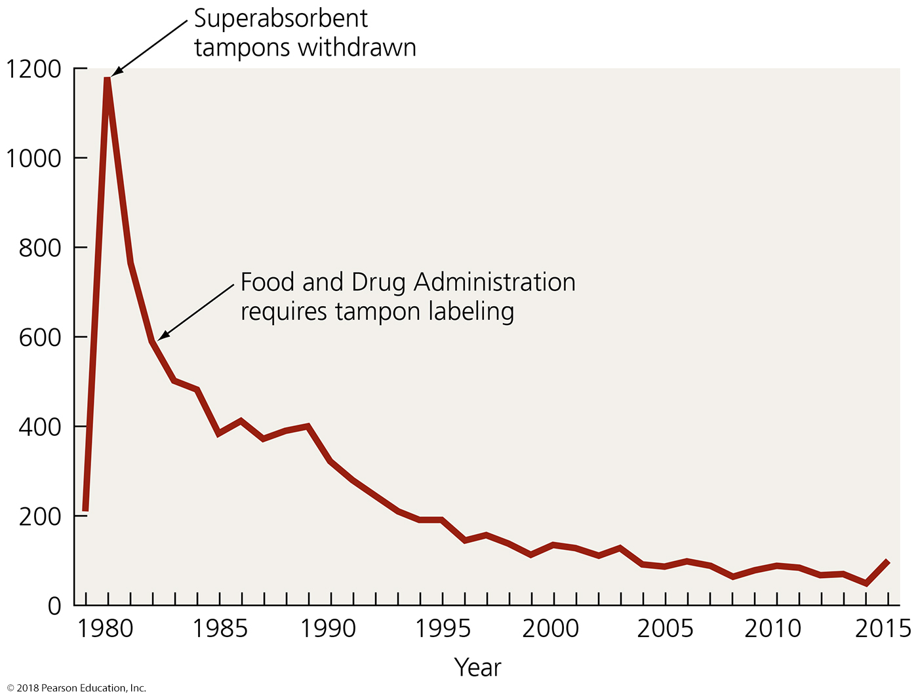
Figure 24.3 The incidence of staphylococcal toxic shock syndrome in the United States, 1979–2015.
Notes:
18

Slide 19
Nonvenereal Diseases of the Reproductive Systems
Bacterial Vaginosis
Signs and symptoms
White vaginal discharge with a “fishy” odor
Pathogens
Caused by various anaerobic bacteria
Pathogenesis and epidemiology
Associated with multiple sexual partners (more transmission potential) and vaginal douching (eliminate protective flora and fluids)
Diagnosis, treatment, and prevention
Diagnosed is based on signs and symptoms
Treated with oral or vaginal metronidazole
Azoles can also slow protozoal growth (“trich”)

Slide 20
Nonvenereal Diseases of the Reproductive Systems
Vaginal Candidiasis
Signs and symptoms
Severe vaginal itching and burning
Pathogen
Most commonly caused by Candida albicans
Many other species of Candida also present
Candida are normal microbiota of skin and mucous membranes
Everyone carries Candida, but usually only at very low levels – microbial antagonism keeps yeast numbers too low to be dangerous

Slide 21
Nonvenereal Diseases of the Reproductive Systems
Vaginal Candidiasis
Pathogenesis and epidemiology
Healthy vaginal pH is about 4.0 (b/c Lactobacillus!)
Candida overgrows if vaginal pH becomes neutral or alkaline or normal microbial populations are reduced
Can become systemic in immunocompromised people
Diagnosis, treatment, and prevention
Identification of Candida and presence of symptoms are diagnostic
Treated with azole, e.g., fluconazole
Prevent by avoiding persistent moisture in genital external area (fungi like moist wet dark areas)
Also, reduced use of antibacterial drugs, use probiotics??

Slide 22
Sexually Transmitted Infections (STIs) and Diseases (STDs)
STIs occur from the sexual transmission of potential pathogens.
Resulting disease is the STD.
STDs are common worldwide.
Young people who experiment with sex are at risk.
Multiple transmission potentials
Presence of lesions from STDs is a risk factor for transmission of HIV
Lesions in skin (males) and especially mucous membranes (females) circumvent which line of defense????

Slide 23
Sexually Transmitted Infections (STIs) and Diseases (STDs)
Female adolescents are at risk because the cervical lining is prone to bacterial infection
Gets tougher with age and “experience” ~ callousing
Bacterial infections can cause pelvic inflammatory disease if left untreated
Prevention includes abstinence or mutual monogamy (No new partners)
Condoms must be used properly and consistently to provide protection from infection
No slipping, no holes, THROW OUT it expired or abused (in wallets, purses, or pants pockets)

Slide 24
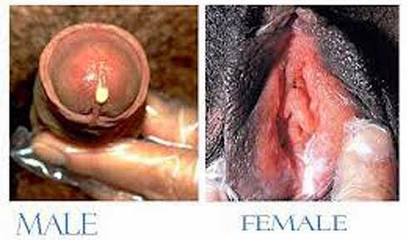
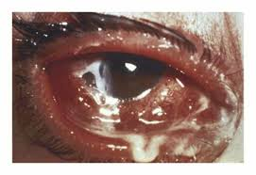
Bacterial STDs
Gonorrhea – “The clap”
Signs and symptoms
Men SOMETIMES (30%) experience painful urination and a purulent discharge
Women are often (90%) asymptomatic
Pelvic inflammatory disease (chronic) may develop if left untreated
Pathogen and virulence factors
Caused by Neisseria gonorrhoeae
Virulence factors include fimbriae, capsule, and endotoxin

Slide 25
Bacterial STDs
Gonorrhea – “the clap”
Pathogenesis
Bacteria attach to epithelial cells of the mucous membranes.
Infections outside the reproductive tract also occur.
Babies delivered vaginally by infected mothers can become infected.
Infections of newborn or opportunistic skin or eyes
This can explain the myth of “going blind if one plays…”
Epidemiology
Gonorrhea occurs only in humans.
Cases in the United States have been declining.
Generally, improved health education and affordable treatment
Risk increases with frequency of sexual encounters.

Slide 26
Figure 24.5 The incidence of civilian gonorrhea in the United States.
Vietnam War
World War II
Incidence of infection correlates with educational quality and only weakly with population or immigration, though it correlated well with soldiers coming home from wars and interactions with “the natives”
Notes:
26

Slide 27
Bacterial STDs
Gonorrhea
Diagnosis, treatment, and prevention
Genetic probes are used to diagnose asymptomatic infection: “My partner hurts when…”
Treated with ceftriaxone and azithromycin
Spread of gonococcal strains resistant to many antimicrobials has complicated treatment
MDR strains uncommon, many stains resistant to a variety of single antibiotics more common
Many antibiotics may need to be tried to find the right one where sensitivity exists
Prevented with safe sex practices

Slide 28
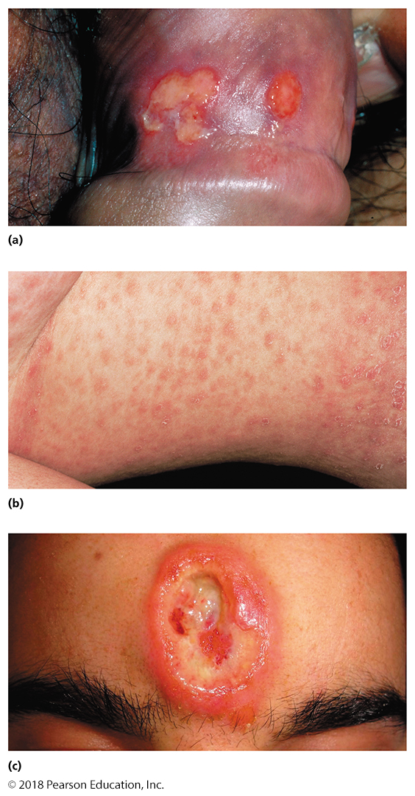
Bacterial STDs
Syphilis
Caused by Treponema pallidum
Signs and symptoms
VERY diagnostic
Four phases of syphilis
Primary syphilis (3-90 d, 21 ave.)
Small, painful chancre
Secondary syphilis (4-10 w)
Sore throat, mild fever, rash
Latent syphilis
No symptoms
Tertiary syphilis (3-15 y)
Dementia, blindness, paralysis
Resembles superinfection

Slide 29
Bacterial STDs
Syphilis
Pathogen and virulence factors
Treponema pallidum causes syphilis
Lives only in humans
Virulence factors have been difficult to identify
Pathogenesis
Transmitted mostly via sexual contact
Sometimes transmitted from mother to child
Most individuals do not develop tertiary syphilis
Earlier detection prevents progression to this stage
Tertiary syphilis has permanent tissue damage and 10-60% fatality rate

Slide 30
Bacterial STDs
Syphilis
Epidemiology
Syphilis occurs worldwide
Endemic among sex workers, men who have sex with men, and users of illegal drugs
Diagnosis, treatment, and prevention
Antibody test is used to diagnose primary, secondary, and congenital syphilis
Tertiary syphilis is difficult to diagnose – other microbes may be at work
Penicillin G is used to treat all but tertiary syphilis – other microbes may be at work
Prevented with safe sex practices

Slide 31
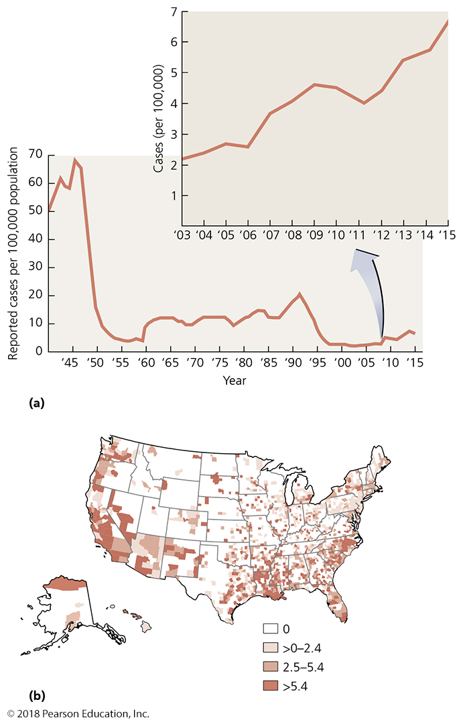
Figure 24.7 The incidence of syphilis in the United States.
Correlates with educational quality and only weakly with population or immigration
Notes:
31

Slide 32
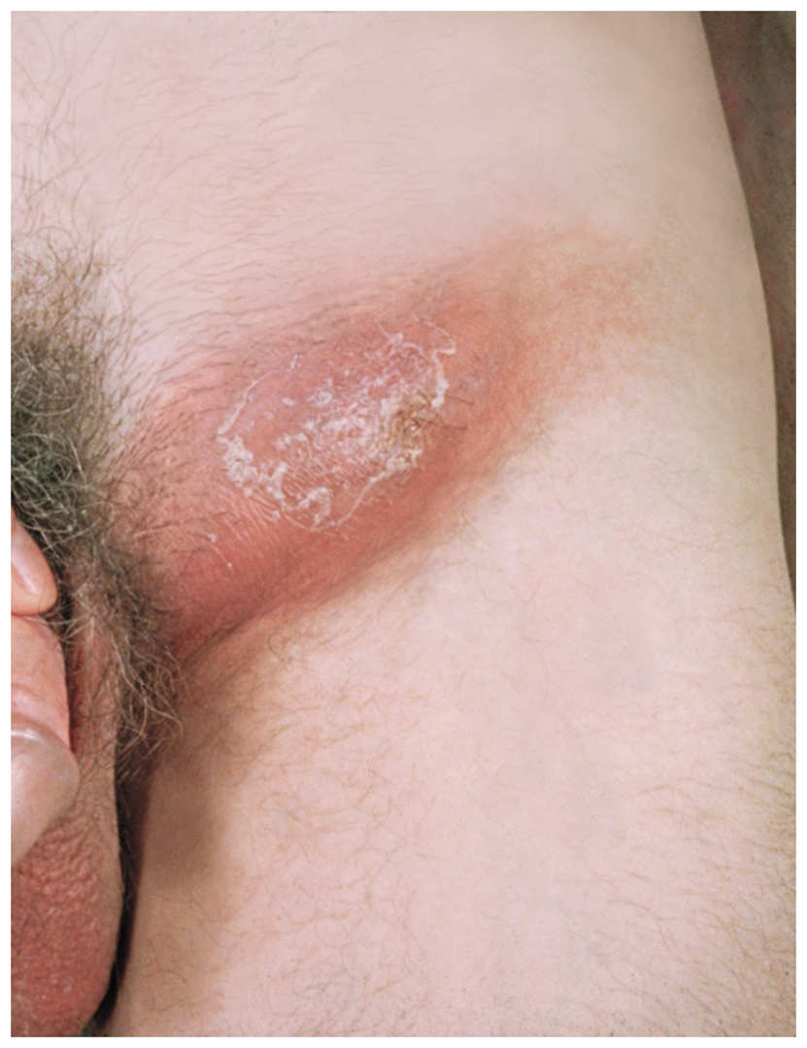
Bacterial STDs
Chlamydial Infections
Signs and symptoms
Women are usually (90%) asymptomatic
Men SOMETIMES (30%) have painful urination and pus discharge from penis
Causes numerous diseases
Epididymitis: inflammation of the epididymis
Orchitis: inflammation of the testes
Trachoma: disease of the eye
Lymphogranuloma venereum: formation of a genital lesion and bubo in the groin as it spreads through lymphatic system

Slide 33
Bacterial STDs
Chlamydial Infections
Pathogens and virulence factors
Caused by Chlamydia trachomatis
All strains but one are pathogens of humans
Grow only within vesicles inside host cells
Developmental cycle
Elementary bodies are the infective form
Reticulate bodies are the reproductive form

Slide 34
Bacterial STDs
Chlamydial Infections
Pathogenesis
Microbes enter body through scrapes or cuts
Infect conjunctiva or cells lining mucous membranes
Spread to the lymphatic system, causing proctitis
Adolescent infection increases cervical cancer risk
Probably due to common risk of polygamous sexual activity
Epidemiology
Most common reportable STD (1,400,000 cases) in the USA
Disease found primarily in developing countries, most prevalent in low socioeconomic groups

Slide 35
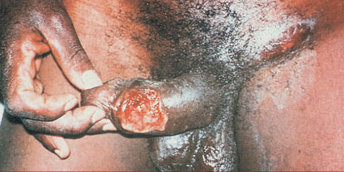
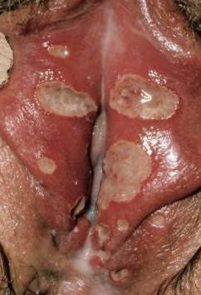
Bacterial STDs
Chancroid [shank] Infections
Pathogens and virulence factors
Caused by Hemophilus ducreyi
Pathogenesis
H. ducreyi enters skin through microabrasions incurred during sexual intercourse.
A PAINFUL local tissue reaction leads to development of erythomatous papule, which progresses to pustule in 4–7 days.
It then undergoes central necrosis to ulcerate.
Most individuals diagnosed with chancroid in the USA have visited countries or areas where the disease is known to occur frequently, although outbreaks have been observed in association with crack cocaine use and prostitution

Slide 36
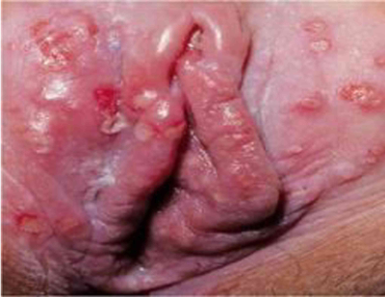
Viral STDs
Genital Herpes
Signs and symptoms
Small blisters on or around the genitals or rectum
Pathogen and virulence factors
Used to be called herpes simplex virus (HSV)-2 and -1
Human herpesvirus 2 causes most cases – late onset
Human herpesvirus 1 causes remainder of cases (more common in oral herpes)
Pathogenesis
Herpesvirus kills epithelial cells at infection site
Virus can become latent in nerve cells
Blisters may form at sites far from initial infection
Babies can become infected during birth

Slide 37
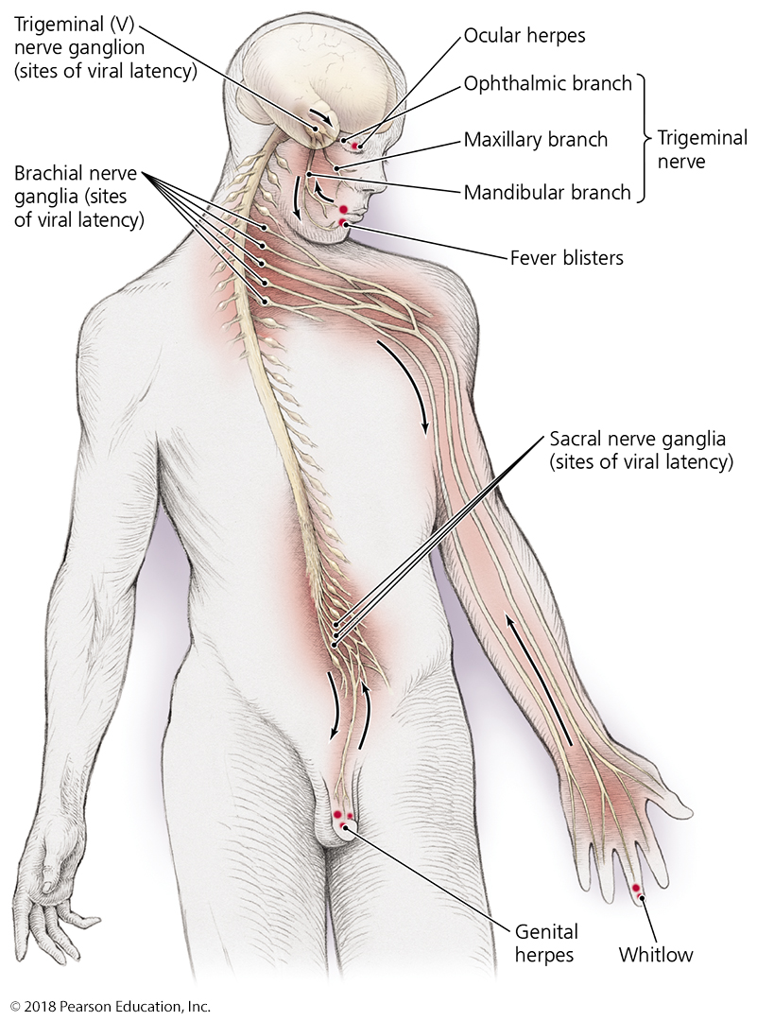
Figure 24.10 Sites of events in genital herpesvirus infections.
Note that the virus causing each of these diseases can be the same
It only varies based on which nerve ganglion it resides
It spreads to other ganglia only though skin-to-skin contact
Rubbing eyes or skin without hygiene
Oral sex
Notes:
37

Slide 38
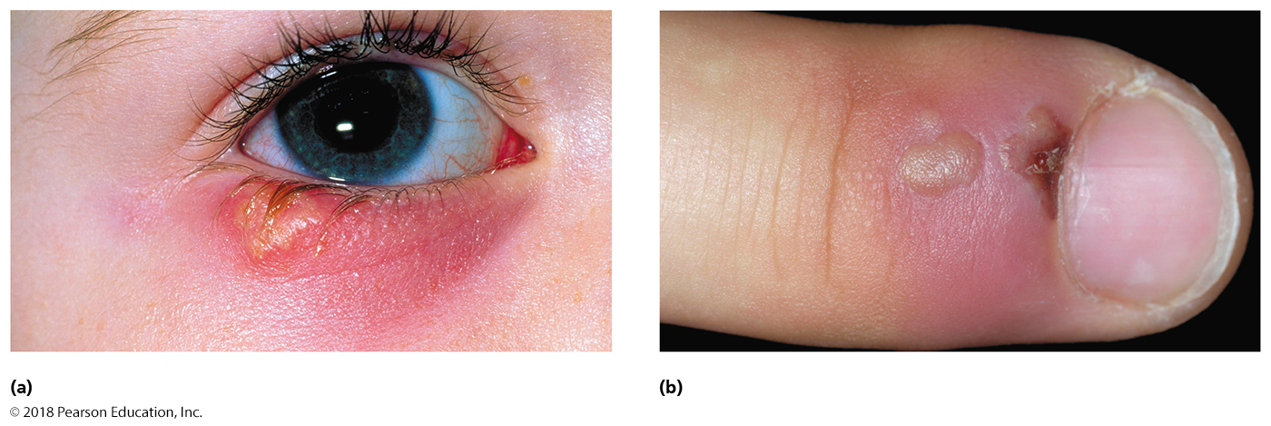
Figure 24.11 Herpes lesions of the eyes and skin.
Notes:
38

Slide 39
Viral STDs
Genital Herpes
Epidemiology
Genital herpes quadruples the risk of HIV infection.
70% of USA has HHV-1, 16% of USA has HHV-2
Diagnosis, treatment, and prevention
Diagnosis is based on characteristic lesions.
Acyclovir or other antiviral agents can lessen symptoms.
Circumcised males are at lower risk of infection.
Condoms often provide little protection (skin to skin transmission outside of condom)
Laytex gloves essential for dentists/oral hygienists/ob-gyn
Infected pregnant women should deliver by C-section.
Prevention is done only through abstinence or monogamy
No vaccine likely to be developed – no sequalae or mortality

Slide 40
Anogenital (and other) Warts
Pathogen, signs, and symptoms
Papillomas, or warts, are growths of skin epithelium
May form on the face, trunk, hands, feet, elbows, knees, genitalia, or anus
Large growths called condylomata acuminata
Caused by human papillomaviruses (HPV)
90% of anogenital warts are caused by subtypes 6 and 11
~ 12 strains of HPV can cause various cancers
Cervical cancer – 70% by 16, 18
Also anal, oropharyngeal, penile, vulvar, vaginal cancers
HPV vaccine protect against these highly carcinogenic strains
Cervarix – 16, 18 (protect against most carcinogenic)
Gardesil – 16, 18, 6, 11 (also other anogenital wart causes)
Gardesil 9 – 16, 18, 6, 11, 31, 33, 45, 52, 58 (20% more inclusive for cervical cancer and other cancer causes)

Slide 41
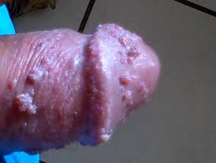
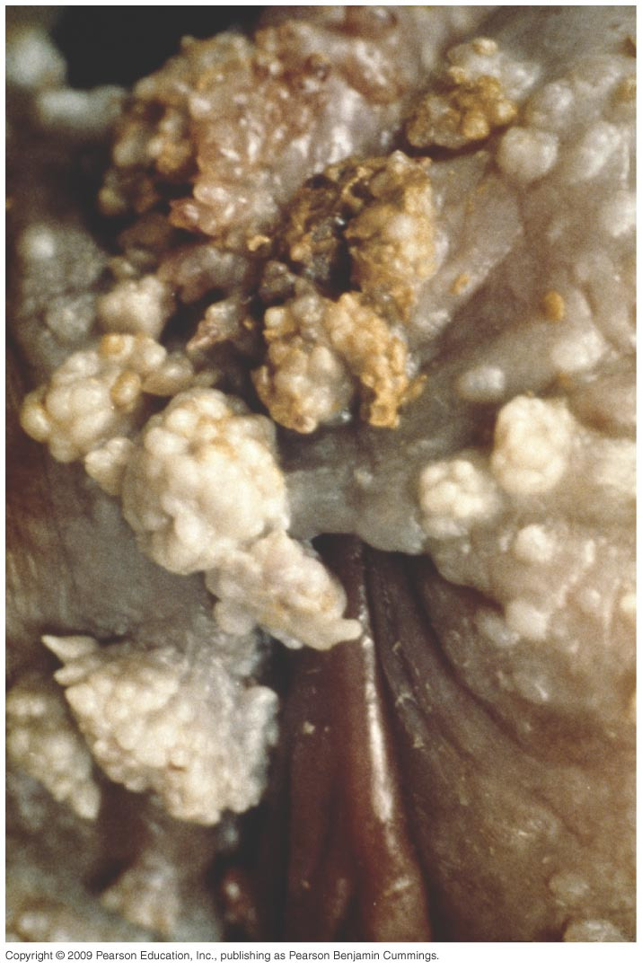
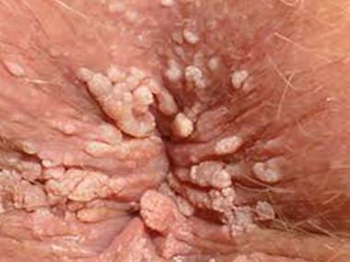
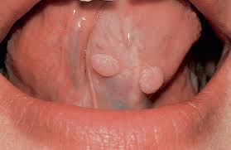
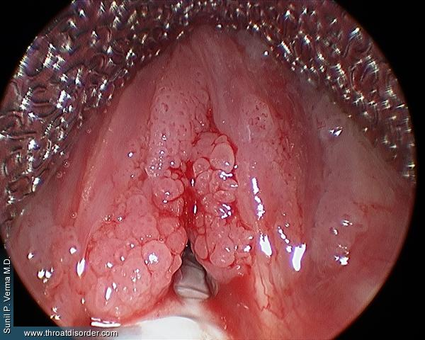
Various appearances of HPV infections

Slide 42
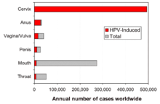
Anogenital Warts
Pathogenesis and epidemiology
HPVs invade skin or mucous membranes during sex
Most common STD in the United States
75-80% of adults have at least one HPV strain
Most adults (90%) are asymptomatic carriers
Transmission can be familial (less common)
HPV causes nearly all cervical cancers and nearly all anal cancers
Diagnosis, treatment, and prevention
Diagnosis is made by presence of warts
Variety of methods available to remove warts
Vaccine is available against HPV strains associated with cervical and anogenital cancers
Reducing transmission also involves use of laytex condoms/gloves, minimizing contact when presenting warts

Slide 43
Protozoan STDs
Trichomoniasis – “trich”
Signs and symptoms
Females (30%) have foul vaginal discharge (green/yellow), musty odor, and irritation
70% of women and nearly all males are asymptomatic carriers
Pathogen and virulence factors
Caused by Trichomonas vaginalis
Pathogenesis and epidemiology
Transmitted primarily via sexual intercourse
Most common curable STD in women (1.1 million cases/yr in USA)
Most easily treated STD – single oral dose works; treat partner too!
Trichomoniasis increases risk of infection by HIV
Shared risk factors for obtaining either disease
May increase risk for prostate cancer through subclinical chronic prostatitis
Various virulence factors contribute to disease

Slide 44
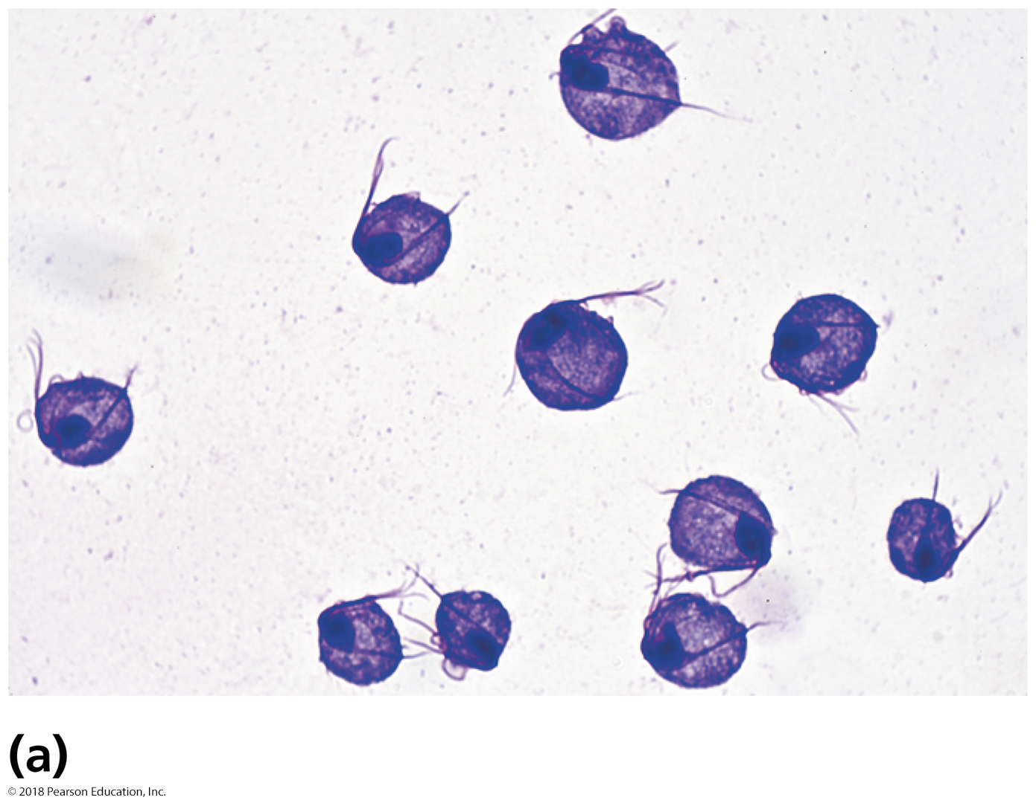
Trichomoniasis
Diagnosis, treatment, and prevention
Diagnosed by presence of Trichomonas in clinical samples
Treated with a single dose of oral metronidazole or tinidazole
Treat the partner as well as yourself!
Essential to prevent reinfection from subclinical female or male carrier
Prevented by avoiding sexual intercourse with infected persons or testing partners before intercourse

