Slide 1
Microbiology
Chapter 23
Diseases of the Digestive System

Slide 2
Structures of the Digestive System - SUMMARY
Digestive System Structures Are Divided into Two Groups
Gastrointestinal tract (GI tract)
The pathway from the mouth to the anus
Most organs of the GI tract are protected by the peritoneum
Accessory digestive organs
Organs involved in grinding food (teeth, tongue) or providing digestive secretions

Slide 3
The Gastrointestinal Tract and its Functions
The main tube (a.k.a. the alimentary canal)
Functions:
Mechanically breaks down food
Enzymatically digests food
Absorbs nutrients into the blood
Absorbs water into the blood
Eliminates indigestible waste
Components of the gastrointestinal tract
Mouth
Pharynx
Esophagus
Stomach
Small intestine – duodenum, jejunum, ileum
Large intestine (colon)
Rectum and anus

Slide 4
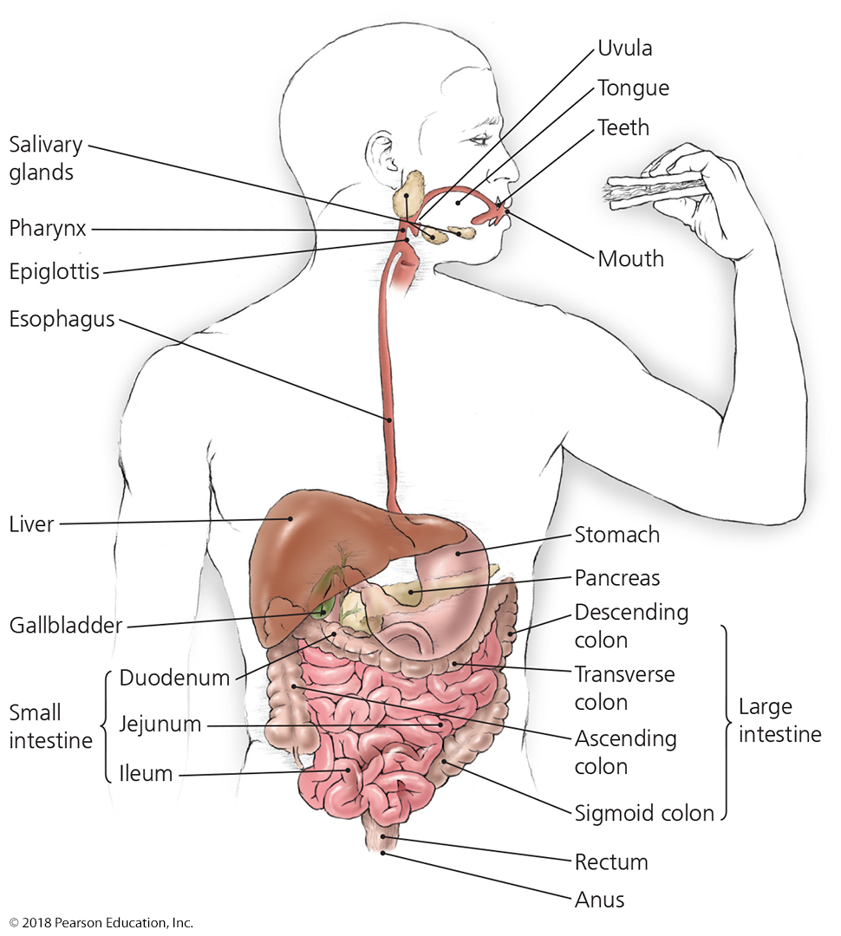
Figure 23.1 Major structures of the digestive system.
NOTE how the duodenum goes retroperitoneal (to accept secretions from the liver and pancreas), although the stomach, jejunum, ileum, cecum, and the transverse segment of the large intestines are peritoneal
Notes:
4

Slide 5
Structures of the Digestive System
The Accessory Digestive Organs
Not part of the alimentary canal
Tongue and teeth
Salivary glands
Liver
Gallbladder
Pancreas

Slide 6
Microbiome of the Digestive System
Esophagus, stomach, and duodenum
These regions are “almost” free of microbes.
Peristalsis, acidity, enzymes and rapid transport of food and liquid help prevent microbial colonization.
Mouth, tongue and teeth
Viridans streptococci are most prevalent in this region.
Streptococcus mutans can cause issues with teeth
jejunum, ileum, colon and rectum
Trillions of microbes
Microbiota here are microbial antagonists.
Mucous membrane prevents entry of microbes into the bloodstream (and contains lysozyme, IgA, etc.).
Liver macrophages (Kuppfer cells) engulf any bacteria escaping into blood from intestines and stomach

Slide 7
Physical and Chemical Defenses of the GI tract, #1
Mouth
Saliva is hypotonic and contains lysozyme and lactoferrin
Spitting, gagging reflex – pathogen expulsion
Swallowing – leads to stomach
Stomach
Acidic environment, acidic enzymes kill pathogens
Vomiting - pushes highly active toxins or pathogens rapidly from body

Slide 8
Physical and Chemical Defenses of the GI tract, #2
Small Intestine
Duodenum
Pancreas - digestive enzymes
Gall bladder, liver - biological detergents (cholates)
Jejunum, Ileum
Peristaltic flow – pushes toxins and pathogens out of body
Large Intestine
Cecum – contains appendix; vestigial in humans
Diarrhea – increased fluid flow by not absorbing water “flushes” toxins and pathogens
Continues to be effective as long as body remains hydrated
Oral rehydration therapy is based on this

Slide 9
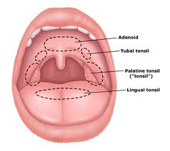
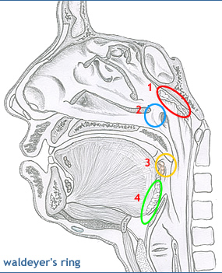
Immunological Defenses of the upper GI tract
Waldeyer’s tonsilar ring
Develop immune responses to fight pathogens before they infect tissues
IgA, lysozyme secretion
adenoids, tubal tonsils
Service eyes, ears, sinuses and respiratory system
palatine tonsils, lingual tonsil
Palatine and lingual tonsils service GI system
Microscopic lymphoid structures found in esophagus, stomach

Slide 10
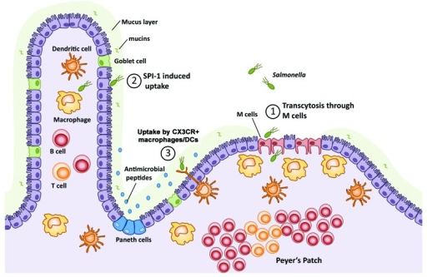
Immunological Defenses of the lower GI tract
Gut-associated Lymphatic tissues (GALT)
Peyer’s patches in jejunum and ileum
Constitutive lymphoid tissues b/c constitutive bacterial presence
“tonsils” of the gut
M cells are specialized epithelial cells that transfer pathogens from the lumen directly to macrophages and dendritic cells in the Peyer’s patches
intraepithelial dendritic cells sample microbial and food antigens by poking “fingers” out into lumen
Goblet cells make mucus
Paneth cells are epithelial cells that express defensins and lysozyme

Slide 11
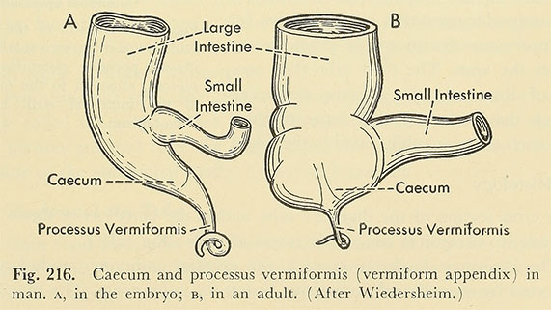
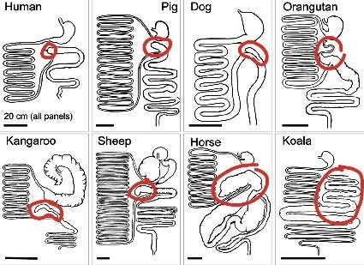
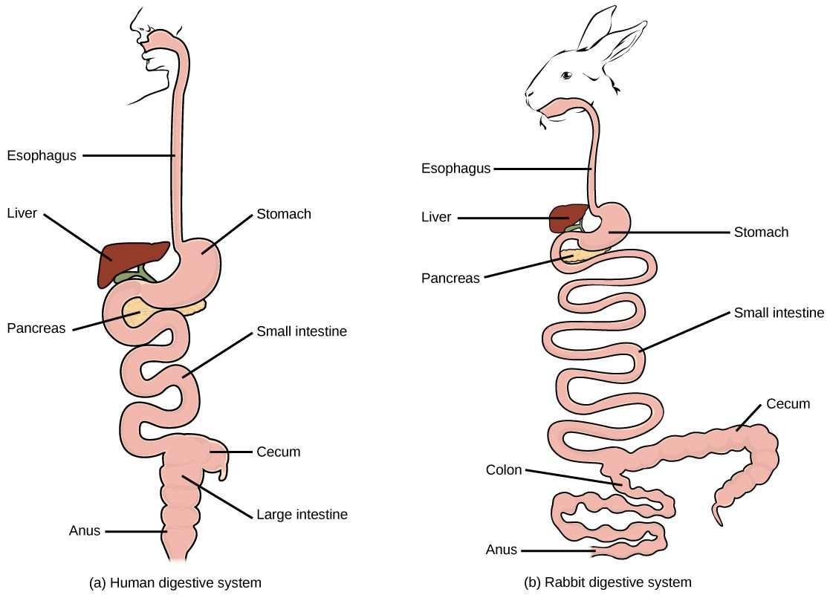
Gut-associated Lymphatic tissues (GALT)
The veriform appendix is on the cecum near ileo-cecal junction
What is the cecum?
A dead-end extension of the colon
Allows indigested “tough” foods (cellulose, tough plants, etc.) to be further processed (fermented?) before passing into colon (detour)
It tends to be extensive in herbivores, and tends to be miniscule or absent in omnivores and carnivores
In the human fetus, it begins to develop, but then regresses greatly by birth

Slide 12
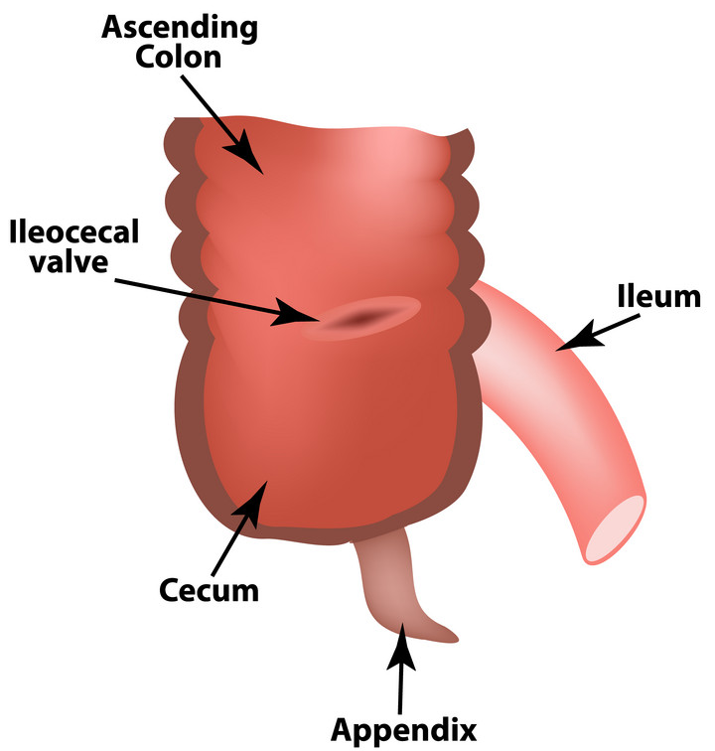
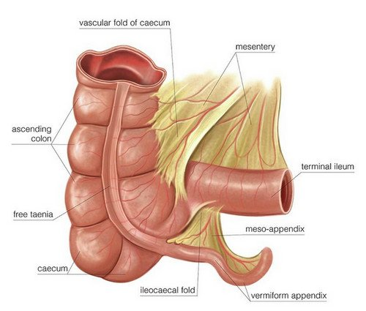
The appendix as a GALT
In humans, the cecum does not harbor microbes but still harbors lymphoid tissues (there are still connective tissues)
The veriform appendix is at the end of the cecum near ileo-cecal junction
The appendix is the taenia coli (connective tissues, muscles, nerves) without the intestinal tube
can swell from inflammation – appendicitis
Appendectomy removes these inconveniently activated B and T cells but may predispose one to intestinal infections (notably Clostridium difficile)

Slide 13
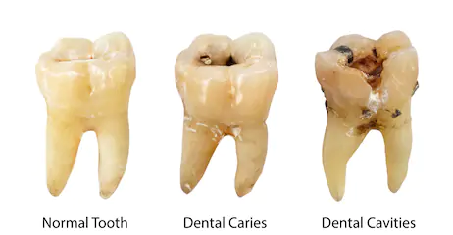
Bacterial Diseases of the Digestive System
Dental Caries, Gingivitis, and Periodontal Disease
Signs and symptoms
Caries (“tooth decay”)
Appears as holes or pits in the teeth
Gingivitis
Inflammation of the gums (gingiva), most often due to bacterial infection on roots that is affecting gingival tissues
Periodontal disease (periodontitis)
Gingiva are chronically swollen, tender, bright red, or bleeding
Gingiva permanently recede, exposing the roots of teeth
Tooth fall out far more easily because there is no enamel on the roots of teeth, and infection can contact the mandible (jaw bone)

Slide 14
Bacterial Diseases of the Digestive System
Dental Caries, Gingivitis, and Periodontal Disease
Pathogen, virulence factors, and pathogenesis
Streptococcus mutans is a frequent cause of caries
Dextran and fimbriae allow biofilm formation (called calculus or more commonly, tartar) on teeth
Porphyromonas gingivalis causes periodontal disease
Proteases break down gingival tissue
Persistant inflammation of gingiva (called what?) and tissue damage causes degenerative gum regression
Damage can spread to bone and cause bone loss, tooth loss

Slide 15
Dental Caries, Gingivitis, and Periodontal Disease – SUMMARY SLIDE
Epidemiology
Most adults have experienced dental caries
Diets high in sucrose, glucose increase the risk of decay
Diagnosis, treatment, and prevention
Caries
Diagnosed by visual inspection
Treated by filling cavities if caught early
Prevented by brushing teeth daily
Gingivitis
Diagnosed by inspection of gums
Treated by scaling and consistent prevention
Prevented by daily flossing (self-scaling) and use of antibacterial rinses

Slide 16
The Stages of Tooth Decay
Gingiva unaffected; bony matrix degraded
Tartar is accumulation of calcified biofilm and/or plaques (calculus sing.; calculi pl.)
Tooth decay became common with introduction of table sugar in Renaissance (What is end product of sugar breakdown in glycolysis?)
Lactic acid released by these bacteria decays tooth enamel
Tooth decay RARE in carbohydrate-free diet
Most common causes are Streptococcus sobrinus and S. mutans)
Prevented by scrubbing teeth, and regular oral care
first degree
caries
second degree
caries
third degree
caries

Slide 17
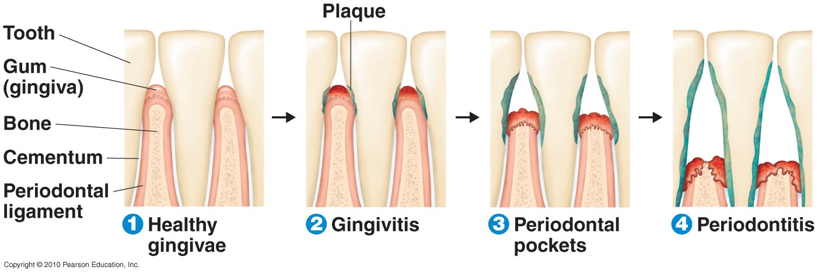
The Stages of Periodontal Disease
teeth “okay”, gum tissue degraded starting at plaques in roots, NOT crowns
Caused by many species of bacteria
97-100% of adults experienced periodontitis by age 45
mandible resorption and ultimately tooth loss in advanced periodontitis
Prevented by regular TOOTH FLOSS, specialized oral care, and brushing of teeth

Slide 18
Bacterial Diseases of the Digestive System
Peptic Ulcers
Signs and symptoms
Abdominal pain is main symptom
Pathogen and virulence factors
Caused by Helicobacter pylori
35-70% of people harbor H. pylori; disruption of proper microbiotic health may predispose one to infection
Numerous virulence factors
Flagella enable burrowing through stomach lining
Adhesins facilitate attachment to gastric cells
Urease neutralizes stomach acid (urease makes ammonia and carbon dioxide from urea)

Slide 19
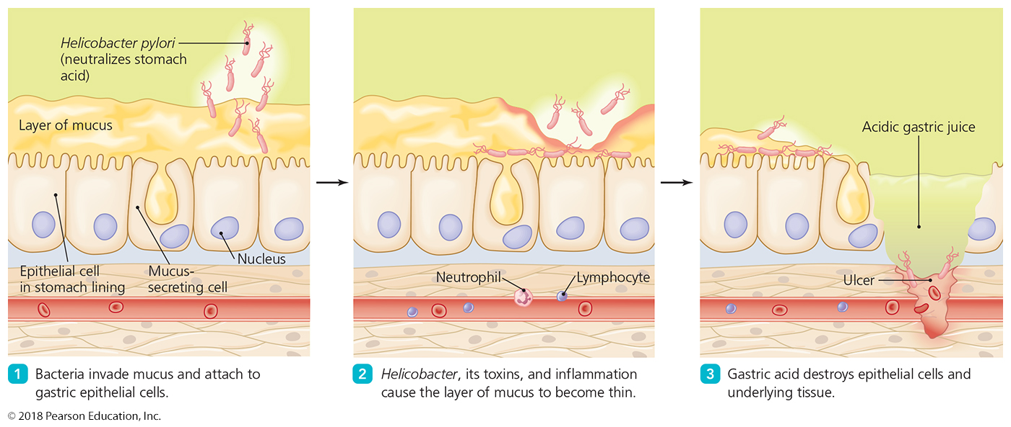
Figure 23.4 The role of Helicobacter pylori in the formation of peptic ulcers.
Notes:
19

Slide 20
Bacterial Diseases of the Digestive System
Peptic Ulcers
Epidemiology
Fecal-oral transmission is likely (improper food handling?)
Stress may worsen ulcer symptoms
Chronic peptic ulcers are pro-carcinogenic (excessive repair and re-injury of tissues)
Diagnosis, treatment, and prevention
Diagnosis based on X-ray exam to identify ulcers and presence of H. pylori in clinical specimens
Treated with antimicrobials and drugs that inhibit stomach acid (slows destruction of cellular tissues)
Prevented by avoiding fecal-oral transmission
Wash your food! Not necessarily human feces!

Slide 21
Bacterial Diseases of the Digestive System – SUMMARY SLIDE
Bacterial Gastroenteritis
“tummy trouble”
Inflammation of stomach or intestinal tissues caused by bacteria
Most often associated with contaminated food or water and/or poor living conditions

Slide 22
Bacterial Diseases of the Digestive System
Bacterial Gastroenteritis
General features
Similar manifestations despite different causative agents
Nausea, vomiting, diarrhea, abdominal pain, and cramps
Dysentery is the above symptoms with loose, frequent stool containing mucus and/or blood

Slide 23
Bacterial Diseases of the Digestive System
Bacterial Gastroenteritis
Treatment
Always involves fluid and electrolyte replacement (oral rehydration therapy)
antibiotic use indicated only if:
symptoms continue or worsen after 3-5 days
dysentery continues (to prevent septic infection of blood)
Antidiarrheal drugs are COUNTERPRODUCTIVE
They prolong the symptoms by preventing diarrhea formation
Best method of pathogen expulsion from intestines is now blocked
Prevention
Proper handling, storage, and preparation of food
“Consuming raw or undercooked meats, poultry, seafood, shellfish or eggs may increase your risk of foodborne illness.”

Slide 24
Bacterial Diseases of the Digestive System
Bacterial Gastroenteritis: Shigellosis
Pathogen and virulence factors
Caused by four species of Shigella
Virulence factors include type III secretion systems and enterotoxins (Shiga toxin)
Pathogenesis and epidemiology
Pathogen colonizes cells of the small, then large intestine
Rarely causes dysentery
toxin does more damage than the microbe itself
Diagnosis, treatment, and prevention
Diagnosed by symptoms and presence of Shigella in stool
Supportive treatment (oral rehydration therapy) and administration of antimicrobials to block toxin production

Slide 25
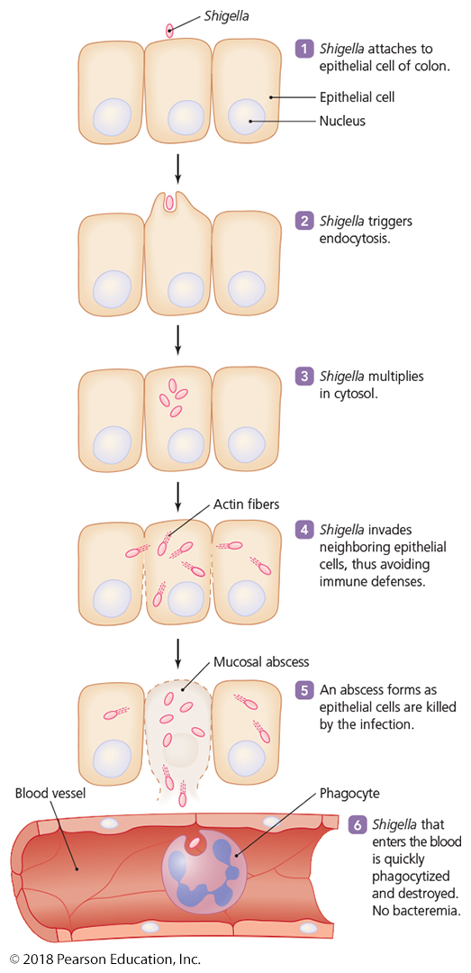
Figure 23.6 The events in shigellosis.
Notes:
25

Slide 26
Bacterial Diseases of the Digestive System
Bacterial Gastroenteritis: Traveler's Diarrhea
“Montezuma’s revenge”, “Delhi belly”
Pathogens and virulence factors
Caused by enterotoxic Escherichia coli (ETEC) or Shigella-toxin E. coli (STEC)
ETEC and STEC present in 80% of meat samples
ETEC and STEC and their toxins are easily killed by heating
Virulence factors: adhesins, fimbriae, and toxins

Slide 27
Bacterial Diseases of the Digestive System
Bacterial Gastroenteritis: Traveler's Diarrhea
Pathogenesis and epidemiology
Diarrhea mediated by enterotoxins
Common in developing countries
Most commonly seen when eating uncooked food that was not handled correctly (e.g., fruits, lettuce)
Diagnosis, treatment, and prevention
Diagnosis is based on signs and symptoms
Conclusive diagnosis is often not done when “low tech” solution clears symptoms quickly
Causative agent usually only determined if treatment is unsuccessful or if the symptoms abnormal
Treatment is based on fluid and electrolyte replacement
Prevention: avoid undercooked or untrusted food/water

Slide 28
Bacterial Diseases of the Digestive System
Bacterial Gastroenteritis: Campylobacter Diarrhea
Pathogen and virulence factors
Caused by Campylobacter jejuni
Virulence factors: adhesins, cytotoxins, and endotoxin
Pathogenesis and epidemiology
Major source of food-borne illness
Virulence factors cause bleeding lesions and inflammation
Chickens (less commonly cows and pigs) are the main source of human infections
Diagnosis, treatment, and prevention
Diagnosis is based on signs and symptoms
Most cases resolve without treatment
Prevented with proper hygiene after handling raw poultry or changing diapers, bedsheets, etc.

Slide 29
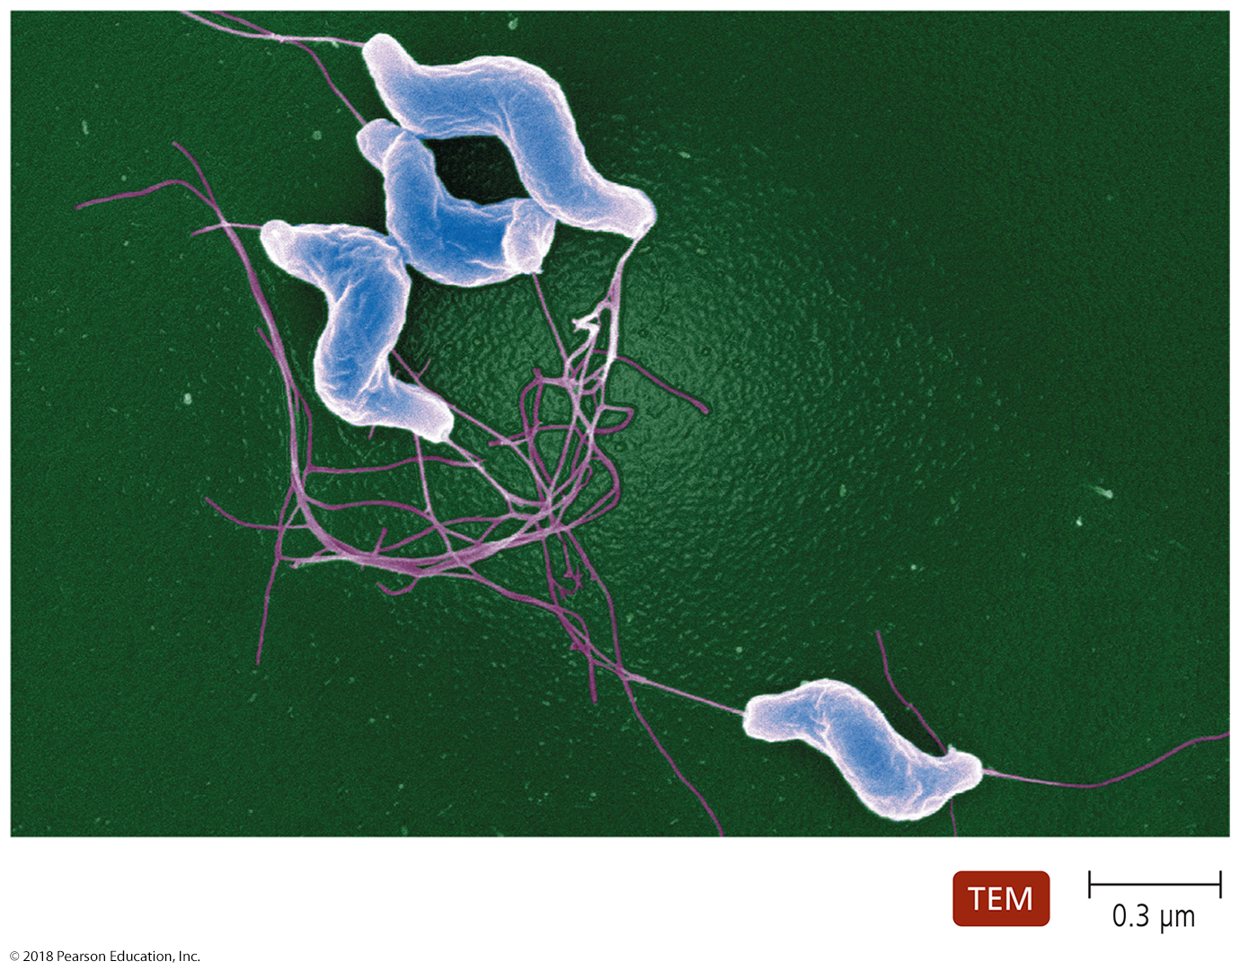
Figure 23.7 Campylobacter jejuni, the most common cause of bacterial gastroenteritis in the United States.
Notes:
29

Slide 30
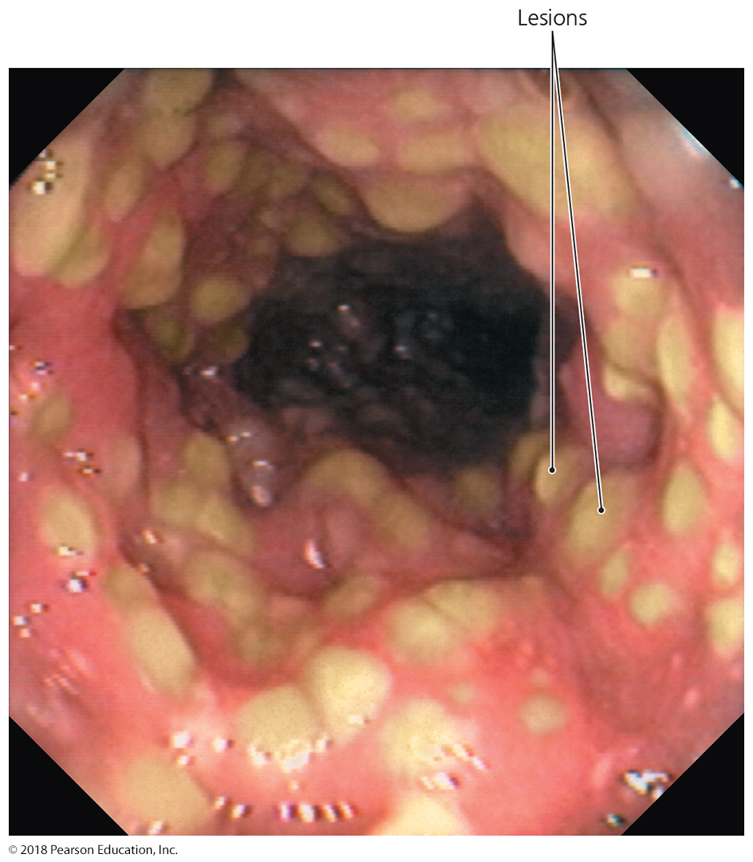
Bacterial Diseases of the Digestive System
Bacterial Gastroenteritis: C. diff. (Antimicrobial-Associated) Diarrhea
Signs and symptoms
Pseudomembranous colitis occurs in severe cases
Pathogen and virulence factors
Caused by Clostridium difficile
Chronic or broad-spectrum antimicrobial use facilitates overgrowth of C. difficile
C. difficile produces two toxins
Pathogenesis
Toxins mediate inflammation
and pseudomembrane formation

Slide 31
Bacterial Diseases of the Digestive System
Bacterial Gastroenteritis: C. diff. (Antimicrobial-Associated) Diarrhea
Epidemiology
By-product of modern medicine
Any antimicrobial drug (especially broad-spectrum) can trigger the disease
Diagnosis, treatment, and prevention
Diagnosis is based on presence of bacterial toxin in stool
Treated with antimicrobials, experimental probiotic fecal transplants (reintroduce gut microbial antagonism)
Freeze-dried microbes in oral capsule
Rectal introduction (enema, colonoscopy)
Avoid unnecessary use of antimicrobials

Slide 32
Bacterial Diseases of the Digestive System
Bacterial Gastroenteritis: Salmonellosis and Typhoid Fever
Pathogen and virulence factors
Caused by Salmonella enterica serotypes
Serotypes typhi and paratyphi cause typhoid fever
Serotypes enteritidis and typhimurium cause salmonellosis – most common in first-world
Bacteria tolerate acidity of stomach and pass to the intestine
Toxins disrupt numerous cellular activities
Pathogenesis and epidemiology
Typhoid fever is acquired by contaminated food or water
Salmonellosis is often acquired by consuming contaminated eggs

Slide 33
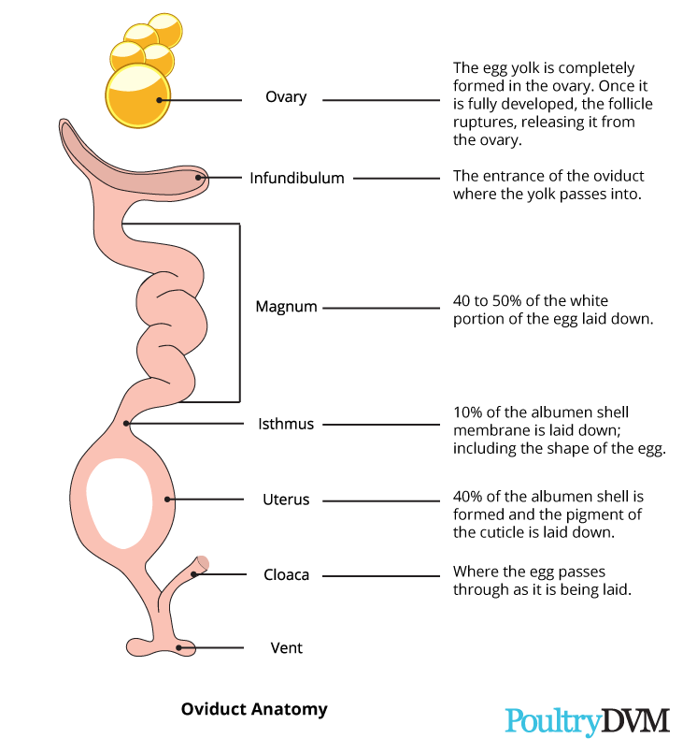
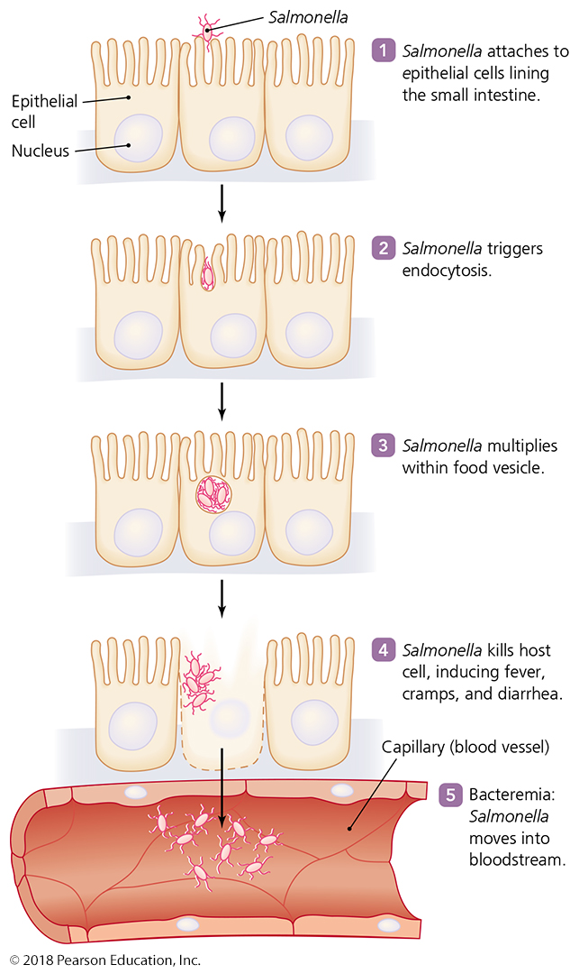
Figure 23.9 The events in salmonellosis.
Salmonella from bird gut infects the cloaca, then the reproductive track. It is incorporated into eggs as they are made and laid
Notes:
33

Slide 34
Bacterial Diseases of the Digestive System
Bacterial Gastroenteritis: Salmonellosis and Typhoid Fever
Diagnosis, treatment, and prevention
Diagnosis is made by finding Salmonella in stool
Salmonellosis is usually self-limiting
Typhoid fever can kill up to 30% of people
Typhoid fever can be treated with antimicrobial drugs
Typhoid vaccine recommended for travelers to certain parts of the world (rural SE Asia, Africa) but needs to be administered every 2 years for frequent travelers
Prevented in humans with proper hygiene
Prevented in poultry with reduced antibiotic use and reduced crowding of chickens (proper hygiene of chickens - “free range” or “cage-free” chickens and eggs)

Slide 35
Bacterial Diseases of the Digestive System
Bacterial Gastroenteritis: Cholera
Pathogen and virulence factors
Caused by Vibrio cholerae
Occurs in saltwater and freshwater
Environment within the human body activates some Vibrio genes
Most important virulence factor is production of cholera toxin – forces excessive release of chloride, carbonate, and water – rapid dehydration
Pathogenesis and epidemiology
Pandemics have occurred throughout history
Genetic mutation in cystic fibrosis transmembrane receptor may confer resistance
The mutation prevents water and chloride release into body fluids

Slide 36
Bacterial Diseases of the Digestive System
Bacterial Gastroenteritis: Cholera
Diagnosis, treatment, and prevention
Diagnosis is based on presence of "rice-water" stool
Treated with supportive care and administration of doxycycline
Oral rehydration therapy essential because of excessive diuretic effect of cholera toxin
Doxycycline essential to kill bacteria and prevent toxin formation
Available vaccine provides only short-lived immunity
Proper hygiene is an important preventive measure
Use of clean water in affected areas is crucial!
Excessive lack of care or understanding of “clean water” leads to epidemics spreading to this day

Slide 37
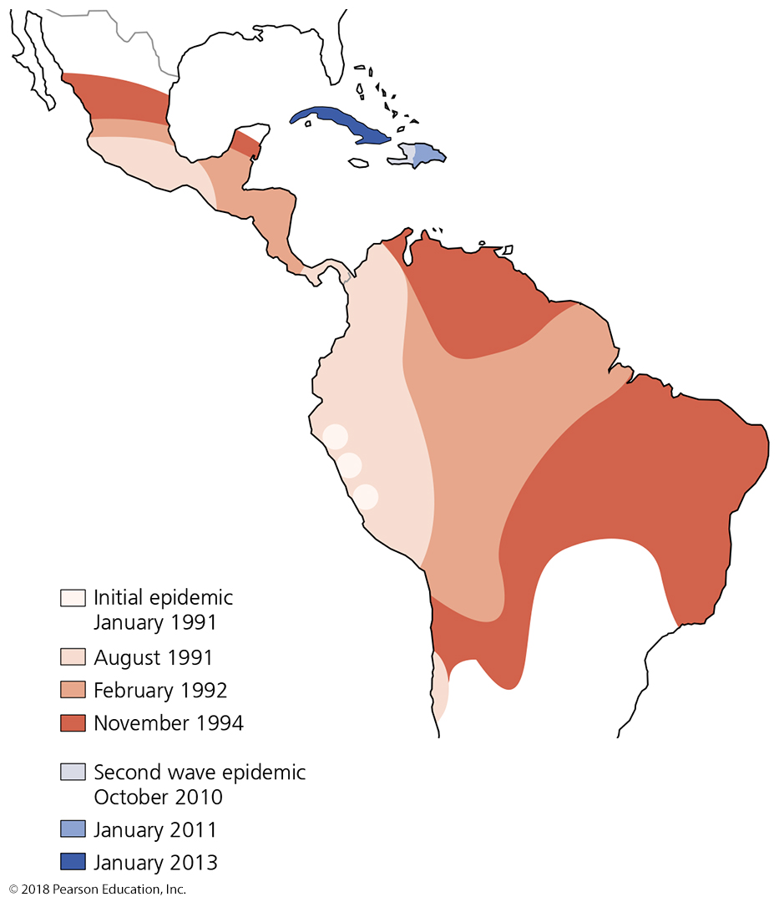
Figure 23.11 Cholera pandemic.
Notes:
37

Slide 38
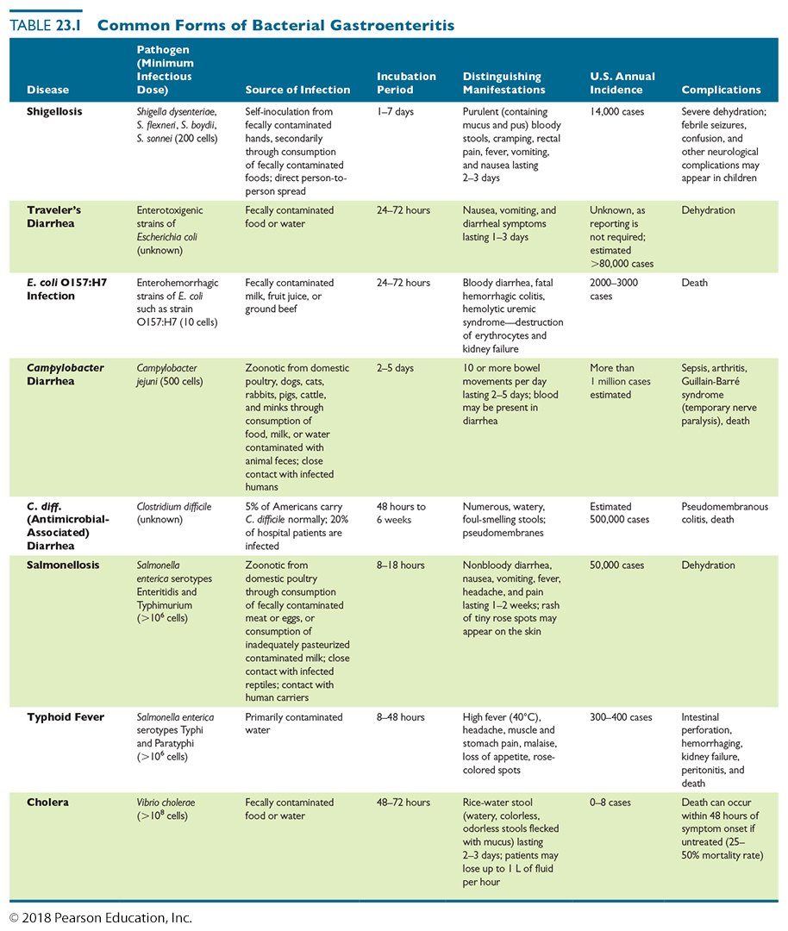
Table 23.1 Common Forms of Bacterial Gastroenteritis (1 of 2)
Notes:
38

Slide 39
Table 23.1 Common Forms of Bacterial Gastroenteritis (2 of 2)
Notes:
39

Slide 40
Bacterial Diseases of the Digestive System
Bacterial Food Poisoning (Intoxication)
Signs and symptoms
Nausea, vomiting, diarrhea, and cramping
Pathogen and virulence factors
Caused by enterotoxins of Staphylococcus aureus
Re-heating intoxicated (contaminated) food destroys bacteria but not the toxins
Pathogenesis and epidemiology
Outbreaks are associated with social functions and improper food storage
Diagnosis, treatment, and prevention
Diagnosis is based on signs and symptoms
Treated with fluid and electrolyte replacement (only need to clear out toxins)
Proper hygiene can reduce incidence

Slide 41
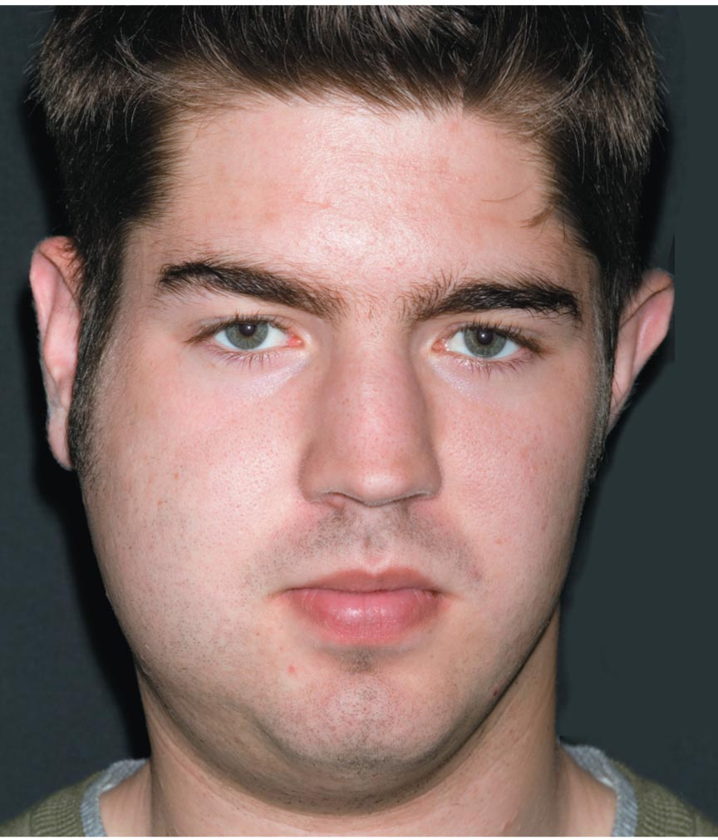
Viral Diseases of the Digestive System
Mumps
Caused by the mumps virus
Humans are the only natural host
Once a very common childhood disease
Nearly nonexistent in developed countries because of immunization (MMR)
Vaccine with two boosters usually prevents
Transmitted through saliva
No specific treatment
Infected individuals develop
lifelong immunity
Can cause meningitis, deafness, and male sterility through testiculitis

Slide 42
Viral Diseases of the Digestive System
Viral Gastroenteritis
Signs and symptoms
Similar to those of bacterial gastroenteritis
Dehydration is common complication
Pathogens and pathogenesis
Caused by caliciviruses, astroviruses, and rotaviruses
These viruses infect cells lining the intestinal tract
Epidemiology
More cases occur in winter
Rotaviruses are common cause of childhood deaths in developing countries
Vaccination has nearly eliminated serious rotaviral infections in developed nations

Slide 43
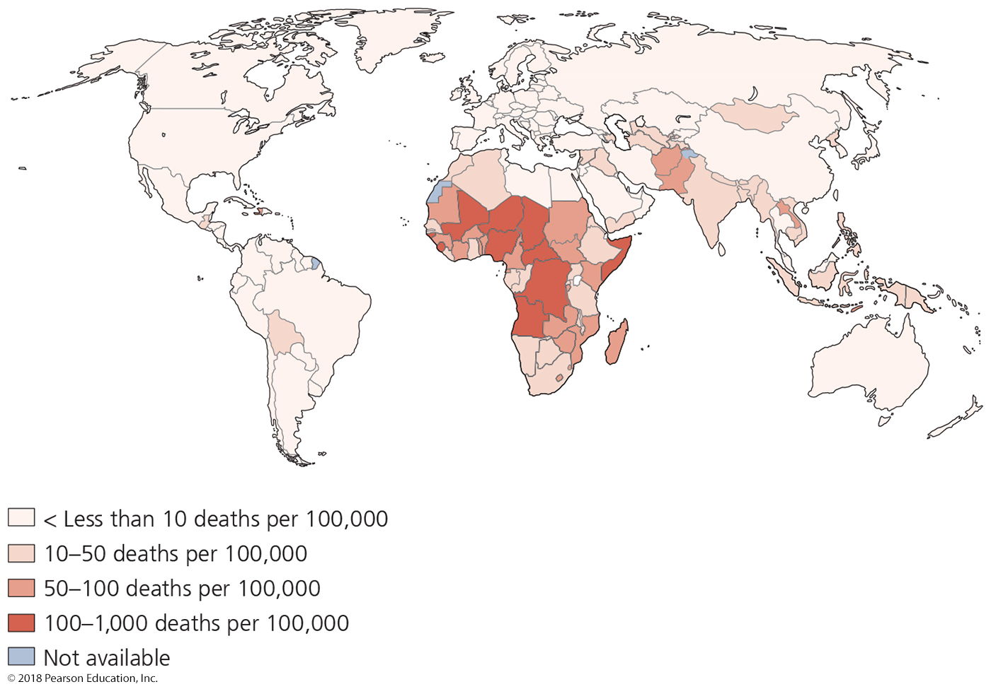
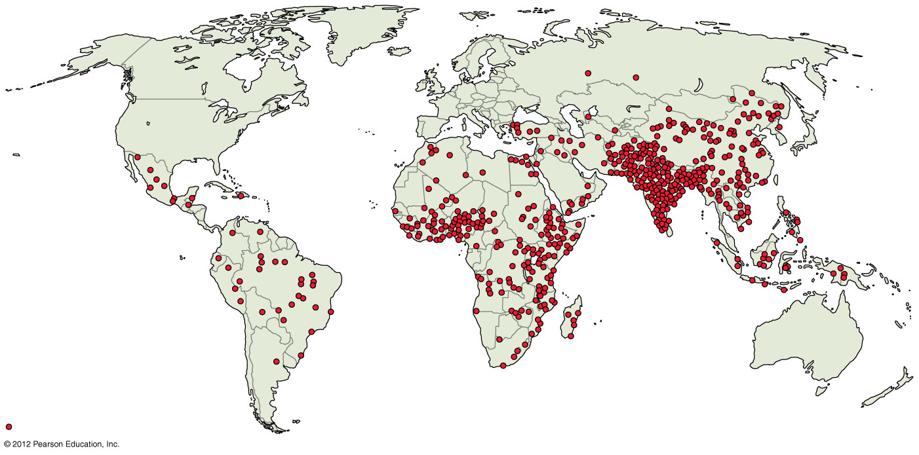
Figure 23.15 Deaths from rotaviral diarrhea are most common in developing countries.
= 1000 deaths
Notes:
43

Slide 44
Viral Diseases of the Digestive System
Viral Gastroenteritis
Diagnosis
Serological test distinguishes among viruses
Treatment
No antivirals
Based on fluid and electrolyte replacement
Prevention involves proper treatment of water and sewage and good hygiene practices (hand sanitizers on cruise ships!)
Two vaccines for rotavirus exists – lingual administration
RotaTeq
Rotarix

Slide 45
Viral Diseases of the Digestive System
Viral Hepatitis
Signs and symptoms
Jaundice, abdominal pain, fatigue, vomiting, and weight loss (body loses ability to clear poisons and toxins and to provide energy for whole body)
Symptoms may occur years after initial infection
Pathogen and pathogenesis
Liver damage due mostly to chronic host immune response due to chronic viral presence and chronic infection of regenerated tissue
Five different viruses cause hepatitis
Hepatitis A virus (HAV)
Hepatitis B virus (HBV)
Hepatitis C virus (HCV)
Hepatitis delta virus (HDV)
Hepatitis E virus (HEV)

Slide 46
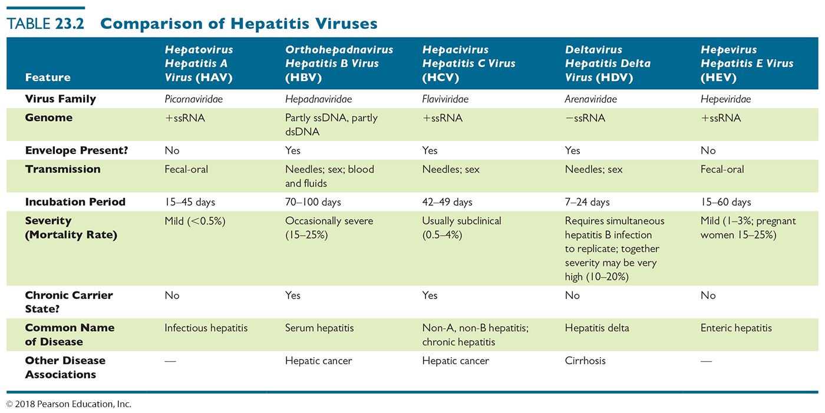
Table 23.2 Comparison of Hepatitis Viruses – KNOW BOXED INFORMATION
Notes:
46

Slide 47
Viral Diseases of the Digestive System
Viral Hepatitis
Diagnosis, treatment, and prevention
Initial diagnosis made by observation of jaundice, enlarged liver, or fluid in the abdomen
Serological testing can identify viral antigens
HBV diagnosed by viral proteins in body fluids
Supportive care for symptoms
Alpha interferon and nucleotide analogs help reduce levels of virus (Hep A, B, and C viruses)
Prevented with good hygiene and protected sex or abstinence
Vaccines are available against HAV and HBV
Many colleges require HBV vaccination before University admission or living in University dormatories
Sovaldi, Harvoni available for some HCV subtypes

Slide 48
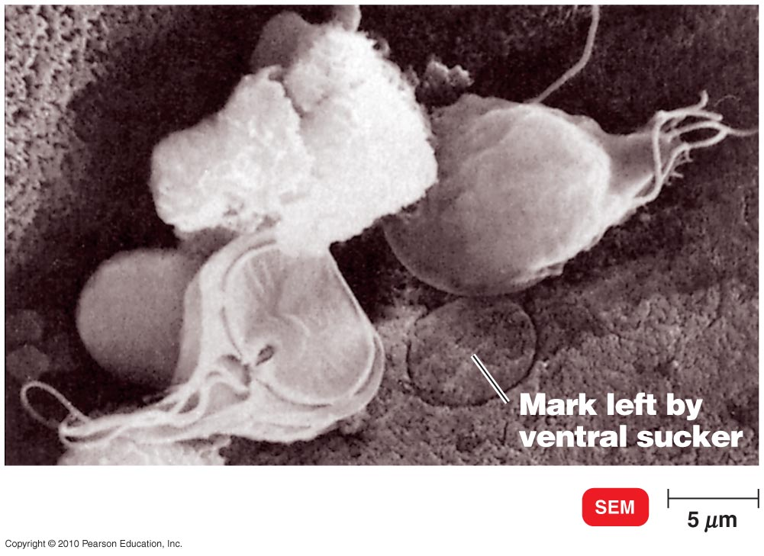
Protozoan Diseases of the Intestinal Tract
Giardiasis
Signs and symptoms
Often asymptomatic
Diarrhea and associated symptoms can last up to four weeks
Pathogen
Caused by Giardia intestinalis
G. intestinalis cysts are resistant to chlorine, heat, drying, and stomach acid

Slide 49
Protozoan Diseases of the Intestinal Tract
Giardiasis
Epidemiology
Occurs in BOTH developed and developing countries
Individuals ingest cysts from contaminated water, food, or hands
Hikers, campers, and swimmers are at particular risk
Diagnosis, treatment, and prevention
Diagnosed by microscopic observation of Giardia in stool
Treated with tinidazole or metronidazole (U.S.)
Oral rehydration therapy may be needed
Prevention relies on using good hygiene, filtering water in endemic areas, always sanitizing water, or not swimming in some areas.

Slide 50
Protozoan Diseases of the Intestinal Tract
Cryptosporidiosis
Signs and symptoms
Severe watery diarrhea with potentially serious complications
Pathogen and pathogenesis
Caused by the apicomplexan Cryptosporidium parvum
Pathogenicity of C. parvum is unclear
Epidemiology
Infection results from drinking contaminated water
Diagnosis, treatment, and prevention
Presence of oocysts in feces is diagnostic
Treated with fluid and electrolyte replacement
Prevented with proper hygiene

Slide 51
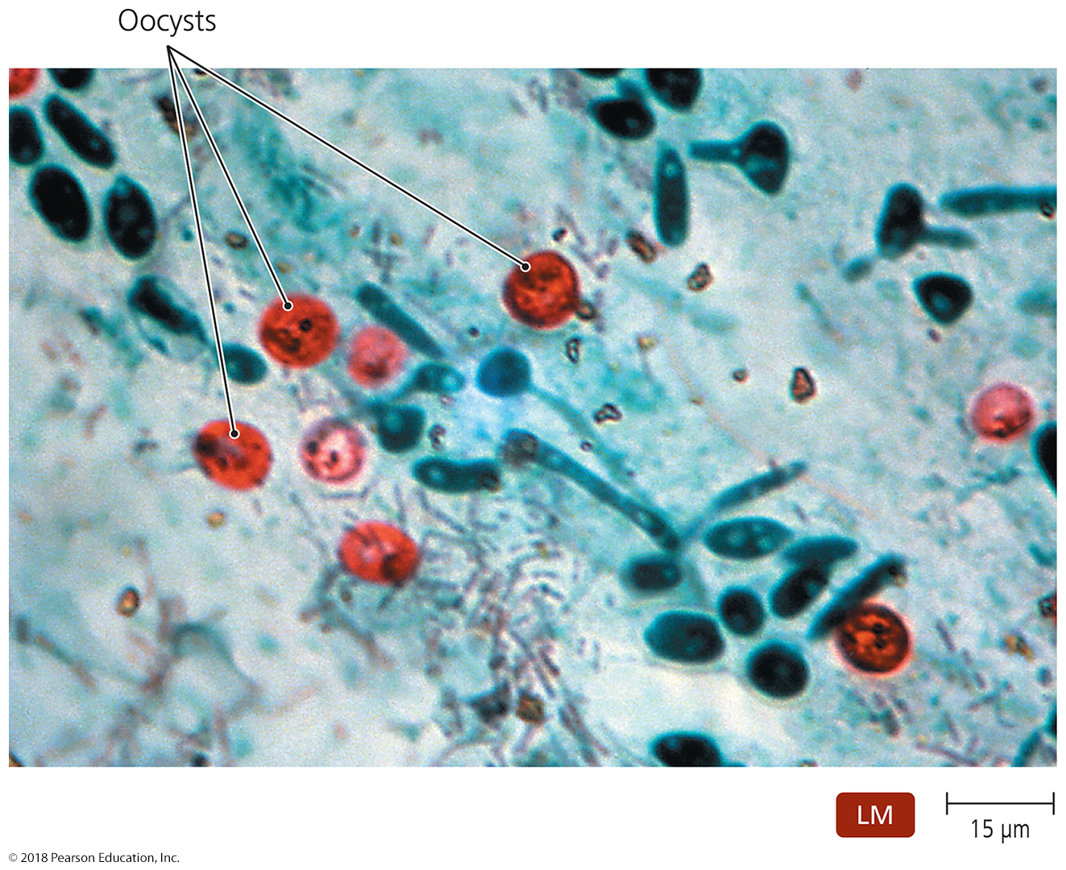
Figure 23.17 Oocysts of Cryptosporidium parvum in feces.
Notes:
51

Slide 52
Protozoan Diseases of the Intestinal Tract
Amoebiasis or Amoebic Dynsentery
Signs and symptoms
Luminal amoebiasis is asymptomatic
Invasive amoebic dysentery causes severe diarrhea, colitis, and appendicitis
Invasive extraintestinal amoebiasis causes necrotic lesions in various organs – usually occurs in the immunocompromised
Pathogen, virulence factors, and pathogenesis
Caused by Entamoeba histolytica (more common) or E. dispar (less common; more virulent)
Virulent strains produce numerous proteins that are toxic to cells and facilitate invasion
Trophozoites in the peritoneal cavity or blood cause symptoms

Slide 53
Protozoan Diseases of the Intestinal Tract
Amoebiasis
Epidemiology
Transmitted by consumption of contaminated food or water, from contaminated hands, or by oral-anal intercourse
Up to 10% of the world is infected with enteric amoeba
Majority of individuals develop luminal amoebiasis and are asymptomatic carriers (90%)
Most of the remainder are treatable; mortality < 1:10000
Human carriers help maintain transmission
Diagnosis, treatment, and prevention
Diagnosed by microscopic observation of Entamoeba in stool or intestinal biopsy
Treated with oral rehydration therapy and antiamoebic drugs
Prevent with proper hygiene and safe sex practices
Individuals in endemic areas should drink bottled water and avoid uncooked vegetables or unpeeled fruits

Slide 54
Helminthic Infestations of the Intestinal Tract
Helminths are macroscopic, multicellular worms.
Helminths can infest the GI tract as non-disease-causing parasites
Helminths can pass to bloodstream, and into or through the liver and enter tissues.

Slide 55
Helminthic Infestations of the Intestinal Tract
Tapeworm Infestations
Tapeworm is the common name for a cestode
Flat, segmented, parasitic helminth
Intestinal parasites that lack own digestive system
Signs and symptoms
Usually asymptomatic
Nausea, abdominal pain, weight loss, and diarrhea may occur
Pathogens
Taenia saginata: beef tapeworm
Taenia solium: pork tapeworm
Life cycle split between primary and intermediate host

Slide 56
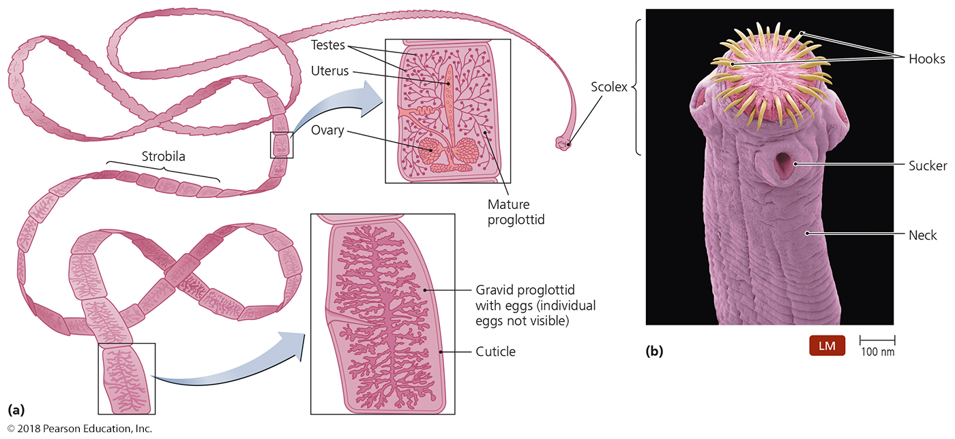
Figure 23.18 Features of tapeworm morphology.
Notes:
56

Slide 57
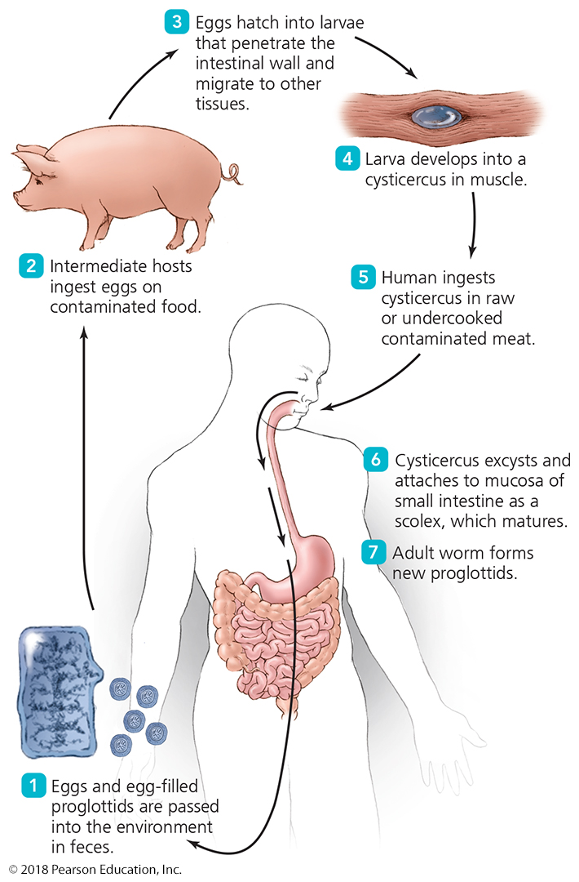
Figure 23.19 Life cycle of Taenia solium.
Notes:
57

Slide 58
Helminthic Infestations of the Intestinal Tract
Tapeworm Infestations
Epidemiology
Taenia species live worldwide where beef and pork are food
High incidence
Regions of inadequate sewage treatment
Regions where humans live in close contact with livestock
Diagnosis, treatment, and prevention
Diagnosed by presence of proglottids in fecal sample
Treated with niclosamide or praziquantel
Prevention relies on thorough cooking of meats

Slide 59
Helminthic Infestations of the Intestinal Tract
Pinworm Infestations (NOTE: NOT infection!)
Pinworms are nematodes
Long, thin, unsegmented, cylindrical helminth
Signs and symptoms
Perianal itching, irritability, and decreased appetite
Scooting in dogs (some cases) (https://www.youtube.com/watch?v=aanuVblbIiY)
One-third of cases are asymptomatic
Pathogen and infestation
Caused by Enterobius vermicularis
Females deposit eggs in the perianal region at night
Eggs can be dislodged and spread the disease
Usually introduced orally; egg survives the stomach and hatches in the intestines
Pinworm feeds on intestinal bacteria

Slide 60
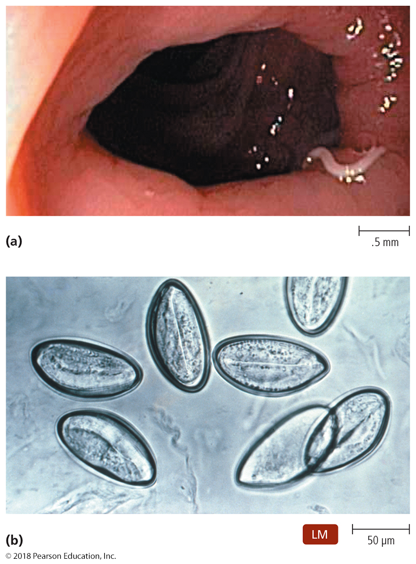
Helminthic Infestations of the Intestinal Tract
Pinworm Infestations
Epidemiology
Endemic all over the world
Infestations commonly occur in children and pets
Enterobius is the most common parasitic worm in the US
infestation rates average 20%, can approach 50% in some rural areas
The adult
The eggs

Slide 61
Helminthic Infestations of the Intestinal Tract
Pinworm Infestations
Diagnosis, treatment, and prevention
Diagnosis is based on identification of eggs or adult pinworms (“Scotch tape” test)
Treated with pyrantel pamoate or mebendazole
More effective long-term strategy involves altering hygienic habits
Prevention requires strict personal hygiene
Make children wash hands after playing outside before eating or using bathroom
regular bathing
no towel or underware sharing
Proper and frequent clothes/underware washing

