Slide 1
Microbiology
Chapter 22
Diseases of the Respiratory System

Slide 2
Function and Structures of the Respiratory System
Respiratory system exchanges gases between the atmosphere and the blood
Divided into two main parts
Upper respiratory system
shared with digestive/olfactory system
Lower respiratory system

Slide 3
Structures of the Respiratory System
Structures of the Upper Respiratory System, Sinuses, and Ears
Components of the upper respiratory system
Nose
Nasal cavity
Pharynx
Uvula
Note that the mouth is not included (many animals are not mouth-breathers)
Sinuses, ears (and eyes) are added because they drain into the nasal cavity, but they are NOT part of the respiratory system
Various antimicrobial chemicals and biochemicals
Where are these released into?

Slide 4
Structures of the Respiratory System
Structures of the Lower Respiratory System
Components of the lower respiratory system
Larynx
Trachea
Bronchi
Alveoli
Diaphragm
Various protective components
Ciliated mucous membrane, alveolar macrophages, and secretory antibodies

Slide 5
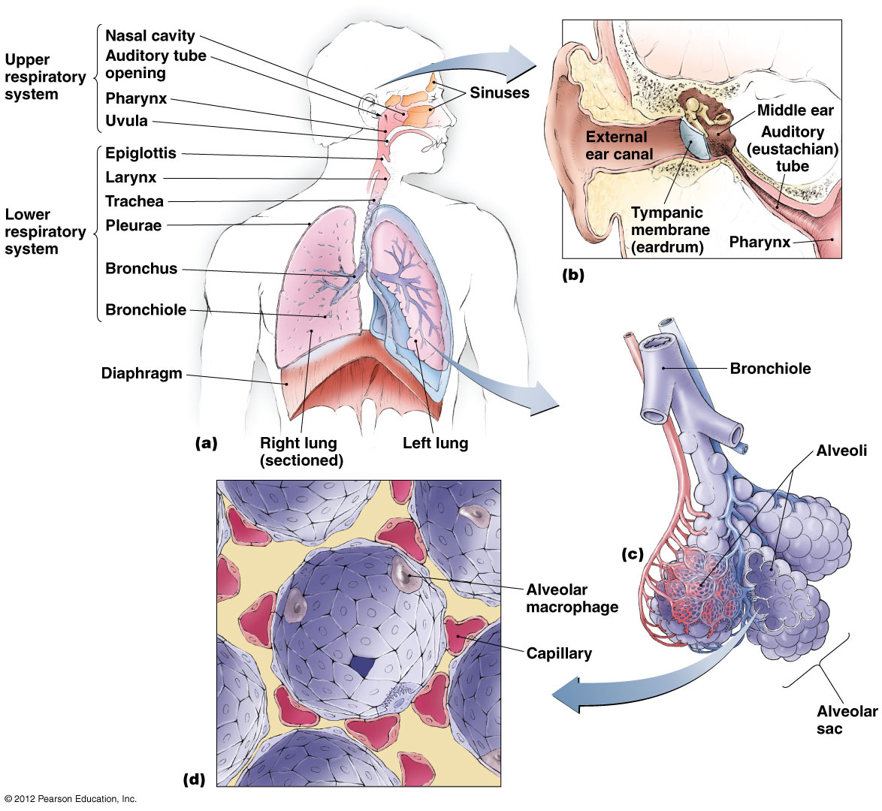
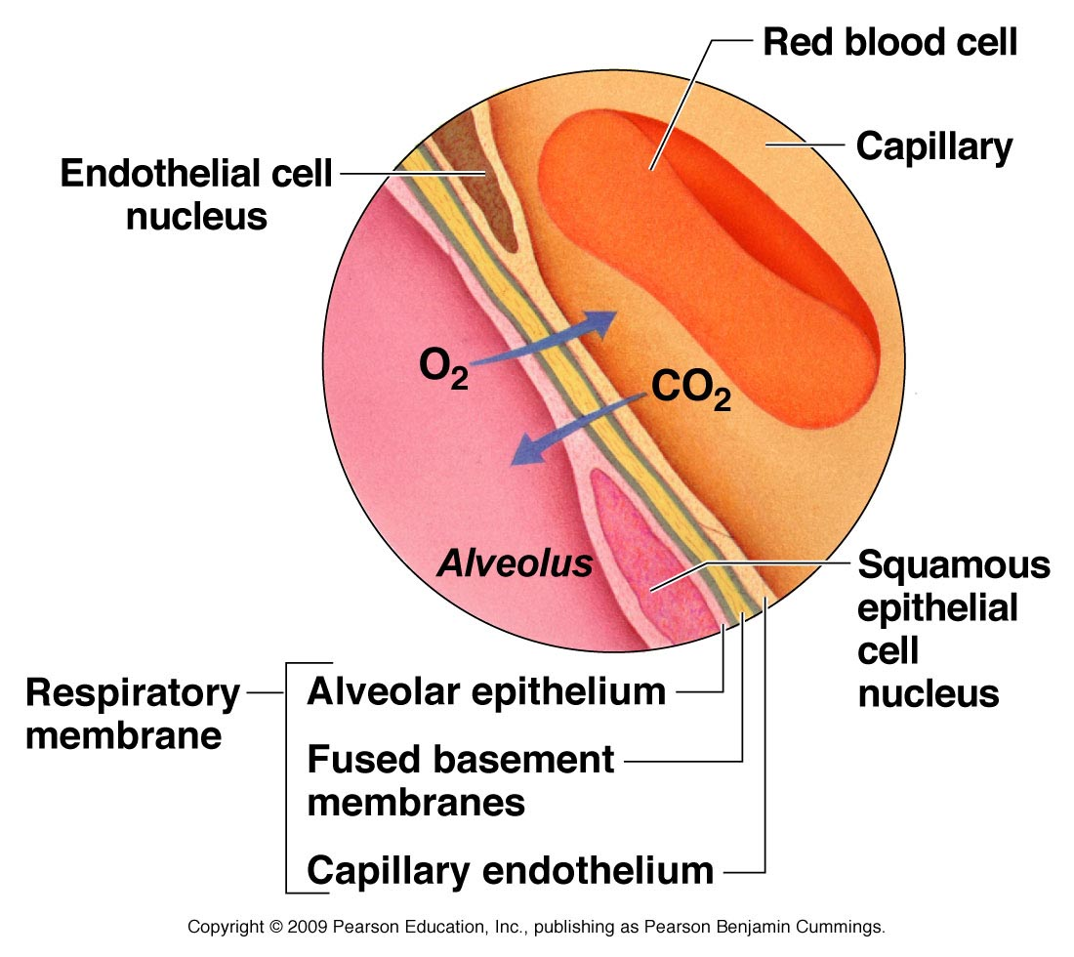
Figure 22.1 Structures of the respiratory system.
Notes:
5

Slide 6
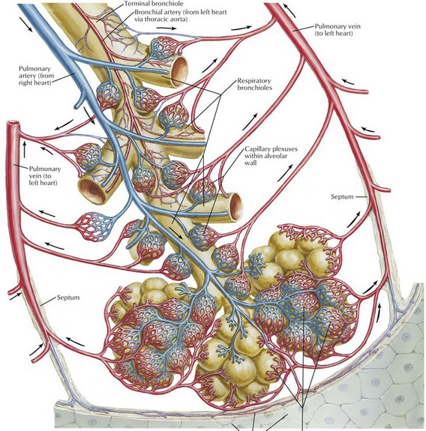
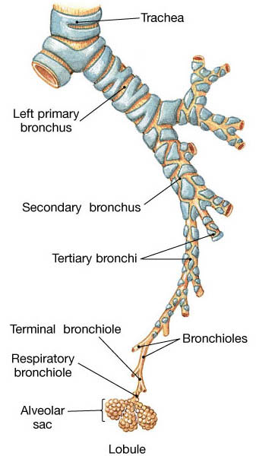
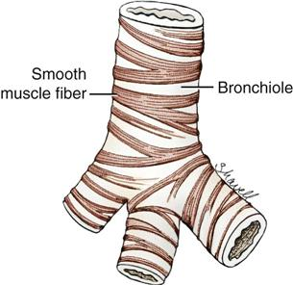
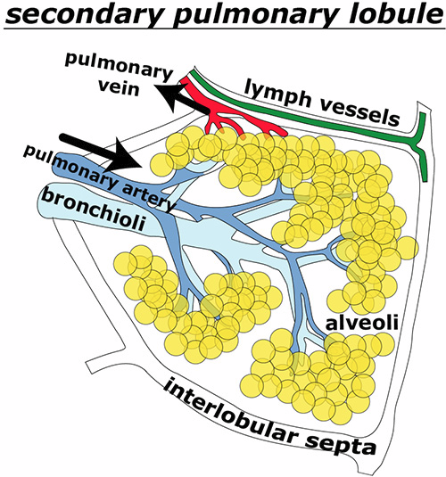
Figure 22.1: microanatomy and microcirculature of the respiratory system: the lobule
Conducting zone –
cartilage shielding smooth muscles
limited compression
mucus formation
ciliary elevator
Infection detection and fighting
Respiratory zone –
no cartilage shielding smooth muscles
variable compression
surfactant formation
gas exchange
pathogen clearing
Individual respiratory zones are segregated into pulmonary lobules (1 cm³) containing up to 60000 alveoli
Pulmonary arterioles follow the bronchioles
Pulmonary venules and lymphatics follow the walls of the lobules
Notes:
6

Slide 7
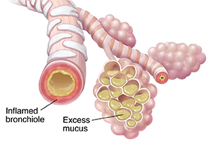
Diseases of the respiratory system
Signs and symptoms
Pharyngitis
Sore/inflamed throat and difficulty swallowing
Agitation of tissues; no direct difficulty breathing
Laryngitis
Sore/inflamed voice box (no swallowing deficits – why?)
Difficulty speaking; no direct difficulty breathing
Bronchitis
Inflammation of the bronchi and bronchioles
Constriction and mucus buildup will inhibit breathing
Pneumonia
Disease in the alveoli (where gas exchange occurs)
Dangerous blocking of breathing due to mucus buildup
These can co-present depending on infection spread

Slide 8
Structure of the Respiratory System
Microbiome of the Respiratory System
Upper respiratory system
Colonized by many microorganisms
Normal microbiome limits growth of pathogens
Normal microbiome may be opportunistic pathogens
Corynebacteria (diphtheria), Streptococcus (strep throat), Candida (thrush)
Lower respiratory system
Typically microorganisms are not present
Alveolar macrophages clean up invaders
Possibly limited numbers of normal microbiota near BALT (bronchia-associated lymphoid tissue)
BALT tend to make stable structures near chronic presence of resident microbiota

Slide 9
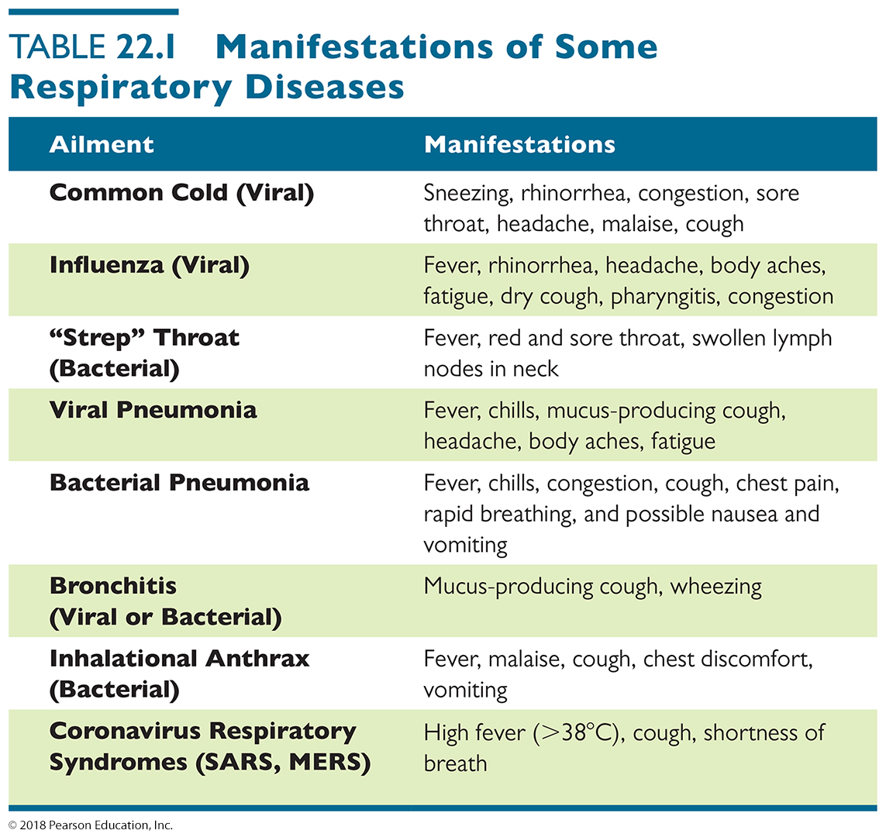
Table 22.1 Manifestations of Some Respiratory Diseases – PARTIAL SUMMARY
Notes:
9

Slide 10
Streptococcal Respiratory Diseases
Group A Streptococcal URI
Signs and symptoms
Pharyngitis (acute Group A streptococcal pharyngitis is commonly known as what?)
Sore throat and difficulty swallowing
Often accompanied by fever, malaise, and headache
Streptococcal exotoxins destroy blood to feed strep
Laryngitis and bronchitis can occur if infection spreads to lower respiratory tract
Complications including scarlet fever, rheumatic fever (heart damage), and acute glomerulonephritis occur in some cases
increased virulence, or overreaction of immune system

Slide 11
Streptococcal Respiratory Diseases
Pathogen and virulence factors
Caused by group A streptococci (S. pyogenes)
Variety of virulence factors – FOR REFERENCE ONLY
M proteins – complement inhibitor
C5a peptidase – complement inhibitor
Hyaluronic acid capsule – Hide from immune system
Streptokinases – break down blood clots
Pyrogenic toxins – stimulate inflammation for more blood and cells etc.
Streptolysins – break open blood cells (food; nutrients)

Slide 12
Streptococcal Respiratory Diseases
Pathogenesis – occurs when:
large inoculum introduced (common) – respiratory droplets
normal microbiota are depleted
adaptive immunity impaired – makes one more susceptible
Epidemiology
Spread via respiratory droplets
Occurs most often in winter and spring
Diagnosis, treatment, and prevention
Often confused with viral pharyngitis
Oral penicillin is an effective treatment with most strains
Allergic to penicillin? clindamycin, azithromycin, cephalexin
narrow-spectrum antibiotics are strongly preferred - why?
Vaccine does not exist yet; natural immunity easily acquired, especially after antibiotic treatment

Slide 13
Bacterial Diseases of the Upper Respiratory System, Sinuses, and Ears
Diphtheria
Signs and symptoms
Sore throat, localized pain, and fever
Presence of a pseudomembrane that can obstruct airways – this caused death in the past
Pathogen and virulence factors
Caused by Corynebacterium diphtheriae
Ubiquitous in animals and humans – decrease in normal microbiota can make one sick with it
Virulence factors
C. diptheriae produces diphtheria toxin
Prevents polypeptide synthesis and causes
cell death

Slide 14
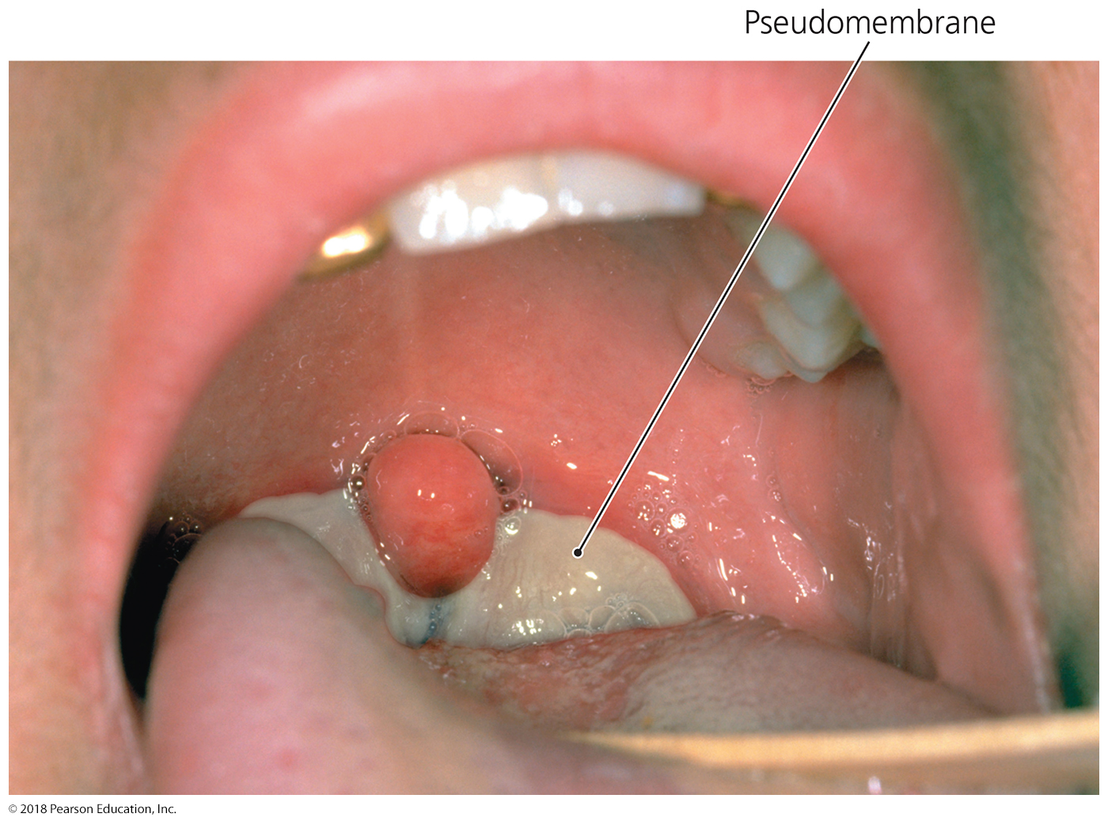
Figure 22.2 A pseudomembrane, characteristic of diphtheria.
pseudomembrane
Notes:
14

Slide 15
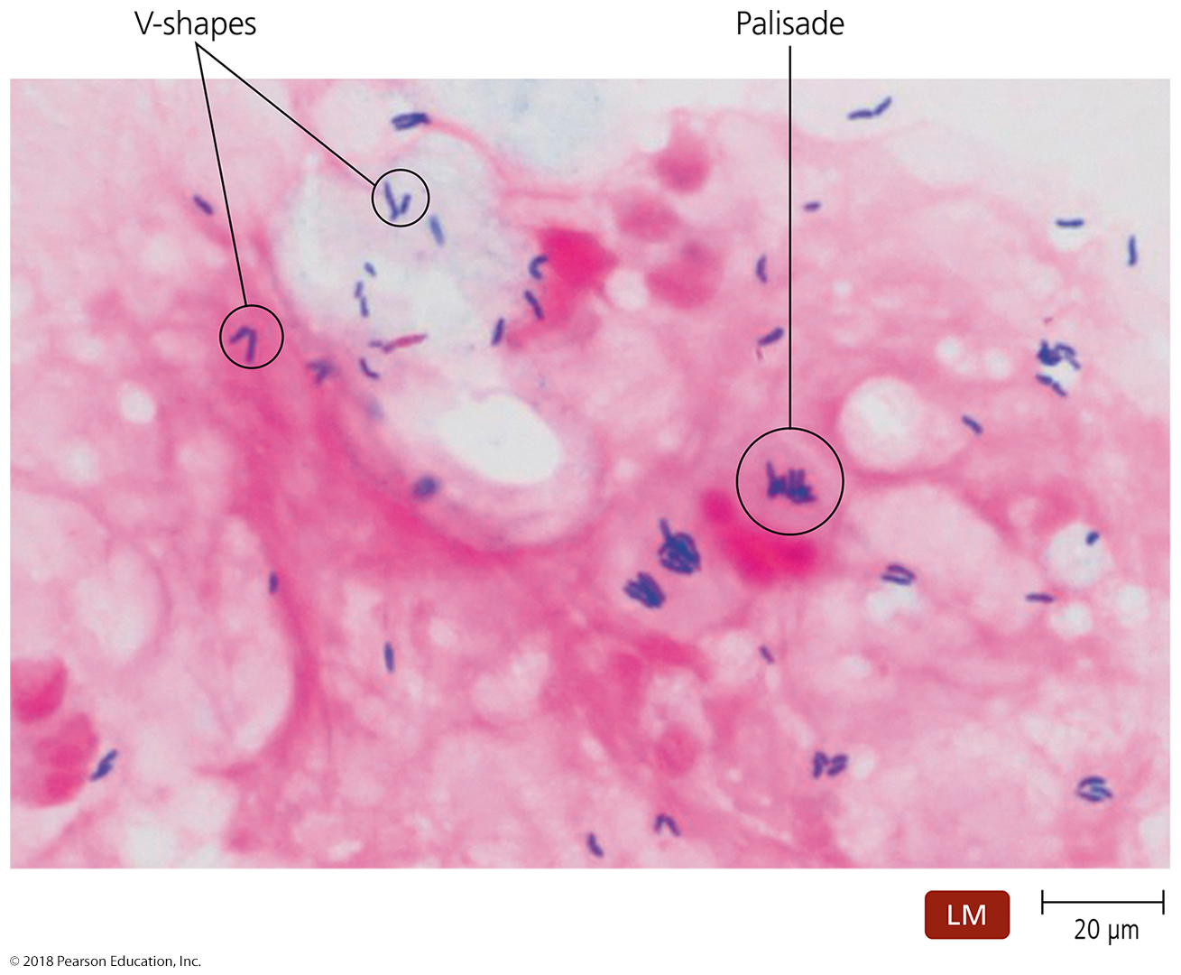
Figure 22.3 Characteristic arrangements of Gram-stained cells of Corynebacterium diphtheriae.
Notes:
15

Slide 16
Bacterial Diseases of the Upper Respiratory System, Sinuses, and Ears
Diphtheria
Pathogenesis and epidemiology
Spread via respiratory droplets or skin contact
Most healthy people do not feel symptoms from the bacteria, only from the toxin or the pseudomembrane
Symptomatic in immunocompromised or immunodeficient individuals (e.g., HIV)
Leading cause of death among unimmunized children – pseudomembrane blocks breathing even though bacteria not strongly infective
Diagnosis, treatment, and prevention
Diagnosis is based on presence of a pseudomembrane
Treated with antitoxin and antibiotics
Immunization (with toxoid) is an effective prevention

Slide 17
Sinusitis and Otitis Media
Signs and symptoms
Malaise accompanied by headache and inflamed nasal passages
Otitis media results in severe pain in the ears
Pathogen and virulence factors
Caused by various respiratory microbiota
Group A Strep and S. pneumonia most common
May be due to damage to upper respiratory system and auditory tube
Diagnosis, treatment, and prevention
Symptoms are often diagnostic
No known way to prevent rhinosinusitis
Flushing nasal and sinus cavities with saline solution can reduce duration of symptoms – flush out/inhibit pathogens
Prevention of some cases by vaccination (Prevnar, Hib)

Slide 18
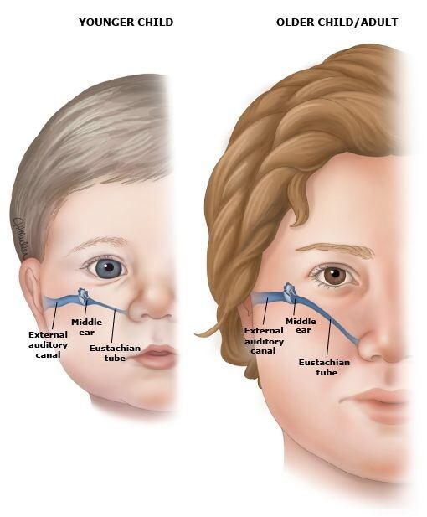
Sinusitis and Otitis Media
Pathogenesis and epidemiology
Bacteria in the pharynx spread to the sinuses via the throat
Rhinosinusitis is more common in adults
Otitis media is more common in children – major disease in children
Why is it more common in children??

Slide 19
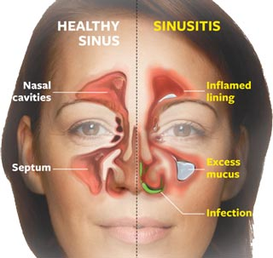
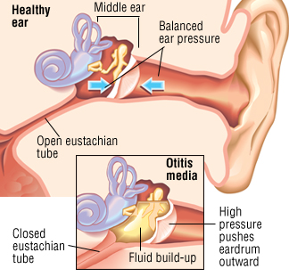
Sinusitis and Otitis Media
Pathology images

Slide 20
Viral Diseases of the Upper Respiratory System
Common Cold – acute viral nasopharyngitis
Signs and symptoms
Sneezing, runny nose, congestion, sore throat, malaise, and cough
Pathogens and virulence factors
Over 200 known – all viruses
Enteroviruses (rhinoviruses) are the most common cause (30-80%)
Numerous other viruses cause colds (RSV, coronavirus, adenovirus, influenza virus, parainfluenza virus, etc.)
More severe infections in some may feel only like a cold in others
The flu, SARS, MERS, RSV
Pathogenesis
Cold viruses replicate in and kill infected cells
Cannot grow deeper in body or beyond stomach (acidity)
Cold viruses replicate at the lower temperature of the nasal cavity – warm conditions can slow down viral infection

Slide 21
Viral Diseases of the Upper Respiratory System
Common Cold
Epidemiology
Rhinoviruses are highly infective
one virus particle can initiate the disease
Some seasonality – more common in fall or winter
Spread by coughing/sneezing, fomites, or person-to-person contact
We can develop some immunity to serotypes over time with repeated colds (this is why adults tend to have fewer colds or less severe colds)
Diagnosis, treatment, and prevention
Signs and symptoms are usually diagnostic
Pleconaril (picovir) can reduce duration of symptoms
Hand antisepsis is important preventive measure
coronavirus, influenza highly sensitive to handwashing
rhinovirus, adenovirus sensitive to hand sanitizers

Slide 22
Bacterial Diseases of the Lower Respiratory System
Lower respiratory organs are usually axenic.
Have only “necessary” resident microbiota, if any
Alveolar macrophages phagocytose anything foreign to keep respiratory membrane clear and narrow for gas transport
Bacterial infection of the lower respiratory system can cause life-threatening illness.
Could be caused by upsetting the microbiome balance
Most often, fluid buildup prevents gas exchange
Lung tissue, once destroyed by pathogens or by the immune system, cannot be repaired
Lung tissue is among the last to develop; childhood LRT infection can predispose one to chronic LRT diseases

Slide 23
Bacterial Diseases of the Lower Respiratory System
Bacterial Pneumonias
Lung inflammation accompanied by fluid-filled alveoli and bronchioles
Described by affected region or organism causing the disease. Examples include but are not limited to:
Lobar pneumonia – throughout but limited to one lobe of lung
Mycoplasmal pneumonia
Healthcare-associated pneumonia
Bacterial pneumonias are the most serious and the most frequent in adults

Slide 24
Bacterial Pneumonias
Pneumoccocal pneumonia
Signs and symptoms
Fever, chills, congestion, cough, and chest pain
Results in short, rapid breathing
Blood enters the alveoli (and gets oxidized), causing rust-colored sputum
Pathogen and virulence factors
Caused by Streptococcus pneumoniae
Virulence factors
Adhesins
Capsule (R vs. S strains) – prevents macrophage phagocytosis

Slide 25
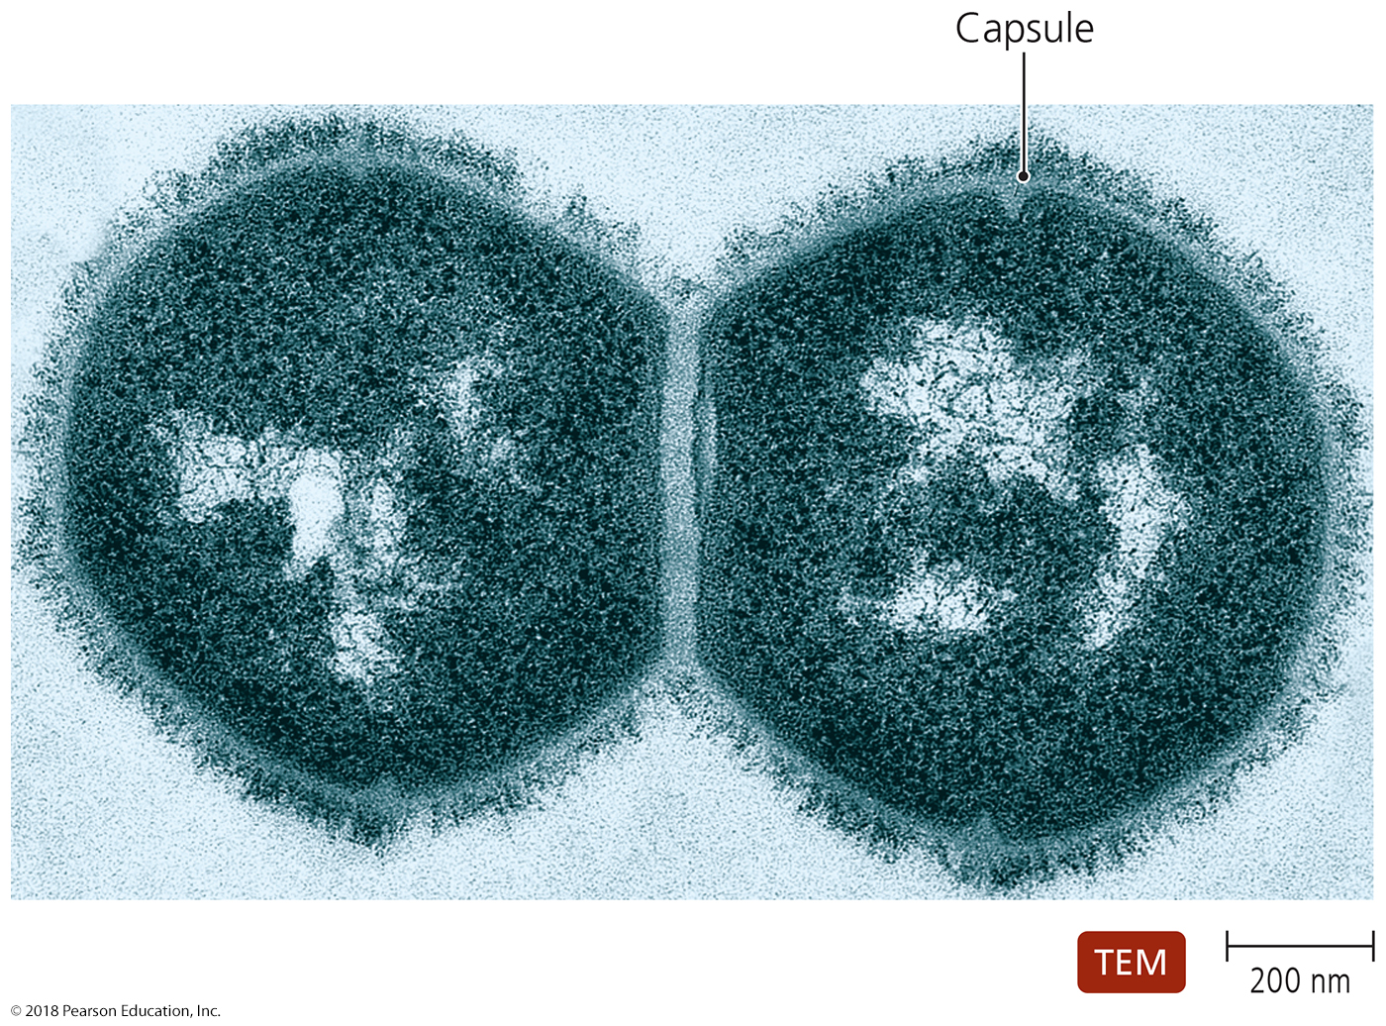
Figure 22.6 Streptococcus pneumoniae, the most common cause of bacterial pneumonia.
Notes:
25

Slide 26
Bacterial Pneumonias
Pneumoccocal pneumonia
Pathogenesis and epidemiology
Infection occurs by inhalation of bacteria
Bacterial replication causes damage to the lungs
Accounts for most cases of bacterial pneumonia
Diagnosis, treatment, and prevention
Diagnosed by identifying diplococci in sputum smears
Penicillin is drug of choice for treatment
Some strains are now penicillin resistant (treat with doxycycline, clarithromycin)
Vaccination is the method of prevention (prevnar, pneumovax)

Slide 27
Bacterial Pneumonias
Primary atypical (mycoplasmal) pneumonia
Atypical - not caused by pneumococcus
Signs and symptoms
Fever, malaise, sore throat, and excessive sweating, cough
NOT treated with penicillins or other beta-lactam antibiotics
Not as severe as with pneumococcal (“walking”)
Symptoms may last for weeks
Pathogen and virulence factors
Caused by Mycoplasma pneumoniae
Similar mycoplasmal species cause similar pneumonias in cows, sheep, birds
Virulence factors include an adhesion protein
Pathogenesis
Bacteria colonize and kill epithelial cells
Mucus buildup and colonization by other bacteria

Slide 28
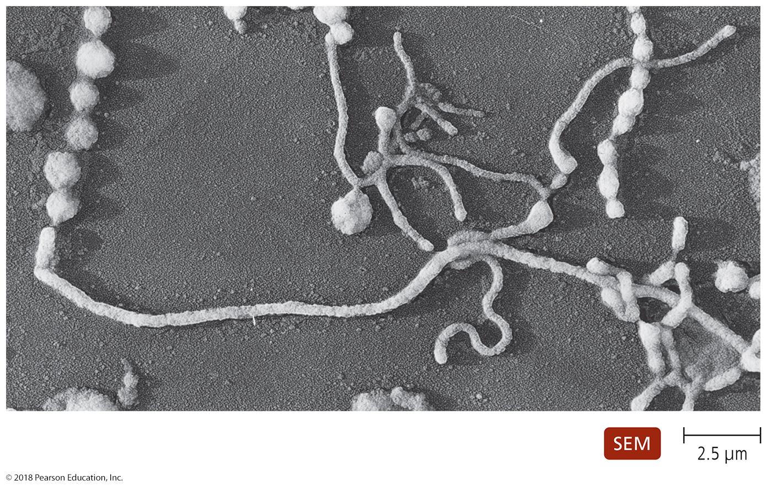
Figure 22.7 Pleomorphic forms of Mycoplasma.
This single species has various cellular shapes. How is it described?
Notes:
28

Slide 29
Bacterial Pneumonias
Primary atypical (mycoplasmal) pneumonia
Epidemiology
Bacteria spread by nasal secretions
Most common pneumonia in teenagers and young adults
“I can still function well; I do not need to go to the hospital”
Diagnosis, treatment, and prevention
Difficult to diagnose
Treated with erythromycin, clarithromycin or doxycycline (penicillin will fail because there is no peptidoglycan cell wall)
These antibiotics are also used to treat penicillin-resistant pneumonia
Prevention difficult since infected individuals may be asymptomatic (called walking pneumonia due to mild symptoms)
Recombinant vaccines are being developed

Slide 30
Bacterial Pneumonias
Klebsiellar pneumonia
Signs and symptoms
Pneumonia symptoms with thick bloody sputum and chills
Pathogen and virulence factors
Caused by Klebsiella pneumoniae – gram-negative
Virulence factors include a capsule
Pathogenesis and epidemiology
Immunocompromised patients at greater risk for infection
(elderly, children, AIDS patients)
Diagnosis, treatment, and prevention
Diagnosed by identifying Klebsiella in sputum samples
Treated with antimicrobials
MDR Klebsiella can have up to 50% mortality rate
Prevention involves good aseptic technique by health care workers
Vaccine based on outer membrane under development

Slide 31
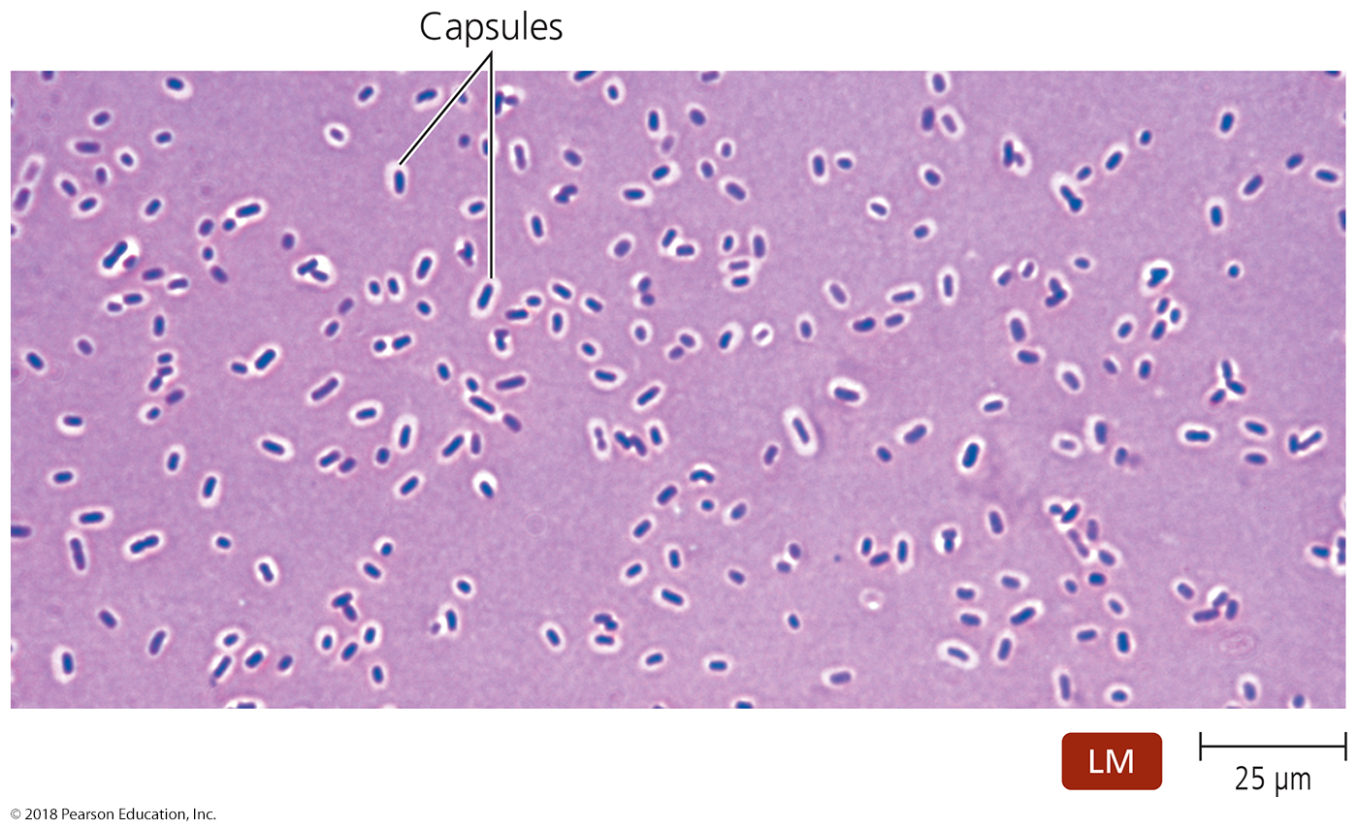
Figure 22.8 The prominent capsule of Klebsiella pneumoniae.
What type of stain allows one to “visualize” capsules?
Notes:
31

Slide 32
Bacterial Pneumonias
Other bacterial pneumonias
Haemophilus influenzae and Staphylococcus aureus
Disease similar to pneumococcal pneumonia
Hib vaccine prevents most common Haemophilus diseases
epiglottitis, pneumonia, pharyngitis, meningitis, otitis media
Yersinia pestis
Causes pneumonia, called pneumonic plague
Zoonotic - most common in sub-Saharan Africa/Madagascar

Slide 33
Other bacterial pneumonias
Legionnaires’ Disease
Found in Disneyland in California two years ago
Signs and symptoms
Typical pneumonia symptoms
Pulmonary function can rapidly decrease
Complications of neural and kidney functions can happen
Pathogen and virulence factors
Most cases caused by Legionella pneumophila
Pathogenesis
L. pneumophila lives in and kills human cells
Causes tissue damage and inflammation

Slide 34
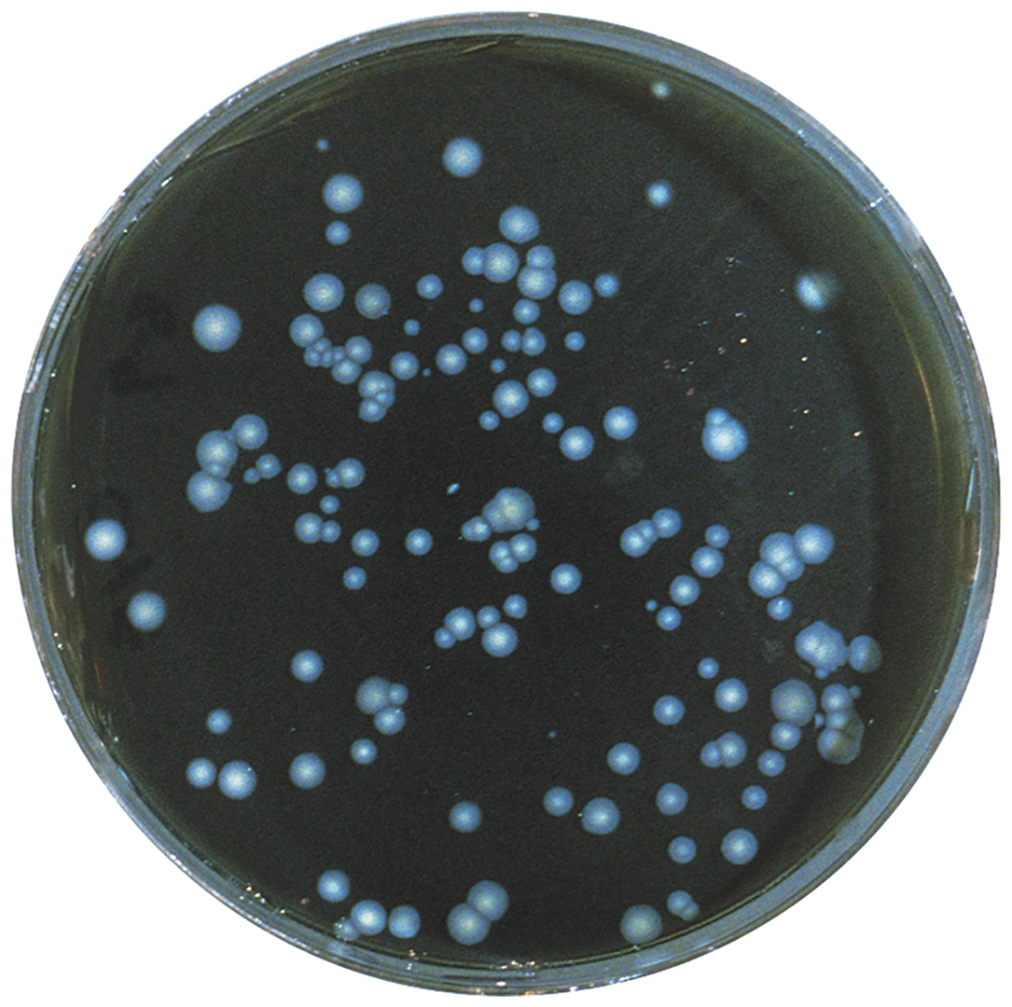
Figure 22.9 Legionella pneumophila growing on buffered charcoal yeast extract agar.
Notes:
34

Slide 35
Legionnaires’ Disease
Epidemiology
Legionella survives in domestic water sources
The elderly, smokers (b/c chronic lung damage), and immunocompromised individuals are at increased risk for infection
Diagnosis, treatment, and prevention
Diagnosed with fluorescent antibody staining or serology
Quinolones or macrolides are the preferred treatment
Controlled in public by reducing bacterial presence in water – sanitizers; periodic high-level antimicrobial treatments

Slide 36
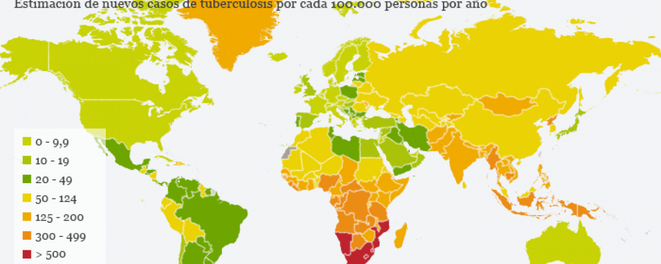
Other bacterial pneumonias
Tuberculosis
The leading disease killer in the world outside the USA
Incidence has declined in the industrialized world
Map below as of 2016

Slide 37
Other bacterial pneumonias
Tuberculosis
Signs and symptoms
Initially limited to minor cough and mild fever
Symptoms are not always apparent
Many can “stop” the disease at this stage
Pathogen and virulence factors
Caused by Mycobacterium tuberculosis
Presence of mycolic acid gives bacteria unique features
Slow and intracellular (in endosomes) growth
Protection from phagocytic lysis
Enhanced viability in aerosol droplets
Resistance to many antimicrobial drugs

Slide 38
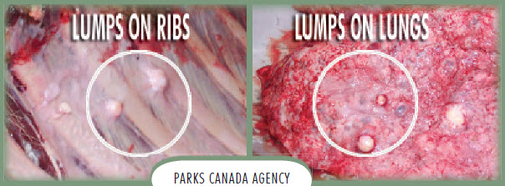
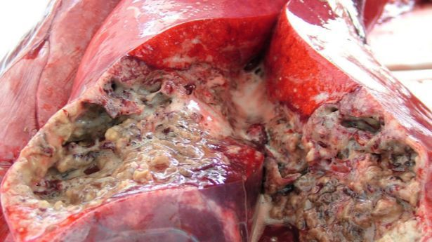
Tuberculosis
Pathogenesis
Spread via inhalation of respiratory drops
Three stages of tuberculosis
Primary tuberculosis – single tubercle in single/few alveolus
Secondary tuberculosis - lobar
Disseminated tuberculosis – through lung

Slide 39
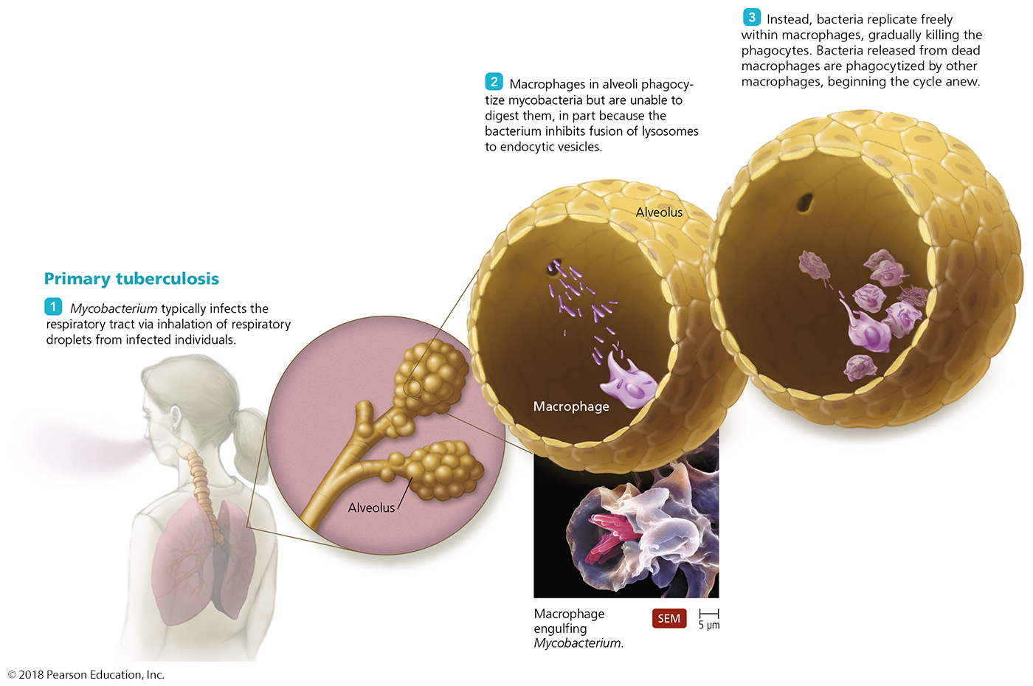
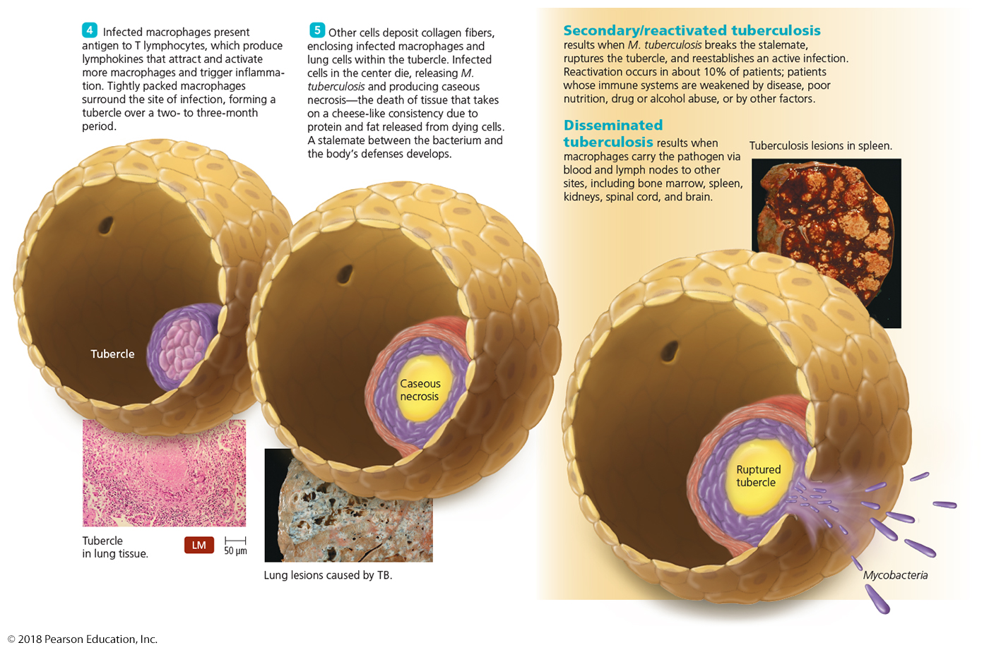
Disease in Depth: Tuberculosis: Pathogenesis
Notes:
39

Slide 40
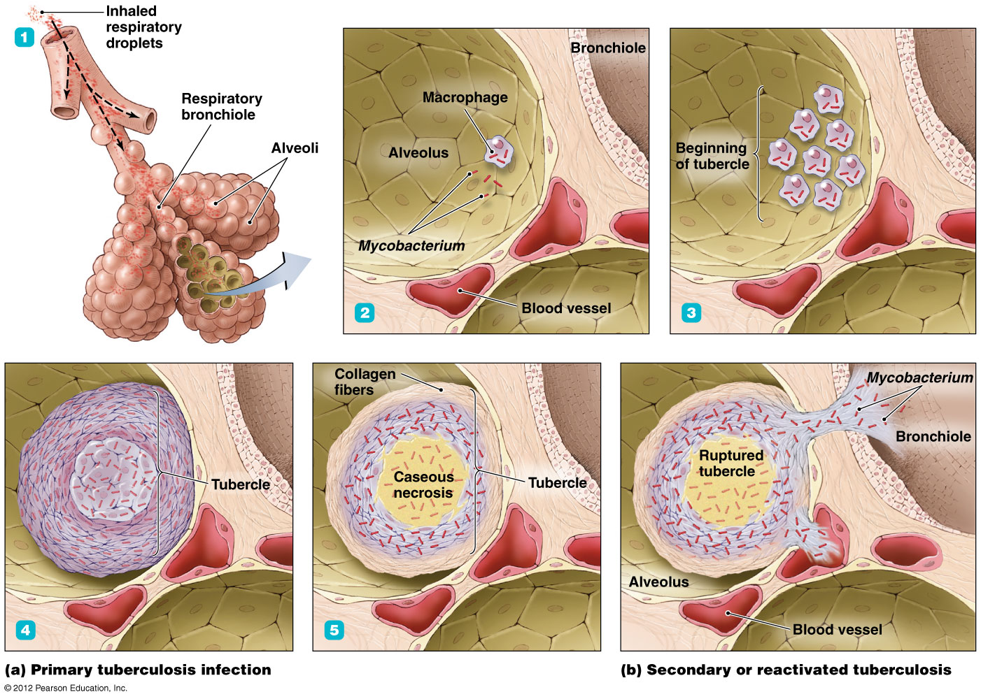
Disease in Depth: Tuberculosis: Pathogenesis
Notes:
40

Slide 41
Tuberculosis
Epidemiology
One-third of the world’s population is infected
Most are noncontagious – body stops it at primary stage
Most deaths occur in Asia and Africa
Leading killer of HIV+ and AIDS individuals outside USA
Easily reactivated due to immunodeficiency
Diagnosis, treatment, and prevention
Tuberculin skin test identifies exposure to tuberculosis
Chest X-ray images can identify tubercles in the lungs
Done for those vaccinated or infected, that will test positive with tuberculin test
Treatment requires combination of drugs, treatment for up to a year (2 weeks to become noncontagious)
Drug-resistant strains of M. tuberculosis have emerged
BCG vaccine is available where tuberculosis is common

Slide 42
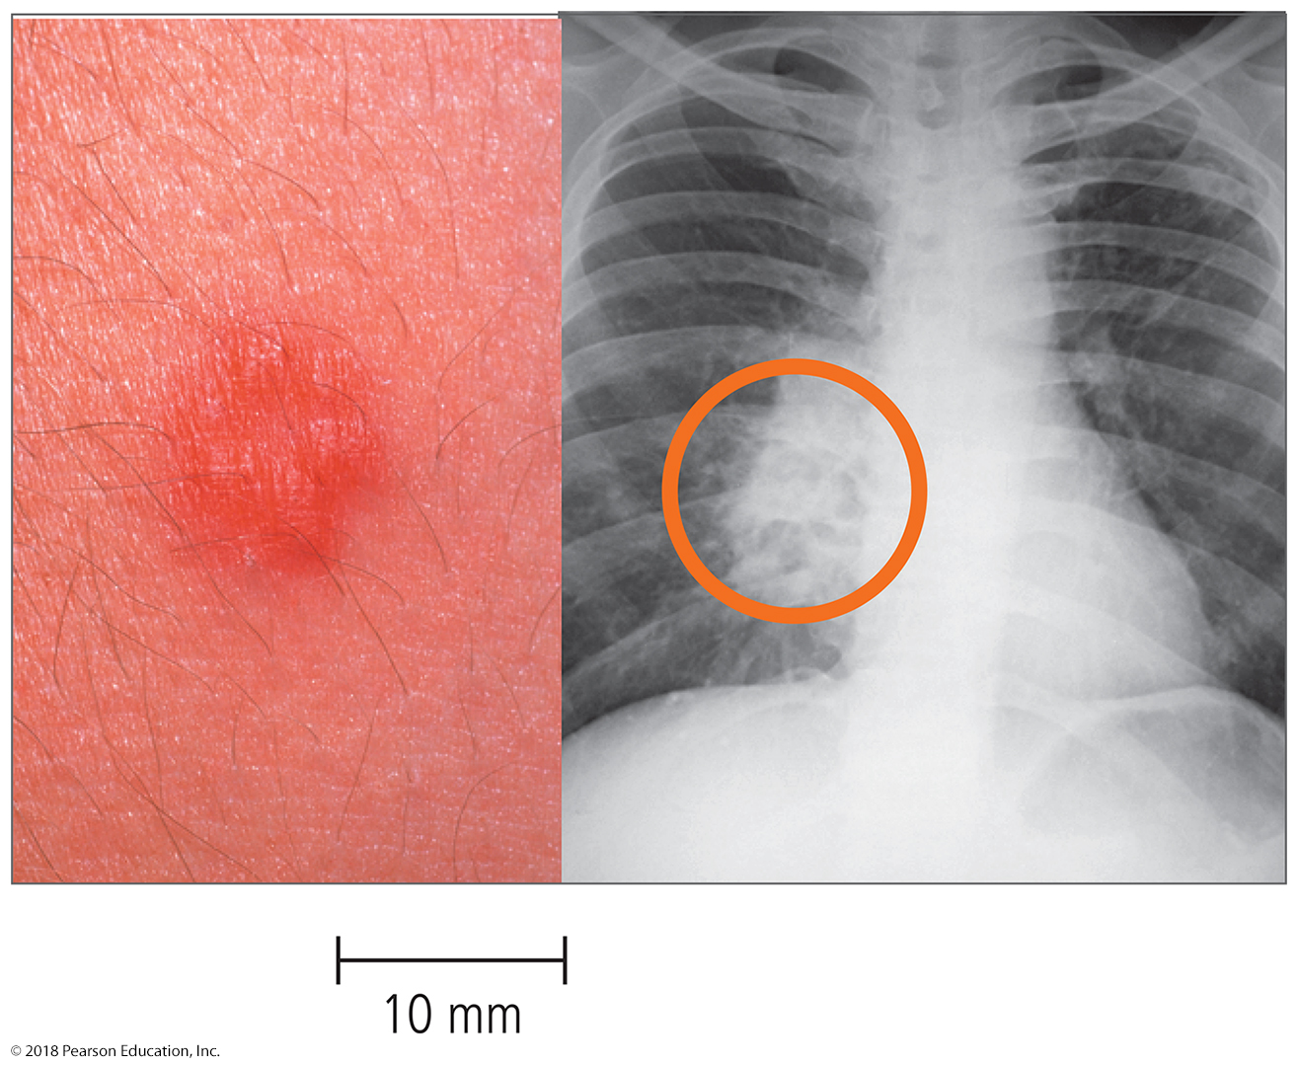
Disease at a Glance: Diagnosis of tuberculosis—overview.
Notes:
42

Slide 43
Other forms of Tuberculosis
Mycobacterium bovis:
<1% U.S. cases
Transmitted from cows to humans, not human to human
common among farmers, especially immunocompromised
M. avium-intracellulare complex (MAC) is opportunistic
Transmitted from birds (poultry, pigeons)
Seen only in immunodeficient individuals
infects people with late-stage HIV infection
other chronic medical complications

Slide 44
Bacterial Diseases of the Lower Respiratory System
Pertussis (Whooping Cough)
Signs and symptoms
Initially cold-like, then characteristic cough develops
Pathogen and virulence factors
Bordetella pertussis is the causative agent
Produces numerous virulence factors
Includes adhesins and several toxins producing increased mucus and bronchioconstriction
Pathogenesis
Pertussis progresses through four phases
Incubation, catarrhal (common cold), paroxysmal (violent cough for weeks), and convalescent (body healing)

Slide 45
Pertussis (Whooping Cough)
Pertussis (Whooping Cough)
Epidemiology
Highly contagious
Bacteria spread through airborne droplets
Bacteria do not survive long outside the body
Epidemic in areas where “herd immunity” is weakened due to anti-vax’ers
Diagnosis, treatment, and prevention
Symptoms are usually diagnostic
Treatment is primarily supportive
Prevention is with the DTaP vaccine

Slide 46
Bacterial Diseases of the Lower Respiratory System
Inhalational/Pulmonary Anthrax
Signs and symptoms
Initially resembles a cold or flu
Progresses to severe coughing, lethargy, shock, and death
Pathogen and virulence factors
Bacillus anthracis is the causative agent
Virulence factors include a capsule and anthrax toxin
Pathogenesis and epidemiology
Anthrax not spread from person to person
Acquired by contact or inhalation of endospores
(remember post office terrorism after 911??)

Slide 47
Inhalation/Pulmonary Anthrax
Inhalation/Pulmonary Anthrax
Diagnosis, treatment, and prevention
Diagnosis based on identification of bacteria in sputum
Early and aggressive antimicrobial treatment is necessary
Anthrax vaccine is available to select individuals
usually military and military-associated civilians, especially those expected to (or who may, under conflict) come into contact with anthrax
Side effects almost always seen, and serious side effects seen in up to 1% of individuals

Slide 48
Viral Diseases of the Lower Respiratory System
Influenza
Signs and symptoms
Pharyngitis, congestion, cough, and myalgia
Sudden fever distinguishes flu from a common cold
This virus will invade human tissues
Pathogens and virulence factors
Influenza virus types A and B are the causative agents
Mutations in hemagglutinin and neuraminidase produce new strains
Occurs via antigenic drift (mutation) and antigenic shift (recombination)

Slide 49
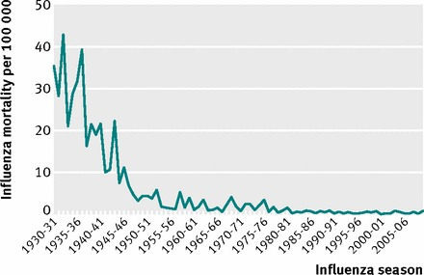
Viral Diseases of the Lower Respiratory System
Influenza
Concern about the fatality associated with strains similar to those of past pandemics
In the USA, 670,000 died from the 1918/1919 Flu
3,000/yr – 49,000/yr suspected cases from 1976 to 2007
12,000/yr – 56,000/yr suspected cases from 2011-2014
Improved health, nutrition, education may lowered fatality
2% → < 0.05% in the USA since 1919

Slide 50
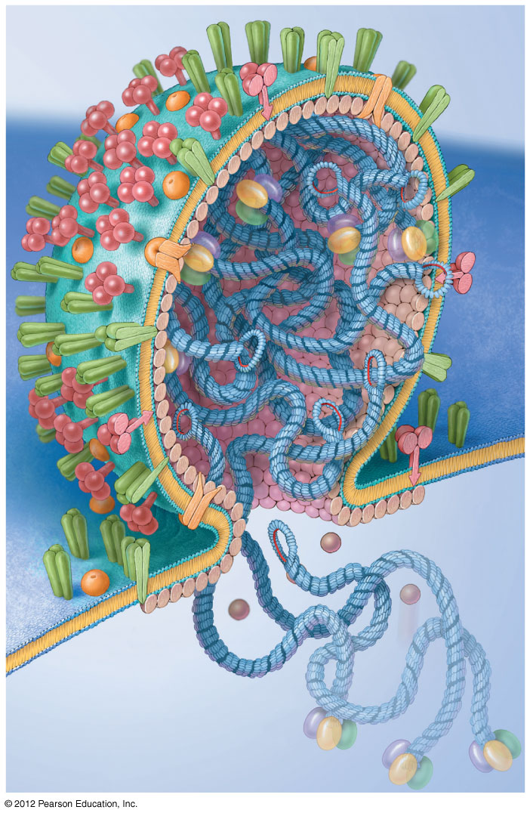
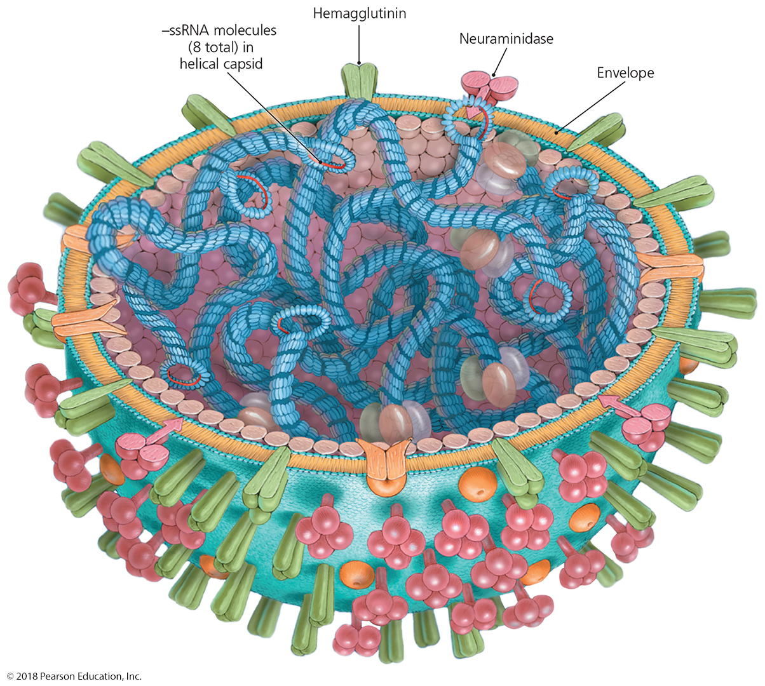
Disease in Depth: Virulence Factors
Notes:
50

Slide 51
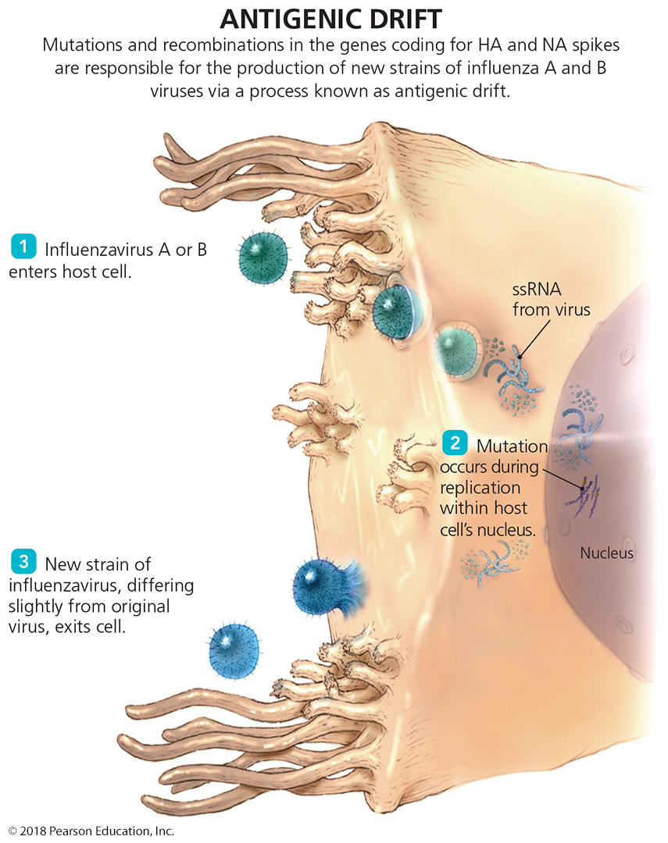
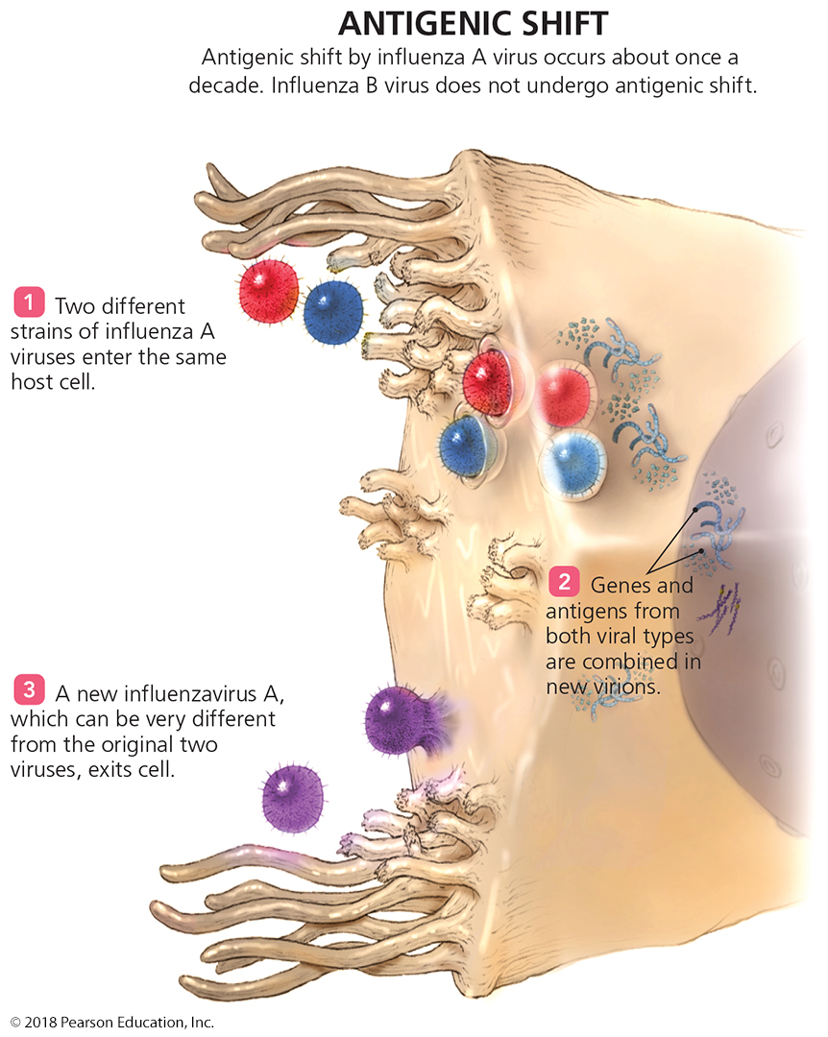
Disease in Depth: Pathogenesis
Notes:
51

Slide 52
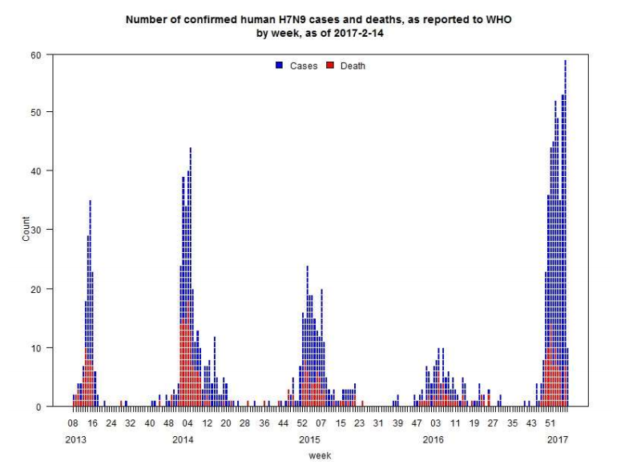
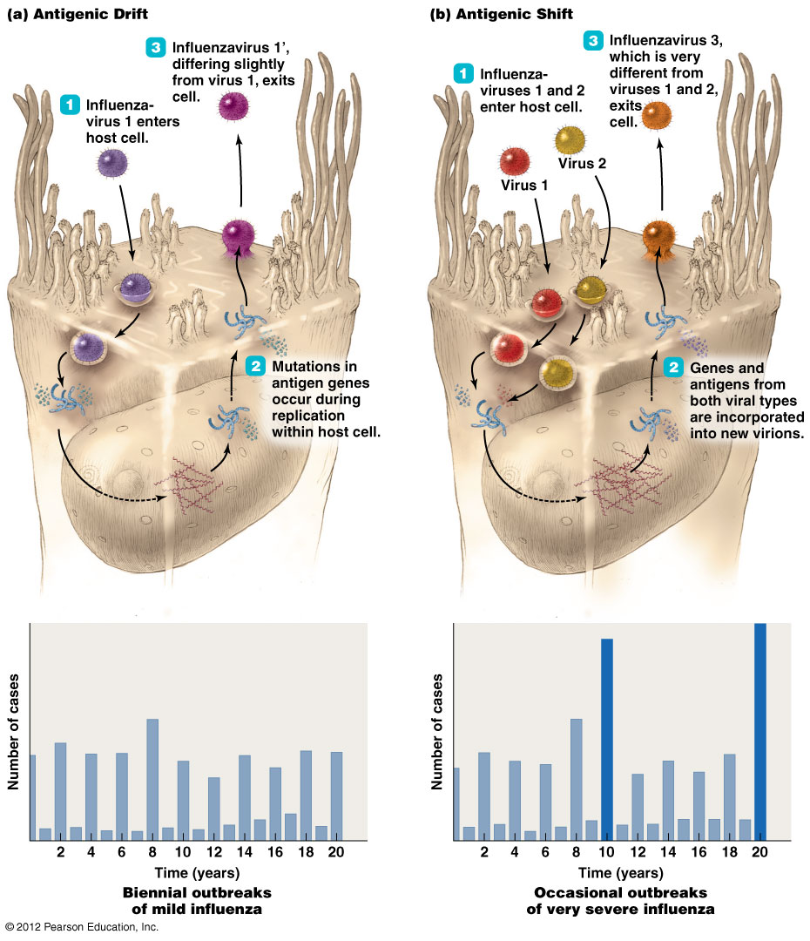
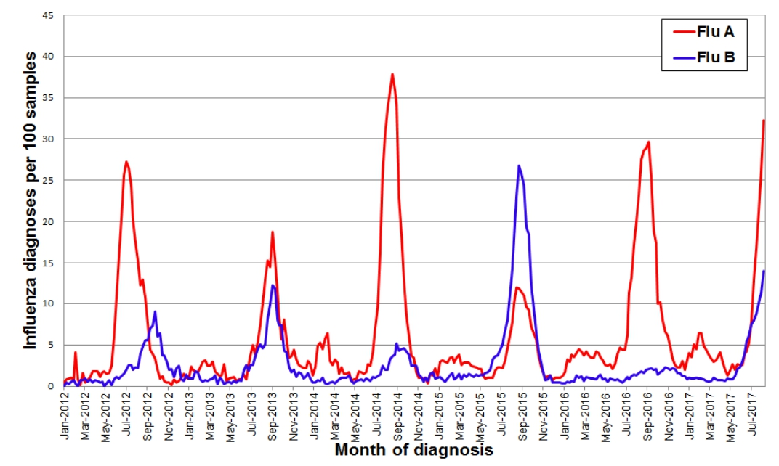
Disease in Depth: Pathogenesis
Notes:
52

Slide 53
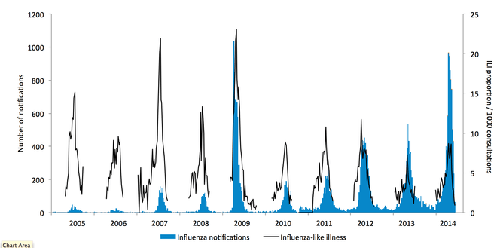
Disease in Depth: Yearly Influenza Pathogenesis
In which years was there a likely antigenic shift?
Notes:
53

Slide 54
Viral Diseases of the Lower Respiratory System
Influenza
Pathogenesis
Symptoms are result of the immune response to the virus infection
healthy people often die from immune system overreaction
Virus causes damage to the lung epithelium
Flu patients are susceptible to secondary bacterial infections
Why is this?
Epidemiology
Transmitted by inhalation or self-innoculation
Infection provides some immunological protection from similar strains in the future
Complications most often among elderly, children, or the chronically ill or immunocompromised
Concern that changes in type A influenza viruses may cause another major pandemic (almost 2009 Avian flu; 2017 H7N9)

Slide 55
Influenza
Diagnosis, treatment, and prevention
Signs and symptoms during a community-wide outbreak are often diagnostic
Treatment involves supportive care to relieve symptoms and improve health
Oseltamivir and zanamivir can be administered early in infection
Disease can be lessened by immunization with a multivalent vaccine
Several flu strains are moving through the population at the same time
the most prevalent strains with “interesting” mutations are chosen for vaccine development - multivalent

Slide 56
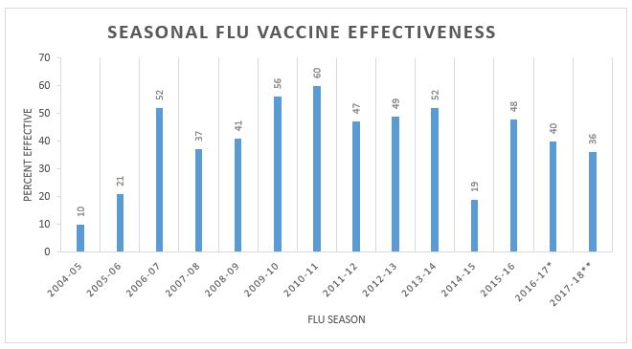
Influenza
Diagnosis, treatment, and prevention
Prevention by vaccination is rare because the vaccine is based on the best guess for a future infection.
Average effectiveness is 40-55%
Because of antigenic shift, the 2017 vaccine was only 30-40% protective; the 2014 vaccine was only 20% effective

Slide 57
Viral Diseases of the Lower Respiratory System
Coronaviral Respiratory Syndromes
Two recently emerging diseases
Severe acute respiratory syndrome (SARS)
No outbreaks in over 10 years
Middle East respiratory syndrome (MERS)
Occasional outbreaks – most recent 2014-2016 in Korea/China
Signs and symptoms
High fever, shortness of breath, difficulty breathing
Later, patients develop dry cough and pneumonia
Pathogen and virulence factors
Coronaviruses (e.g., SARS-CoV and (MERS-CoV) are the causative agents
Most coronaviral diseases are usually mild
SARS and MERS have higher fatalities

Slide 58
Viral Diseases of the Lower Respiratory System
Coronavirus Respiratory Syndromes
Pathogenesis and epidemiology
Coronaviruses spread via respiratory droplets
Virus spreads from the lungs to the heart and kidneys
Tissue spread seen only in some, less immunocompetent hosts
Diagnosis, treatment, and prevention
Diagnosis is based on signs and symptoms
Confirmed by isolating the virus or antibodies against the virus
Treatment is supportive
vaccination not likely due to lack of chronic outbreaks of serious coronaviruses

Slide 59
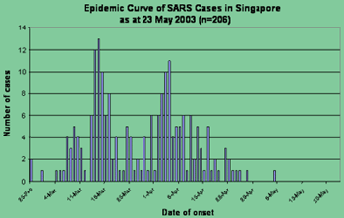
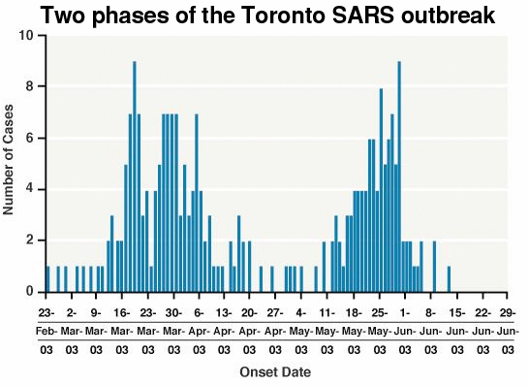
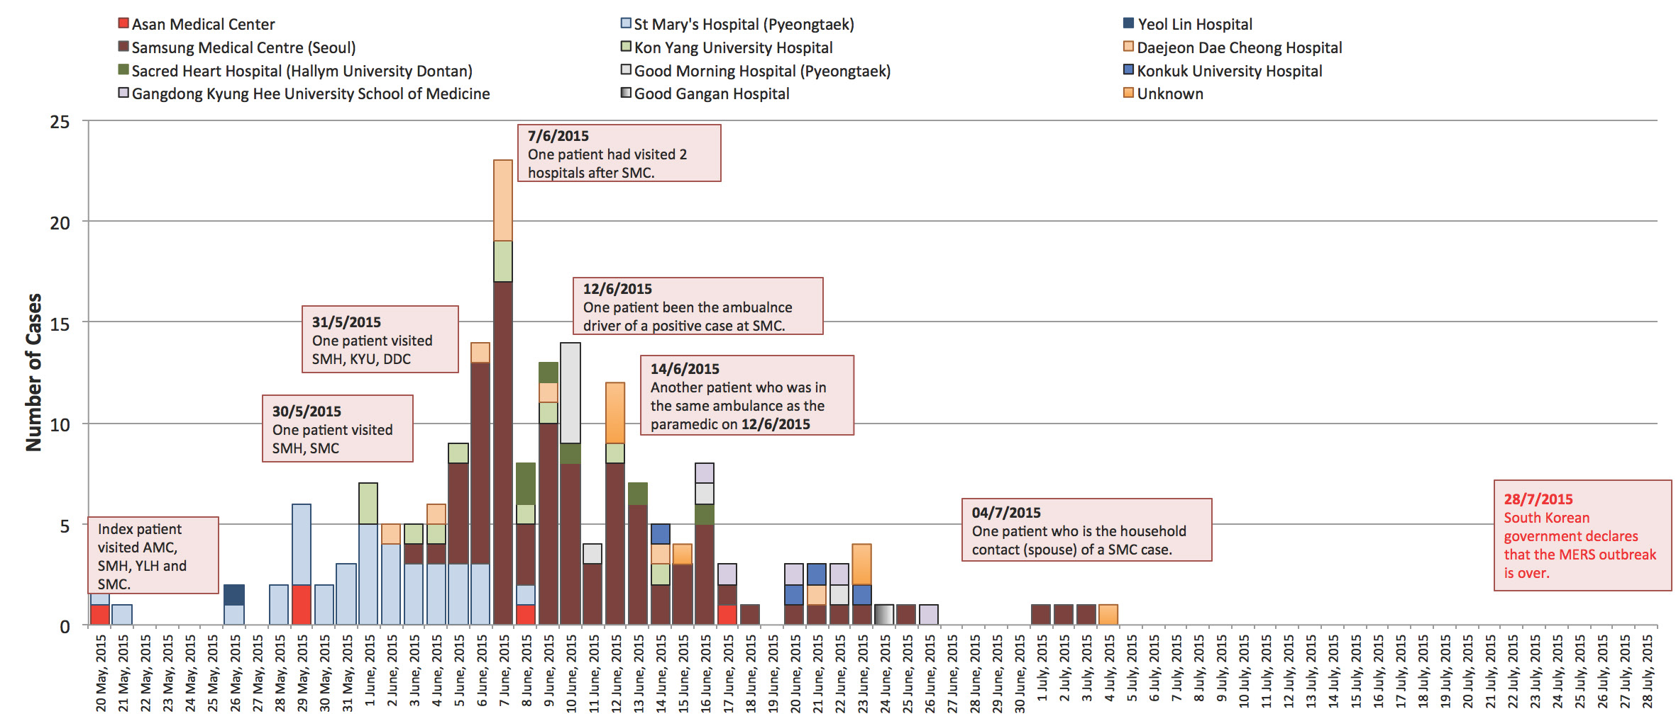
Coronavirus Outbreaks

Slide 60
Viral Diseases of the Lower Respiratory System
Respiratory Syncytial Virus (RSV) Infection
Most common childhood respiratory disease
Signs and symptoms
Fever, runny nose, and coughing in babies or immunocompromised individuals
Mild cold-like symptoms in older children and adults
Pathogen
Respiratory syncytial virus
Pathogenesis
Virus causes syncytia to form in the lungs
Fusion of virus-infected cells with normal cells
Immune response to RSV further damages the lungs
Children can be forever more susceptible to pneumonias

Slide 61
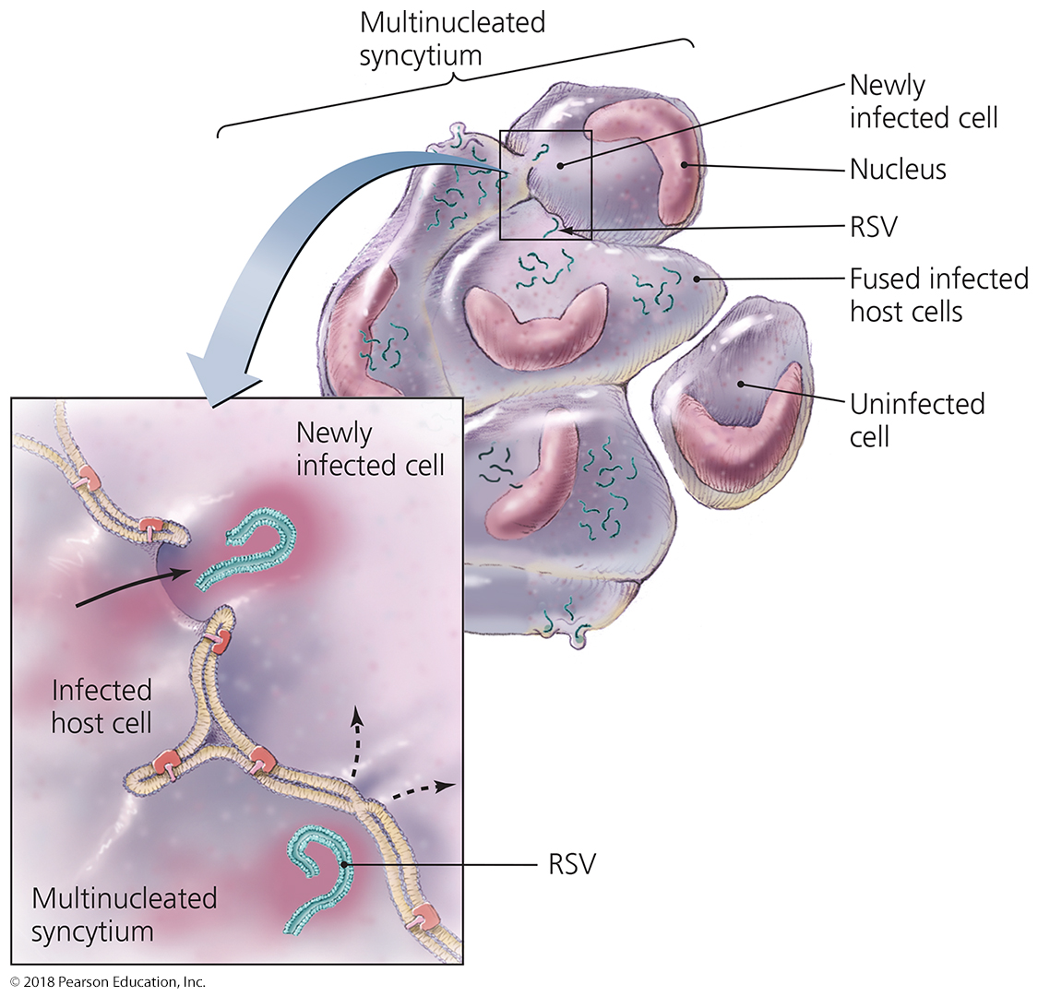
Figure 22.11 A syncytium forms when RSV triggers infected cells to fuse with uninfected cells.
Notes:
61

Slide 62
Viral Diseases of the Lower Respiratory System
Respiratory Syncytial Virus (RSV) Infection
Epidemiology
Transmission via close contact with infected persons
Prevalent in the United States
Diagnosis, treatment, and prevention
Diagnosis is made by immunoassay
Supportive treatment for young children
Prevention includes aseptic technique of health care and day care employees
Passive immunization exists, but is expensive and rare

Slide 63
Viral Diseases of the Lower Respiratory System
Other Viral Respiratory Diseases
Other viruses cause respiratory disease in children, the elderly, or immunocompromised individuals
Cytomegalovirus
Asymptomatic in most people; can cause disease in pregnancy and immunocompromised individuals
C of TORCH diseases
Metapneumovirus
Estimated to be the second most common cause of viral respiratory disease
Most people develop natural immunity to it
Parainfluenzaviruses
Three strains cause croup and viral pneumonia
Occur primarily in young children

Slide 64
Mycoses of the Lower Respiratory System
Cases of mycoses (fungal diseases) have increased over the last two decades
AIDS patients are susceptible to fungal infections
Fungal infections seen in North America include
Coccidioidomycosis
Blastomycosis
Histoplasmosis
Pneumocystis pneumonia
Subcutaneous infection often co-presents with LRT infection

Slide 65
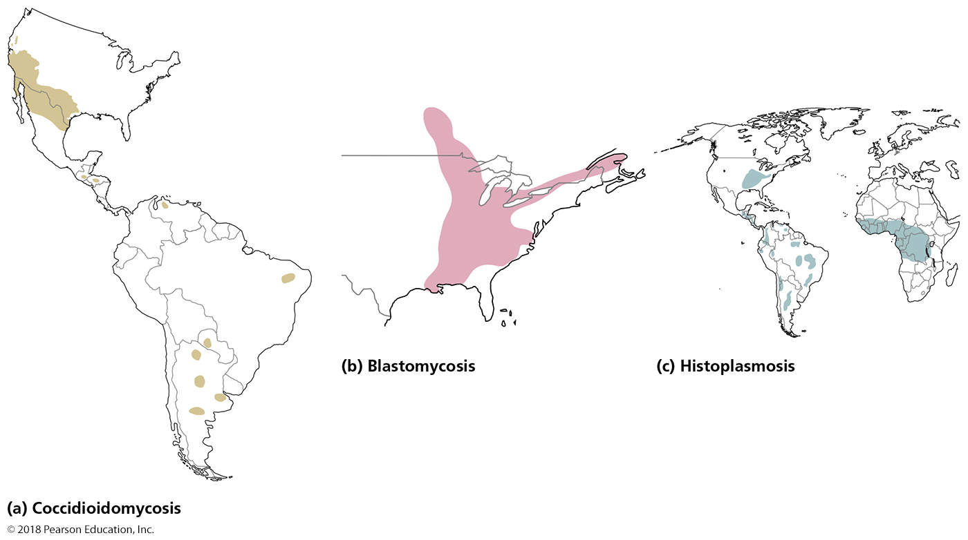
Figure 22.13 The geographic distributions of three systemic fungal diseases endemic to North America.
Notes:
65

Slide 66
Mycoses of the Lower Respiratory System
Coccidioidomycosis
Signs and symptoms
Resembles pneumonia or tuberculosis
Can become systemic in immunocompromised persons
Pathogen and virulence factors
Caused by Coccidioides immitis
Pathogen assumes yeast form at human body temperature
Pathogenesis
Arthroconidia from the soil enter the body through inhalation

Slide 67
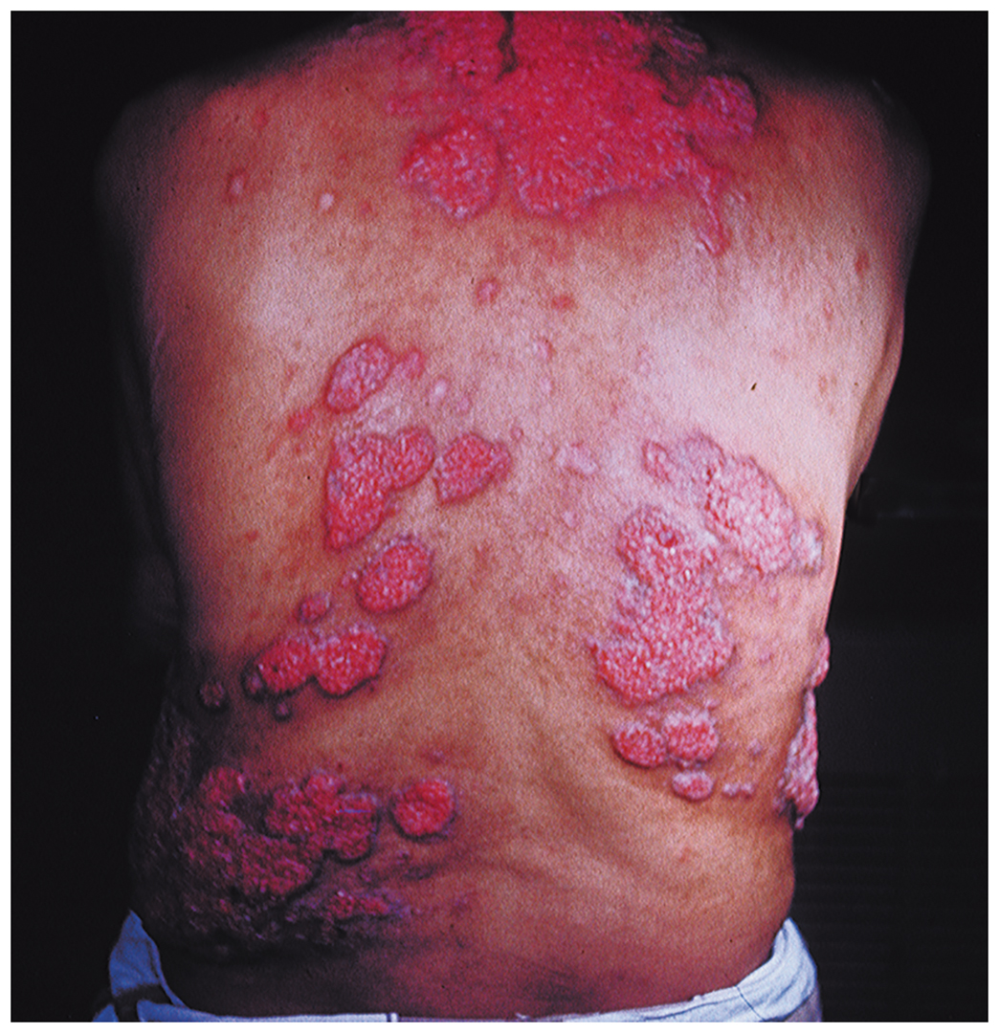
Figure 22.14 Coccidioidomycosis lesions in subcutaneous tissue.
Notes:
67

Slide 68
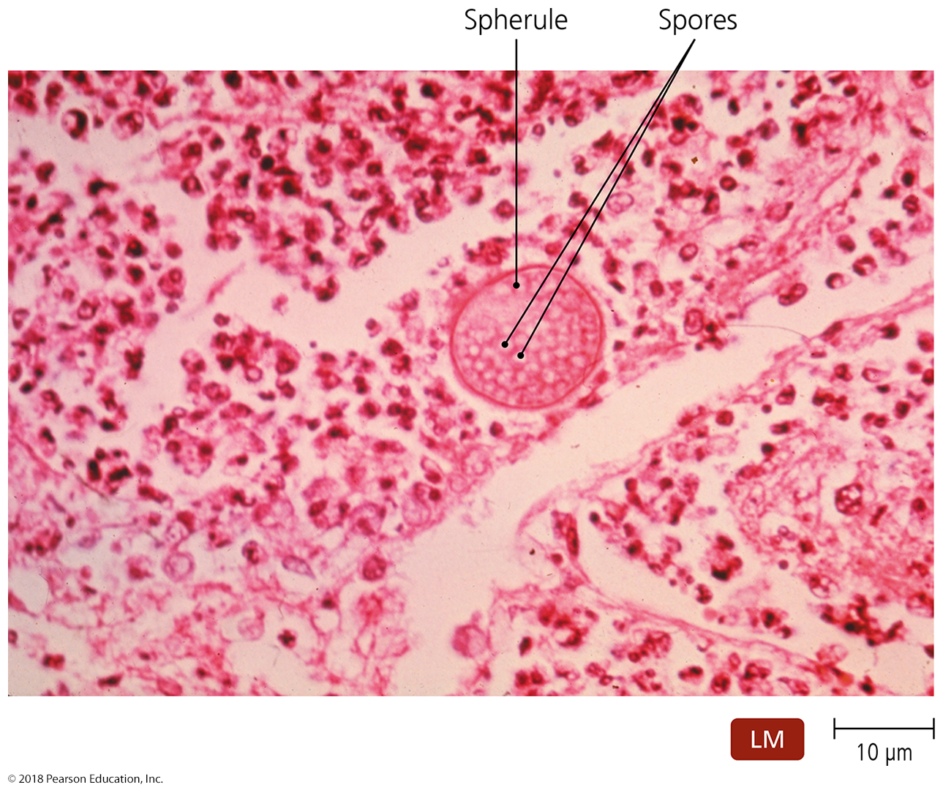
Figure 22.15 Spherules of Coccidioides immitis.
Notes:
68

Slide 69
Coccidioidomycosis
Epidemiology
Almost exclusively in southwestern United States and northern Mexico
Diagnosis, treatment, and prevention
Diagnosed by presence of spherules in clinical specimens
Treated with amphotericin B
Protective masks can prevent exposure to arthroconidia

Slide 70
Mycoses of the Lower Respiratory System
Blastomycosis
Signs and symptoms
Flulike symptoms
Systemic infections can produce lesions on the face and upper body or purulent lesions on various organs
Pathogen
Caused by Blastomyces dermatitidis
Pathogenic yeast form at human body temperature

Slide 71
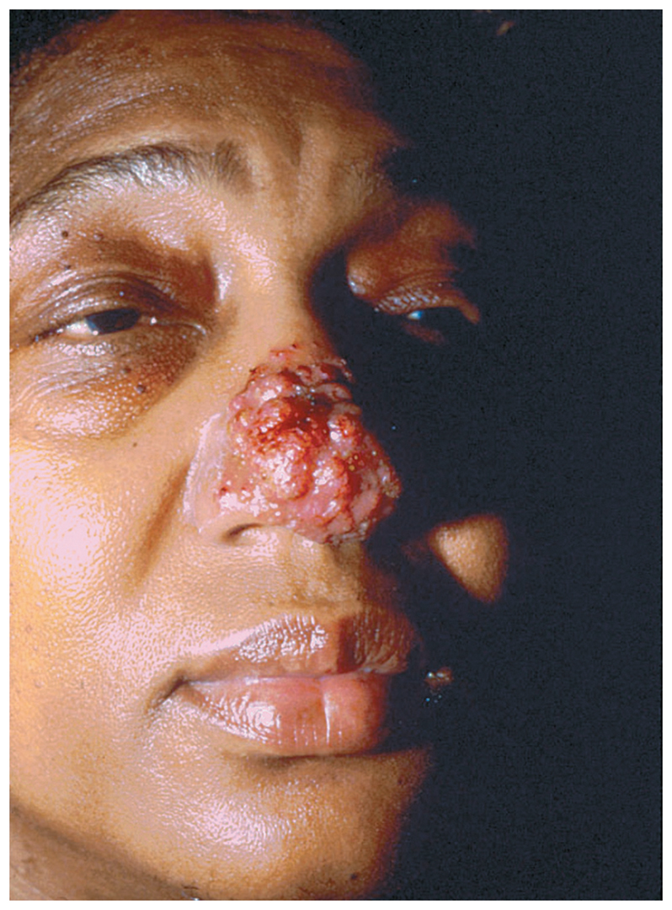
Figure 22.16 Cutaneous blastomycosis in an American woman.
Notes:
71

Slide 72
Blastomycosis
Pathogenesis and epidemiology
Enters body through inhalation of dust carrying fungal spores
Incidence of human infection is increasing
Endemic across southeastern United States and north to Canada
Diagnosis, treatment, and prevention
Diagnosis is based on identifying fungus in clinical samples
Treated with amphotericin B
Relapse common in AIDS patients

Slide 73
Mycoses of the Lower Respiratory System
Histoplasmosis
Signs and symptoms
Asymptomatic in most cases
Symptomatic infection causes coughing with bloody sputum or skin lesions
Pathogen
Caused by Histoplasma capsulatum
Pathogenic yeast form at human body temperature
Histoplasma produces several proteins that inhibit macrophage activation and other host defenses

Slide 74
Histoplasmosis
Pathogenesis and epidemiology
Humans inhale airborne spores from the soil
Prevalent in the eastern United States
Diagnosis, treatment, and prevention
Diagnosis is based on identifying fungus in clinical samples
Infections in immunocompetent individuals typically resolve without treatment

Slide 75
Mycoses of the Lower Respiratory System
Pneumocystis Pneumonia
Signs and symptoms
Difficulty breathing, anemia, hypoxia, and fever
Pathogen
Caused by Pneumocystis jirovecii
previously known as P. carinii
disease still called PCP (pneumocystis carinii pneumonia)
Pathogenesis and epidemiology
Transmit by inhalation of droplets containing the fungus
Common disease in AIDS patients
Rarely seen in healthy individuals – diagnostic for AIDS
Diagnosis, treatment, and prevention
Diagnosis is based on clinical and microscopic findings
Treated with trimethoprim and sulfamethoxazole
Impossible to prevent infection with P. jirovecii
everyone harbors it but nearly all people are subclinical

Slide 76
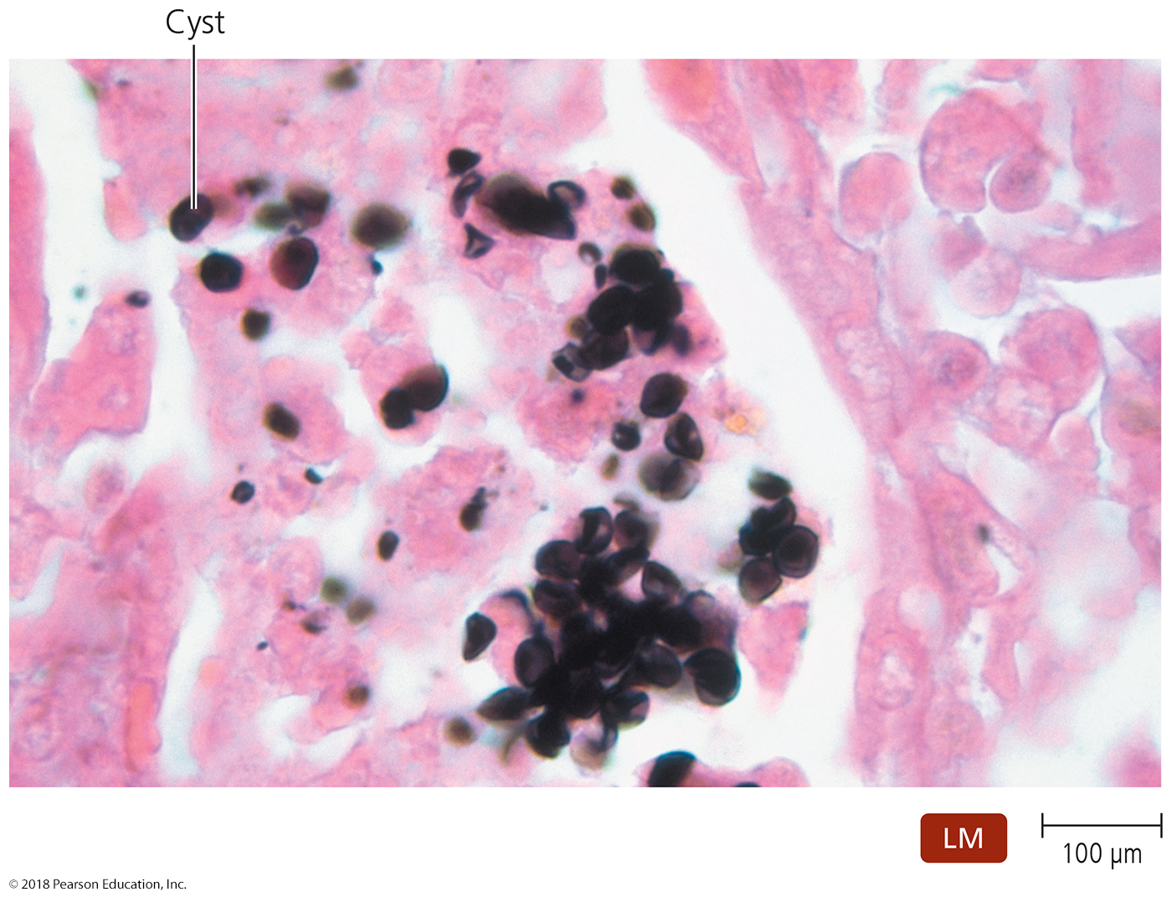
Figure 22.17 Cysts of Pneumocystis jirovecii in lung tissue.
Notes:
76

