Slide 1
Microbiology
Chapter 20
Microbial Diseases of the Nervous System and Eyes

Slide 2
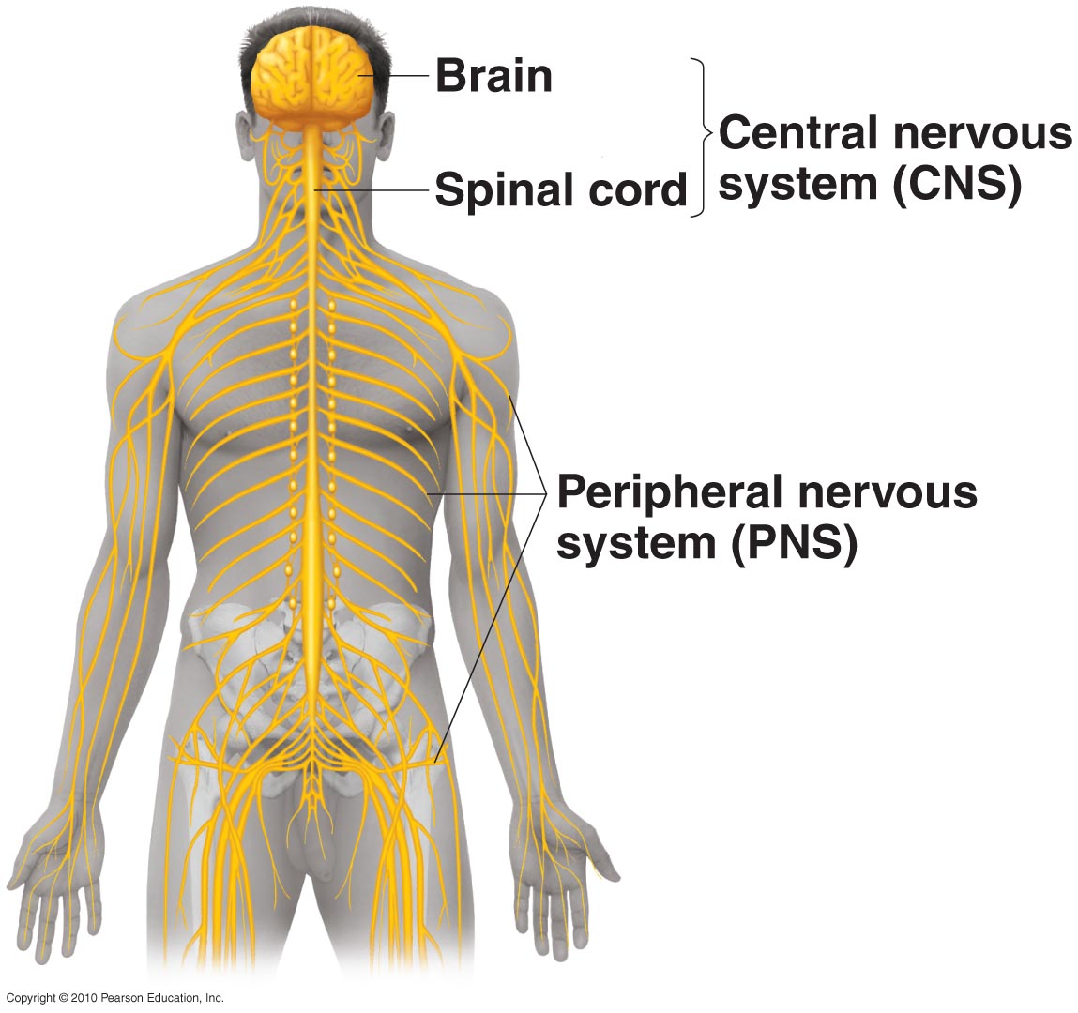
The Human Nervous System
cranial
nerves -
branch from the brain and/or brainstem
Peripheral nerves - branch
from the spinal column
Figure 19.1

Slide 3
Natural Defenses of the Nervous System
Meninges
Three membrane layers (dura mater, arachnoid mater and pia mater)
Sub-arachnoid space superficial to pia mater houses readily “flushed” cerebrospinal fluid (CSF)
Physical barriers, shock absorption, fluid flow
Blood:Brain Barrier (BBB)
Capillary endothelial cells are stitched with tight junctions
Capillaries are completely surrounded by pericytes and astrocytes, that together help maintain the BBB
Microglia and perivascular macrophages
Macrophage-like cells resident within neuronal spaces
Remove cellular debris and signal infections

Slide 4
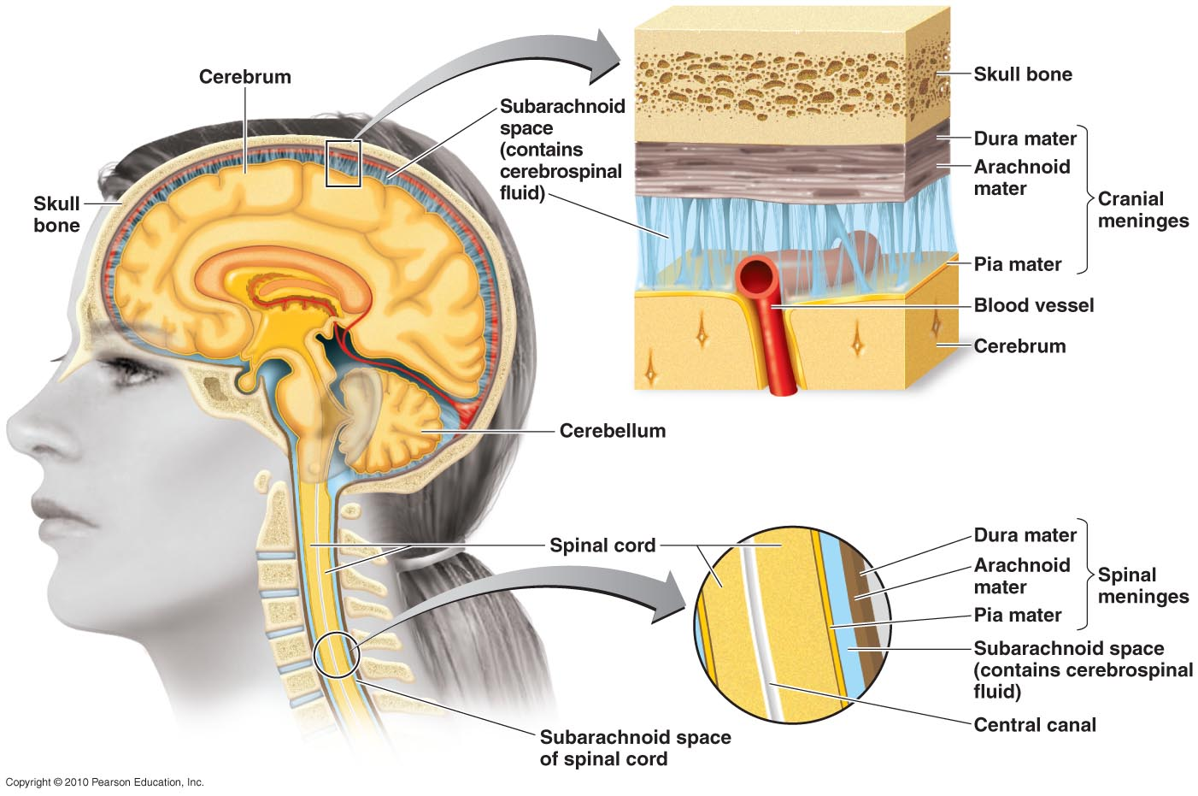
The Meninges
Three membrane layers of the meninges
dura mater, arachnoid mater and pia mater
Sub-arachnoid space between pia mater and arachnoid mater houses cerebrospinal fluid (CSF) and interfaces with circulatory system
Inflammation of meninges - meningitis

Slide 5
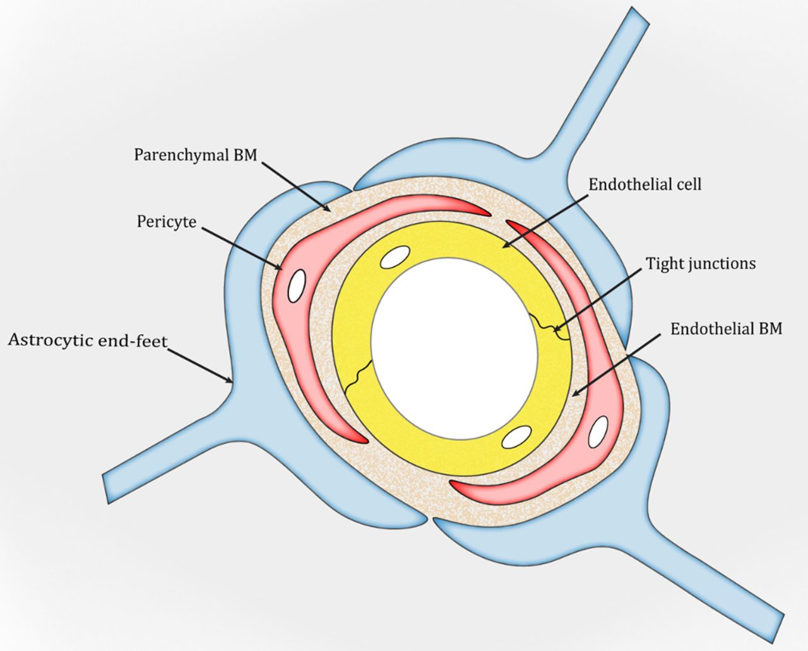
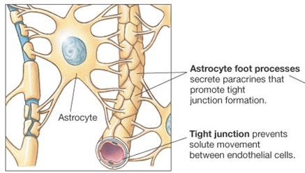
The Blood-Brain Barrier (BBB)
Capillary endothelial cells that form vessel walls are zipped together with tight junctions
Pericytes surround endothelial cells, especially in the absence of astrocytes
Astrocytes sheathe capillaries with their foot processes
Altogether, these strongly inhibit diapedesis of cells and the free migration of proteins, hormones, and most chemicals from the blood into the brain.

Slide 6
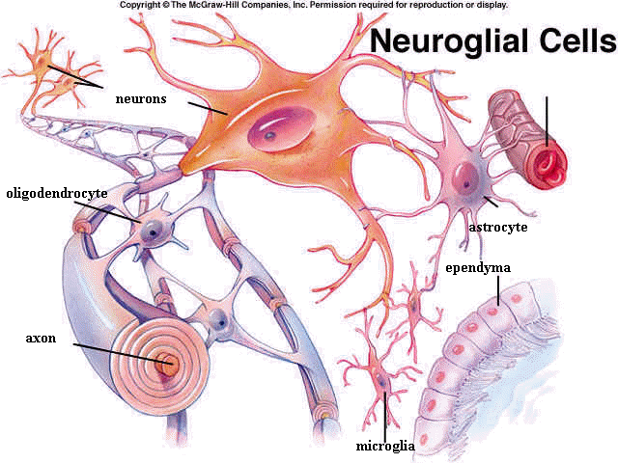
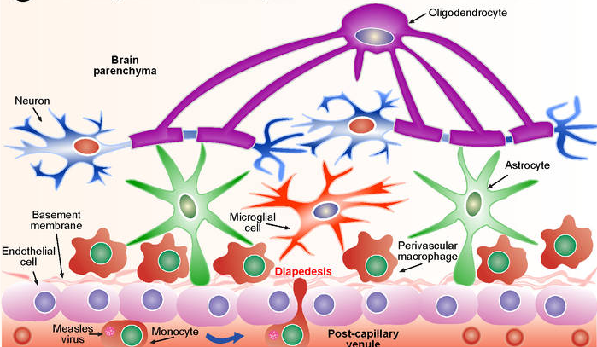
Interstitial Defenses of the CNS
Perivascular regions
Astrocytes sheath and completely surround blood vessels
Perivascular macrophages reside near vessels and astrocytes and protect neurons from pathogens coming from blood
Perineuronal regions
Oligodendrocytes sheath and completely surround neurons
Microglia reside near neurons and oligodendrocytes and protect neurons from pathogens in the brain

Slide 7
Poor Immune Defenses of the CNS
Brain is considered “immunologically privileged” – free of constant surveillance by the immune system
Scant lymphatic capillaries in brain; no adaptive immune cells
MHC poorly expressed, and complement is sparsely found
Microglial phagocytic activity is greatly reduced, compared to activity of other macrophages
Diapedesis of systemic monocytes does occur under chronic inflammatory conditions; risk of sequalae greatly increases
Why?
An immune response that destroys neurons may permanently destroy neural function
Cytokine release could greatly hinder neural function
Are normal biota tolerated in the nervous system?

Slide 8
Most Common Pathogens in meningitis – SUMMARY SLIDE
Bacteria (first 5 are 90% of cases)
Neisseria meningitidis
Haemophilus influenza
Listeria monocytogenes
Streptococcus pneumoniae
Streptococcus agalactiae (Group B strep)
Staphylococcus aureus, Escherichia coli, Klebsiella pneumoniae, Streptococcus pyogenes
Fungi
Cryptococcus neoformans – basidiomycote yeast
Coccidioides immitis – ascomycote dimorphic mold
Aseptic meningitis – viruses
enteroviruses, herpesviruses, poxviruses, measles, others)

Slide 9
Bacterial Meningitis - SUMMARY
Many opportunistic bacteria species can cause
Symptoms are diagnostic:
Initially, fever, headache, and stiff neck
Followed by nausea and vomiting
May progress to convulsions and coma
If untreated for too long:
Mortality high
Lingering or permanent neurological damage common from encephalitis – inflammation of nervous tissue in CNS
Diagnosis (by CSF sample from a lumbar spinal tap)
Gram stain
latex agglutination of CSF
Treatment - cephalosporins, vancomycin
Prevention – vaccination for some causes, diagnosis/treatment of pregnant female (GBS especially)

Slide 10
Neonatal Meningitis
More frequent than in adults….why?
BBB not formed yet
fetal immune response weaker
Especially common in premature births and prognosis is often worse

Slide 11
Neisseria Meningitis
Also called meningococcal meningitis
Caused by N. meningitidis
Gram-negative, aerobic cocci with a capsule
10% of people are healthy nasopharyngeal carriers
Begins as throat infection, skin lesions (petechiae)
Serotypes A, C, Y, W-135 in U.S. (MCV4 vaccine)
Serotype B in Europe (B vaccine)
Serotype A in Africa, China, and Middle East
Prevention - MCV4 or B Vaccination and booster recommended at 11 y.o. and for college students, and military recruits

Slide 12
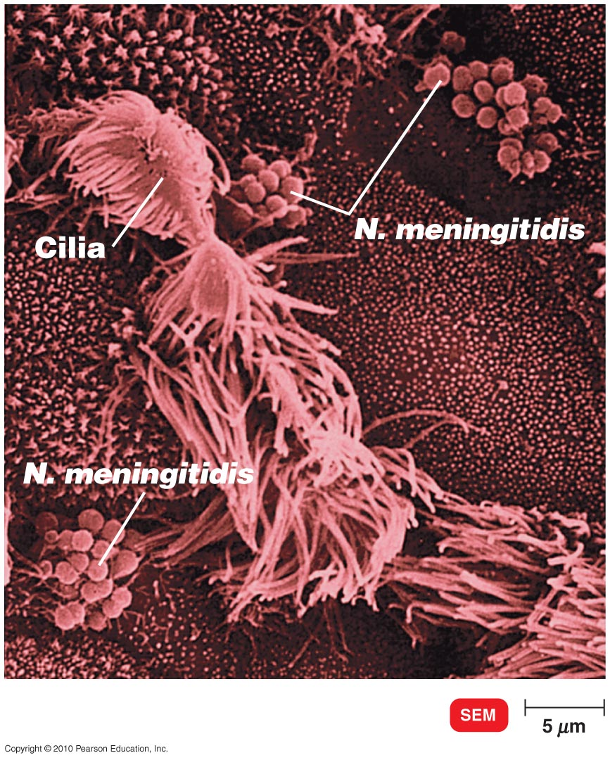
Neisseria Meningitis
Figure 22.3

Slide 13
Streptococcus pneumoniae Meningitis
Also called pneumococcal meningitis
Caused by S. pneumoniae (a gram-positive diplococcus a.k.a. pneumococcus)
70% of people are healthy nasopharyngeal carriers
Most common in children (1 month to 4 years)
Mortality: 30% in children, 80% in elderly
Prevented by vaccination (Prevnar 13 for children, Pneumovax for adults only)

Slide 14
Haemophilus influenzae Meningitis
Occurs mostly in children (6 months to 4 years)
Gram-negative aerobic bacteria, normal throat microbiota
Capsule antigen type b most common in USA
Prevented by Hib vaccine

Slide 15
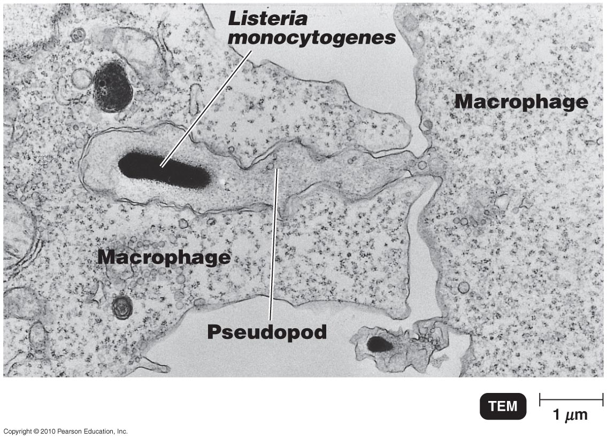
Listeriosis
Caused by Listeria monocytogenes
Gram-negative aerobic rod
Usually foodborne; it can be transmitted to fetus
Obligate intracellular bacterium; reproduces in phagocytes

Slide 16
Non-Meningial bacterial CNS diseases
Usually due to actions of bacterial toxins at peripheral nerves
Clostridium species most commonly indicated
C. tetani – tetanus
C. botulinum – botulism
Treatment – antitoxin (passive immunization), supportive care, antibiotics to kill any residual or germinating bacteria, intestinal or wound cleaning to remove all bacteria and their spores

Slide 17
Tetanus
Caused by Clostridium tetani
Gram-positive, endospore-forming, obligate anaerobe
Grows in deep wounds
Tetanospasmin released from dead cells blocks relaxation pathway in muscles
Prevention by vaccination with tetanus toxoid (DTP) and booster (dT) (diphtheria + tetanus)
Treatment with tetanus immune globulin

Slide 18
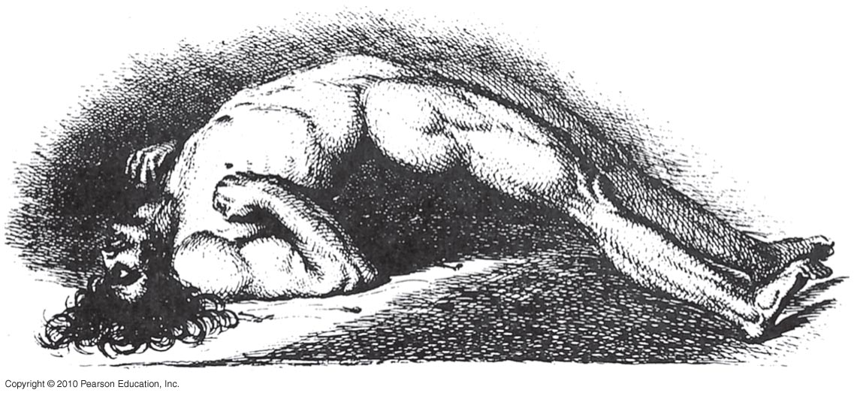
An Advanced Case of Tetanus

Slide 19
Botulism
Caused by Clostridium botulinum
Gram-positive, endospore-forming, obligate anaerobe
Intoxication comes from ingesting botulinal toxin
Botulinum toxin blocks release of neurotransmitter, causing flaccid paralysis
Prevention
Proper canning
Nitrites prevent endospore germination in sausages

Slide 20
Fungal Meningitis
Primary infection is in lungs – most humans resolve here
In the immunocompromised, a chronic lung infection leads to meningitis by spreading through blood to CNS
Cryptococcus neoformans (yeast)
Also called cryptococcosis or cryptococcal meningitis
Soil fungus associated with pigeon and chicken droppings
Var. neoformans is opportunistic
more prevalent and acute seen in SCID, AIDS); mortality up to 30%
Var. gattii affects even healthy people
Treatment: Amphoterecin B, flucytosine, fluconazole
Coccidioides immitis (mold)
Systemic infection; genetic susceptibility
Endemic in SW US deserts
Primary infection in lungs
Self-resolves, or treated with amphoterecin B, itraconazole
Prevention – discourage birds from “hanging out”; ventilation

Slide 21
Cryptococcus neoformans
Figure 22.15

Slide 22
Protozoan CNS diseases - SUMMARY
Kinetoplasids - sleeping sicknesses
Trypanosoma brucei
Trypanosoma cruzi
Amoebozoa – amebic meningoencephaopathy
Naegleria fowleri
Acanthamoeba sp.

Slide 23
African Sleeping Sickness
Trypanosoma brucei gambiense
Chronic (2 to 4 years)
T. b. rhodesiense infection
Acute (few months)
Transmitted from animals to humans by tsetse fly
Highly fatal if untreated
Prevention: Elimination of the vector
Treatment: Eflornithine blocks an enzyme necessary for the parasite, also suramin, pentamidine
Parasite evades host antibodies through antigenic variation (100 times)

Slide 24
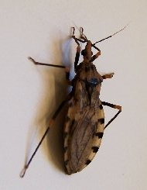
Chagas’ Disease
Trypanosoma cruzi
Moderately chronic (8-12 weeks) in immunocompetent
Tropically restricted – Central and South America
Transmitted from animals to humans by kissing bugs
Heart overgrowth, mortality if left untreated
Prevention: separation from the vector
Treatment: benznidazole (the earlier the better)

Slide 25
(Amoebic) Meningoencephalitis
encephalitis – inflammation of brain itself
As brain is shielded by meninges, meningitis often presents with encephalitis,
Common causes
Naegleria fowleri
Acanthamoeba sp. cause granulatomous amoebic encephalitis (GAE)
Entry through nasal mucosa or conjunctiva (overworn and uncleaned contact lenses)
Usually infected by swimming in warm water
Rare (1:1,000,000) but treatment generally ineffective
Acanthamoeba is more frequent in AIDS victims

Slide 26
Primary amebic meningoencephalitis – (PAM) caused by Naegleria fowleri

Slide 27
Viral diseases of the CNS - Acute Encephalitis - SUMMARY
Viral disease is acute b/c they infect the BBB infection and passage more easily into brain tissues
Most common: arboviruses (arthropod-borne)
Initial infection in tissues, followed by lymphatics, and in chronic cases, reaching brain
Western Equine Encephalitis
Eastern Equine Encephalitis
California Encephalitis
St. Louis Encephalitis
West Nile Encephalitis
Zika virus
Herpes simplex virus (in newborns and in elderly)
Rabies, enteroviruses (polio, Coxsackie), measles

Slide 28
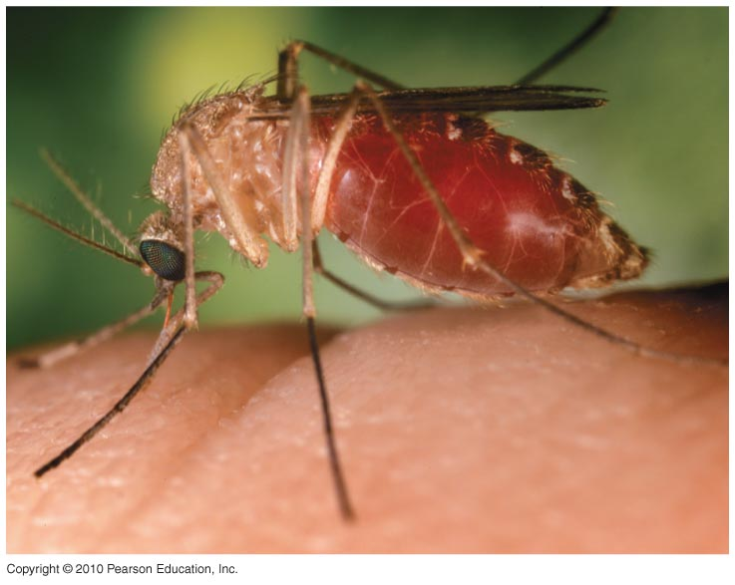
Arboviral Encephalitis
Arboviruses
Arthropod-borne viruses that belong to several families
Prevention: controlling mosquitoes (predators, netting, repellants, zappers)

Slide 29
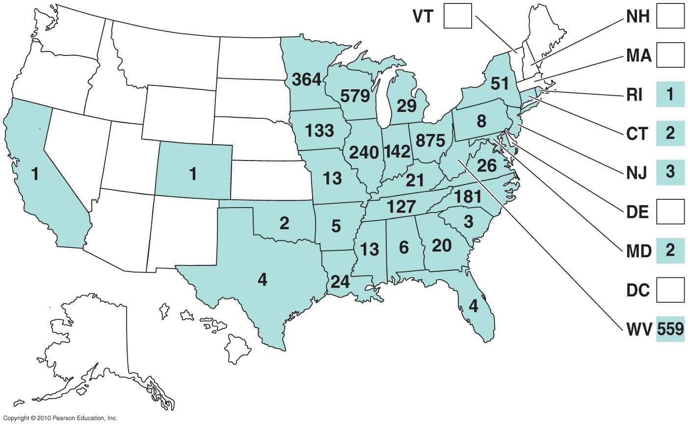
California Serogroup Arbovirus Cases – FOR REFERENCE ONLY 1964–2006

Slide 30
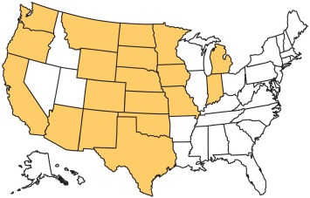
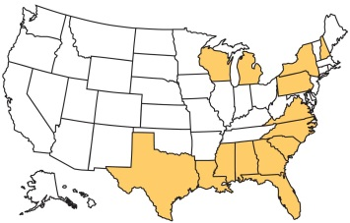
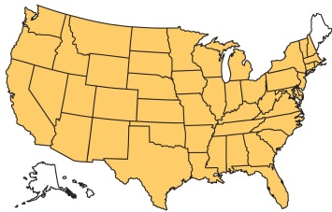
Arboviral Encephalitis – FOR REFERENCE ONLY
Encephalitis | Reservoir | Mosquito vector | U.S. distribution
Western equine | Birds, horses | Culex
Eastern equine | Birds, horses | Aedes, Culiseta
St. Louis | Birds | Culex
Diseases in Focus 22.2

Slide 31
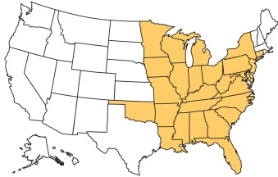
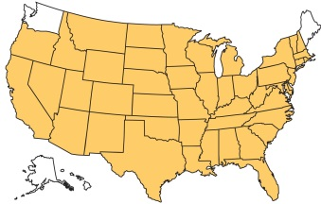
Arboviral Encephalitis – FOR REFERENCE ONLY
Encephalitis | Reservoir | Mosquito vector | U.S. distribution
California | Small mammals | Aedes
West Nile | Birds, mammals | Culex, Aedes
Outside the US: Japanese B encephalitis, Zika Virus
Diseases in Focus 22.2

Slide 32
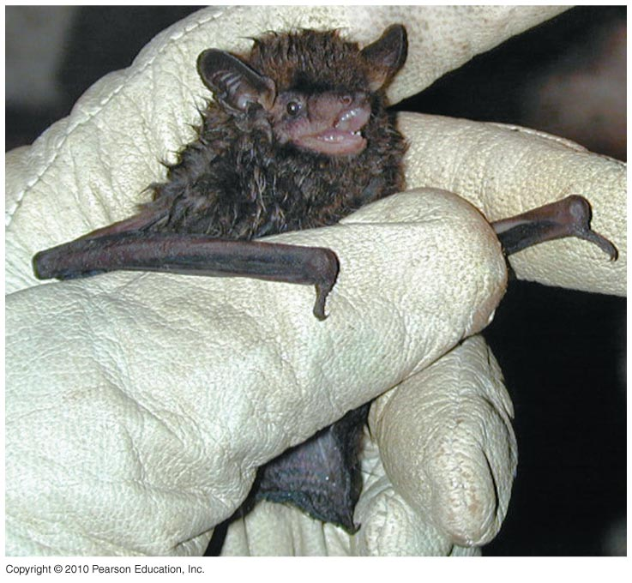
Rabies
Caused by the rabies virus (Rhabdovirus, lyssavirus)
Transmitted by animal bite
Furious rabies: Animals are restless then highly excitable
Paralytic rabies: Animals seem unaware of surroundings

Slide 33
Rabies Virus
Virus multiplies in skeletal muscles and then brain cells, causing encephalitis
Initial symptoms may include muscle spasms of the mouth and pharynx and hydrophobia
Prevention of Rabies
Preexposure prophylaxis: Injection of human diploid cells vaccine (HDCV)
Postexposure treatment: Vaccine plus rabies immune globulin (RIG)

Slide 34
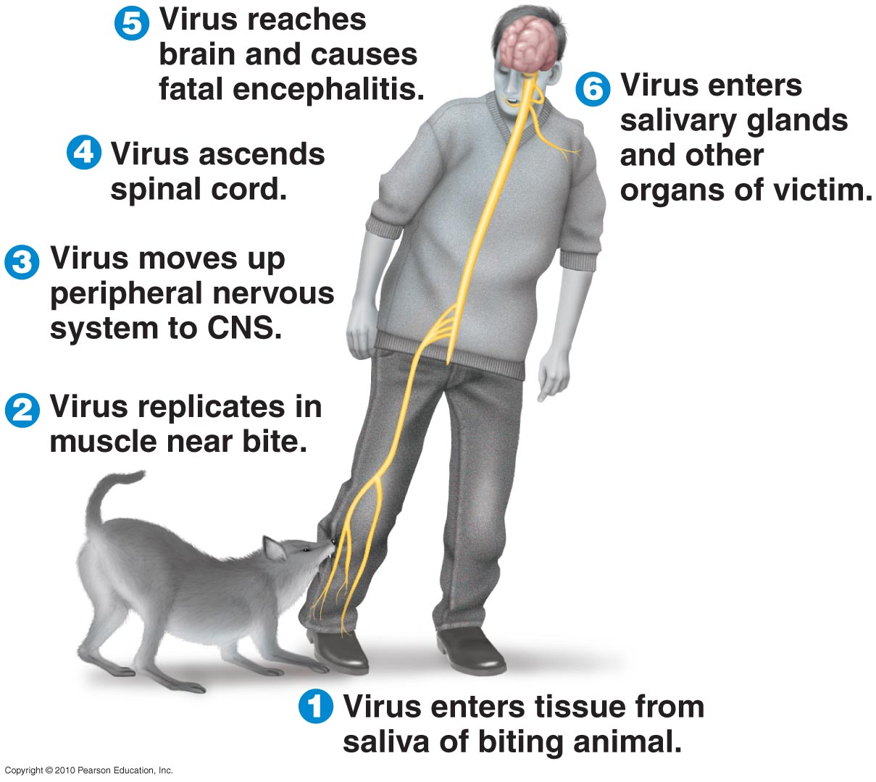
Pathology of Rabies Infection
Figure 22.12

Slide 35
Reported Cases of Rabies in Animals
Figure 19.16

Slide 36
Reported Cases of Rabies in Animals
Transmission to humans or pets is rare from bats

Slide 37
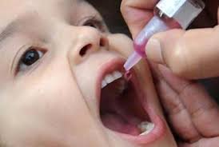
Poliomyelitis (Polio)
Caused by three strains of poliovirus
Transmitted by ingestion
Initial symptoms: Sore throat and nausea
Viremia may occur; if persistent, virus can enter the CNS
Destruction of motor cells and paralysis occurs in <1% of cases
Prevention: vaccination (injected inactivated polio vaccine > oral attenuated polio vaccine)
Eradicated in most countries
Recent resurgence of mutated vaccine strains in poor countries - oral vaccination with attenuated strains is still done because they cannot afford to do it more safely

Slide 38
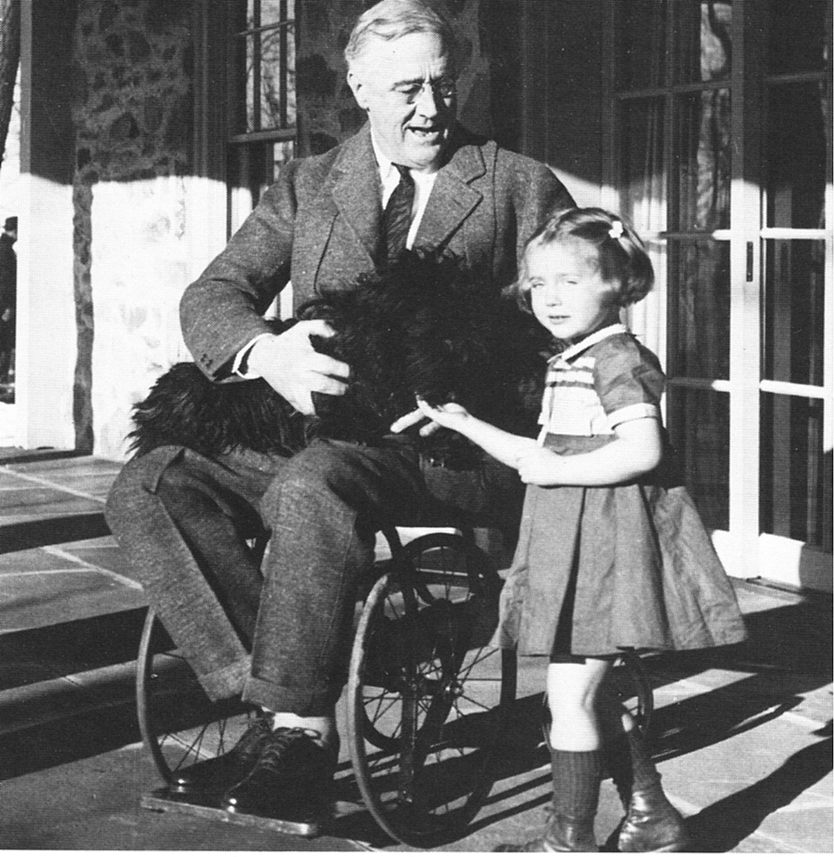
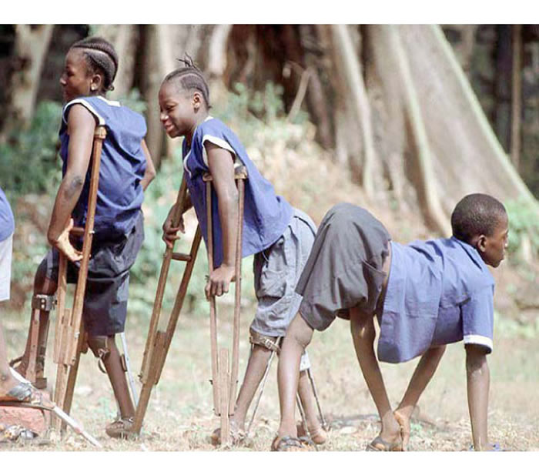
What can vaccination against polio prevent?
Polio can cause meningitis, paralysis or death, with permanent pain, fatigue, and muscle weakness in up to half of survivors

Slide 39
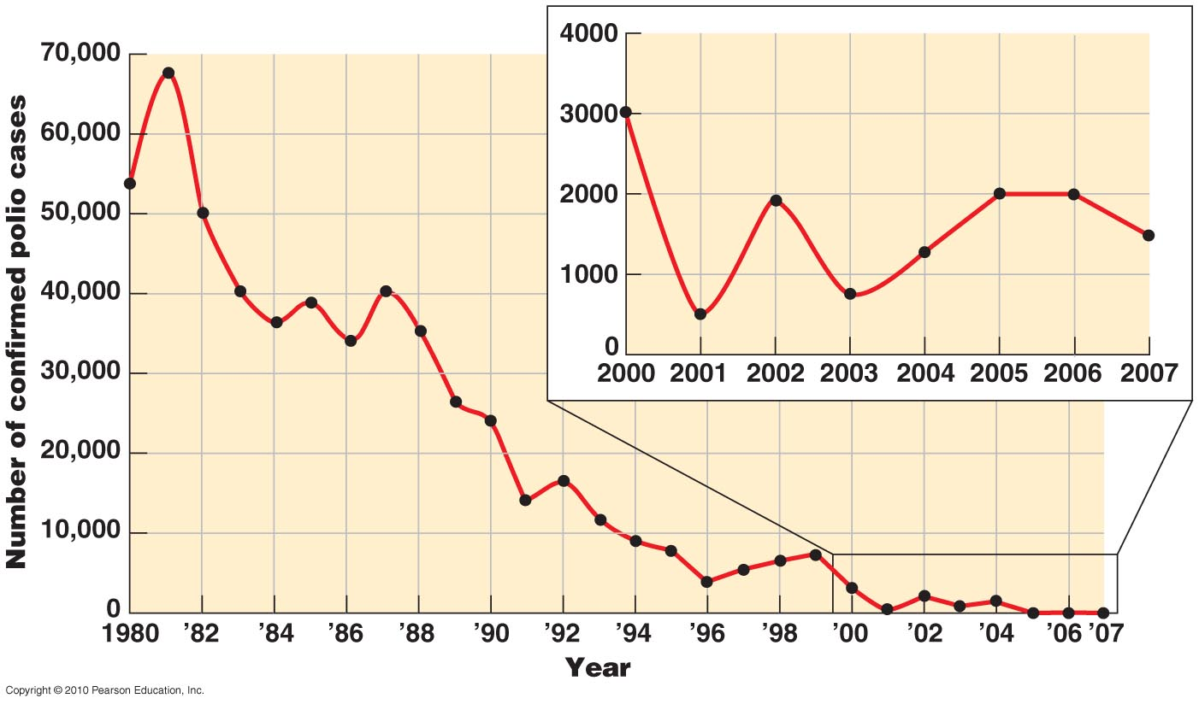
Worldwide Annual Incidence of Poliomyelitis
Figure 22.11

Slide 40
Transmissible Spongiform Encephalopathies
Caused by prions
Creutzfeldt-Jakob disease – from ingesting cow meat
Infantile familial insomnia – genetically transmitted
Sheep – scrapie
Bovine spongiform encephalopathy; “Mad Cow”
Mink encephalopathy
Chronic and fatal
Acquired by ingestion, inheritance, transplant
No vaccination – intracellular neuronal protein
No treatment yet available for living tissues – very difficult to destroy

Slide 41
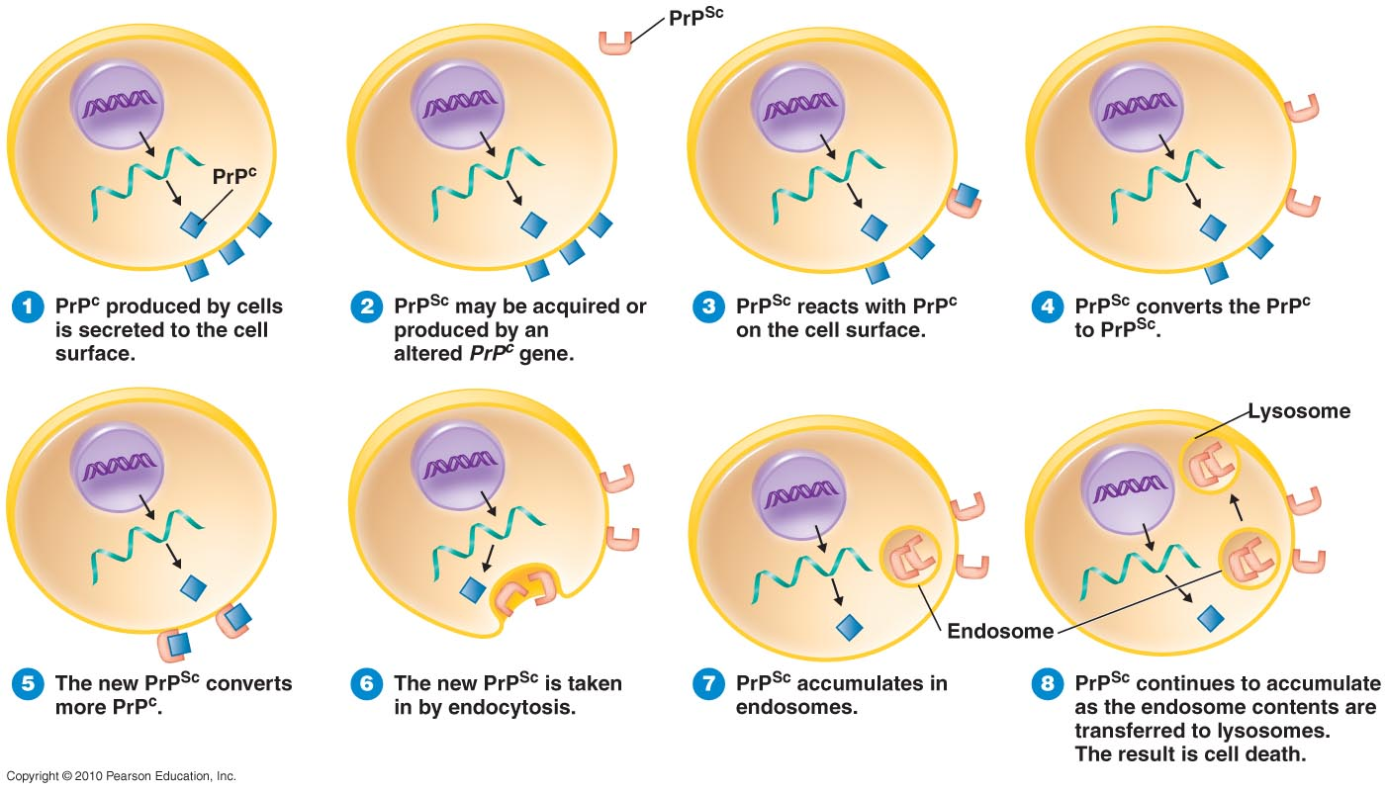
Prions: the zombie/Borg protein

Slide 42
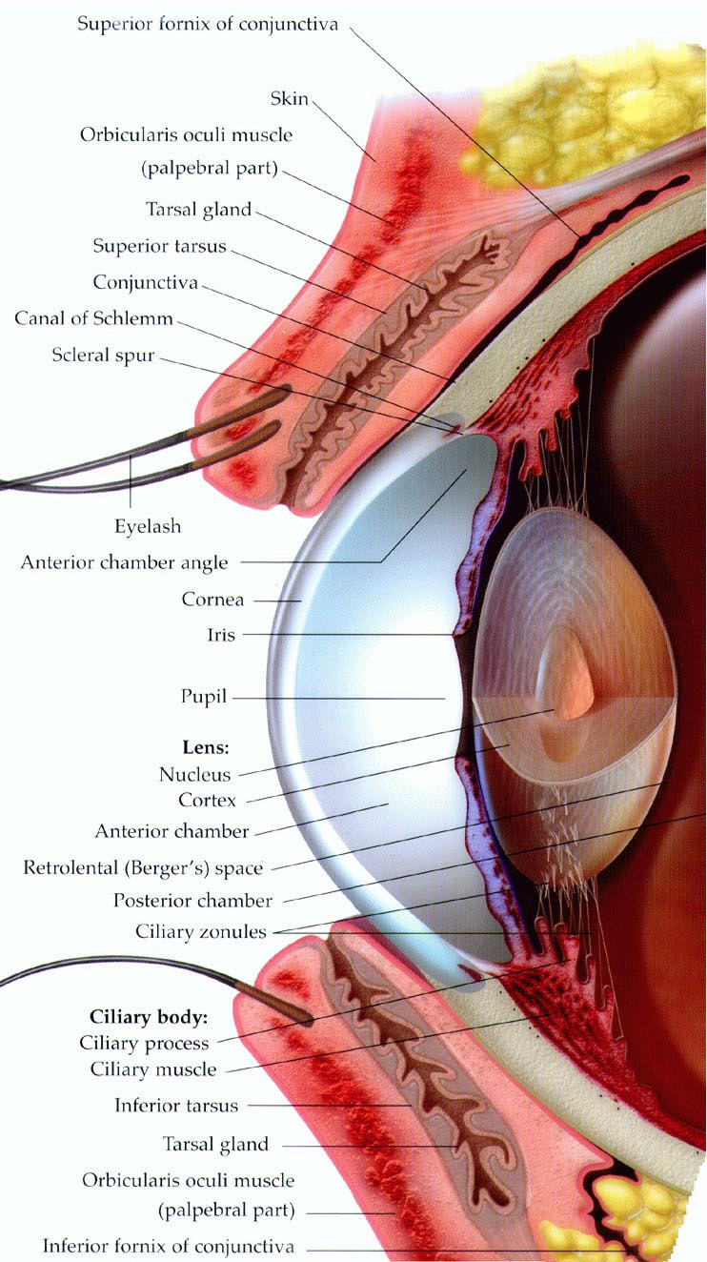
Anatomy of the Eye: a microbiological perspective
Physical barriers
eyelids, eyelashes
blinking
conjunctiva, cornea
Ocular Secretions
All contain protective biochemicals
Occasional
lacrimal glands
Constitutive
ciliary glands
tarsal glands
all drain to nasal cavity via lacrimal apparatus

Slide 43
Immunological Defense of the Eye
Immune cells are optically opaque
They cannot be present in cornea, lens, retina, or in the anterior and vitreous chambers if we want to see properly
For these reasons, the eyes are immunologically privileged. Those few immune cells that are allowed to enter when necessary in are generally functionally “damped” (similar to what is seen in CNS)
We rely on physical defenses to clear our eyes, and on special features of corneal epithelium and conjunctiva (unusually rapid turnover after damage) to eliminate infections
Tears contain lysozyme, lactoferrin, IgA to fight microbes (as do most mucous secretions)

Slide 44
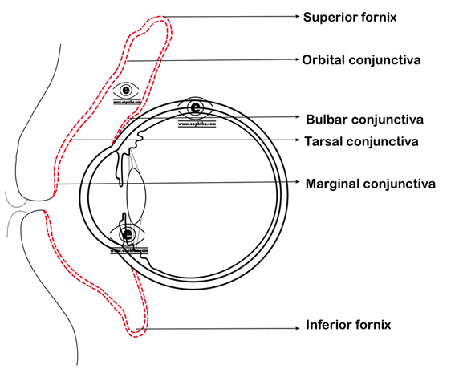
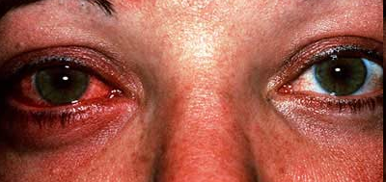
THE CONJUNCTIVA
The conjunctiva is a mucous membrane that lines the inner surface of the eyelid, the anterior surface of the eye, and fuses into the corneal epithelium. The conjunctiva lubricates the eye and protects against infections; its inflammation is called conjunctivitis (pink eye)

Slide 45
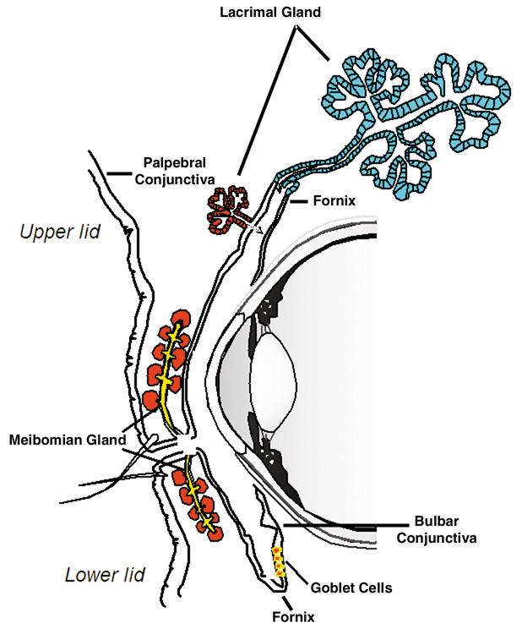
LACRIMAL GLANDS
Occasional, high-volume
Only operate in acute situations (physical trauma, emotional trauma)
Lacrimal glands produce a dilute salt solution (tears) and release it onto superior anterior eye surface

Slide 46
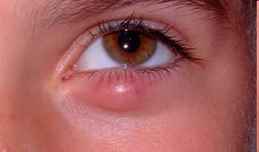
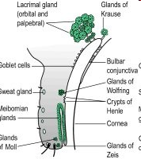
OCULAR SECRETIONS #1
Constitutive release, low volume – keep eye moist
Ciliary glands lie superficial to the conjunctiva
modified integumentary secretory glands; their inflammation is called a stye
Glands of Zeis (sebaceous) – oily lubricant
Glands of Moll (apocrine sweat) – surfactant, anti dessicant
Both reside between or with eyelashes (note hair association)

Slide 47
OCULAR SECRETIONS #2
tarsal glands (a.k.a. Meibomian glands) are modified sebaceous glands
they reside lie deep to eyelashes and provide oily fluid called meibum to bathe eye
Their primary secretion is lipids; proteins also observed
their dysfunction causes dry eyes, and leaves one susceptible to infections

Slide 48
MICROBIOTA OF THE EYE
20% of people have no recoverable microbes
In the other 80%, the identified microbiota resemble that found on the skin (proximity to skin, rub your eyes, etc.), but the levels are far less than on skin
Diphtherioides
Staphylococcus epidemidis, S. aureus
Corynebacterium sp.
Micrococcus sp.
gamma-hemolytic Streptococcus sp.
Neisseria sp.
Some fungi (e.g., Candida)

Slide 49
Bacterial Diseases of the Eye
Conjunctivitis (a.k.a. pinkeye or red eye)
An inflammation of the conjunctiva
Commonly caused by Haemophilus influenzae
Various other microbes can also be the cause (streptococci, staphylococci, gonorrheae, Chlamydia, etc.)
Associated with unsanitary conditions and chronically used contact lenses (biofilms),
Change them regularly or upon discomfort!
Do not make your own cleaner or use saliva
Self-resolves in most cases; broad-spectrum antibiotics can be administered as eyedrops

Slide 50
Trachoma
Chronic infection of (more virulent) Chlamydia trachomatis
Infection of epithelial cells of the eye
Causes inclusion conjunctivitis, or chlamydial conjunctivitis
Transmitted to a newborn's eyes during passage through the birth canal
Also can develop in adults by transferring bacteria manually
Spread through swimming pool water
Treated with tetracycline
Rare in USA; common in tropical climates
Almost all children in arid Africa/Asia infected early in life (massive overuse of unclean water)
Leading cause of blindness worldwide
Untreated infection causes permanent scarring
Scars abrade the cornea, leading to blindness

Slide 51
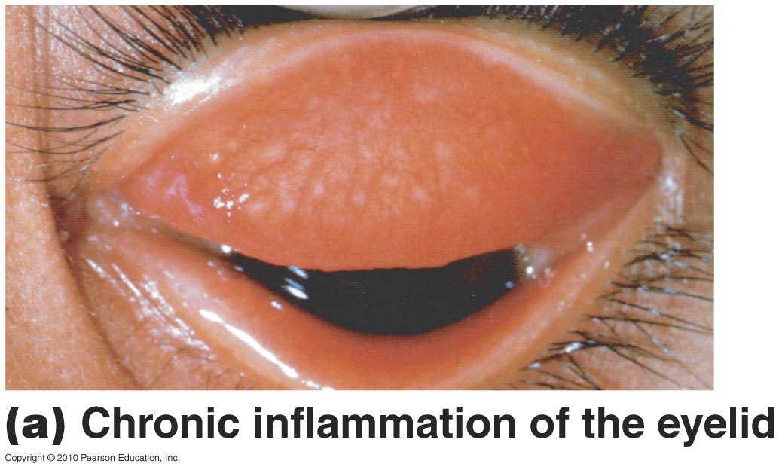
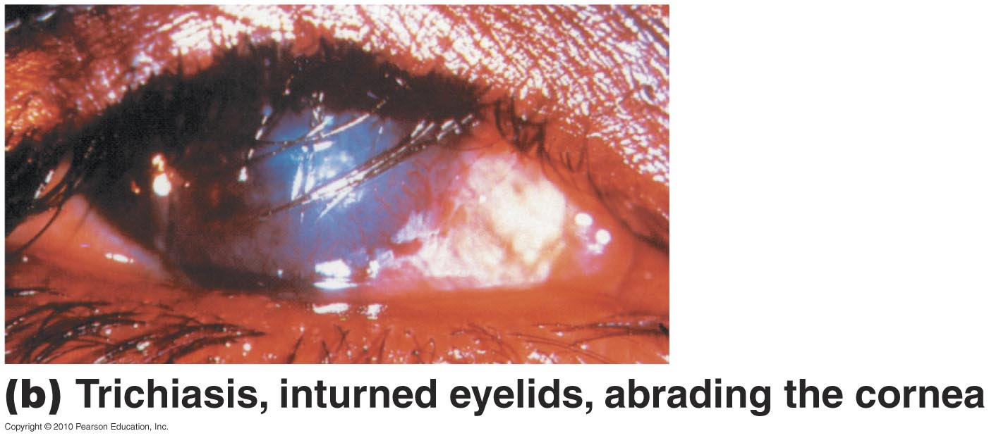
Trachoma

Slide 52
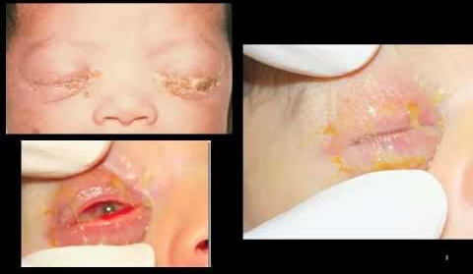
Bacterial Diseases of the Eye
Ophthalmia neonatorum
a.k.a. neonatal conjunctivitis
Caused by Neisseria gonorrhoeae as well as Chlamydia trachomatis
Transmitted to a newborn's eyes during passage through the birth canal
Prevented by antibiotic treatment of pregnant mother
Also prevented by
Caesarian section
Also prevented by
Treating a newborn’s
eyes with antibiotics

Slide 53
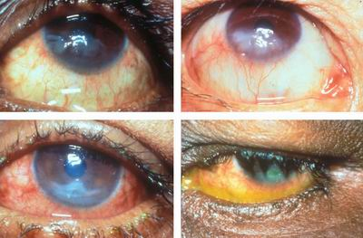
Keratitis
Deeper infection than conjunctivitis; usually co-presents with conjunctivitis
Inflammation and infection of the cornea
Can completely destroy cornea and cause blindness
HSV, Bacteria (U.S.)
Fusarium and Aspergillus (Africa and Asia)
Acanthamoeba, Naeglaria (esp. with contact lenses)

Slide 54
Agents of keratitis
Herpetic keratitis
Caused by herpes simplex virus 1 (HSV-1) or HSV-2.
Chronic remitting HSV-1 or HSV-2, unusual sexual activity are risk factors
Treated with trifluridine, acyclovir
Acanthamoeba keratitis
Transmitted via water
Associated with unsanitary contact lenses
Treatment usually not successful

Slide 55
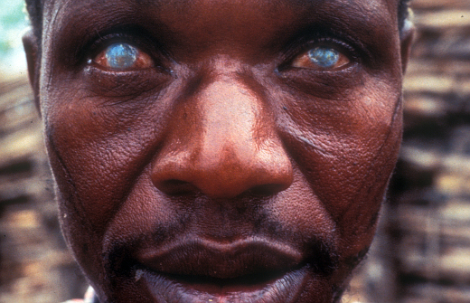
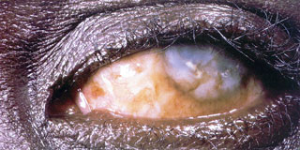
River Blindness (onchocerciasis)
Endemic in Latin America, Africa, tropical Asia, Middle East
Caused by the roundworm nematode Onchocerca volvulus (possibly the Wolbachia sp. bacteria living within them)
The nematodes are transmitted by black flies (Simulium sp.); the larvae migrate everywhere but persist at immunologically privileged sites like eyes
Microfilariae can be seen with eye exam (primary diagnosis)
Prevented by insect repellent; treated with ivermectin, doxycycline

