Slide 1
Microbiology
Chapter 17
Immunization and Immune Testing

Slide 2
Immunization
Two Artificial Methods of Immunity - REVIEW
Passive immunotherapy
Individual acquires immunity through the transfer of antibodies formed by immune person or animal
Protection is only temporary
“Give a man a fish, and he eats for a day…”
Active immunization
Administration of antigens so patient actively mounts an adaptive immune response
Patients develop their OWN immune response
“…Teach a man to fish, and he eats forever.”

Slide 3
Purpose of Vaccination
Vaccination allows the adaptive immune system to have its primary immune response with a compromised pathogen BEFORE one is infected with the real pathogen
Therefore, the first contact with the actual pathogen will elicit a secondary response (quicker, stronger)
When the person encounters the pathogen in the environment, that person hopefully either will not get sick or might get sick with a lesser form of the disease
Public health benefit - Creates important herd immunity
So few people (< 5-10%) can spread the infection that most contagious pathogens cannot move through populations

Slide 4
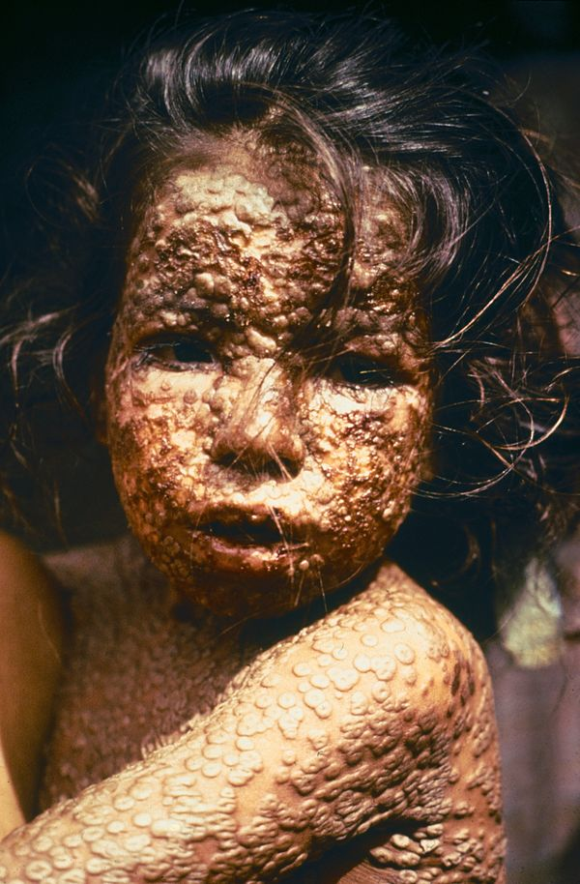
Brief History of Immunization
Part 1 – pre-vaccination
Smallpox killed 30% of those it infected; scarred most others; anyone could catch it
Chinese noticed children who recovered from smallpox did not contract the disease again (1400s-1500s).
They intentionally infected children by scraping their skin and rubbing in material from a smallpox scab
This gave a milder form of the disease, but gave the same degree of immunity
Introduced to the Middle East (1500s-1600s)
Process known as variolation
Variolation spread to Europe, England and America in the early 1700s but was stopped due to risk of death.

Slide 5
Brief History of Immunization
Part 2 – post-vaccination
1796 — Edward Jenner popularized process of vaccination
Five doctors before him discovered that cowpox (vaccinia virus) exposure (farmers, milkmaids) protected one from smallpox infection
The boy he inoculated with cowpox (twice!) did not know what he was getting – nowadays this procedure would never be allowed!
Most civilized societies were vaccinated by 1900; incidence was 1:1000 where vaccination was practiced
1879—Louis Pasteur developed a vaccine against Pasteurella multoceda
Later, antibody transfer was developed when it was discovered vaccines protected people through the action of antibodies

Slide 6
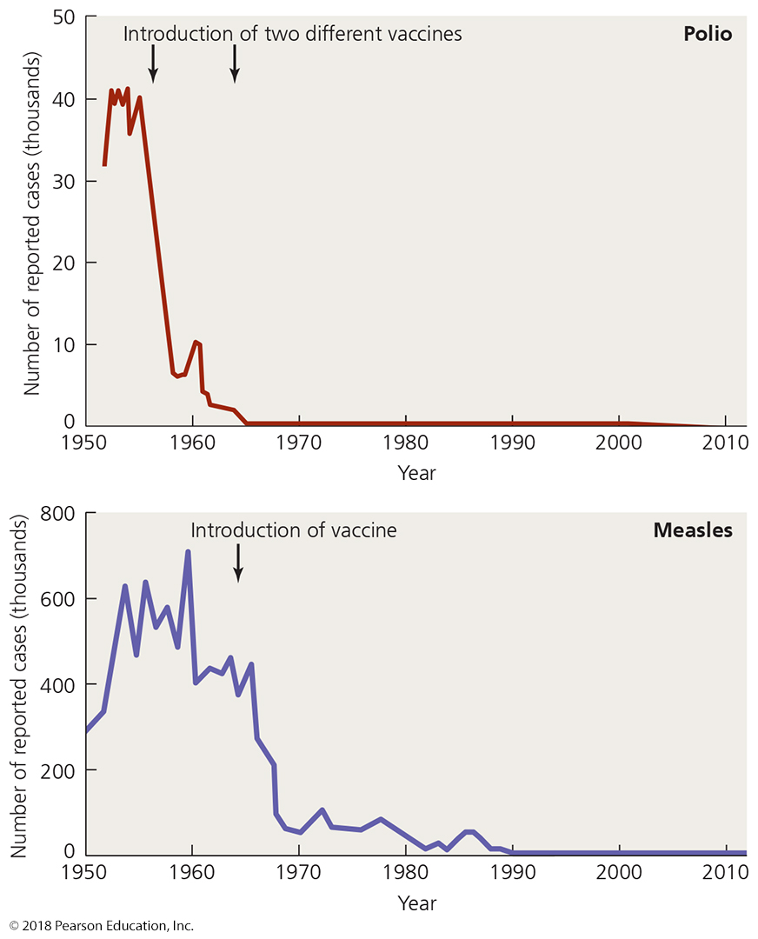
Figure 17.1 The effect of immunization in reducing the prevalence of two infectious diseases in the United States.
annual incidence graphs
(what does this mean?)
inactivated virus (injected)
attenuated virus (oral)
0.3% of population each year (actual infection rate probably 6-10x higher):
All children were infected by adulthood
(0.1% of reported cases
were LETHAL)
Single vaccination
85-95% people protected
Second vaccination
Remaining people protected
introduction of second vaccination
Notes:
6

Slide 7
Brief History of Immunization
Challenges for the future
Many developing nations do not receive vaccines
Too expensive - cannot be stored or distributed there safely
Effective vaccines not developed for some pathogens
Vaccines hard to develop for pathogens that mutate frequently (HIV, influenza A)
Vaccine development difficult – sometimes hard to isolate method that will induce immunity safely (Lyme disease)
Vaccine-associated risks discourage investment in developing new vaccines
Mild toxicity – causes patient to feel ill for a couple of days, could be discouraging to get more vaccines
Low-grade disease sometimes (1%) seen in the immunocompromised patient if attenuated vaccine used
Anaphylactic shock – rare but still not able to be anticipated

Slide 8
Active Immunization
Attenuated (modified live) vaccines
Use pathogens with reduced virulence
Process of reducing virulence called attenuation
Pro - Active microbes stimulate a stronger immune response than dead microbes
Yellow fever, poliomyelitis (oral)
Con - Can result in mild infections
Con - Some may harm the fetus (rubella)
Con - (rare) virus may revert to full-strength version
We discontinued oral polio vaccination in the USA after a 2000 breakout of severe polio in the Haiti and the DR

Slide 9
Active Immunization
Contact immunity after vaccination
Immuinized person spreads vaccine strain to others through bodily fluid transfer
Infection begins in the next person form the vaccine strain
Most commonly observed with oral vaccinations
Oral poliomyelitis vaccination exhibited this effect
Pro – someone can achieve immunity without being direct vaccinated
Con - Modified microbes may retain enough residual virulence to cause disease in susceptible individuals (e.g. vaccine-strain polio) before immunity attained
Rotavirus can spread from vaccinated babies to others
This occurred with smallpox variolations in the 1700s, and occasionally with smallpox vaccinations in the 1800s

Slide 10
Active Immunization
Inactivated (killed) vaccines
Pro - Safer than live vaccines
Dead pathogens cannot cause disease
Also easier to produce
Con - Often requires multiple doses to achieve full immunity
Some B cells recognize proteins only in “living” shapes
Some antigens fall apart before they can become epitopes
Con - Often contain adjuvants
Chemicals added to increase effective antigenicity
These can also increase incidence of side effects

Slide 11
Other Vaccine Types
Whole agent vaccines (covered just before)
Inactivated but whole microbes
Hepatitis A, rabies
Subunit vaccines
Antigenic fragments of microbes (usually purified proteins)
Prevnar, pertussis
Toxoid vaccines
Chemically or thermally inactivated toxins used to stimulate active immunity without toxemia
Useful for some bacterial diseases in which the toxins create more disease than the pathogen
tetanus, diphtheria, botulism
Require multiple doses because toxoids possess few epitopes; need boosters

Slide 12
Other Vaccine types
Vaccines using recombinant gene technology
Also known as recombinant vaccines
DNA encoding immunogenic antigens (naturally within the genome of a dangerous pathogen) is inserted into genome of “safe” microbe (often, Saccharomyces cerevisiae is chosen)
Antigens expressed by vaccine microbe – no purification needed
Recombinant DNA techniques used to improve vaccines
Gardesil/Cervarix
Hepatitis B (used to be inactivated vaccine)
Rotavirus (in development for African rotavirus)
Combination vaccines
Simultaneous administration of antigens from several pathogens
e.g., MMR, DTaP

Slide 13
Active Immunization
Vaccine manufacture
Many viruses are cultured inside chicken eggs
Influenza, MMR, yellow fever
Individuals with egg allergies must avoid egg vaccines
Many vaccines mass-produced by growing microbes in culture vessels (in vitro)
Some pathogens cannot grow in eggs
Influenza (for those with egg allergies)
Rotavirus
Smallpox (using vaccinia virus, a.k.a. cowpox)
Rabies
Recombinant vaccines are grown, then purified from the “new” host species

Slide 14
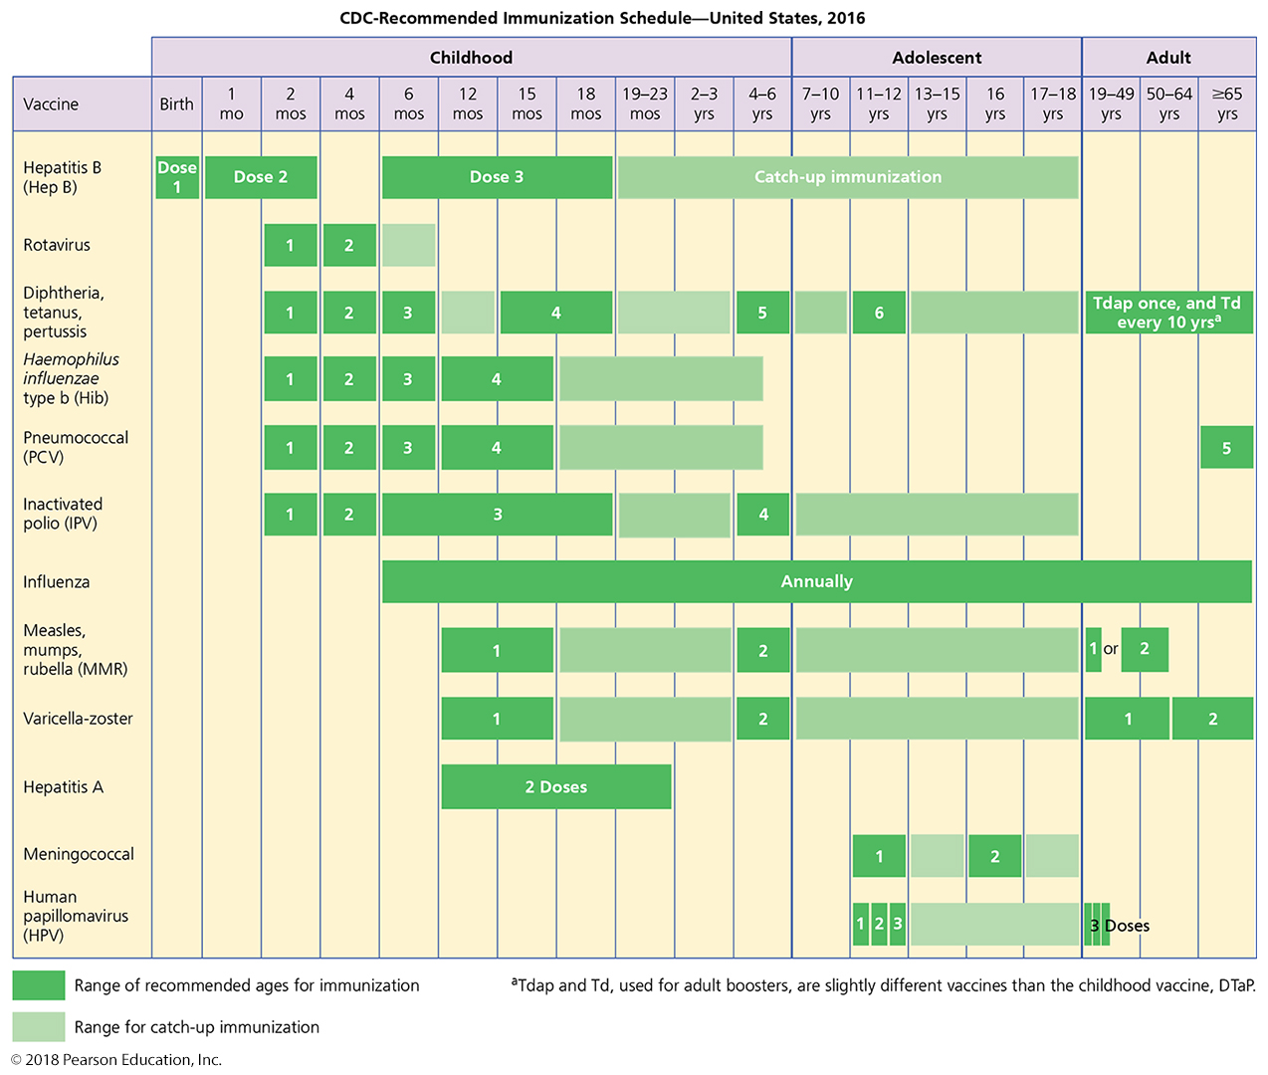
Figure 17.3 The CDC’s recommended immunization schedule for the general population – FOR REFERENCE ONLY
Notes:
14

Slide 15
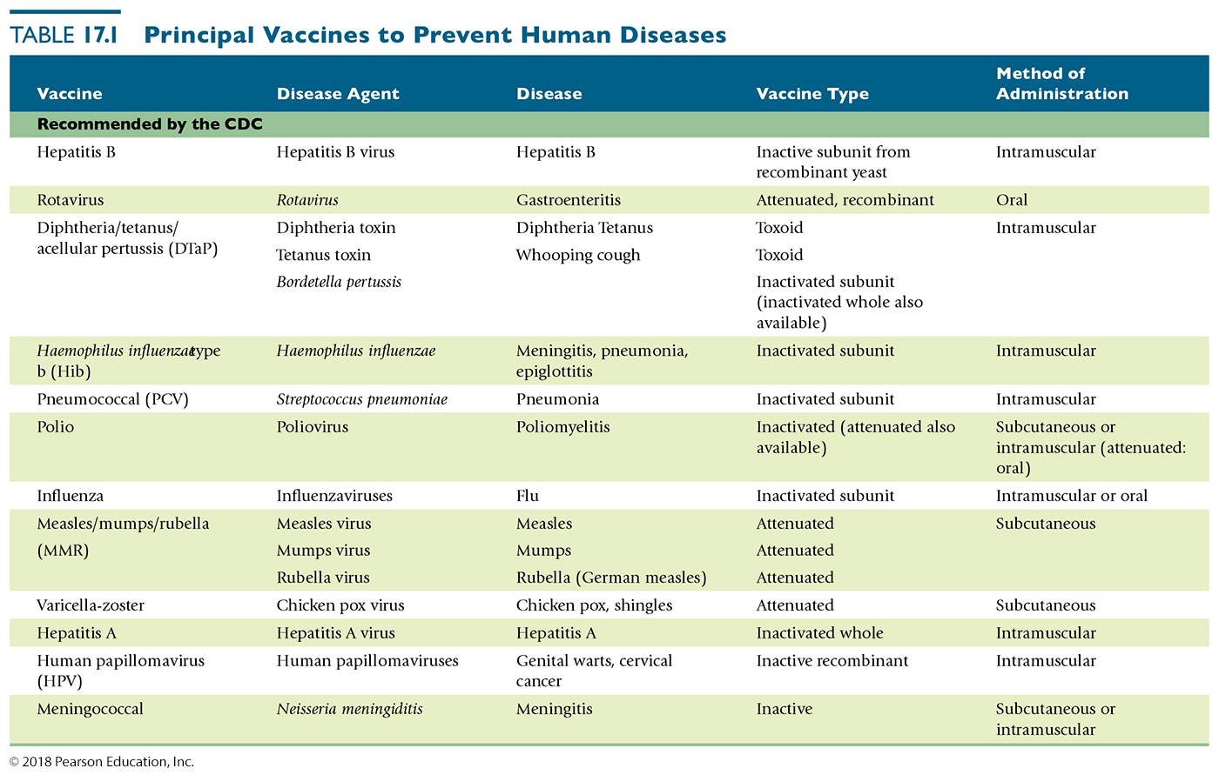
Table 17.1 Principal Vaccines to Prevent Human Diseases (1 of 2) – FOR REFERENCE ONLY
Notes:
15

Slide 16
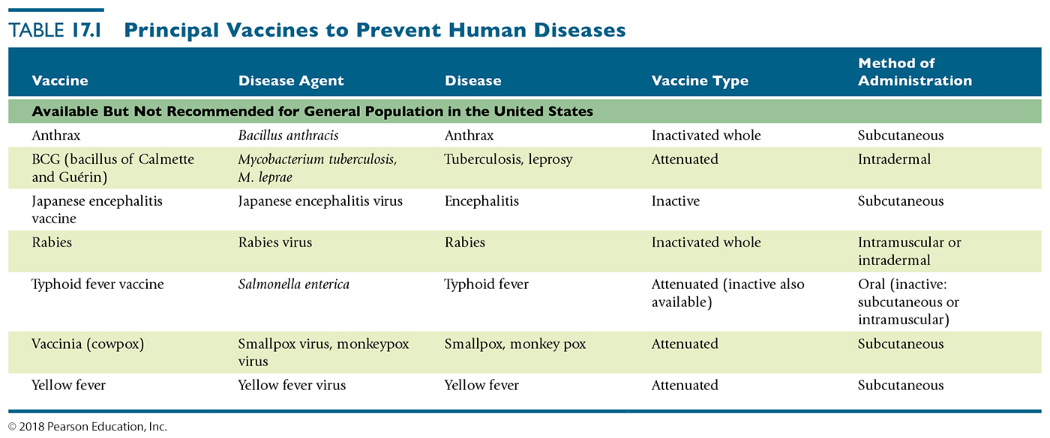
Table 17.1 Principal Vaccines to Prevent Human Diseases (2 of 2) – FOR REFERENCE ONLY
Notes:
16

Slide 17
Active Immunization
Vaccine safety
Problems associated with immunization
Mild toxicity – injection site swelling or pain (about 1%)
Residual virulence from attenuated viruses (about 1%)
Risk of anaphylactic shock – in a few people (1:100000)
Cannot know how anything introduced in the body will effect every individual, especially when you are giving them to millions of people
Allegations certain vaccines cause autism, diabetes, and asthma
Research has not substantiated these allegations
the danger of not vaccinating is bigger threat to public

Slide 18
Passive Immunotherapy
Administration of antiserum (serum that contains useful antibodies)
Pro - Provides immediate protection against a recent infection or ongoing disease
Useful for rapidly developing virus infections (rabies)
Con - Antisera have several limitations
Contains antibodies against many antigens
Some of these antibodies may react to self antigens in the patient
Can trigger allergic reactions called serum sickness
Viral pathogens may contaminate antisera
Antibodies of antisera are degraded relatively quickly
Individual not protected from subsequent infections
Some of these limitations are overcome through the development of hybridomas – cultured cells that make recombinant antibodies through cloned antibody genes

Slide 19
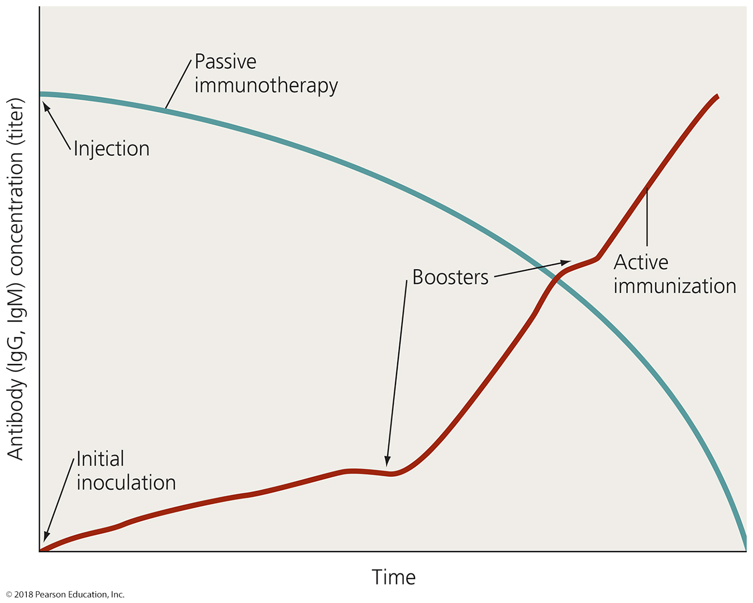
Figure 17.5 The characteristics of immunity produced by active immunization (red) and passive immunotherapy (blue).
Notes:
19

Slide 20
Serological Tests That Use Antigens and Corresponding Antibodies
Serology is the determination of the presence of specific antigens or antibodies in blood serum
Serological tests available to identify a variety of antigens and antibodies in serum
Serological tests have several uses
Monitor the spread of infection within a population
Inexpensive AIDS, STD/STI tests at public clinics serve this purpose
Establish diagnosis or effectiveness of treatment of disease

Slide 21
Serological Tests That Use Antigens and Corresponding Antibodies
Agglutination Tests
Agglutination occurs due to the cross-linking of antibodies with large particulate antigens
Agglutination is the clumping of insoluble particles
Reactions can be easy to see and interpret with the unaided eye
In your lab – staphyloslide assay, Strep latex assays
Hemagglutination
Agglutination of red blood cells
Can be used to determine blood type (archaic method)

Slide 22
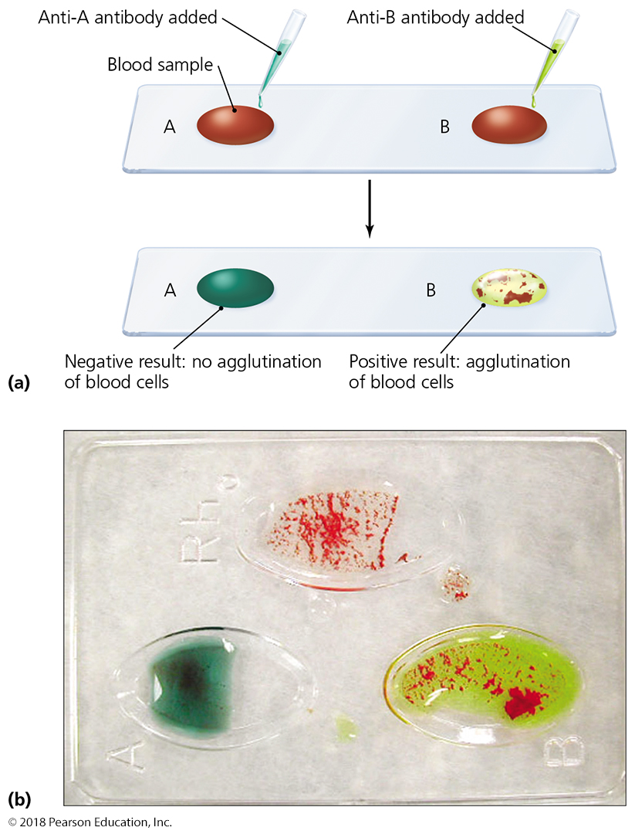
Figure 17.8 The use of hemagglutination to determine blood types in humans.
D/ Rh
What is the blood type of this person?
A
B
Notes:
22

Slide 23
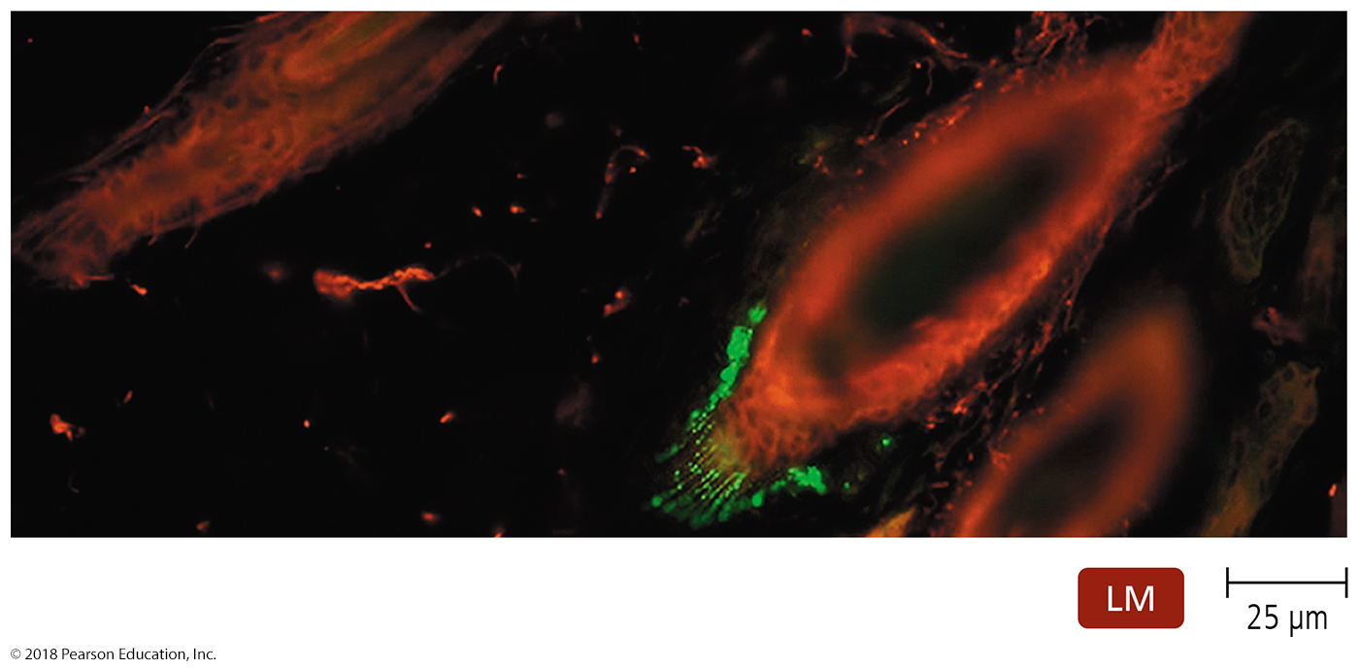
Serological Tests That Use Antigens and Corresponding Antibodies
Fluorescent Antibody Tests
Use antibody molecules linked to some “label” that enables them to be easily detected
Fluorescently labeled antibodies used in two types of tests
Direct fluorescent antibody tests – anti-pathogen Ab labeled
Indirect fluorescent antibody tests – anti-antibody labeled – used to find antibodies, or Ab:antigen complex
Used to detect either antigens or antibodies
Often used when looking
for antigens in cells or
tissues
(e.g., rabies in green)

Slide 24
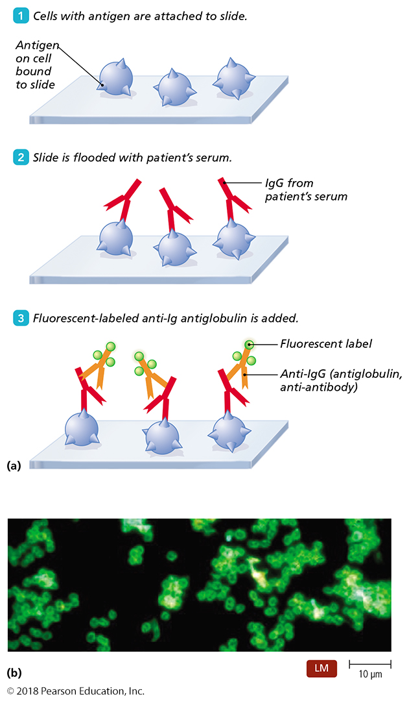
Figure 17.11 The fluorescent antibody test.
Notes:
24

Slide 25
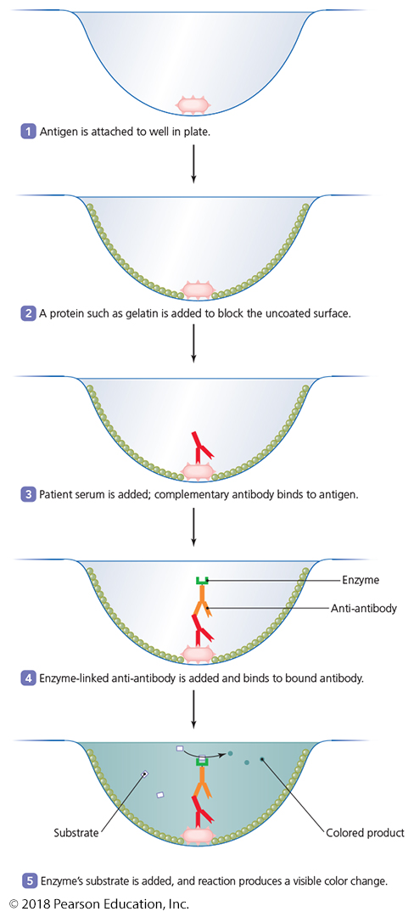
Serological Tests That Use Antigens and Corresponding Antibodies
ELISAs (EIAs)
Stands for enzyme-linked immunosorbent assay (ELISA) or enzyme immunoassay (EIA)
Uses an enzyme as the label
Reaction of enzyme with its substrate produces a colored product indicating a positive test
Commonly used to detect the presence of serum antibodies
Often, antibodies are far more numerous than the pathogens themselves

Slide 26
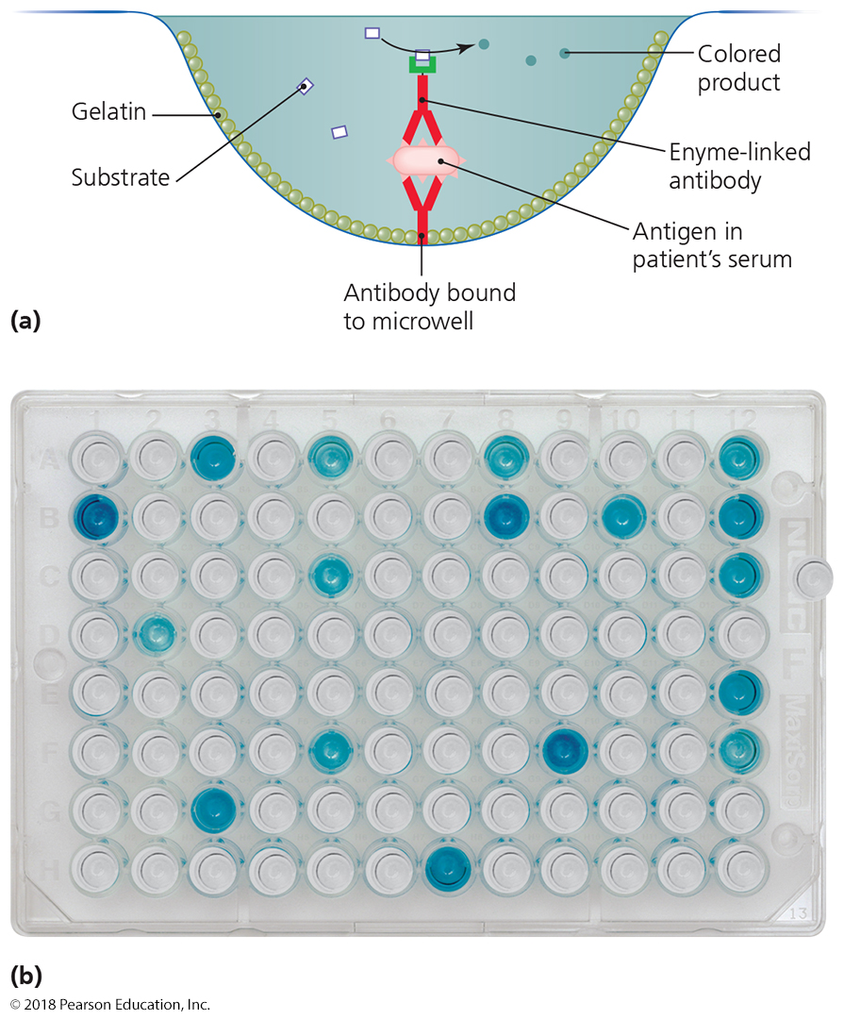
Serological Tests That Use Antigens and Corresponding Antibodies
Antibody sandwich ELISAs
Modification of the ELISA technique
Commonly used to detect antigen
Antigen being tested for is “sandwiched” between two antibody molecules

Slide 27
Serological Tests That Use Antigens and Corresponding Antibodies
Advantages of the ELISA/EIA
Can detect either antibody or antigen
Sensitive
Can quantify amounts of antigen or antibody
Easy to perform and can test many samples quickly
Analysis can be automated
Relatively inexpensive and easy to automate (if many samples are being studied at once)
Plates coated with antigen can be stored for later testing

Slide 28
Serological Tests That Use Antigens and Corresponding Antibodies
Immunoblot
Also called a Western blot
Technique to detect antibodies against multiple antigens
Used to confirm the presence of specific antigenic proteins
Three steps
Electrophoresis separates proteins in a sample
Blotting transfers protein to nitrocellulose membrane
Color generated where antibody has bound to specific proteins

Slide 29
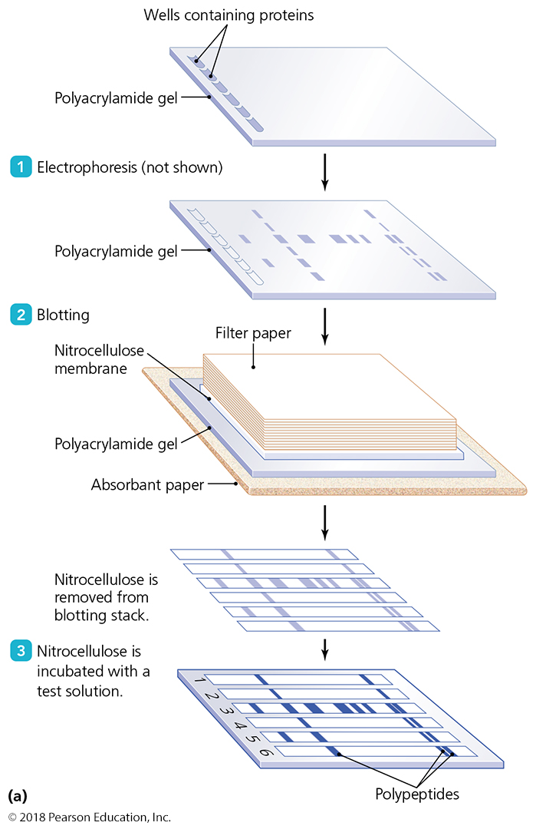
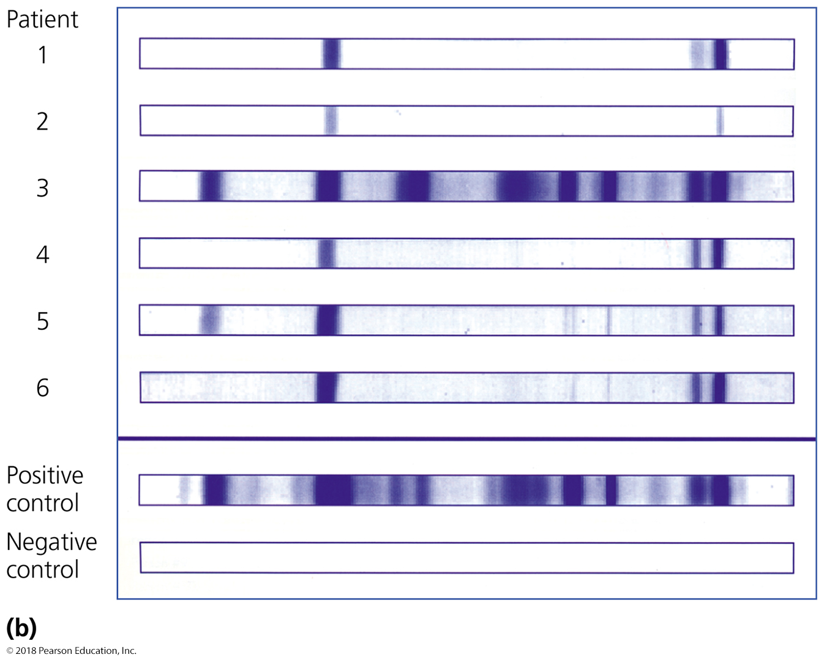
Figure 17.14 Immunoblotting (Western blotting).
Which patient is definitely infected by this particular pathogen?
Which patient MAY be infected?
Notes:
29

Slide 30
Serological Tests That Use Antigens and Corresponding Antibodies
Point-of-Care Testing
Simple immunoassays that give results in minutes
Will anyone want to go through or wait for a pregnancy test that takes ten days to get results?
Useful in determining a quick diagnosis or a preliminary diagnosis
Common tests
Immunofiltration assay
Immunochromatography assay

