Slide 1
Microbiology
Chapter 16
Adaptive Immunity

Slide 2
Overview of Adaptive Immunity
Adaptive immunity is the body’s ability to recognize and defend itself against distinct invaders and their products
  Recognize specific sequences, not chemical patterns
“Only” found in vertebrates
Repeated contact with the same antigen results in more refined and faster response due to memory
The body constantly displays parts of proteins it is expressing (or finding) to show the adaptive immune system what type of proteins the host is holding
  Some are “self” or “allowed to exist” and are tolerated
  Remainders are foreign (“nonself”) and their sources and production eliminated

Slide 3
Five attributes of Adaptive Immunity
Specificity – each cell recognizes only a unique biochemical structure/sequence
Inducibility – needs some time to get fully activated
  Need to amplify cells and create “improved” cells
Clonality – cells that recognize a pathogen are amplified
  Recognizing a specific pathogen with a random sequence ~ hitting the jackpot or “getting lucky”
  Those rare lucky cells need to be expanded because they are actually useful – used for refinement, memory, or specialized function to clear pathogens
Memory – cells that recognize a pathogen are stored, and back-up’s made for the next re-infection
  Allows a rapid response upon reinfection
Unresponsiveness to self (or tolerance)
  Cells that recognize self would be activated WAY too much to just be lucky; these are eliminated or “frozen”

Slide 4
Overview of Adaptive Immunity
Innate immune system “managed” by lymphocytes
  Each manager is sequence-specific, so only a few are activated with each infection
  These managers can activate innate immune cells to clear the infection
Two main types of adaptive lymphocytes
  B lymphocytes (B cells) – mature in the bone marrow
    Antigen-specific phagocytes
  T lymphocytes (T cells) – mature in the thymus
    Many managerial functions possible
      Activate effector cells/ change how “cleanup” occurs
      Activate B cells
      Kill compromised tissue cells
      Muffle/silence the “cleanup”

Slide 5
Two types of adaptive immune responses
Cell-mediated immune responses
  Foreign particles localized and exactly defined
  Intracellular infections – infections limited to specific cells
    a few protozoa and bacteria
    Virus-infected cells
    nonself cells (tissue transplants; fetal cells; cancerous cells)
  Eliminating the cell eliminates the pathogen
    “surgical” cleansing – killing of cells; engulfing of cells and cell debris
    Heavy use of macrophages and cytotoxic cells
    inflammation and damage by friendly fire is often minimal
Humoral immune responses
  Foreign particles are diffuse or moving
  Extracellular pathogens – infections can spread through tissues
    Allergens, viruses between cells, released toxins
  Heavy use of secreted molecules to tag pathogens (antibodies) or if necessary destroy everything in extracellular space (toxic enzymes)
    Heavy use of granulocytes
    “Carpetbombing” cleansing; inflammation and friendly fire common

Slide 6
Lymphocytes in motion
https://www.youtube.com/watch?v=ntk8XsxVDi0
https://www.youtube.com/watch?v=UeW-lDmnl9M
Lymphocytes move like macrophages and amoeba
Note:
the amoeboid motion of the T cells
how the T cells “suction” onto target cells
how “excited” they get when they attach to a “matched” cell
Notes:
6

Slide 7
How do lymphocytes learn about infections?
Lymphocytes are residents of the lymphatic system
  Lymphocytes, being managers, sit at their desks (lymph nodes) and wait for the “action” to come to them
    Most lymphocytes are resting in lymph nodes and do not move through the bloodstream
    They leave their desks when they are “told” about infections, then enter the blood stream
    Circulating lymphocytes are alerted to trouble and are trying to find the danger (to manage it)

Slide 8
About the Lymphatic System #1
Tissues and Organs of the Lymphatic System
  Purpose: cleanse interstitial fluid and return it to the blood
  Lymph – interstitial fluid entering lymphatic vessels
    Liquid with similar composition to blood plasma
    Arises from fluid leaked from blood vessels into surrounding tissues
      Contains:
        salts and lipoproteins
        cellular waste and debris
        any pathogens and their debris from infections
        Any metastatic cancers cells
        dendritic cells from tissues with antigens looking for “matching” T cells
  Lymphatic vessels
    One-way system that drains interstitial fluid from the body tissues and returns it to the circulatory system
    Run somewhat parallel to veins

Slide 9
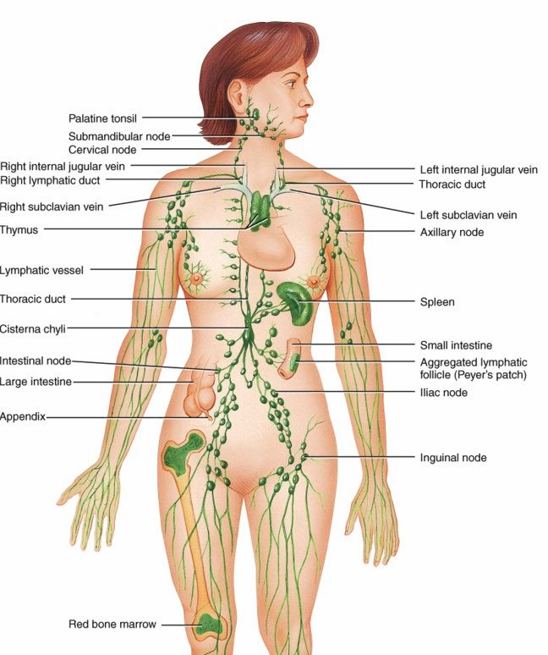
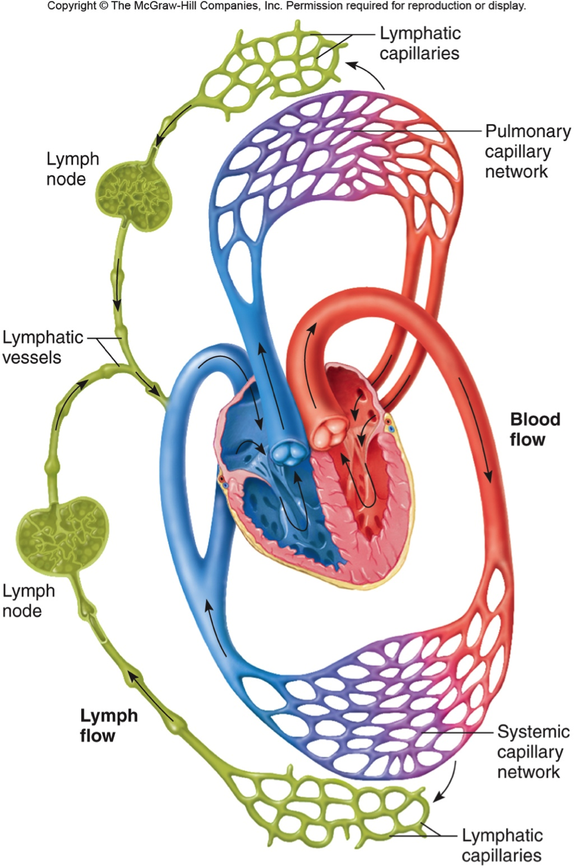
Figure 16.2 The lymphatic system schematic
7200 L fluid/
day through
20 L fluid/
day into tissues
18 L fluid/
day out of tissues
Note chains of lymph nodes leading to the subclabvian vein
2 L fluid/
day from tissues
Notes:
9

Slide 10
About the Lymphatic System #2
Tissues and Organs of the Lymphatic System
  Lymphoid organs
    Primary lymphoid organs – generate leukocytes
      Red bone marrow – ALL cells, including early T cells
      Thymus – T cell maturation and education
    Secondary lymphoid organs – arranged in chains; filter fluids
      “first” filters
        Spleen – filters blood for pathogens
        Tonsils – sense mouth, ear, eyes, sinus, nose fluid
        Mucosa-associated lymphoid tissue (MALT) – sense gut and bronchioles
      “downstream” filters
        Lymph nodes – filter lymph from tissues and upstream lymphoid organs

Slide 11
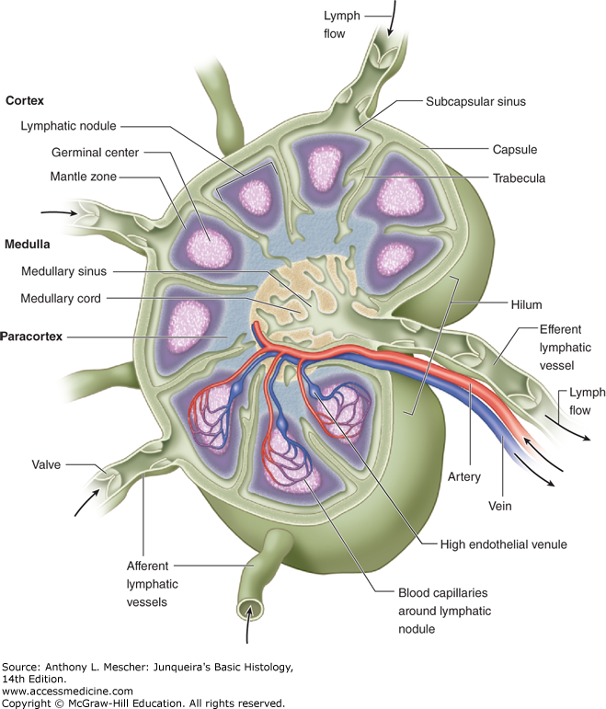
Structure of secondary lymphoid organs
The spleen, tonsils, MALT, and lymph nodes are quite similar anatomically, and all have these structures:
  Capsule – external covering; protrudes into structure via trabeculae
  Nodules – units of lymph node segregated by trabeculae
  Sinuses – channels for fluid flow through nodules
  Cortex – outside layer
  Paracortex – medial layer
  Medulla – inside layer
  Efferent lymphatic vessel – fluid exit from structure

Slide 12
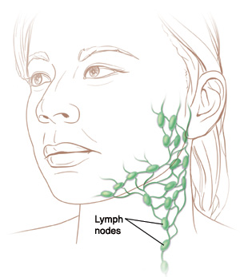
Function of secondary lymphoid organs
Fluid flows into the structure
  Mucus from oral/nasal cavity into tonsils
  Mucus from gut/bronchioles into MALT
  blood into spleen
  Lymph from afferent lymphatic vessels into lymph nodes
Fluid flows first into the cortex of nodules, where they first interact with B cells.
Fluid next migrates to the paracortex to interact with T cells.
Fluid and any “matching‘” cells exit the lymph node at the medulla to head to the next node and eventually the general circulation.

Slide 13
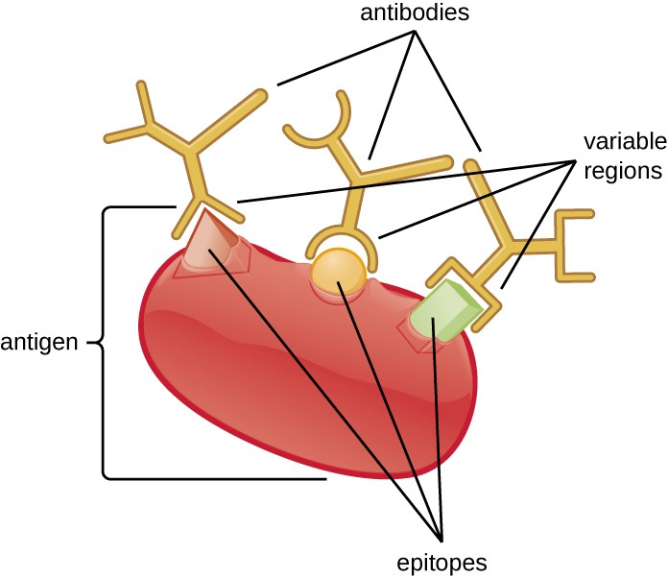
Foreign particles: antigens vs. epitopes
Antigens
  Properties of antigens
    Molecules that elicit immune responses
    Can initiate allergic reactions (allergens)
    Most pathogens have many antigens for the immune system to detect
    Food and dust can also contain antigenic (and allergenic) particles
      Peanut, shellfish, gluten, pollen, mold
Epitopes
    Portions of antigens that directly bind antibodies or T-cell receptors
      What the immune system actually “sees”
    Multiple epitopes occur on each antigen

Slide 14
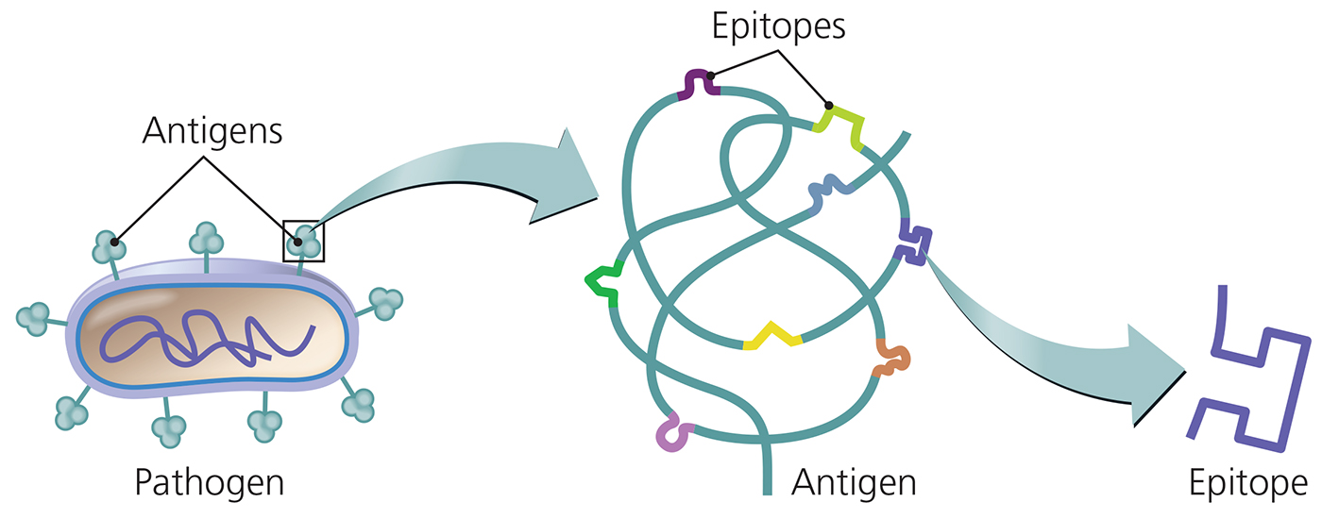
Figure 16.3a Antigens, molecules that provoke a specific immune response.
    Large foreign particles make the best antigens, especially if they have repeating units of epitopes
        e.g., LPS in bacteria, capsomeres or spike proteins in viruses
loose or small antigens generally do not initiate strong immune responses (too few epitopes – poor resolution for immune system)
      e.g., exotoxins, extracellular enzymes
Notes:
14

Slide 15
Types of Antigens
Exogenous antigens – discovered outside of cells
  includes toxins and other components of microbial cell walls, membranes, flagella, and pili
  Immune system cells have to ingest them to learn about them
Endogenous antigens - discovered inside a body's cells
  viral proteins, intracellular pathogens, mutated self-proteins (oncogenes)
  Infected cells display epitopes for these antigens to immune system
Foreign antigens – by far the most common
Self antigens (autoantigens) – seen even when host is healthy – supposed to be ignored

Slide 16
T cells vs. B cells – SUMMARY SLIDE
Two groups of cells recognize specific sequences of amino acids or sugars
  T Lymphocytes (T cells) - managers
    They recognize only EPITOPES bound to MHC
    When activated, they manage epitope-matched infections
    T cells will NOT process any antigens unless they are infected
  B Lymphocytes (B Cells) - workers
    They recognize EPITOPES and phagocytose ANTIGENS in their natural form
    They process these SPECIFIC antigens and present these SPECIFIC epitopes to T cells
    B cells recognizing specific antigens make secreted forms of their receptors to bind antigen anywhere in the body
    These secreted antigen-binding proteins are called antibodies

Slide 17
Pathogen Identification by B cells vs. T cells
Focus on what is holding the epitope, and how the cell behaves after the epitope is found

Slide 18
Elements of Adaptive Immunity
T Lymphocytes (T Cells)
  Lifecycle:
    Born in the red bone marrow
    Mature in the thymus
    Reside in secondary lymphoid tissues
    Circulate between the lymph and blood
  Have T cell receptors (TCRs) on their plasma membrane
    Each TCR has a randomized receptor gene sequence
  Each matured T cell will react to only a specific epitope, and only if bound to MHC
    Most TCR’s never find their matched epitope
    Other TCRs only recognize one epitope

Slide 19
How T cells detect epitopes
In all cells, endogenous antigens are broken down intracellularly
Antigen presenting cells (APCs) swallow exogenous antigens (pathogens) and break them down into epitopes within phagolysosomes
  Dendritic cells – for initial detection in lymph nodes
  Macrophages – for discovery in tissues after detection
  B cells – pathogen specific – in lymph nodes and tissues
  Some specialized endothelial cells – to hone to tissues
Protein epitopes are loaded onto “display” molecules called Major Histocompatibility Complexes (MHC)
  Class I MHC displays endogenous epitopes found in all cells
    Displays to active cytotoxic T cells
  Class II MHC displays exogenous epitopes discovered by antigen-presenting cells (APCs)
    Displays to helper, follicular, and regulatory T cells

Slide 20
Types of T lymphocytes
All develop from a single T-cell that “got lucky”, recognized a presented epitope, and subsequently expanded clonally
Memory T cells are generated and saved for re-infections
Four functional types of T cells based on (surface glycoproteins and) characteristic functions
  Cytotoxic T lymphocyte
    Directly kills compromised cells
  Helper T lymphocyte
    Directs effector immune response (macrophages, granulocytes, tissue cells)
    Cell-mediated vs. humoral response to infection controlled here
  Follicular T lymphocyte
    Activates B cells at germinal centers of secondary lymphoid organs
  Regulatory T lymphocyte
    Represses adaptive immune responses
      male-specific fetal antigens, prostate, brain antigens, ocular antigens, chronic mucosal resident microbia (gut, skin, oral, reproductive)

Slide 21
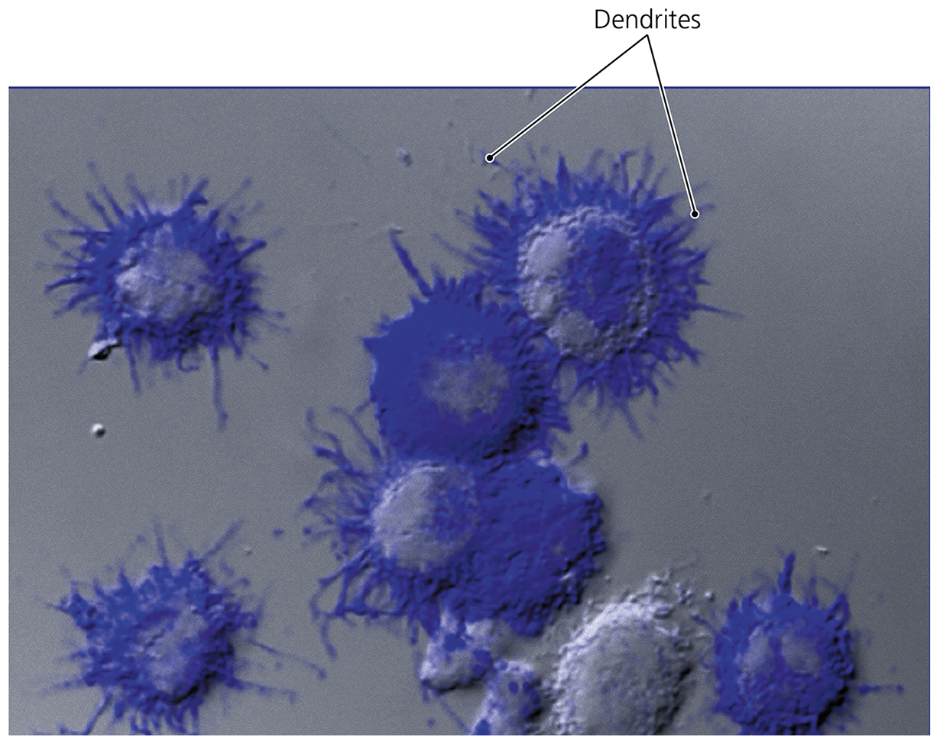
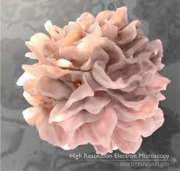
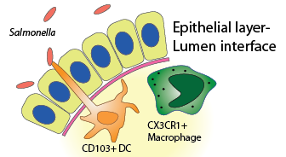
Magic of dendritic cells
Dendrites used to increase contact area with T cells
Also used to sample medium beyond tightly-bound cell borders
(into lymph node sinuses, mouth, mucus, gut, epidermis, lungs)
Notes:
21

Slide 22
Learning about an antigen
How B cells detect epitopes
  Each B cell recognizes a distinct epitope because its B cell receptor (BCR) gene is randomized.
  The BCR binds its specific epitope in lymph nodes or in tissues, almost always associated with its antigen
    NO presentation molecules needed
  B cells phagocytose the antigen and break it down into epitopes within phagolysosomes
  The B cell loads all protein epitopes from the antigen onto MHC Class II, especially the epitopes it did not recognize
    B cells are epitope-specific
    Antigens have many epitopes
    B cells cannot recognize any other epitopes, but can display ALL epitopes to T cells

Slide 23
B Lymphocytes (B Cells) and Antibodies
Found in clusters near T cells
  primarily in the cortex of spleen, lymph nodes, tonsils, and MALT
  Very few B cells circulate in the blood
    Usually recently-activated B cells
Only a “lucky” B cell will recognize a foreign antigen
  The B cell will expand into a population of thousands to millions at lymph node when it finds a matching T cell
    Germinal center forms from expanding B cells and expanding matched T cells (swollen lymph node)
  In some expanded B cells, The BCR is further randomized to try to make a tighter-binding BCR – affinity maturation
  A soluble form of the “lucky” receptor is secreted to find, bind, and label antigen anywhere in the body – antibody
  Many expanded B cells are terminally differentiated into short-lived plasma cells, that become antibody factories
  Some are “back-ups” to be saved for future re-infections - memory B cells

Slide 24
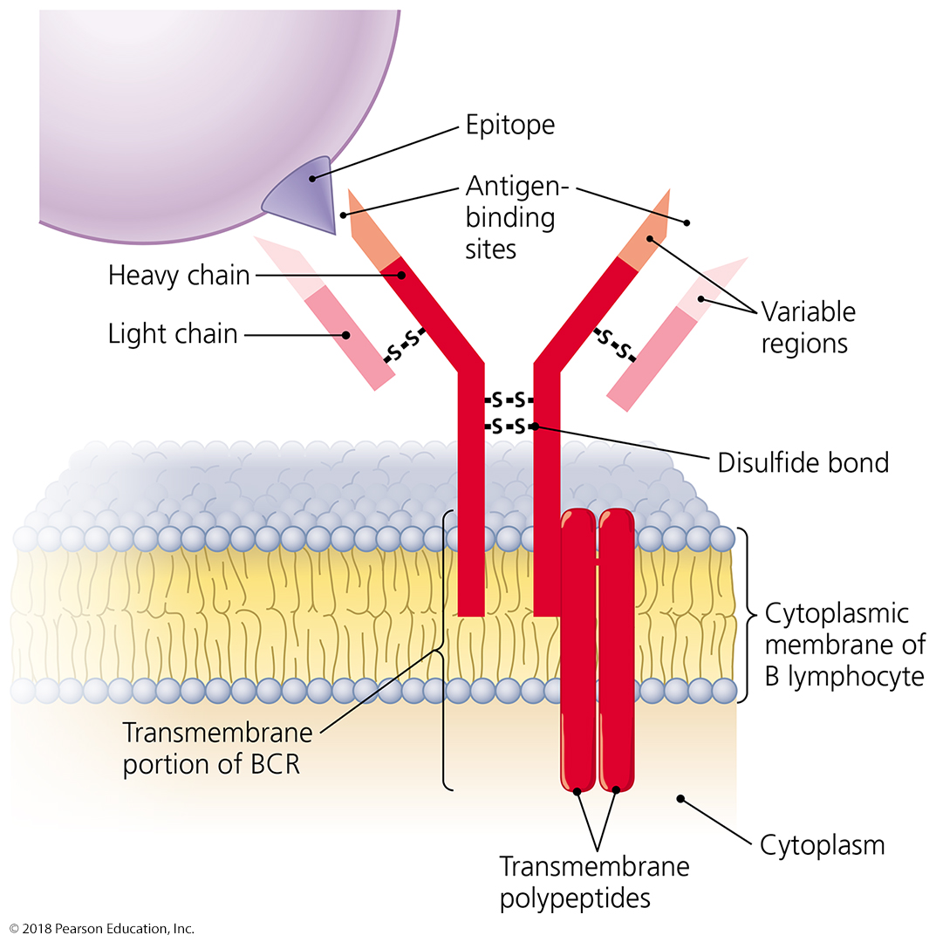
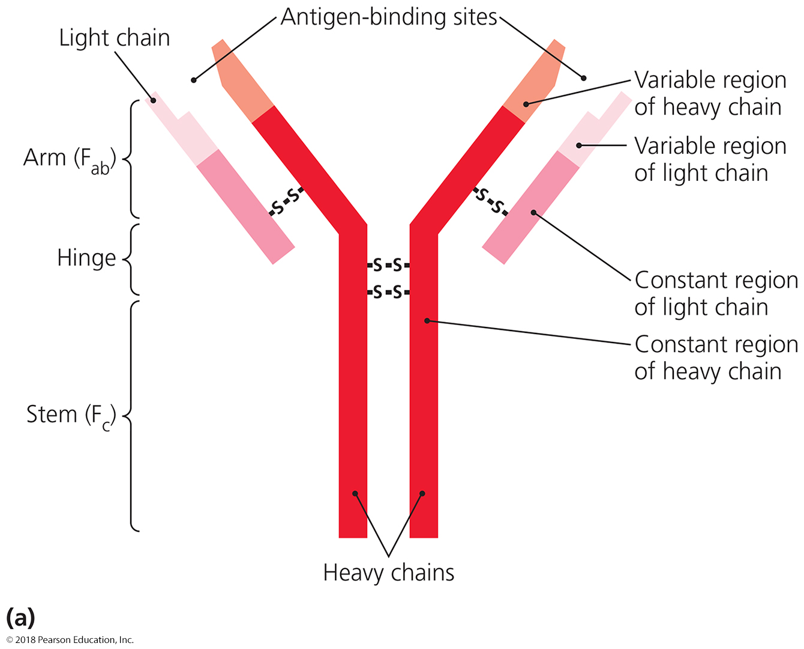
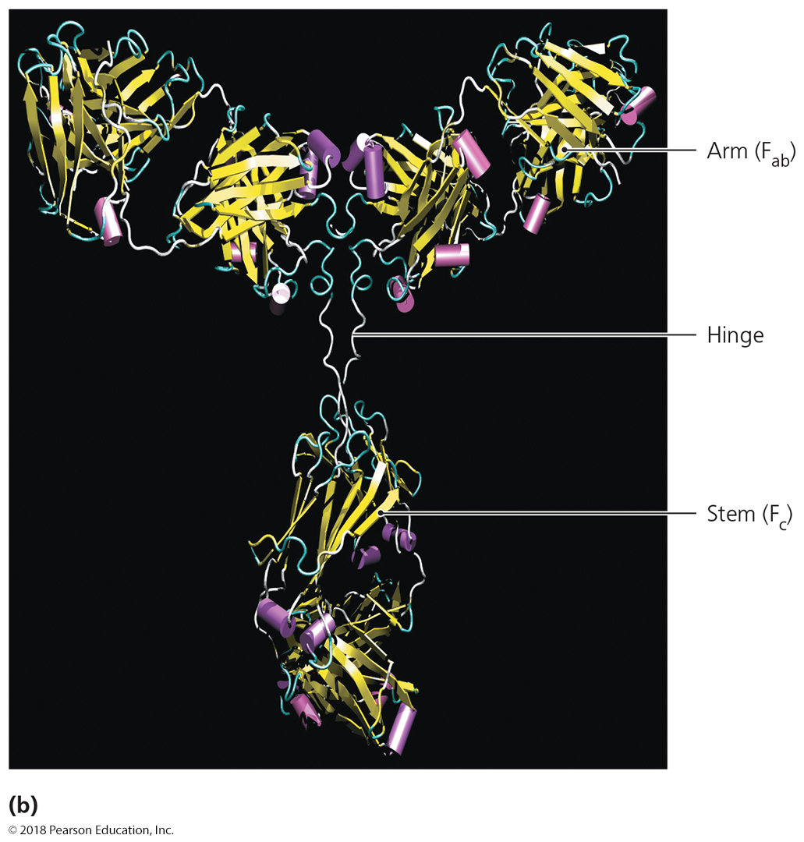
Figure 16.10 B cell receptor (BCR) and antibodies.
Notes:
24

Slide 25
Elements of Adaptive Immunity
Functions of Antibodies
  Antigen-binding sites are complementary to epitopes
  Antibodies function in several ways – “kisses of death”
    Activation of complement and inflammation – through classical complement pathway
    Neutralization – block up active sites of pathogenic enzymes or prevent critical contacts from happening
    Opsonization – antibody-coated pathogens are tagged and are very easily discovered by the immune system
    Agglutination – form a massive protein web that precipitates and stops pathogens from moving – easier to catch and swallow
    Antibody-dependent cellular cytotoxicity (ADCC) – antibodies bound to a compromised host cell are ‘tagged’ for “assisted suicide” by cytotoxic immune cells

Slide 26
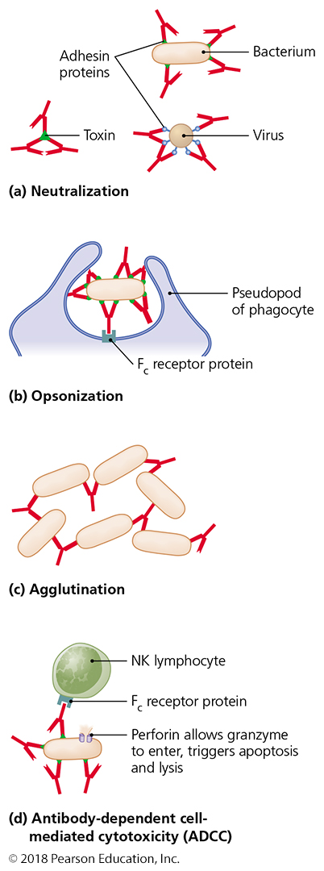
Figure 16.14 Four functions of antibodies.
Notes:
26

Slide 27
Elements of Adaptive Immunity
B Lymphocytes and Antibody Classes
  “first guess”
    All naïve and invariant B cells produce this antibody
      IgM—first antibody produced; strongly activate complement; allow even weak pathogen contacts to trigger strong response (5x pathogen binding sites)
      IgD—exact function is not known (membrane-bound form); mucosal immunity????
  “better guess”
    Pathogen-experienced B cells produce these antibodies
      IgA—associated with ALL body secretions
      IgG—most common and longest-lasting antibody; transfers into mother’s milk and through placenta
      IgE—involved in response to parasitic infections and allergies; granulocyte activators

Slide 28
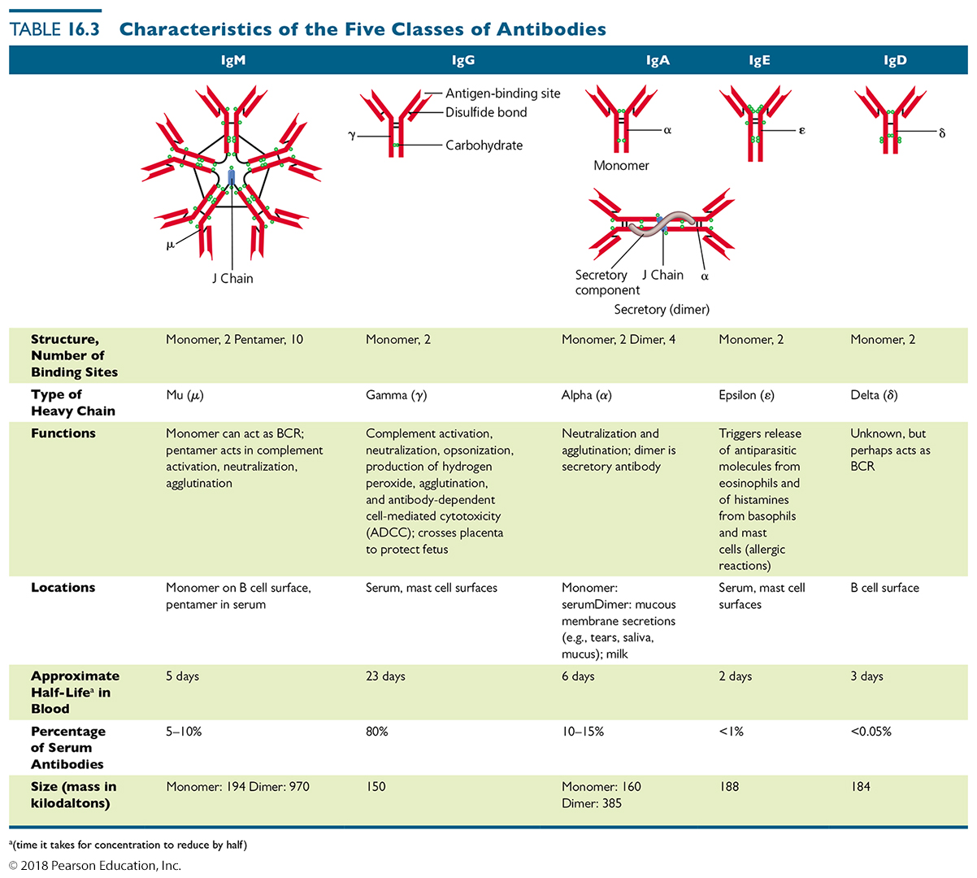
Table 16.3 Characteristics of the Five Classes of Antibodies
Notes:
28

Slide 29
Elements of Adaptive Immunity
Immune Response Cytokines
  Soluble regulatory proteins that act as intercellular signals – coordinate immune system function during an infection and clearing of the infection and tissue repair afterward
  Cytokines secreted by various leukocytes
    They allow managers to control cells without having to touch them – “manager’s e-mails”
  Cytokine network
    Complex web of signals among cells of the immune system
      “many e-mails”, effector cells decide course of action based on all cytokines present

Slide 30
Memory Cells and the Benefit of Immunological Memory
Primary immune response
  Very few cells initially “match” the foreign antigens
  Small amounts of antibodies produced initially
  May take days to produce enough memory cells, plasma cells, and antibodies to eliminate the antigen from the body
  Tends to be of low affinity, primarily IgM
Secondary (and subsequent) immune response
  Far more memory cells already “matched” to re-exposed foreign antigens
  Antibodies produced much faster
  Tends to be high affinity antibody response
  Tends to be mostly IgG

Slide 31
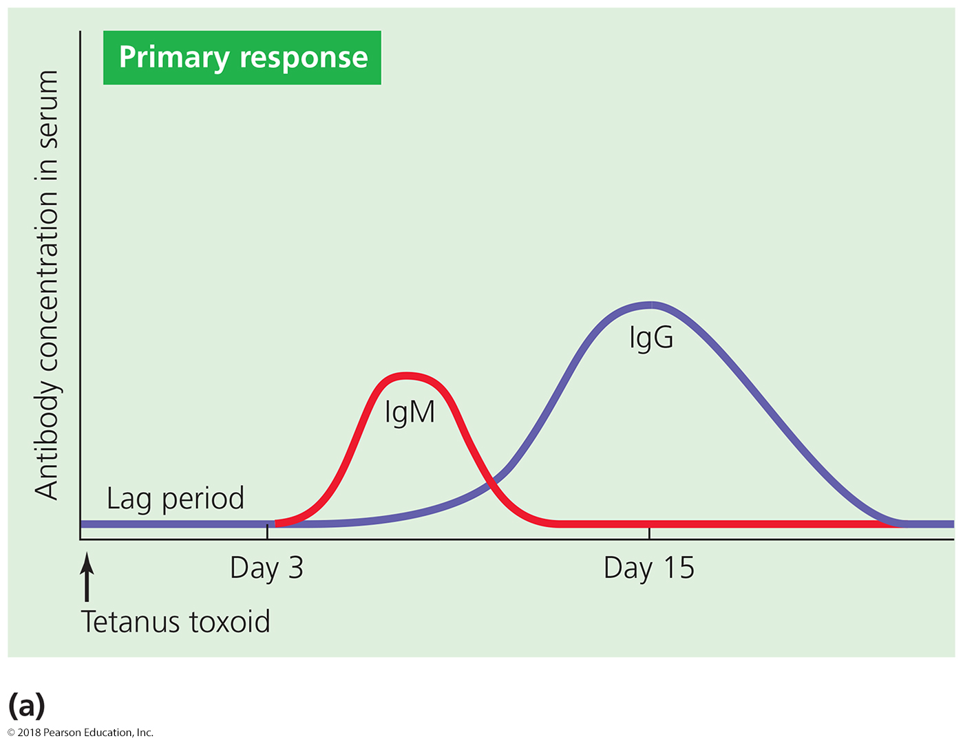
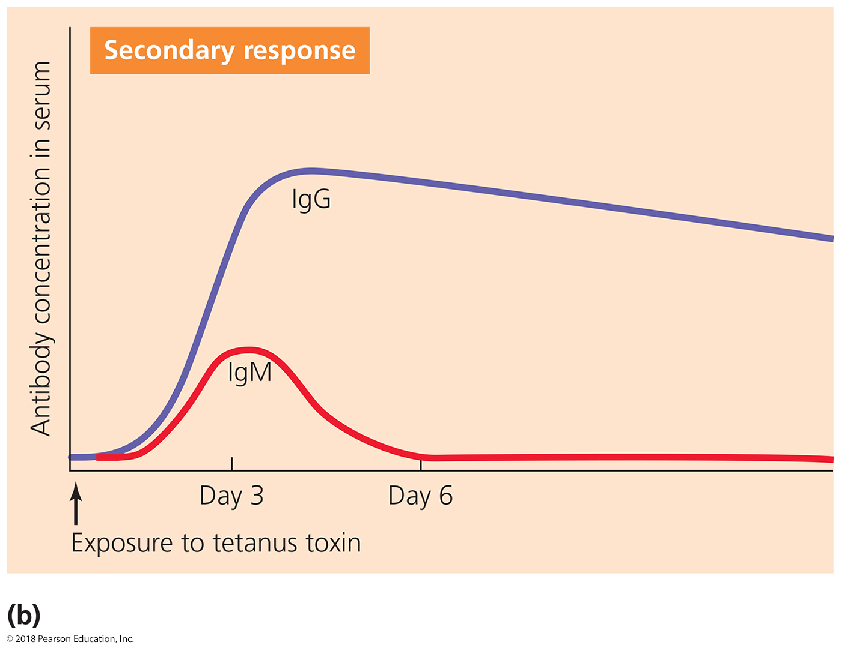
Figure 16.19 The production of primary and secondary antibody immune responses.
Notes:
31

Slide 32
Types of Acquired Immunity
Specific immunity acquired during an
individual’s life
Two types
  Naturally acquired
    Response against antigens encountered in daily life
    Obtained through NATURAL sources
      natural exposure to pathogen, placenta, mother’s milk
  Artificially acquired
    Response to antigens introduced via a vaccine
Distinguished as either active or passive
  Active – the body generates its own response
  Passive – the protection comes from the outside

Slide 33
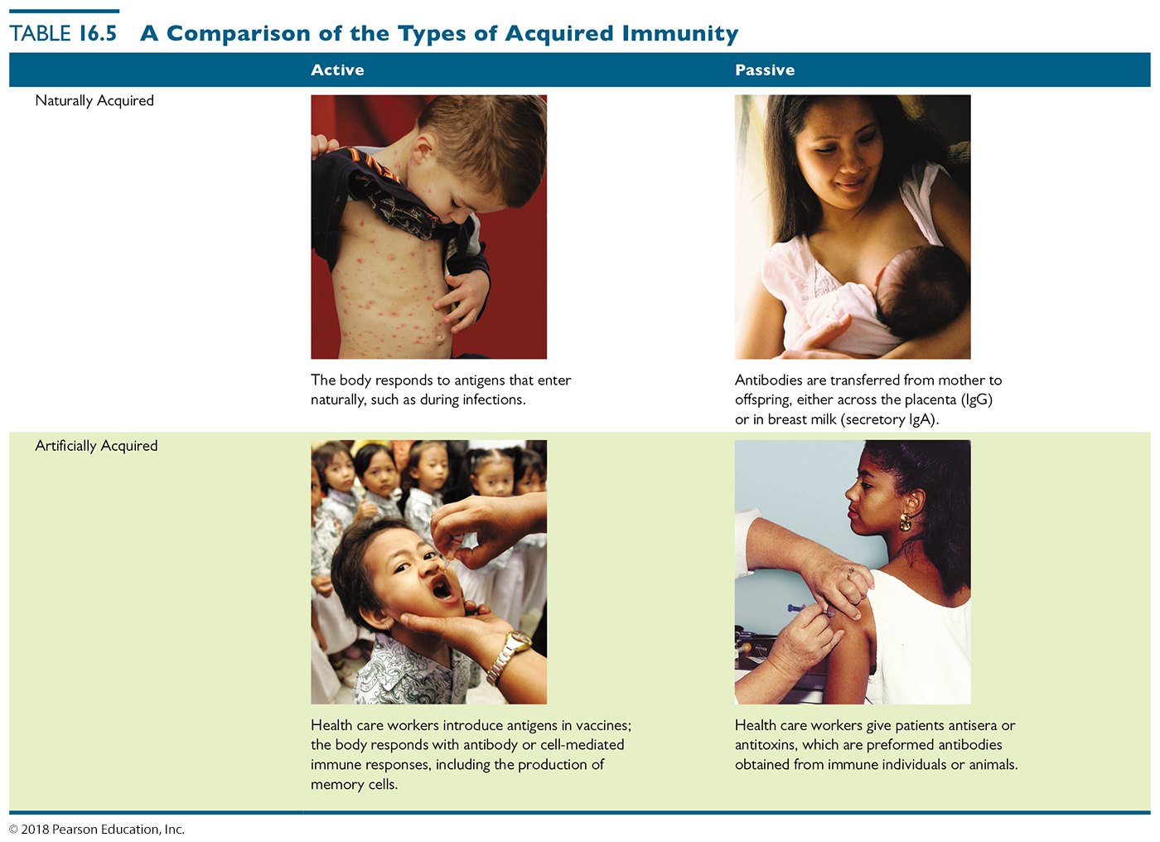
Table 16.5 A Comparison of the Types of Acquired Immunity
Notes:
33

