Slide 1
Microbiology
Chapter 15
Innate Immunity

Slide 2



Innate Immunity vs. Adaptive Immunity
Let’s find Waldo
  1. Do we know who Waldo is?
    He is a person.
    He wears …….
  2. Can we identify him once we see him?
    First, we look for patterns (see #1), then we look for specifics!
  3. Can we get better at finding him with each puzzle?

Slide 3
Innate Immunity
    Nonspecific
      only detects chemical patterns
      often polymers (DNA, peptidoglycan, β-glucan) lipopolysaccharide
    Quick
      rapid detection
      rapid response after detection (seconds to minutes)
      Essential for rapid removal of pathogens during disease
 | Innate immunity | Adaptive Immunity
specificity | Chemical patterns (seen only in pathogens) | amino acid or sugar sequences in polymers
speed | Rapid (sec-min) | Delayed (hrs – days)
memory | none | Successive refinement
presence | all life forms (some more than others) | vertebrates only

Slide 4
The Body’s Three Lines of Defense – SUMMARY SLIDE
First line – external structures and “dumb” functions
  Skin, mucous membranes, eyes, microbiome, fluids of other organ systems
  Always on, low-level protection – 99.9% protection
Second line – cells of innate immune system
  Macrophages, granulocytes, innate lymphoid cells
  On with pathogen contact; low-level protection
  Rapid, but unrefined and no memory of history
Third line – cells of the adaptive immune system
  Dendritic cells, other lymphoid cells, other granulocytes
  On with specific sequence detection; high-level protection
  Slow, but rapidly improves with repeated contact

Slide 5
The Body’s First Line of Defense – SUMMARY SLIDE
Structures, chemicals, and processes that work to prevent pathogens from entering the body
  Skin – physical and biochemical defenses
  Mucous membranes – thick mobile fluid
    Biochemicals - lysozyme, antimicrobial peptides, acids, salt
    Respiratory – ciliary elevator
    Intestinal – peristalsis, high volume excretion
    Reproductive system (women) – probiotic acidity
  Eyes – tear fluid
  Microbiome – microbial antagonism
  Organ-specific fluids
    Stomach – high acidity, digestive enzymes
    Urinary – acidic, high volume excretion

Slide 6
Skin - The Body’s First Line of Defense
Physical defenses
  Skin composed of two major layers
    Epidermis – epithelial tissue
      Multiple layers of tightly packed dead and living cells
        Few pathogens can penetrate these layers
        New dead cells constantly produced from living cells, pushing older cells further away
        Shedding of dead skin cells removes microorganisms embedded in skin
      Epidermal dendritic cells and macrophages phagocytize invading pathogens
    Dermis – loose connective tissue
      Collagen and elastin fibers help seal epidermal abrasions that could introduce microorganisms
      Also contains dendritic cells and macrophages

Slide 7
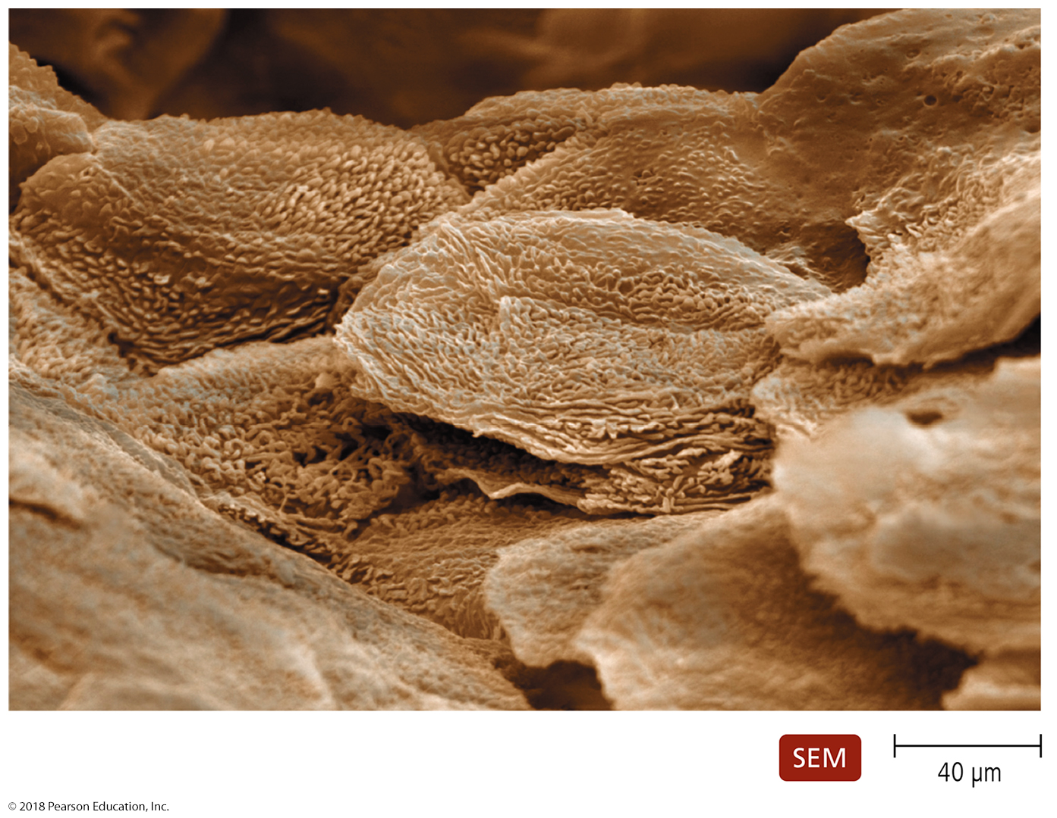
Figure 15.1 A scanning electron micrograph of the surface of human skin.
Notes:
7

Slide 8
Skin - The Body’s First Line of Defense
(Bio)chemical defenses
  Skin has chemicals that defend against pathogens
  Several of these are also seen in mucus fluid
    Perspiration secreted by sweat glands
      Salt inhibits growth of pathogens
      Antimicrobial peptides act against microorganisms
      Lysozyme destroys cell wall of bacteria
      IgA binds known pathogens before they infect
    Sebum secreted by sebaceous (oil) glands
      Helps keep skin pliable and less likely to break
      or tear (~ conditioner for hair or skin/hand lotion)
      Lowers skin pH to a level inhibitory to many pathogenic bacteria (pH of 5-6)

Slide 9
Mucous Membranes - The Body’s First Line of Defense
Physical defenses
  Mucous membranes line all body cavities open to environment
  Three distinct layers
    Thick fluid layer (mucus) lies on top of epithelium
      Goblet cells produce mucus and biochemicals that defend against pathogens
        Lysozyme, IgA, antimicrobial peptides – same as skin
        Mucins thicken the mucus and slow pathogen motility
        no sebum and no salt
    THIN epithelium
      Tightly packed epithelial cells prevent entry of many pathogens
        Single layer (columnar) or few layers (cuboidal, pseudostratified)
      Continual shedding of cells carries away attached microorganisms
      Ciliated cells whisk mucus and unattached microorganisms along
    connective tissue layer that supports the epithelium
      Dendritic cells and macrophages in here phagocytize pathogens

Slide 10
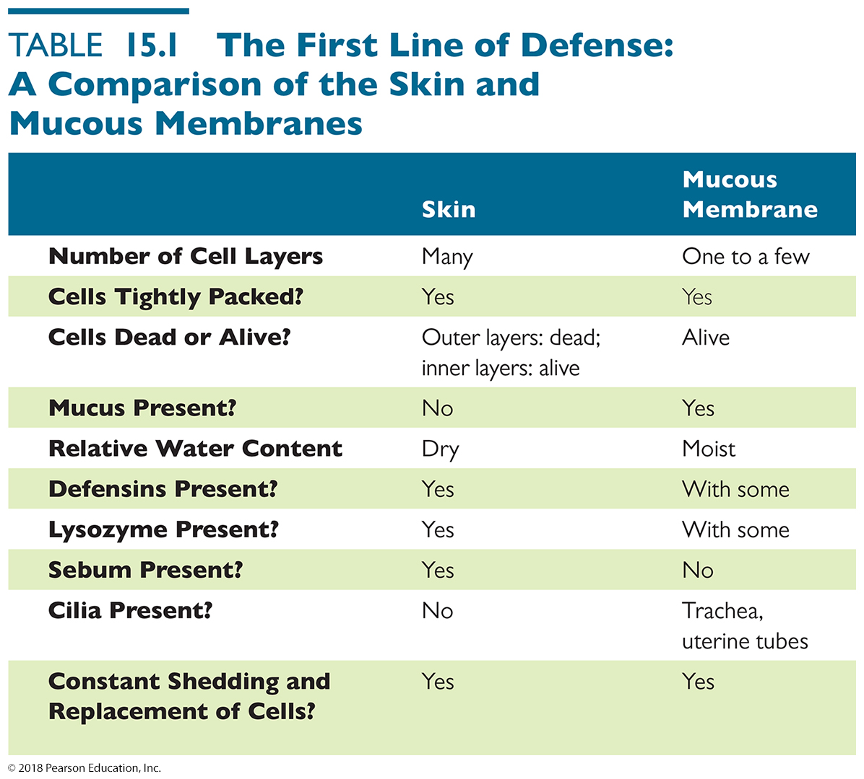
Table 15.1 The First Line of Defense: A Comparison of the Skin and Mucous Membranes
Notes:
10

Slide 11
The Eyes - The Body’s First Line of Defense
The Lacrimal Apparatus participates strongly in Innate Immunity
  Responsible for pathogen removal from the eyes and delivery of pathogens to immune system
    The lacrimal apparatus produces and drains ocular secretions (tears)
    tears resembles fluid secreted by the skin
      Lysozyme, salt, antimicrobial peptides, and sebum
      They synergize to inhibit bacterial growth
    Constitutive tear production helps keep eyes moist and allows eyelids to move with minimal friction
      Blinking spreads tears and washes surface of the eye
    Acute tear production used to flush out acute invaders (dust, spit, gnats, etc.)

Slide 12
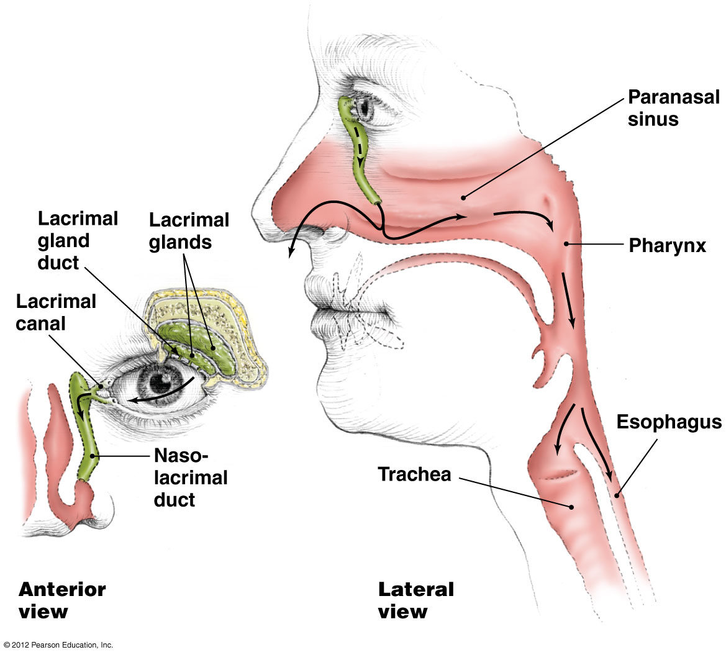
Figure 15.3 The lacrimal apparatus-overview
Why do you sniffle when you cry?)

Slide 13
Microbial antagonism - The Body’s First Line of Defense
Microbial antagonism
  Resident microbiota compete with one another as well as transient microbes and potential pathogens
  Members of the microbiome make it hard for pathogens to establish themselves
    Consumption of nutrients
    Create an environment unfavorable to other microorganisms – metabolic wastes and antiobiotics
    Prevent pathogens from attaching to host cells
    Their continual “detection” by the immune system keeps the body’s second line of defense primed

Slide 14
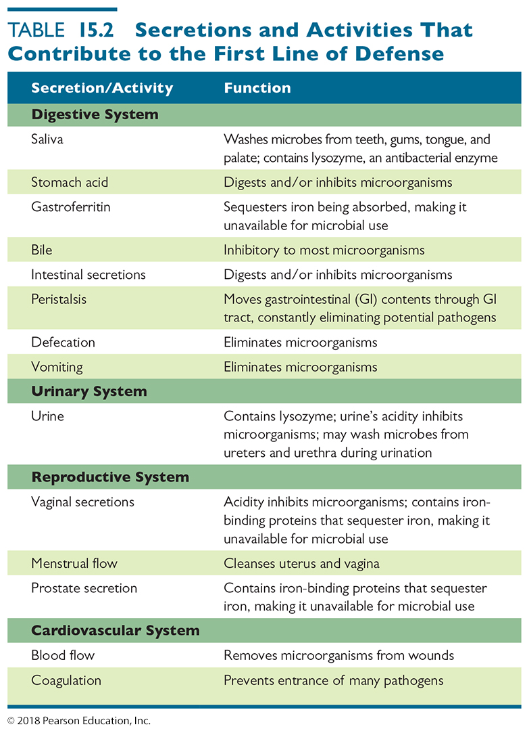
Secretions and Activities of Other Organ Systems That Contribute to the First Line of Defense (1 of 2)
Notes:
14

Slide 15
Secretions and Activities of Other Organ Systems That Contribute to the First Line of Defense (2 of 2)
Notes:
15

Slide 16
The Body’s Second Line of Defense – SUMMARY SLIDE
If pathogens get past the physical and chemical barriers, the 2nd line of the innate immune system comes into play
  pathogens have penetrated the skin or mucous membranes and have now entered connective tissues
Composed of cells, antimicrobial chemicals, and cellular processes
  Many of these components are contained in or originate in the blood

Slide 17
The Body’s Second Line of Defense
blood
formed elements (blood cells)
plasma
clotting factors
serum
Acellular Defensive Components of Blood
  Serum
    The fluid remaining when clotting factors are removed from plasma
    Contains iron-binding compounds (ferritin most common)
      Iron needed for metabolism
      Some microbes produce proteins that bind iron
    Complement proteins and antibodies are also found in serum

Slide 18
Blood cells - The Body’s Second Line of Defense – SUMMARY SLIDE
Defensive blood cells: Leukocytes
  Cells and cell fragments in plasma called formed elements
  Three types of formed elements
    Erythrocytes – red blood cells
      Carry oxygen and carbon dioxide in the blood
    Platelets
      Fragments of a megakaryocyte
      Involved in blood clotting
      Analogous to stuff caught in strainers that clogs the sink
        the strainer ~ clotting factors
    Leukocytes
      Involved in defending the body against invaders
      Divided into granulocytes and agranulocytes

Slide 19
Blood cells - The Body’s Second Line of Defense – SUMMARY SLIDE
Cells and cell fragments in plasma called formed elements
Three types of formed elements
  Erythrocytes – red blood cells
    Carry oxygen and carbon dioxide in the blood
  Platelets
    Fragments of a megakaryocyte
    Involved in blood clotting
    Analogous to stuff caught in strainers that clogs the sink
      the strainer ~ clotting factors
  Leukocytes – white blood cells
    Involved in defending the body against invaders
    Divided into granulocytes and agranulocytes

Slide 20
Leukocytes – SUMMARY SLIDE
Cells of the immune system (leukocytes) can be subdivided by function and capacity
leukocytes
granulocytes
“carpetbombers”
agranulocytes
basophils
monocytes
lymphocytes
eosinophils
macro-
phages
innate
lymphoid cells
neutrophils
dendritic cells
B cells
T cells
phagocytic cells
adaptive
immune system
“managers”
cytotoxic cells

Slide 21
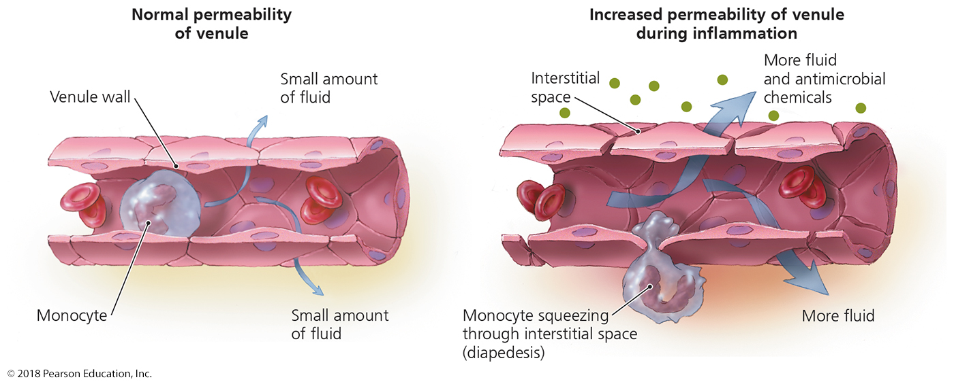
Getting to the infection
Most infections are in tissues, but most leukocytes are in the circulatory system
How to get cells from the circulatory system (the highway) to the tissues (local roads?)
They perform diapedesis
  squeeze through capillary walls (the thinnest walls of the circulatory system) to enter tissues from circulation
  “leave the highway and enter any neighborhood”

Slide 22
Granulocytes - The Body’s Second Line of Defense
Contain large granules that they release when activated
Granules contains inflammatory chemicals and toxic enzymes – “carpet bombing” and “flares”’
They tend to respond to infections outside of host cells (extracellular or exogenous infections)
Some swallow pathogens and their debris; some do not
  Phagocytic cells – engulf pathogens or their debris (especially when “tagged” by immune system) and release granule contents (called degranulation)
    Eosinophils — attack large pathogens (helminths, organ transplants)
    Neutrophils — attack any foreign pathogen; most common leukocyte
  Non-phagocytic cells – only release granule contents
    Basophils — attack blood-borne pathogens

Slide 23
Agranulocytes - The Body’s Second Line of Defense
  Cytoplasm appears uniform under a light microscope
  Two types
    Lymphocytes – common in the blood
      Manage immune response to infections
      Innate lymphoid cells recognize non-self or “compromised-self” cells
      B cells, T cells, NKT cells – to be discussed in Chapter 16
    Monocytes
      Circulate in the blood, looking for inflammatory signals
      Leave the blood (by what process?) and mature into phagocytes
      FAR more common in tissues
      They are phagocytic in tissues but do not affect healthy tissues
        Macrophages – engulf and destroy engulfed pathogens
        Dendritic cells – macrophages interfacing with adaptive immune cells

Slide 24
Effector functions - The Body’s Second Line of Defense – SUMMARY SLIDE
How do immune cells eliminate pathogens?
  Killing and removing pathogens is crucial to reducing disease and infections
    Degranulation – “carpet bombing” of large or mobile pathogens – accompanies inflammation
    Cytotoxicity – direct cell to cell killing of intracellular pathogens – often occurs without inflammation
    Phagocytosis - swallow and digest pathogens or their debris

Slide 25
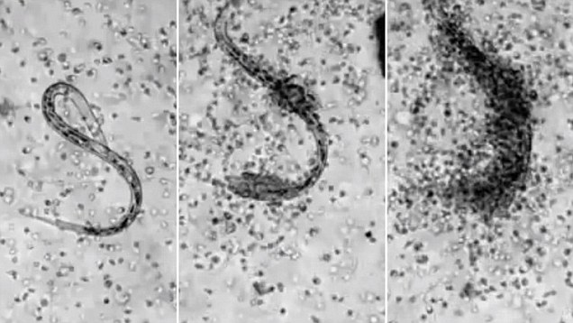
The Body’s Second Line of Defense
Nonphagocytic Killing
  Killing by eosinophils
    Adhering to pathogen surface
    Degranulation at pathogen surface focused “carpetbombing”
    https://www.youtube.com/watch?v=tRgq3v1W61w

Slide 26
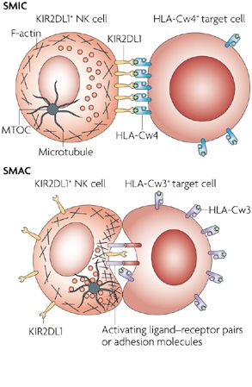
The Body’s Second Line of Defense
Nonphagocytic Killing
  Killing by natural killer lymphocytes (NK cells)
    “glues” itself onto surface of virally infected cells and tumors
    Creates a “synapase” to focus its toxins
    Secrete toxins onto surface of cell
      membrane pore-making proteins and proteases
      No release of toxic components into interstitial fluid; no inflammation
    Move onto the next cell when cell signals it is dying
https://www.youtube.com/watch?v=c3zhmTFuDTE
https://www.youtube.com/watch?v=O7kyu9rGqTY

Slide 27
The Body’s Second Line of Defense
Phagocytic Killing
  Killing by neutrophils
    Often phagocytoses microbes and destroyed them internally
    Can also destroy microbes by degranulation
    Short lived – only live hours after germination at bone marrow
    https://www.youtube.com/watch?v=Z_mXDvZQ6dU

Slide 28
Phagocytes - The Body’s Second Line of Defense
Phagocytosis – swallowing of pathogens
  Phagocytosis is divided into six stages
    Chemotaxis – detect inflammatory or infection signals; diapedesis; move toward pathogen signals
    Adhesion – attach to pathogen (who may tagged for clearance)
      using pathogen receptors (if untagged or to confirm foreign status)
      using “immune system tags” to make identification easier
    Ingestion – swallow pathogen
    Maturation – fuse “swallowed” pathogen with lysosome
    Killing – let the lysosome do its work
    Elimination – release pieces of pathogen that cannot be digested
    Antigen Presentation – digested pieces of microbe (antigens) presented to adaptive immune system

Slide 29
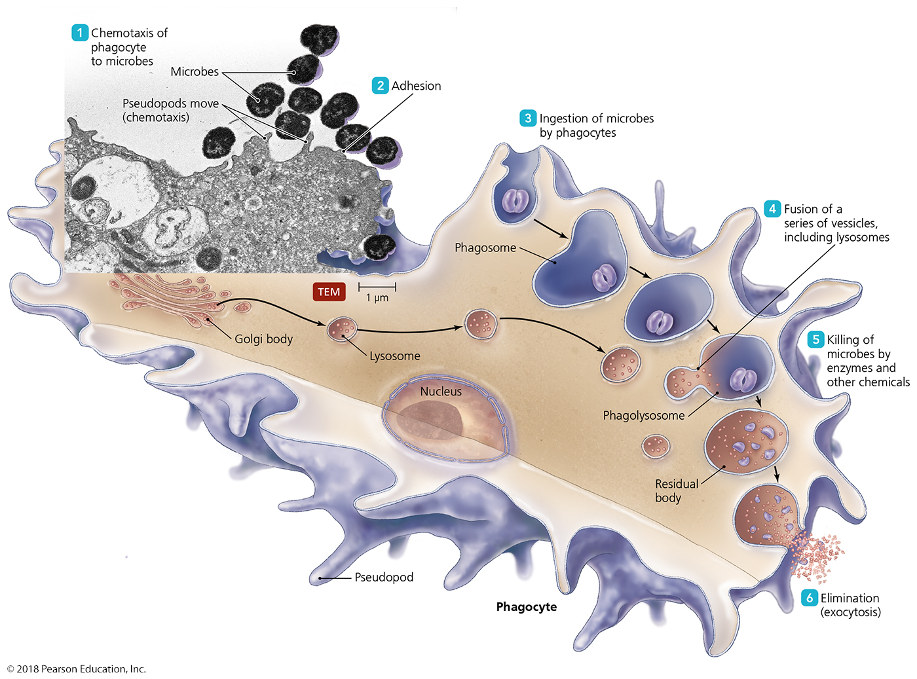
Figure 15.6 The events in phagocytosis.
Notes:
29

Slide 30
How does the immune system knows it contacted a pathogen???
  Toll-like receptors (TLRs)
    TLRs are found at:
      cell surface (touch extracellular pathogen)
      in endosomes (touch swallowed pathogen)
    Bind pathogen-associated molecular patterns (PAMPs) present in bacteria and viruses
      (capsules, cell walls, lipids, DNA)
    TLR binding of pathogen initiates immune activation
      Apoptosis (if it detects pathogens on or in cells)
      Secretion of inflammatory mediators
      Production of stimulants of immune response
Notes:
30

Slide 31
The Body’s Second Line of Defense - Interferon
Why should immune system slow down viral infections?
  400 particles can be created from 1 particle in 20 minutes
  Need to slow down viral infections to save the host and let immune system catch up
  Need to warn tissues to get ready for and to resist a viral infection

Slide 32
Interferons - The Body’s Second Line of Defense
Interferons
  Protein molecules released by host cells (especially lymphocytes) to inhibit the spread of viral infections
  Cause many symptoms associated with viral infections – nausea, muscle soreness, weakness
  Warns nearby cells to initiate virus-resistance programming
  Three types
    Type I (alpha and beta) – rapidly induced; highly active; initial viral clearance at tissues
    Type II (gamma) – shift immune response to anti-viral response
    Type III (lambda) – less active than Type I, final viral clearance from tissues??

Slide 33
The Body’s Second Line of Defense - complement
Complement
  Set of serum proteins that interact in groups to kill pathogens
  Complement activation results in lysis of the foreign or compromised cell by forming the membrane attack complex on the cell membrane of the pathogen
    Bacteria (especially gram-neg), protozoa, helminth, enveloped virus
    Pathogen-infected host cell (if labeled by the immune system)
  Pathogens or pathogen-infected cells covered in complement (especially C3) are “labeled” and are quickly recognized by the immune system
    bound and ingested by phagocytes, or killed by cytotoxic lymphocytes
  triggers inflammation and fever
  Activated by three pathways:
    Alternative – always on at low level, but healthy cells shut it off
    Lectin – when clustered pathogen polysaccharides are detected (innate) – rapid on to high level
    Classical – when clustered antibodies are detected (adaptive) – rapid on to high level

Slide 34
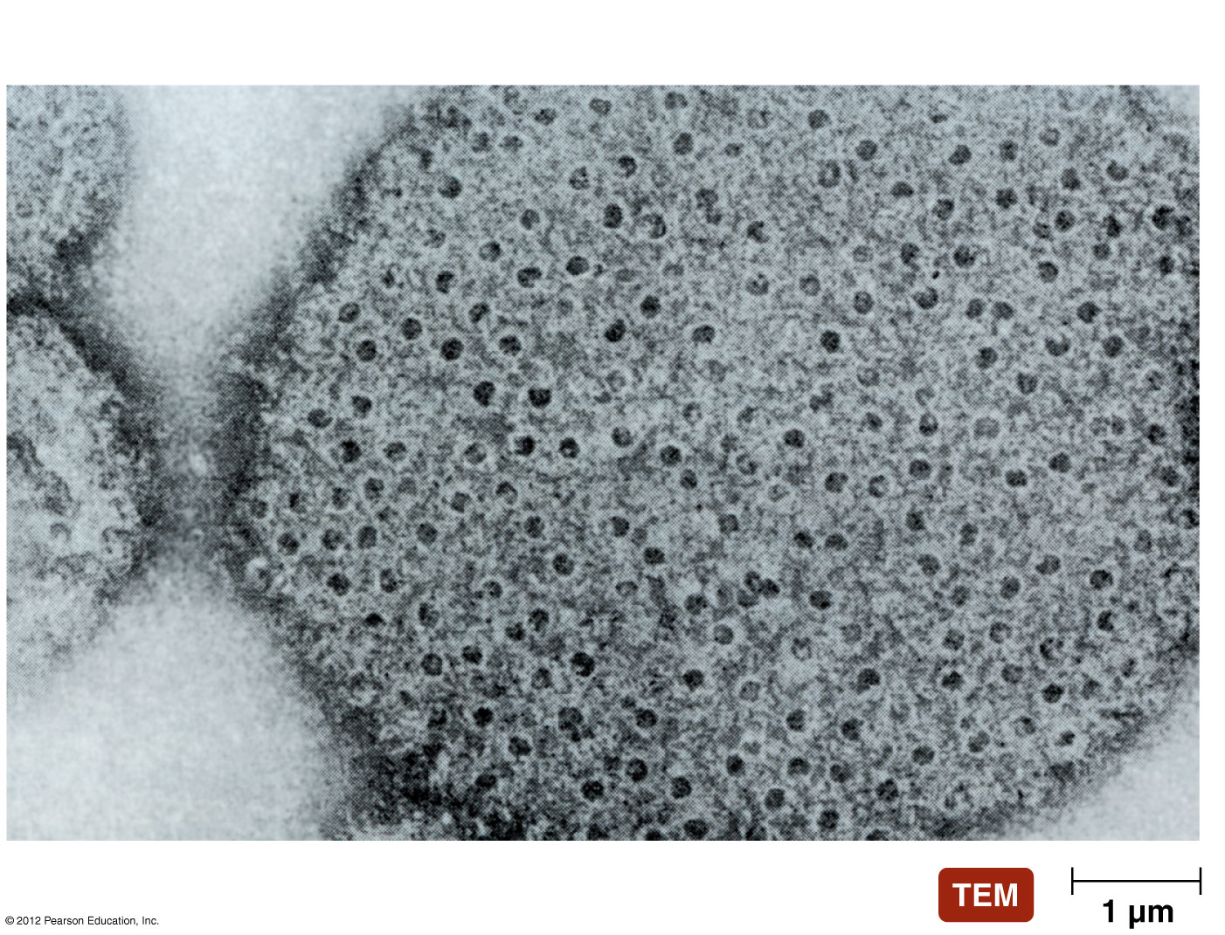
Membrane Attack Complexes
Membrane attack complex

Slide 35
Inflammation – SUMMARY SLIDE
How does our body let the immune system know there is an infection?
How does our body help the immune system arrive at and fight an infection?
Inflammation
  Four classic signs: Redness, heat, swelling, pain
  Inflammation is classified by duration
    Acute – days to a few weeks - the body successfully clears the infection and repairs any tissue damage
    Chronic – the body cannot clear the infection, no matter how long and hard it tries (weeks/months/years)
      The effects of chronic immune activation, and poor-quality tissue repair, begin to permanently damage tissues

Slide 36
The fours signs of inflammation
So what is inflammation?
  Nonspecific response to tissue damage from
  various causes (infection, burn, physical trauma)
  Characterized by redness, heat, swelling, and pain
    Redness is increased blood flow to get the immune system to the site of infection
    Heat inhibits pathogens
    Swelling (localized edema)
      makes room for immune cells at site of damage
      Restricted drainage into lymphatic system
        Better tissue clearing of infections
        More careful monitoring of interstitial fluid by downstream lymph nodes
    Pain alerts body to damage to protect from further insult

Slide 37
Acute vs. Chronic Inflammation
Acute inflammation
  Develops quickly and is short lived – days to weeks
  Is typically beneficial
  Is important in the success of the second line of defense
    Dilation and increased permeability of the blood vessels
    Migration of phagocytes
    Tissue repair
Chronic inflammation
  Long-lasting (pathogen may be present, or not!)
  Damage to tissues can cause secondary disease called sequelae (e.g., arthritis or neurologia after Lyme’s Disease, liver failure after hepatitis, paralysis after polio; immunodeficiency after HIV)

Slide 38
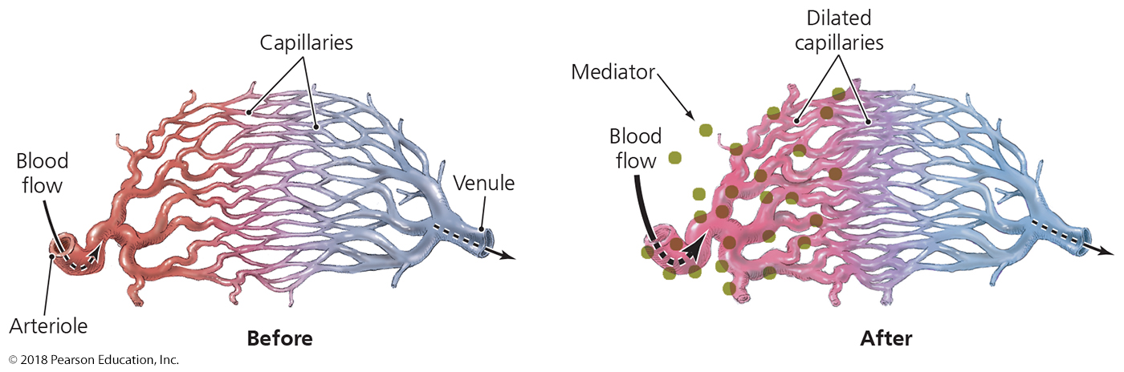
The Body’s Second Line of Defense
Inflammation - redness
  Dilation of blood vessels
    Vasodilation produces redness and localized heat associated with inflammation
    Allows greater fluid flow from blood (cells, clotting factors)

Slide 39
Figure 15.13 Increased vascular permeability during inflammation.
Inflammation - redness
  Increased permeability of blood vessels
    Vasodilation also makes vessels more “leaky”
    Cells more easily pass into inflamed tissues – diapedesis
    Fluid MUCH more easily enters tissues – edema
Notes:
39

Slide 40
The Body’s Second Line of Defense
Tissue repair (after pathogens cleared)
  Immune system lowers the “caution flag” – no more pathogens
  Restarted delivery of nutrients and oxygen to site facilitates repair
  Phagocytes clear all debris (dead tissues and pathogens)
  Some tissues cannot be repaired (biological limitations)
    Fibrinogen deposition to make tissue more resistant to subsequent attack – scar tissue
    Scar tissue often inhibits tissue function – degenerative disease – commonly seen in older organs

Slide 41
The Body’s Second Line of Defense
Fever
  Systemic temperature increase
  A body temperature over 37°C (or the body’s natural set point)
  Results when pyrogens trigger the hypothalamus to increase the body's core temperature
    Endogenous pyrogens
      IL-1 released by phagocytes that have encountered exogenous pyrogens
    Exogenous pyrogens
      Bacterial toxins
      Bacterial membrane lipids, especially lipopolysaccharide (LPS)
      Cytoplasmic contents of bacteria released by lysis
      Antibody-antigen complexes

