Slide 1
Microbiology
Chapter 14
Infection, Infectious Diseases and Epidemiology

Slide 2
Symbiosis Between Microbes and Their Hosts
Before infection, pathogens must attach to the outside surface of an organism
Lots of microbes already live on our “outside surfaces”
Skin
Mucous membranes
Eyes
Mouth
Upper respiratory tract
Gut
Reproductive tract
Do these microbes help us? Hurt us?
How do we classify this help or hurt?

Slide 3
Symbiotic Relationships Between Microbes and Their Hosts
Symbiosis means “to live together”
Recall: defined as intentional exchange of specific services
Note that symbiosis is no longer defined as beneficial to both host and guest
We have symbiotic relationships with countless microorganisms
Microbes usually benefit (or else why invade the other organism?)
The effect on the host defines which symbiotic relationship is occurring

Slide 4
Symbiotic Relationships Between Microbes and Their Hosts
Types of symbiosis
Microbe benefits:
Mutualism – benefits the host
Commensalism – does not harm or help the host
Parasitism – hurts the host
Microbe suffers:
Amensalism – hurts the microbe but does not benefit the host in a direct sense
The host is no better than if the microbe was never there
e.g., antibiotic use between microbes
e.g., immune system acting on infection

Slide 5
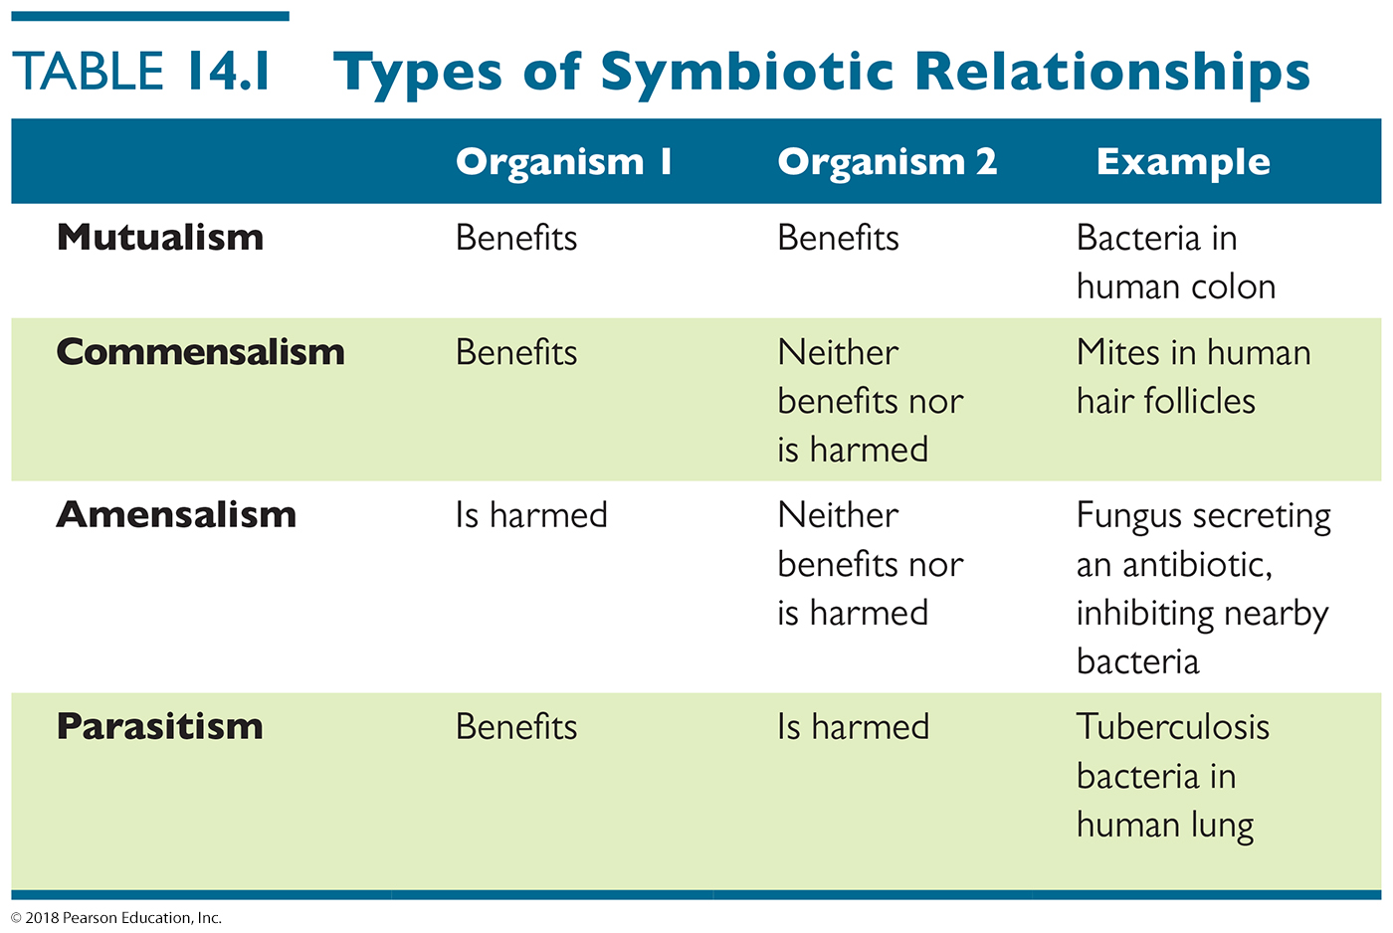
Table 14.1 Types of Symbiotic Relationships
the microbe
the host
Notes:
5

Slide 6
Symbiosis Between Microbes and Their Hosts
Microbiome of Humans
The microbiome are organisms that colonize the body’s surfaces without normally causing disease
Also termed normal microbiota, normal flora, and indigenous microbiota

Slide 7
Symbiosis Between Microbes and Their Hosts
Microbiome of Humans
Microbes that live on or in humans are classified into two descriptive groups:
Resident microbiota – there all the time, usually present on most people; usually not pathogenic
These are usually difficult to remove by handwashing, chemicals, etc.
Transient microbiota – there sometimes, present only on some people; could be pathogenic
These are usually easier to remove

Slide 8
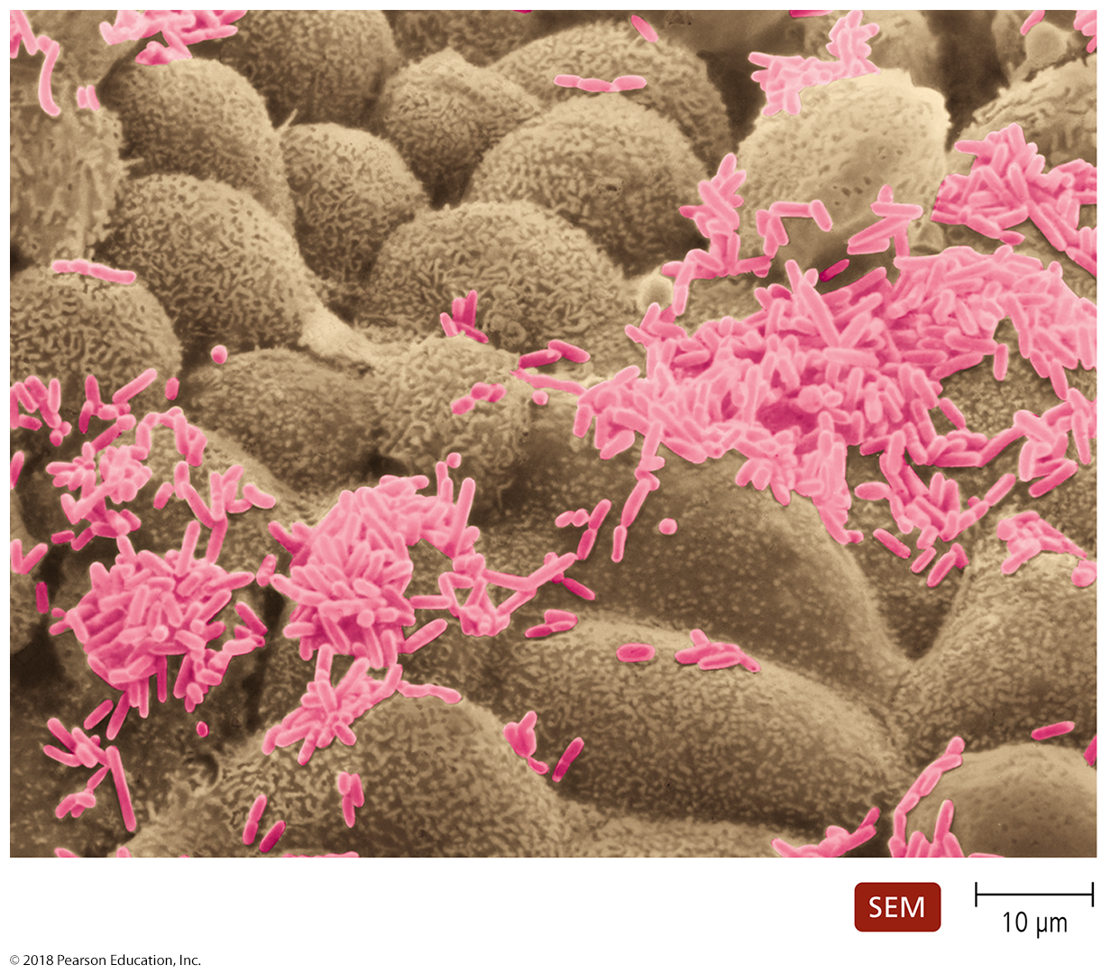
Normal Microbiota in Hosts
Resident microbiota
Are a part of the normal microbiota throughout life
Are mostly commensal

Slide 9
Table 14.2 Some Resident Microbiota (1 of 2)
Notes:
9

Slide 10
Table 14.2 Some Resident Microbiota (2 of 2)
Notes:
10

Slide 11
Transient microbiota
Remain on or in the body for short period
Found in the same regions as resident microbiota, but usually more superficially or externally
Cannot persist in the body
Competition from other microorganisms
Elimination by the body’s defense cells
Chemical or physical changes in the body
Usually a minority species unless/until resident microbiota disappear
Expansion in their numbers accompanies disease if the transient microbe is pathogenic
Many diseases occur by microbiota changes (superinfections or secondary infections)

Slide 12
Acquisition of the microbiome
How do we get our microbiome? When do the microbes move in?
Development in womb (mostly) free of microorganisms
Amniotic sac protect fetus from mother’s external flora
Placenta protects fetus from mother’s internal flora
First exposure to microbiome usually during (natural) birthing process
Much of one’s resident microbiota established during first months of life
maternal, personal contact
sheets/clothes
Food (mother’s, other’s milk especially)
HOPEFULLY NOT from diseased mother or unclean clothes

Slide 13
How Normal Microbiota Become Opportunistic Pathogens
Opportunistic pathogens
Normal microbiota are usually wiped out easily if they get in the body, if the host is healthy
What makes pathogens opportunistic:
Introduction of normal microbiota into unusual site in body (e.g., Escherichia coli in mouth or urinary tract)
Immune suppression (tissue transplant, hormones)
Changes in the normal microbiota
Change in soap, food, chronic antibiotic treatment
Stressful conditions (usually weakens immune system)
Can be physical or mental – chronic stress is perceived by the mind, that then controls the body
Job change, exercise surge, microbiology class

Slide 14
Reservoirs of Infectious Diseases of Humans – SUMMARY SLIDE
Where do our pathogens come from???
Most pathogens cannot survive for long outside their host (temperature, osmolarity, dry out, growth factors)
Reservoirs of infection
Sites where pathogens are commonly found and known to contact humans on a regular basis
Three types of reservoirs
Animal reservoir (flu virus, dermatophytes)
Human carriers (common cold, HIV, MRSA, lice)
Nonliving reservoir (doorknobs, rusty nails, food)
KNOW THESE

Slide 15
Animal Reservoirs
Also known as Zoonoses
Diseases that naturally spread from animal host to humans (the flu, ringworm)
We acquire zoonoses through various routes
Direct contact with animal or its waste
Eating animals (sheep fluke, trichinellosis)
Bloodsucking arthropods (malaria, sleeping sickness)
Humans are usually dead-end host to most zoonotic pathogens (we are not eaten, we can treat ourselves)
Difficult to eradicate (too many animal reservoirs)
e.g., have we been able to eradicate mosquitos??

Slide 16
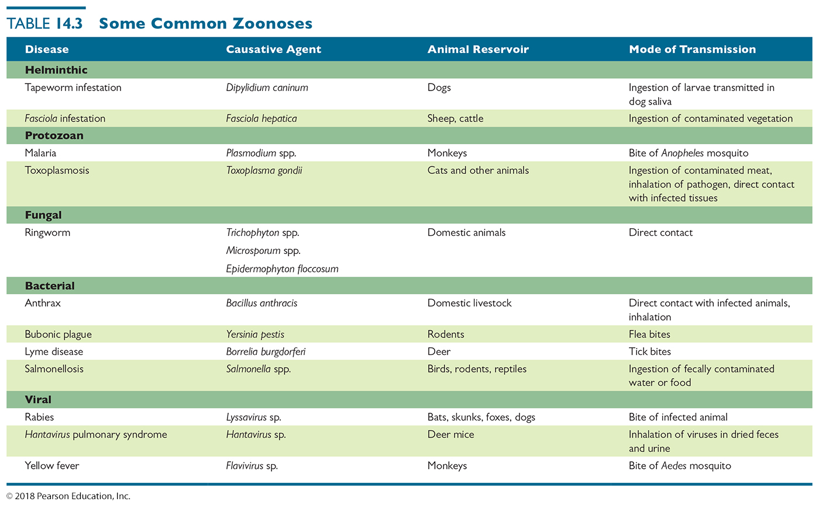
Table 14.3 Some Common Zoonoses – FOR REFERNCE ONLY!
Notes:
16

Slide 17
Human Carriers
Asymptomatic infected individuals can be infective to others (Zika, gonorrhea, HPV, Hepatitis C)
Some individuals eventually develop illness, while others never get sick (Zika, influenza, West Nile Virus)
Healthy carriers may have defensive systems that protect them
Unusual genetic variants that prevent infections
(e.g., CCR5 mutation in 1% of the population prevents HIV infection those individuals)
Sickle cell hemoglobin mutant makes blood cells unlivable for malaria parasite

Slide 18
Nonliving Reservoirs
Soil, water, and food can be reservoirs of infection
Presence of microorganisms often due to contamination by feces or urine
Often seen when food or soil cannot be “cooked” to eliminate pathogen
Consider that lettuce is frequently reported to contain pathogenic coliforms…who boils lettuce?

Slide 19
The Invasion and Establishment of Microbes in Hosts: Infection
Exposure to Microbes: Contamination and Infection
Contamination
The mere presence of microbes in or on the body
This does not mean an infection has occurred!
Infection
When organism evades body’s external defenses, multiplies, and becomes established in the body
This does NOT mean that a disease or that damage to the body is yet occurring.

Slide 20
Portals of Entry – SUMMARY SLIDE
Defined as sites through which pathogens enter the body
Three major pathways
Skin
Mucous membranes
Placenta
Compromised skin, mucous membrane or placenta can GREATLY predispose one to infections (this is how blood-borne infections and venereal diseases are often transmitted)
Fourth pathway is parenteral route
circumvents the usual portals, introducing microbes directly to internal tissues
Most often accomplished by puncturing the skin
nonliving - rusty nail, severe burns, hypodermic needles
zoonotic - animal bite
iatrogenic – surgery, bedsores
Honorable mentions: compound fractures, thorns

Slide 21
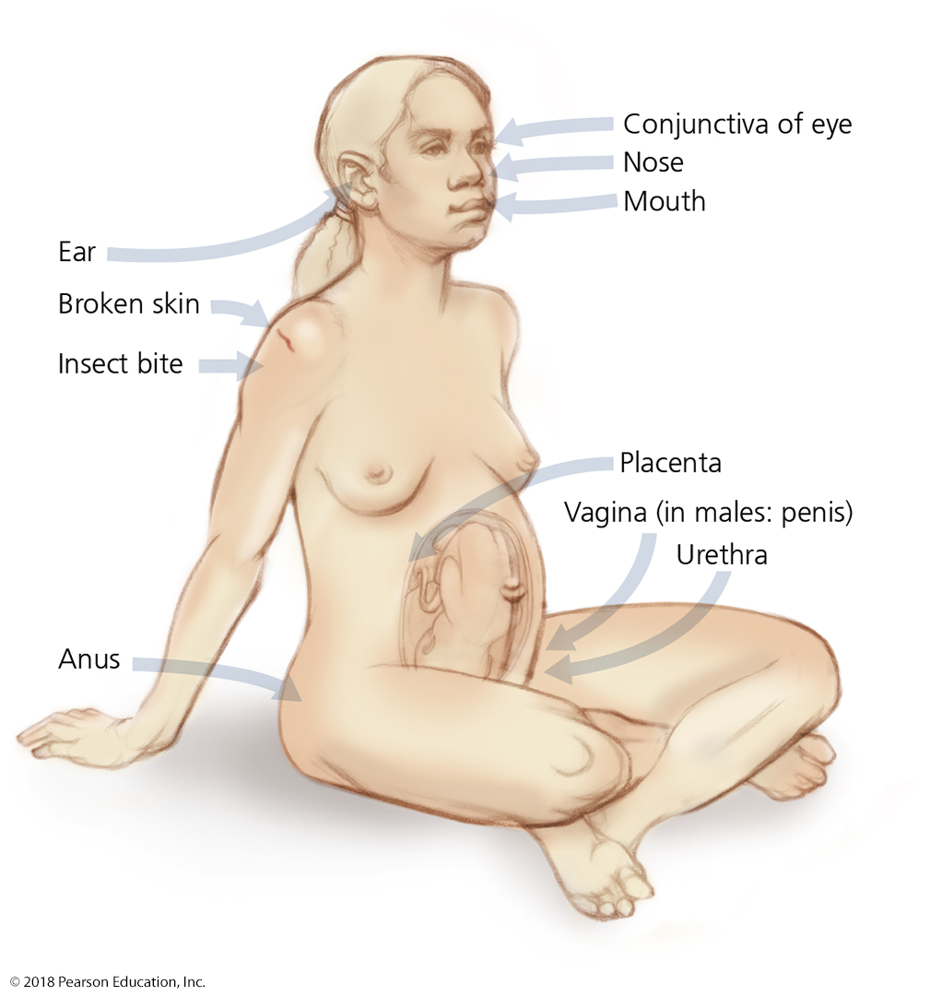
Figure 14.3 Routes of entry for invading pathogens.
Notes:
21

Slide 22
Topical portal of entry – the skin
Portals of Entry
Skin
Outer layer of dead skin cells acts as a barrier to pathogens
Some pathogens can enter through openings or cuts
Openings can be visible, or can be microabrasions,
e.g., from excessive handwashing, sexual intercourse, manual labor
Others enter by burrowing into or digesting outer layers of skin (MRSA, botflies, mangofly maggots)

Slide 23
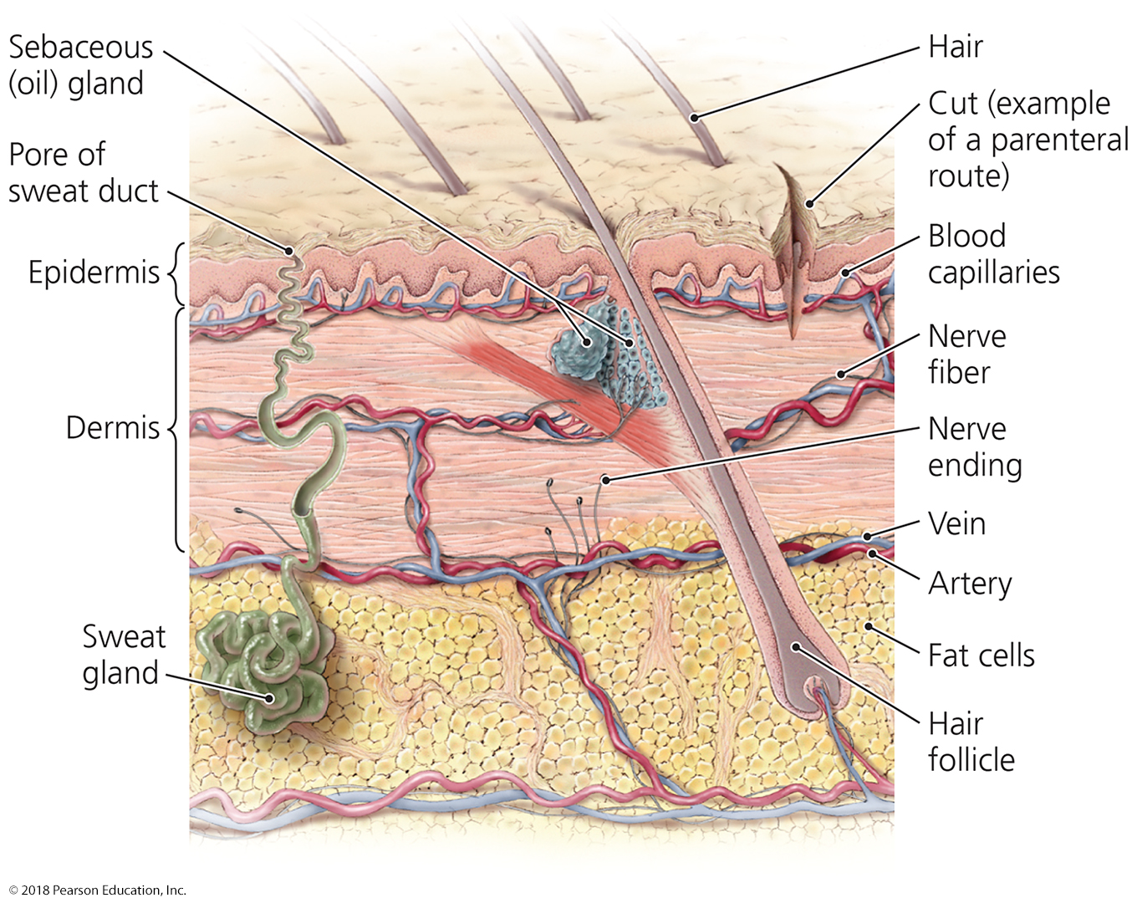
Figure 14.4 A cross section of skin.
Notes:
23

Slide 24
Mucous portal of entry – the mucous membranes
Portals of Entry
Mucous membranes
Line the body cavities that are open to the environment (eye, nasal, mouth, throat, rectum, urethra, vaginal,
Provide a moist, warm environment hospitable to pathogens
Respiratory tract is the most common site of entry
Entry is through the nose, mouth, or eyes
Gastrointestinal tract is also a common route of entry
Must survive the acidic pH of the stomach if introduced with food
Can avoid stomach acidity if introduced with water and without food
An intact liver eliminates many of these pathogens

Slide 25
Placental portal of entry – the placenta
Portals of Entry
Placenta (can include amniotic sac)
Typically forms effective barrier to pathogens
Some pathogens may cross the placenta and infect the fetus (especially TORCH pathogens)
Can cause spontaneous abortion, birth defects, premature birth, developmental disorders
Improperly developed placenta (genetics, smoking, malnutrition) can predispose fetus to placental-penetrating pathogens

Slide 26
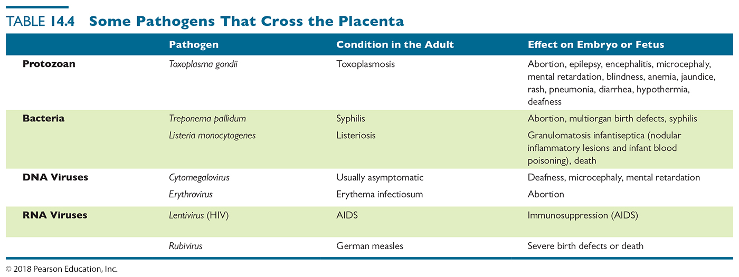
Table 14.4 Some Pathogens That Cross the Placenta
TORCH pathogens:
T – toxoplasmosis
O – other – syphilis, parvovirus, chickenpox, HIV
R – rubella (German measles)
C – cytomegalovirus
H – human herpesvirus-1 and human herpesvirus-2
Notes:
26

Slide 27
The Invasion and Establishment of Microbes in Hosts: Infection
Portals of Entry
Parenteral route
Not a true portal of entry (because of surface avoidance)
Standard portals of entry are circumvented
Pathogens deposited directly into tissues beneath the skin or mucous membranes
Needle (legitimate or illegitimate)
Surgery
Tooth (animal bite)
Thorn
Bedsores
Compound fractures
Severe burns

Slide 28
The Invasion and Establishment of Microbes in Hosts: Infection
The Role of Adhesion in Infection
Adhesion
Process by which microorganisms attach themselves to cells
Required to establish colonies successfully within the host
What types of molecules are adhesion factors
Specialized structures (e.g., fimbriae in bacteria)
Attachment molecules (e.g., spike proteins for virus)
Many virulence factors are adhesion factors
The better one attaches to cells, the better one can penetrate through cells and infect tissues

Slide 29
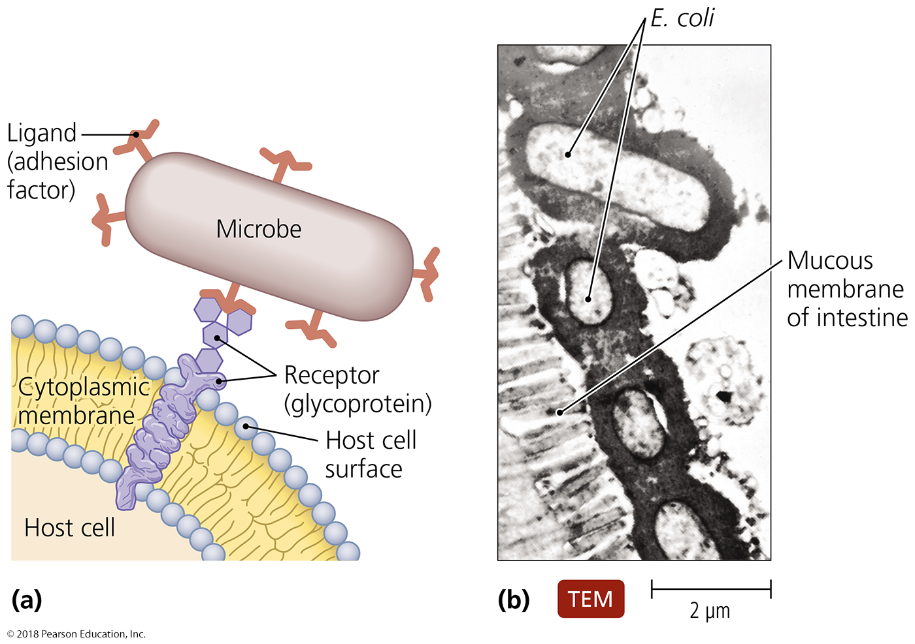
Figure 14.5 The adhesion of pathogens to host cells.
Notes:
29

Slide 30
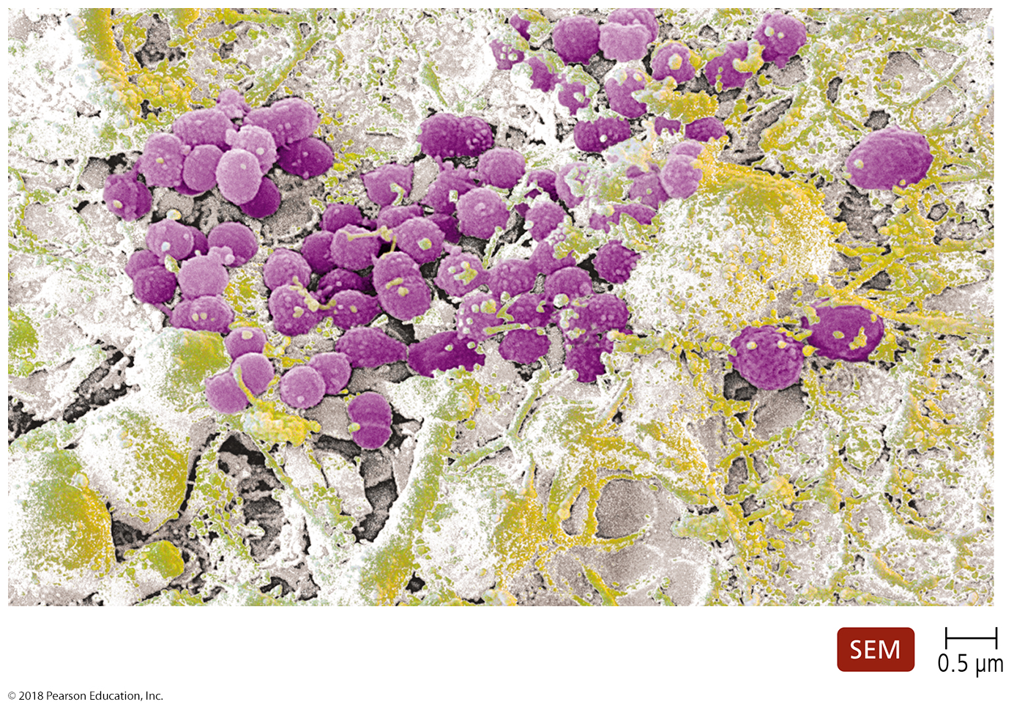
Figure 14.6 Dental plaque.
Notes:
30

Slide 31
Infection
Infection is the invasion of the host by a pathogen
Disease results if the invading pathogen alters normal body functions
Disease is also referred to as morbidity
NOTE that some studies show infection rate, while other show morbidity rate.
What is the difference?

Slide 32
Manifestations of Disease: Symptoms, Signs, and Syndromes
Symptoms
Subjective characteristics of disease felt only by the patient
Signs
Objective manifestations of disease observed or measured by others (especially medical professionals)
A person may feel feverish but may actually be cold!
Syndrome
Symptoms and signs that characterize a disease or an abnormal condition
Asymptomatic, or subclinical, infections lack symptoms but may still have signs of infection
(discharge or pus in urine without pain or blood is common for gonorrhea and chlamydia infections)
UNDERSTAND THIS DIFFERENCE!

Slide 33
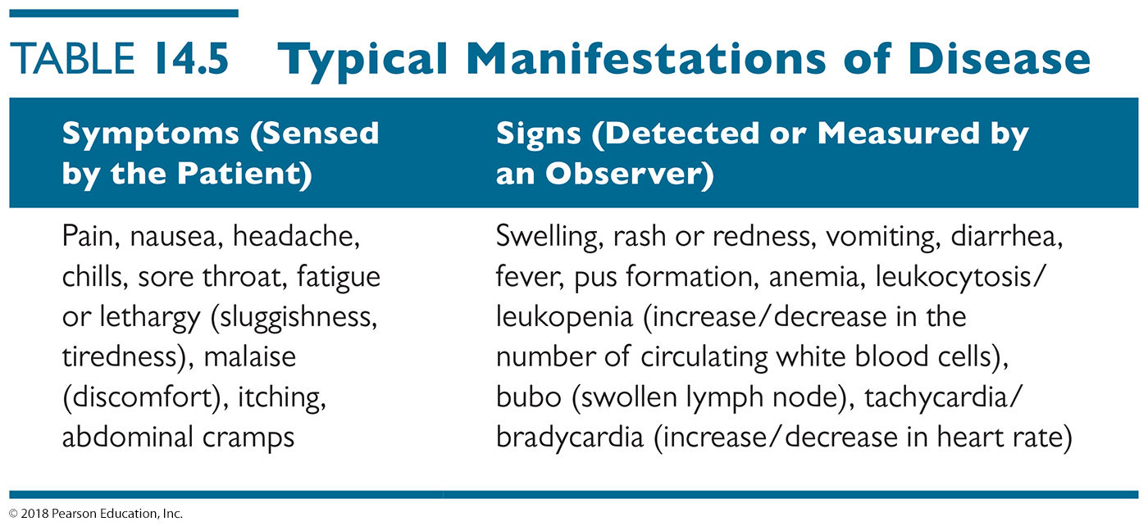
Table 14.5 Typical Manifestations of Disease
Notes:
33

Slide 34
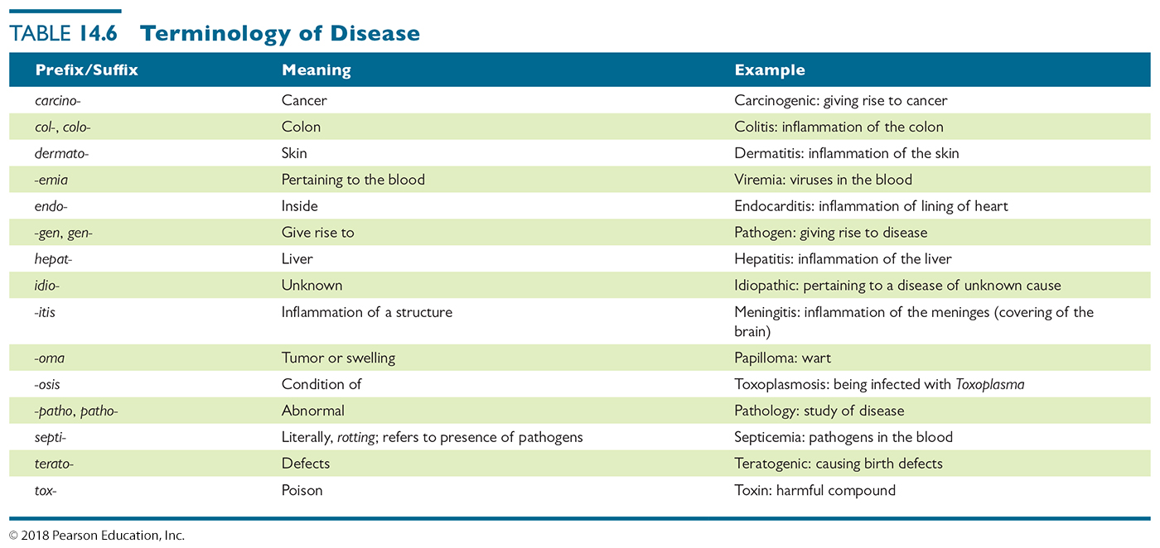
Table 14.6 Terminology of Disease - KNOW ALL OF THESE!!!
Test your knowledge - predict: What is a teratogen? Septicemia? Hepatitis? Lymphoma?
Notes:
34

Slide 35
The Nature of Infectious Disease
Causation of Disease: Etiology
Etiology – study of the cause of a disease
Diseases have various causes. For example:
Chlamydia is usually sexually transmitted
Cystic fibrosis is a recessive genetic disorder
Allergy is an immune system disorder
Germ theory of (infectious) disease
Infectious disease - caused by invaded and expanded populations of pathogenic microorganisms
This explained over 90% of known disease cases before World War I

Slide 36
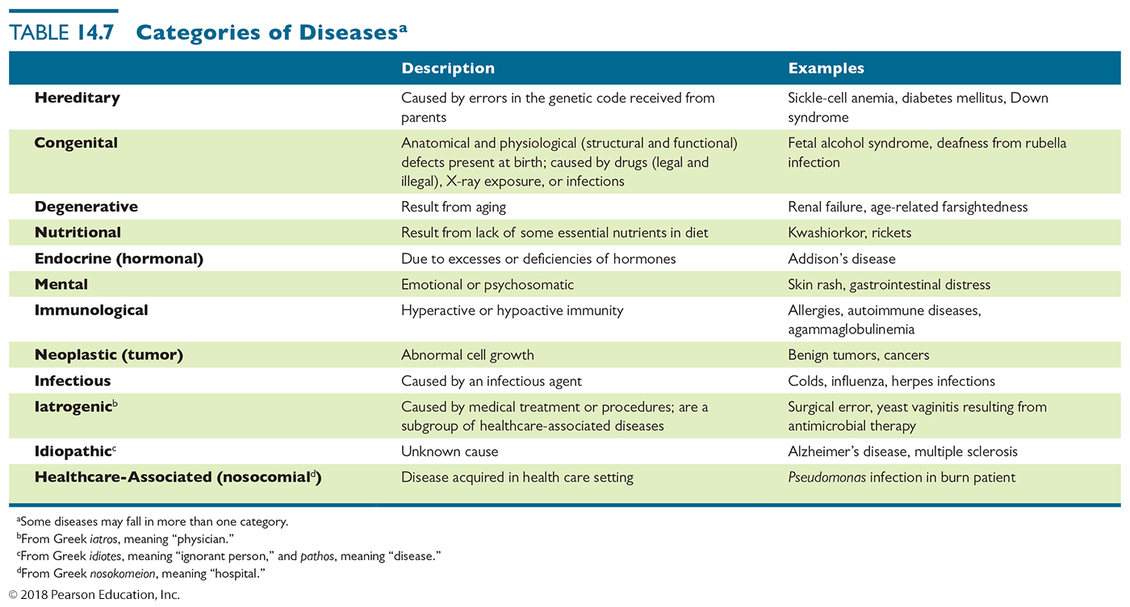
Table 14.7 Categories of Diseasesª
Notes:
36

Slide 37
The Nature of Infectious Disease – SUMMARY SLIDE
Virulence Factors of Infectious Agents
Pathogenicity
Ability of a microorganism to cause disease
Virulence
The severity of disease caused by a pathogen
Specific proteins or virulence factors make it easier to cause disease or make disease more severe
Adhesion factors – micrboes stay stuck and infect better
Biofilms – hidden from destruction by body’s defenses
Extracellular enzymes – chew up outside tissues (for food, for passage, for defense)
Toxins – destroy outside tissues to accelerate disease
Antiphagocytic factors – prevent swallowing or enzymatic destruction by immune system

Slide 38
The Nature of Infectious Disease
Virulence Factors of Infectious Agents
Extracellular enzymes
Secreted by the pathogen
Dissolve structural chemicals in the body
Usually aid in providing additional nutrition for pathogen
Important to virulence of the pathogen
Mutant strains of the same species that do not secrete the enzymes are often avirulent – unable to cause full disease state
These avirulent mutant strains are often developed or used for vaccine preparation

Slide 39
The Nature of Infectious Disease
Virulence Factors of Infectious Agents
Toxins
Chemicals that harm tissues or trigger host immune responses that cause damage
Do not directly aid the pathogen, except to clear its obstacles
Toxemia refers to the presence of toxins in the bloodstream
The toxins are carried beyond the site of infection
Two types
Exotoxins – secreted by live bacteria
Endotoxins – part of bacterial structure
Usually released when organism dies
Ex: Lipid A of LPS

Slide 40
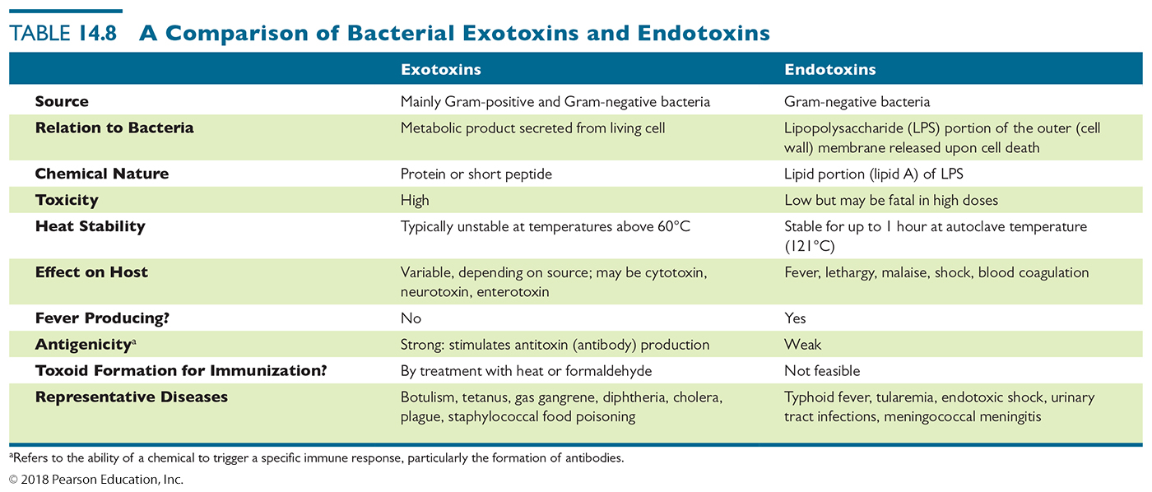
Table 14.8 A Comparison of Bacterial Exotoxins and Endotoxins – FOR REFERENCE ONLY
Notes:
40

Slide 41
Virulence Factors of Infectious Agents
Antiphagocytic factors
Prevent phagocytosis by the host’s phagocytic cells
Allow pathogens to remain in a host for longer time
Bacterial capsule
Composed of chemicals not recognized as foreign
Slippery and difficult for phagocytes to engulf
Mycobacteria infamous for this
Antiphagocytic chemicals
Prevent fusion of lysosome and phagocytic vesicles – listeria and mycobacteria do this
Leukocidins directly destroy phagocytic white blood cells

Slide 42
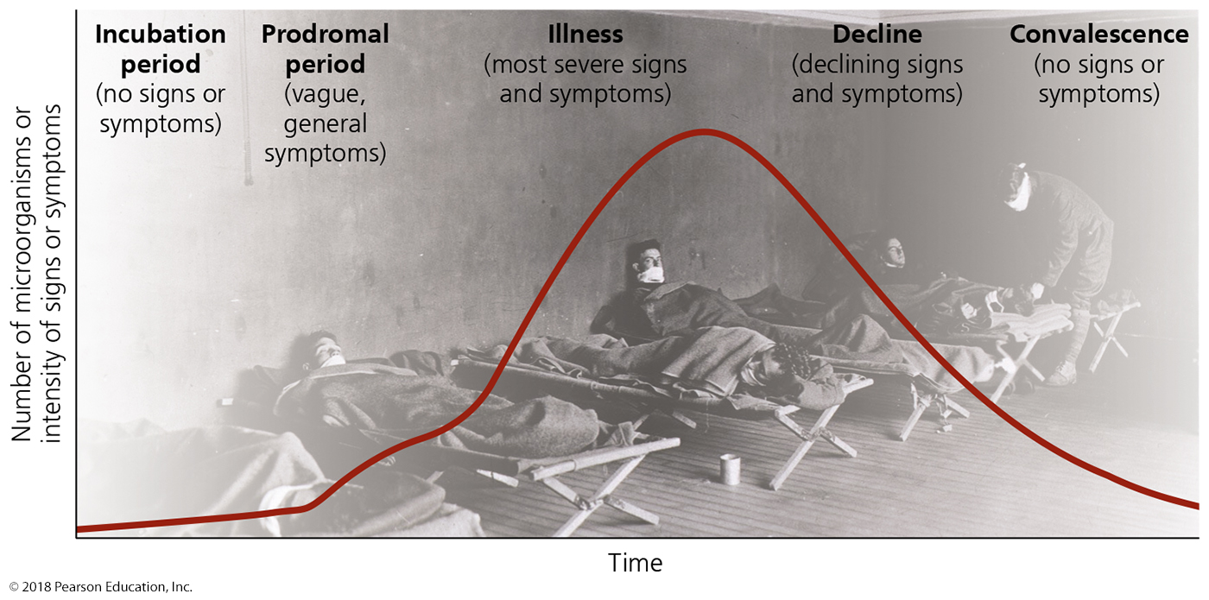
The Stages of Infectious Disease
Many infectious diseases have five stages following infection and expansion of the microbe
Incubation period - asymptomatic
Prodromal period – mild or “warning” symptoms
Illness – strongest symptoms, signs
Decline (of symptoms) – occurs ONLY if pathogen numbers reduced
Convalescence – recovery of host after infection and disease cleared

Slide 43
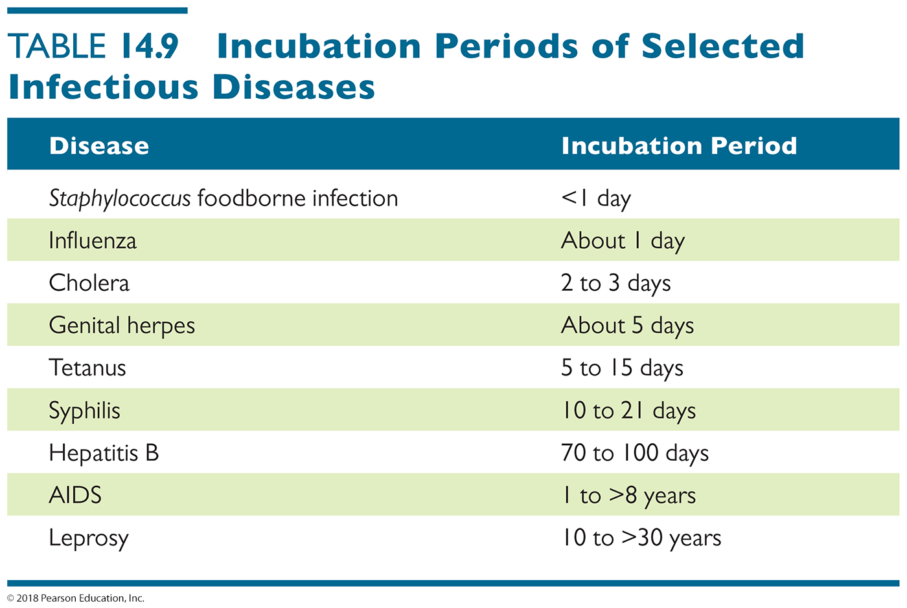
Table 14.9 Incubation Periods of Selected Infectious Diseases
Notes:
43

Slide 44
The Movement of Pathogens Out of Hosts: Portals of Exit
Pathogens leave host through portals of exit
Many portals of exit are also portals of entry
Pathogens often leave hosts in materials the body secretes or excretes
Urine
Sweat (and milk secretions)
Sneeze
Coughed blood or phlegm
Feces
Skin flakes
Saliva (dog bite, mosquito bite)
Semen, reproductive and lubricating fluids

Slide 45
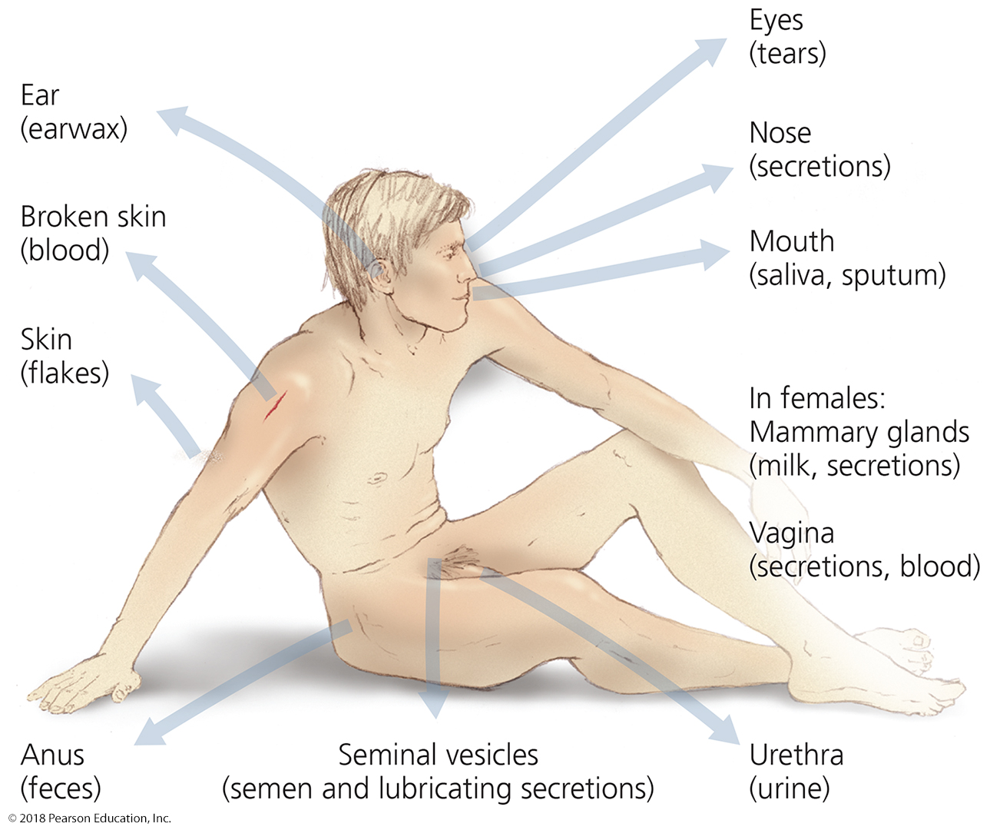
Figure 14.11 Portals of exit.
Notes:
45

Slide 46
Modes of Infectious Disease Transmission – SUMMARY SLIDE
Transmission is the migration of a pathogen from a reservoir or a portal of exit,
to another host’s portal of entry
Three methods of transmission
Contact transmission – person-to-person
Direct, indirect (through fomite), or droplet
short-distance – often by touch
Vehicle transmission – through an inanimate object
(air, water, food, bodily fluid)
long-distance transmission
Vector transmission
Biological or mechanical
KNOW THESE

Slide 47
Contact Transmission
Direct contact transmission
Usually involves body contact between hosts
Transmission within a single individual can also occur
(from skin to eyes, from throat to sinuses)
Indirect contact transmission
Pathogens are spread from host to host by fomites
Unlike droplets, fomites do not move (doorknob, toilet handle, cell phone screen), but are touched by both hosts
Droplet transmission
Spread of pathogens in droplets of mucus by exhaling, coughing, and sneezing

Slide 48
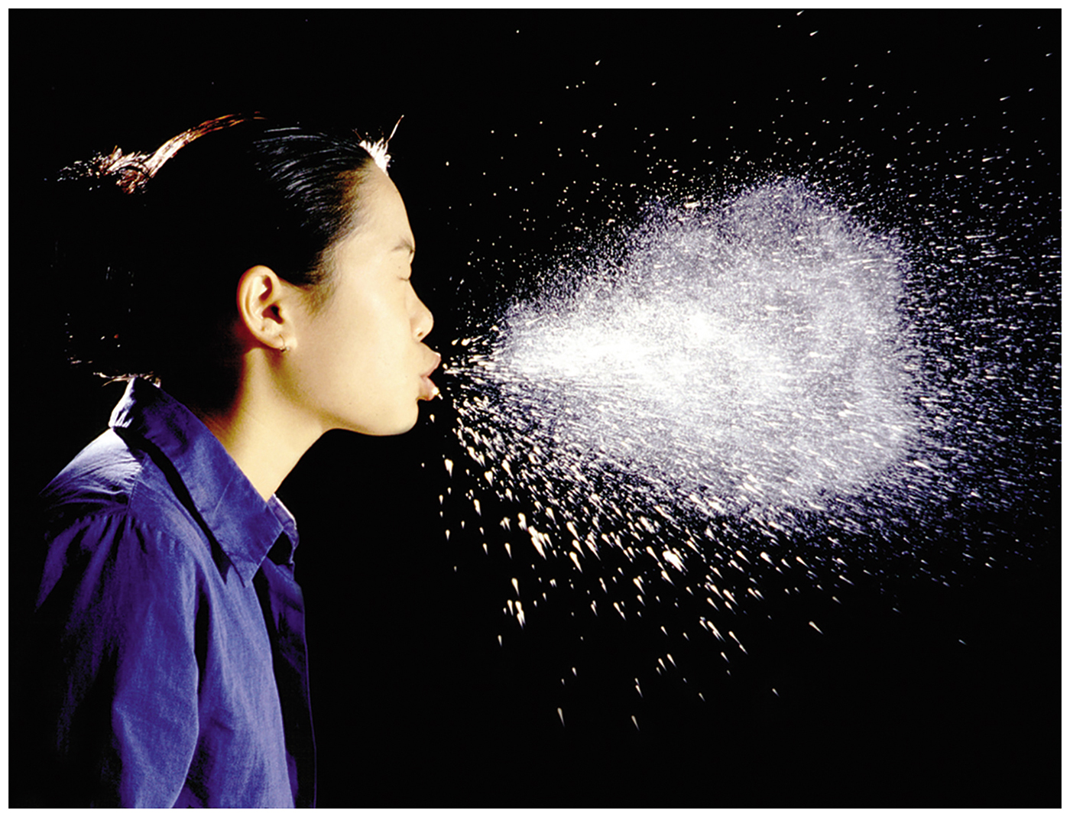
Figure 14.12 Droplet transmission.
Notes:
48

Slide 49
Vehicle Transmission #1
Airborne transmission
When pathogens travel more than 1 m via an aerosol
Aerosols can occur from various activities
Sneezing, coughing, air-conditioning systems, sweeping, misting systems
Waterborne transmission
Important in the spread of many gastrointestinal diseases
water is absorbed without changing stomach pH)
Fecal-oral infection
Why are coliforms measured in pools and oceans?
This is why you keep your dog from eating poo…
Also why manure must be matured before being used to grow plants

Slide 50
Vehicle Transmission #2
Foodborne transmission
Spread of pathogens in and on foods
Inadequately processed, cooked, or refrigerated foods
Intentionally contaminated foods (ice cream or taco shell licking, spitting into juices) encouraged by social media
Foods may become contaminated with feces
Chipotle, fast food contaminations
Bodily fluid transmission
Bodily fluids such as blood, urine, sweat, and saliva can carry pathogens
Most easily prevented by covering the conjunctiva or breaks in the skin or mucous membranes
Latex gloves, condoms, surgical mask

Slide 51
Vector Transmission
Mechanical vectors
Passively transmit pathogens present on their body to new hosts
Biological vectors
Transmit pathogens and serve as host for some stage of the pathogen’s life cycle
Biting arthropods transmit many diseases to humans
Some protozoa go between multiple animal species as one animals eats another

Slide 52
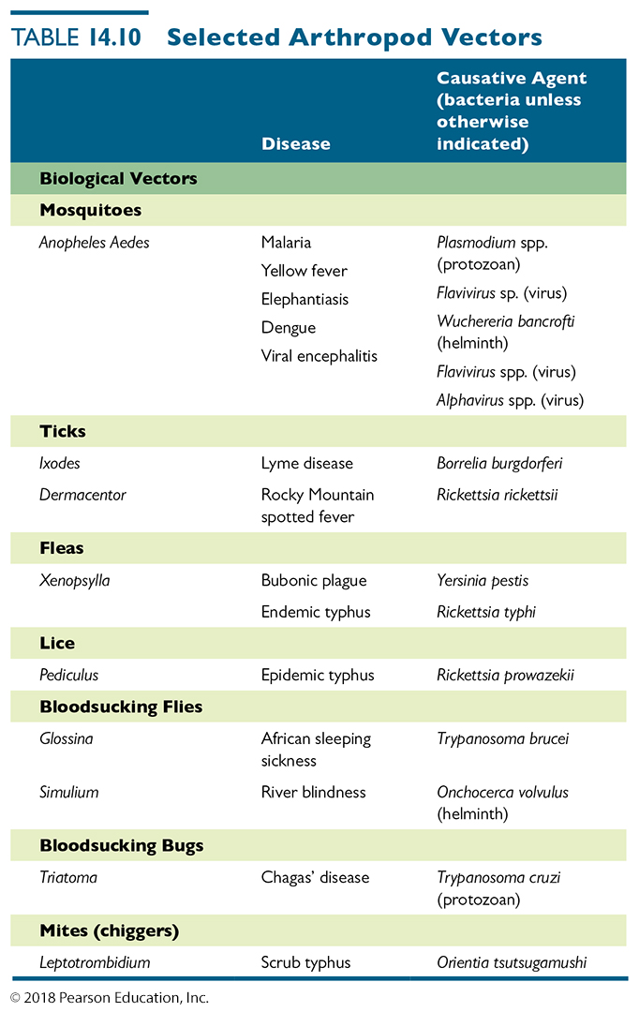
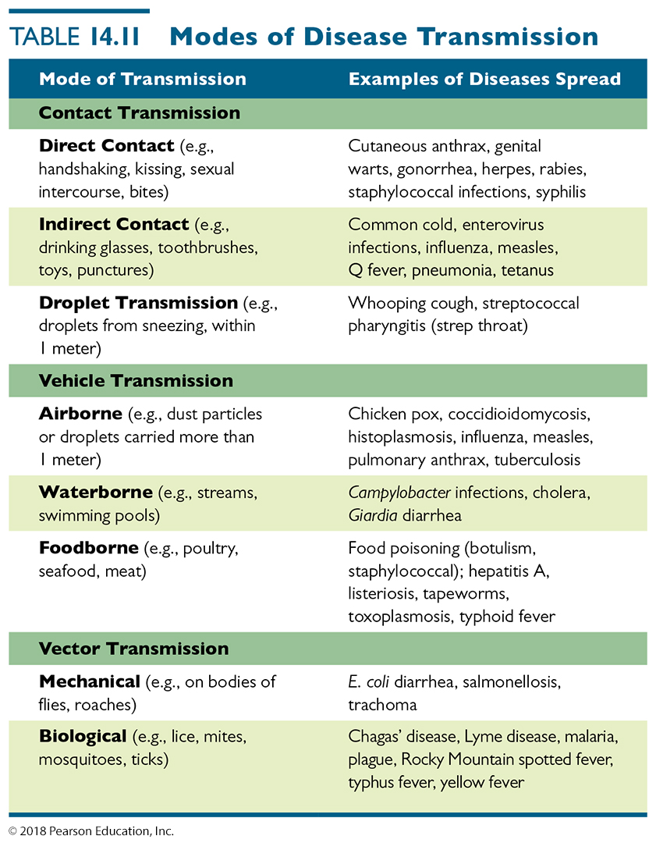
Table 14.10s and 14.11 Selected Arthropod Vectors & Modes of Disease Transmission – FOR REFERENCE ONLY
Notes:
52

Slide 53
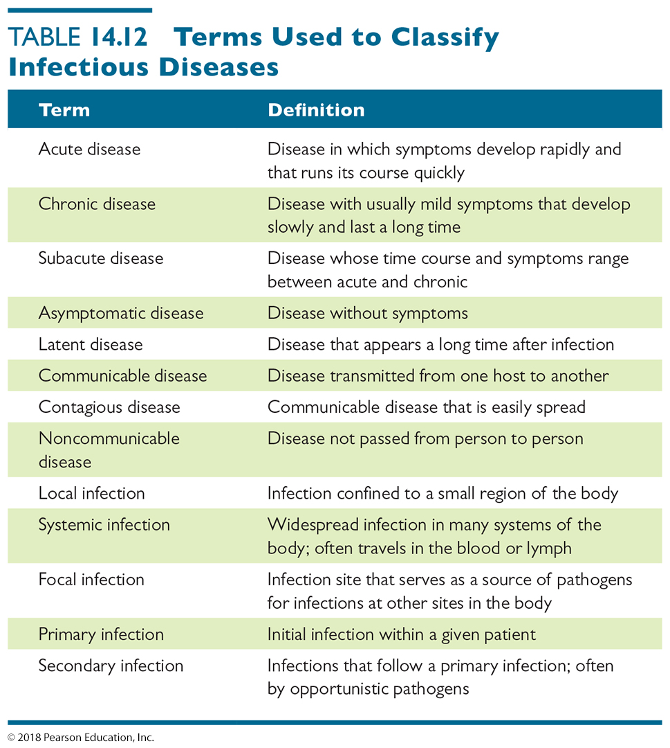
Table 14.12 Terms Used to Classify Infectious Diseases KNOW ALL THESE TERMS
Notes:
53

Slide 54
Frequency of Disease
Disease occurrence in a population is tracked using two measures
Incidence – acute (short period of time)
Number of new cases of a disease in a given area during a given period of time
Prevalence – chronic, additive (long period of time)
Number of total cases of a disease in a given area during a given period of time
Occurrence also evaluated in terms of frequency and geographic distribution
Notifiable/reportable disease – when detected in a patient, the CDC MUST BE INFORMED!

Slide 55
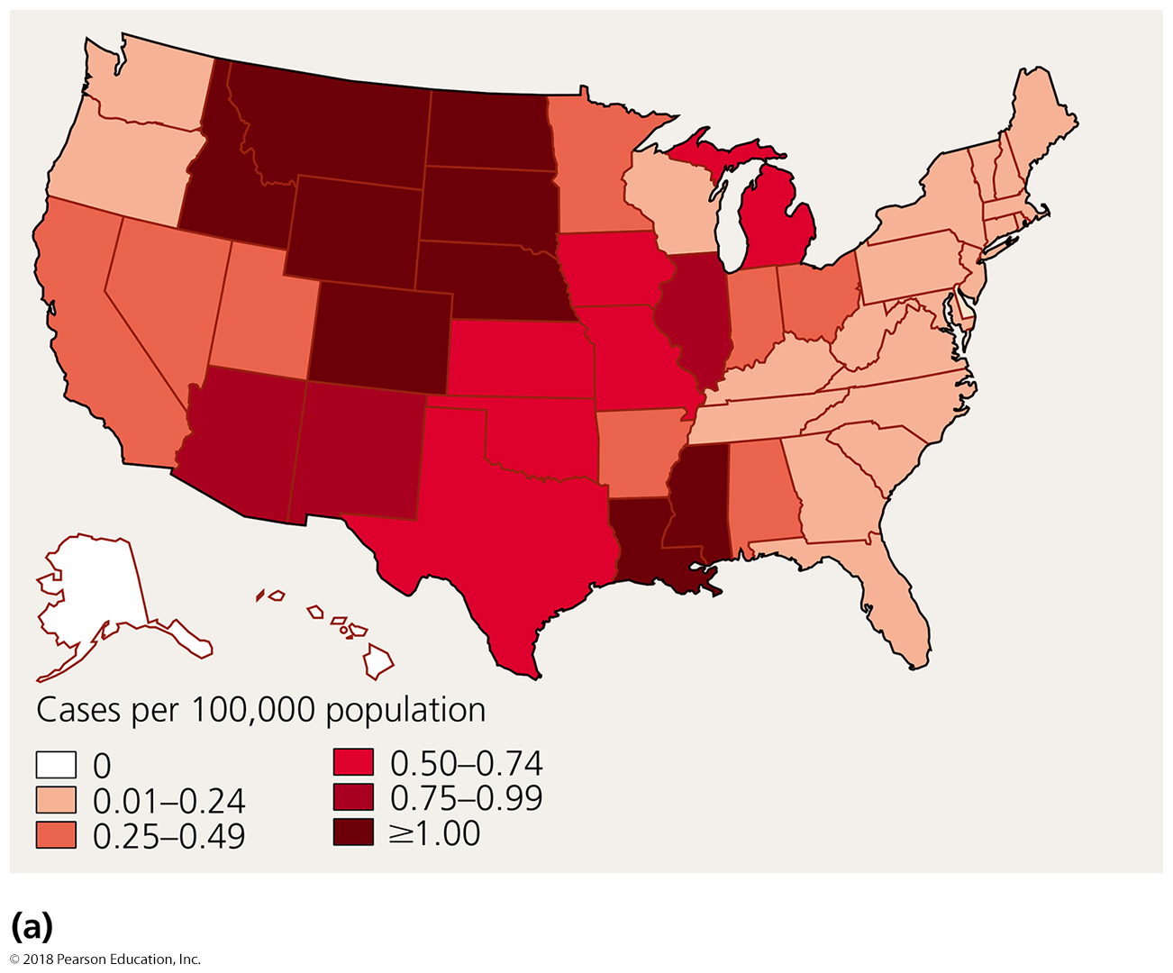
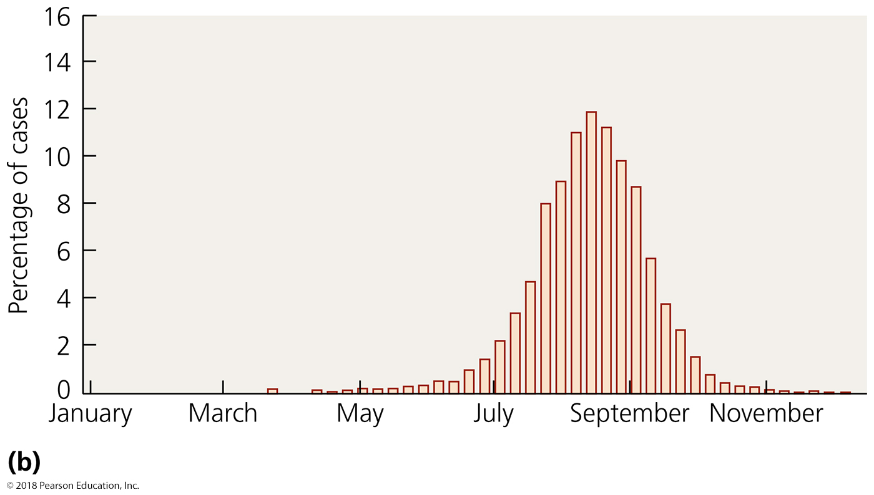
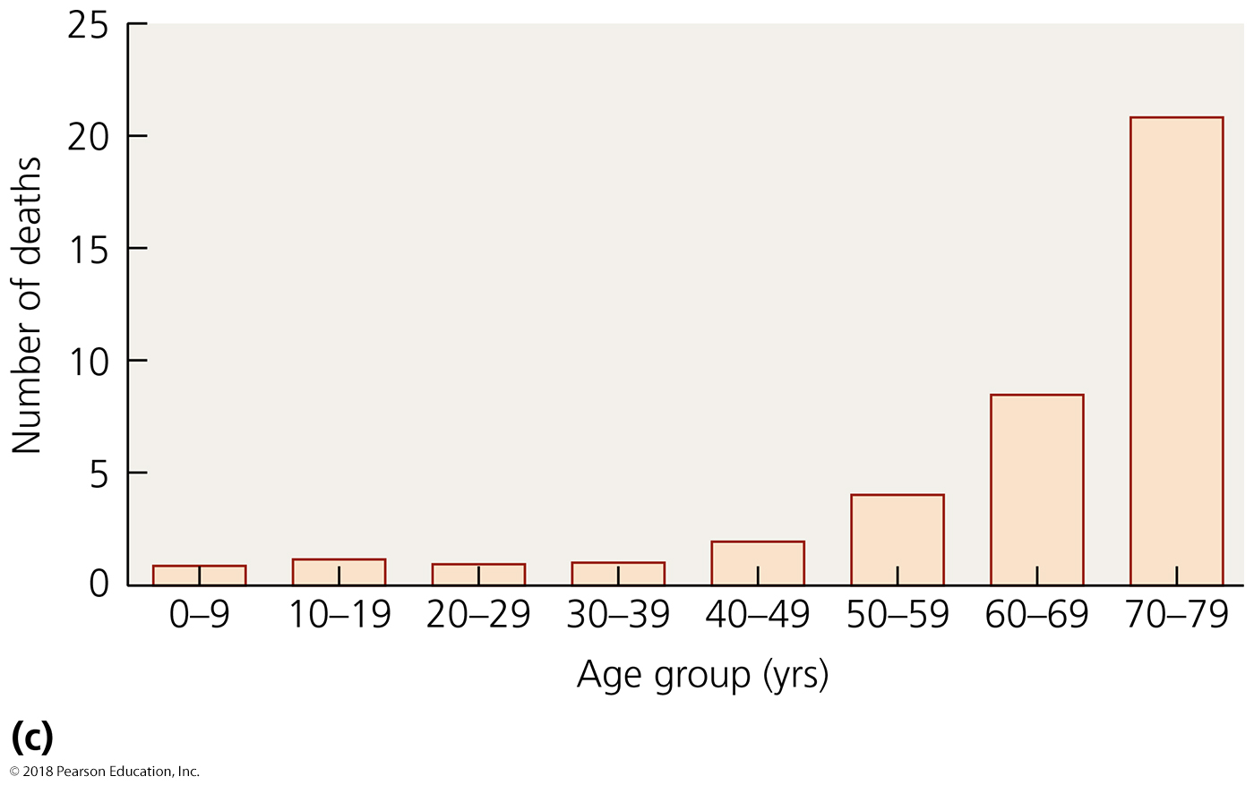
Figure 14.15 Epidemiologists report data in a variety of ways.
Notes:
55

Slide 56
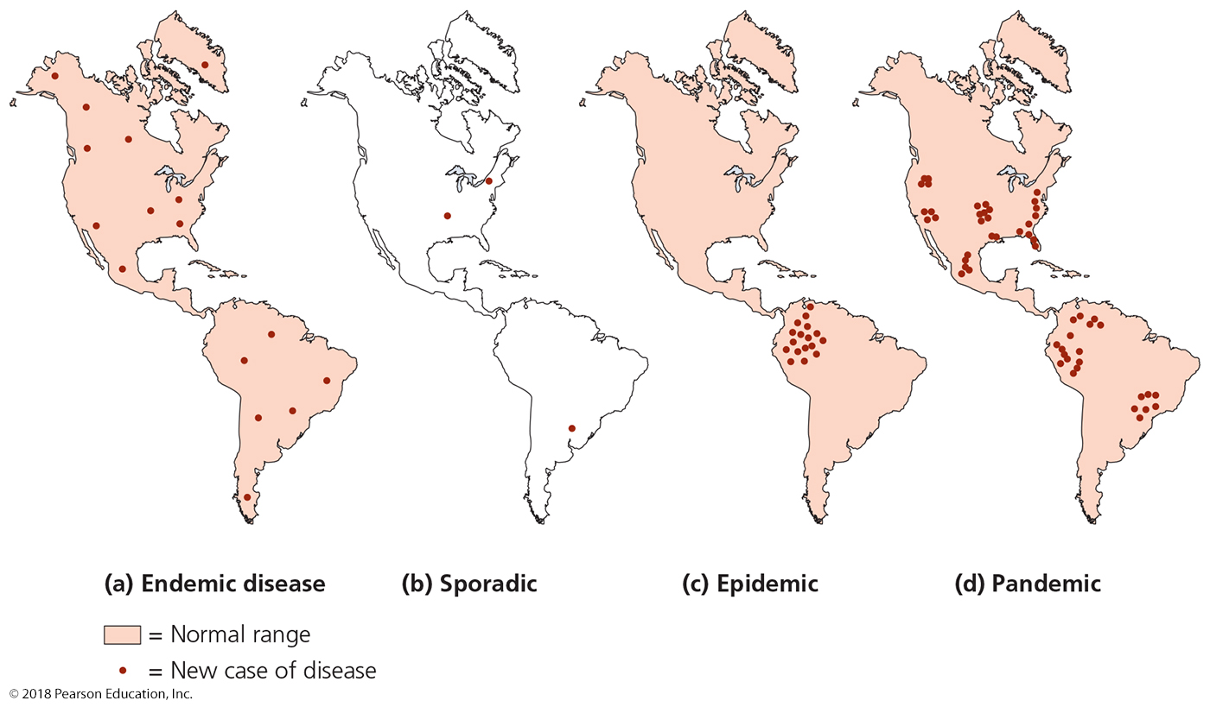
Figure 14.16 Illustrations of the different terms for the occurrence of disease KNOW THESE
Breakout, but usually only in one location
Breakouts in many locations
No breakouts, but
could pop up anywhere
rare occurrences
and
Not expected in these locations
Notes:
56

Slide 57
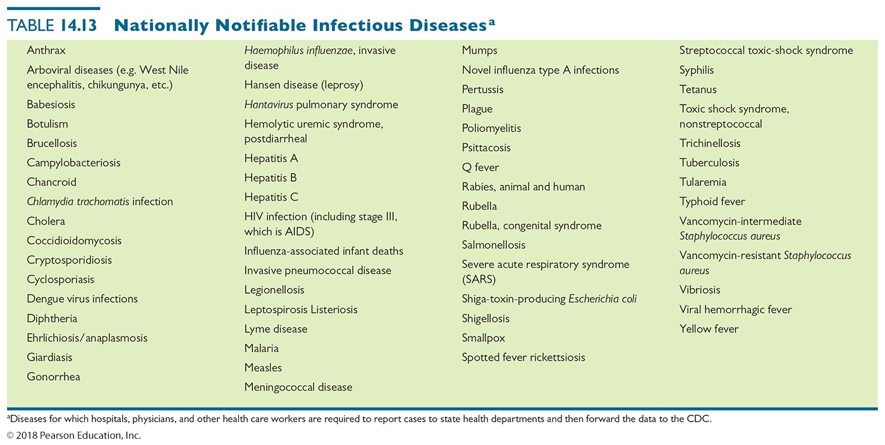
Table 14.13 Nationally Notifiable Infectious Diseasesª
Note that MRSA (recently) and common causes of less severe food poisoning (ETEC, EHEC, norovirus) are not listed
Note that almost all sexually transmitted diseases are listed
Notes:
57

Slide 58
Epidemiology of Infectious Diseases
Hospital Epidemiology: Healthcare-Associated (Nosocomial) Infections
Types of healthcare-associated infections
Exogenous
Pathogen acquired from the health care environment (e.g., microbe in air, sheets, food, water)
Endogenous
Pathogen arises from normal microbiota within patient
iatrogenic
Results from modern medical procedures (catheters, surgery)
Superinfections
Use of antimicrobial drugs inhibits some resident microbiota, allowing other microbes to thrive

Slide 59
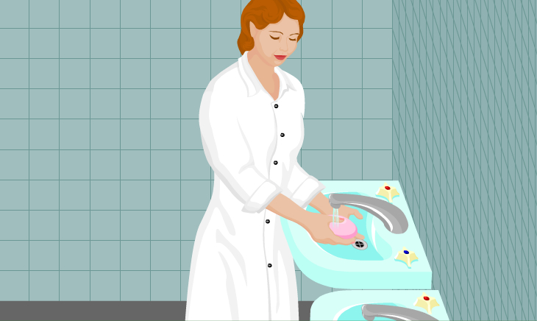
Epidemiology of Infectious Diseases
Hospital Epidemiology: Healthcare-Associated (Nosocomial) Infections
Control of healthcare-associated infections
Requires aggressive control measures
Handwashing is the most effective way to reduce healthcare-associated infections

Slide 60
Epidemiology of Infectious Diseases
Epidemiology and Public Health
Public health education
Diseases transmitted sexually and through the air are difficult to control
Public health agencies campaign to educate the public on healthful choices to limit disease

Slide 61
Epidemiology of Infectious Diseases
Tell Me Why
Why are all iatrogenic infections healthcare associated, but not all healthcare-associated infections are iatrogenic?

