Slide 1
Microbiology
Chapter 13
Characterizing and Classifying Viruses and Prions

Slide 2
Characteristics of Viruses
Minuscule, acellular, infectious agents
No organelles (with one exception)
DNA or RNA wrapped in a protein capsid (~ nucleus)
Can increase numbers only by using the cell’s resources
Can infect any (probably, every) species on the planet
Cause most of the diseases that plague the industrialized world today
Not living:
Does not metabolize biomolecules (only build nucleic acids)
Neither grow nor respond to the environment (extracellular form)
Cannot reproduce independently
Have extracellular (survival) and intracellular (duplicating) structure

Slide 3
Extracellular vs. intracellular states of viruses
Extracellular state
Must keep virus safe until it contacts its next host cell
Protein coat (capsid) surrounds nucleic acid
Nucleic acid and capsid together called nucleocapsid
Some have phospholipid envelope formed from plasma membrane of host cell that surrounds nucleocapsid
Outermost layer (either capsid or envelope) provides protection and proteins to bind to host cells
Intracellular state
Must be dissociated to allow virus to activate
Capsid removed and viral proteins released to initiate integration or DNA/RNA synthesis
Virus is now only the nucleic acid and viral proteins

Slide 4
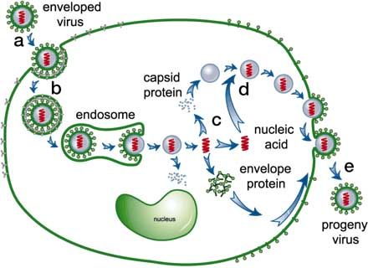
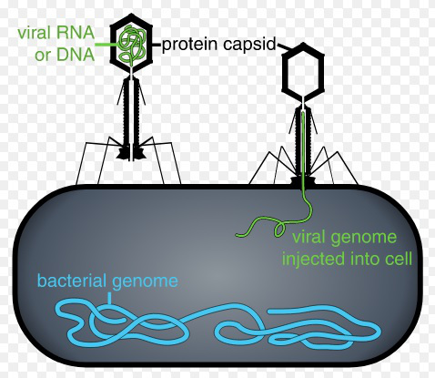
Extracellular vs. intracellular states of viruses
Note the “storage and transport” form vs. “take over cell” form

Slide 5
Classification of Viruses – SUMMARY SLIDE
Virus classification based on:
Type of nucleic acid (DNA/RNA, single/double stranded)
Presence of an membrane (enveloped/nonenveloped)
Shape (of capsid – polyhedral/helical/complex)
Viral genera are organized only into families
Relationships among viruses are not well understood by taxonomists
Viral genome often evolves too rapidly

Slide 6
Genomic Structure of Viruses
Show more variety in the nature of their genomes than do cells
These properties are the primary way scientists currently categorize and classify viruses
Can be DNA or RNA
Can be single-stranded (ssDNA or ssRNA) or double-stranded (dsDNA or dsRNA)
Can be linear or circular
Can be a single chromosome or multiple chromosomes

Slide 7
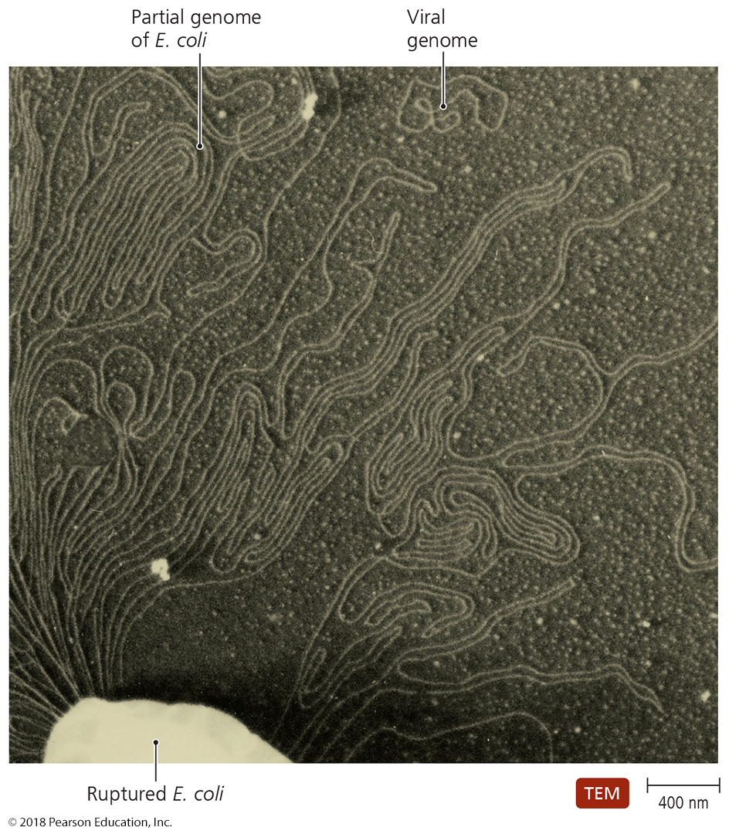
Genetic Material of Viruses
Evolutionary experimentation on steroids
Whatever may work, they’ll try to stay one step ahead
Much smaller than genomes of cells; usually larger than genomes of plasmids
Only need to encode genes to infect, replicate, and fight the host

Slide 8
Characteristics of Viruses
Hosts of Viruses
Most viruses infect cells of only particular hosts
Due to specificity of viral surface proteins for complementary proteins on host cell surface
May be so specific they only infect one type of cell in a particular host (e.g., cold viruses infect only epithelial cells)
Or they infect many kinds of cells or many different hosts (bind well-conserved protein or sugar pattern; e.g., influenza virus, rabies virus)
All organisms are susceptible to at least one virus
Viruses often co-evolve with their hosts, or evolve and change their specificity (e.g., HIV or smallpox)

Slide 9
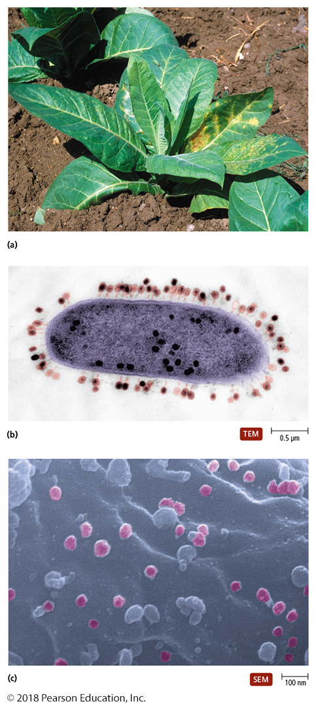
Figure 13.3 Some examples of plant, bacterial, and human hosts of viral infections.
Tobacco mosaic virus – don’t smoke and garden!
Bacteriophage (virus)
Animal virus
Notes:
9

Slide 10
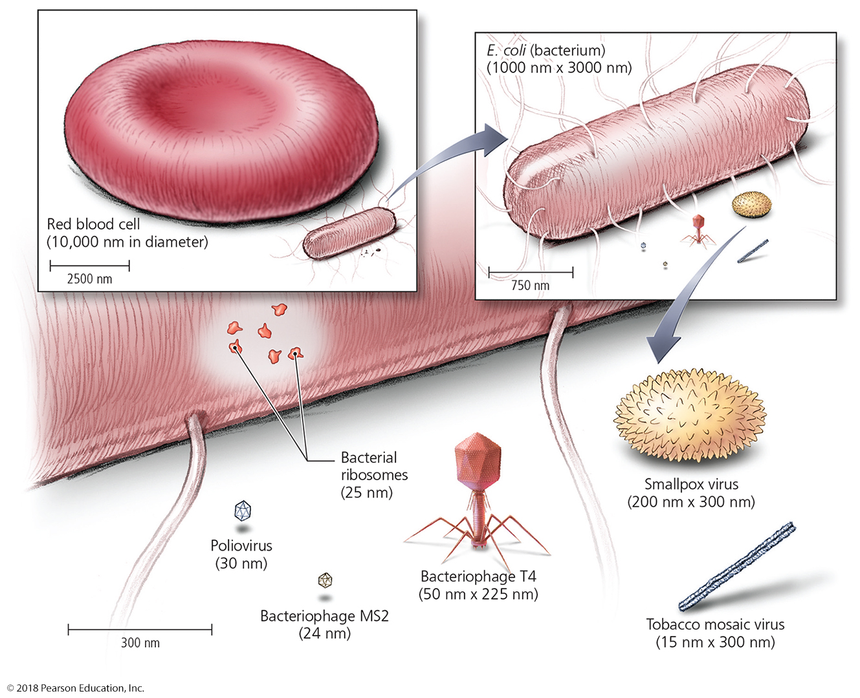
Figure 13.4 Sizes of selected virions – how small are they???
Notes:
10

Slide 11
Capsid Morphology
Capsid forms symmetrical 3D-geometric pattern
Composed of protein subunits called capsomeres
Capsomeres may be made of a single protein or multiple types of proteins
Surround and protect the viral nucleic acid
Many capsomeres directly bind DNA
If the virus is non-enveloped and thus the capsid is the outside layer, then the capsomere ALSO has the means of attachment to host’s cells

Slide 12
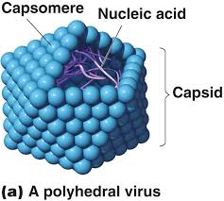
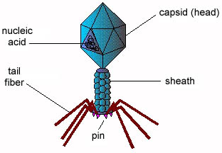
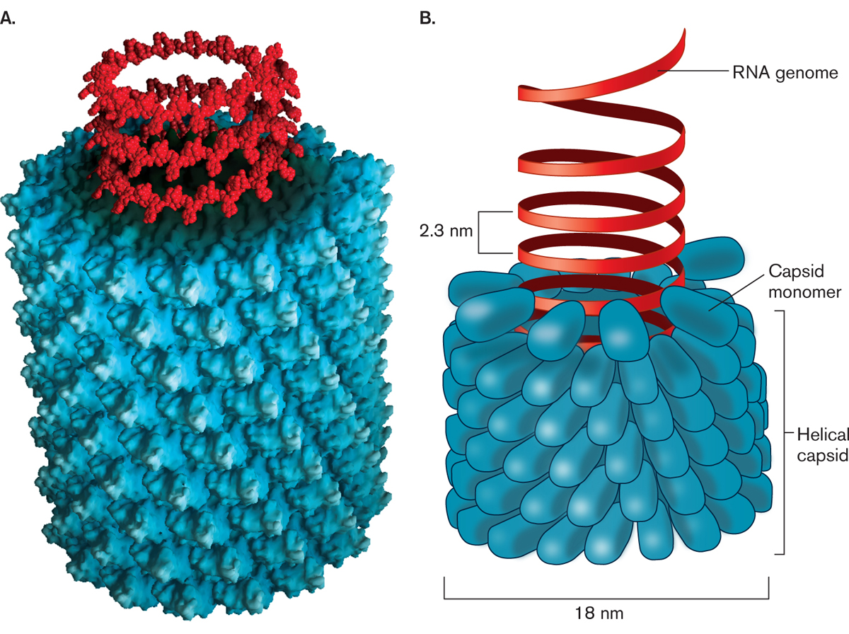
Viral (really capsid) Shapes
After determining the type of genomic DNA, Viruses are sub-classified by the shape of the capsid
Three basic types of viral capsid shapes
Helical – long, like a tube
Polyhedral – round-ish (D&D dice)
Complex – has extra “stuff”

Slide 13
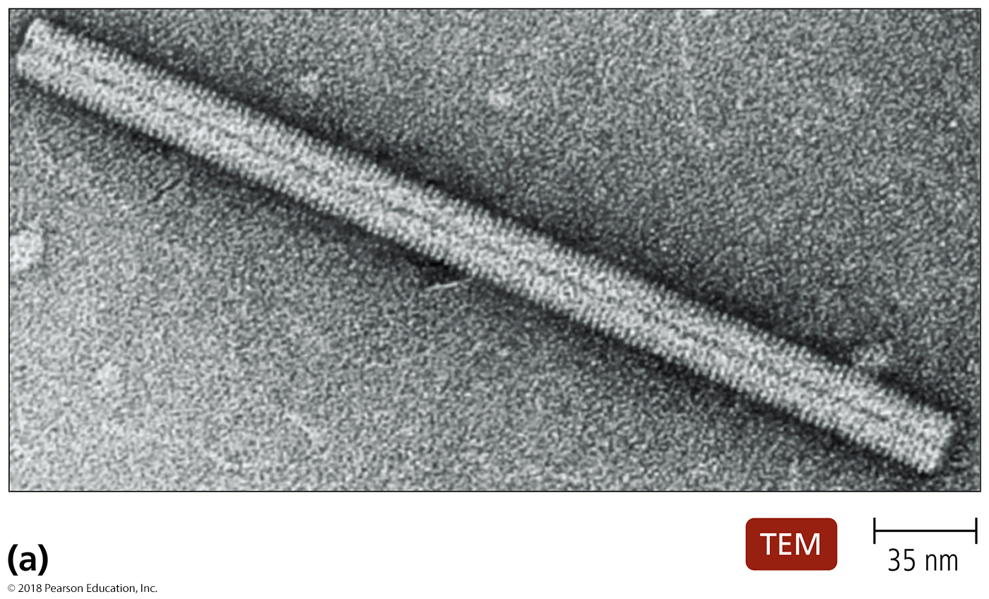
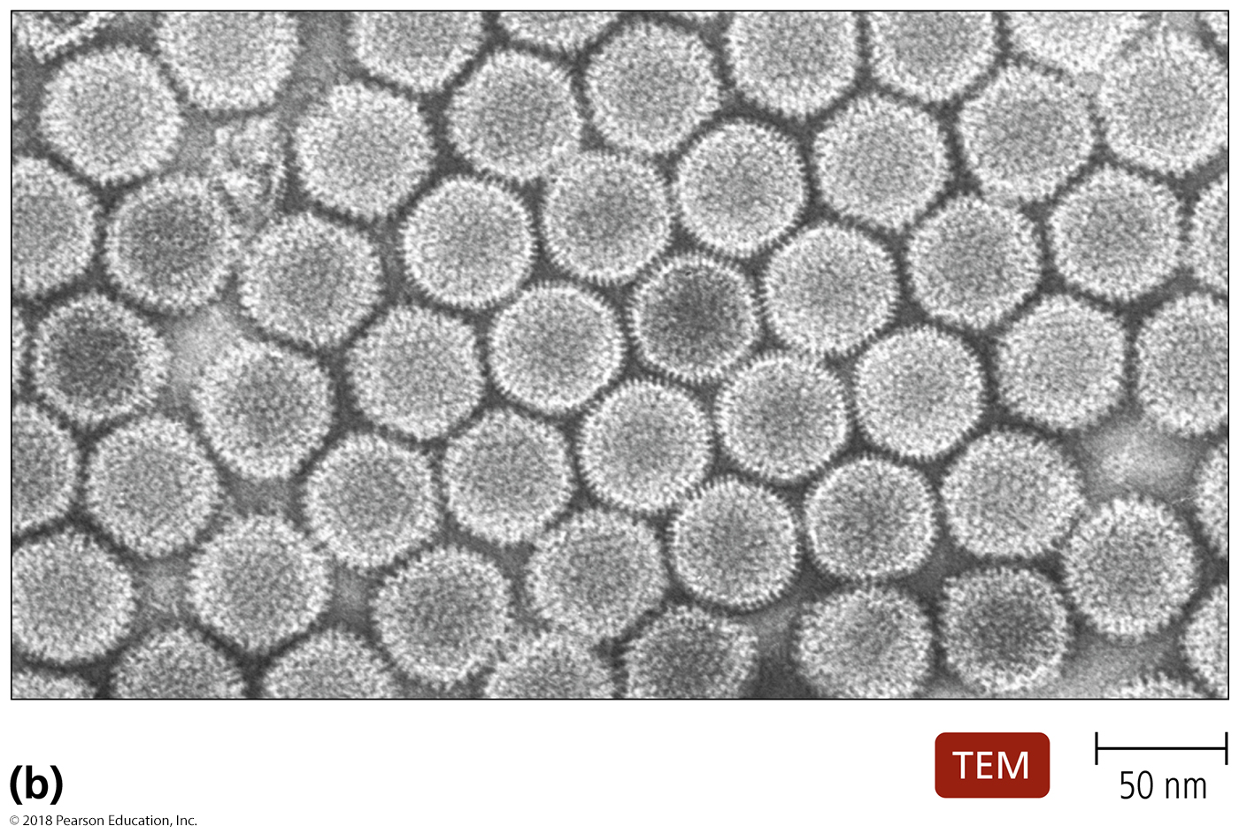
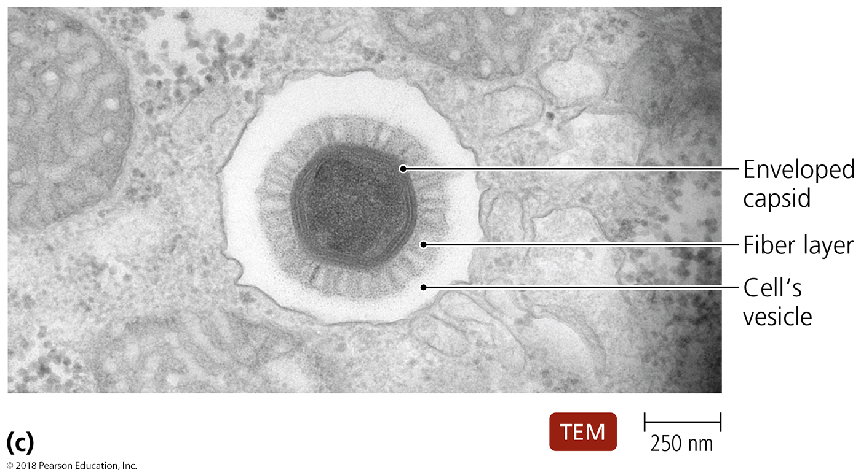
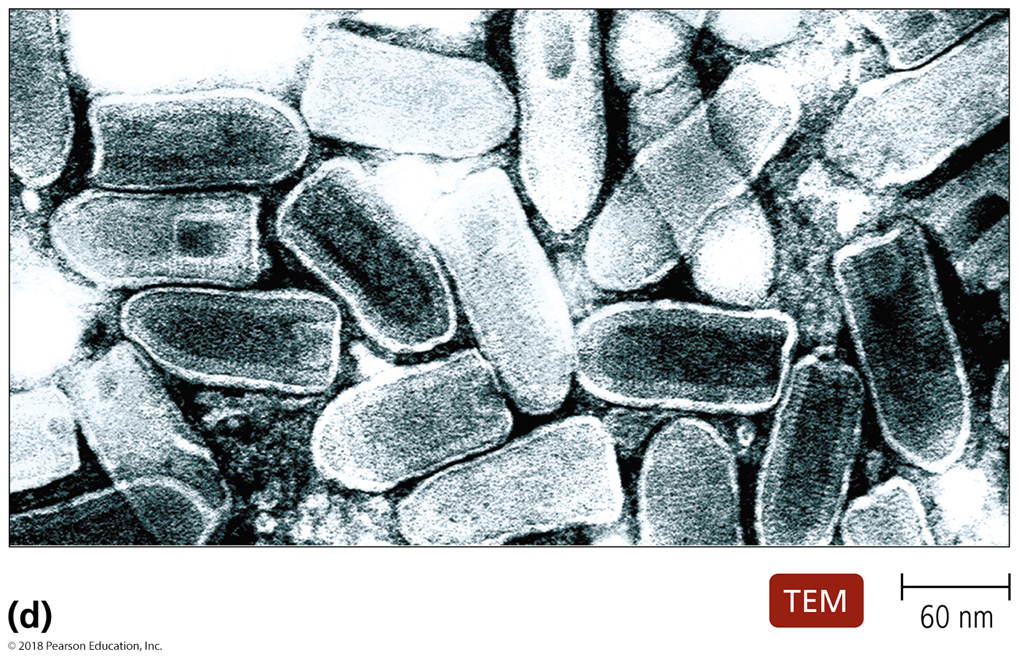
Figure 13.5 The shapes of virions.
Notes:
13

Slide 14
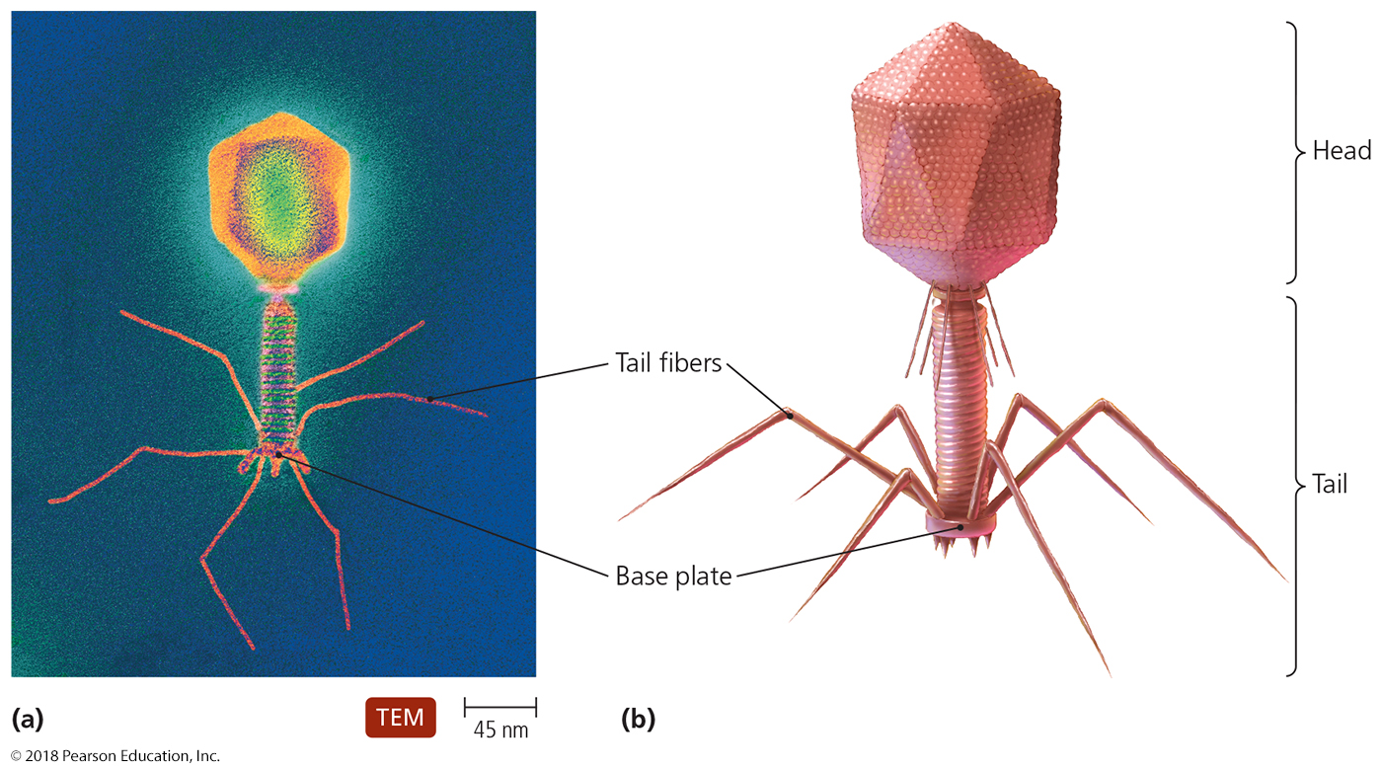
Figure 13.6 The complex shape of bacteriophage T4.
Notes:
14

Slide 15
The Viral Envelope
Acquired from host cell during viral release
Envelope is portion of membrane system of host
Composed of phospholipid bilayer and proteins
Some proteins are virally coded glycoproteins (spikes)
Viral envelope proteins play role in host recognition
Enveloped viruses are more fragile than naked viruses
Membrane forms part of virus protection
Capsid less sturdy because of primary protection from membrane
Destruction of membrane leads to a highly fragile virus that cannot bind the cell membrane and infect cells

Slide 16
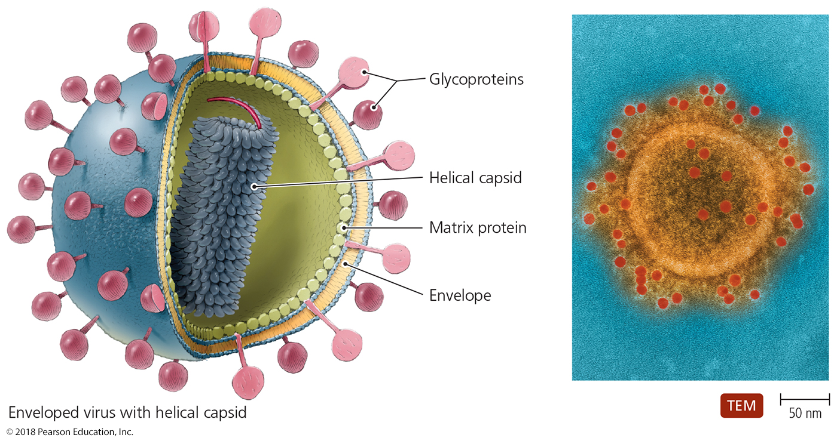
Figure 13.7 Enveloped virion.
Notes:
16

Slide 17
Table 13.1 The Novel Properties of Viruses
Notes:
17

Slide 18
Table 13.2 Families of Human Viruses (1 of 2) – FOR REFERENCE ONLY
Notes:
18

Slide 19
Table 13.2 Families of Human Viruses (2 of 2) – FOR REFERENCE ONLY
Notes:
19

Slide 20
Viral Replication – the Lytic cycle
Dependent on hosts’ organelles and enzymes to produce new virions
Lytic replication
Commonly observed among rapidly progressing viral disease (gastroenteritis, SARS, parvovirus, lytic bacteriophage)
Viral replication results in death of the host cell by lysis
Five stages of lytic replication cycle
Attachment – have to touch the cell to get in
Entry – gotta get in the cell to activate
Synthesis – must make your pieces to propagate
Assembly – must make “ready to go” viruses
Release – need to leave to move on

Slide 21
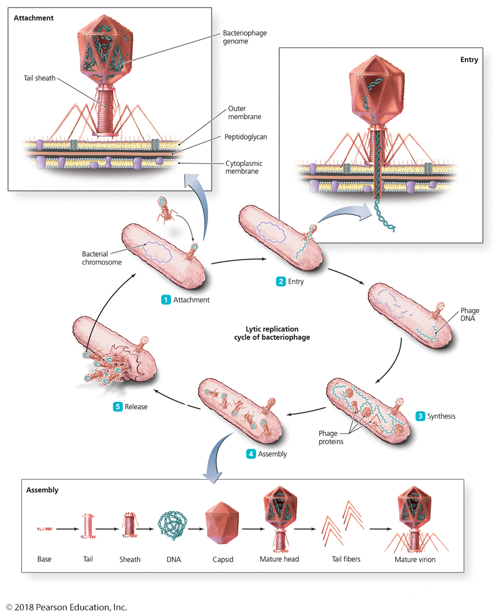
Figure 13.8 The lytic replication cycle in bacteriophages.
Notes:
21

Slide 22
Viral Replication – the lysogenic cycle
Lysogenic Replication of Bacteriophages
Modified replication cycle – virus pauses between entry and assembly (integrates into the genome)
Prophages—inactive phages that integrated into the genome
Infected host cells grow and reproduce “normally” for generations before they lyse
Lysogenic conversion
It occurs when phages carry genes that alter phenotype of a bacterium (e.g., S. pneumonia becomes more virulent after transduction by a specific phage)
Lytic Induction
Organismal stress (UV irradiation, osmotic shock) reactivates quiet virus, and lytic cycle resumes

Slide 23
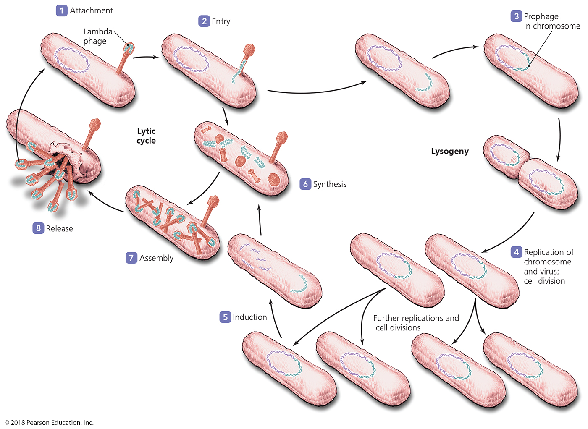
Figure 13.11 The lysogenic replication cycle in bacteriophages.
Notes:
23

Slide 24
Replication of Animal Viruses
Same basic replication pathway as bacteriophages
Differences result from:
Presence of envelope around some viruses
Eukaryotic nature of animal cells
Lack of cell wall in animal cells
Viruses generally infect much more easily (why?)
Six Phases of viral replication
Attachment – has to touch cell to get in
Entry – has to get into cell to activate
Uncoating – capsid needs to release DNA/proteins in cells
Genome Integration – for lysogenic cycle only
Assembly – need to build “ready to go” viruses
Release – must leave in order to move on

Slide 25
Viral Replication
Replication of Animal Viruses
Attachment of animal viruses
Biochemical attraction between viral protein (envelope protein or capsid protein) and cell receptor
Animal viruses do not have tails or tail fibers (seen only in bacteriophages that have to penetrate thick cell wall or two membranes)
Entry and uncoating of animal viruses
Enter host cell by at least three different mechanisms
Nonenveloped virus - nucleocapsid pushes nucleic acid through membrane (direct penetration)
Enveloped virus - capsid is released into the cytoplasm either at the membrane (membrane fusion) or deeper inside the cell (endocytosis)

Slide 26
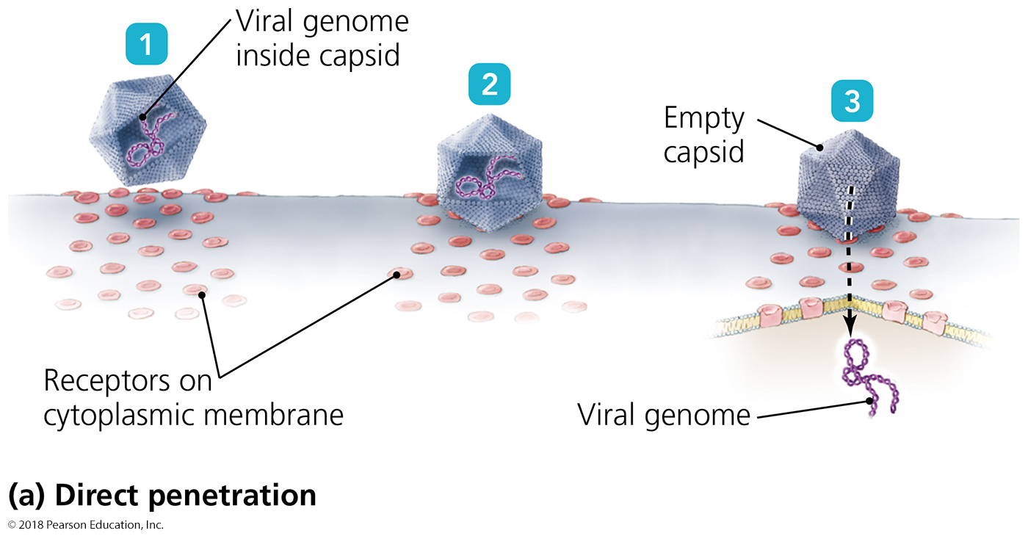
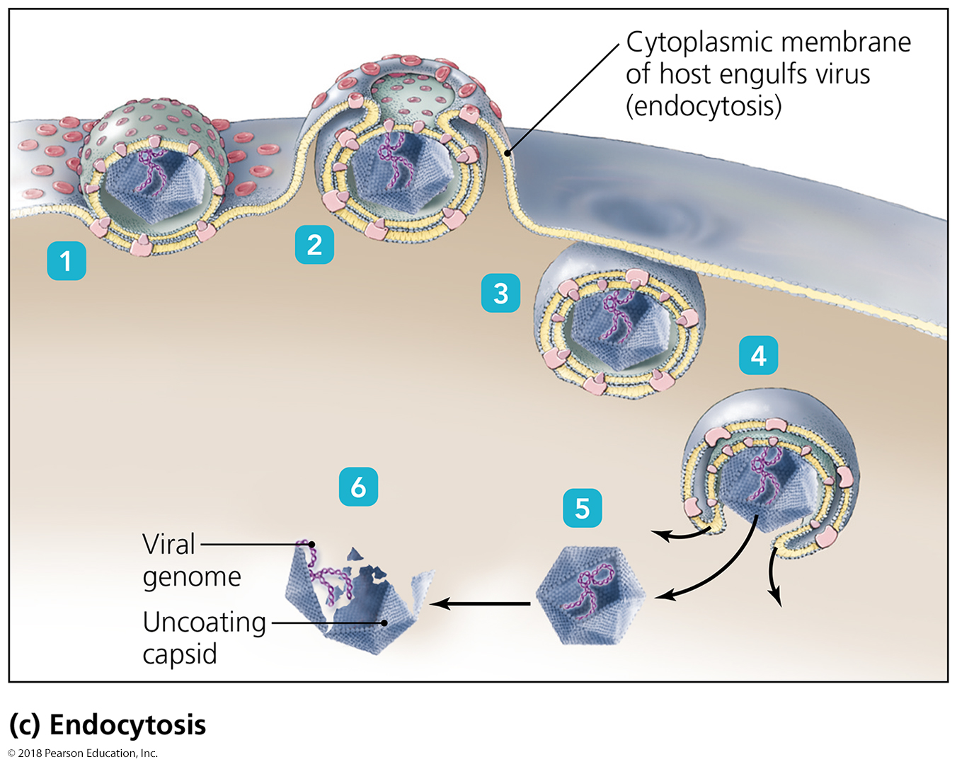
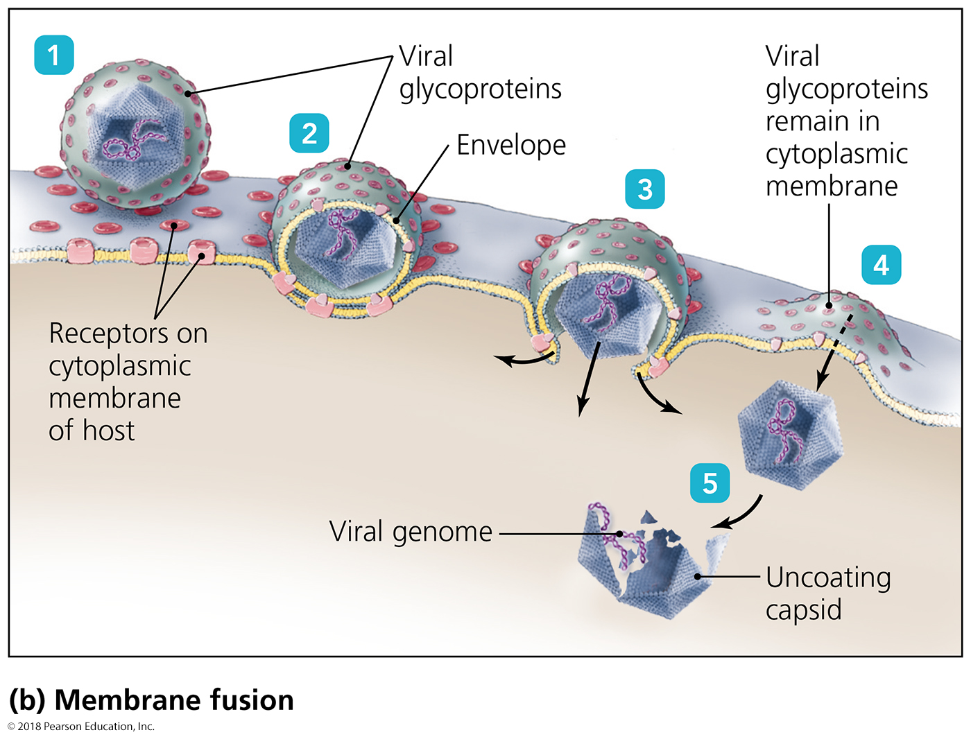
Figure 13.12 Three mechanisms of entry of animal viruses.
Notes:
26

Slide 27
Viral Replication
Replication of Animal Viruses
Synthesis of DNA viruses of animals
Each type of animal virus requires different strategy depending on its nucleic acid
DNA viruses often enter the nucleus (why?)
RNA viruses often replicate in the cytoplasm (Why?)

Slide 28
Viral Replication
Replication of Animal Viruses
Assembly and release of animal viruses
Most DNA viruses assemble in nucleus (why?)
Most RNA viruses develop solely in cytoplasm (why?)
Enveloped viruses steal some of the cell membrane as they exit – this process is called budding
Naked viruses are released by exocytosis or lysis
Exocytosis is less damaging to cells than is lysis (why?) and is thus seen more often in persistent or latent infections

Slide 29
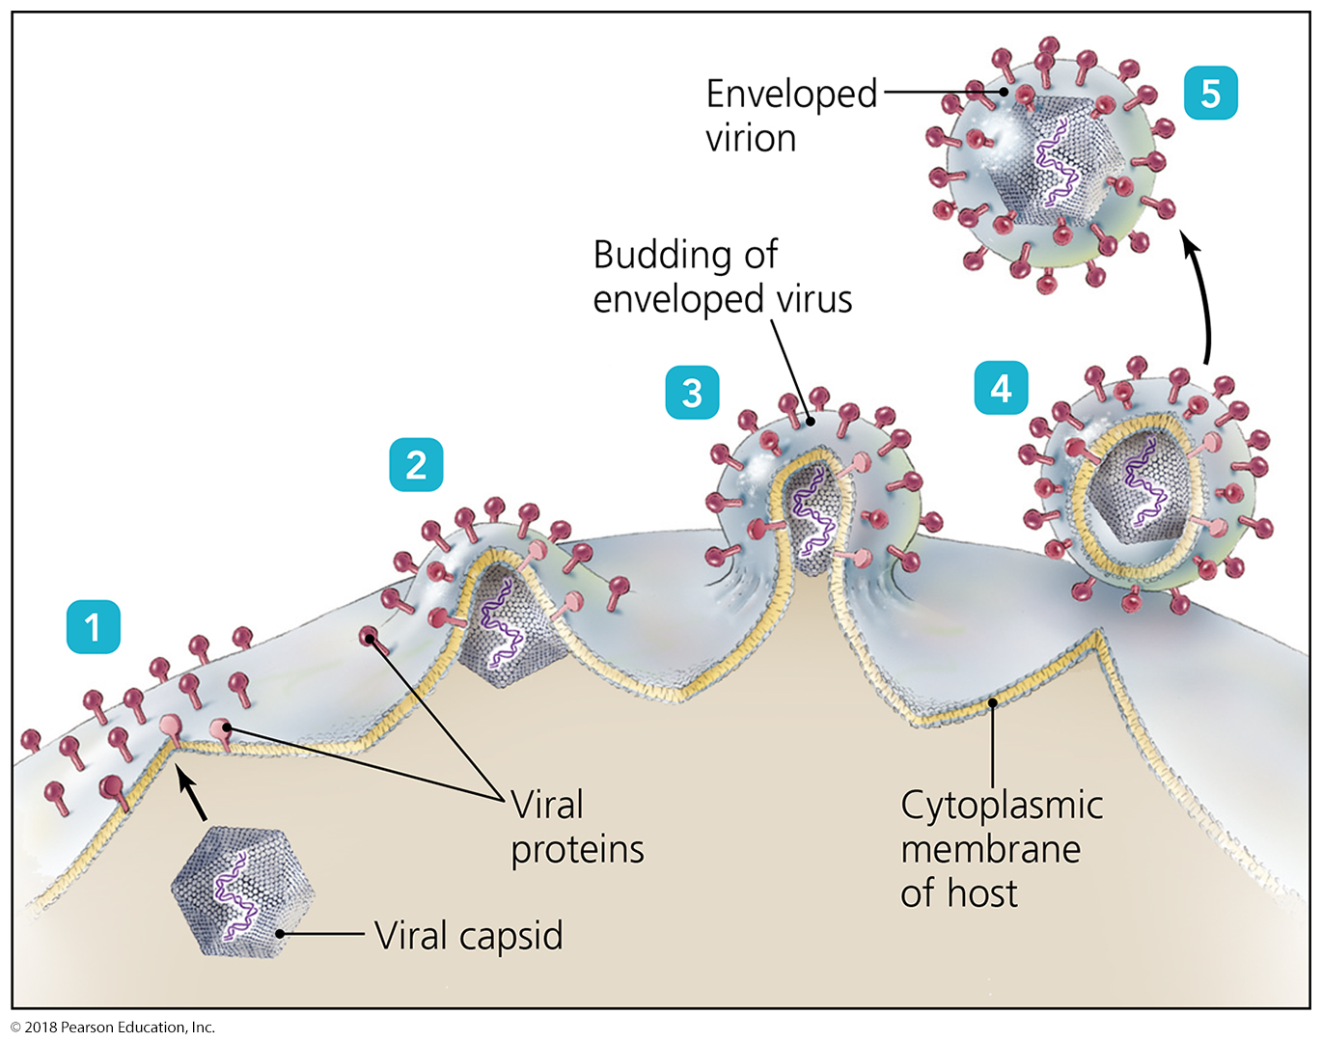
Figure 13.14 The process of budding in enveloped viruses.
Notes:
29

Slide 30
Viral Replication
Replication of Animal Viruses
Latency of animal viruses
When animal viruses remain dormant in host cells, viruses are called latent viruses or proviruses
May be prolonged for years with no viral activity
Incorporation of provirus into host DNA is permanent
Common examples: HIV, Chickenpox virus
Reactivation occurs in response to a cellular stress
Latency and reactivation commonly seen in chronic viral infections

Slide 31
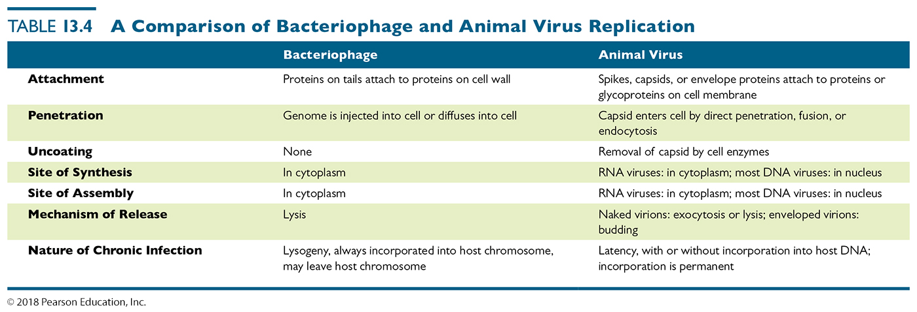
Table 13.4 A Comparison of Bacteriophage and Animal Virus Replication
Notes:
31

Slide 32
The Role of Viruses in Cancer
Viruses cause 20–25% of human cancers.
Specific viruses are known to cause some human cancers:
Burkitt’s lymphoma
Hodgkin’s disease
Kaposi’s sarcoma
Cervical cancer – by human papillomavirus (what is the vaccine?)
Some carry copies of oncogenes as part of their genomes and immediately corrupt host genomes.
Others corrupt healthy proto-oncogenes already present in host, gradually converting them to oncogenes.
Oncogenes have permanent growth-promoting activity
Others stop growth control by disrupting tumor suppressor genes.
Tumor suppressor genes have growth-regulating activity

Slide 33
The Role of Viruses in Cancer
Neoplasia
Uncontrolled cell division in multicellular animal
Mass of neoplastic cells is tumor
Benign versus malignant tumors
Benign tumors do not affect the body negatively and are NOT cancer
Malignant tumors are called cancers because they cause disease
Metastasis occurs when fragments of tumors spread to toher parts of the body
Cancer is a disease from malignant tumors

Slide 34
Oncogenic conversion by virus integration – to review on your own
Proto-oncogenes promote cell growth and division
Proto-oncogenes are under tight control
viral alteration of genomes can dysregulate proto-oncogenes, converting them to oncogenes
Uncontrolled activation of oncogenes can lead to cancer if the cell does not kill itself or is killed
Other environmental factors that contribute to the activation of oncogenes:
Ultraviolet light
Radiation
Carcinogens

Slide 35
Disruption of growth control by virus integration – to review on your own
Tumor suppressors usually have regulatory function
Loss of regulation through viral insertion and gene disruption promotes excessive proto-oncogene expression
Individuals heterozygous for some tumor suppressor genes more easily develop cancer
The functional copy gets inactivated by virus – this is called loss of heterozygosity

Slide 36
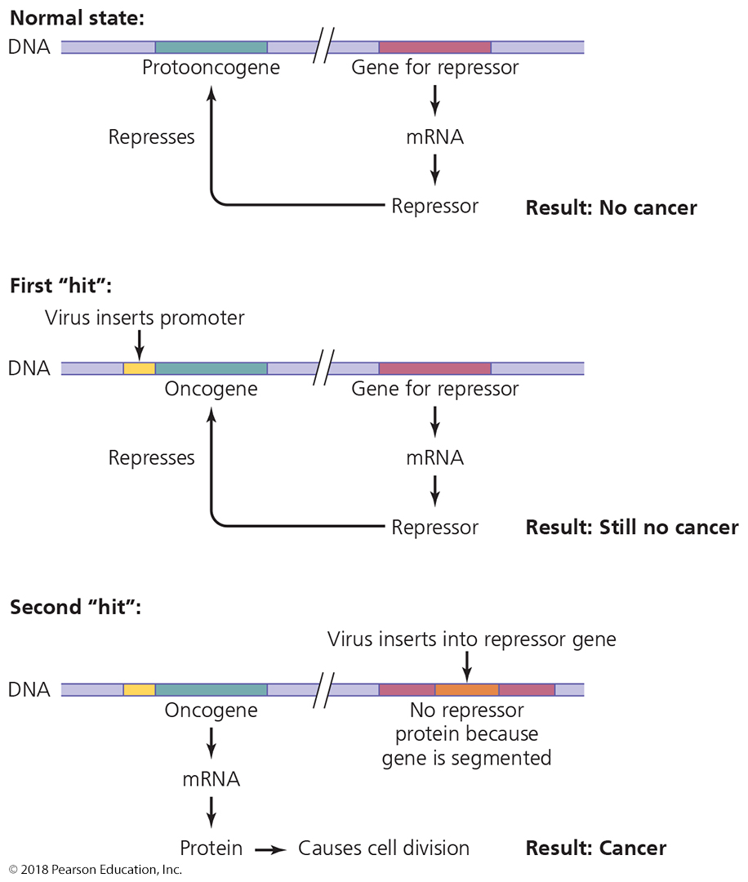
Figure 13.16 The oncogene theory of the induction of cancer in humans.
Notes:
36

Slide 37
Culturing Viruses in the Laboratory
Viruses cannot grow in standard microbiological media
Cultured inside host cells
Done to grow vaccine viruses
Three types of media for culturing viruses:
Media consisting of mature organisms (bacteria, mold)
Embryonated eggs – the shell limits viral spread
Vaccines from weakened viruses are commonly made this way; people allergic to egg products cannot receive vaccine made this way
Cell cultures
People allergic to egg products must receive weakened virus made this way

Slide 38
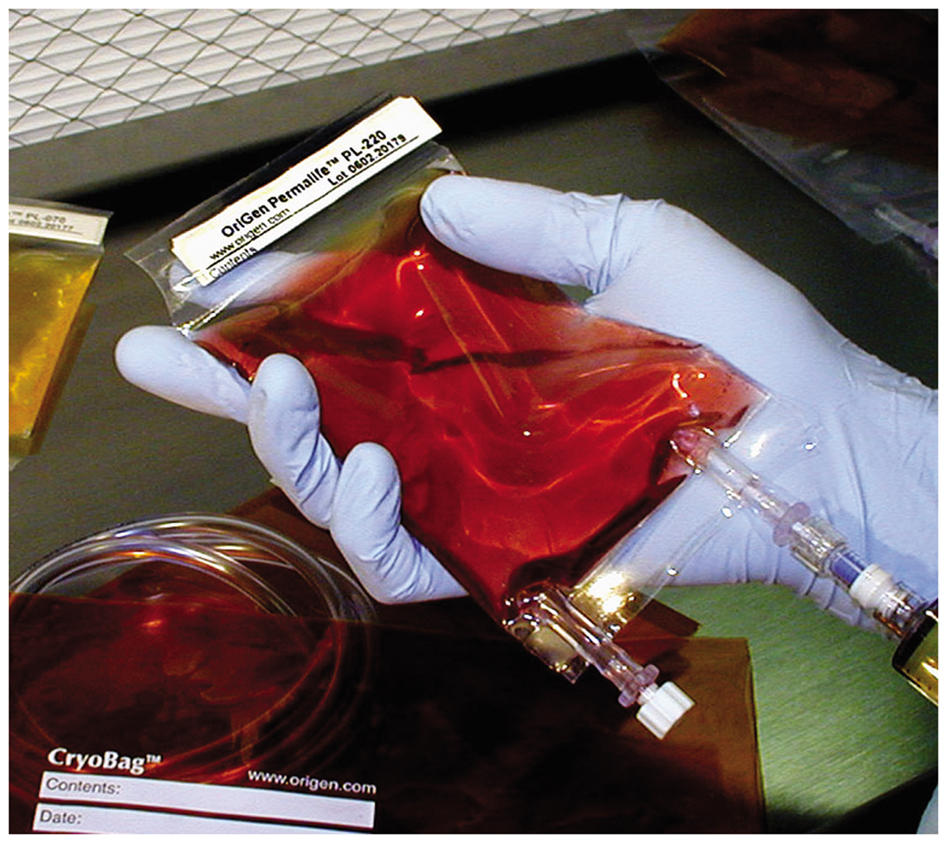
Figure 13.19 An example of cell culture.
Notes:
38

Slide 39
Characteristics of Prions
Proteinaceous infectious agents
No RNA; no DNA, no membrane
Cellular PrP
Normal, functional structure has α-helices
Made by all mammals in nerves, neuronal function unknown
Refolded when bound by prion PrP into prion PrP form
Prion PrP
Disease-causing form has β-pleated sheets - refolded
Far more stable; does not unfold back to normal protein
Is NOT destroyed by cooking (needs 1.5M NaOH)
Prion PrP causes cellular PrP to refold into prion PrP
Protein corruption is a vampire/Borg mechanism

Slide 40
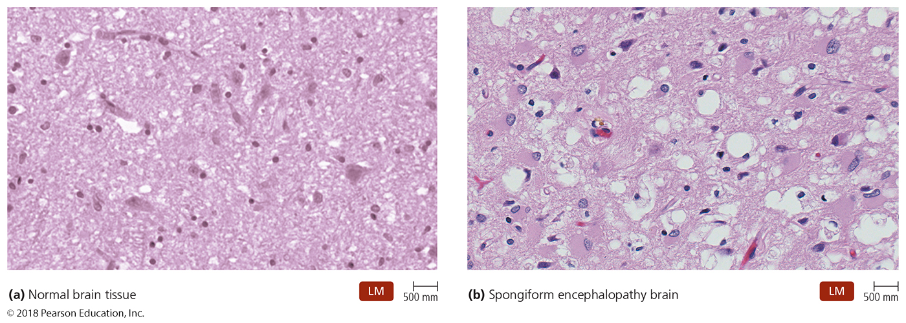
Figure 13.24 Brain tissue – what does prion-diseased tissue look like?
No prion – normal looking
Prion infected– heavily damaged
Prion diseases are called
spongiform encephalopathies
Notes:
40

Slide 41
Characteristics of Prion diseases
Called Spongiform encephalopathies
Large vacuoles form in brain
Characteristic spongy appearance
Present in many mammalian species:
Cows - Bovine Spongiform Encephalopathy (BSE; a.k.a, mad cow disease)
Sheep, goats - scrapie
Humans - kuru (New Guinea), Creutzfeld-Jakob Disease (vCJD), fetal familial insomnia (genetic)
Deer - chronic wasting disease (CWD)
Mink – transmissible mink encephalopathy
Also seen in ostriches

Slide 42
Characteristics of Prions
Transmitted by ingestion, transplantation, or contact of mucous membranes with infected tissues
No standard treatment for any prion disease – 100% fatal in 10-50 years after ingestion of tainted meat
Normal sterilization procedures do not deactivate prions
Prions destroyed only by incineration or autoclaving in concentrated sodium hydroxide (1N, 121ºC for 1 hour)
Prionzyme can destroy prions at room temperature
European Union recently approved use of Prionzyme to remove prions from medical equipment
Americans using Prionzyme currently to treat soil in areas where chronic wasting disease is endemic.

Slide 43
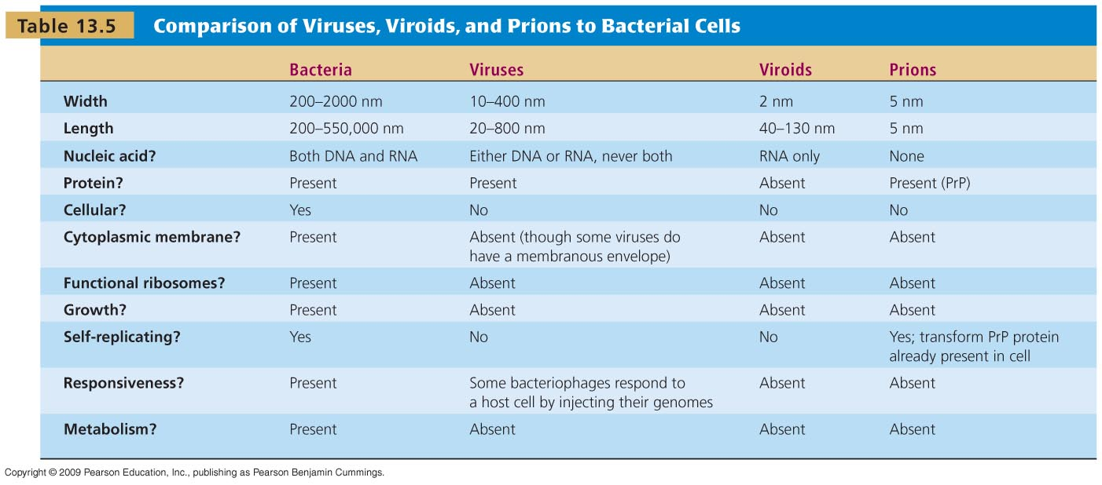
Other Parasitic Particles: Viroids and Prions
[INSERT TABLE 13.5]

