Slide 1
Microbiology
Chapter 12
Characterizing and Classifying Eukaryotes

Slide 2
General Characteristics of Eukaryotic Organisms – SUMMARY SLIDE
Eukaryotic microorganisms
Protozoa
Fungi
Algae
Slime molds
Water molds
Animal parasites
Includes both human pathogens and organisms vital for human life

Slide 3
General Characteristics of Eukaryotic Organisms
ASEXUAL Reproduction of Eukaryotes
More complicated than that in prokaryotes
Most eukaryotic DNA packaged as multiple chromosomes coiled around histones in the nucleus
After replicating multiple chromosomes, identical pairs must be segregated correctly before cell division (disjunction), or else daughter cells will not be the same as the parent cell and will be genetically unstable
Asexual reproduction involves mitosis (= nuclear separation) followed by (most of the time) cytokinesis (= cytoplasm splitting)
Have variety of methods of asexual reproduction
Binary Fission (most common), Budding, Fragmentation, Spore Formation, Schizogony

Slide 4
General Characteristics of Eukaryotic Organisms
SEXUAL Reproduction of Eukaryotes
Nearly all can reproduce sexually by forming gametes and zygotes
Gametes are haploid cells formed from diploid cells by a process called meiosis
Gametes are one of two different mating types (~ genders) to ensure that genetically distinct gametes interact sexually
e.g. male/female, a/α, +/-, a/A, others
Zygotes are diploid cells that form from two haploid cells of opposite mating types.
Algae, fungi, and some protozoa reproduce both sexually and asexually
Prefer to exist as haploids (less genome; efficiency gain)
Evolutionary selection test for a successful genome combination
They usually only reproduce sexually when subjected to environmental stress

Slide 5
General Characteristics of Eukaryotic Organisms – to review on your own
Nuclear division in Eukaryotes
Nucleus has one or two complete copies of genome
Single copy – haploid (most fungi, many algae, some protozoa)
Two copies – diploid (remaining fungi, algae, and protozoa, most animals and plants)
Two types
Mitosis – nuclear division for asexual reproduction
start and finish in the same genomic state
diploid → diploid ; haploid → haploid
Meiosis – the nuclear division involved in making gametes for (eventual) sexual reproduction
diploid → haploid

Slide 6
Mitosis – to review on your own
Begins after cell has duplicated its DNA; cell separates replicated DNA equally into two nuclei
Both children have identical gene content as parent
Haploid → haploid and diploid → diploid
Four phases – note “palindromic” behavior
Prophase – chromosome condense; nuclear membrane breaks up
Metaphase – chromosomes move to equatorial plate
Anaphase – chromosomes separate
Telophase –nuclear membrane reforms; chromosomes relax

Slide 7
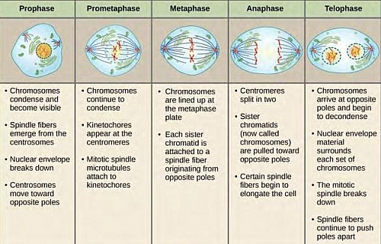
Mitotic cycle – to review on your own

Slide 8
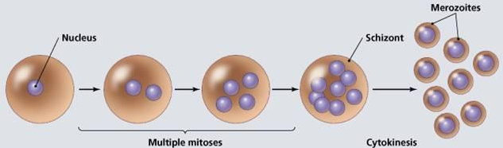
Cytokinesis (cytoplasmic division)
In most organisms, cytokinesis occurs simultaneously with telophase of mitosis
In some algae and fungi, cytokinesis may be postponed or it may not occur at all
Results in multinucleated cells
called coenocytes, schizonts, aseptate hyphae, etc. depending on organism

Slide 9
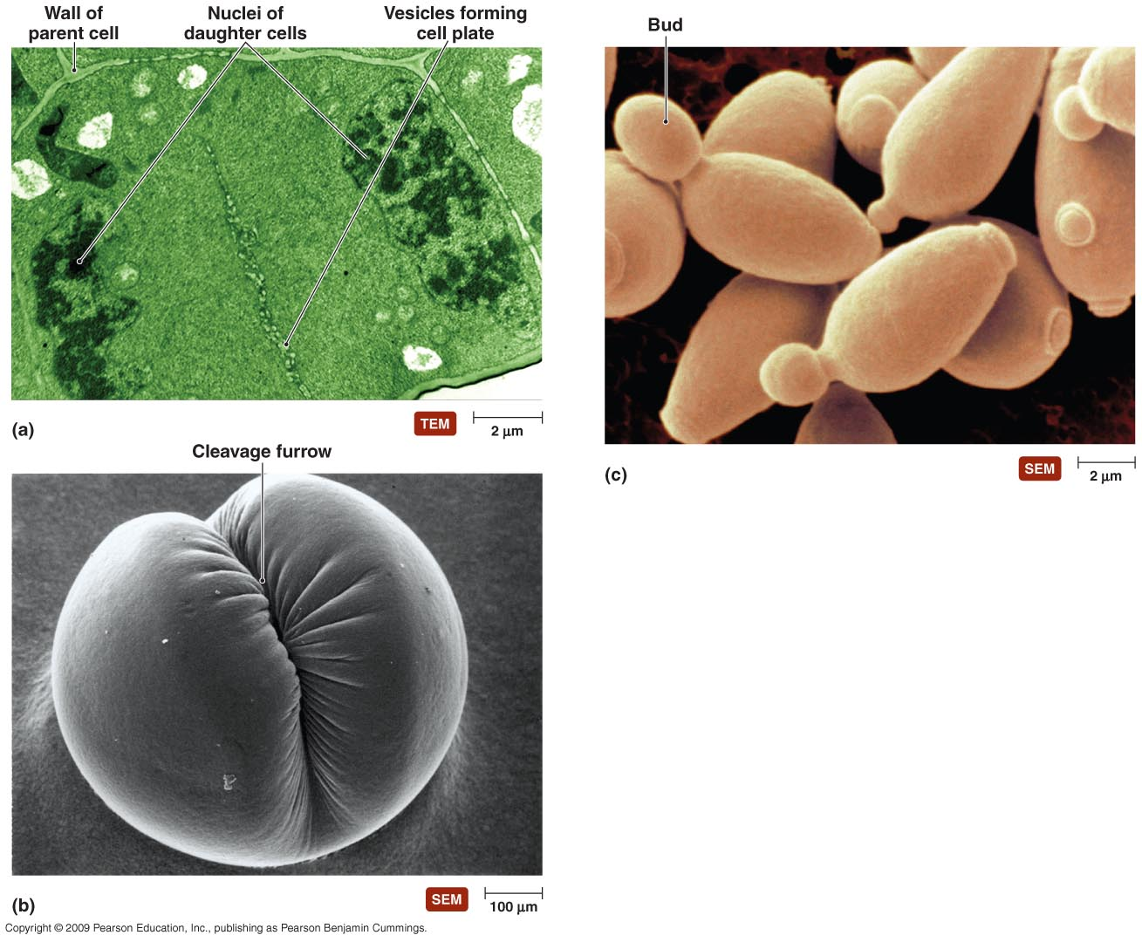
Cytokinesis occurs differently in different organisms
Plants, green algae
Budding yeast
[INSERT FIGURE 12.2]
Animals, most other protists

Slide 10
Figure 12.3 Schizogony.
Schizogony - multiple rounds of mitosis (creating schizont) preceding multiple rounds of cytokinesis
Notes:
10

Slide 11
Protists (over 20 Kingdoms currently)
Often called Protozoa (archaic term; still used in medical microbiology)
Diverse group defined by two characteristics:
Eukaryotic
Unicellular
Many are motile by means of cilia, flagella, and/or pseudopods
Exceptions
apicomplexans – reply on their hosts to move
Red, green, and brown algae – photosynthetic and so do not need to hunt for food

Slide 12
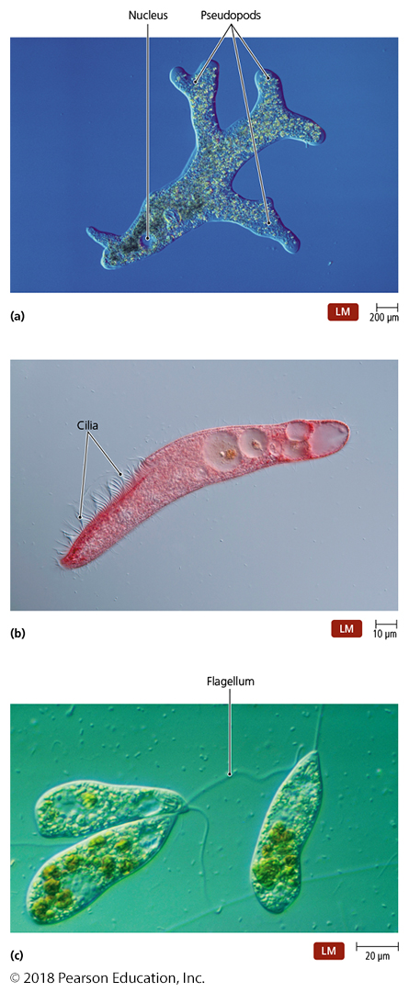
Figure 1.6 Locomotive structures of protozoa.
https://www.youtube.com/watch?v=7pR7TNzJ_pA
https://www.youtube.com/watch?v=oQCAY902ZAk
https://www.youtube.com/watch?v=fI7nEWUjk3A
Notes:
12

Slide 13
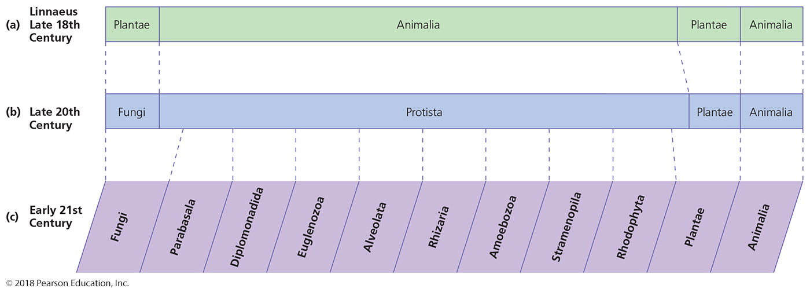
The changing classification of eukaryotes over the centuries.
The Eukaryotic Kingdoms
Know these kingdoms
Notes:
13

Slide 14
Classification of Protista – SUMMARY SLIDE
One current scheme groups protists into five groups
Parabasala
Diplomonadida
Euglenozoa – euglenids, kinetoplasmids
Alveolates – ciliates, apicomplexans, dinoflagellates
Amoebozoa
Fungi, plants and animals (all the multicellular eukaryotes) appear to have evolved from some of these forms
KNOW THESE!

Slide 15
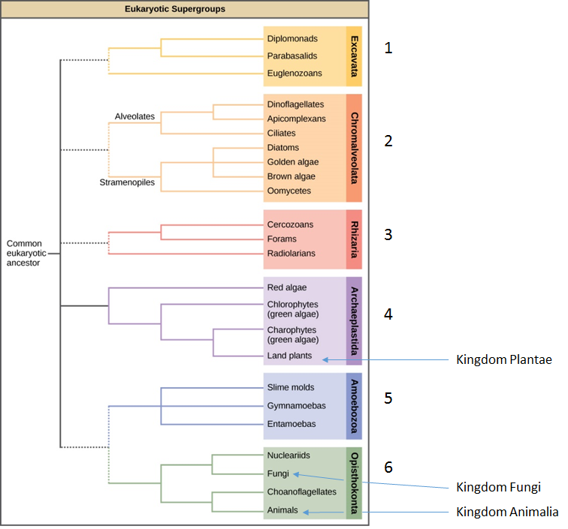

Slide 16
Distribution of Protista
Require moist environments
Most live in ponds, streams, lakes, and oceans
Others live in moist soil, beach sand, and decaying organic matter
Very few are pathogens
Some amoeba,
many apicomplexans (e.g., plasmodia)
limited species in other kingdoms

Slide 17
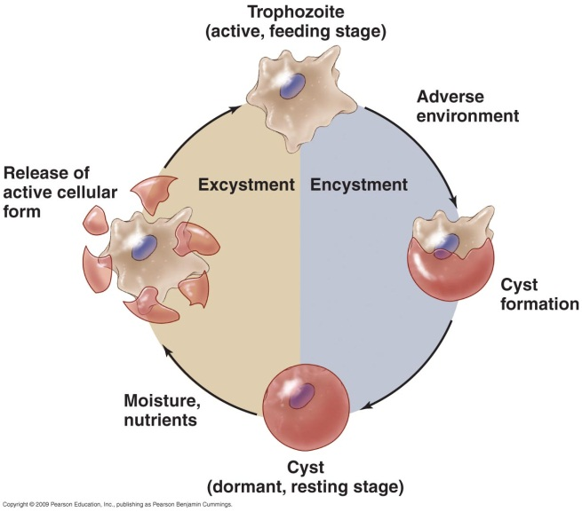
Morphology of Protozoa
Great morphological diversity
Some have two nuclei
Macronucleus
DNA for gene expression
Copied from micronucleus
Destroyed after genomic change
Micronucleus
DNA for conjugation, recombination and sexual reproduction ONLY
Regenerates macronuclei after genomic change (sexual reproduction, conjugation)
Variety in number and kinds of mitochondria
Some have contractile vacuoles that pump water out of cells
Different stages in life cycle
Motile feeding stage called a trophozoite
Resting stage called a cyst

Slide 18
Nutrition of Protista
Most are chemoheterotrophic
Obtain nutrients by phagocytizing bacteria, decaying organic matter, other protozoa, or the tissues of host
Few absorb nutrients from surrounding water
Dinoflagellates and euglenoids are photoautotrophic
Originally mistakenly characterized as algae
Their motility from flagella now classify them as protozoa
Dinoflagellates are rarely infectious, but dinoflagellate toxins can cause disease when overgrown (red tide)

Slide 19
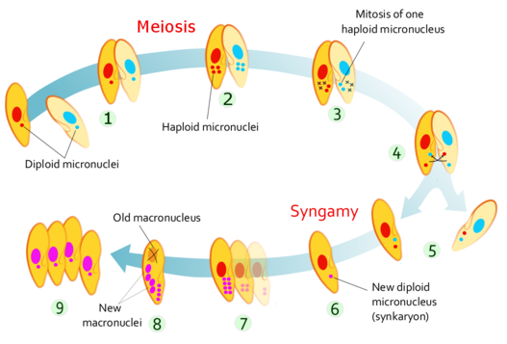
Protozoa
Reproduction of Protozoa
Most reproduce asexually
Binary fission or schizogony
Occassionally they undergo sexual reproduction
Some become gametocytes (haploid cells) that fuse to form diploid zygotes
Some utilize a process called conjugation – bidirectional micronuclear exchange
Recombination of haploid micronuclear DNA between two “adults”; no children made
After micronuclear exchange, “out with the old (macronuclei) and in with the new (macronuclei)”

Slide 20
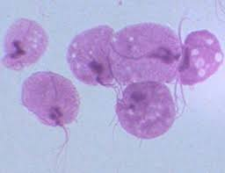
Kingdoms of Protista
Parabasala
a.k.a. parabasalids
Lack mitochondria; aerotolerant anerobe
Have a single nucleus
Contain Golgi body–like structure called a parabasal body
Prominent parabasalid
Trichomonas – “trich”
common STI (1%)
easily treated with metronidazole

Slide 21
Kingdoms of Protista
Diplomonadida
a.k.a. Diplomonads
Aerotolerant anaerobe
Have mitosomes - degenerate “mitochondria”
No mitochondrial DNA
No mitochondrial ribosomes
Also lack Golgi bodies and peroxisomes
Have two equal-sized nuclei, a median body “smile” to make a “clown face” and multiple flagella
Prominent diplomonad
Giardia – intestinal disease from untreated or stagnant water

Slide 22
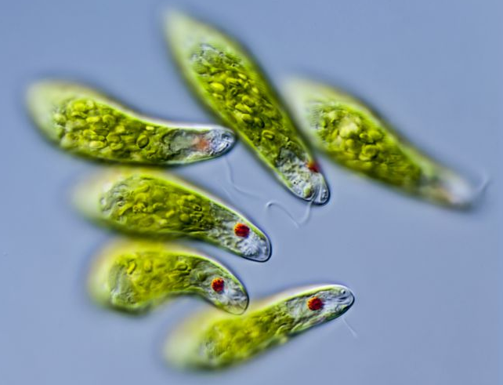
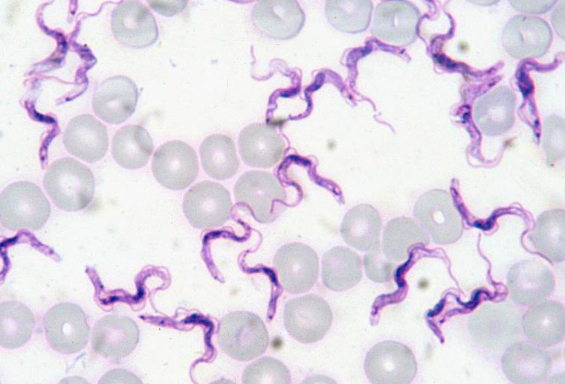
Kingdoms of Protista
Euglenozoa
Have characteristics of both plants and animals
Flagella for movement
Eye spot to find light
Chloroplasts for photosynthesis
Endocytosis to “eat” things in absence of light
Two groups
Euglenids
Kinetoplastids

Slide 23
Classification of Euglenozoa
Euglenids
photoautotrophic, unicellular microbes with chloroplasts
can become chemoheterotrophic in absence of sunlight
almost always noninfective
Stores glucose in chloroplasts as a β-1,3 glucose polysaccharide called paramylon (vs. an α-1,4 of starch stored in plant chloroplasts) – applications for biodegradation???
Kinetoplastids
Have region of mitochondrion called a kinetoplast – may be related to chloroplasts – powers flagellum
Some kinetoplastids are pathogenic
Trypanosoma – African sleeping sickness (tse tse fly)
Leishmania – leishmaniasis (skin ulcers from sandflies)

Slide 24
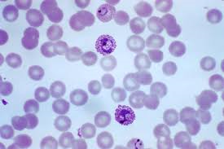
Kingdoms of Protists – SUMMARY SLIDE
Alveolates
Have membrane-bound cavities called alveoli
Purpose is unknown
Divided into three subgroups
Ciliates
Apicomplexans
Dinoflagellates

Slide 25
Classification of Alveolates
Ciliates
Use cilia to move themselves or water
All are chemoheterotrophs and have two nuclei
Balantidium is the only ciliate pathogenic to humans
Apicomplexans
Chemoheterotrophic pathogens of animals
Have specialized organelles to allow them to penetrate host cells
Plasmodium, Cryptosporidium, and Toxoplasma cause disease in humans

Slide 26
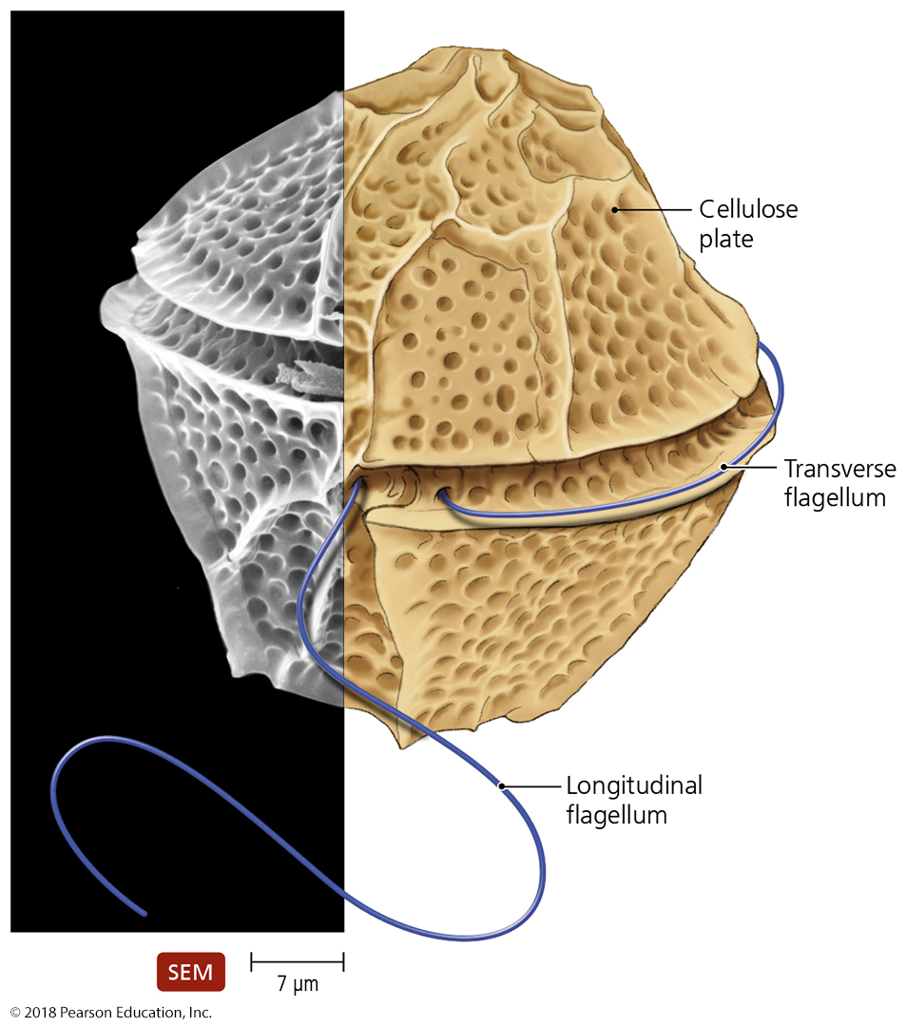
Classification of Alveolates
Classification of Alveolates
Dinoflagellates
Unicellular microbes with photosynthetic pigments
Historically classified as algae
Large proportion of freshwater and marine plankton
Motile dinoflagellates have two flagella
Many dinoflagellates are bioluminescent
Abundance in marine water is one cause of red tides
Some dinoflagellates produce neurotoxins – paralysis kills fish and marine mammals

Slide 27
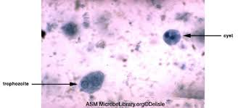
Kingdoms of Protista
Amoebozoa
Moves and feeds by pseudopods
Includes some human pathogens
Naegleria – eye and brain pathogen
Acanthamoeba – skin, eye and brain pathogen
Entamoeba – intestinal pathogen

Slide 28
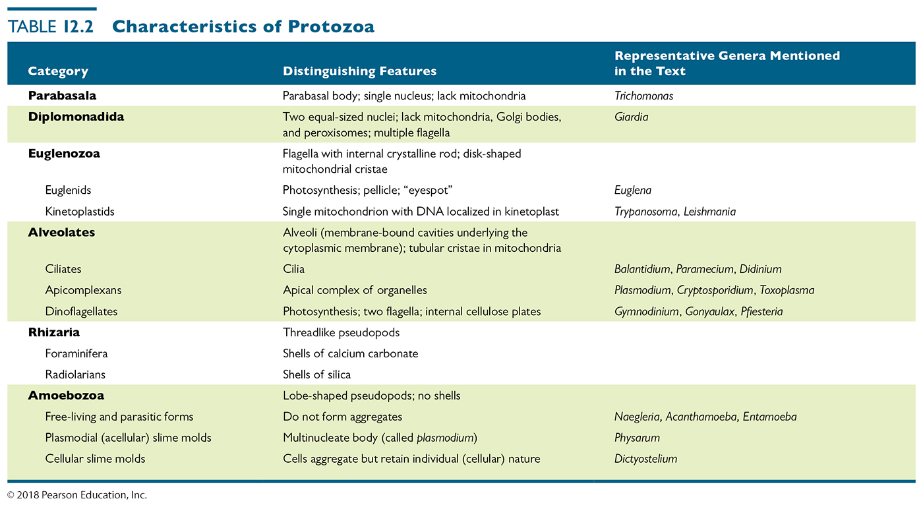
Table 12.2 Characteristics of Protozoa
IGNORE THIS LINE
Notes:
28

Slide 29
FUNGI
Chemoheterotrophic
Do not perform photosynthesis
Lack chlorophyll
Have cell walls typically composed of β-glucan and chitin
Related to animals

Slide 30
Why are Fungi important to study???
Many decompose dead organisms and recycle their nutrients (called saprobes)
Others decompose living organisms and consume their nutrients
30% cause diseases of plants, animals, and humans
Can spoil fruit, pickles, jams, and jellies
Some help plants absorb water and minerals
A few are used as food, in religious ceremonies, and in manufacture of foods and beverages
Many produce antibiotics, other drugs, and some poisons/toxins (magic mushrooms?)
Serve as important research tools

Slide 31
Morphology of Fungi
Two basic body shapes
Molds—composed of long filaments called hyphae
Anchor down and fully utilize a food/energy source
Grow above the substrate and distribute spores
Yeasts—small, globular, and composed of a single cell
Able to move around to different locations/food
Some fungi are dimorphic
Produce both yeastlike and moldlike shapes
Shape changes in response to environmental conditions
Yeast-like cells are more mobile than hyphae
Allows fungus to relocate without “giving up” and forming spores

Slide 32
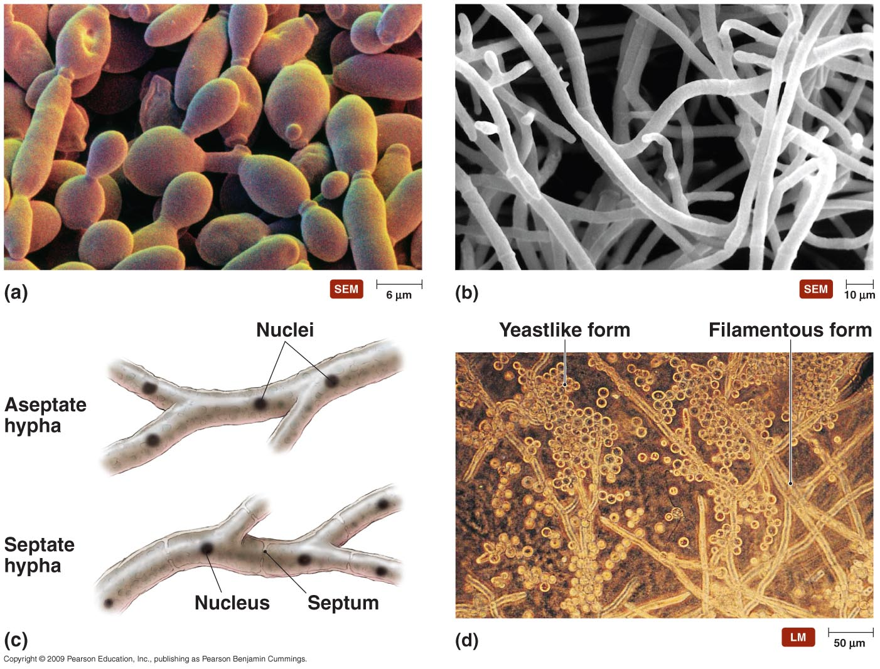
Basic shapes of fungi
[INSERT FIGURE 12.16]

Slide 33
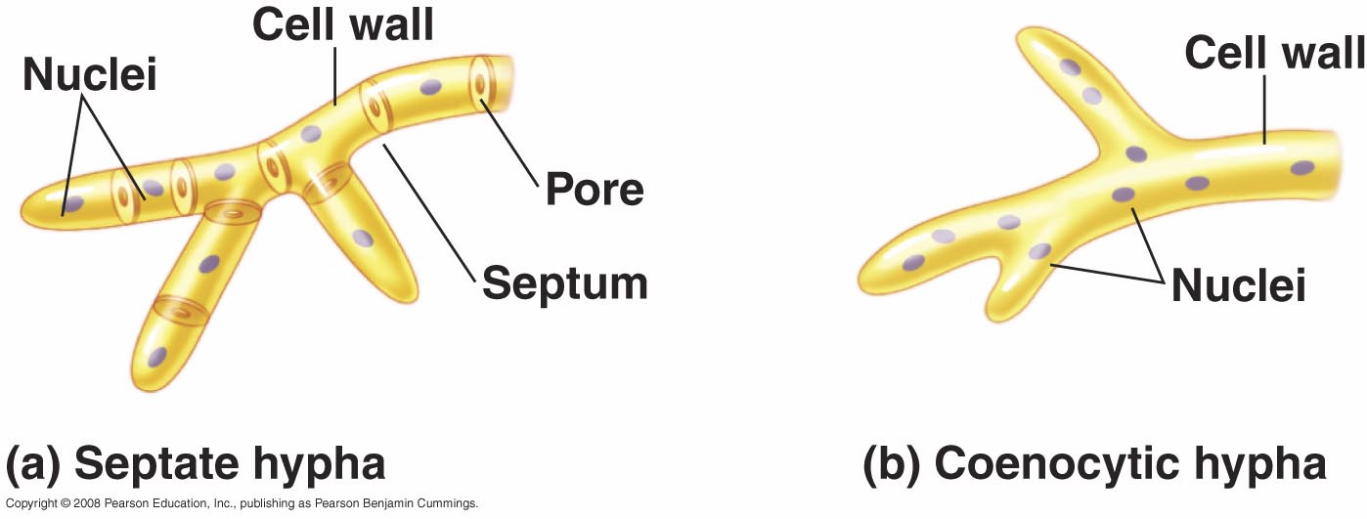
Septate vs. aseptate hyphae
Learn to distinguish septate hyphae and aseptate (or coenocytic) hyphae
Septate hyphae – each nucleus is separated from other nuclei by cell membrane and cell wall (septum), containing a pore to allow nutrients to move throughout the fungus
Aseptate hyphae – no cell walls between nuclei
Notes:
33

Slide 34
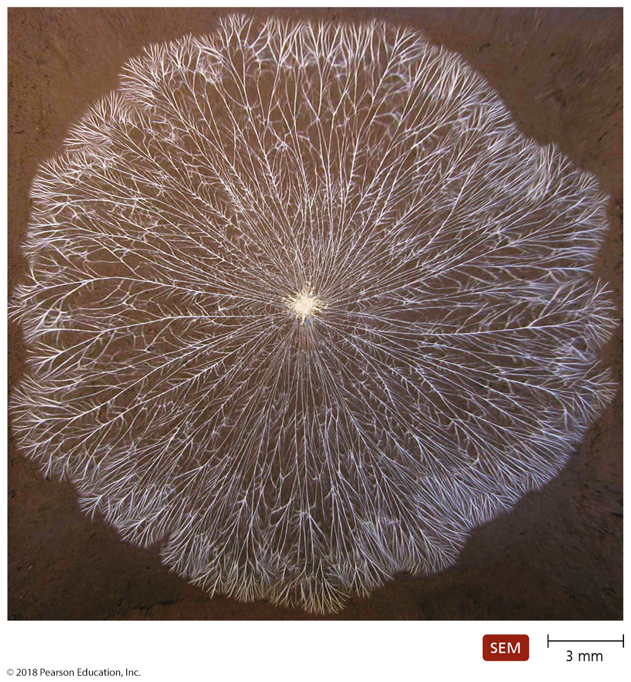
The fungal mycelium – how nutrients are absorbed, and distributed, throughout the fungus.
Notes:
34

Slide 35
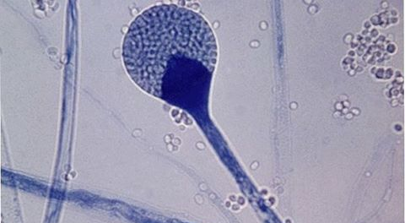
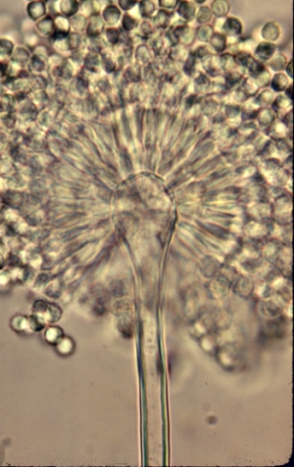
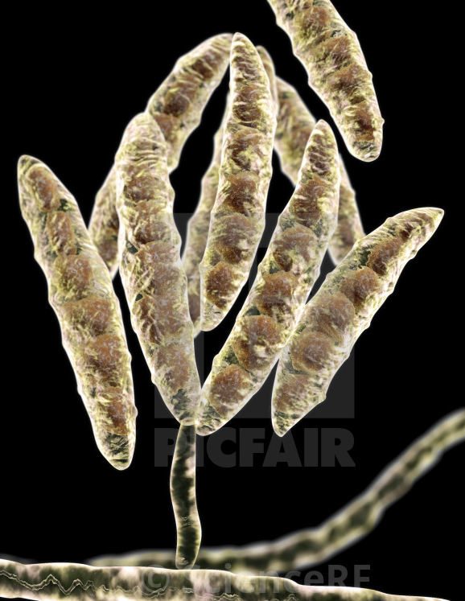
Asexual Reproduction in Fungi
All reproduce asexually using mitosis and cytokinesis
Asexual spores are named without rules
Spore-forming structures are highly diverse morphologically
Conidia (conidium, sing.) from condiophores (Ascomycota)
Sporangiospores from sporangiophore (Zygomycota), etc.
All spores are generated from haploids by mitosis and cytokinesis and are genetically identical to one another

Slide 36
Sexual Reproduction in Fungi
They also reproduce sexually, but far less often
Sexual spores are named based on their classification
e.g. basidiospores from basidiophore, zygospores from zygophore, ascospores from ascophore
In general, -spores from -phores
Ascophores and ascospores also have classical species-specific names (peziza, asci, etc.)
Haploid mating parts attract and/or grow toward each other
Membranes fuse, mixing cellular contents, including mitochondria (plasmogamy) and nuclei
Sometimes nuclear fusion is delayed, and the cell remains dikaryotic (undergoes di-mitosis and cytokinesis indefinitely)
Nuclei fuse, forming diploid genome (karyogamy)
Zygote often undergoes meiosis immediately to make genetically diverse haploid spores of both mating types

Slide 37
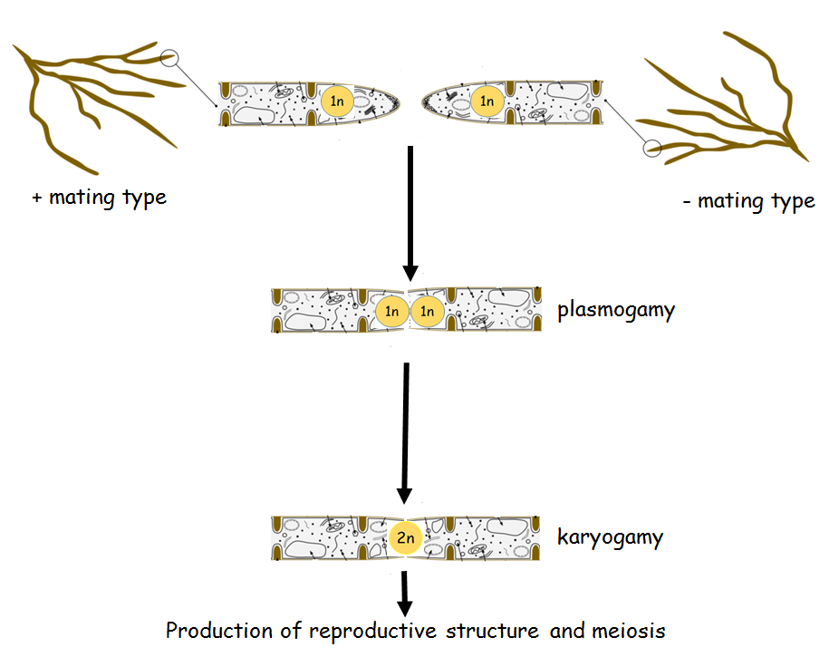
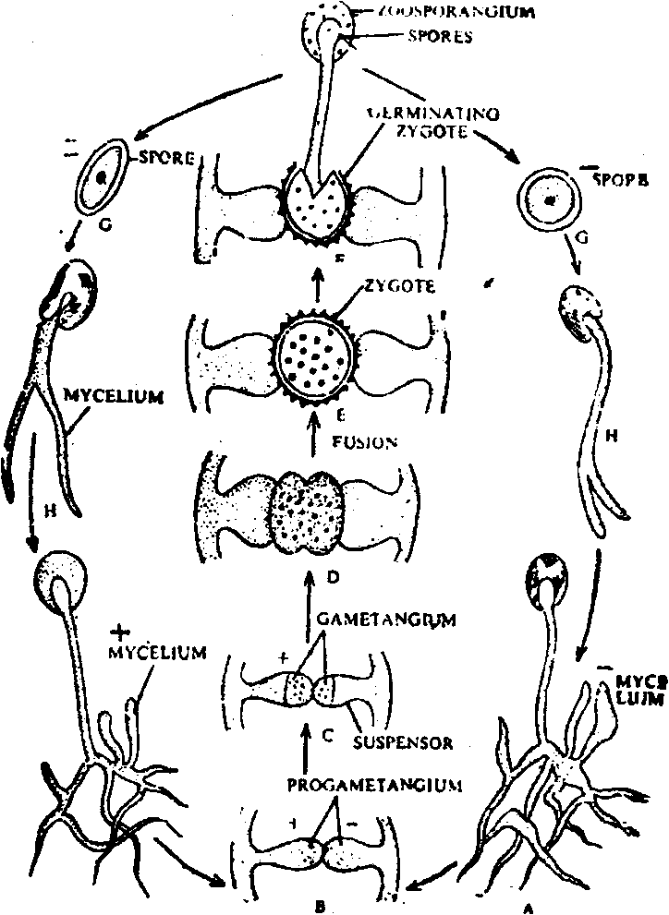
Sexual reproduction in molds:
Instead of male and female, there is (+) and (-)

Slide 38
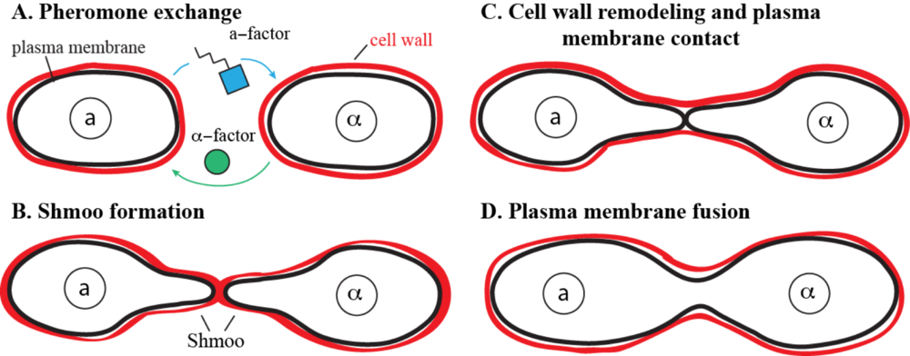
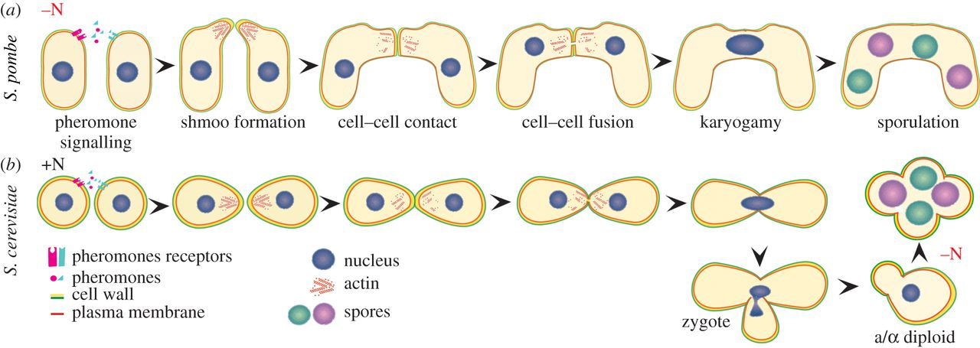
Sexual reproduction in yeasts
Instead of male and female, there is (a) and (α)

Slide 39
Classification of Fungi – SUMMARY SLIDE
Division Zygomycota
Division Ascomycota
Division Basidiomycota

Slide 40
Classification of Fungi – SUMMARY SLIDE
They differ primarily on how long their non-haploid life cycle lasts
Zygomycota – zygospore quickly becomes a zygosporangium that generates haploid spores
Ascomycota – dikaryotic structure forms from fused mycelia (ascocarp) that generates haploid spores from meiosis
Basidiomycota - haploid mycelia are microscopic; most of lifetime is growing the dikaryotic basidiocarp; haploid spores immediately form from diploid basidospores (basidiophore is dikaryotic)

Slide 41
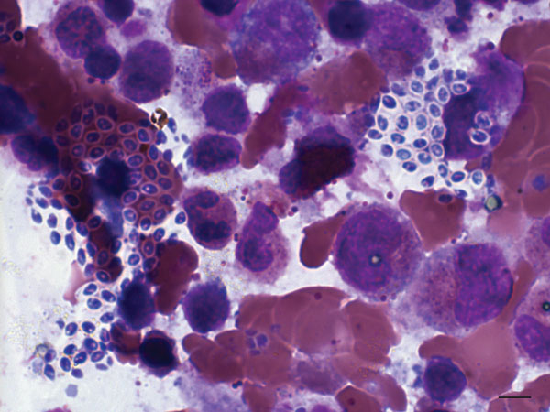
Division Zygomycota
1100 known species
Most are saprobes
Others are obligate parasites
of insects, bread, and other fungi
Reproduce asexually via sporangiospores
Most notable human pathogen - Microsporidium
Once classified as protozoa
Obligate intracellular parasites
Spread as small, resistant spores that punch into new cell during germination
Opportunistic lung infections of immunocompromised

Slide 42
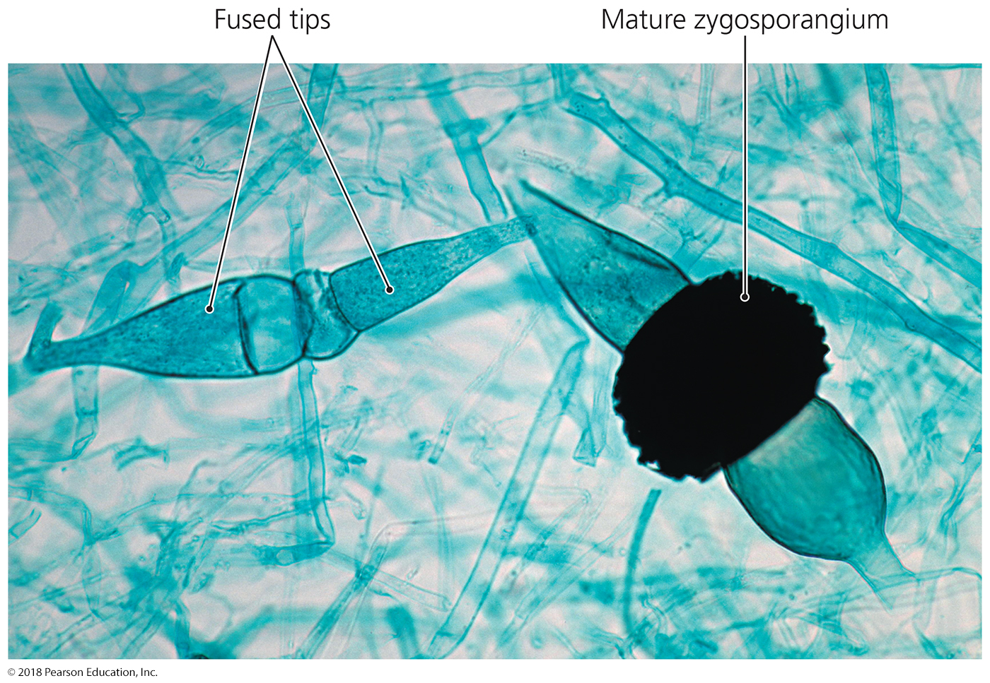
Figure 12.18 Zygosporangium.
Notes:
42

Slide 43
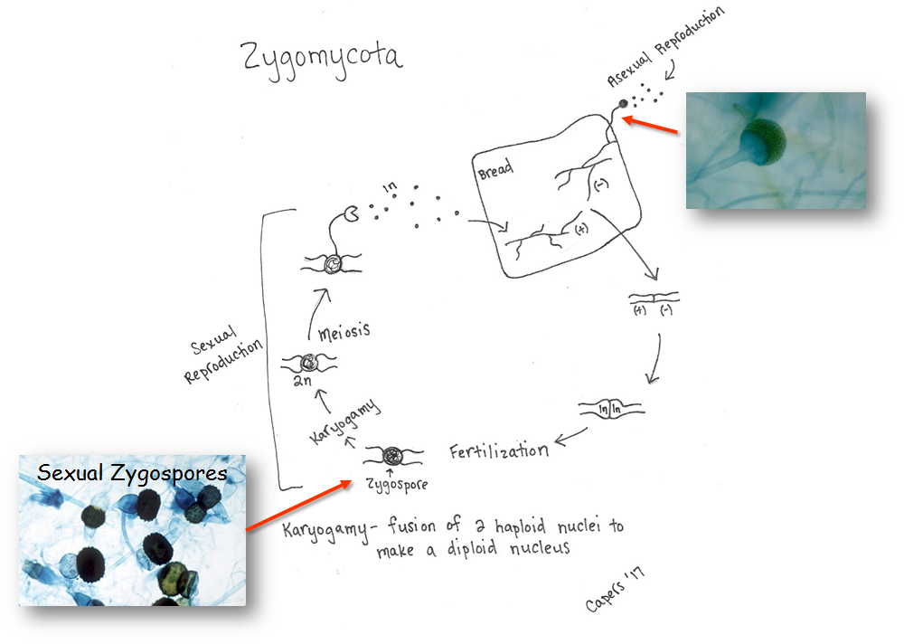
These are rare structures to observe
Learn to distinguish sexual spore formation from asexual spore formation

Slide 44
Division Ascomycota
32,000 known species
Sexual reproduction: ascomycetes form ascospores in sacs called asci
Asexual reproduction: also reproduce by conidiophores and conidiospores (a.k.a conidia) throughout life cycle
Includes most of the fungi that spoil food
Some infect plants and humans
Candida – yeast infections, thrush, candidiasis
Fusarium – fungal wilt of barley, banana, tomatoes, etc.
Many are beneficial
Penicillium – antiobiotic production, otherwise not useful
Saccharomyces – wine, beer, mead, bread production

Slide 45
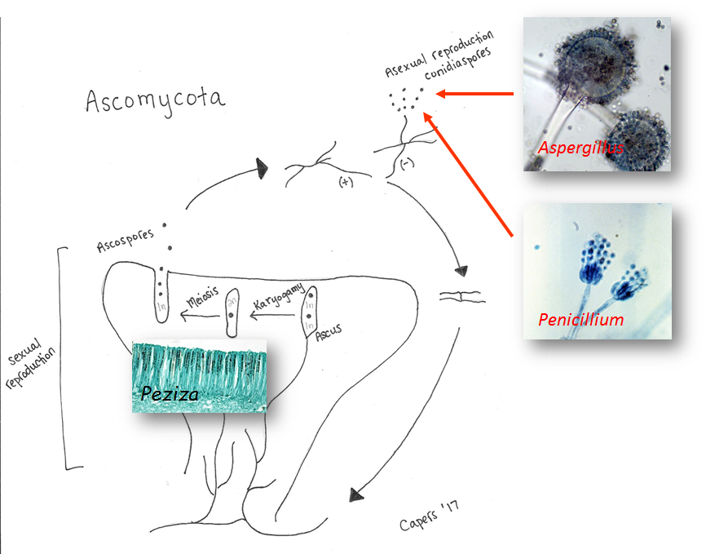
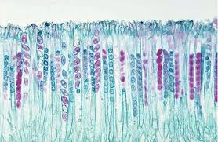

Slide 46
Asexual spore formation in Penicillium

Slide 47
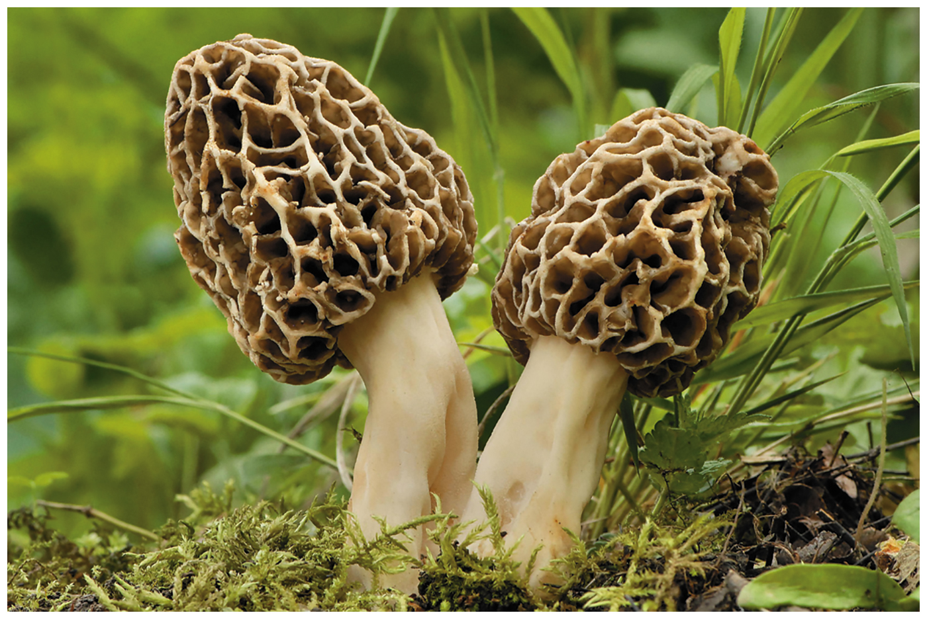
Figure 12.19 Ascocarps (fruiting bodies) of the common morel, Morchella esculenta.
Notes:
47

Slide 48
Division Basidiomycota
22,000 known species
Mostly mushrooms
Some infective yeast-like species (Cryptococcus)
After plasmogamy, dikaryotic fruiting body (called a basidiocarp) grows before karyogamy, then immediate meiosis and distribution of haploid spores
Basidiomycetes affect humans in several ways
Most are decomposers that return nutrients to the soil or make them more bioavailable to others
Most mushrooms produce toxins or hallucinatory chemicals (very few are edible, even after boiling, and even fewer are sold commercially)
Some cause expensive crop damage (decompose and intoxicate soil and plants)

Slide 49
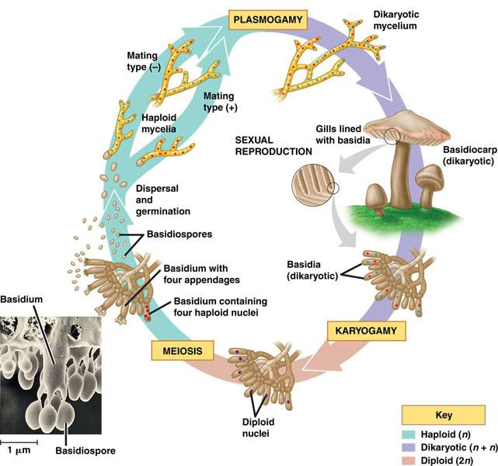
The lifecycle of macroscopic basidiomycota
Multinucleate body grows after plasmogamy
LONG delay of karyogamy

Slide 50
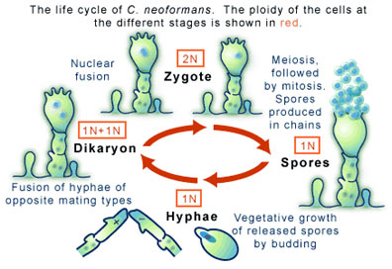
The lifecycle of Cryptococcus neoformans, the agent of opportunistic cryptococcal pneumonia and meningitis
The haploid state is yeastlike and opportunistically pathogenic

Slide 51
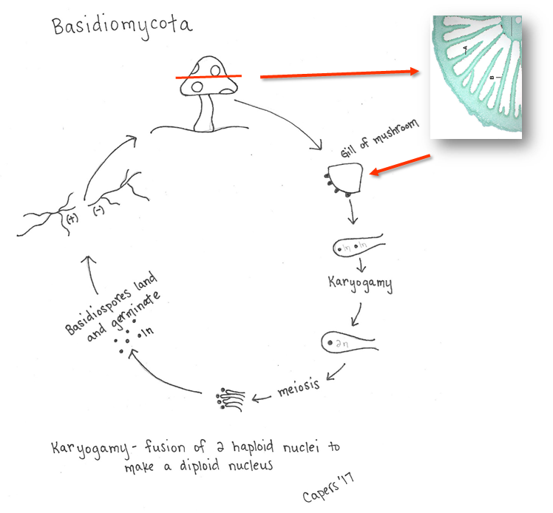
Multinucleate body grows after plasmogamy
LONG delay of karyogamy

Slide 52
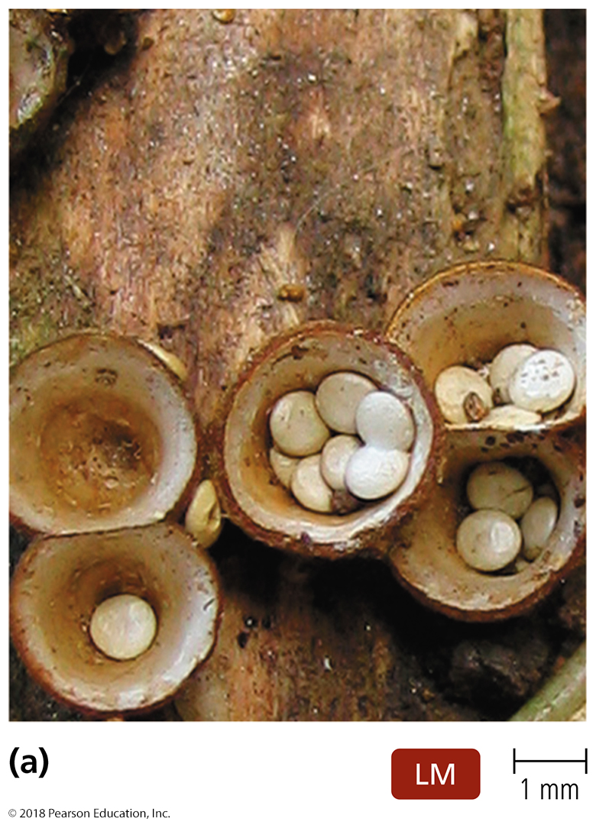
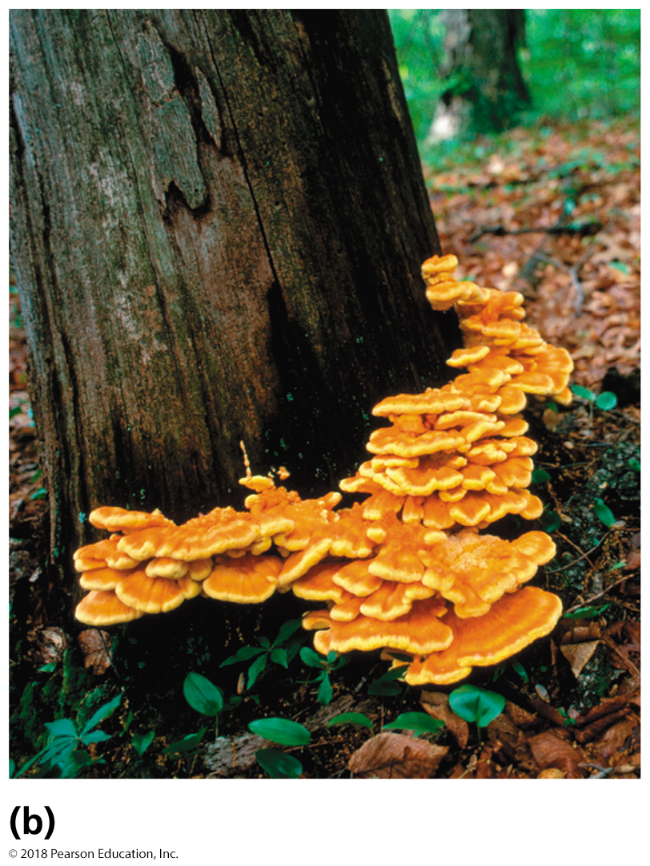
Figure 12.20 Basidiocarps (fruiting bodies).
Notes:
52

Slide 53
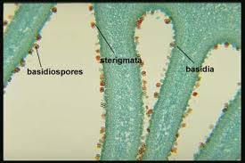
Inside the basidiocarp – where meiosis occurs
production of 4 haploid cells after meiosis

Slide 54
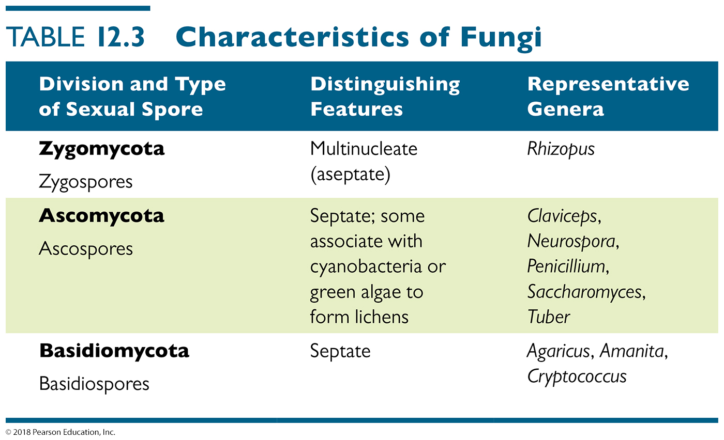
Table 12.3 Characteristics of Fungi
Notes:
54

Slide 55
Other Eukaryotes of Microbiological Interest: Parasitic Helminths and Vectors
Helminths
Tapeworms, Flukes, Nematodes
They have diagnostic infectious structures
Arthropod vectors – carriers of pathogens
They are not infective themselves, but carry infectious microbes and pathogens that infect us as they feed off of us.
Mechanical vectors – transmit disease through physical contact (a bus, or car, or truck)
Biological vectors – transmit disease and participate in pathogen development (a grease truck, ice cream truck, or pizza delivery man)

Slide 56
Phylum Platyhelmenthes (flatworms) - tapeworms

Slide 57
Phylum Platyhelminthes (flatworms) – the fluke

Slide 58
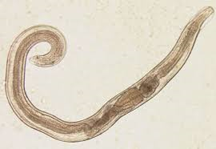
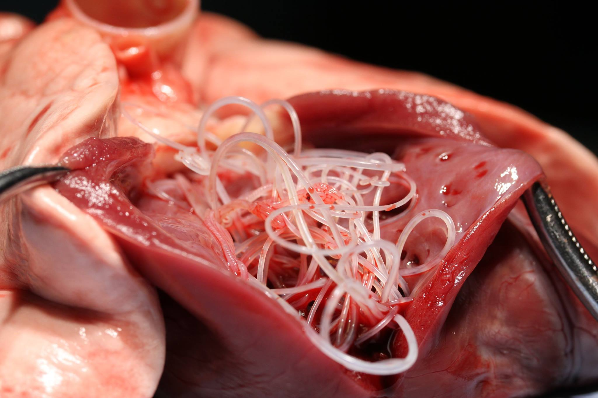
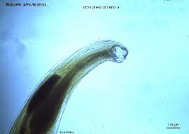
Phylum Nematoda
pinworm
Intracellular –
trichinella
(cyst form)
heartworm
hookworm

Slide 59
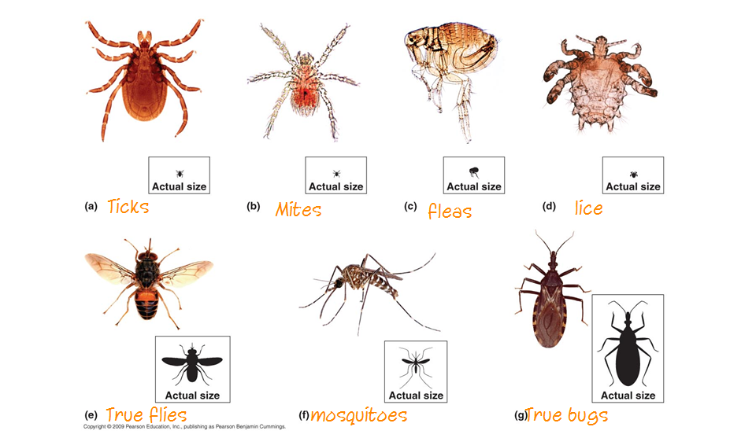
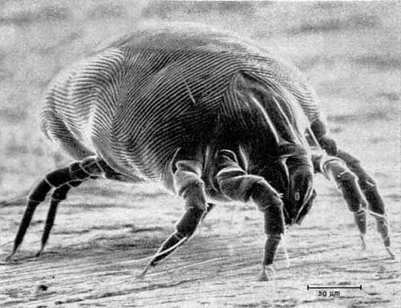
Arthropods – Microbe Vectors – SUMMARY SLIDE
Disease vectors are members of two classes of arthropods.
Arachnida
8 legs
ticks
mites
Insecta
6 legs
mosquitos
fleas
lice
flies

Slide 60
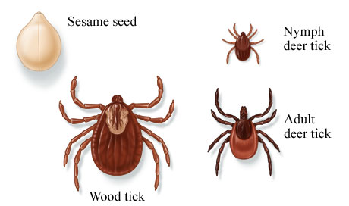
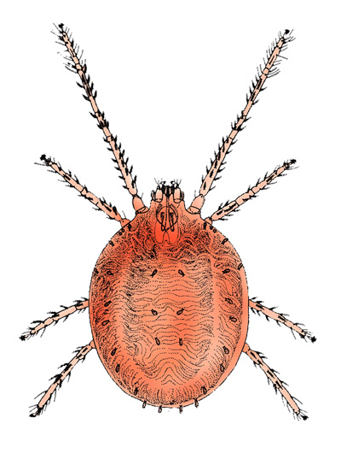
Arachnid Vectors
Adult arachnids have four pairs of legs.
Ticks are the most important arachnid vectors.
Hard ticks are most prominent tick vectors.
A few mite species transmit rickettsial diseases.
mite

Slide 61
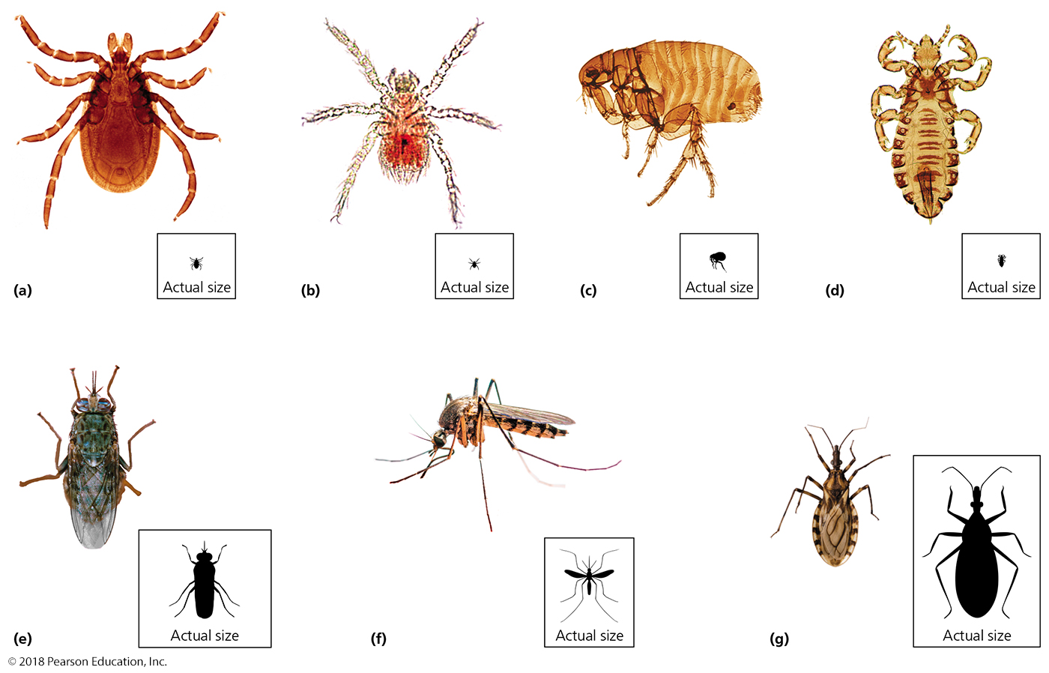
Insect Vectors
Adult insects have three pairs of legs and three body regions
Include:
Fleas
Lice
Flies
Mosquitoes
Most important arthropod vectors of disease
Kissing bugs

