Slide 1
Microbiology
Chapter 11
Characterizing and Classifying Prokaryotes

Slide 2
We can characterize prokaryotes by structure
Morphology of Prokaryotic Cells
Most diverse group of cellular microbes
Thrive in various habitats
Only a few are capable of colonizing humans and causing disease
Exist in a variety of shapes

Slide 3
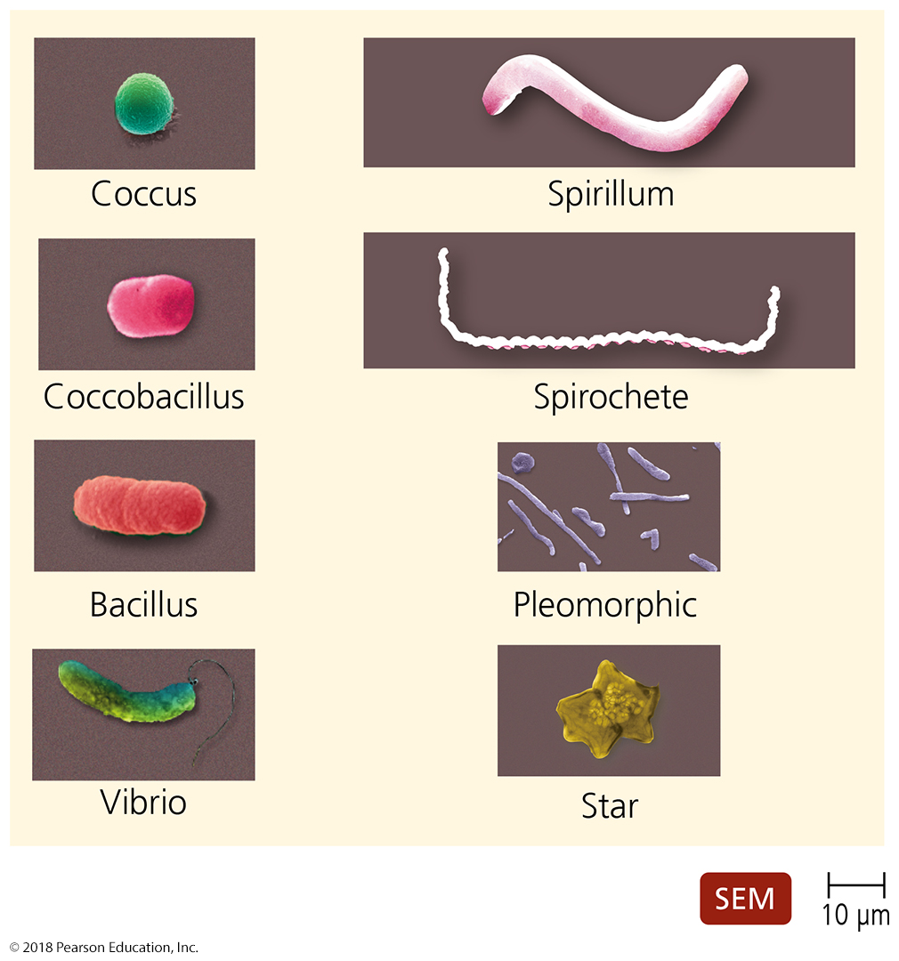
Figure 11.1 Typical prokaryotic morphologies.
“rod”
“curved”
Notes:
3

Slide 4
General Characteristics of Prokaryotic Organisms
Endospores
Produced by the Gram-positive bacteria Bacillus and Clostridium
Each vegetative cell transforms into one endospore
Each endospore germinates to form one vegetative cell
Defensive strategy against unfavorable conditions
Concern to:
food processors (food must be destroyed)
health care professionals (extra-hard cleaning and decontamination)
governments (public health hazard; food unable to be sold)

Slide 5
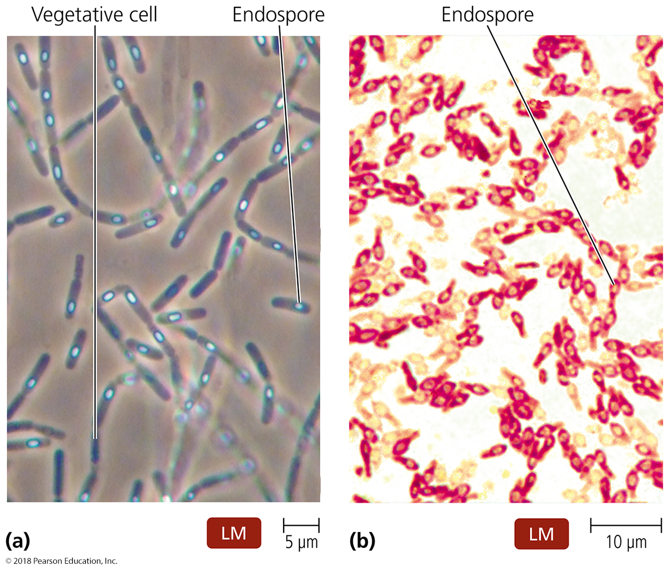
Figure 11.2 Locations of endospores.
Notes:
5

Slide 6
General Characteristics of Prokaryotic Organisms – SUMMARY SLIDE
Reproduction of Prokaryotic Cells
All reproduce asexually
Three main methods:
Binary fission (most common)
Snapping division (old cell wall does not break for daughter cells until they get big enough)
Budding

Slide 7
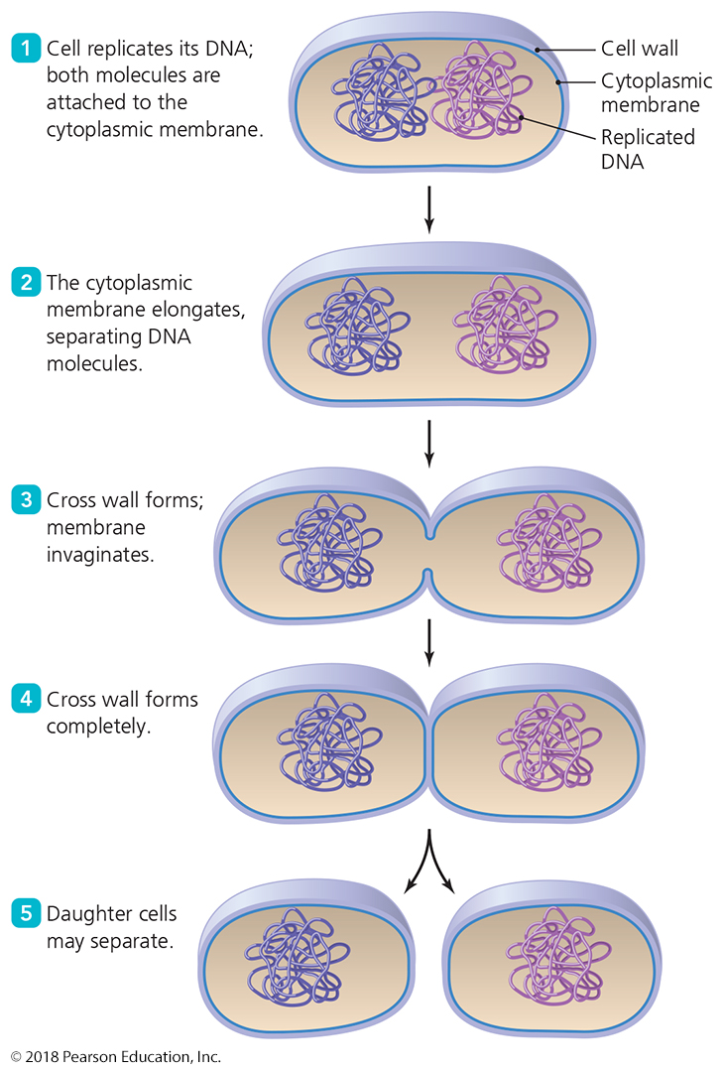
Figure 11.3 Binary fission (in gram positive bacteria).
Each cell begins making its own cell wall as the septum forms
The two cells physically rip themselves away from each other and their old cell wall
Notes:
7

Slide 8
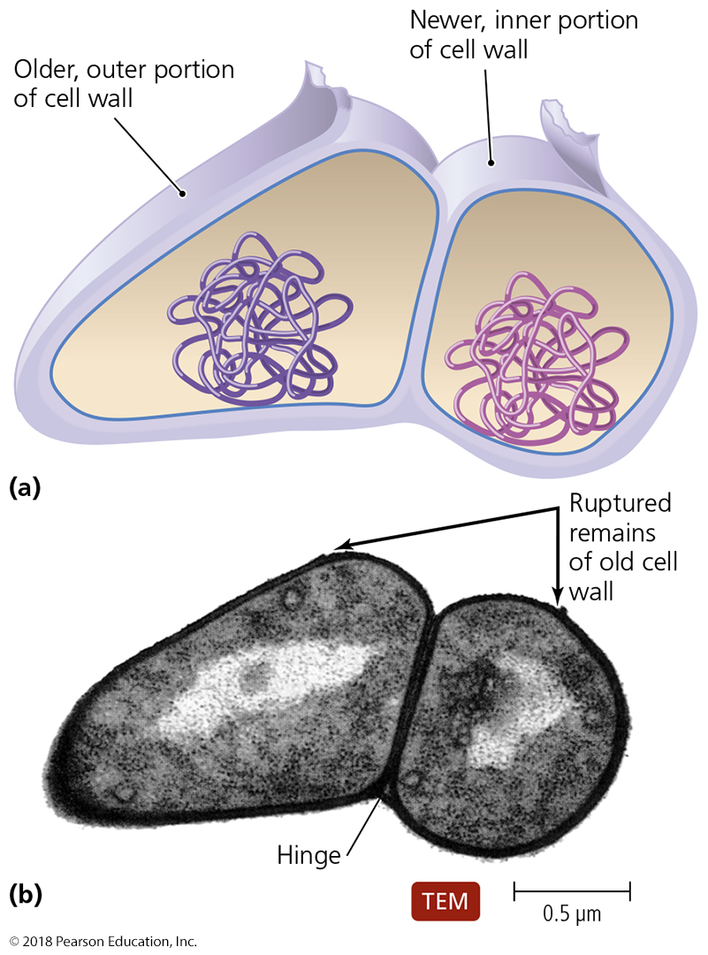
Figure 11.4 Snapping division, a variation of binary fission (in gram positive).
Notes:
8

Slide 9
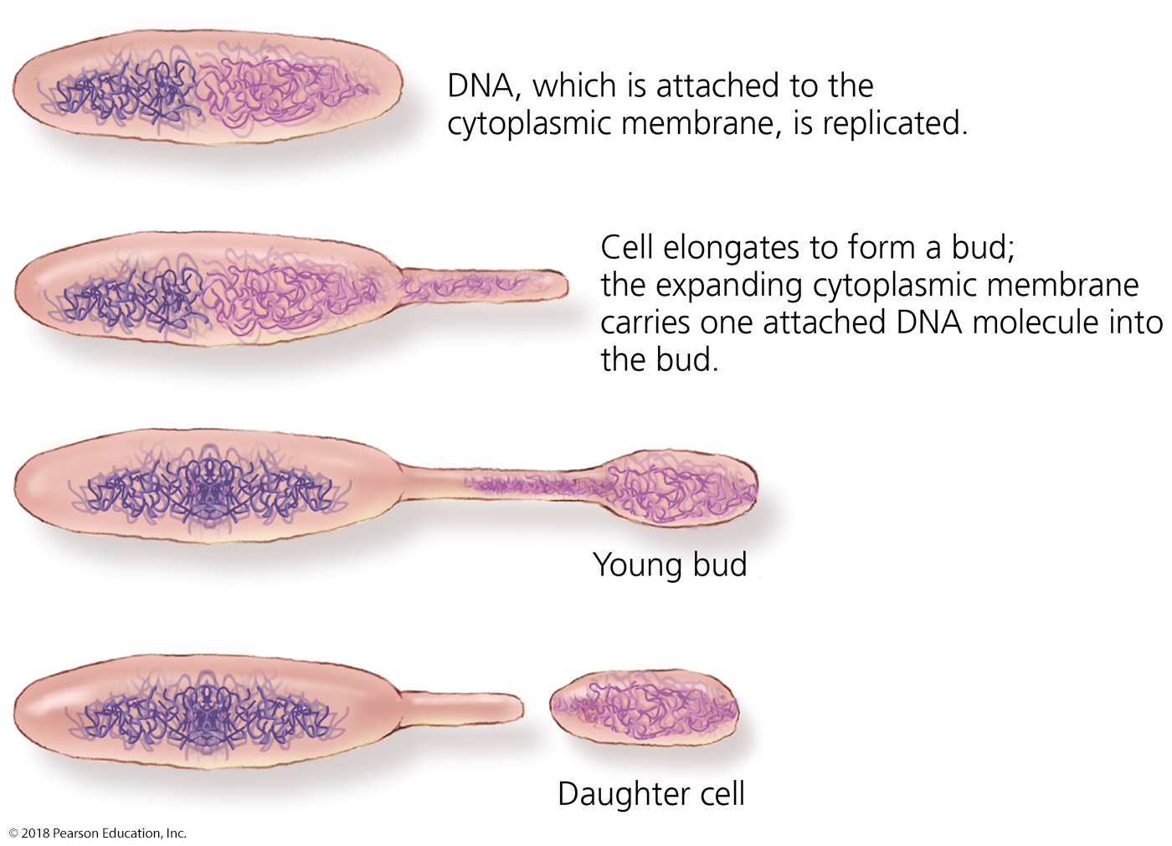
Figure 11.6 Budding.
Notes:
9

Slide 10
General Characteristics of Prokaryotic Organisms
Arrangements of Prokaryotic Cells
NOT the same as colony morphology!
Visible only under microscope
Seen from solid culture or gentle liquid culture
Results from two aspects of division during binary fission:
Planes by which cells divide
Must the daughter cells separate from each other to divide again

Slide 11
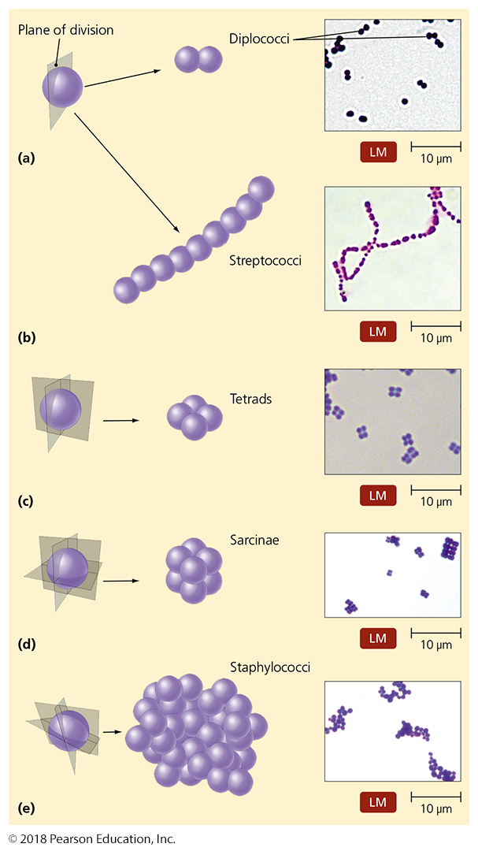
Know each of these arrangements of cocci.
Single division plane; cells separate easily
Or stop dividing when bound to neighbor
Single division plane; cells do not separate
two division planes at right angles; cells stop dividing when bound to neighbors
three division planes at right angles; cells stop dividing when bound to neighbors
RANDOM division planes; cells do not need to separate to keep dividing
Notes:
11

Slide 12
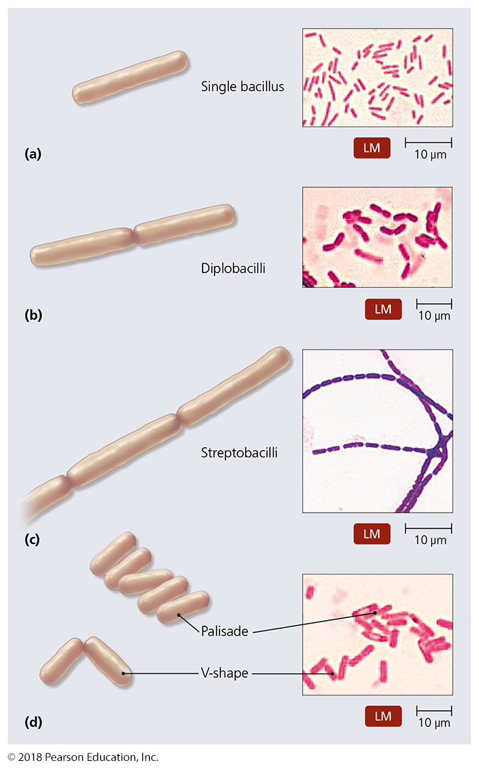
Know each of these arrangements of bacilli.
cells separate easily
Single division plane (short axis); cells stop dividing when bound to neighbor
Single division plane (short axis); cells do not stop dividing
Single division plane; cells do not stop dividing; snapping division keeps them clustered
Notes:
12

Slide 13
Modern Prokaryotic Classification
Currently based on genetic relatedness of 16S or 18S rRNA sequences
This rRNA channels the mRNA into and through the ribosome
critical function for ribosome
TIGHTLY conserved through billions of years
Three Domains of life on Earth:
Bacteria (sorted by 16S rRNA gene sequence)
Archaea (sorted by 18S rRNA gene sequence)
Eukarya (sorted by 18S rRNA gene sequence)

Slide 14
Figure 11.10 Prokaryotic taxonomy – SUMMARY SLIDE
Archaea
Extremophiles
thermophiles, halophiles, methanogens
Bacteria
Gram (+) bacteria – phylogenetically older group
low G+C
Clostridium, Mycoplasma, Bacillus, Listeria, Lactobacillus, Streptococcus, Enterococcus, Staphylococcus,
high G+C
Corynebacterium, Mycobacterium, Actinomycetes
Gram (-) bacteria – phylogenetically younger group
Proteobacteria
alpha-, beta-, gamma, delta-, epsilon-, zeta-
Chlamydia, Spirochetes, Bacterioides
Notes:
14

Slide 15
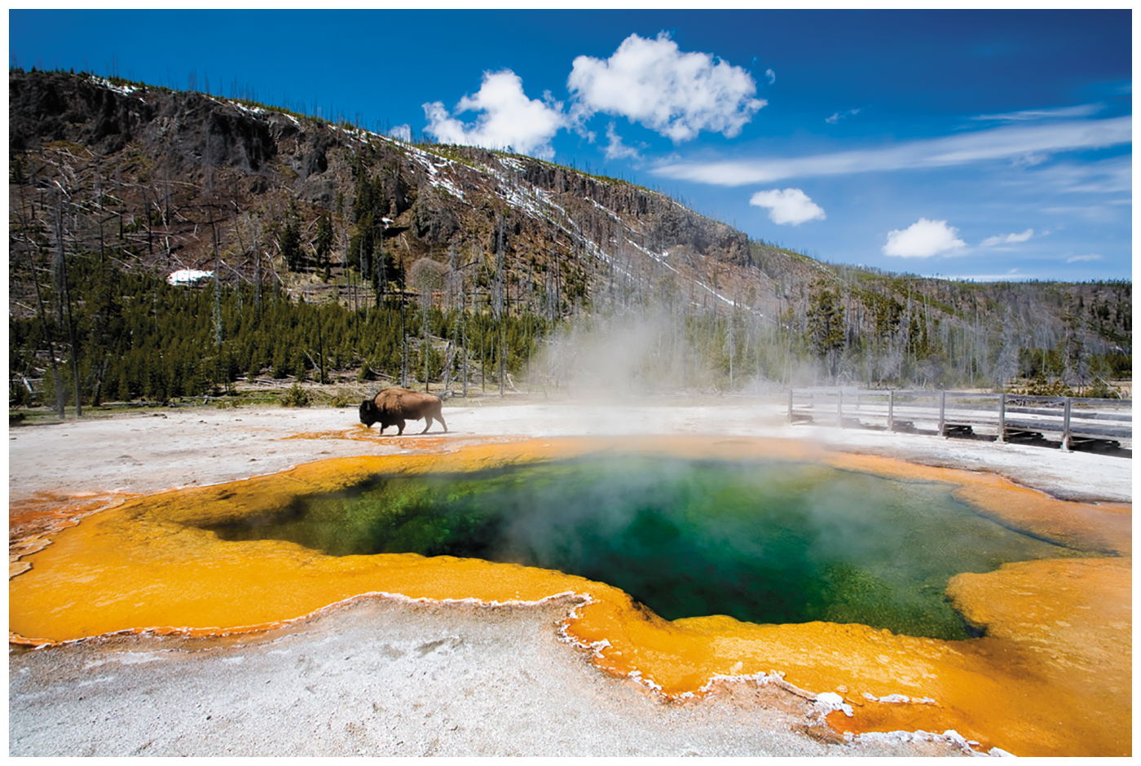
Survey of Archaea
Generally not pathogenic
Extremophiles
Require extreme conditions to survive
Temperature, pH, and/or salinity
Prominent members are thermophiles (> 60 C) and halophiles (> 9% NaCl)

Slide 16
Survey of Archaea
Methanogens
Largest group of archaea
Convert carbon dioxide, hydrogen gas, and organic acids to methane gas
Convert organic wastes in pond, lake, and ocean sediments to methane
Some live in colons of animals (cows)
One of primary sources of environmental methane
Have produced ~10 trillion tons of methane that is buried in mud on ocean floor

Slide 17
Survey of Bacteria
Low G + C Gram-Positive Bacteria
Clostridia (Clostridium or Clostridioides sp.)
Rod-shaped, obligate anaerobes
Many form endospores spontaneously
In preparation for exposure to oxygen-rich world until reingested into an oxygen-poor environment
Important in medicine, industry, and bioenergy
C. difficile – gastroenteritis from overuse of antibiotics
C. perfringens – gas gangrene
C. tetani – tetanus
C. botulinum – botulism, botox-based therapies (inhibit muscle spasms, relax muscles for cosmetics
C. thermocellum – cellulose-based ethanol production

Slide 18
Which are the endospores?

Slide 19
Survey of Bacteria
Low G + C Gram-Positive Bacteria
Mycoplasma species
Facultative or obligate anaerobes
Lack cell walls (Which antibiotics will not work???)
Smallest free-living cells – cannot resolve most cells clearly in a light microscope
Colonize mucous membranes of the respiratory (atypical pneumonia) and urinary tracts (vaginoses, pelvic inflammatory disease)
Major contaminant of mammalian cell culture

Slide 20
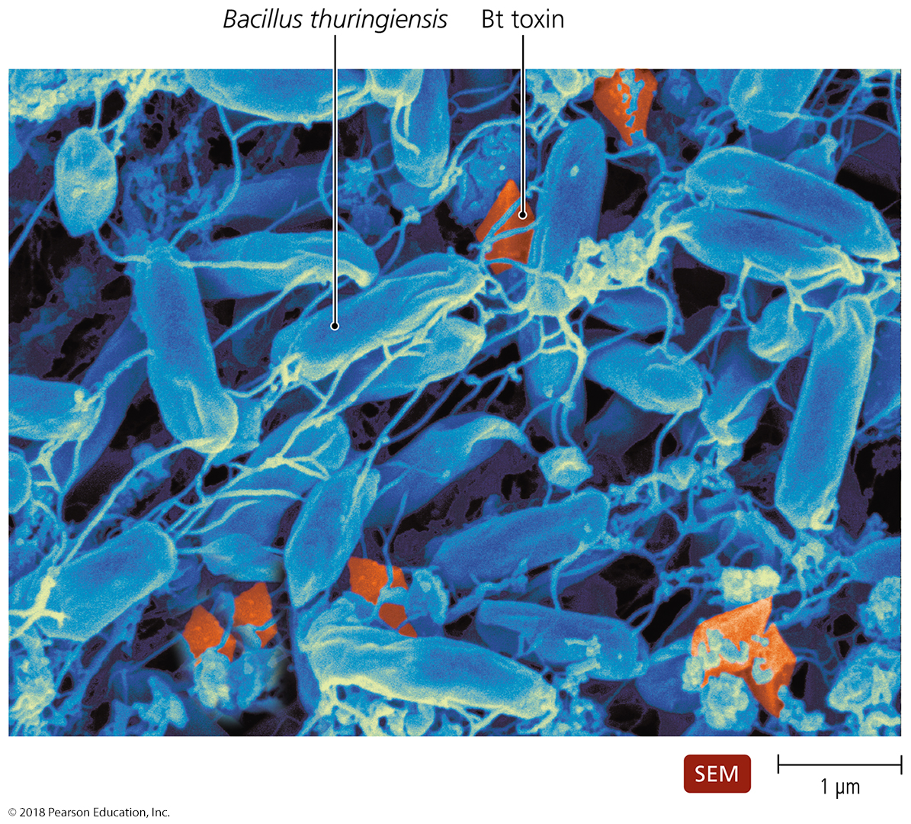
Survey of Bacteria
Low G + C Gram-Positive Bacteria
Bacillus
Many are common in soil
Form endospores – highly resistant to UV
Bacillus anthracis - anthrax
Bacillus cereus - grain-based food poisoning
Bacillus thuringiensis toxin used by farmers and gardeners as an insecticide
(cloned toxin gene used to create Bt transgenic vegatables)

Slide 21
Survey of Bacteria
Low G + C Gram-Positive Bacteria
Listeria species
L. monocytogenes – listeriosis through contaminated milk and meat products
Capable of reproducing under refrigeration
Can cross the placenta in pregnant women
Lactobacillus species
Grows in the body naturally but rarely causes disease
Used in the production of various foods (yogurt, kefir)
Primary genus used in probiotic formulations

Slide 22
Survey of Bacteria
Low G + C Gram-Positive Bacteria
Streptococcus and Enterococcus
Cause numerous diseases (mucosa and gut)
Various strains of multi-drug-resistant streptococci
MDR enterococci often precede MDR streptococci and staphylococci
Staphylococcus
Cause numerous disease (skin, mucosa)
One of the most common inhabitants of humans
Produces toxins and enzymes that contribute to disease, especially when patient or skin weakened

Slide 23
Survey of Bacteria
High G + C Gram-Positive Bacteria
Corynebacterium
Pleomorphic aerobes and facultative anaerobes
Most are harmless
C. diphtheriae - diphtheria
Produces metachromatic granules (phosphates) and V-shaped arrangements of cells
Mycobacterium
Aerobic rods that sometimes form filaments
Slow growth partly due to mycolic acid in its cell walls
Mycolic acid makes it resistant to antibiotics, detergents, and the immune system
M. tuberculosis – tuberculosis (consumption)
M. leprae – Hansen’s disease (leprosy)

Slide 24
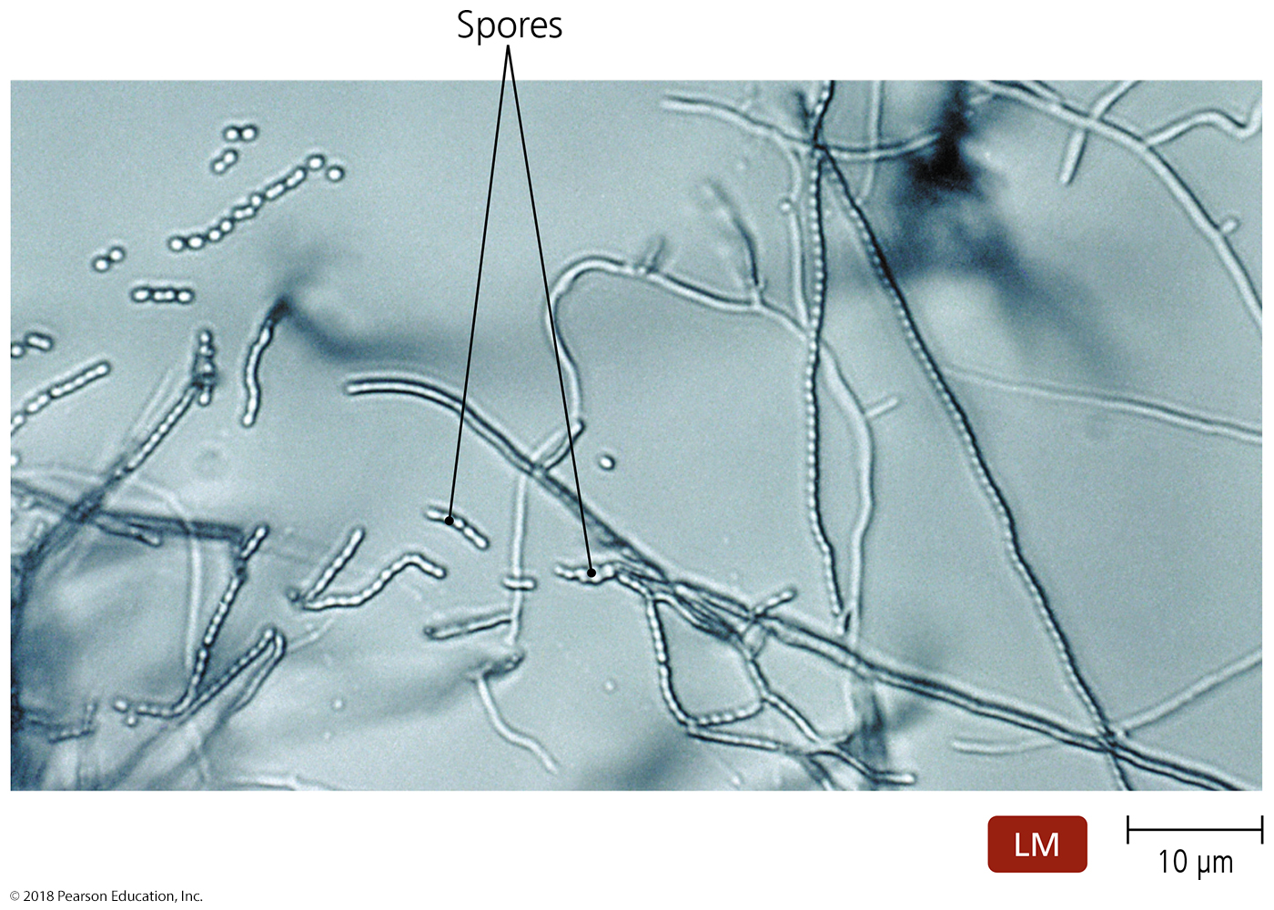
Survey of Bacteria
High G + C Gram-Positive Bacteria
Actinomycetes
Form branching filaments resembling fungi
Important genera include Actinomyces, Streptomyces
Generally live in the soil and are not pathogenic
Nocardia can colonize human oral mucosa if inhaled or ingestde
Some Nocardia species can cause opportunistic oral or gingival disease
can progress to pneumonia, endocarditis or encephalitis with high mortality

Slide 25
Survey of Bacteria
Gram-Negative Proteobacteria
Largest and most diverse group of gram-neg bacteria
At least six classes of proteobacteria:
Alphaproteobacteria
Betaproteobacteria
Gammaproteobacteria
Deltaproteobacteria
Epsilonproteobacteria
Zetaproteobacteria

Slide 26
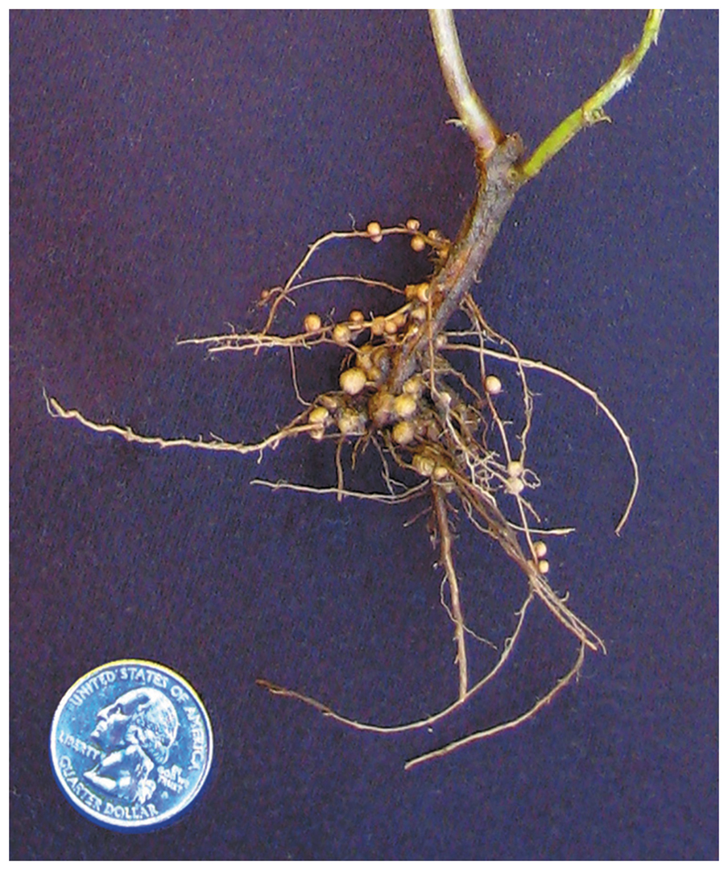
Survey of Bacteria
Gram-Negative Proteobacteria
Class Alphaproteobacteria
Nonpathogenic species
Nitrogen fixers and nitrifying bacteria
Grow in association with the roots of plants
Oxidation of nitrogenous compounds provides electrons
Important in the environment and agriculture

Slide 27
Survey of Bacteria
Gram-Negative Proteobacteria
Class Alphaproteobacteria
Pathogenic species
Rickettsia
Transmitted through bite of an arthropod
Causes several human diseases -typhus,(NOT Typhoid!), Rocky Mountain spotted fever
Brucella
Causes brucellosis (Malta fever) – undulating fever

Slide 28
Survey of Bacteria
Gram-Negative Proteobacteria
Class Betaproteobacteria
Pathogenic betaproteobacteria
Neisseria - inhabits mucous membranes of mammals
N. gonorrhea – gonorrhea, N. meningiditis - meningitis
Bordetella – upper respiratory infections
B. pertussis – whooping cough
B. bronchioseptica – kennel cough
Burkholderia - colonizes moist surfaces and respiratory passages
B. cepacia) – opportunistic pneumonia (especially in cystic fibrosis patients)
B. mallei – glanders (equine disease); bioweapon?

Slide 29
Survey of Bacteria
Gram-Negative Proteobacteria
Class Gammaproteobacteria
Largest and most diverse class of proteobacteria
Some are intracellular pathogens
Legionella
Causes Legionnaires’ disease
Coxiella
C. burnetti – Q Fever
transmitted by ticks
was developed as a bioweapon due to its considerable heat, dryness, and disinfectant resistance

Slide 30
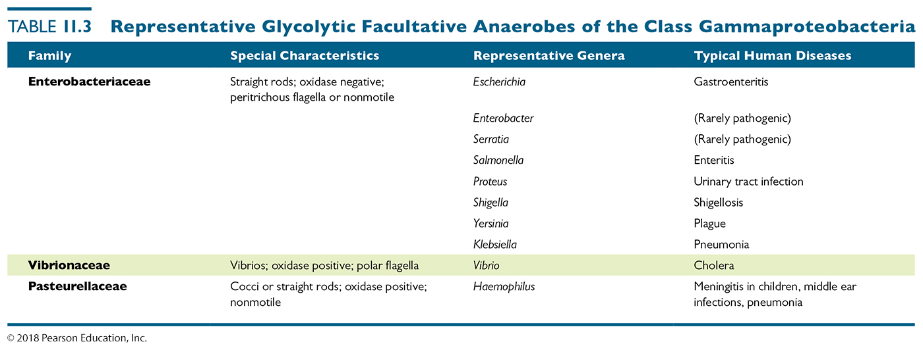
Table 11.3 Representative Glycolytic Facultative Anaerobes of the Class Gammaproteobacteria
Many pathogenic gammaproteobacteria are divided into three families:
Enterobacteriaceae
Vibronaceae
Pasturellaceae
Notes:
30

Slide 31
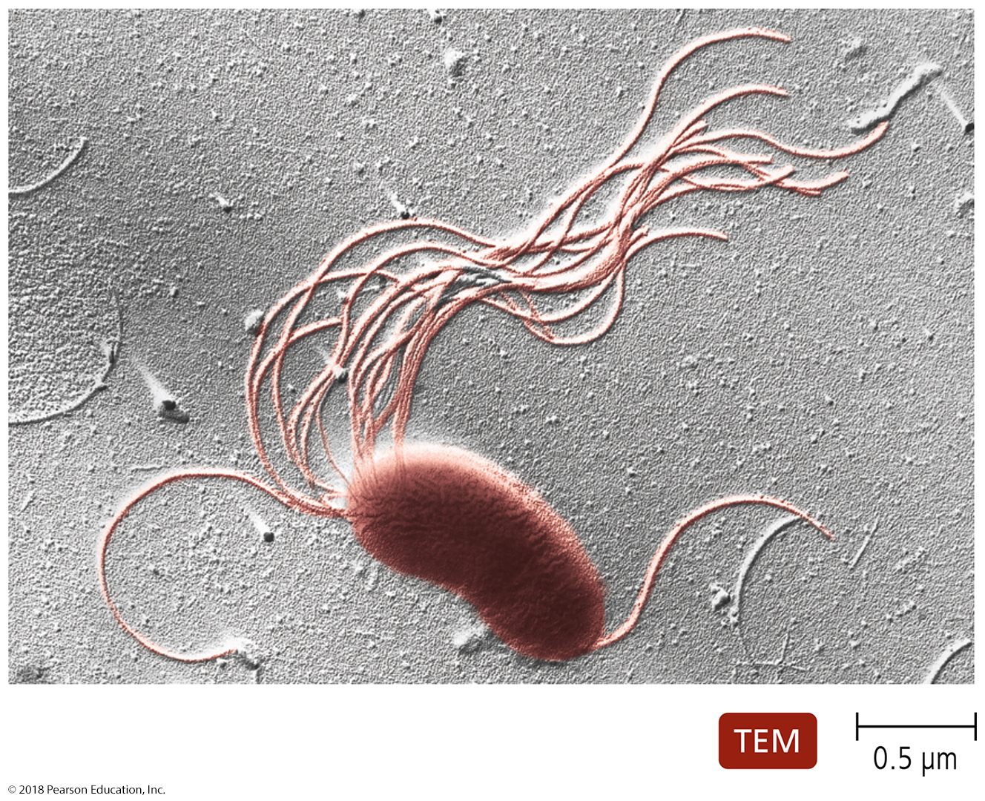
Survey of Bacteria
Gram-Negative Proteobacteria
Class Gammaproteobacteria
Pseudomonas species
obligate aerobes
Break down numerous organic compounds
Important pathogens of humans and animals
Pseudomonas causes urinary tract, ear, and lung infections
Naturally multi-drug resistant
Common nosocomial infectious agents

Slide 32
Survey of Bacteria
Gram-Negative Proteobacteria
Class Epsilonproteobacteria
Important genera include
Campylobacter – food poisoning
Helicobacter – gastric ulcers; present in half the population, most of which do not have peptic ulcers

Slide 33
Survey of Bacteria
Other Gram-Negative Bacteria
Chlamydia species
Grow intracellularly in mammals, birds, and some invertebrates (spore-like form is contagious)
Some are smaller than viruses
Chlamydia trachomatis
Most common sexually transmitted bacteria in the United States
Common causes of pulmonary and ocular infection in immunocompromised
trachoma - blindness from C. trachomatis
Antibiotic eyedrops to newborns of infected mothers commonly done to prevent blindness

Slide 34
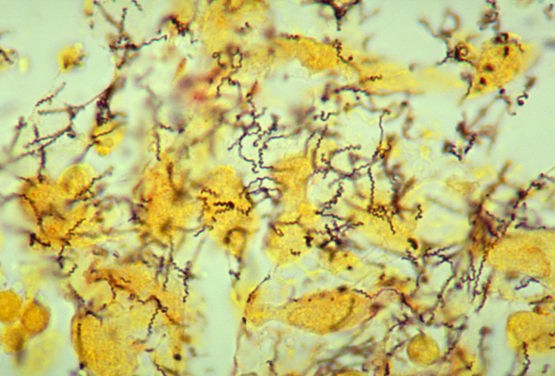
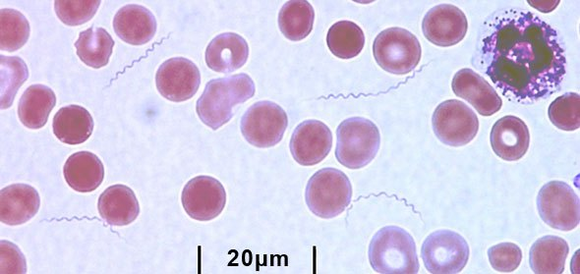
Survey of Bacteria
Other Gram-Negative Bacteria
Spirochetes
Unique morphology – called spirochete
Motile bacteria that move in a corkscrew motion
Flagella integrated with outer membrane
Treponema pallidum – syphilis
Borrelia burgdorferi – Lyme Disease

Slide 35
Survey of Bacteria
Other Gram-Negative Bacteria
Bacteroids
Obligate anaerobe
Their preferred food sources are potentially toxic plant sugars – mutualism with mammals
Prevotella
Inhabits the gut, gingiva, and women’s reproductive system
More common in guts of those with a carbohydrate-rich diet
Bacteroides
Inhabit digestive tracts of humans and animals (50-90% of enteric bacteria by number)
Especially common in those whose diets are rich in protein and animal fats

