Slide 1
Microbiology
Chapter 10
Antimicrobial Drugs

Slide 2
The History of Antimicrobial Agents
Drugs
Chemicals that affect physiology in any manner
Chemotherapeutic agents
Drugs that act against diseases (not just cancer!)
Antimicrobial agents (antimicrobials)
Chemotherapeutic agents that treat infections

Slide 3
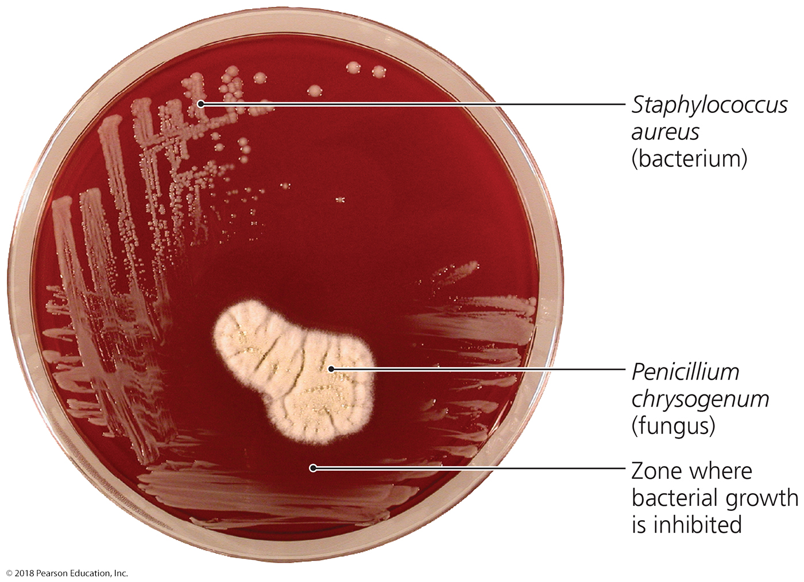
Figure 10.1 Antibiotic effect of the mold Penicillium chrysogenum.
Notes:
3

Slide 4
Clinical Considerations in Prescribing Antimicrobial Drugs
Ideal Antimicrobial Agent
Readily available
Inexpensive
Chemically stable
Easily administered
Nontoxic and nonallergenic
Selectively toxic against wide range of pathogens

Slide 5
The Chemistry of Antimicrobial Agents
Naturally Produced
Isolated from medium in situ
First available before below chemistries developed
Semisynthetic
Naturally-produced antibiotics that are chemically modified
Modifications make them more effective, longer lasting, or easier to administer than natural predecessor (swallowed vs. injected)
Synthetic
Antimicrobials that are completely synthesized in a lab
Often cheaper, especially when produced in bulk
Greatly allows the development of far more diverse derivatives

Slide 6
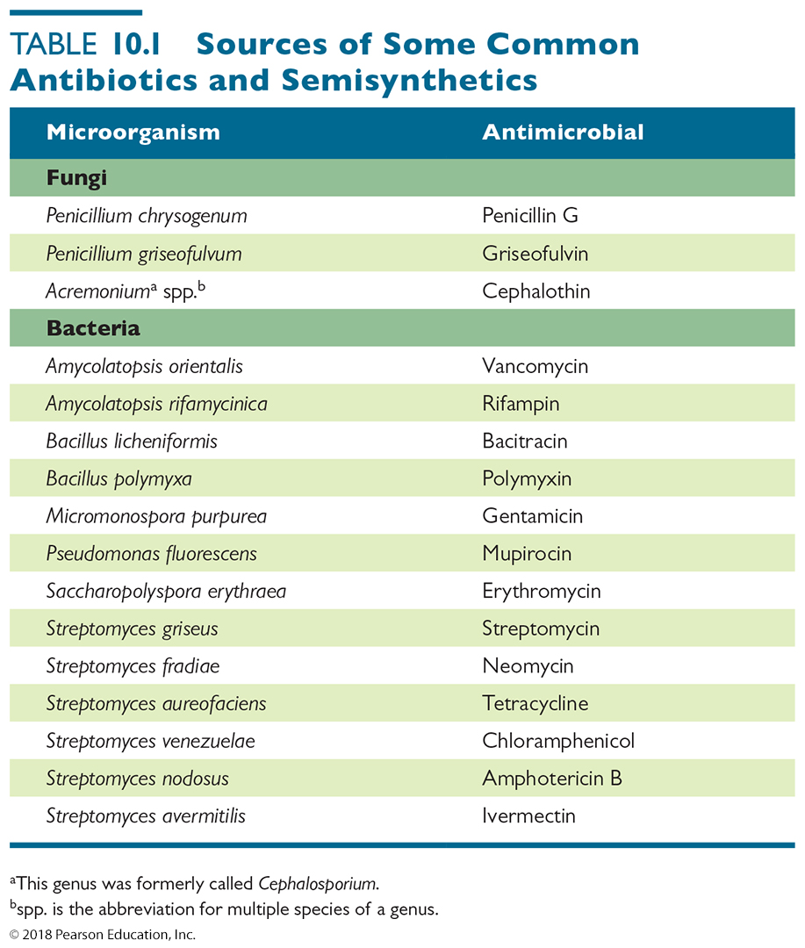
Table 10.1 Sources of Some Common Antibiotics and Semisynthetics
Notes:
6

Slide 7
Mechanisms of Antimicrobial Action
Successful chemotherapy requires selective toxicity (kill the microbe; not the human)
Antibacterial drugs constitute largest number and diversity of antimicrobial agents
big difference between humans and bacteria
HOWEVER less difference between bacteria and mitochondria…why?
Fewer drugs to treat eukaryotic infections
Antiviral drugs limited and harder to develop
Viral polymerases are often derived from cellular polymerases and therefore are too similar to make a drug easily to discriminate between the viral polymerase and cellular polymerases

Slide 8
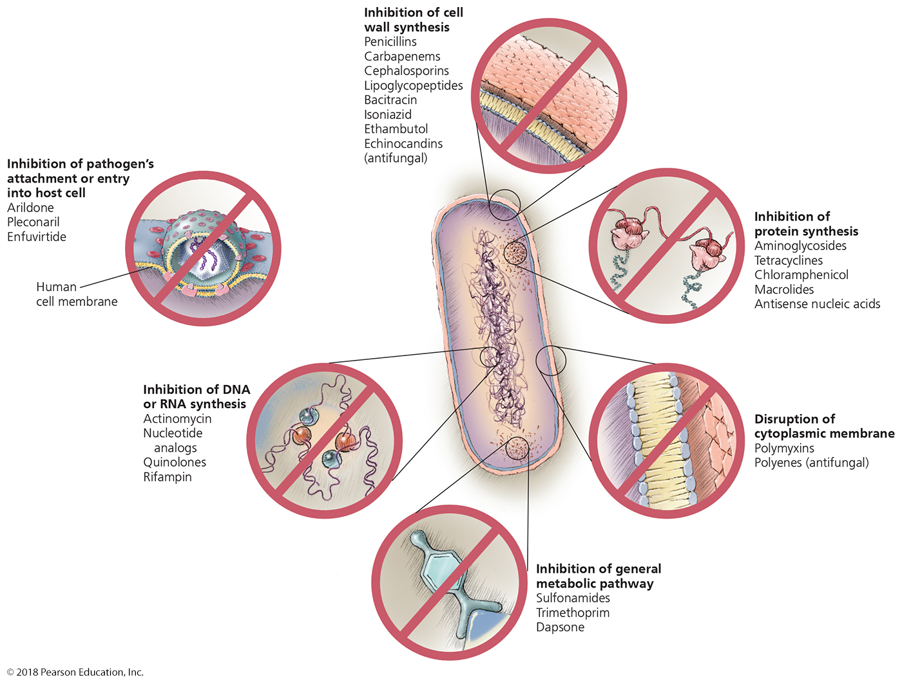
Figure 10.2 Mechanisms of action of microbial drugs – SUMMARY SLIDE
Notes:
8

Slide 9
Mechanisms of Antimicrobial Action
Inhibition of BACTERIAL Cell Wall Synthesis
Inhibition of synthesis of bacterial walls
New peptidoglycan made at cell membrane, pushing “older” layers away from membrane and toward glycocalyx
Prevents bacteria from increasing amount of stable three-dimensional peptidoglycan
Have no effect on existing peptidoglycan layer
Biggest need for proteoglycan is when bacteria are growing and dividing; thus the are effective at SLOWING DOWN the growth of cells
Will these drugs be bacteriocidal or bacteriostatic?
If these do not kill cells, how does our body decrease the numbers of bacteria while using these drugs?

Slide 10
Mechanisms of Antimicrobial Action
Inhibition of Cell Wall Synthesis
Beta-lactams are most prominent in this group
Functional groups are beta-lactam rings
Beta-lactams bind to enzymes that cross-link NAM subunits with pentapeptides
prevent cross-hatching; think of how quickly nylons are ruined if one cannot bind together the “runners”
Bacteria with weakened cell walls that cannot be fully stabilized are far more easily lysed or digested

Slide 11
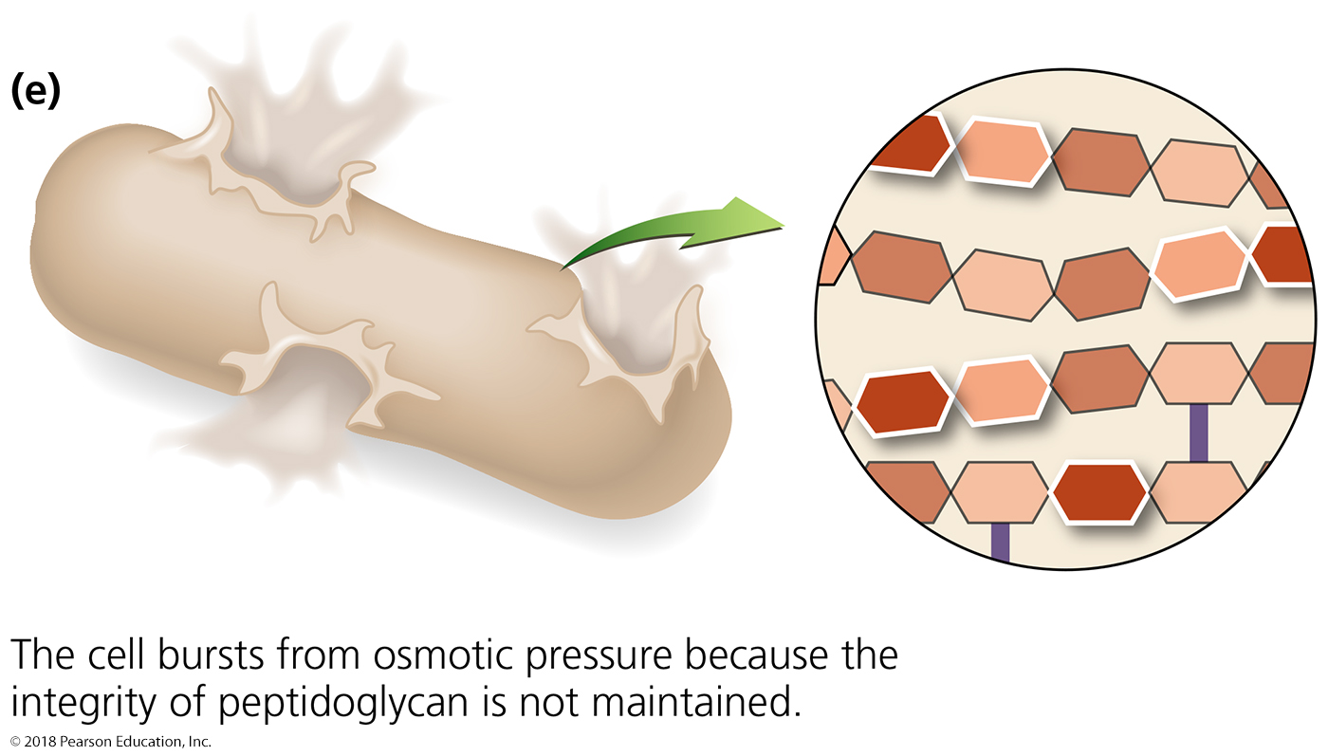
Figure 10.3a-b Bacterial cell wall synthesis and the inhibitory effects of beta-lactams on it.
Growth of cell wall under normal circumstances: pentapeptide crosslinks the NAM’s and crosshatches each peptidoglycan layer;
beta-lactams block this crosslinking
Growth
Notes:
11

Slide 12
Mechanisms of Antimicrobial Action
Chemicals that inhibit Bacterial Cell Wall Synthesis
Natural beta-lactams (penicillin, cephalosporin)
Useful for gram-positive oral (or topical) infections
Ineffective against gram-negative bacteria
Needs to be injected, cannot be ingested
Destroyed by liver quickly, requiring frequent injections
Semisynthetic derivatives of beta-lactams
More stable in acidic environments (e.g., stomach)
More readily absorbed into stomach and intestines
Less susceptible to deactivation by liver enzymes
More active against more types of bacteria (especially gram-negative bacteria)

Slide 13
Mechanisms of Antimicrobial Action
Other inhibitors of Cell Wall Synthesis
Vancomycin and cycloserine
Commonly used when treating MRSA or β-lactam resisters
Interferes with pentapeptide formation onto disaccharides
This step precedes the crosslinking of polysaccharide polymers discussed before
Bacitracin
Blocks transport of NAG and NAM from cytoplasm
One of the components of Neosporin
Isoniazid and ethambutol
Disrupt mycolic acid formation in mycobacterial species
Mycolic acid sits on peptidoglycan and makes it impenetrable by most compounds.
Causes mycobacterial cell walls to be far more sensitive to other antibiotics and cellular immune system

Slide 14
Mechanisms of Antimicrobial Action
Inhibition of FUNGAL Cell Wall Synthesis
Fungal cells composed of various polysaccharides not found in mammalian cells
In principal, drugs that act here SHOULD be able to be discovered and used successfully
Echinocandins inhibit the enzyme that synthesizes β-glucan
Should make fungi more susceptible to osmotic shock

Slide 15
Mechanisms of Antimicrobial Action
Inhibition of BACTERIAL Protein Synthesis
Interference with prokaryotic ribosomes
Prokaryotic ribosomes are 70S (30S and 50S)
Eukaryotic ribosomes are 80S (40S and 60S)
Drugs can selectively target translation by MANY ways
Aminoglycosides - streptomycin, gentamycin, neomycin
Tetracycline - doxycycline
Chloramphenicol
Macrolides – erythromycin, clarithromycin
Oxazolidinone
Mitochondria of animals and humans contain prokaryotic-like 70S ribosomes
Can be harmful – source of human toxicity when allergic reactions are not seen – mitochondrial dysfunction
KNOW THESE!!

Slide 16
NOT ON EXAMS - Some mechanisms by which antimicrobials target prokaryotic ribosomes to inhibit protein synthesis.
Notes:
16

Slide 17
Mechanisms of Antimicrobial Action
Disruption of Cytoplasmic Membranes
Some drugs form channels through cytoplasmic membrane and damage its fluidity and signaling capacity
Nystatin and amphotericin B attach to ergosterol in fungal membranes
Humans somewhat susceptible because cholesterol similar to ergosterol and nystatin and amphotericin will bind cholesterol weakly
Bacteria lack sterols; these drugs cannot affect bacteria and so bacteria are not susceptible
Polymyxin disrupts cytoplasmic membranes of Gram-negative bacteria (outer membrane crucial to function)
Toxic to human kidneys
Some parasitic drugs act against cytoplasmic membranes; often human toxicity

Slide 18
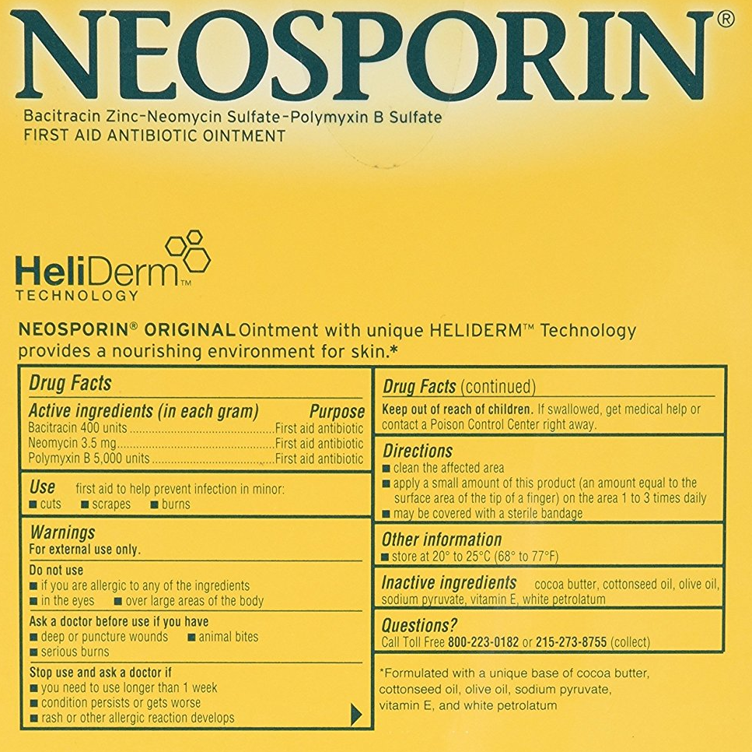
Why does Neosporin work? What is in it?
Bacterial cell well inhibitor
Ribosome inhibitor
Plasma membrane disruptor
Reduce toxicity by restricting use to topical administration

Slide 19
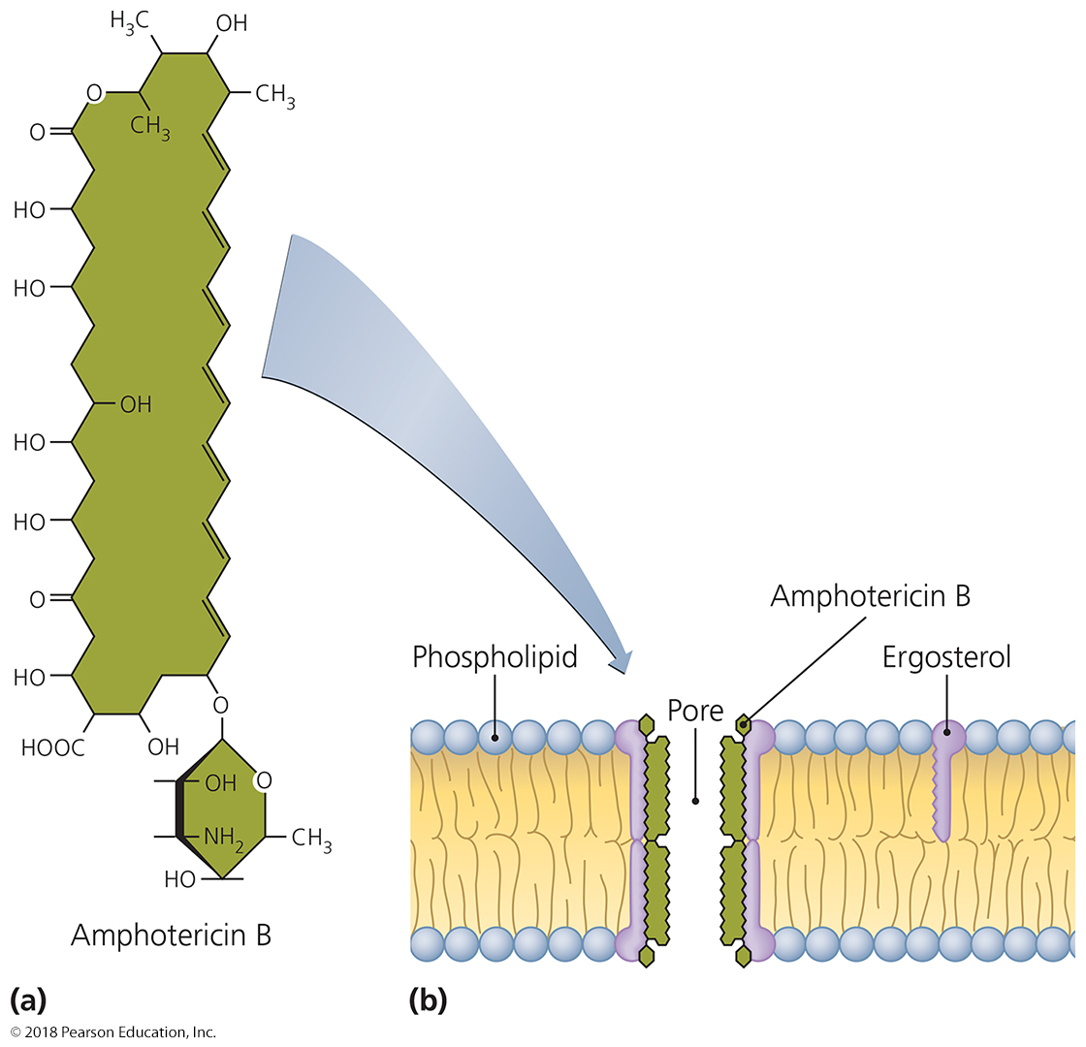
Figure 10.5 Disruption of the cytoplasmic membrane by the antifungal amphotericin B.
Notes:
19

Slide 20
Mechanisms of Antimicrobial Action
Inhibition of Metabolic Pathways
Antimetabolic agents can be effective when pathogen and host metabolic processes differ
Metabolic antagonists – sulfa drugs inhibit DNA, RNA synthesis in bacteria
Quinolones and fluoroquinolones
Act against prokaryotic DNA gyrase – replication fork opening
Trimethoprim also interferes with nucleotide synthesis (lice).
Agents that disrupt tubulin polymerization (albendazole) are used to inhibit protozoa and parasitic worms.

Slide 21
Mechanisms of Antimicrobial Action
Inhibiting stages of the viral life cycle
Viral life cycle events do not occur in normal cells, and so are good targets for slowing viral disease
Most are virus specific due to rapid evolution of viruses
Viral attachment - Pleconaril blocks
Viral uncoating - amantadine, rimantadine, arildone
Polymerase activation - Protease inhibitors block
RNA, DNA polymerase – multiple polymerase inhibitors developed
Reverse transcriptase inhibitors
Act against an enzyme HIV uses in its replication cycle
Do not harm people because humans lack reverse transcriptase
Have limited duration of use due to rapid evolution of viral escape mutants

Slide 22
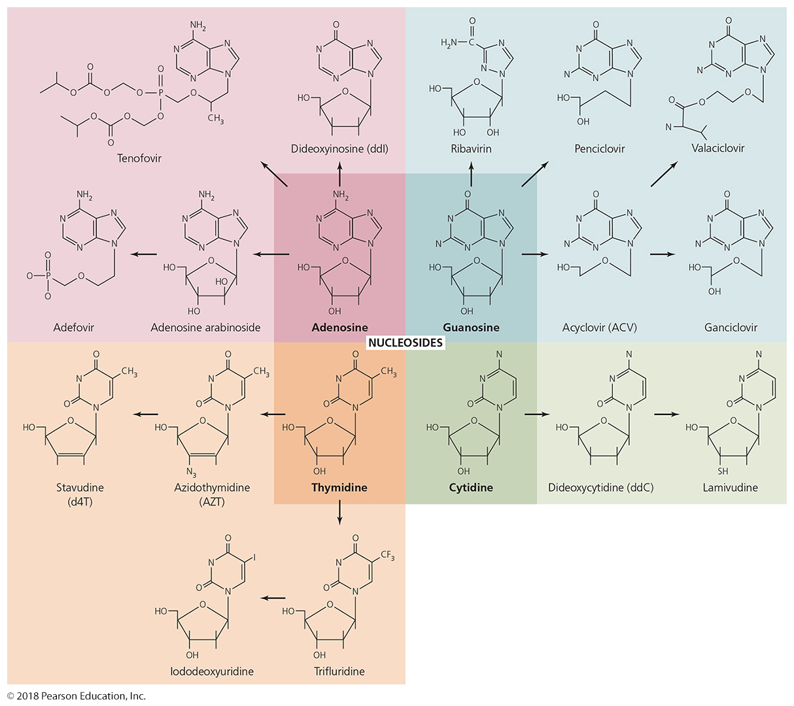
Figure 10.7 Nucleosides and some of their antimicrobial analogs.
The movie “Dallas Buyers Club” featured AZT (OD and toxic) and ddC (neurotoxic)
Notes:
22

Slide 23
Clinical Considerations in Prescribing Antimicrobial Drugs
Spectrum of Action
Defined by the number of distinct microbres a drug acts against
Narrow-spectrum effective against few organisms
Con - Useful for only a few diseases
Pro - Kill only a few species; allows remaining flora to be unaffected to maintain antagonism
Broad-spectrum effective against many organisms
Pro - Useful for many diseases
Con - Killing of normal flora also - reduces microbial antagonism
MAJOR Con - May allow for secondary or superinfections to develop (e.g., Candida, C. diff, diphtheria, S. pyogenes)

Slide 24
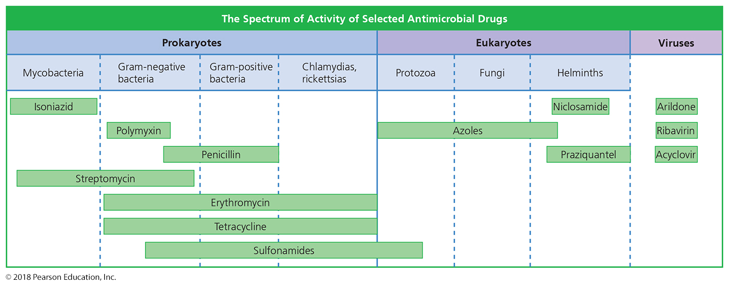
Figure 10.8 Spectrum of action for selected antimicrobial agents.
Notes:
24

Slide 25
Clinical Considerations in Prescribing Antimicrobial Drugs – SUMMARY SLIDE
Effectiveness
Ascertained by
Diffusion susceptibility test
Kirby-Bauer
Minimum inhibitory concentration test
Smallest amount that will inhibit growth
Minimum bactericidal concentration test
Smallest amount to kill microbe instead of simply stop growth

Slide 26
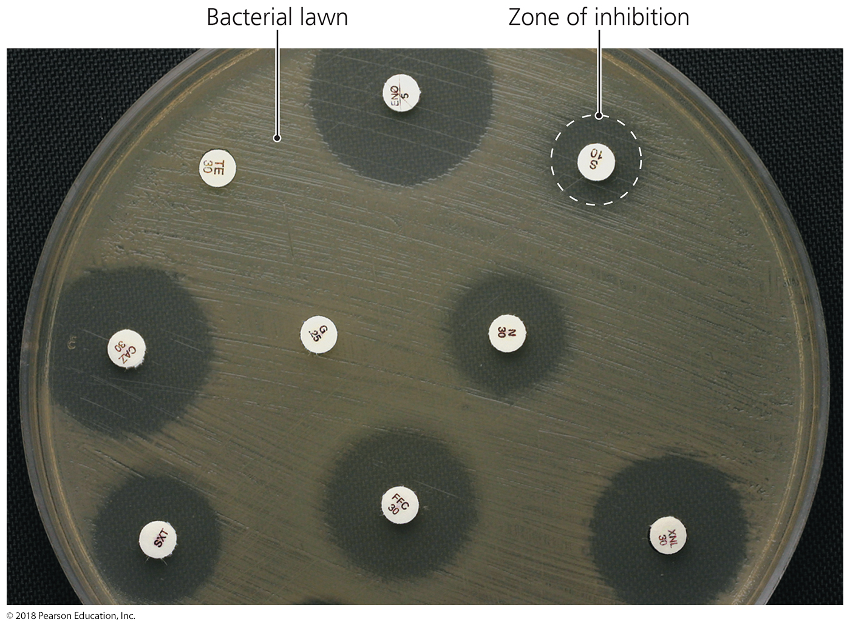
Figure 10.9 Zones of inhibition in a diffusion susceptibility (Kirby-Bauer) test.
Notes:
26

Slide 27
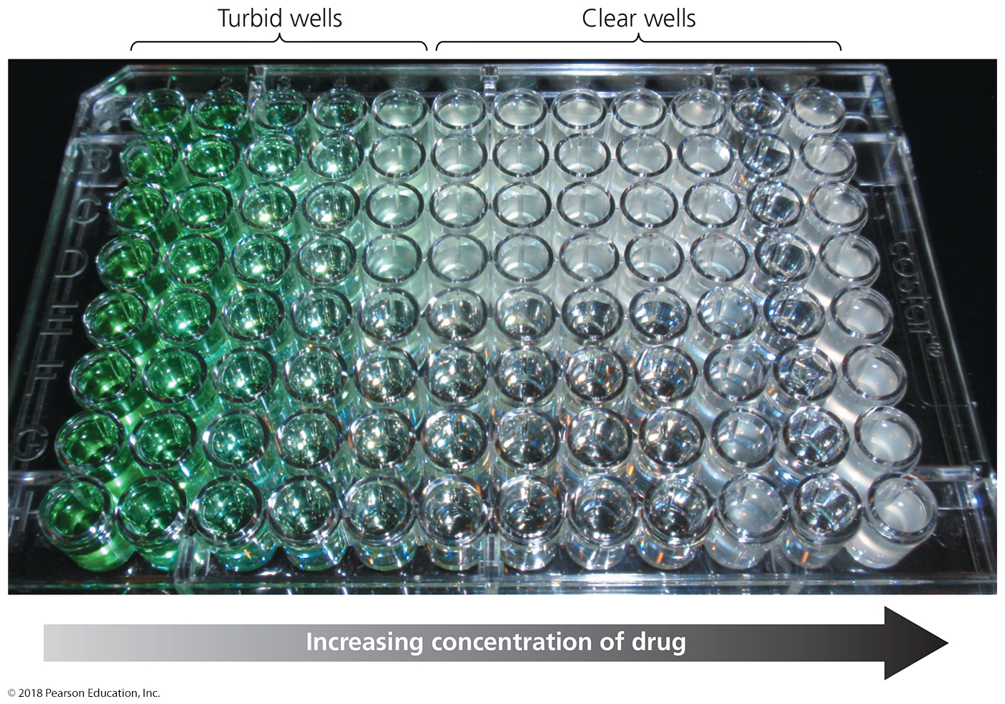
Figure 10.10 Minimum inhibitory concentration (MIC) test in wells.
Notes:
27

Slide 28
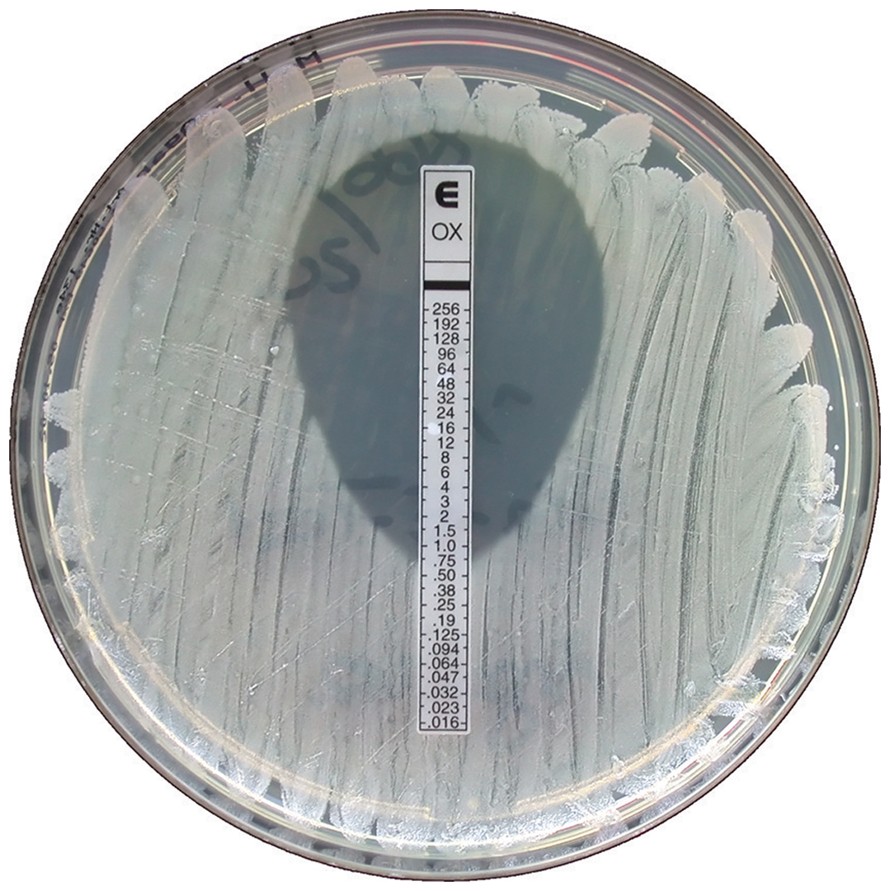
Figure 10.11 An E-test, which combines aspects of Kirby-Bauer and MIC tests.
Notes:
28

Slide 29
Clinical Considerations in Prescribing Antimicrobial Drugs
Routes of Administration
Topical application of drug for external infections
Oral route requires no needles and is self-administered
Intramuscular administration delivers drug via needle into muscle; levels in blood never approach that of IV
Intravenous administration (needle and/or catheter) delivers drug directly to bloodstream
Kidneys and liver remove drug from circulation
Must know how antimicrobial agent will be distributed to infected tissues
Must know if drug is powerful enough to work even with low blood availability

Slide 30
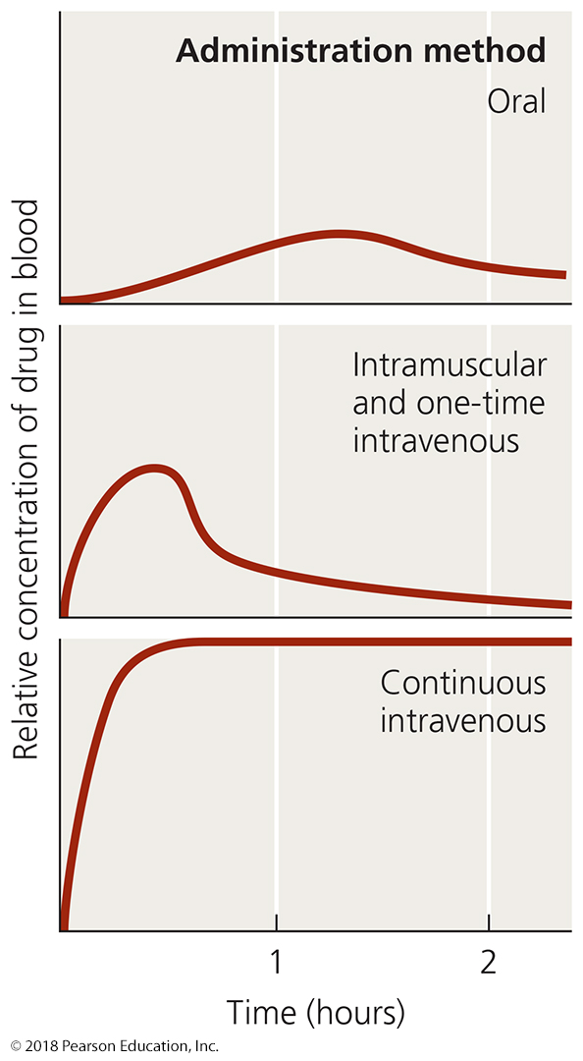
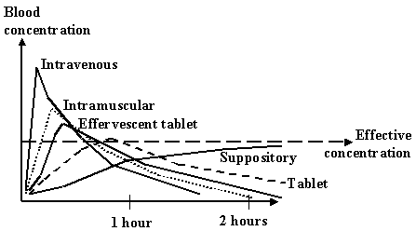
Figure 10.13 The effect of route of administration on blood levels of a chemotherapeutic agent.
Which method will not get enough drug to body tissues through the blood?
Which method allows a large interval between repeated treatment?
Notes:
30

Slide 31
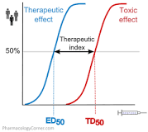
Clinical Considerations in Prescribing Antimicrobial Drugs
Safety and Side Effects
Toxicity
Cause of many adverse reactions poorly understood
Drugs may be toxic to kidneys, liver, or nerves
Consideration especially needed when prescribing drugs to pregnant women
Therapeutic index is the ratio of the dose of a drug that can be tolerated to the drug's effective dose
If much greater than 1, the drug can be used at high levels before toxic effects are seen
If close to 1, then drug will cause side effects very easily when therapeutic doses seen
If less than 1, then what?

Slide 32
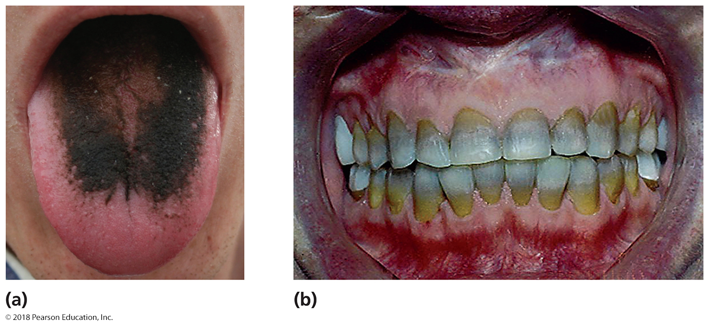
Figure 10.14 Some side effects resulting from toxicity of antimicrobial agents.
Oral thrush from
destruction of oral flora
yellowing of teeth from
tetracycline treatment during youth
Notes:
32

Slide 33
Clinical Considerations in Prescribing Antimicrobial Drugs
Safety and Side Effects
Allergies
Allergic reactions are rare but may be life threatening
Anaphylactic shock
Immune system starts up immediate systemic protection if “foreign molecule” is found throughout the body too quickly
Disruption of normal microbiota
Secondary infection - dominant pathogenic organism changes (e.g., inflammatory acne)
Superinfection - Overgrowth of normal (often, minority) flora when dominant flora eliminated (e.g., Candida infection, Corynebacterium diphtheriae)
Of greatest concern for hospitalized patients – why?

Slide 34
The Development of Resistance in Populations
Antibiotics can stop working 1-10 years after they begin being used
Some pathogens are naturally resistant
Resistance by bacteria acquired in two ways:
New mutations of chromosomal genes – RARE
Acquisition of R plasmids or R variants of genes via transformation, transduction, and conjugation
Most cases of multi-drug resistance involved these mechanisms
Integration into genome through recombination (or maintenance of plasmid) make these strains permanently resistant

Slide 35
Figure 10.15 The development of a resistant strain of bacteria.
Notes:
35

Slide 36
Resistance to Antimicrobial Drugs
Mechanisms of Resistance
Many mechanisms of microbial resistance
Produce enzyme that destroys or deactivates drug
Slows or prevents entry of drug into the cell
Alter target of drug so the drug binds less effectively
Alter their own metabolic chemistry to circumvent drug effect (e.g. with sulfa drugs, or viral escape mutants)
Pump antimicrobial drug out of the cell before it can act (especially common with porins in gram-negative bacteria – Pseudomonas is infamous for this)
Bacteria in biofilms can resist antimicrobials
Mycobacterium tuberculosis produces MfpA protein
Binds DNA gyrase, preventing the binding of fluoroquinolone drugs

Slide 37
Figure 10.16 How beta-lactamase (penicillinase) renders penicillin inactive.
Beta-lactamase is an enzyme encoded by a gene (bla) that is most commonly found in plasmids acquired by horizontal gene transfer
Notes:
37

Slide 38
Resistance to Antimicrobial Drugs
Multiple Resistance and Cross Resistance
Pathogen can acquire resistance to more than one drug
Common when R plasmids exchanged or recombined
Develops in hospitals and nursing homes
Patients get them: hospital-acquired (HA)
Constant use of drugs eliminates sensitive cells that may help repress the growth of often slower-growing drug-resistant strains
Favors expansion of resistant cells (superinfection?)
Tough strains that escape hospital and survive in the outside world can become community-associated (CA)
CA strains (S. aureus) can be very problematic for even healthy people!

Slide 39
Resistance to Antimicrobial Drugs
Multiple Resistance and Cross Resistance
Multiple-drug-resistant (MDR) pathogens are resistant to at least three antimicrobial agents
S. aureus, K. pneumonia, M. tuberculosis now have MDR strains
Cross resistance (one mutation makes a bug resistant to multiple antibiotics at once) can occur when drugs are similar in structure
seen in multi-generation drugs like penicillins and cephalosporins

Slide 40
Resistance to Antimicrobial Drugs
Retarding Resistance
Maintain high concentration of drug in patient for sufficient time
Inhibit the pathogen so immune system can eliminate all microbes, even the antibiotic-resistant ones
Inhibit the resistance factor
Allows antibiotics to become useful again
Clavulinic acid inhibits penicillinase, prolonging the lifetime and activity of penecillins or cephalosporins
Use multiple antimicrobial agents in combination
Synergism – second drug enhances the effect of a first drug
Antagonism - drugs interfere with each other

Slide 41
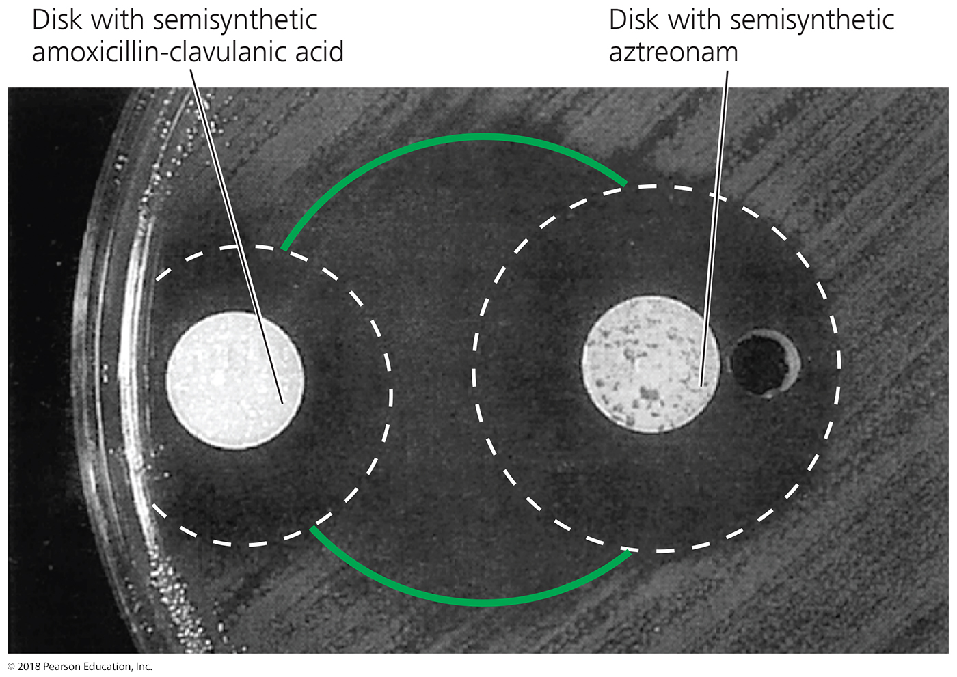
Figure 10.17 An example of synergism between two antimicrobial agents.
Notes:
41

Slide 42
Resistance to Antimicrobial Drugs
Retarding Resistance
Use antimicrobials only when necessary
Develop new variations of existing drugs
Second-generation drugs
Third-generation drugs
Fourth-generation drugs
Search for new antibiotics
Design drugs complementary to the shape of microbial proteins to inhibit them
should be harder for resistance to develop because the mode of action is novel
few compounds have been discovered through this strategy, and resistance did develop quickly

Slide 43
The Ongoing Battle of the Mouse and the Mousetrap
Penicillin G/V
natural compounds had inconveniences; narrow spectrum
Aminopenicillins:
Oxacillin, Ampicillin
Amoxicillin
Bla gene becomes common;
insufficiently wide spectrum
(1) Methicillin
Penicillins + clavulanates
(2) Carboxycillins:
Carbenicillin, ticarcillin
(3) Ureidopenicillins:
Mezlocillin, Azlocillin
(4) Carbapenems:
Imipenem (+ cilastatin)
= Primaxin
(5) Monobactams
Aztreonam
(6) Cephalosporins:
(6.1) cephalothin
(6.2) cefamandol, cefalcor
(6.3) cefixime
(6.4) cefepime
(6.5) ceftobiprole
newly isolated drug
Narrow spectrum but nontoxic
Bla gene mutants circumvent;
appearance of MRSA
Inhibit earlier steps
Of cell wall synthesis:
Bacitracin (topical),
Vancomycin,
cycloserine
Vancomycin-resistant
Enterococci (VRE)
VRE genes appears in
MRSA = VRSA
Second-gen. vancomycins:
telavancin
oritavancin

Slide 44
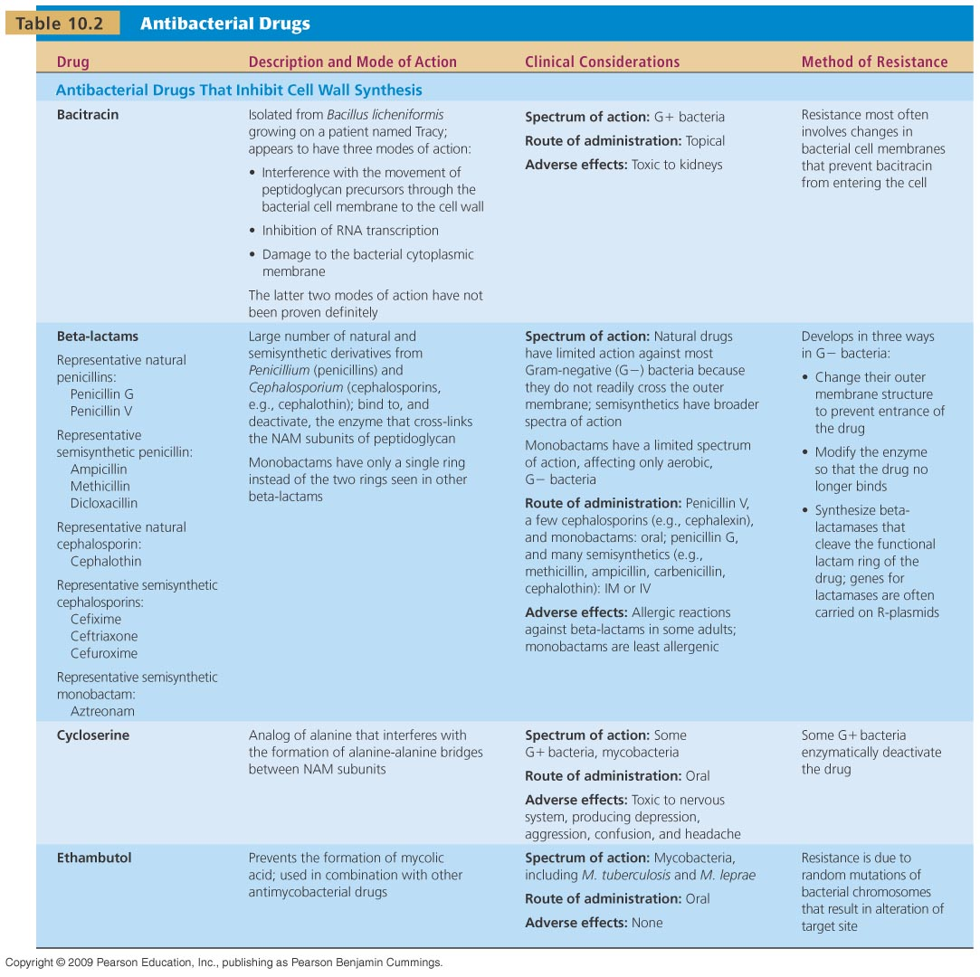
[INSERT TABLE 10.2]

Slide 45
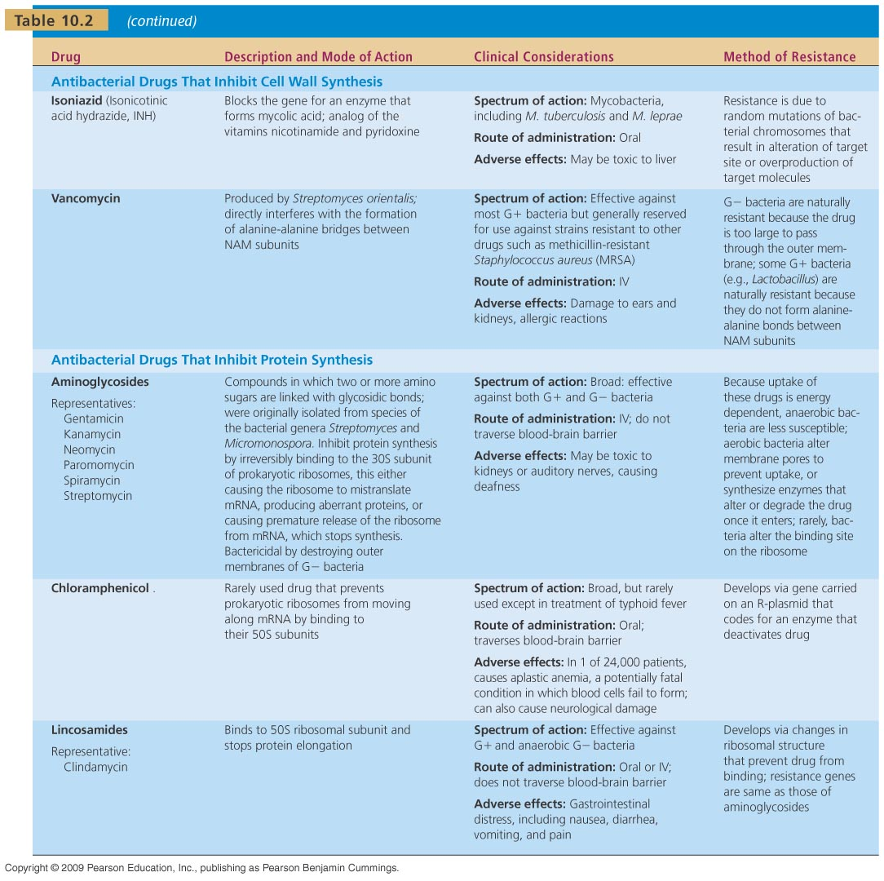
[INSERT TABLE 10.2]

Slide 46
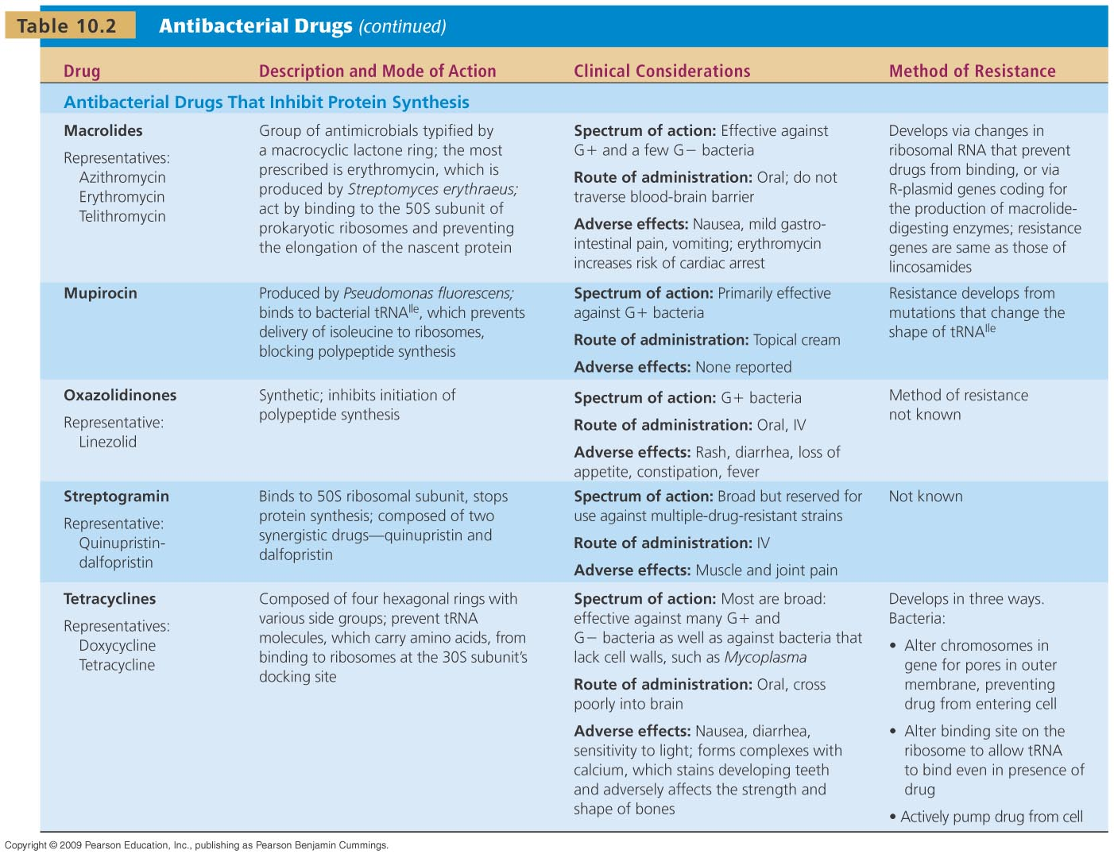
[INSERT TABLE 10.2]

Slide 47
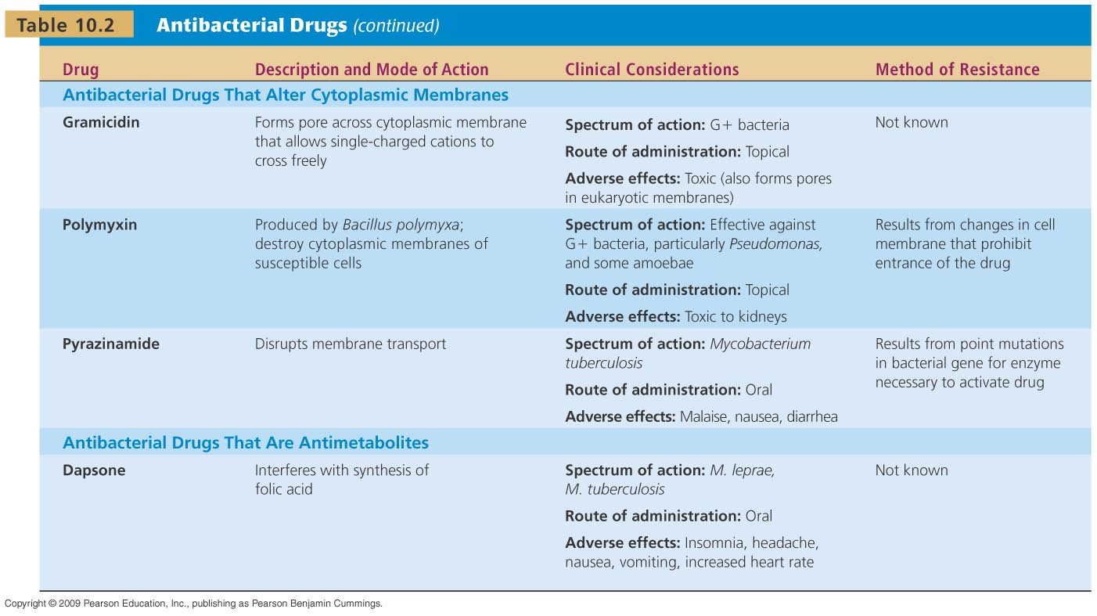
[INSERT TABLE 10.2]

Slide 48
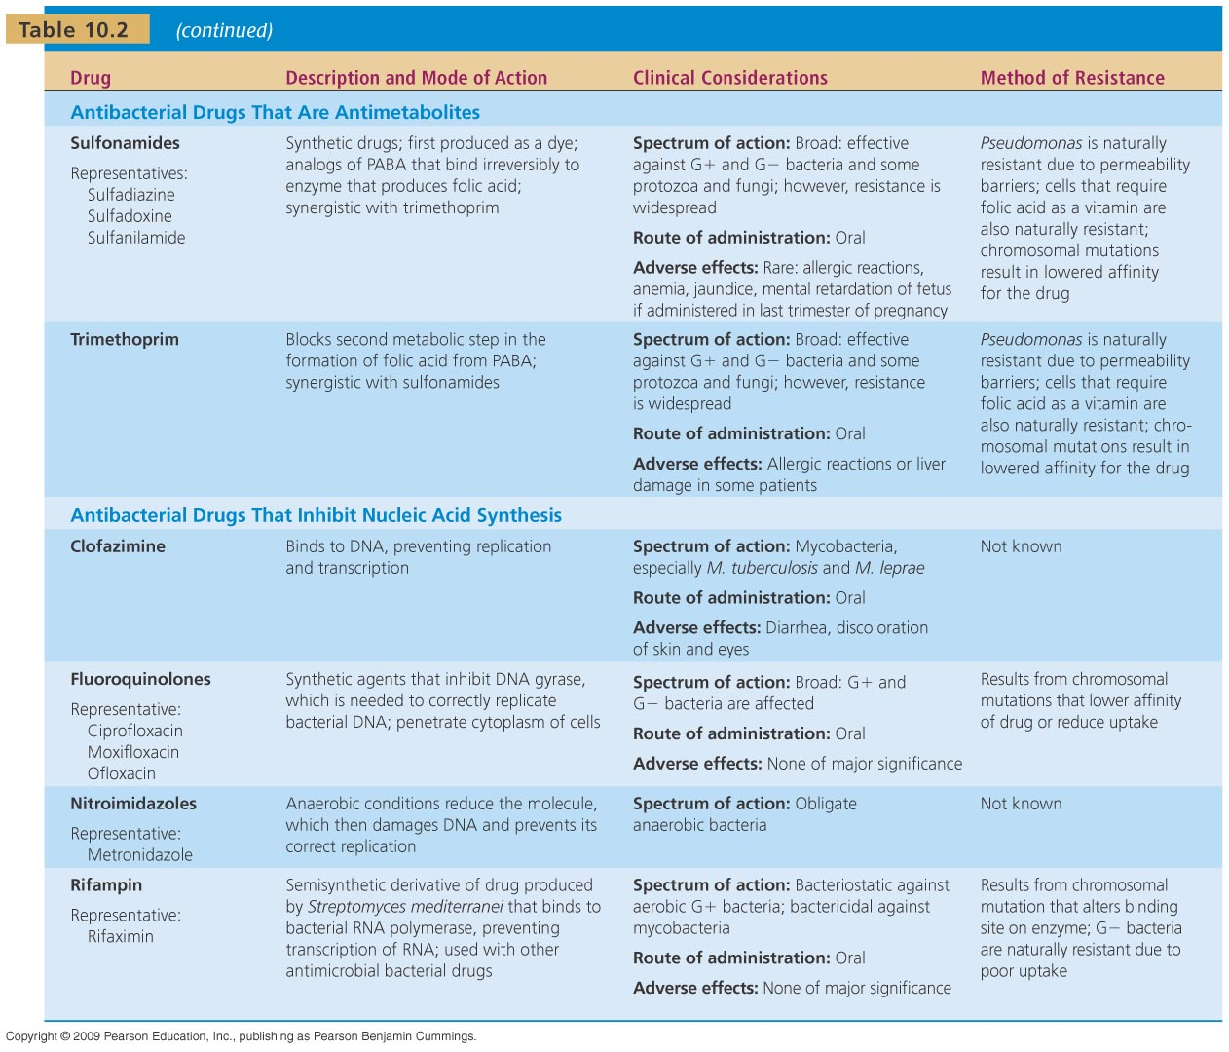
[INSERT TABLE 10.2]

Slide 49
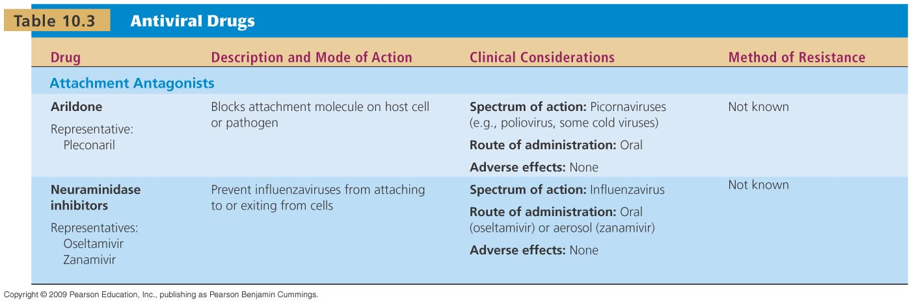
[INSERT TABLE 10.3]

Slide 50
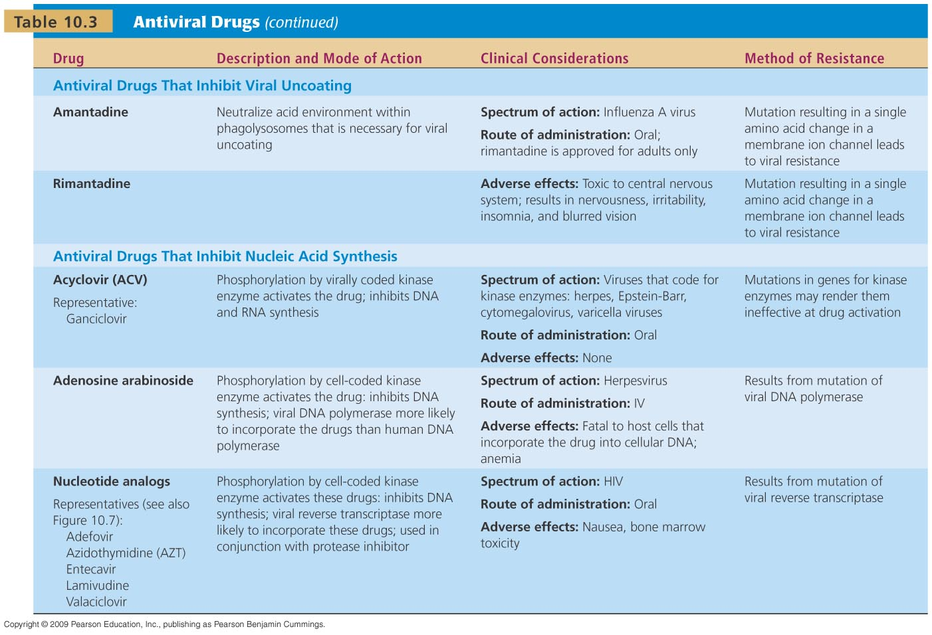
[INSERT TABLE 10.3]

Slide 51
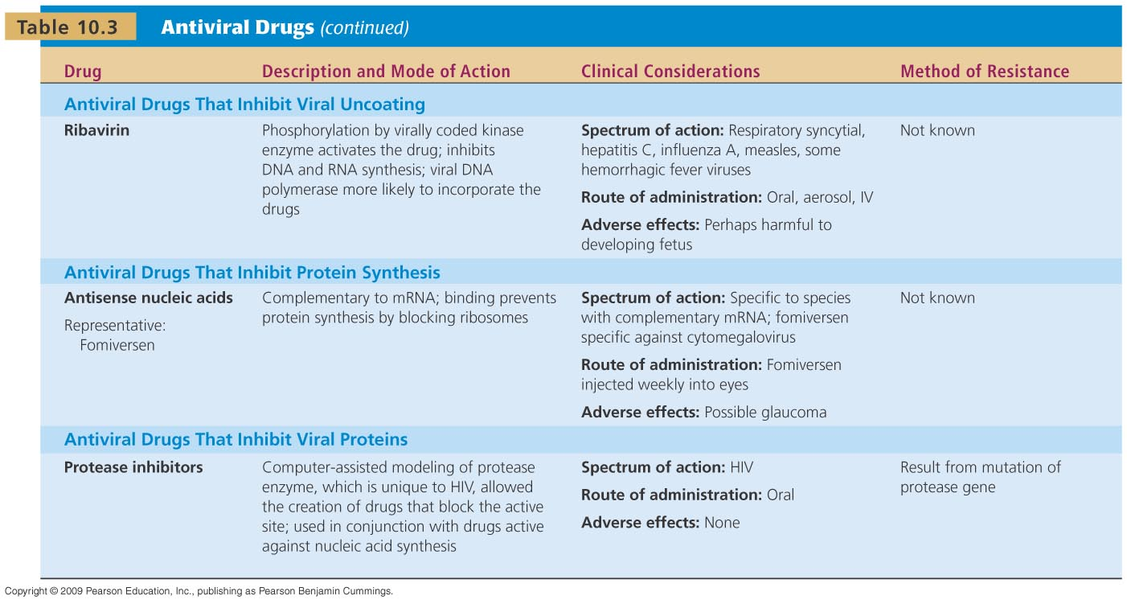
[INSERT TABLE 10.3]

Slide 52
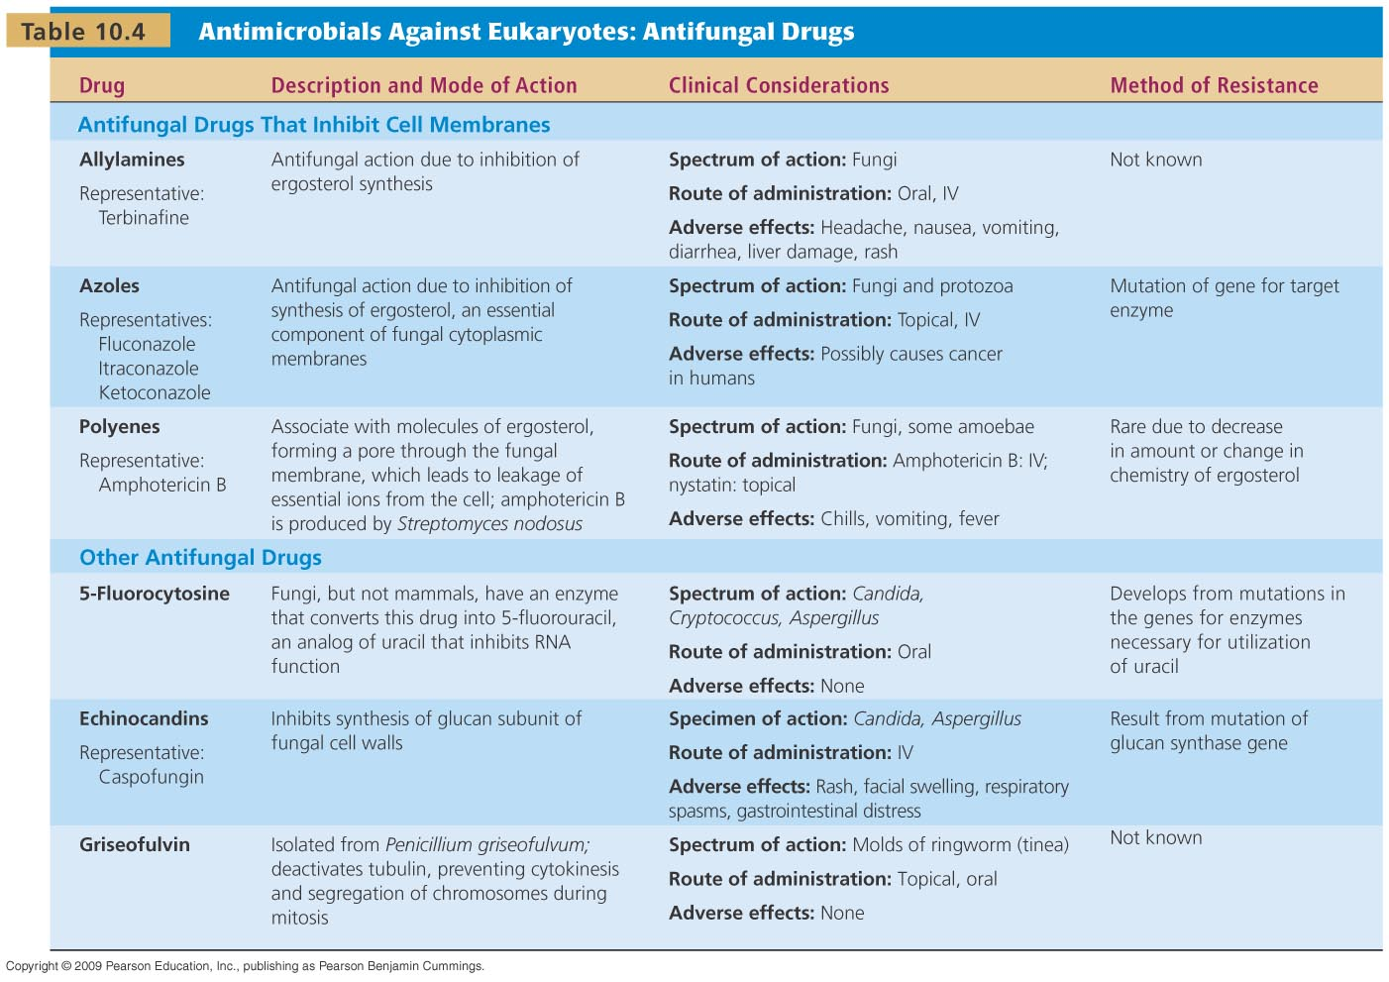
[INSERT TABLE 10.4]

Slide 53
[INSERT TABLE 10.5]

Slide 54
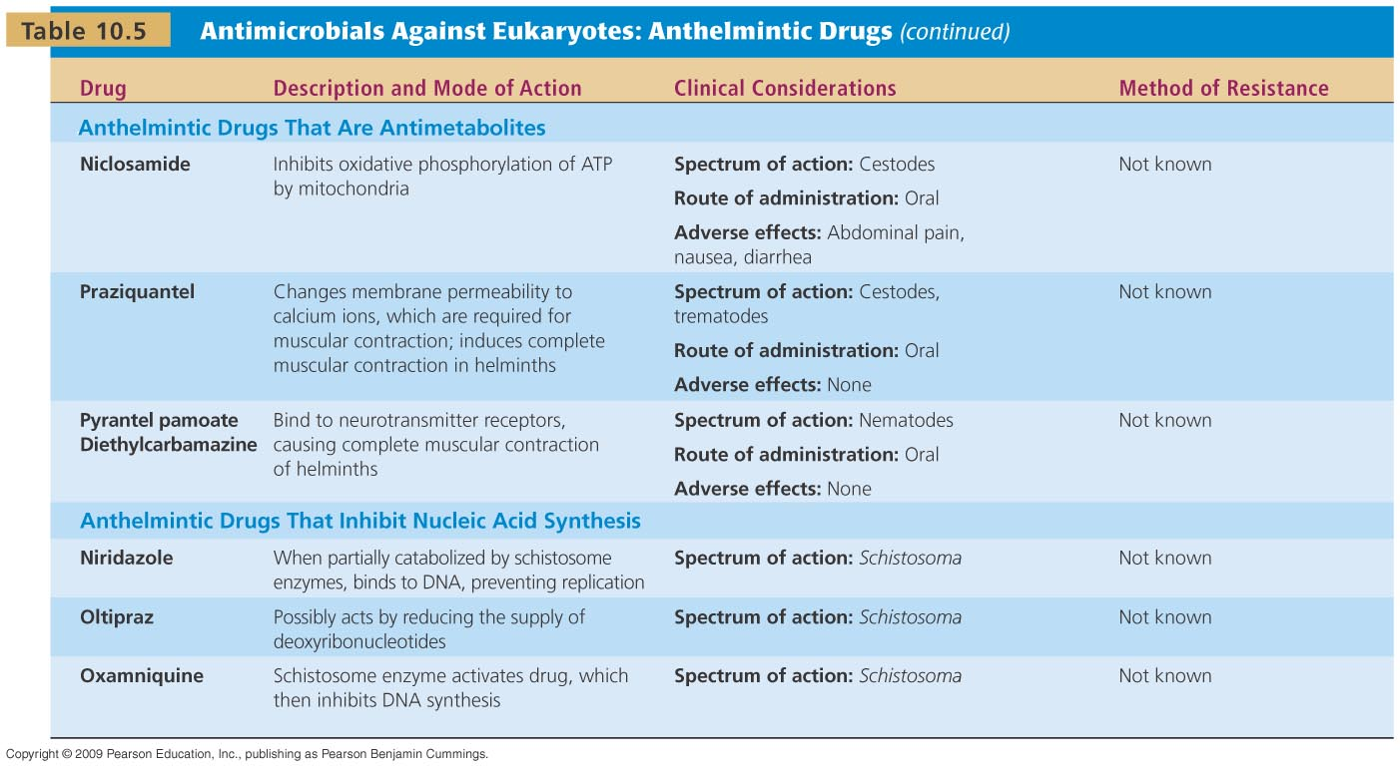
[INSERT TABLE 10.5]

Slide 55
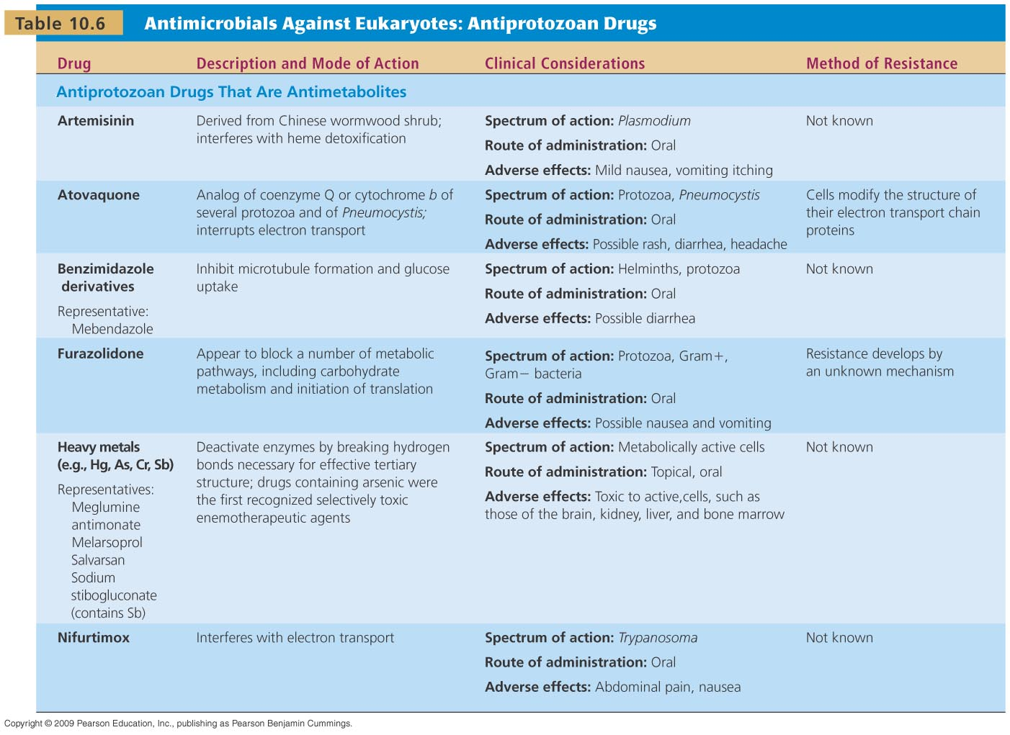
[INSERT TABLE 10.6]

Slide 56
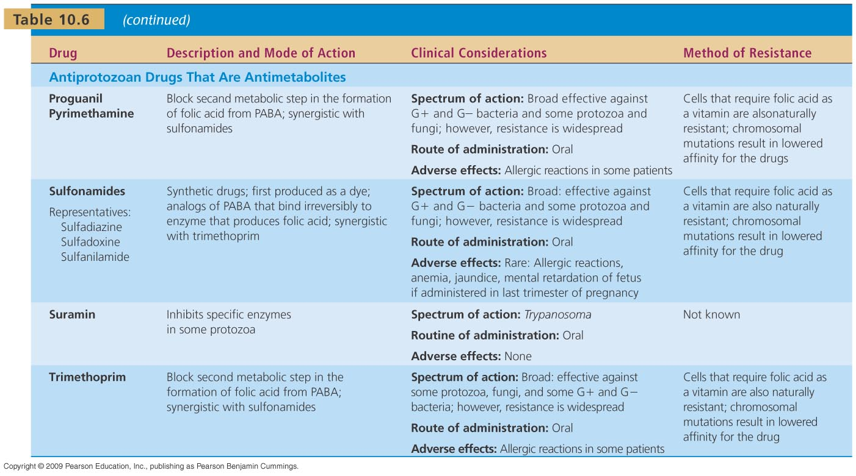
[INSERT TABLE 10.6]

Slide 57
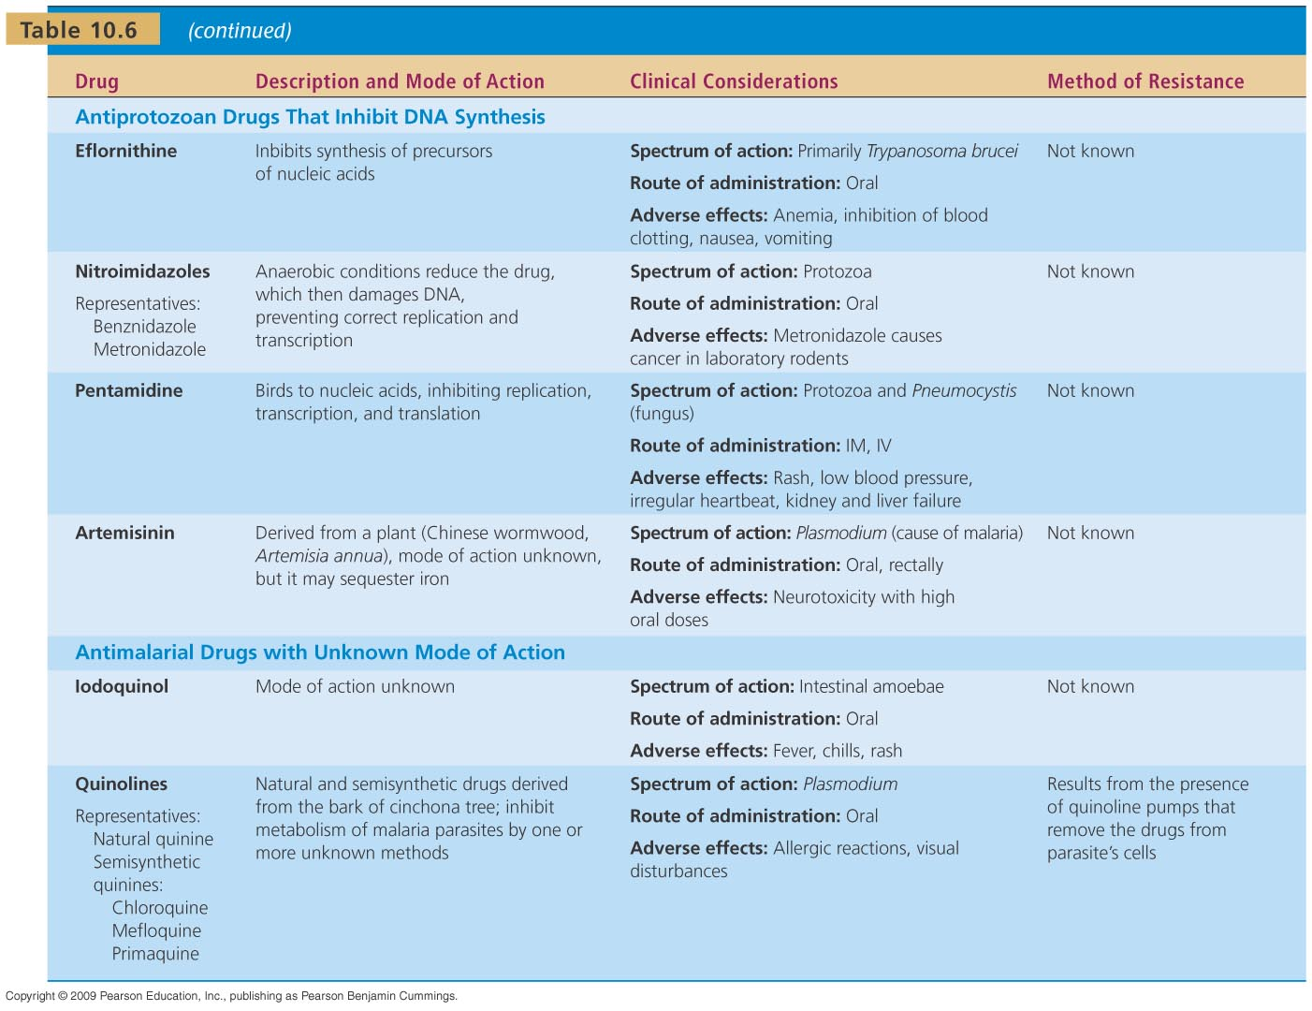
[INSERT TABLE 10.6]

