Slide 1
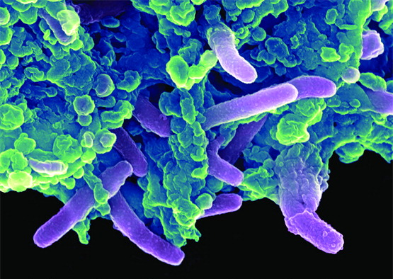
Chapter 9
Controlling Microbial Growth in the Environment

Slide 2
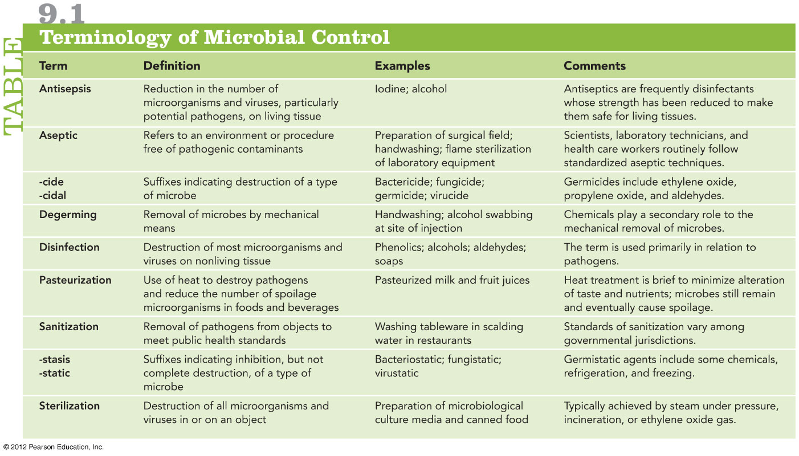
Appreciate the differences in the terminologies!
antisepsis vs. disinfection
-static vs. –cidal
disinfection vs. sterilization
antisepsis vs. sanitization
antisepsis vs. pasteurization

Slide 3
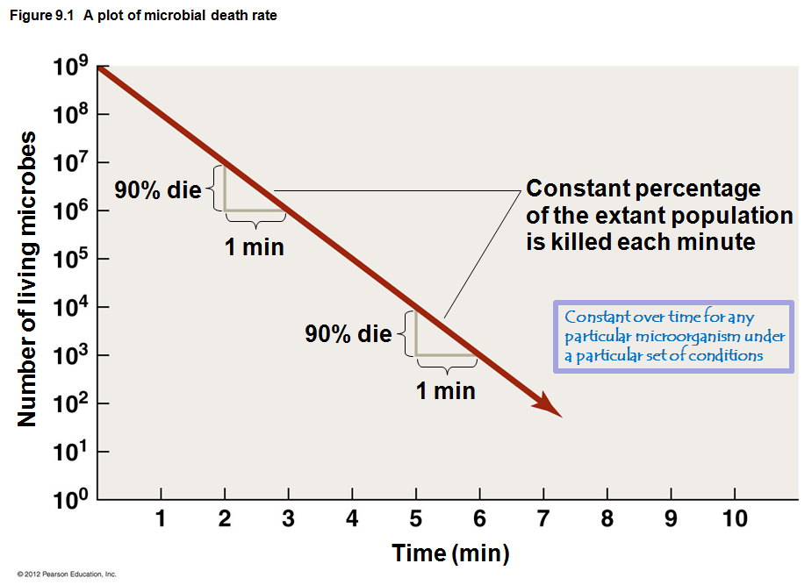
How do we know how long to “cook” something to know it is safe?
We measure death rates to make sure something is free of pathogens!
This is also known as decimal reduction time; see later in this lecture.

Slide 4
How do antimicrobial agents kill microbes?
Cell wall maintains integrity of cell
When damaged, cells are much more sensitive to osmotic effects
Plasma membrane controls passage of chemicals into and out of cell
When damaged, cellular contents leak out
Protein function depends on particular 3-D configuration
Extreme heat or certain chemicals denatures proteins, ruins functions, incapacitates microbe
Chemicals, radiation, and heat can alter/destroy nucleic acids
Produce fatal mutants
Halt protein synthesis through disrupting RNA

Slide 5
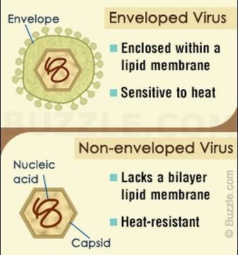
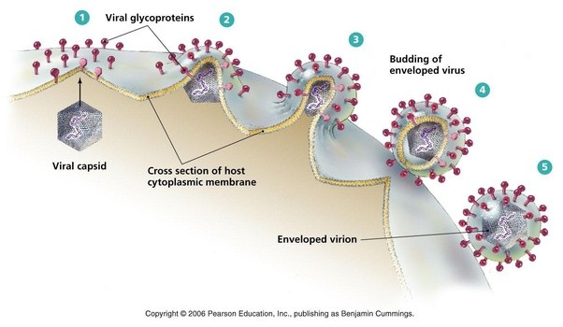
Basic Principles of Microbial Control
How do antimicrobial agents kill viruses?
Enveloped viruses (e.g., flu virus, HIV) less tolerant of harsh conditions compared to nonenveloped viruses (e.g., adenovirus, HPV)
Enveloped viruses rely on their host-derived easily corruptible plasma membrane for function
Disrupt the membrane; ruin the enveloped virus!
Nonenveloped viruses have a much tougher protein capsid shell made of “evolved” proteins

Slide 6
The Selection of Microbial Control Methods
Ideally, antimicrobial agents should be
Inexpensive – used everywhere, repeatedly
Fast-acting – time is money…
Stable during storage – buy in bulk, if nonperishable
Selective toxicity - capable of controlling microbial growth while being harmless to humans, animals, and objects

Slide 7
The Selection of Microbial Control Methods
Factors Affecting the Efficacy and Application of Antimicrobial Methods
Harsh chemicals and extreme heat cannot be used on humans, animals, and fragile objects
Amount of chemical or heat limited by destructive effects on fragile objects
The method of microbial control used is based on site of medical procedure
e.g. degerming of skin vs. oral surgery

Slide 8
The Selection of Microbial Control Methods
Effectiveness of germicides
Germicides classified as high, intermediate, or low effectiveness
High level germicides — kill all pathogens, including endospores – used on invasive instruments
Intermediate level germicides — kill fungal spores, protozoan cysts, viruses, pathogenic bacteria – can be used on nonbiological or noninvasive devices or on surface that contact skin
Low level germicides — kill vegetative bacteria, fungi, protozoa, some viruses – can be used on biological tissues

Slide 9
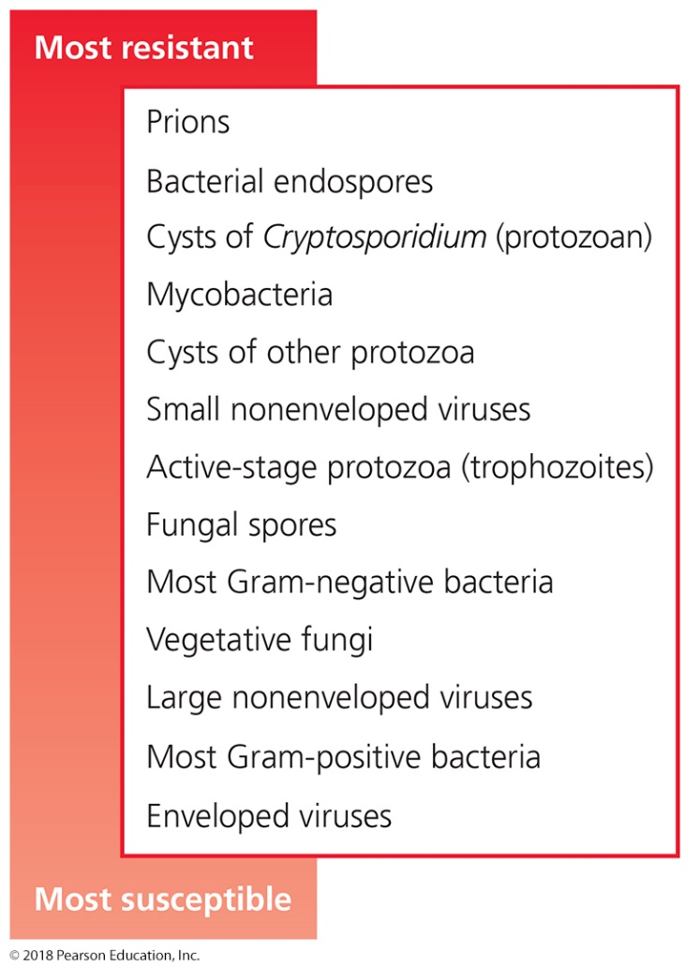
Relative susceptibility of microbes to Antimicrobial Methods
Note difference of “pairs” of organisms:
Hibernating vs. growing forms: cysts vs. trophozoites, spores vs. vegetative fungi. Endospore vs. growing bacteria
Mycobacteria vs. gram-negative vs. gram-positive bacteria
Nonenveloped vs. enveloped viruses
Understand why one form is better protected than the other form

Slide 10
How to kill microbes – SUMMARY SLIDE
Physical methods
Acidity
Temperature
Moist heat
Open-air boiling
Autoclaving
Pasteurization
Dry heat
Baking/
incineration
Drying
Cold temperatures
Refrigeration
Freezing
Freeze-drying
Physical methods
Filtration
Liquid, air
Osmotic effects
Salting/sugaring
Irradiation
Ionizing radiation
Nonionizing radiation
Chemical methods
Phenols
Alcohols
Halogens
Oxidizing agents
Surfactants
Heavy Metals
Aldehydes
Gaseous agents
Enzymes
Antimicrobial drugs

Slide 11
Factors Affecting the Efficacy of Antimicrobial Methods
Temperature and pH
Increased temperature and acidity/alkalinity (for mesophiles and neutrophiles – which means what??):
increases microbial death rates
increases the efficacy of additional antimicrobial methods (except heat with refrigeration/freezing methods!)
Combining high temperatures and extreme pH is more lethal
one boils pickling juices before putting in vegetables
prions destroyed only with pH 14 and 121ºC for 1 hour)

Slide 12
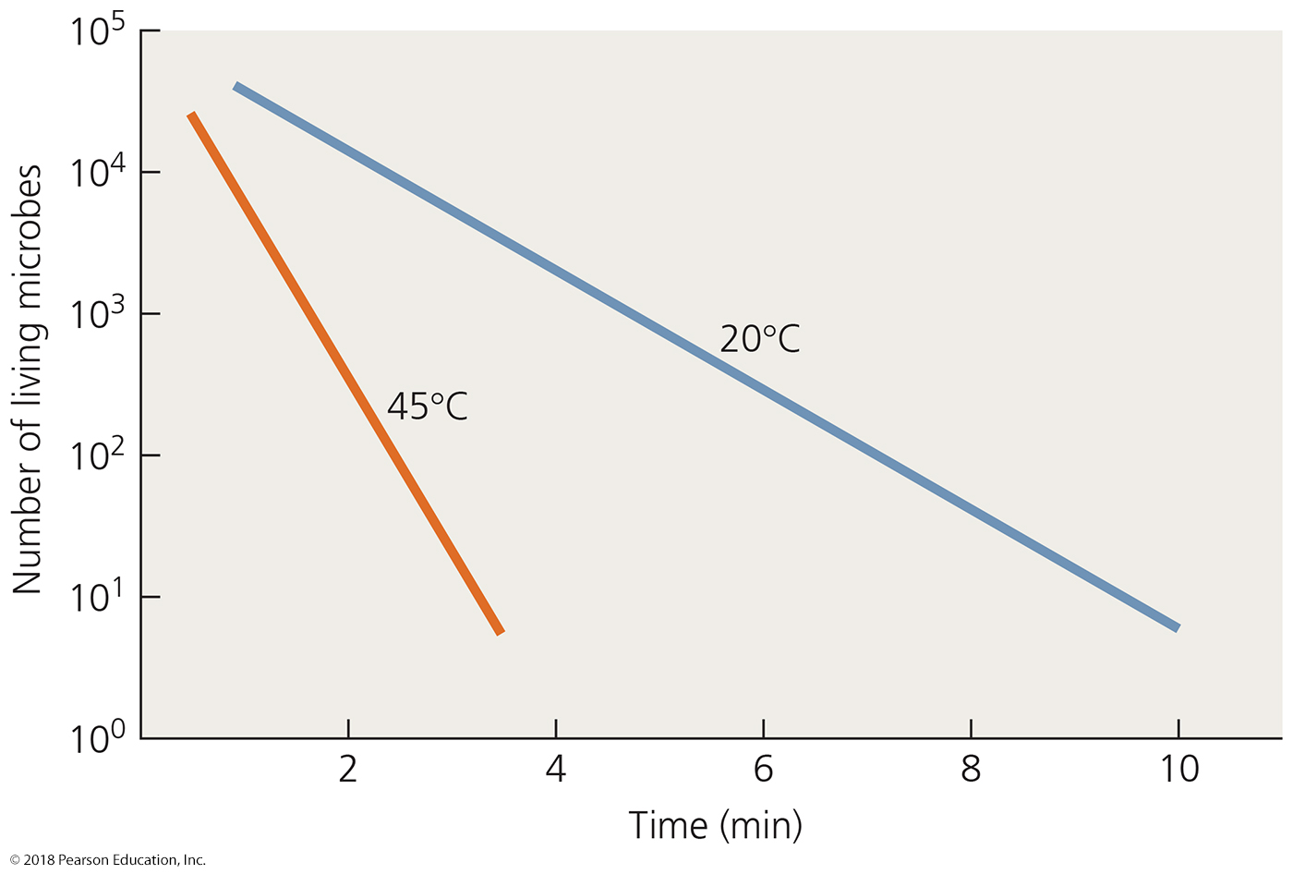
Figure 9.3 Effect of temperature on the efficacy of an antimicrobial chemical.
Notes:
12

Slide 13
Physical Methods of Microbial Control
Biosafety Levels
Four levels of safety in labs dealing with pathogens
Biosafety Level 1 (BSL-1)
Handling pathogens that do not cause disease in healthy humans; commonly available (e.g., your lab)
Biosafety Level 2 (BSL-2)
Handling of moderately hazardous agents
common at most universities/hospitals
Biosafety Level 3 (BSL-3)
Handling of microbes in safety cabinets
uncommon outside of universities/hospitals
Biosafety Level 4 (BSL-4)
Handling of microbes that cause severe or fatal disease; only present in specialized institutions (NIH, CDC)
© 2012 Pearson Education Inc.

Slide 14
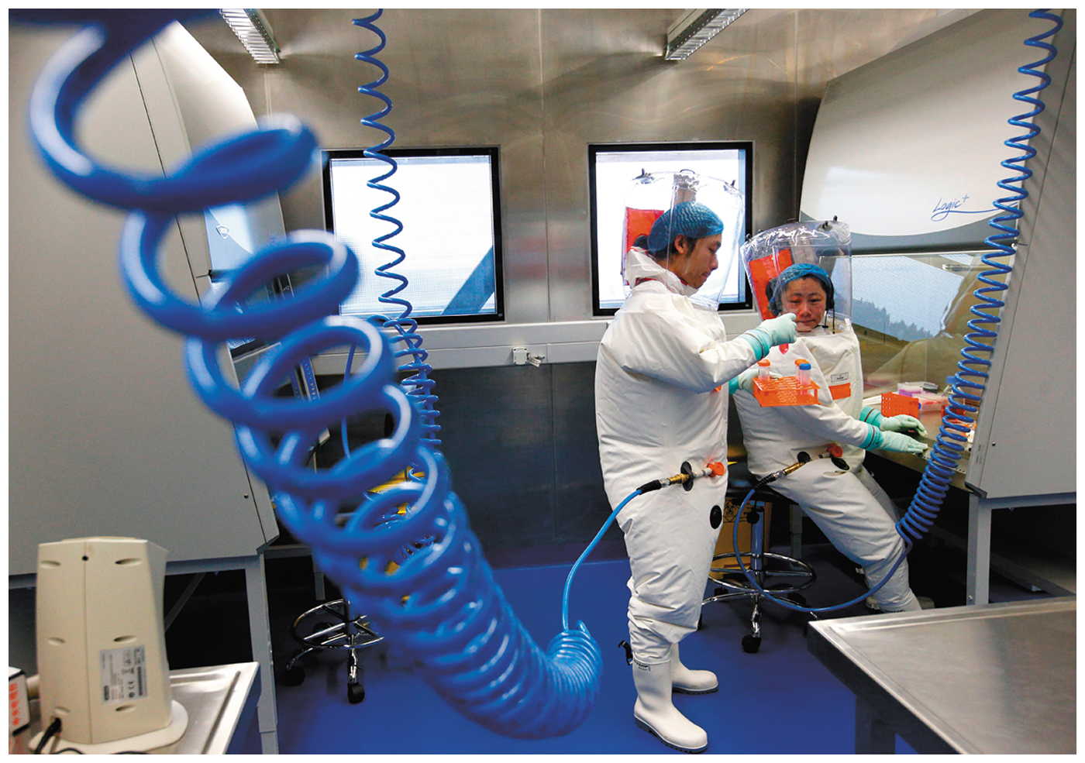
Figure 9.12 A BSL-4 worker carrying Ebola virus cultures

Slide 15
Physical Methods of Microbial Control
Heat-Related Methods
Heat is the primary control method
Is fire the most important invention of man?
Effects of high temperatures
Denatures proteins
Interferes with integrity of cytoplasmic membrane and cell wall
Disrupts structure and function of nucleic acids
Thermal death point
Lowest temperature that kills all cells in broth in 10 min (chosen so the medium is not caramelized)
Thermal death time
Time to sterilize volume of liquid at a given temperature (defined as 12 D-values)
(2.5 minutes for Clostridium botulinum at 121 ºC)
Measured as a 1 trillion-fold (10¹²) reduction of microbes

Slide 16
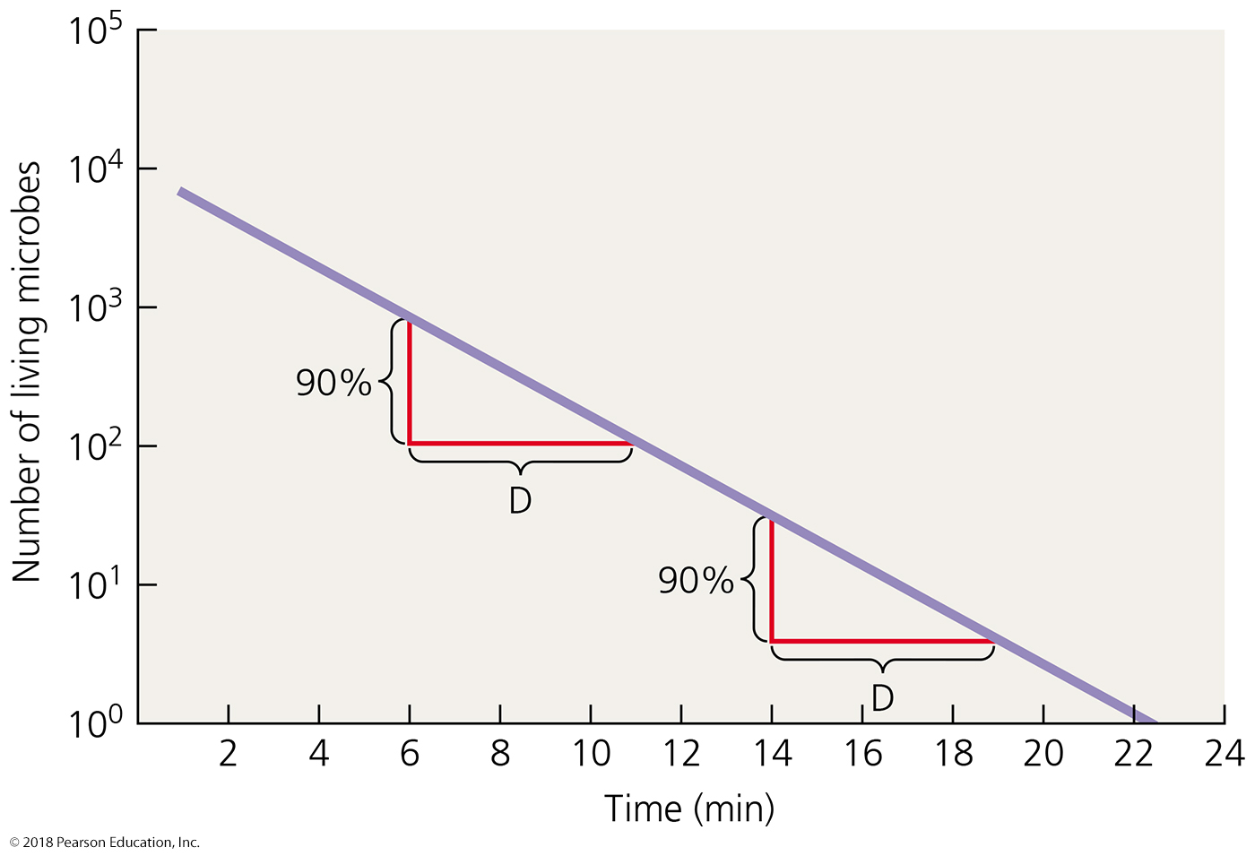
Figure 9.5 Decimal reduction time (D-value) as a measure of microbial death rate.
Decimal reduction time (D-value)
- loss of 90% of microbes
- shift decimal point to the left
- 620 → 62.0 → 6.20 → 0.620
What is the decimal reduction time in this graph?
Would D increase or decrease with increasing temperature?
12 D-values defines the thermal death time
Notes:
16

Slide 17
Physical Methods of Microbial Control
Heat-Related Methods
Moist heat
Used to disinfect, sanitize, and sterilize
More effective than dry heat because water is better conductor of heat than air is
Methods of microbial control using moist heat
Boiling
Autoclaving (pressure cooking on steroids)
Pasteurization
Ultrahigh-temperature sterilization
SUMMARY

Slide 18
Moist Heat-Related Methods
Boiling
Kills vegetative (actively growing) cells of bacteria and fungi, protozoan trophozoites, most viruses
Endospores, protozoan cysts, and some viruses can survive boiling
Boiling time is critical; needs to be confirmed empirically and locally
Different elevations (sea level vs. mountains) require different boiling times
Boiling temperature decreases with increasing altitude, reducing its effectiveness at killing microbes

Slide 19
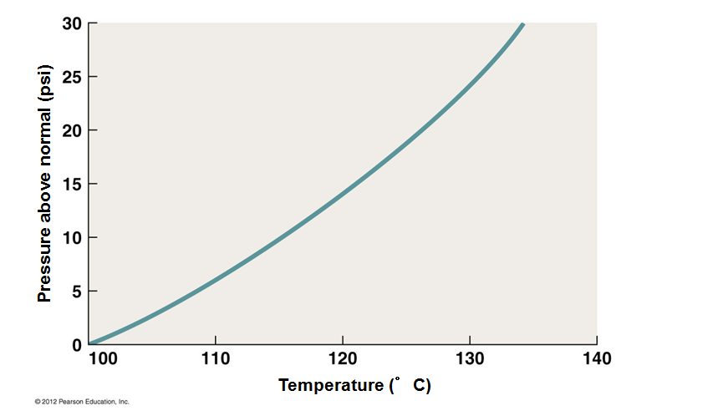
Moist Heat-Related Methods
Autoclaving
Pressure applied to boiling water prevents steam from escaping (~ pressure cooking)
Boiling point increases as pressure increases – water needs more energy (temperature) to fight the high pressure and evaporate
Higher temperatures can be achieved in liquid without losing liquid through boiling
Standard autoclave conditions – 121ºC, 15 psi, 15 min
Boiling point curve – this determines boiling point at a given pressure
See where 121 ^{º}C and 15 psi sit?
Water in autoclave is just below its boiling point

Slide 20
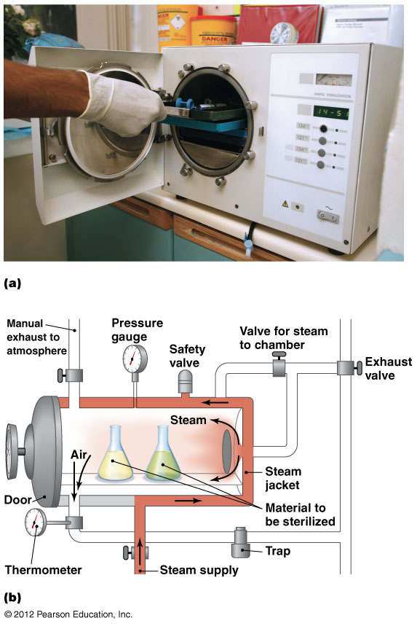
Figure 9.6 Autoclave-overview

Slide 21
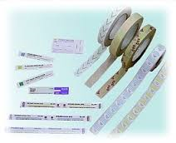
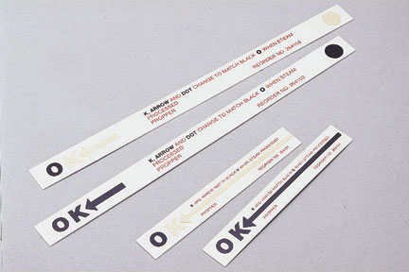
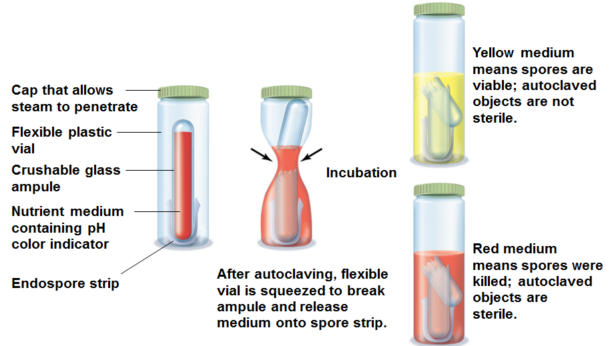
Figure 9.8 Sterility indicators.
How do we know we autoclaved successfully? Or heat-killed all microbes present?

Slide 22
Physical Methods of Microbial Control
Heat-Related Methods
Moist heat
Pasteurization
Used for delicate food that cannot be boiled - milk, ice cream, yogurt, and fruit juices
Pasteurization is NOT sterilization
Heat-tolerant microbes survive (tend to be non-pathogenic); they will eventually spoil food if left out
Pasteurization methods
Large-volume method
batch pasteurization - most commonly used; least expensive
Small-volume methods (usually under pressure)
Flash pasteurization
Ultrahigh-temperature pasteurization
140ºC for 1 sec, then rapid cooling
Treated liquids can be stored at room temperature
Used for fruit juices, soups, mini-creamers, etc.
© 2012 Pearson Education Inc.

Slide 23
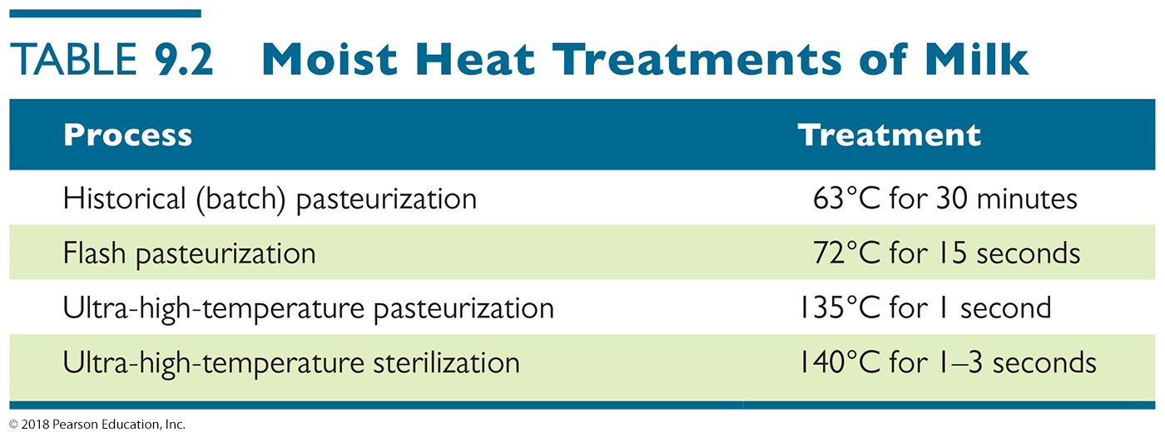
Table 9.2 Moist Heat Treatments of Milk
Notes:
23

Slide 24
Physical Methods of Microbial Control
Heat-Related Methods
Dry heat
Used for materials that cannot be sterilized with moist heat or can tolerate far more heat
Reserved for “tough” materials
hard plastics, metals
Dry heat does not involve heat limits like boiling (100ºC) and so can get a LOT higher!
Denatures proteins and oxidizes metabolic and structural chemicals (“fries” or “burns” them)
Can utilize higher temperatures and longer times than moist heat
Incineration is ultimate means of sterilization
Cremation vs. burial; why fields are burned

Slide 25
Physical Methods of Microbial Control
Refrigeration and Freezing
Decrease microbial metabolism, growth, and reproduction
Chemical reactions occur more slowly at low temperatures
When frozen, liquid water not available
Refrigeration halts growth of most pathogens
Psychrophilic microbes can multiply in refrigerated foods (Listeria sp. are facultative psychrophiles)
Organisms vary in susceptibility to freezing
https://www.youtube.com/watch?v=1NQKEFeFKsc

Slide 26
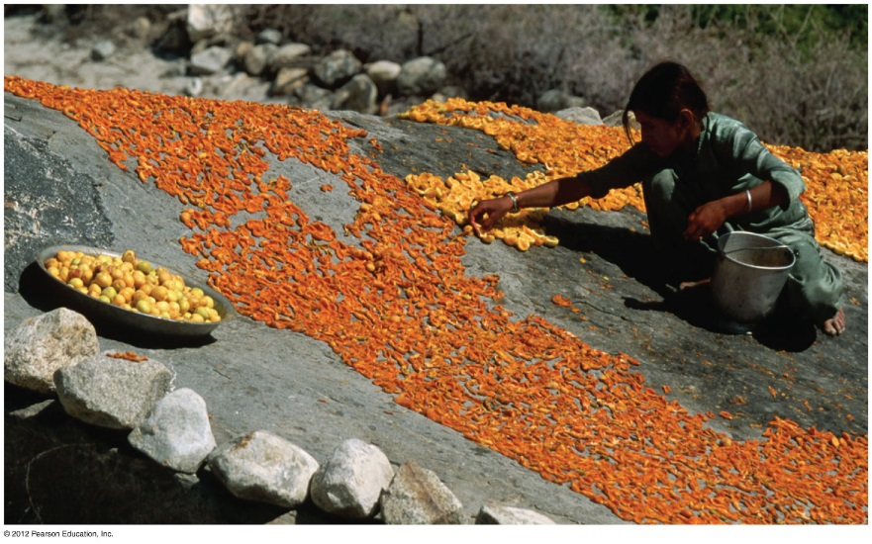
Physical Methods of Microbial Control
Desiccation and Lyophilization
Dessication - drying inhibits growth because of removal of water (what do hypertonic conditions do?)
This is why we dry/dehydrate fruits, vegetables, meats (jerky) to preserve them
Lyophilization used for long-term, low-temperature preservation of microbial cultures
Dessication + freezing
Think: freeze-drying
Prevents formation of
damaging ice crystals
© 2012 Pearson Education Inc.

Slide 27
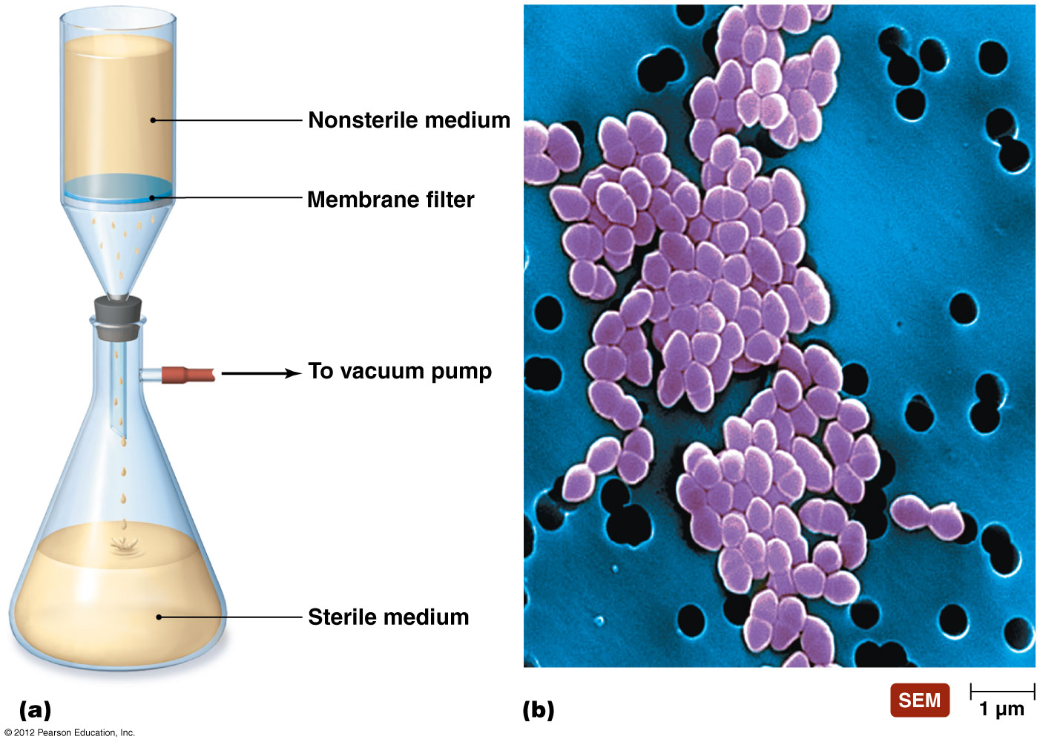
Filtration - removal (vs. killing) of pathogens by letting fluid pass through pores Filtration is done when heating cannot be done (blood, breathing air)

Slide 28
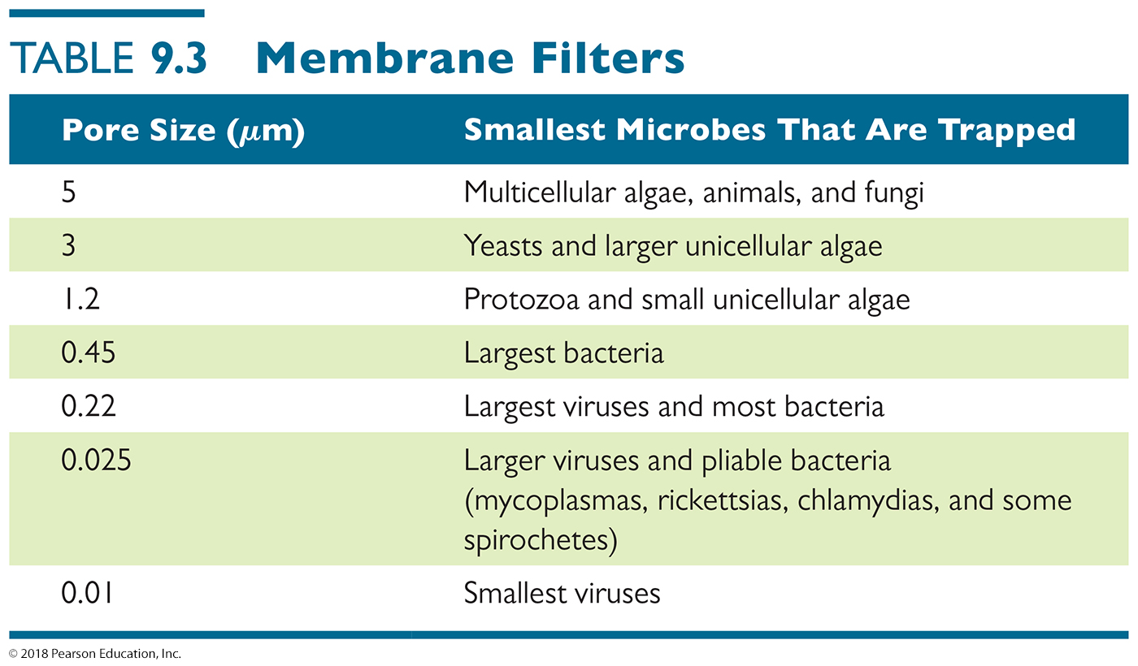
Membrane Filters – decontamination of liquids or gases
The smaller the pore size, the more expensive, and the slower the filtering, or the greater the force needed to separate the liquid medium from the microorganisms.
Notes:
28

Slide 29
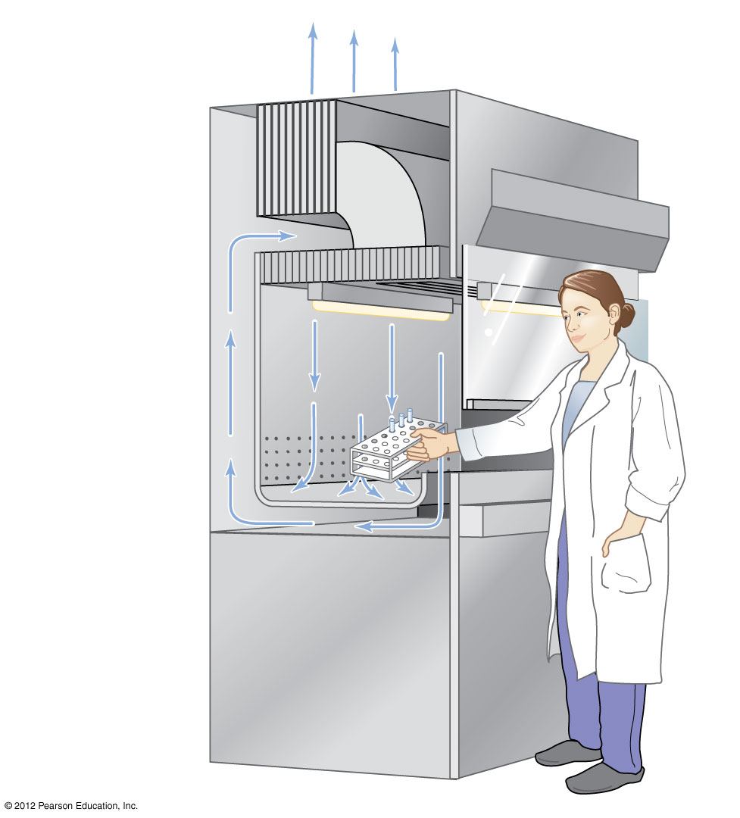
Figure 9.10 The roles of HEPA filters in biological flow safety cabinets
High-Efficiency Air Particulate (HEPA) filters are used to remove pathogens from the air
They are used in Air conditioners, room air filters, and in clean rooms
Special cabinets like this are used to remove pathogens before air is returned to the outside world
Outside
Exhaust HEPA filter
Safety glass viewscreen
Blower
Supply HEPA filter
Light
High-velocity air barrier

Slide 30
Physical Methods of Microbial Control
Osmotic Pressure
Generally used for food preservation
High concentrations of salt or sugar in foods inhibit growth of food-spoiling microbes
Cells in hypertonic solution of salt or sugar lose water (crenation) to match salinity of surroundings
Fungi have greater ability than bacteria to survive hypertonic environments
This is how meats and cheeses are aged during curing – some molds are allowed to grow on aged steaks and cheeses to build flavor and further inhibit bacterial growth via their antibiotic release into the food

Slide 31
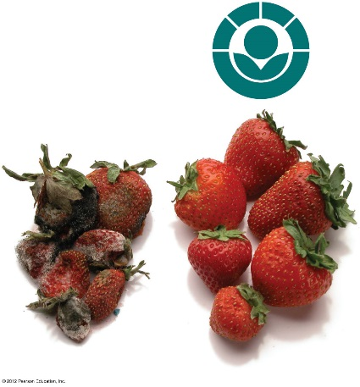
Physical Methods of Microbial Control
Radiation
Ionizing radiation
Wavelengths shorter than 1 nm
Two types are most often used; both are expensive
Electron beams – effective at killing but do not penetrate well (electrocution)
Gamma rays – penetrate well but require hours to kill microbes – need to overwhelm repair pathways and exhaust microbes
Best for surface sterilization
Irradiated food is safe after radiation has ended
non-
irradiated
strawberries
irradiated
strawberries

Slide 32
Physical Methods of Microbial Control
Radiation
Nonionizing radiation
Wavelengths between 1 nm and 330 nm
UV light causes pyrimidine dimers in DNA, forces continuous DNA nucleotide excision repair – death occurs when excessive repairs overwhelm the microbes
UV light does not penetrate solids or liquids well
Effective to disinfect air, thin volumes of fluids, and surfaces of objects
© 2012 Pearson Education Inc.

Slide 33
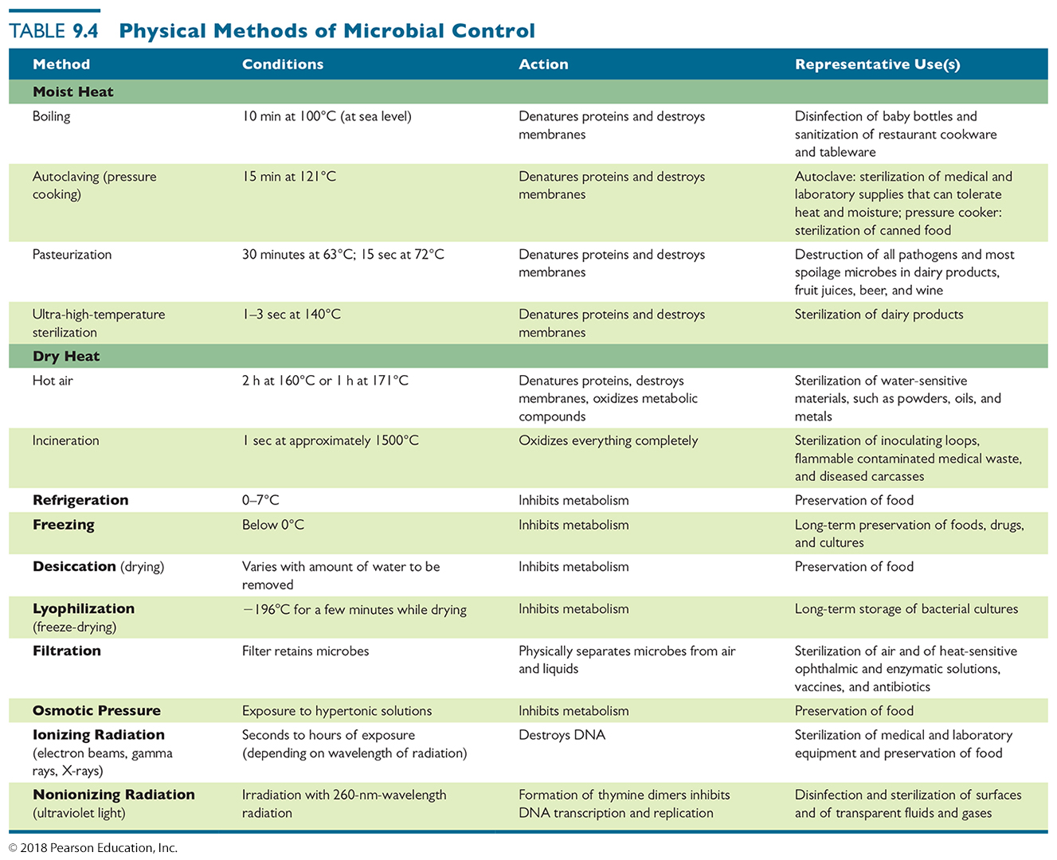
Table 9.4 Physical Methods of Microbial Control
Notes:
33

Slide 34
Chemical Methods of Microbial Control
Phenol and Phenolics
Alcohols
Halogens
Oxidizing Agents
Surfactants
Heavy Metals
Aldehydes
Reactive Gases
Enzymes
Antimicrobials (in Chapter 10)
© 2012 Pearson Education Inc.

Slide 35
Chemical Methods of Microbial Control
Phenol and Phenolics
Intermediate- to low-level disinfectants
Denature proteins and disrupt cell membranes
Effective in presence of organic matter
Remain active for prolonged time
Commonly used in health care settings, labs, and homes
Have disagreeable odor and possible side effects (many are carcinogenic to humans)
Joseph Lister used phenol as a topical antiseptic

Slide 36
Chemical Methods of Microbial Control
Alcohols
Intermediate-level disinfectants
Most commonly used: isopropanol (topical), ethanol (safe on tissues)
Denature proteins; disrupt cytoplasmic membranes
More effective than soap in removing bacteria from hands
Hand sanitizers are ~60% ethanol in aloe gel matrix
This is why hand sanitizers are so common
Swabbing of skin with 70% ethanol prior to injection - degerming
Menthol, thymol, and ethanol are components of Listerine
© 2012 Pearson Education Inc.

Slide 37
Chemical Methods of Microbial Control
Halogens
Intermediate-level antimicrobial chemicals
Widely used in numerous applications
Chlorine – bleach, pools, public water supply
Chloramine used to sanitize fishtank and drinking water
Bromine – disinfection, sanitization (pools)
Iodine – tablets or degerming
betadine swabbing often done before skin surgeries
e.g., watch SOME MEDICAL cyst extraction videos
https://www.youtube.com/watch?v=GWEjc25PHfI
© 2012 Pearson Education Inc.

Slide 38
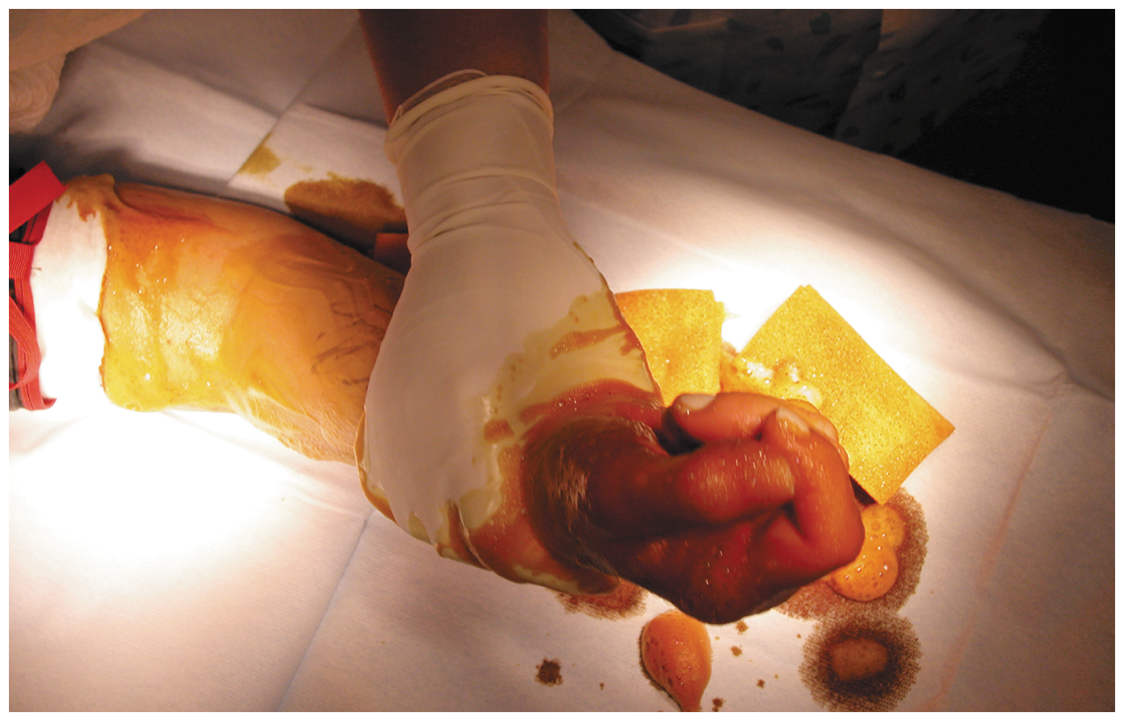
Figure 9.14 Degerming in preparation for surgery on a hand.
Notes:
38

Slide 39
Chemical Methods of Microbial Control
Oxidizing Agents
Kill by oxidation of microbial enzymes via hydroxyl/alkoxyl radical formation
High-level disinfectants and antiseptics
Many examples in use in hospitals and homes:
Hydrogen peroxide can disinfect and sterilize abiologic (high concentrations) or biologic (low concentrations) surfaces
Not highly effective to disinfect open external wounds because of catalase activity from our skin and skin-residing microbes
Ozone treatment of drinking water
Peracetic acid is effective sporocide used to sterilize equipment
Benzoyl peroxide used in acne medications
Sodium percarbonate used in dishwashing machine detergents
© 2012 Pearson Education Inc.

Slide 40
Chemical Methods of Microbial Control
Surfactants
“Surface active” chemicals
Have hydrophilic and hydrophobic ends
Reduce surface tension of solvents
Helps dissolve oils and allows physical methods to remove pathogens form surface easier
Interfere with membrane function
Two main types
Soaps and detergents
Quats

Slide 41
Chemical Methods of Microbial Control
Soaps and detergents
Soaps are from fats/oils
Detergents are synthetic
Chemically optimized to dissolve better in water
Good degerming agents (dissolve oil and bacterial hiding places) but not antimicrobial by themselves
Quats (quaternary ammonium compounds)
positively charged organic surfactants
Low-level disinfectants
Ideal for many medical and industrial applications
Cetylpyridinium chloride found in Cepacol mouthwash
Active ingredient of Lysol and Bactine is benzalkonium chloride

Slide 42
Chemical Methods of Microbial Control
Heavy Metals
Heavy-metal ions denature proteins; “gum-up” membranes (think of soap scum on bathtubs)
Low-level bacteriostatic and fungistatic agents
Many different metals used
1% silver nitrate used to counter blindness caused by N. gonorrhoeae
Thimerosal (mercury) used to preserve vaccines
Copper controls algal growth in freshwater tanks
Zinc is component of many anti-cold medications, combined with gluconate or acetate
Toxicity with humans common; use with care!
© 2012 Pearson Education Inc.

Slide 43
Chemical Methods of Microbial Control
Aldehydes
Compounds containing terminal –CHO groups
Cross-link functional groups to denature proteins and inactivate nucleic acids
Formalin (formaldehyde in water) used in embalming and specimen preservation and disinfection of rooms and instruments
Orthophthaldehyde (OPA) is much safer for humans and so is used to sterilize equipment that contacts humans tissues
Glutaraldehyde disinfects and sterilizes
© 2012 Pearson Education Inc.

Slide 44
Chemical Methods of Microbial Control
Gaseous Agents
Used to sterilize areas in which gas can permeate
Microbicidal and sporicidal gases used in closed chambers to sterilize items
Used in hospitals and dental offices
Used to sterilize equipment outside of business hours
Disadvantages due to high chemical reactivity
Treated areas must be evacuated before and after use
Often highly explosive
Extremely poisonous
Potentially carcinogenic
Ethylene/propylene Oxide, Chlorine gas, Ozone, beta-propione lactone
© 2012 Pearson Education Inc.

Slide 45
Chemical Methods of Microbial Control
Enzymes
Antimicrobial enzymes act against microorganisms
Human tears contain lysozyme
Digests peptidoglycan cell wall of bacteria
Enzymes to control microbes in the environment
Lysozyme used to reduce the number of bacteria in cheese
Lysozyme used instead of sulfites by osme winemakers
Prionzyme can remove prions on medical instruments, environmental contamination
first effective anti-prion treatment

Slide 46
Chemical Methods of Microbial Control
Antimicrobials
Antibiotics, semisynthetic, and synthetic chemicals
Typically used for treatment of disease
Mostly used inside of body
Some used for antimicrobial control outside the body (i.e. triclosan in hand and dish soaps)
© 2012 Pearson Education Inc.

Slide 47
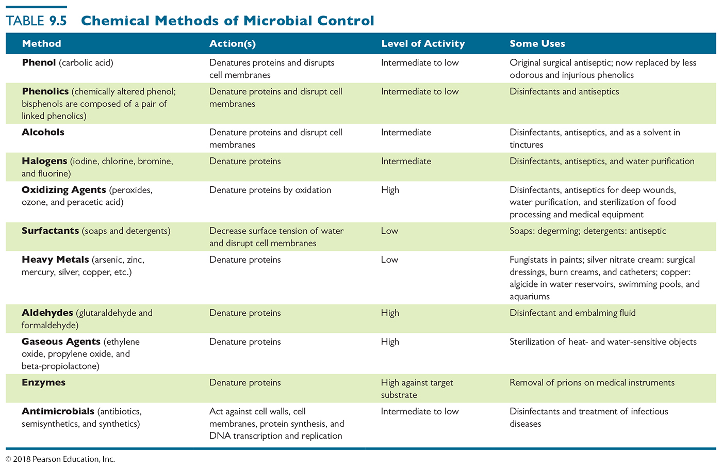
Table 9.5 Chemical Methods of Microbial Control
Notes:
47

Slide 48
Chemical Methods of Microbial Control
Development of Resistant Microbes
Little evidence that products containing antiseptic and disinfecting chemicals add to human or animal health
E.g., triclosan in antibacterial handsoaps
“erring on the side of caution” causes them to be often used for indications when they are not really needed – such as normal handwashing and dishwashing
Excessive use of such products promotes development of resistant microbes

