Slide 1
Microbiology
Chapter 7
Microbial Genetics

Slide 2
The Structure and Replication of Genomes
Genetics
Study of
how traits are expressed in organisms, and
how they are propagated from:
One organism to other organisms (uncommon) or
One organism to their progeny (very common)
Genome
The entire genetic complement of an organism
Includes:
Its nucleotide sequences
Its genes
How genes are housed and protected:
chromosomes (all organisms; large) and
plasmids (for microbes; small)

Slide 3
SUMMARY SLIDE
The Structure of Prokaryotic Genomes
Prokaryotic chromosomes
Large (400 - 8000 kbp) circular molecule of DNA in the nucleoid
Only one copy (haploid), encodes genes “always” essential for life
Plasmids
Small (3-30 kbp) circular pieces of DNA throughout cytosol
Usually 2-20 copies, encodes genes “sometimes” essential for life
The Structure of Eukaryotic Genomes
Eukaryotic chromosomes
HUGE (10000 – 50000000 kbp), divided into more than one genetically unique linear chromosomes in the nucleus
Diploid and haploid states – 1 or 2 slightly different “copies”
Extranuclear chromosomes of eukaryotes
10-100 kbp circular DNA (1-10 copies) in mitochondria and chloroplasts
Plasmids – (3-100 kbp) in nucleus of unicellulars

Slide 4
The Structure of Prokaryotic Genomes
Prokaryotic chromosomes
Large (>400 kbp) circular molecule of DNA in the nucleoid
Most of genome encodes genes and their regulatory regions
Very little DNA has no apparent function
Single copy of the genome – always haploid
Rarely, second copies of some genes are TRANSIENTLY acquired through horizontal gene transfer
These extra copies are often “shuffled” with a nearly exact gene in the genome in a process called recombination
Improved genes survive to progeny
Deteriorated genes result in obsolescence or death
Extra gene copies are degraded soon afterward

Slide 5
The Structure of Prokaryotic Genomes
Plasmids
Present throughout cytosol in 2-20 copies.
Small circular pieces of DNA (3-30 kbp)
They replicate independantly of the main chromosome
Multiple-copy plasmids are replicated multiple times while the chromosome is replicated once
Most plasmids encode only a few genes
plasmids encode a lot of “junk” DNA between genes
Plasmid genes are not essential for everyday function
They encode genes that are useful when “times get tough”.
antibiotic resistance genes
genes to construct pili from fimbriae
genes to undergo horizontal gene transfer (fertility genes)
genes to increase virulence (exotoxins, adhesins)
Multiple distinct plasmids are possible per cell

Slide 6
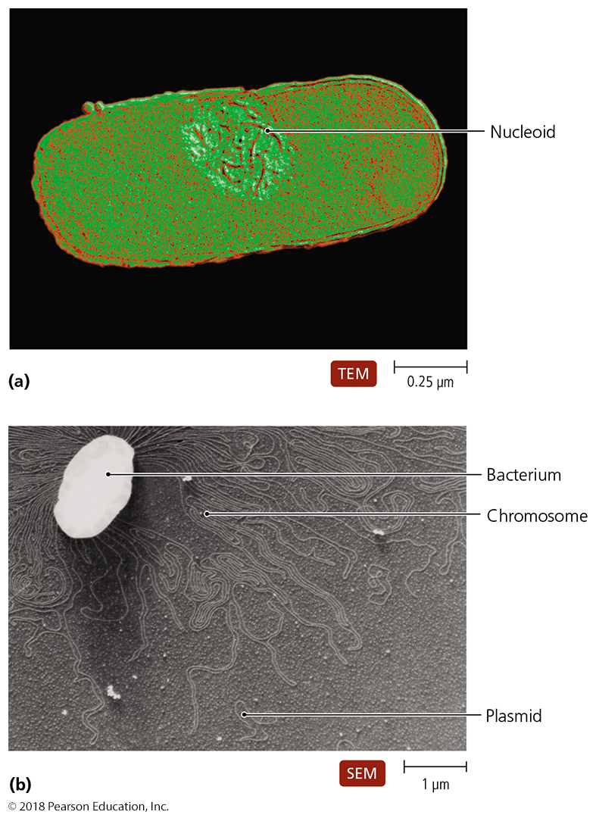
Figure 7.2 Bacterial genome.
Notes:
6

Slide 7
The Structure of Eukaryotic Genomes
Nuclear chromosomes
Genome size is much larger (10Mbp – 50000 Mbp)
DNA is organized and “protected” by two processes
The genome is almost always broken down to manageable pieces (< 200000 kbp); each piece is a chromosome
DNA is wrapped around histones to reserve the fragile structure
Histones are loosened to allow access to DNA for gene expression and genome duplication
Chromosomes are (almost always) linear and (always) sequestered within nucleus

Slide 8
The Structure of Eukaryotic Genomes
Genome inheritance
Two modes of gene passage from parents to their progeny (vertical gene transfer)
Asexual reproduction – progeny have genome identical to their parent (one parent; two children)
Sexual reproduction - progeny have genomes from TWO parents instead of ONE parent (two parents; multiple kids)
Genome content
Genomes can be diploid (two copies per genome) in all eukaryotes at some point in their life
animals and most plants are diploid thru almost all of life
some animals and plants are polyploid (> 3 copies)
Some species are haploid (one gene copy per genome) through most of their life cycle
yeast and molds, some protozoa and some algae

Slide 9
The Structure of Eukaryotic Genomes
Diploid genomes have two very similar but NOT identical chromosome copies after sexual reproduction
One copy from father, and one copy from mother
Mother’s and father’s two chromosome copies are segregated to single copies per cell during meiosis
Genomes split into chromosomes are shuffled among progeny
Improves genetic diversity among children
There are 2N possible varieties of haploid chromosomes in gametes after meiosis
3 chromosomes – 2³ = 8 varieties
23 chromosomes – 2²³ = 8 million varieties
33 chromosomes – 2³³ = 8 billion varieties

Slide 10
The Structure of Eukaryotic Genomes
Extranuclear DNA of eukaryotes
Mitochondrial DNA
Resembles prokaryotic genomic DNA
2-10 circular copies (usually 10-30 kbp) per mitochondria ; all genetically identical (and thus haploid) in each mitochondrion
10-1000 mitochondria per cell (most microbes have < 100 per cell)
In some species, mitochondria can come from mother and father and can be distinct; most species’ mitochondria are from only one parent
Mitochondria replicate independently in cells with metabolic needs
Only code for about 5% of RNA and proteins
Chloroplast DNA
Resembles prokaryotic genomic DNA
2-20 circular copies (100-500 kbp), all genetically identical
Most species’ chloroplasts are from only one parent (usually “mom”)
Chloroplast replicate independently in cells with metabolic needs
Only code for about 5% of RNA and proteins

Slide 11
Table 7.1 Characteristics of Microbial Genomes
Notes:
11

Slide 12
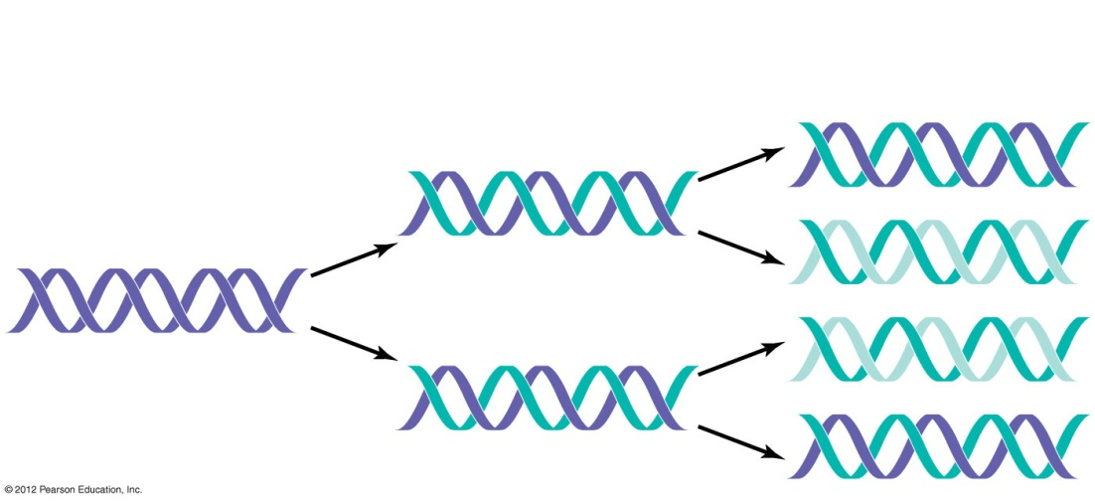
DNA Replication – review on your own
Anabolic polymerization process that requires monomers and energy
Triphosphate ribonucleotides provide energy
Triphosphate deoxyribonucleotides used to build DNA
The key to accurate replication is complementary structure of the two strands
Replication is semiconservative
New DNA composed of one original and one daughter strand
Notes:
12

Slide 13
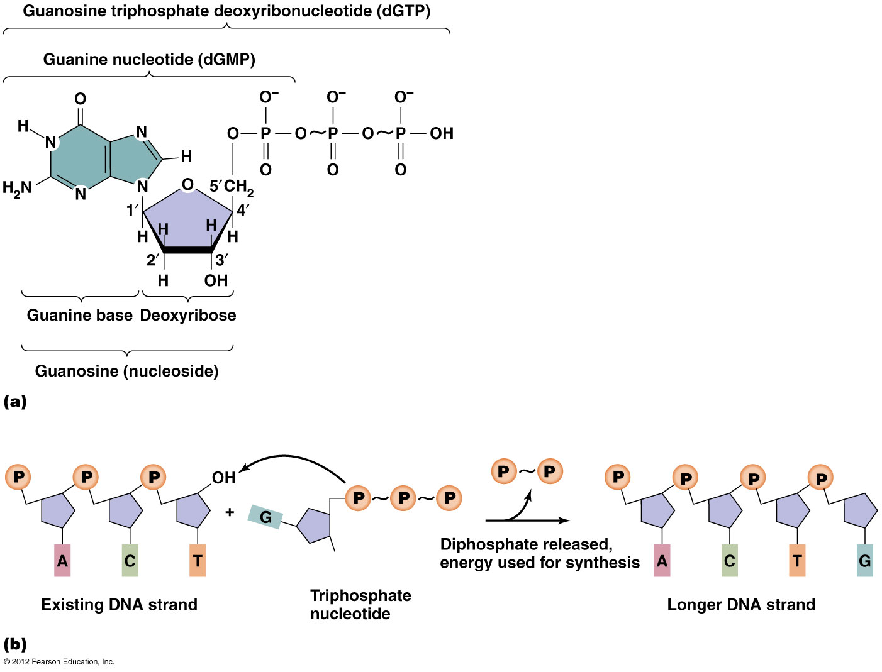
DNA Replication – review on your own
New nucleotides are added only to the 3’ end of a DNA strand.
Thus, DNA synthesis is done in the 5’ → 3’ direction.
5’
3’
5’
3’
5’
3’
5’
3’

Slide 14
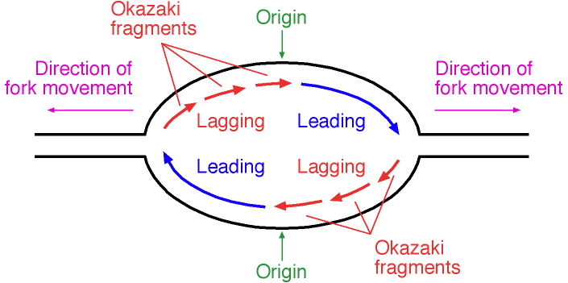
The Structure and Replication of Genomes
DNA Replication in prokaryotes
Initial processes
Bacterial DNA replication begins at a single origin of replication in its single chromosome
The replication bubble forms when two replication forks migrate away from each other - bidirectional
Within each replication fork, DNA polymerase replicates each strand of DNA in only the 5′ to 3′ direction
Because strands are antiparallel, new strands are synthesized in opposite physical directions and thus differently
replication fork
Within each replication fork:
One polymerase follows the fork
One polymerase runs away from the fork
pol
pol
pol
pol
replication fork
© 2012 Pearson Education Inc.
Notes:
14

Slide 15
The Structure and Replication of Genomes
Lagging vs. leading strands – review on your own
Strands synthesized in opposite physical directions are named differently
Leading strand synthesized continuously
Same polymerase is always “right behind” the replication fork as the fork moves
Lagging strand synthesized discontinuously by the construction of Okazaki fragments that are later stitched together
As each polymerase “runs away” from the replication fork, a new polymerase needs to start near the fork, only to also “run away”.
© 2012 Pearson Education Inc.
Notes:
15

Slide 16
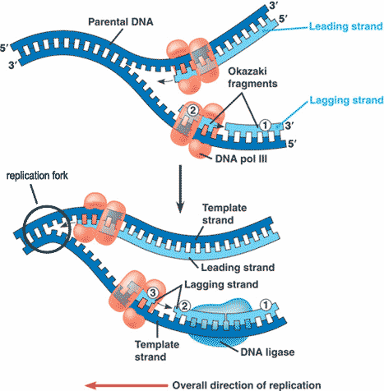
Why are there Okazaki fragments? - review
As DNA unzips, one new strand can keep being made (polymerase moves toward fork) and so fills in the opened “old” DNA
The other strand cannot be filled in until a new primer is made, and synthesis moves away from the fork.
© 2012 Pearson Education Inc.
Notes:
16

Slide 17
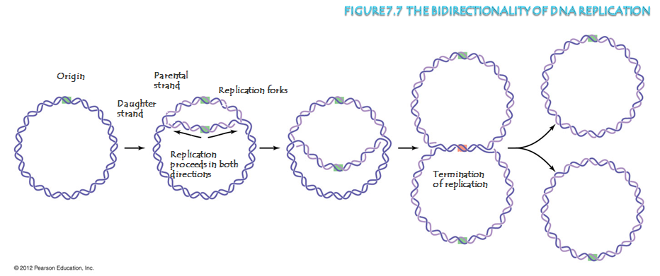
Other characteristics of bacterial DNA Replication
Topoisomerase (a.k.a gyrase) plays two roles
Universal role: remove supercoils in DNA molecule
Prokaryote-only role: cut the intertwined chromosome loops to free them
Fluoroquinolones – antibiotics that inhibit gyrase
DNA is methylated
Protection against viral infection ; nonmethylated dsDNA seen as foreign
Repair of DNA – errors made on new unmethylated strand, not the old methylated strand; error correction is thus focused on the new strand
Loops are intertwined; the loops must be cut to release rings
© 2012 Pearson Education Inc.
Notes:
17

Slide 18
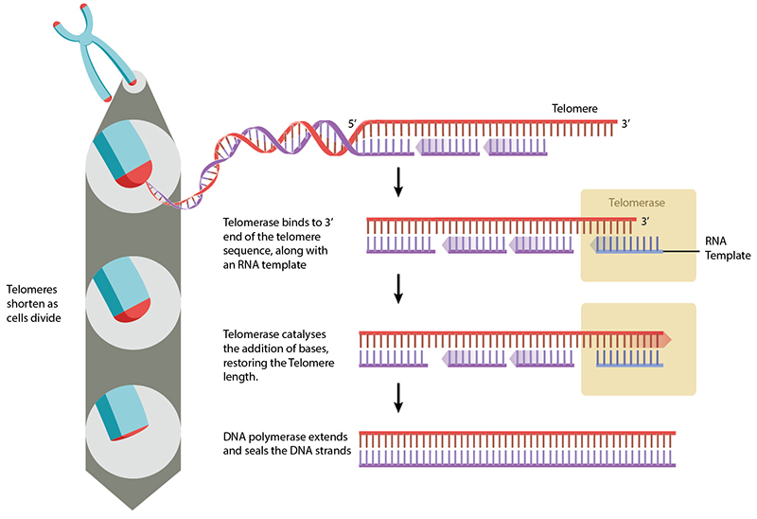
DNA Replication of eukaryotic DNA
Some differences compared to bacterial DNA rep.
Thousands of replication origins
Much bigger genome, and multiple chromosomes
Non-expressed DNA replicated after “active” DNA is replicated
Easiest to start replication where genome is “open”
allows time for important error correction
DNA ends (telomeres) need to be extended or else crucial DNA is lost after each division
© 2012 Pearson Education Inc.
Notes:
18

Slide 19
The Central Dogma of Gene Expression
The Transfer of Genetic Information
Replication
ALL of DNA is copied to pass to daughter cells
Transcription
Information in PART of DNA is copied as RNA
DNA is NOT used to make proteins
RNA gets used (and damaged) to make proteins
Translation
Polypeptides synthesized from RNA
Central dogma of genetics:
DNA → RNA → protein
DNA transcribed to RNA
RNA translated to form polypeptides
© 2012 Pearson Education Inc.
Notes:
19

Slide 20
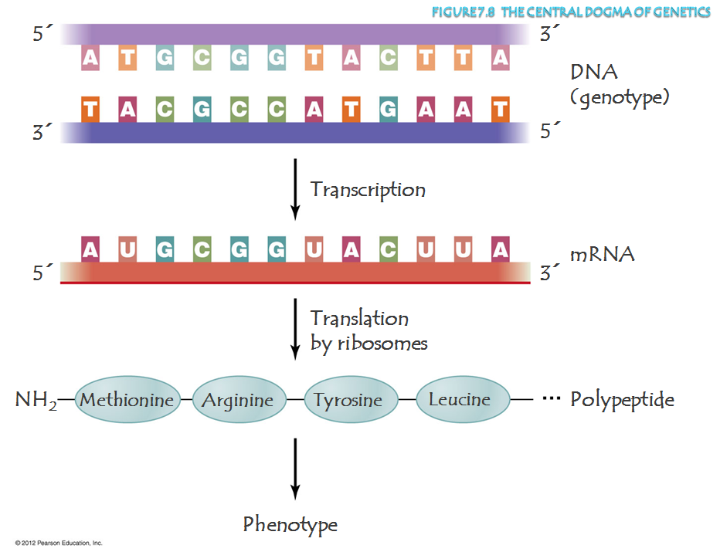
Coding strand
template strand
sense strand, a.k.a. (+) strand

Slide 21
The Events in Transcription – review on your own
Four types of RNA transcribed from DNA
RNA primers – start DNA strand synthesis; removed later
mRNA – to express protein-encoding genes
rRNA – for ribosome structure, mechanics and function
tRNA – to match a specific RNA triplet codon sequence to a specific and correct amino acid
RNA is synthesized in nucleoid of prokaryotes, or the nucleus of eukaryotes
Three steps of transcription
Initiation – most regulation controls this step
Elongation – builds the RNA
Termination – releases the finished RNA
© 2012 Pearson Education Inc.
Notes:
21

Slide 22
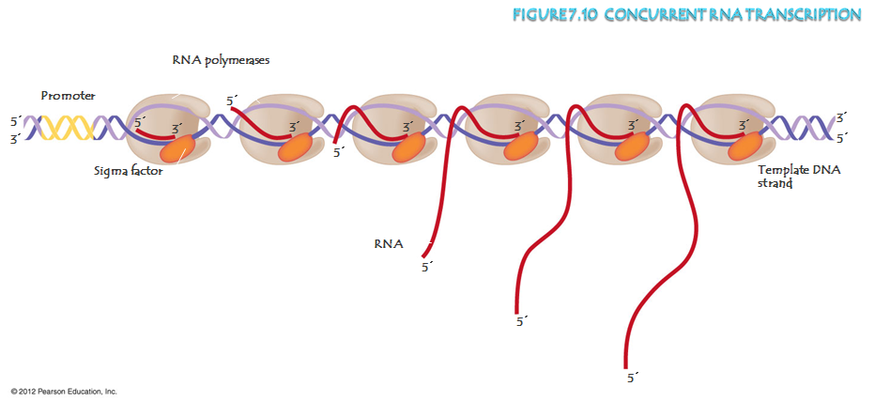
Prokaryotic Gene transcription
Protein translation can begin as RNA is being made at nucleoid - cotranslation

Slide 23
Translation – to review on your own
Occurs in the cytosol in both prokaryotes and eukaryotes
Process where ribosomes use genetic information of nucleotide sequences in mRNA to synthesize polypeptides
Nucleotide triplets are translated to amino acid monomers through the genetic code
Participants in translation
Messenger RNA – dictates the protein sequence via a series of nucleotide triplet codons
Transfer RNA – contains the amino acids to be inserted into the protein
Ribosomes and ribosomal RNA – organizes ribosome and mRNA; catalyzes the production of a protein consistent with the mRNA sequence
© 2012 Pearson Education Inc.
Notes:
23

Slide 24
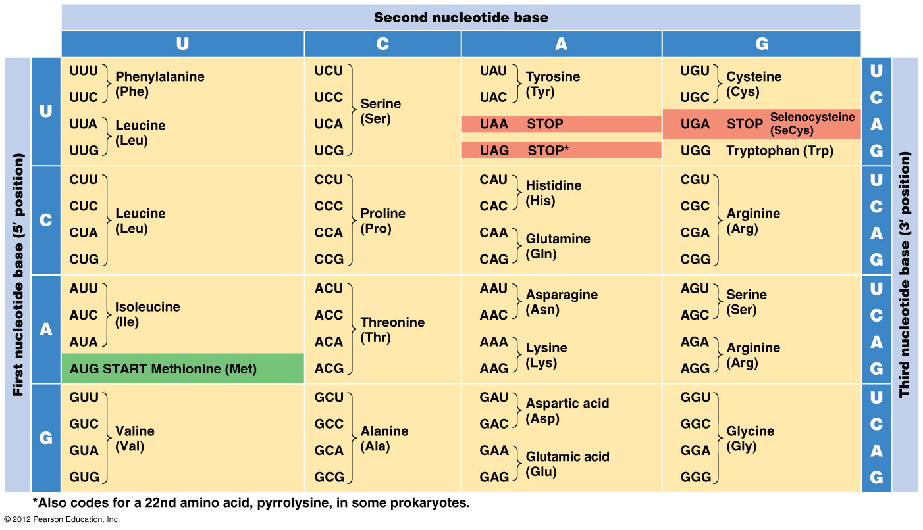
Figure 7.12 The genetic code
From mRNA to proteins: the genetic code
Note the presence of the start codon and three stop codons!!

Slide 25
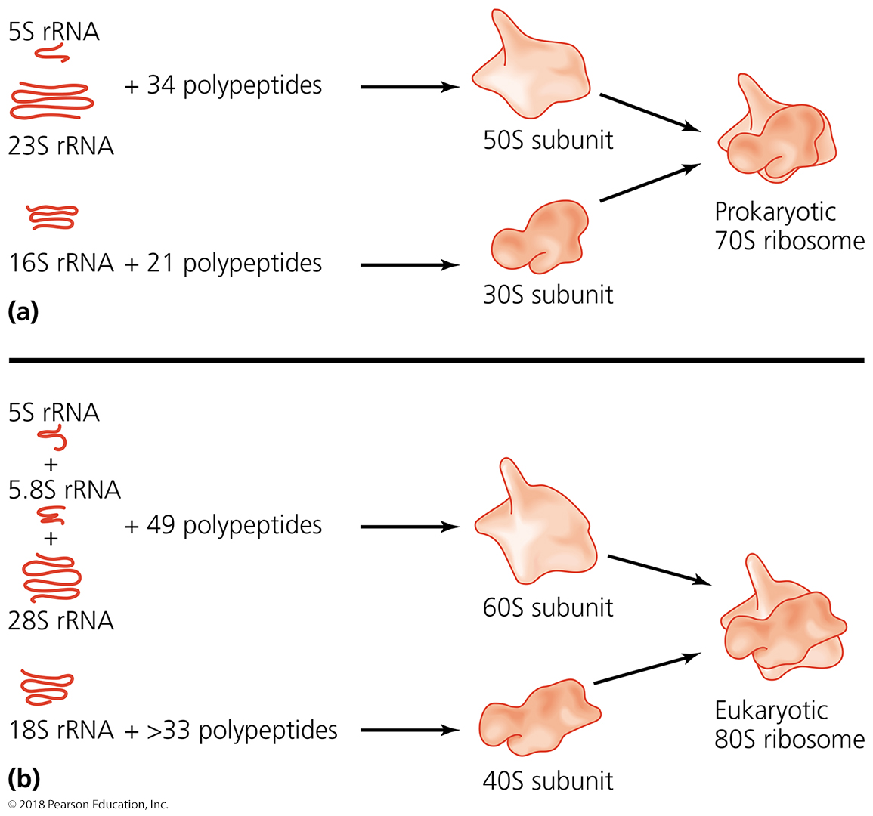
Figure 7.15 Ribosomal structures – note differences in bacteria vs. eukaryotes.
Bacteria
(also mitochondria
also chloroplasts)
Bacterial
Eukaryotes
(also archaea)
Notes:
25

Slide 26
Mutations of Genes
Mutation
Change in the nucleotide base sequence of a gene in the genome
Rare event (1:10⁴ during DNA replication; 1:10⁸ after error correction (error correction 99.99% effective)
Almost always deleterious
Rarely leads to a protein that improves ability of organism to survive
How often are changes to a car bad (flat tire, old brakes)
How often are changes to a car good (does oil in car get better with time)
Ribosomes do not know mRNA is altered; it must remain dumb to what it is making

Slide 27
Ribsomes are Dumb, and only read what they are told……

Slide 28
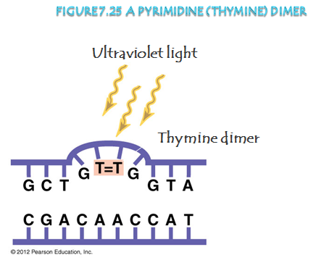
We regulate microbial growth through mutations
Radiation – induces DNA and protein damage
Ionizing radiation – destroy DNA
Gamma ray, X-ray
Gamma rays are used to radiate the surface of foods to eliminate microbes growing on the surface
Once irradiation finished, food is safe to consume
Very high energy particles; EXPENSIVE and DANGEROUS procedure (Bruce Banner → the Hulk)
Nonionizing radiation – mutate DNA
Ultraviolet light
Far less expensive and dangerous
Can irradiate air, thin depths of water, or the surface of solids
Overwhelms and exahusts DNA repair pathways of pathogens
Endospores are resistant to this

Slide 29
Horizontal Gene Transfer
Recipient cell incorporates DNA from a “donor”
Occurs independant of cell division, mitosis or meiosis
Occurs independant of sexual or asexual reproduction
These are most commonly seen among prokaryotes, but has been observed in fungi and some protozoa
This is how new strains within a species of microbes most commonly appear or evolve
Gain antibiotic resistance
Acquire virulence factors

Slide 30
Horizontal Gene Transfer – SUMMARY SLIDE
There are three common modes of horizontal gene transfer. All involve taking up DNA:
Transformation – take up DNA from surroundings (dead cells or cell debris?)
Transduction – take up DNA from a pathogenic infection (most often viral)
Conjugation – take up DNA from an intact cell (involves specialized structures like pili)

Slide 31
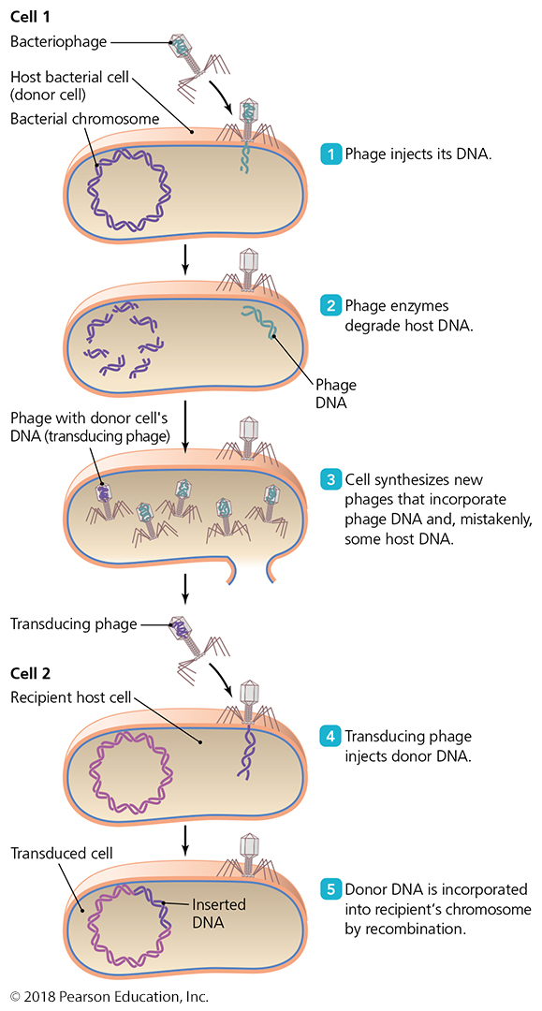
Horizontal Gene Transfer - Transduction
Bacteriophage (virus of bacteria) infects “first” bacterium
As new viral particles are assembled with DNA, the viruses will contain:
Entirely viral DNA
Viral DNA and some host DNA
(rare) only host DNA
Transducing bacteriophage (virus of bacteria) is the third type above
Its interaction with a “second” bacterium leads not to infection but to transduction, when cellular DNA and not viral DNA is injected into the bacterium

Slide 32
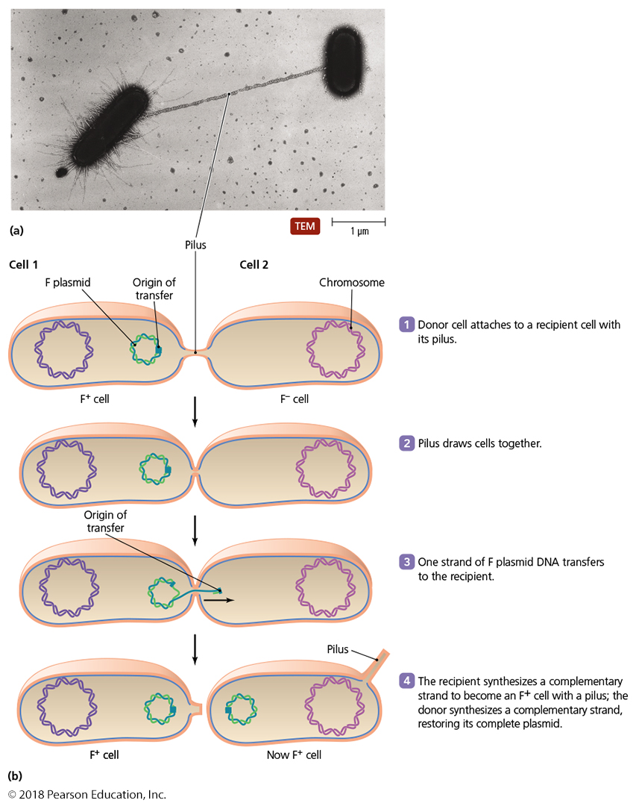
Horizontal Gene Transfer - Conjugation
Physical contact between donor and recipient cell
Mediated by pili
Gene encoding for pili formation is on a plasmid called F
Bacteria harboring the F plasmid are F+
Bacteria lacking the F plasmid are F-
The pilus allows a replicant of F to transfer to the other bacterium
F can contain host genes
If the F plasmid is integrated into the bacterial genome, then a copy of the genome is transferred to the recipient bacterium
Both allow host genes to pass between bacteria
Notes:
32

Slide 33
Genetic Recombination after Gene Transfer
Genetic Recombination
Exchange of nucleotide sequences often occurs between homologous sequences within a single cell
Usually occurs after microbial cells obtain new DNA molecules with potentially new nucleotide sequences (most often from horizontal gene transfer)
Shuffling the deck with new cards…some times you get a better hand, most of the time you do not.
Surviving cells (or those who gained an advantage) pass these rearranged or modified genomes to their descendants
This is a major mechanism explaining how many bacteria evolve to become more resistant to antibiotics

Slide 34
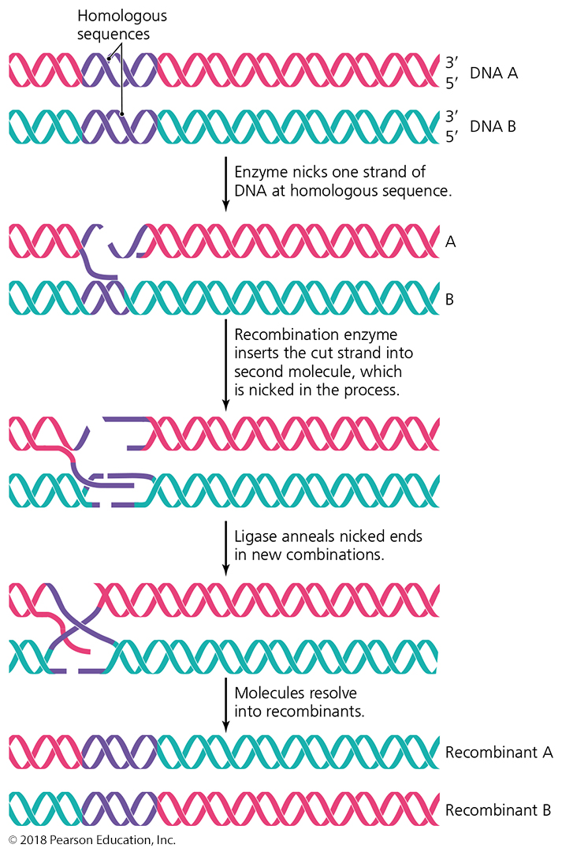
Figure 7.32 Genetic recombination.
A
A
B
B
Shuffling of the deck; can we get a better hand?
A
B
B
A
Notes:
34

