Slide 1
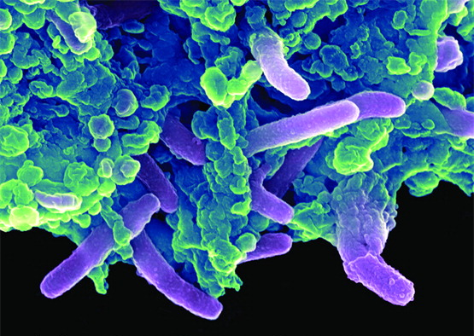
Chapter 6
Microbial Nutrition and Growth

Slide 2
Growth Requirements
Microbial growth
Increase in a population of microbes
Populations generally grow by fission cycles
Fission - one cell divides into two
Result of SPARSE microbial growth is discrete colonies
Colony - An aggregation of cells arising from single “ancestral” cell; all genetically “identical”
Biofilm is colony + protective layers + immigrant microbes + their protective layers
Reproduction results in macroscopic growth
© 2012 Pearson Education Inc.
Notes:
2

Slide 3
Growth Requirements
Organisms use a variety of nutrients for their energy needs and to build organic molecules and cellular structures
Most common nutrients contain necessary elements such as carbon, oxygen, nitrogen, and hydrogen (food, biochemicals)
Microbes obtain nutrients from variety of sources
Obtained from the environment
Obtained from dead material
Stolen from the host
Donated by host
What biological behavior would result in each case happening?
© 2012 Pearson Education Inc.
Notes:
3

Slide 4
Growth Requirements – SUMMARY SLIDE
Nutrients: Chemical and Energy Requirements
Sources of carbon, energy, and electrons
Sources of oxygen
Sources of nitrogen
Sources of Phosphorous, sulfur, trace metals (Fe), vitamins
© 2012 Pearson Education Inc.
Notes:
4

Slide 5
Growth Requirements
Sources of carbon, energy, and electrons
Two groups of organisms are defined based on how they get their carbon atoms
Autotrophs – simple carbon (CO₂, CO₃²⁻)
Heterotrophs – complex carbon (sugars, organic acids, amino acids, fats)
Two groups of organisms are defined based on how they get their energy
Chemotrophs – energy from chemical bonds
Phototrophs – energy from the sun
© 2012 Pearson Education Inc.
Notes:
5

Slide 6
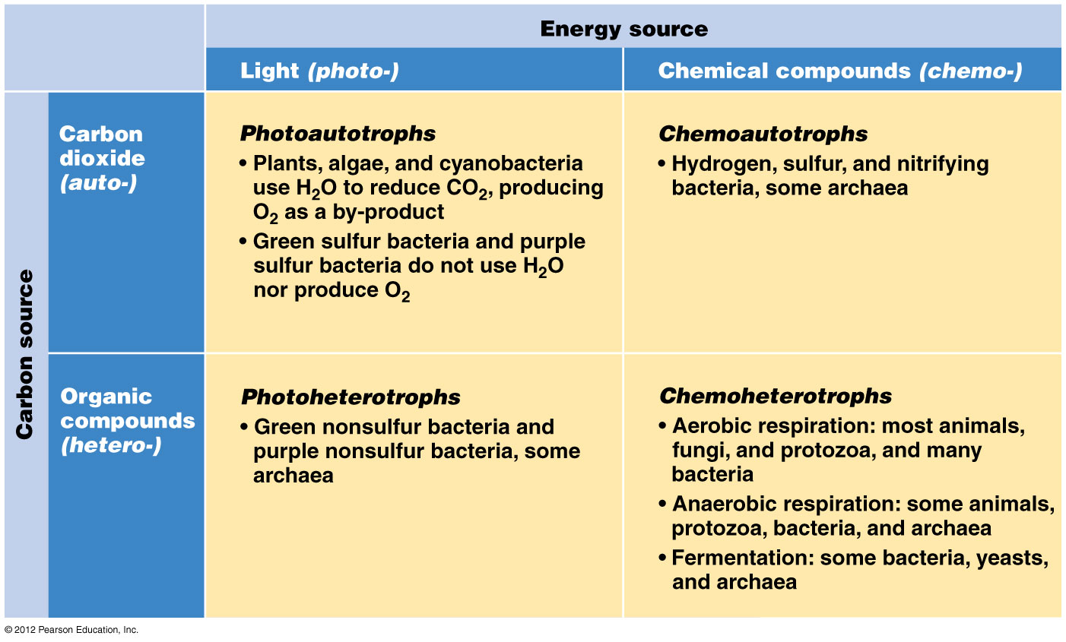
Combining the “trophs”….

Slide 7
Growth Requirements
Oxygen requirements
Oxygen atoms are required by all organisms BUT…
Oxygen added to biochemicals as water during metabolism
Oxygen gas is essential for obligate aerobes
Oxygen reduced to water during oxidative phosphorylation
Oxygen gas is deadly for obligate anaerobes
Obligate anaerobes don’t have enzymes to inactivate toxic forms of oxygen
Toxic forms of oxygen are highly reactive and excellent oxidizing agents
This is why oxygen is excellent electron acceptor in electron transport chain)
Resulting improper oxidation causes irreparable damage to cells
Notes:
7

Slide 8
How can oxygen gas kill bacteria?
Resting oxygen gas and oxygen atoms in compounds (e.g., alcohol, carboxylic acid) are not toxic
O₂ can be easily activated, then chemically reduced into toxic forms of O₂
peroxide, superoxide, hydroxyl, hydroxide
Anti-pathogen defensive enzymes exist in many species that rapidly produce large amounts of toxic forms of oxygen
Overwhelms defensive systems of pathogens
Sunlight and random chemical reaction can also activate O₂ and convert it into toxic forms
Spontaneously occurs, albeit at a lower level
The resulting oxidation rapidly causes irreparable damage to cells without defensive enzymes to re-oxidize the toxic molecules (catalase!)
Obligate anaerobes don’t have enzymes to inactivate these toxic forms of oxygen
© 2012 Pearson Education Inc.
Notes:
8

Slide 9
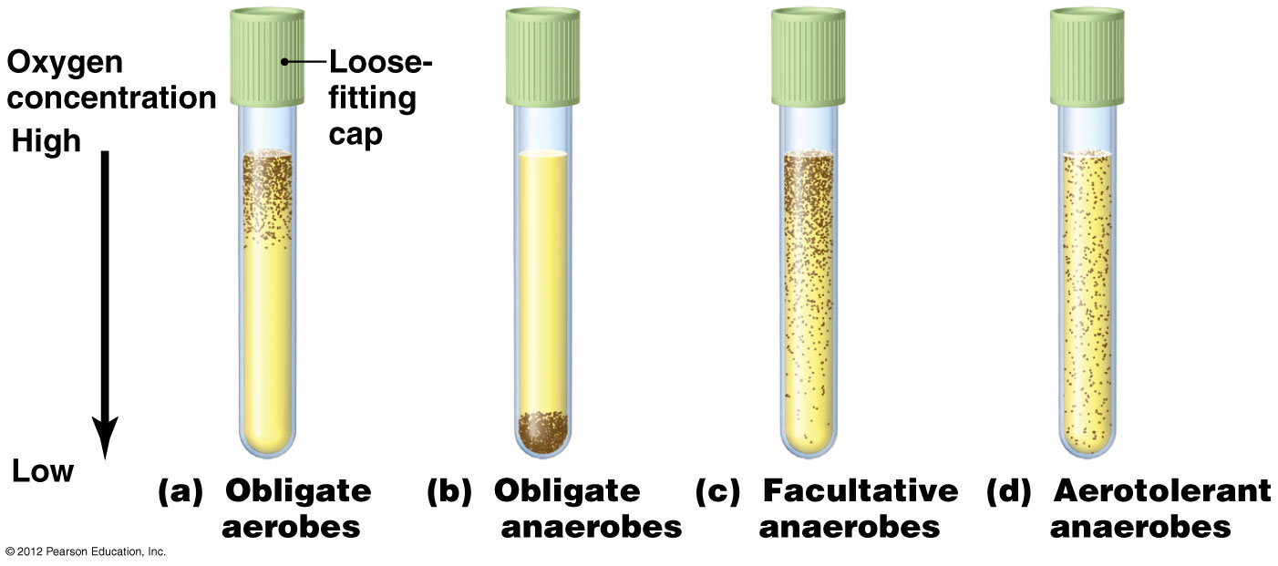
Growth Requirements
Organisms can be characterized based on their oxygen needs
Aerobes – grows in the presence of oxygen gas
Anaerobes – grows in the absence of oxygen gas
Obligate _____ - must have [a particular condition] for survival
Facultative __________ - can survive [a particular condition], but will do better if it is present
e.g., facultative anaerobes can grow without oxygen but growth is enhanced with it
Aerotolerant anaerobes
Are not hurt or helped by presence of oxygen
Microaerophiles
Need lower %
oxygen
Where would the densest growth of microaerophiles be in these test tubes?
© 2012 Pearson Education Inc.
Notes:
9

Slide 10
Growth Requirements
Nitrogen requirements
Anabolism (building of molecules required for growth) often ceases because of insufficient nitrogen
Enzymes needed to build/break down molecules
We require protein in our diet for this exact reason!
Sources of nitrogen:
“broken” – unusable by most organisms
Simplest nitrogen: nitrogen gas (“broken”)
“fixed” - accessible to most lifeforms
Simple nitrogen: from ammonia/nitrates in the soil
Complex nitrogen: from amino acids
“recycled” - from their own amino acids and nucleotides (if fixed nitrogen is rare)
Cost: greatly slowed growth (e.g. plants without fertilizer)
Notes:
10

Slide 11
Growth Requirements
Nitrogen requirements
Nitrogen fixation by certain bacteria is essential to life on Earth
As life expands, the amount of biologically useful (“fixed”) nitrogen must increase!
Some bacteria have ability to “fix” atmospheric nitrogen by oxidizing it to nitrate or reducing it to ammonia
These bacteria use this nitrogen for their own needs
Eventually, this new bioavailable nitrogen makes its way up the food chain, and allows growth of more organisms
Nitrogen-fixing bacteria are not pathogenic
Pathogenic bacteria get nitrogen from the host as amino acids from digested host proteins
Notes:
11

Slide 12
Growth Requirements
Other chemical requirements
Sodium/Potassium – osmotic stability
Phosphorus – nucleic acids
Sulfur - proteins
Trace elements – vitamins, minerals, etc.
Required only in small amounts (iron, molybdenum, copper, chromium, selenium)
Growth factors
Necessary organic chemicals that cannot be synthesized by certain organisms (ex: for humans: niacin, riboflavin, Vitamin C)
Microbes that need many growth factors are called fastidious.
© 2012 Pearson Education Inc.
Notes:
12

Slide 13
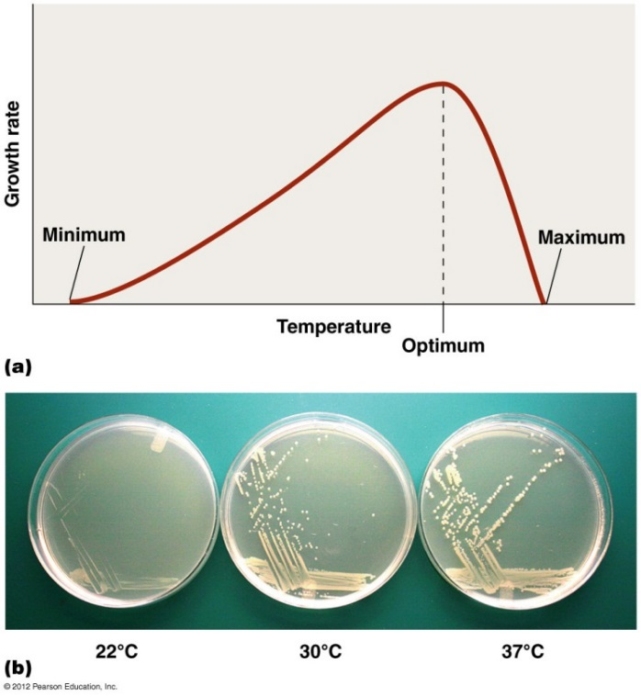
Temperature Requirements
Temperature effects proteins
(slows or eliminates critical protein motions; “boiled eggs”)
Temperature effects membranes of cells and organelles
If it is too cold, membranes become rigid (cold rubber) and fragile
often solved by making phospholipids with polyunsaturated fatty acids
If it is too hot, membranes become too fluid (microwaved plastic) and leaky
can be improved by making phospholipids with saturated fatty acids
Notes:
13

Slide 14
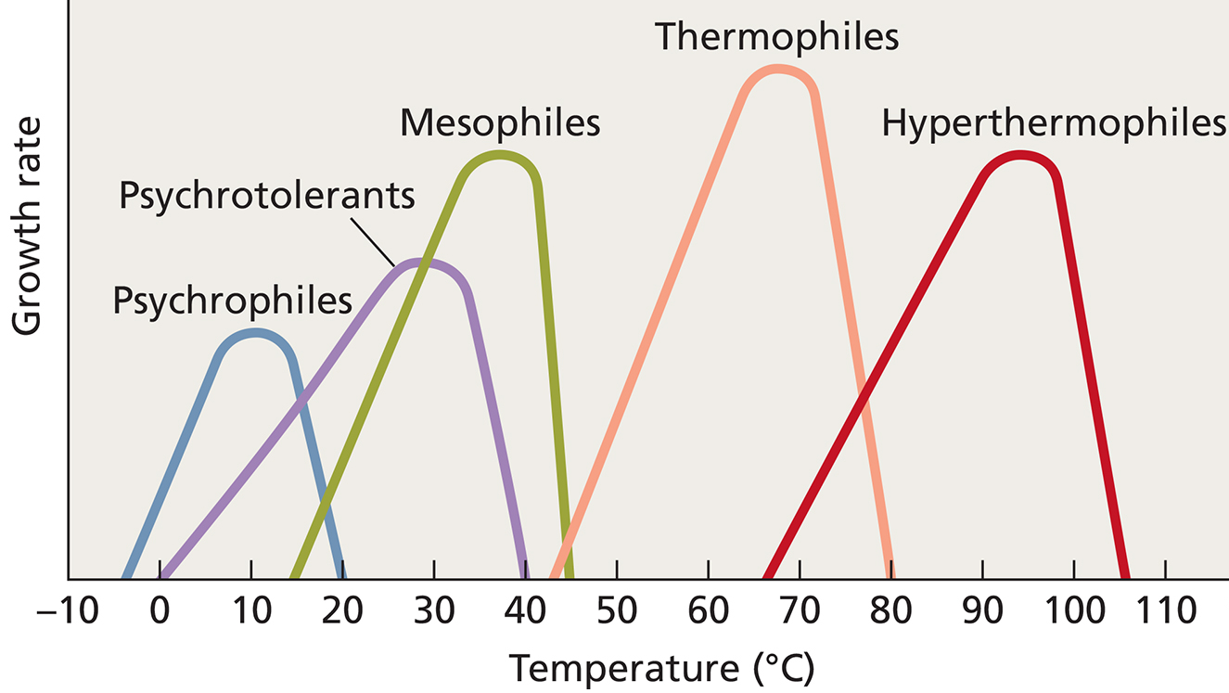
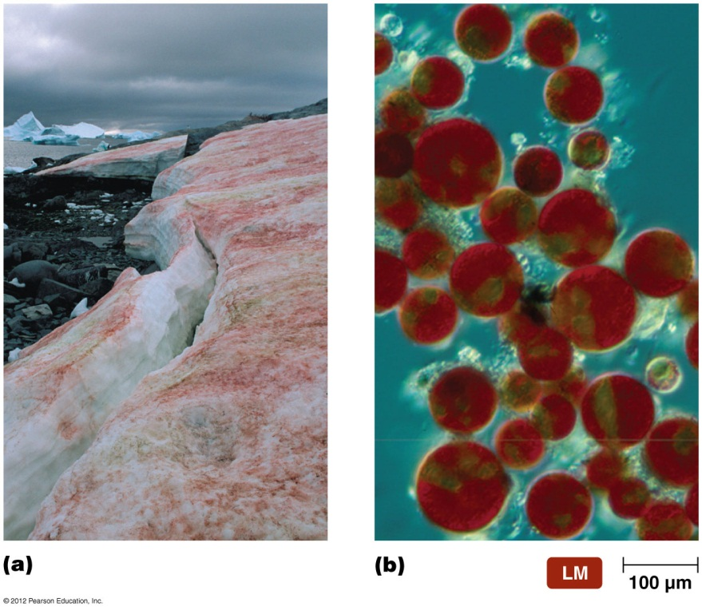
Bacteria can be classified by their growth at various commonly experienced temperatures:
Below freezing point of water
Below body temperature in liquid water
Near or at body temperature
Above body temperature in liquid water
Above the boiling point of water (i.e. pressure cooker)
example of a psychrophile

Slide 15
Acidity Requirements
pH
Organisms are sensitive to changes in acidity
H⁺ and OH–
interferes with H bonding in proteins
Changes activities of critical polar amino acids
Neutrophiles grow best in a narrow range surrounding neutral pH (5-6 to 8-9)
Acidophiles grow best in acidic habitats (2 to 6; a few can go below 2)
Alkalinophiles live in alkaline soils and water ( 8 to 12; a few can go above 12)
Which would grow best in the human body???
© 2012 Pearson Education Inc.
Notes:
15

Slide 16
Hydration Requirements
Microbes require water to dissolve enzymes and nutrients
Water is important reactant in many metabolic reactions
Most cells die in absence of water
Some have cell walls that retain water
Mycolic acid is a waxy lipid that prevents dessication (drying out) of mycobacteria
Endospores (bacteria) and cysts (protozoa) cease most metabolic activity; allows the organism to survive until conditions are better
Notes:
16

Slide 17
Osmotic Requirements
Pressure exerted on a semipermeable membrane by a solution containing solutes that cannot freely cross the membrane
Solutes cannot move, so instead the solvent moves!
Hypotonic solutions have lower solute concentrations;
Cells swell to become hypotonic like their surroundings
Hypertonic solutions have greater solute levels
Cells shrink to become hypertonic like their surroundings
This stops the growth of microbes in food
we dry or pickle many foods with large amounts of salt and/or sugar to increase solute levels and/or remove water!
Organisms can be defined by osmotic preferences
Obligate and facultative halophiles (means what?)
Notes:
17

Slide 18
Social and Communal Requirements
Symbiosis - Organisms exchange specific crucial biochemicals during their association with different species
(host and guest – called symbionts)
Invading organism (guest) always benefits; effects on the host define the type of relationship
Parasitism - host is harmed or killed; the host is definitely better off on its own!
Commensalism – host is not harmed or benefitted
Mutualism – benefits the host (we get Vitamin K from E. coli)
Facultative symbionts - organisms can live on their own but are benefited by a relationship with another
Obligate symbionts – organisms must live together (lifelong interdependency)
Notes:
18

Slide 19
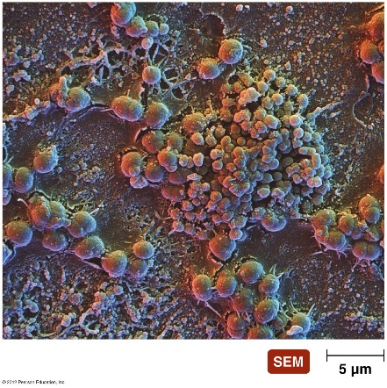
Social and Communal Requirements
Associations
NO intentional exchange of biochemicals (vs. symbionts)
Antagonism – species compete for common nutrients and do not help each other
most microbes on our skin and in our mucous membranes are antagonistic to one another
They tend to fight each other with antibiotics
Their persistent fighting keeps new organisms from moving in and causing disease (resident microbial antagonism)
Synergism – species “share” their non-crucial molecules to improve survival of both species
Probiotic organisms are thought to restore normal microbial floral growth through synergistic effects
Biofilm – “synergism on steroids”
Notes:
19

Slide 20
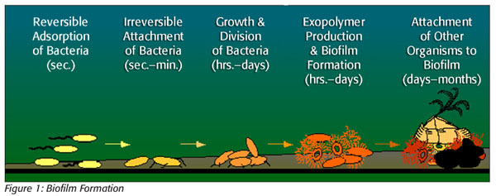
Social and Communal Requirements
Biofilms - “Synergism on steroids”
Complex cooperations among different microorganisms
Develop an extracellular “patchwork” matrix ~ communal glycocalyx
Forms on surfaces often when “they get crowded”
Allows better attachment to a substrate or to other cells
Sequesters nutrients and microbes from outside world
May protect individuals in the biofilm (toothbrushing vs. tartar)
Notes:
20

Slide 21
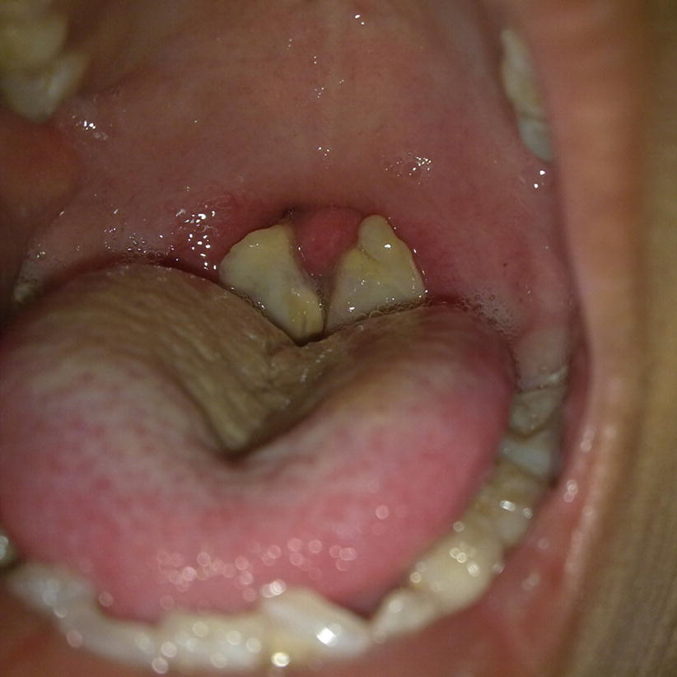
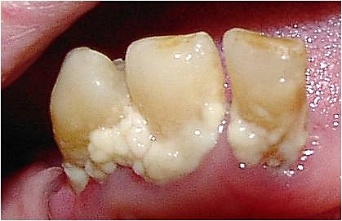
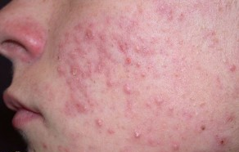
Social and Communal Requirements
Many microorganisms are more harmful as part of a biofilm
Biofilms are associated with many diseases:
chronic infections of artificial implants, on teeth (as tartar), during strep throat (white zones), during diphtheria (corynebacterial pseudomembrane), and during acne vulgaris (closed comedone or “whitehead”), among others
We must finish all of our antibiotics to kill microbes that form biofilms
biofilmed bacteria hide from and resist the medication
Notes:
21

Slide 22
Culturing Microorganisms
Inoculum (specimen) introduced into medium (growth environment)
Environmental specimens
Clinical specimens
Stored specimens
Medium is singular, media is plural
Culture
As a verb - Act of growing microorganisms
As a noun - the microorganisms that are being grown
© 2012 Pearson Education Inc.
Notes:
22

Slide 23
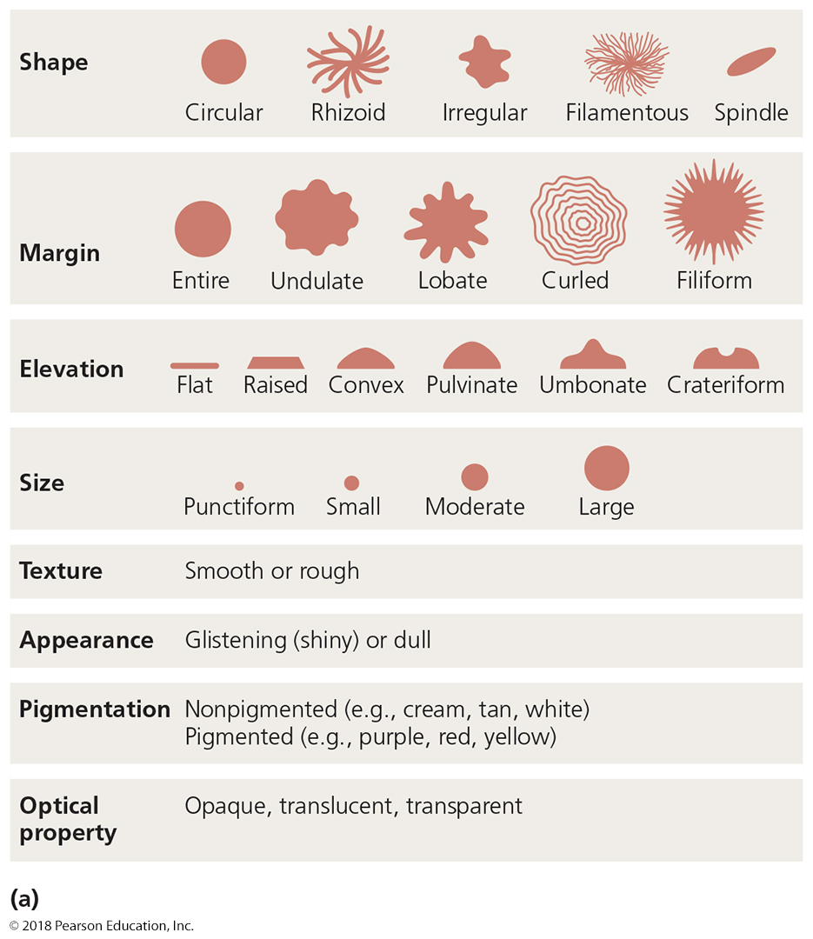
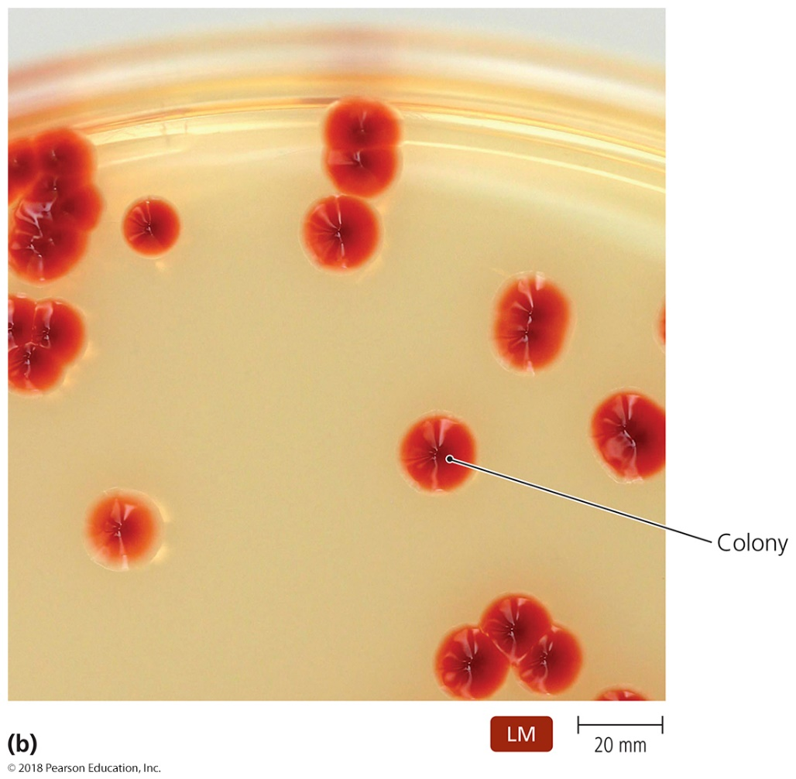
Figure 6.8 Characteristics of bacterial colonies-overview
Only analyze well-separated colonies. Antagonism or Synergism influenced by neighboring colonies can give misleading and random results!

Slide 24
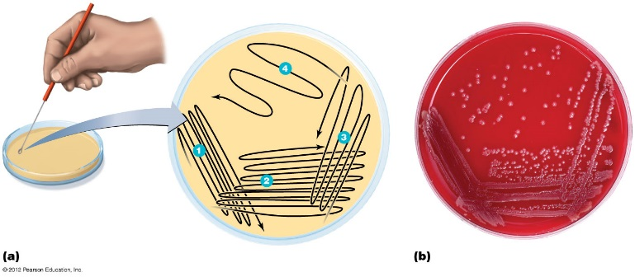
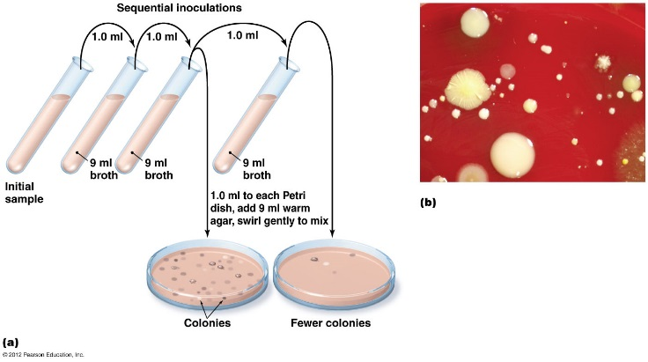
Culturing Microorganisms
Figure 6.10 Pour plate method of isolation-overview
Obtaining Pure Cultures
Must be done on (semi)SOLID medium to prevent bacteria from mixing with each other
Colonies composed of cells arising from a single progenitor
Progenitor is termed a CFU (colony forming unit)
Aseptic technique prevents contamination of sterile substances or objects
Two common isolation techniques:
Streak plates – single plate
Pour plates – bacterial concentration calculable
© 2012 Pearson Education Inc.
Notes:
24

Slide 25
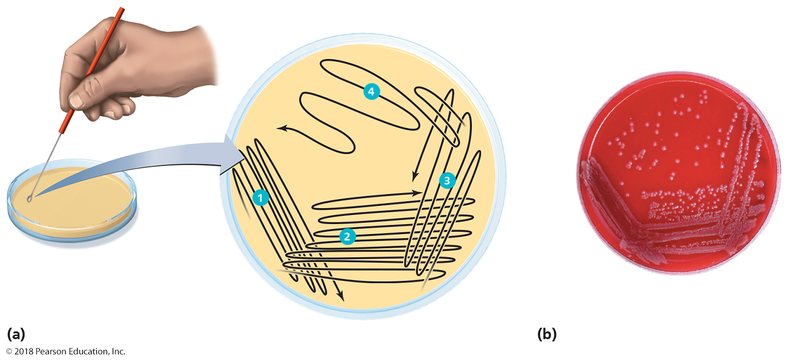
Figure 6.9 The streak-plate method of isolation.
Done properly, it guarantees well-isolated colonies using only a single plate and allows one to see if the plate or the streaking tool was contaminated.
Notes:
25

Slide 26
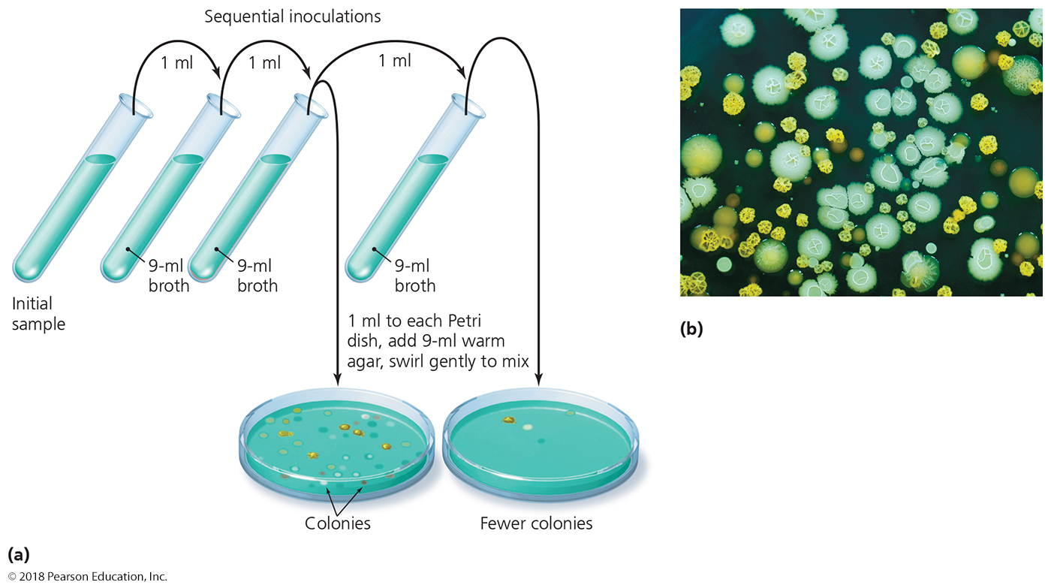
Figure 6.10 The pour-plate method of isolation.
Done properly, it guarantees a uniform distribution of bacteria on each plate, and allows one to calculate a concentration of bacteria in an inoculum.
Notes:
26

Slide 27
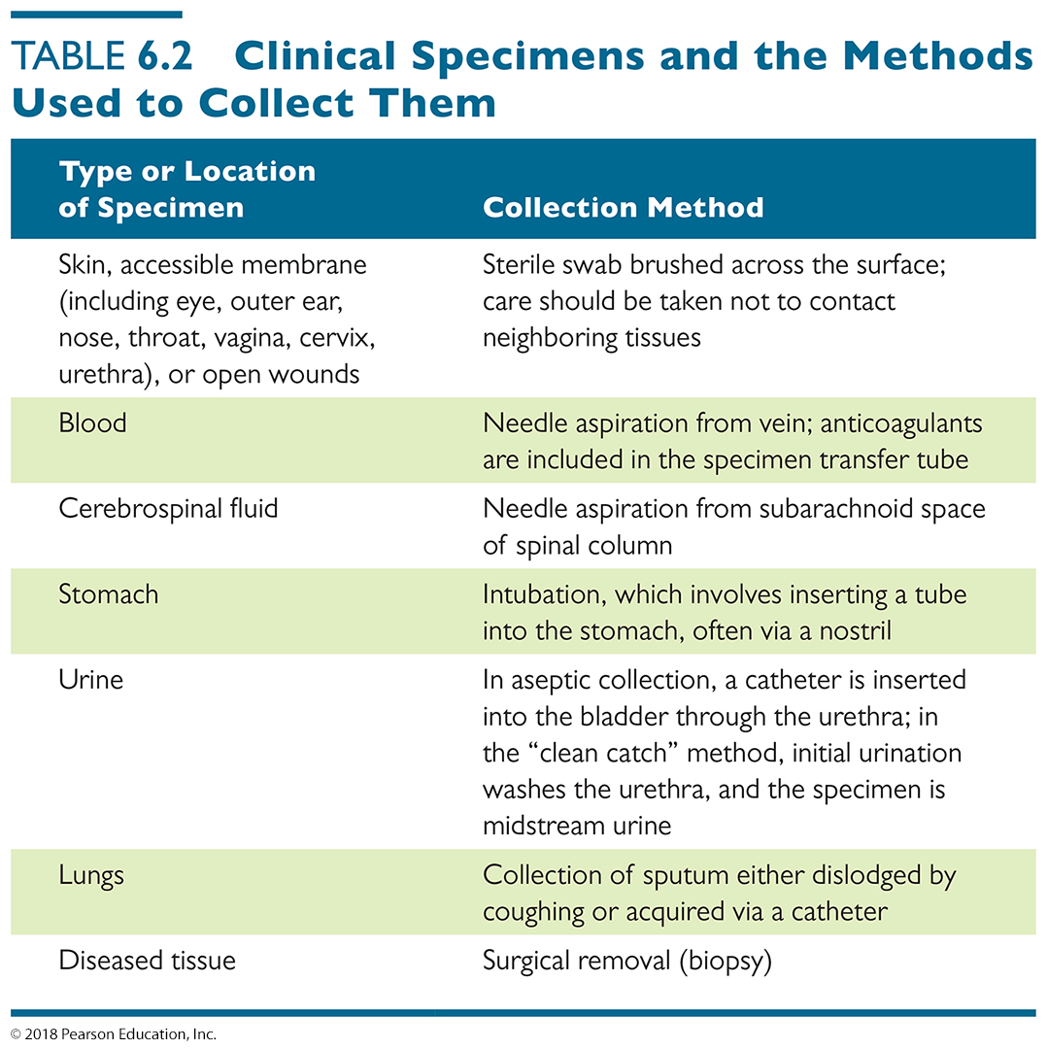
Table 6.2 Clinical Specimens and the Methods Used to Collect Them
Name a tissue or source, and there is a way to culture microbes from that tissue or source!
Notes:
27

Slide 28
Culturing Microorganisms
Culture Medium
Variety of liquid and solid media used to culture microbes
Nutrient broth is a liquid medium.
Good for rapidly expanding defined populations of microbes
Agar is added to nutrient broth to make semi-solid medium.
Used to make Petri plates, stab media, and slant tubes
Plates are designed for isolating specific species of bacteria

Slide 29
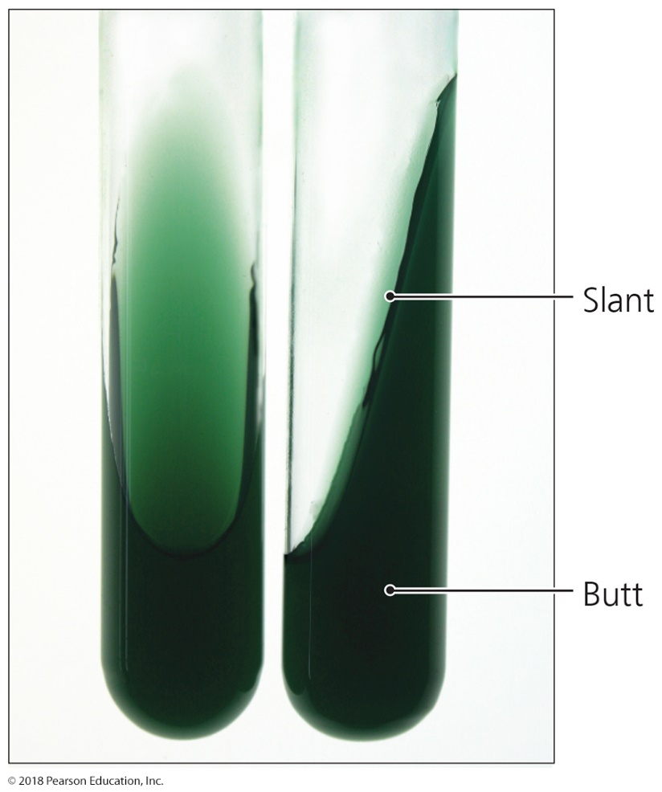
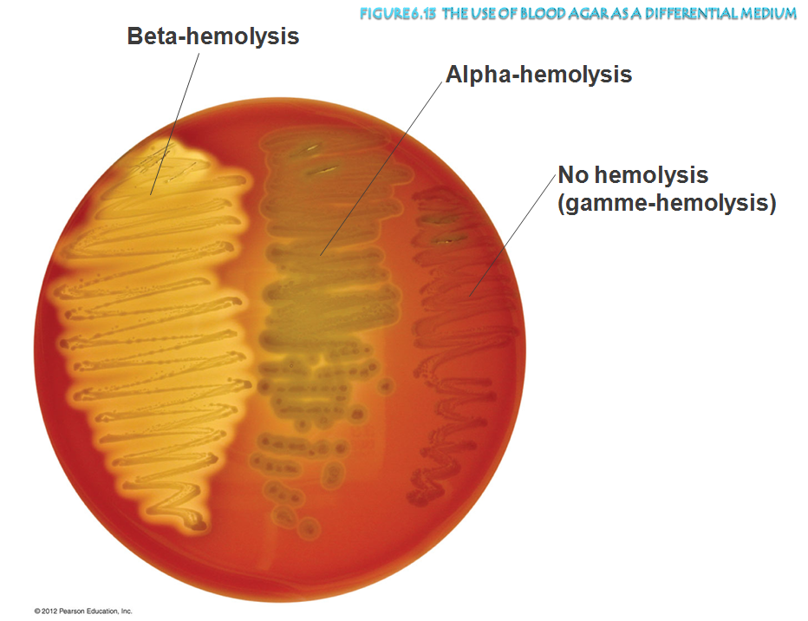
Slant tube contains solid media gelled at an angle Slant allows more surface area and sub-surface volume for aerobes to grow in test tube

Slide 30
Culturing Microorganisms
There are several types of culture medium
Defined medium
Synthetic – ingredients exactly defined
Complex medium (or supportive medium)
Contains nutrients that are released by partial digestion of yeast, beef, soy
Used to grow as many organisms as possible
TSA, nutrient broth, blood is sometimes added
Selective medium
Used to repress the growth of a group of (unimportant) microbes
Enrichment medium
used to promote the group of specific organisms (esp. pathogens)
Differential medium
Use to identify organisms based on differences in colony or medium color
Used to distinguish multiple species present
Transport medium
Used for long term survival and movement of microbe through unstable environments (e.g. to the FDA or the CDC through FedEx), without contaminating the culture or the general public!
Notes:
30

Slide 31
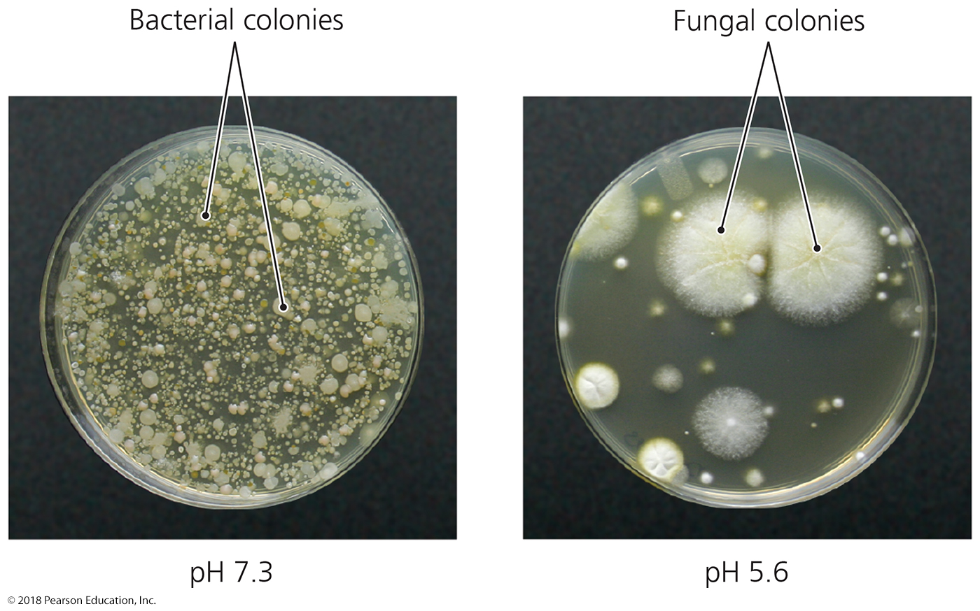
Figure 6.12 An example of the use of a selective medium.
Notes:
31

Slide 32
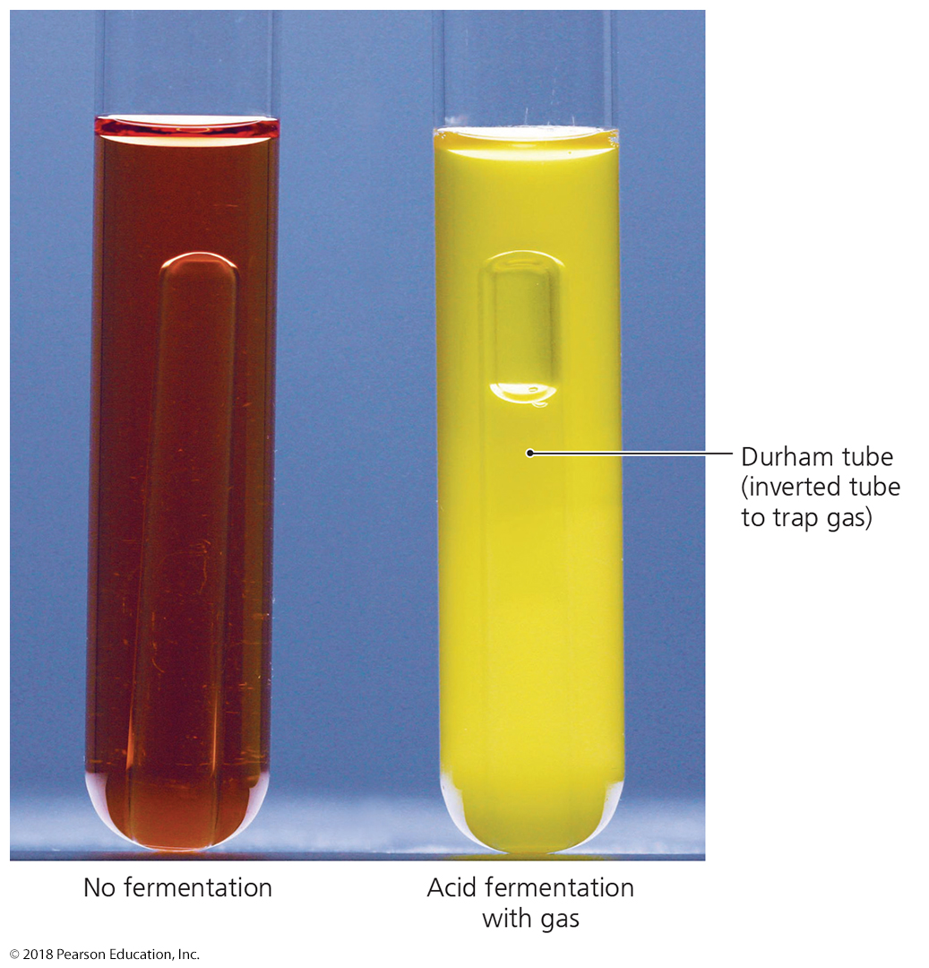
Figure 6.14 The use of carbohydrate utilization tubes as differential media.
Notes:
32

Slide 33
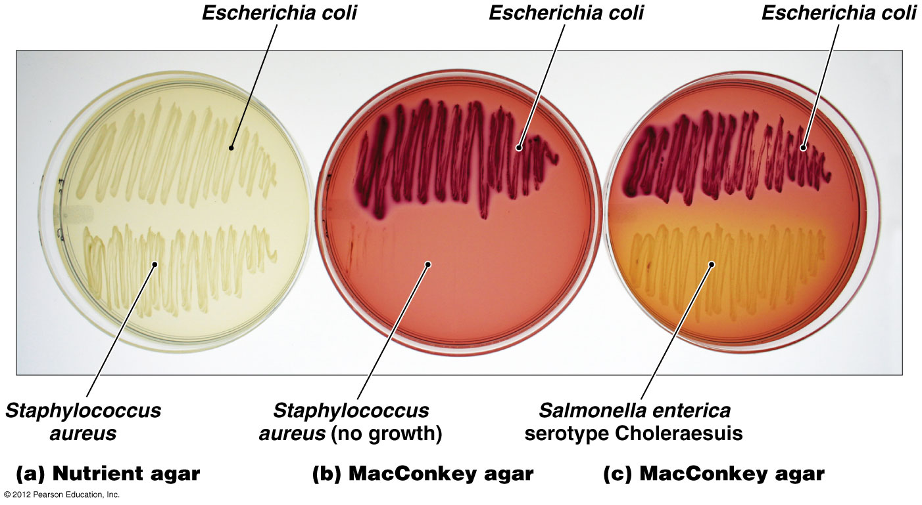
Figure 6.15 Use of MacConkey agar as a selective and differential medium-overview

Slide 34
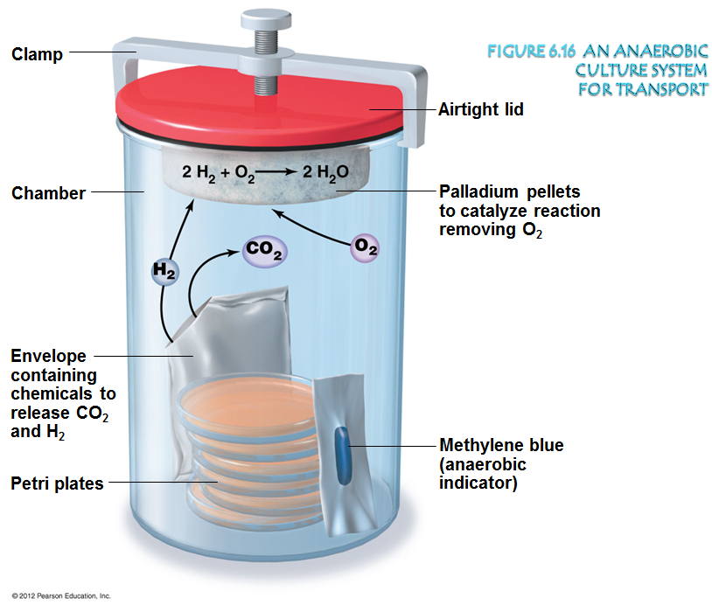

Slide 35
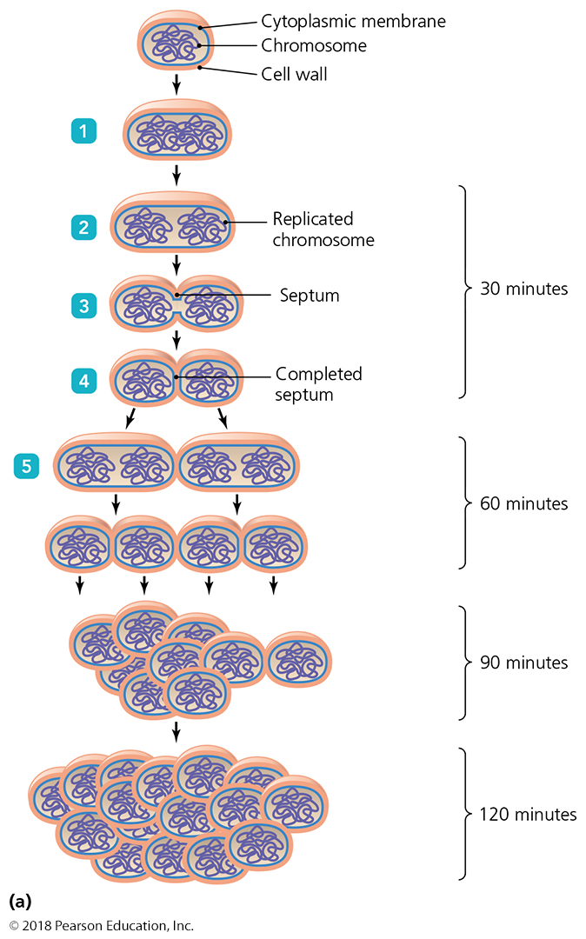
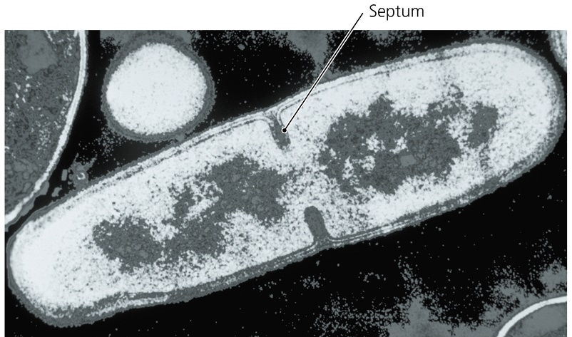
Figure 6.17 Binary fission events-overview
Most microorganisms reproduce by binary fission.
One divides in half to produce two daughter cells.
Involves four steps
Cell growth
DNA division and segregation
Septum formation
cytokinesis

Slide 36
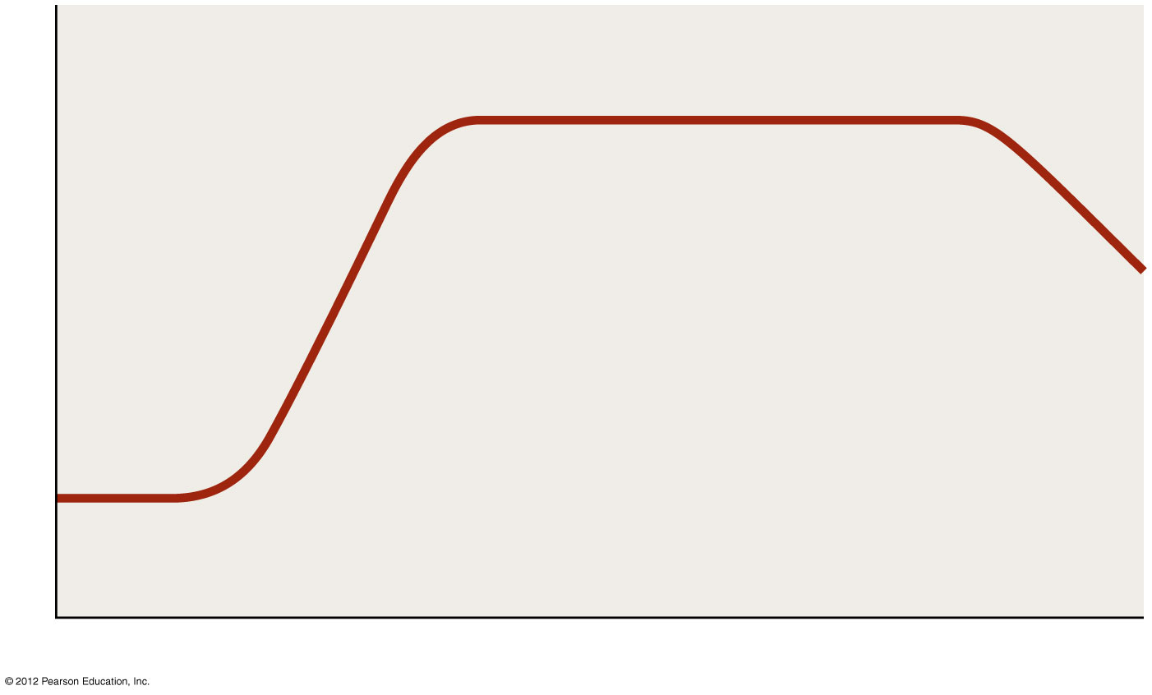
Typical LONG-TERM microbial growth curve
The common phases of microbial growth:
Lag, exponential, stationery, and death/decline
Stationary phase
quiescence
(good times are gone)
Death (decline) phase
Number of live cells (log)
Log (exponential) phase
Adaptation to new conditions
Survival (everyone for themselves)
optimal expansion
Lag phase
Time

