Slide 1
Microbiology
Chapter 4
Visualizing organisms

Slide 2
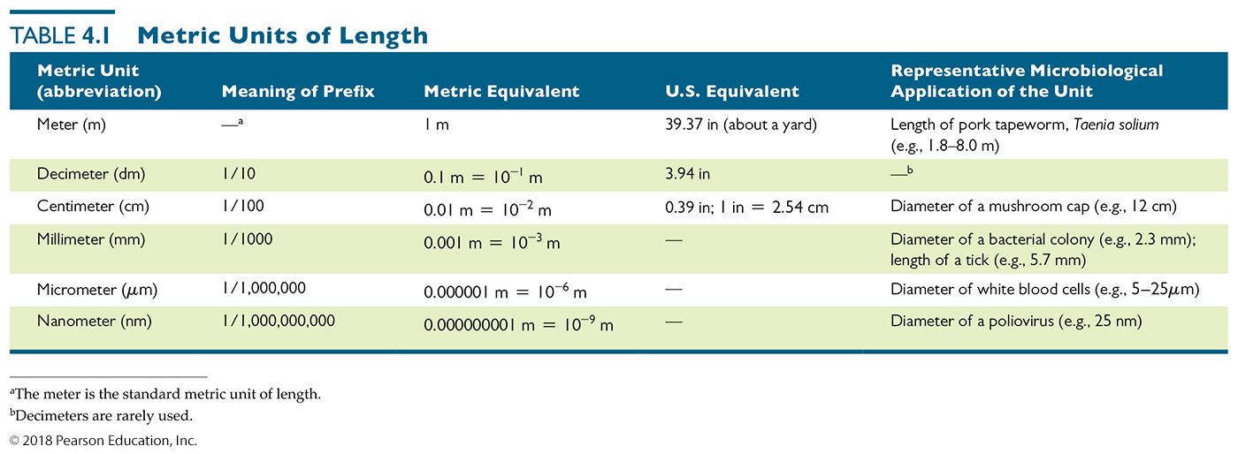
Metric Units of Length
Conversions between millimeters, micrometers, and nanometers are Factors of 1000 (or of 10³)
We will work with things that are micrometers (a.k.a microns) in size most commonly
How many microns in a millimeter?
How many millimeters in a nanometer?
Notes:
2

Slide 3
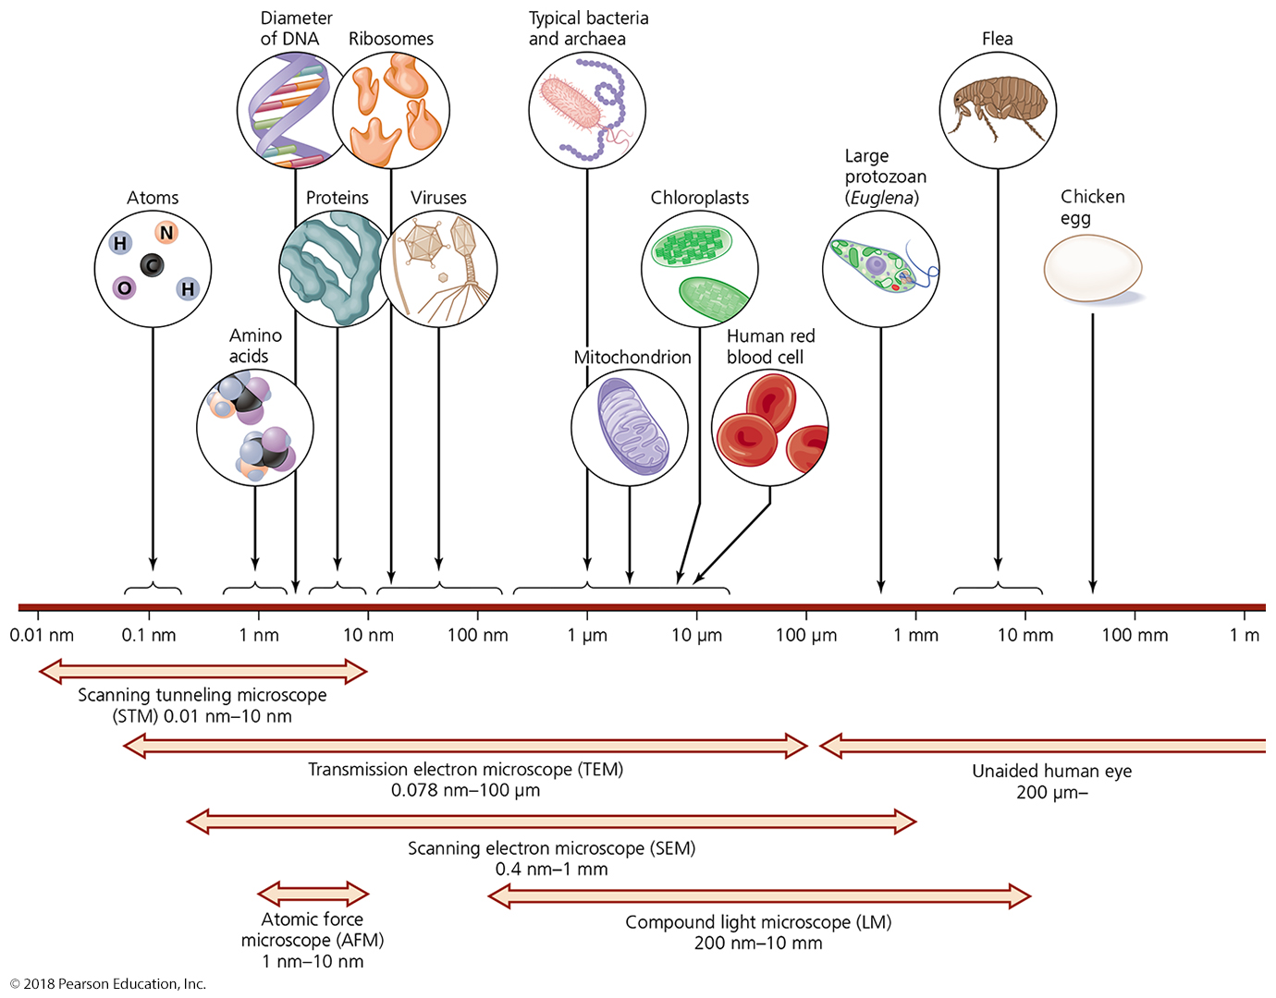
Figure 4.3 The limits of resolution (and some representative objects within those ranges) of the human eye and of various types of microscopes.
Notes:
3

Slide 4
SUMMARY SLIDE – Principles of Microscopy
How imaging of microbes is optimized
Wavelength of radiation (sound, light, electrons)
Determines ultimate resolution of region of interest
Sets limits on what we can easily see
Magnification
Results when a beam of radiation is refracted (bent)
Degree of magnification – thickness of lens, curvature, the speed of light through substance
Resolution
Ability to distinguish objects that are close together
Blue filter allows shorter wavelengths to pass which increases resolution
Contrast
Differences between neighboring objects
Most often, intensity between an object and its background
Notes:
4

Slide 5
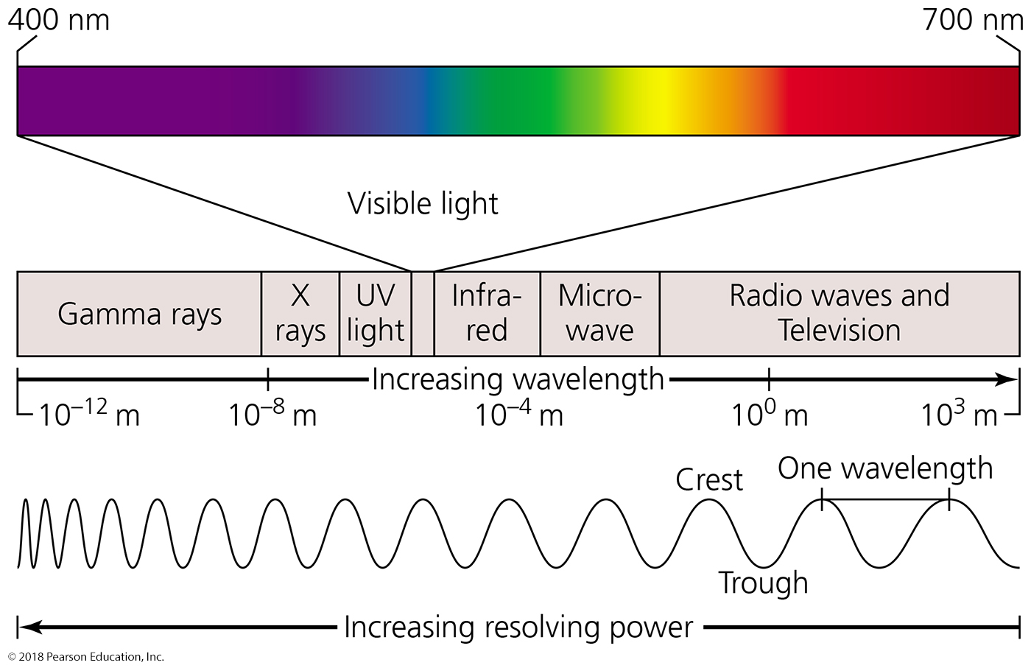
WAVELENGTH OF LIGHT - The electromagnetic spectrum.
Notes:
5

Slide 6
Why Wavelength Matters
An object is seen ONLY IF a “light” wave crest and trough
pass through an object at the same time
Let’s look at a
virus
and a
bacterium
critical distance at short wavelength
critical distance at long wavelength
virus seen
virus too small to be seen
bacterium seen (in more detail)
bacterium seen
Which wavelengths would you prefer to use to see stuff???
Notes:
6

Slide 7
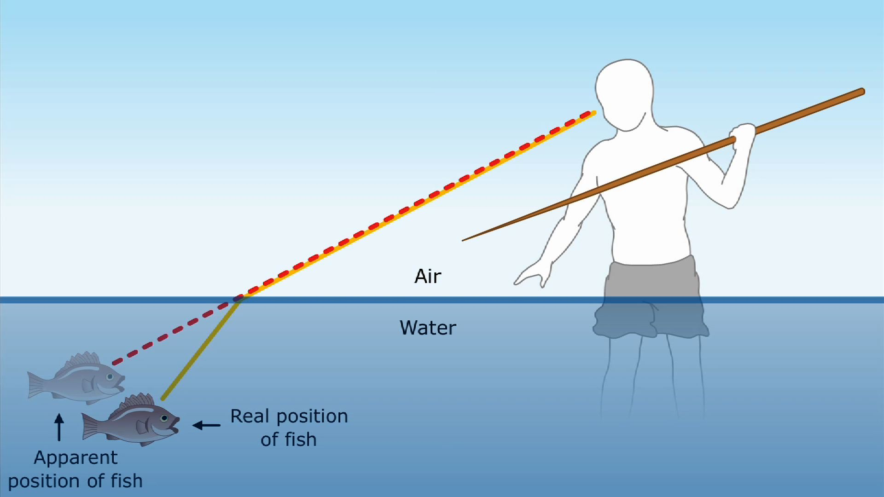
Light refraction and image magnification by a convex glass lens.
Light bends when it interacts with matter - refraction
Flat surface
Notes:
7

Slide 8
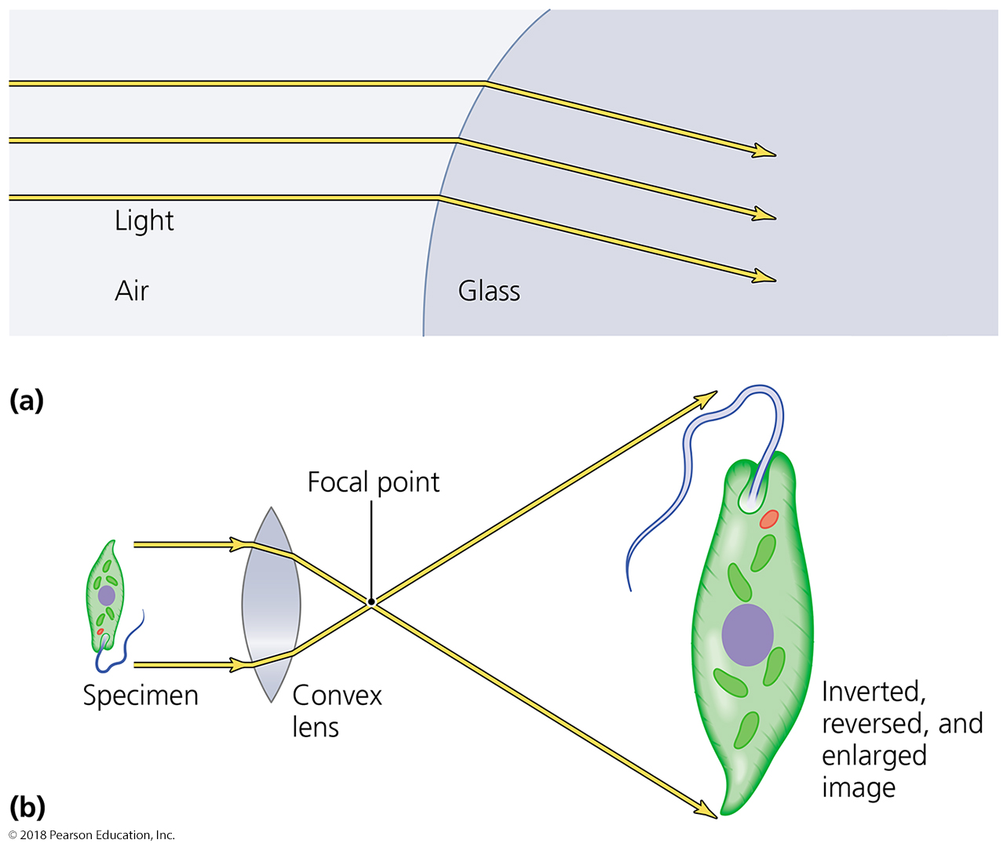
Light refraction and image magnification by a convex glass lens.
Light bends when it interacts with matter - refraction
What happens to intense light as it is spread out to magnify an image??
curved surface
Notes:
8

Slide 9
Microscopy
General Principles of Microscopy
Resolution
Ability to distinguish two points that are close together
The better the resolution, the better nearby objects are distinguished from one another when they are really close

Slide 10
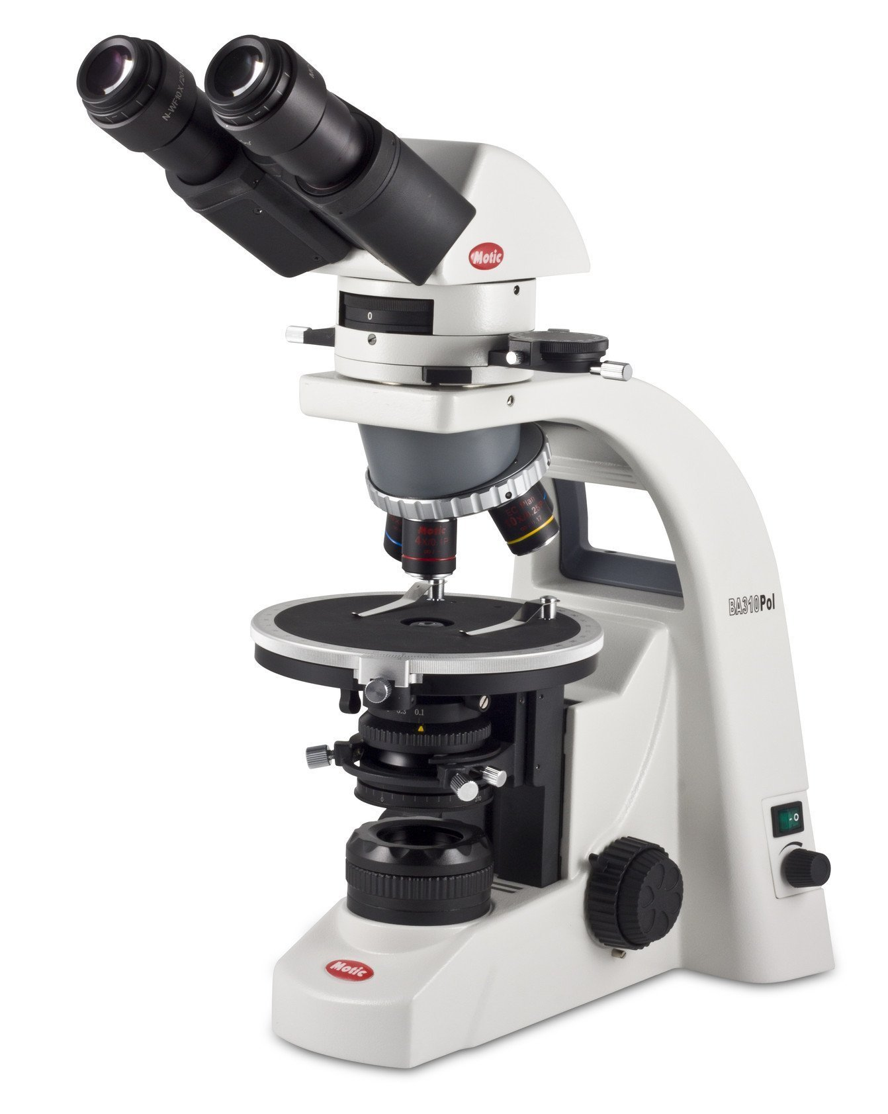
Light Microscopy – Simple microscope
Light Microscopy
Also known as bright-field microscopes
Uses visible light to “see” objects
Advantage: We also use visible light to see objects
Therefore we can see objects directly through light microscopes

Slide 11
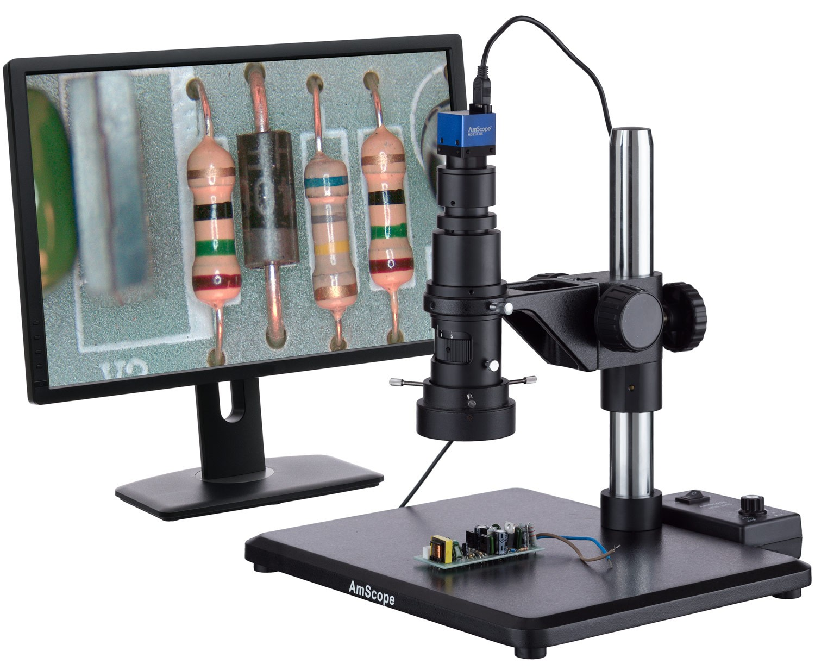
Light Microscopy – Simple microscope
Simple microscope
Contains a single magnifying lens
(USB microscopes)
Similar to magnifying glass
von Leeuwenhoek and Hooke built simple microscopes to observe microorganisms

Slide 12
Light Microscopy – Compound microscope
Compound microscope
Series of lenses (usually 2) for magnification
Light passes through specimen into objective lens, and then into ocular lenses
Total magnification = magnification of objective lens × magnification of ocular lens – greater magnification than with simple microscopes
Oil immersion lens are specialized objective lenses that increase resolution by concentrating light, improving brightness and focal depth
Have one or two ocular lenses
Most have condenser lens (concentrates and directs light into specimen) – does NOT magnify samples

Slide 13
The effect of immersion oil on resolution.
Microscope
objective
Microscope
objective
Notes:
13

Slide 14
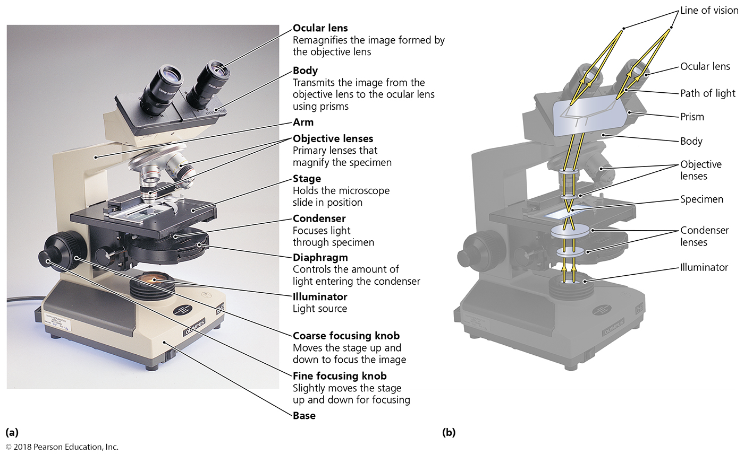
Review on your own: A bright-field compound light microscope.
Notes:
14

Slide 15
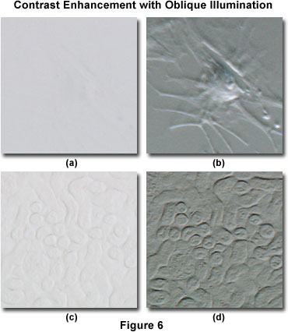
General Principles of Microscopy
Contrast
The difference in intensity between two objects, or between an object and its background
Is it the object or the background?
Important in determining resolution
Need to know there are two “things” in order to know resolution
Use of light that is in phase also increases contrast
Staining increases contrast (by adding intensity)

Slide 16
Three kinds of light microscopy based on improving contrast WITHOUT staining
For each:
What is the color of the background?
What is the color of the object itself?
Notes:
16

Slide 17
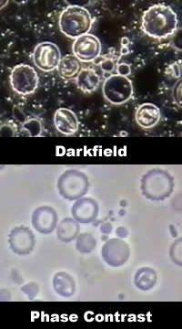
Dark Field Microscopy
Best for observing pale objects and external features
Only light rays scattered by specimen enter objective lens
Specimen appears light against dark background
Increases contrast and enables observation of more details
Useful for examining small or colorless cells

Slide 18
Phase Contrast Microscopy
Used to examine living organisms or specimens that would be damaged/altered by attaching them to slides or staining
Contrast is created because light waves are out of phase
Best for viewing internal structures

Slide 19
Fluorescence Microscopy
Special type of light microscopy
UV (invisible) light is the light source (dark background)
Specimen radiates UV energy back as a longer wavelength, visible light (think highlighters and neon colors)
UV light increases contrast (dark background vs. bright colored object)
Some cells are naturally fluorescent; Most cells must be stained with fluorescent dyes
Used in immunofluorescence to identify specific pathogens or specific proteins – increases specificity of staining
Fluorescence is narrow-wavelength emission (single color vs. white), allowing multi-labeling and seeing multiple colors

Slide 20
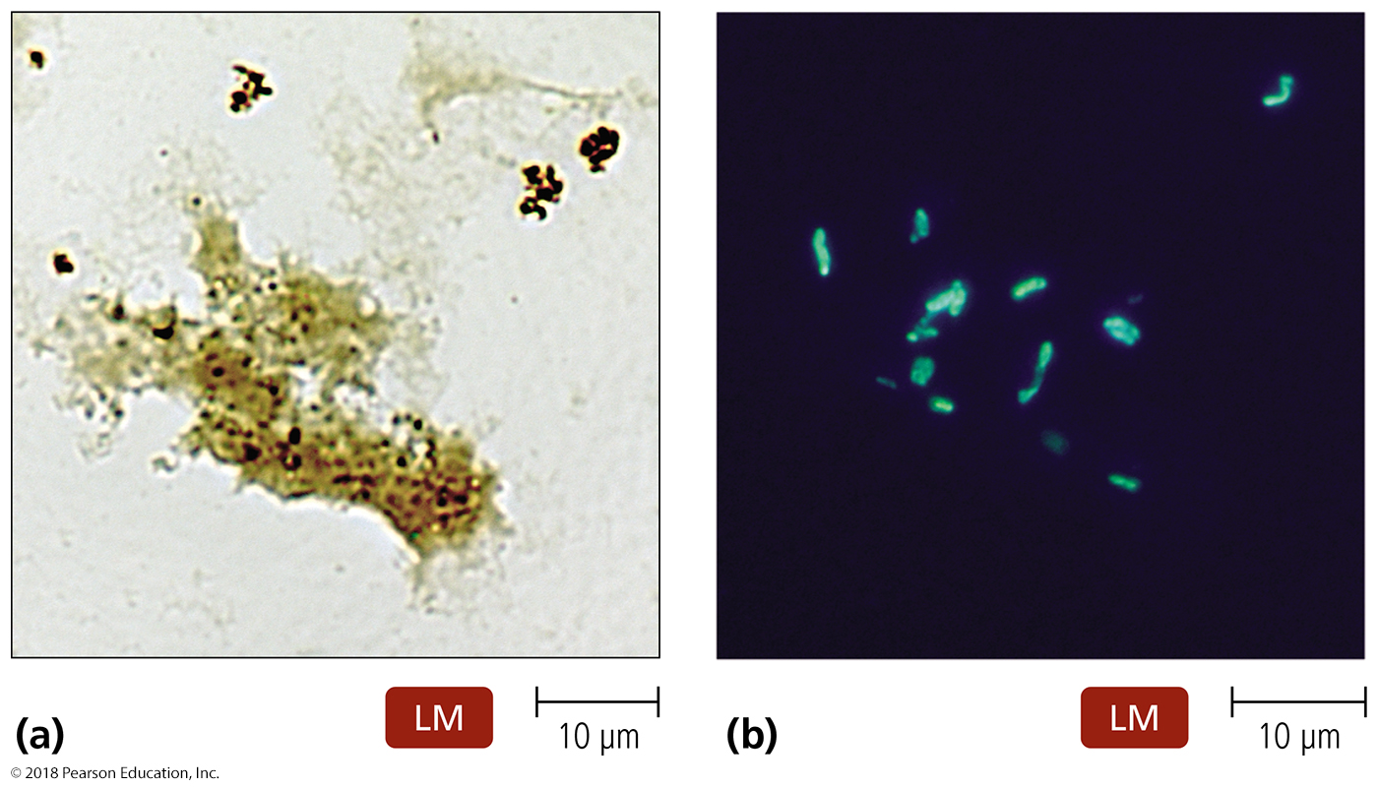
Figure 4.7 Fluorescence microscopy.
Notes:
20

Slide 21
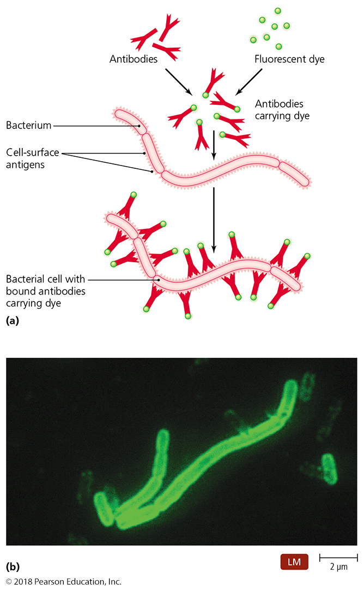
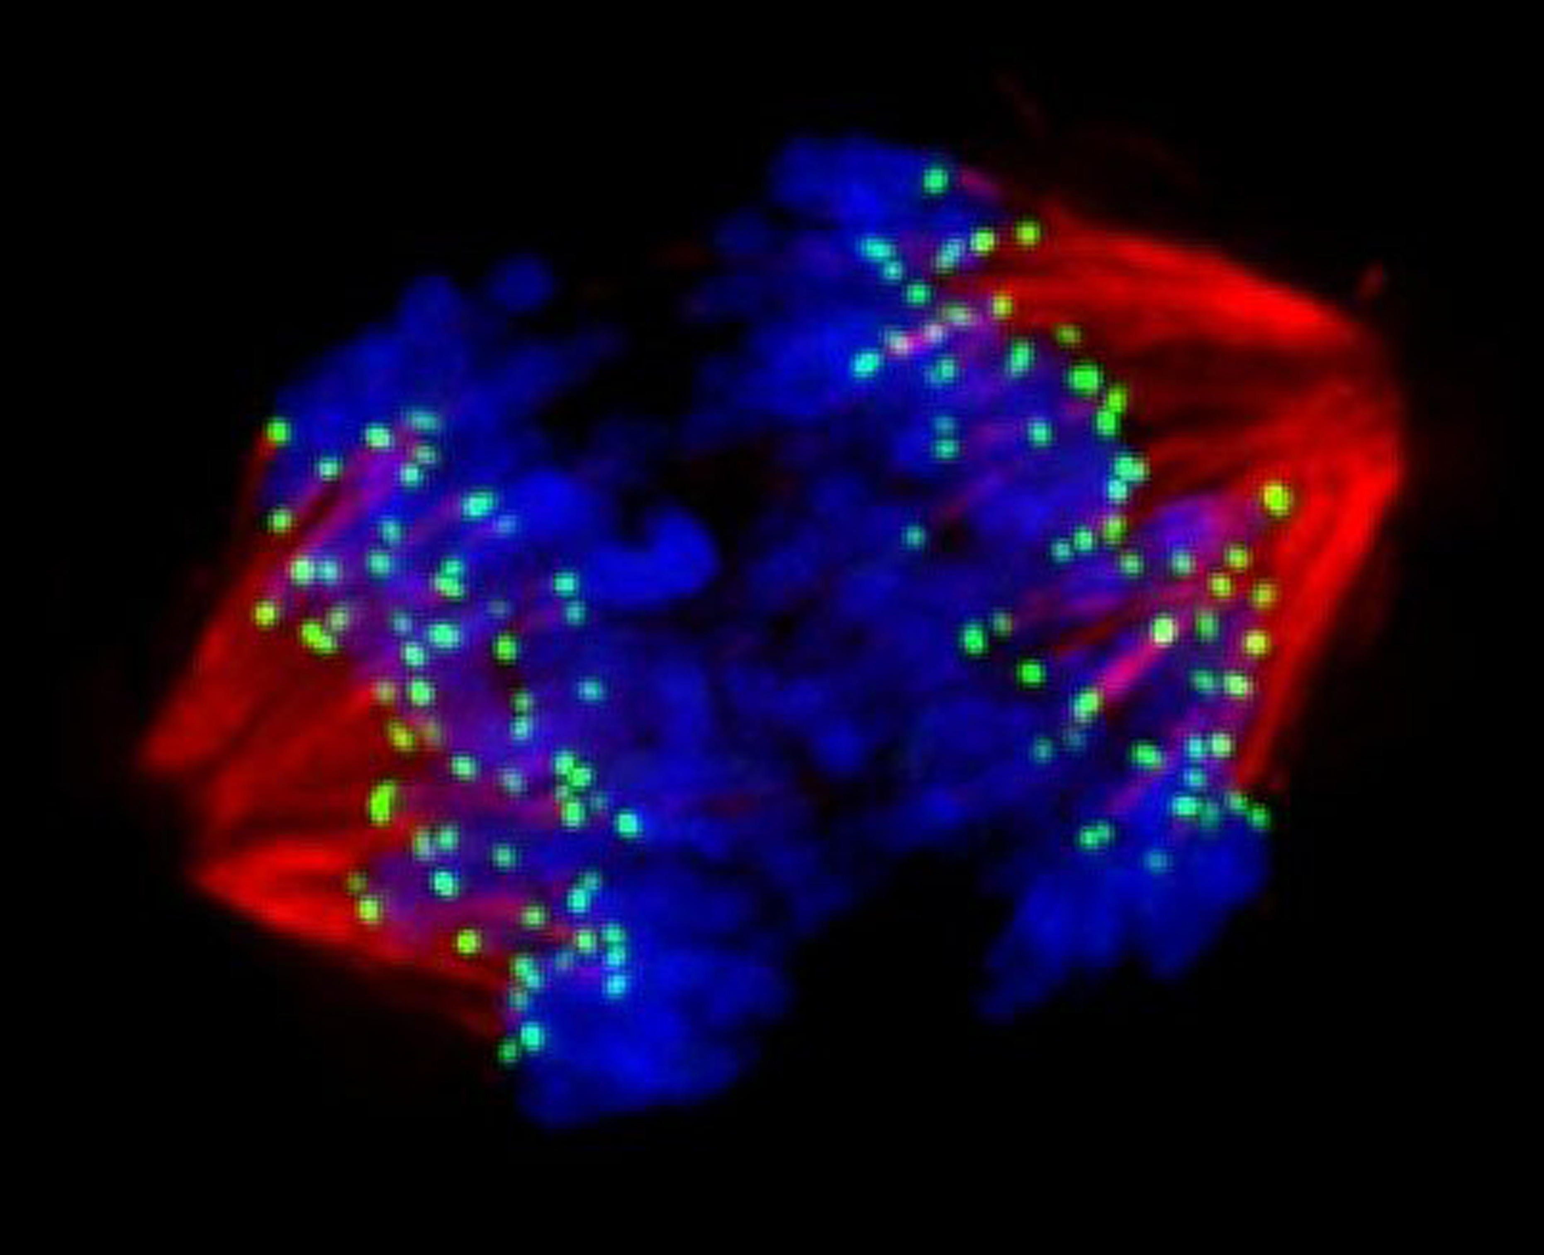
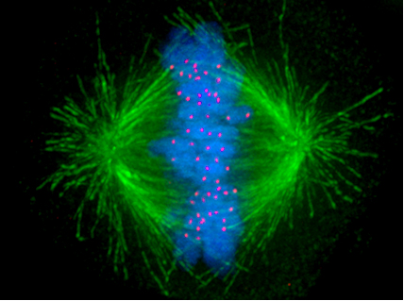
Figure 4.8 Immunofluorescence.
Notes:
21

Slide 22
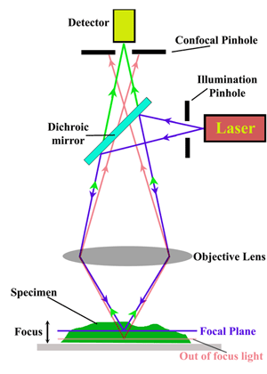
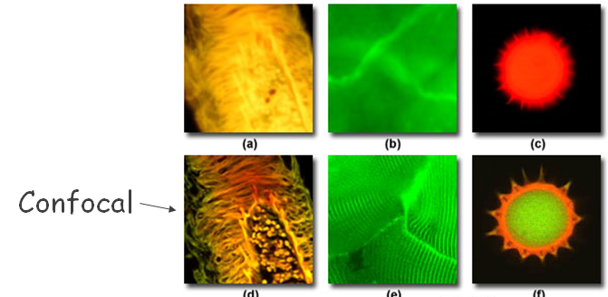
Confocal Microscopy
Adaptation of fluorescence microscopy
Use UV lasers to illuminate fluorescent chemicals in a highly constricted volume (“confocal”)
Resolution increased because light passes through pinhole aperture; deepens focal depth
Stage moves to illuminate the entire sample
Computer assembles:
“2D” image from a plane of tiny volumes
“3D” images from stacks of 2D image planes
Notes:
22

Slide 23
Electron Microscopy
Light microscopes cannot resolve structures closer than 200 nm
lowest wavelength of visible light is 400 nm
Electron microscopes have greater resolving power and magnification
Electron wavelength is 0.05 nm with average power; 4000x better!
Magnify objects 10,000× to 100,000×
Cannot see directly (electrocution); must use computers and mathematics to reconstruct image
Detailed views of bacteria, viruses, internal cellular structures, molecules, and large atoms
Two types:
Transmission electron microscopes (see through)
Scanning electron microscopes (bounce off)

Slide 24
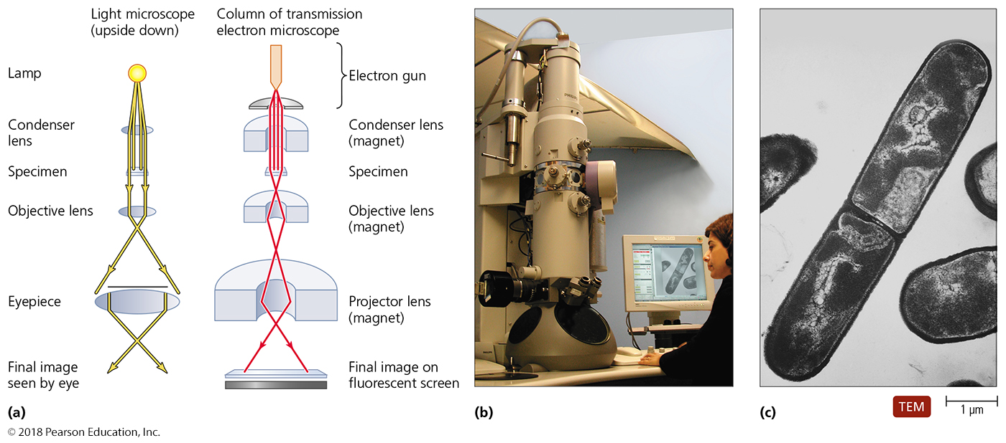
Figure 4.10 A transmission electron microscope (TEM).
Electrons that pass through sample (or outside sample) in parallel beams are detected (light parts)
Electrons that do not pass through are assumed to hit structure (dark parts)
Notes:
24

Slide 25
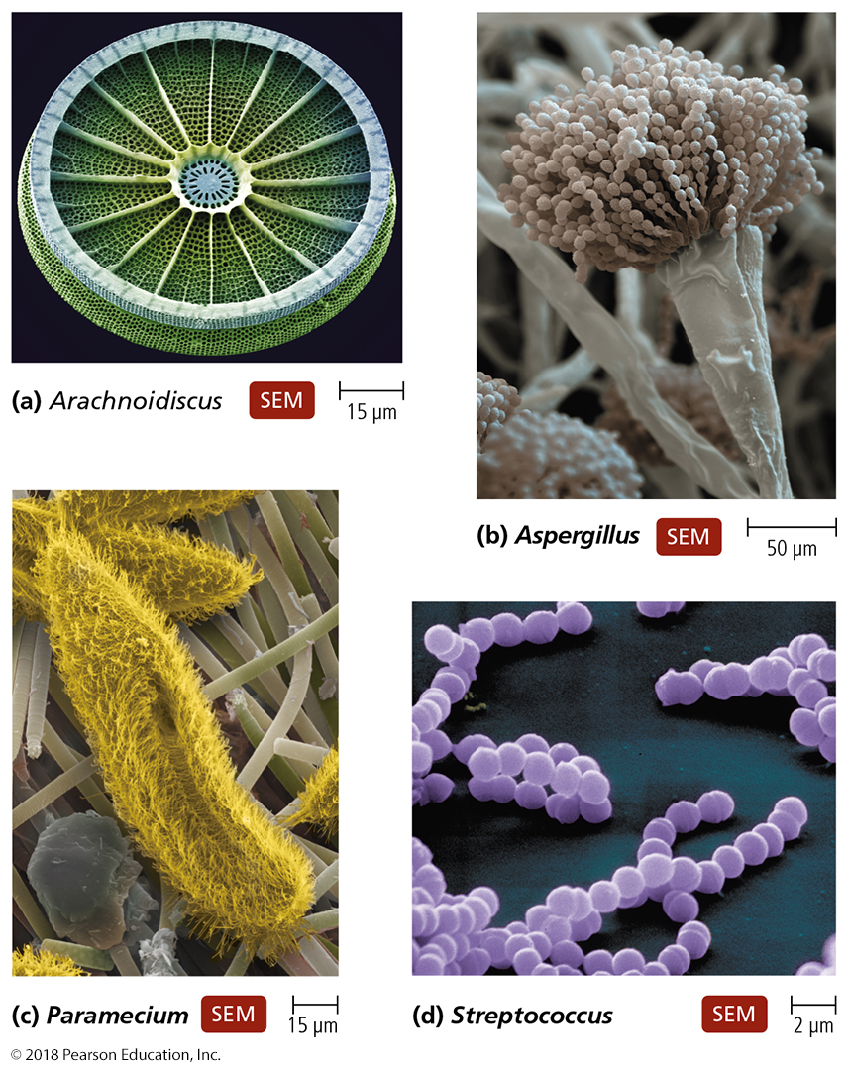
Scanning electron microscopy (SEM) images.
Electrons reflect off of sample; reflection patterns used to reconstruct a 3D image
Notes:
25

Slide 26
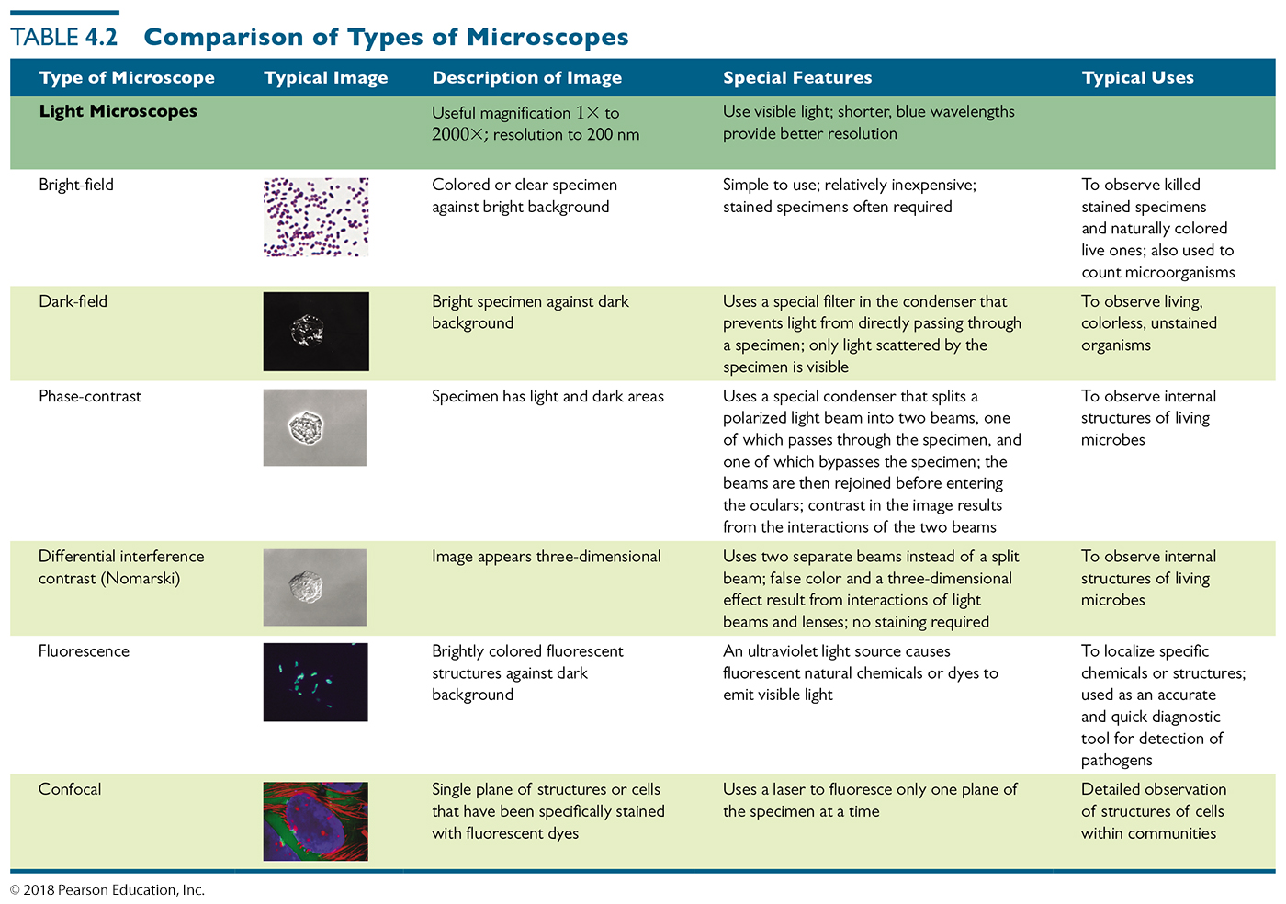
Table 4.2 Comparison of Types of Microscopes (1 of 3)
Notes:
26

Slide 27
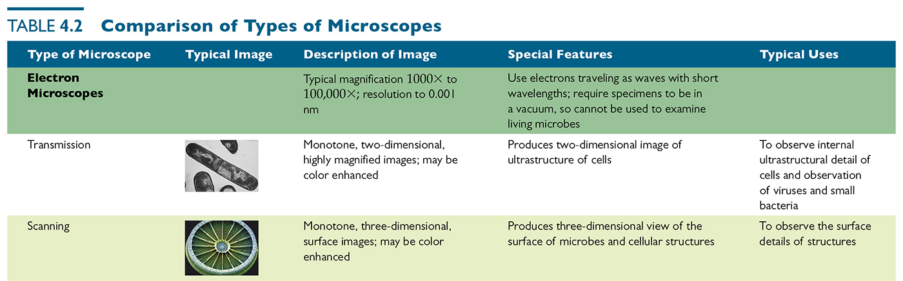
Table 4.2 Comparison of Types of Microscopes (2 of 3)
Notes:
27

Slide 28
Staining of specimens
Most microorganisms are difficult to view by bright-field microscopy
Fluorescent and electron microscopy is expensive
Coloring specimens with stain increases contrast and resolution
Specimens must be prepared for staining

Slide 29
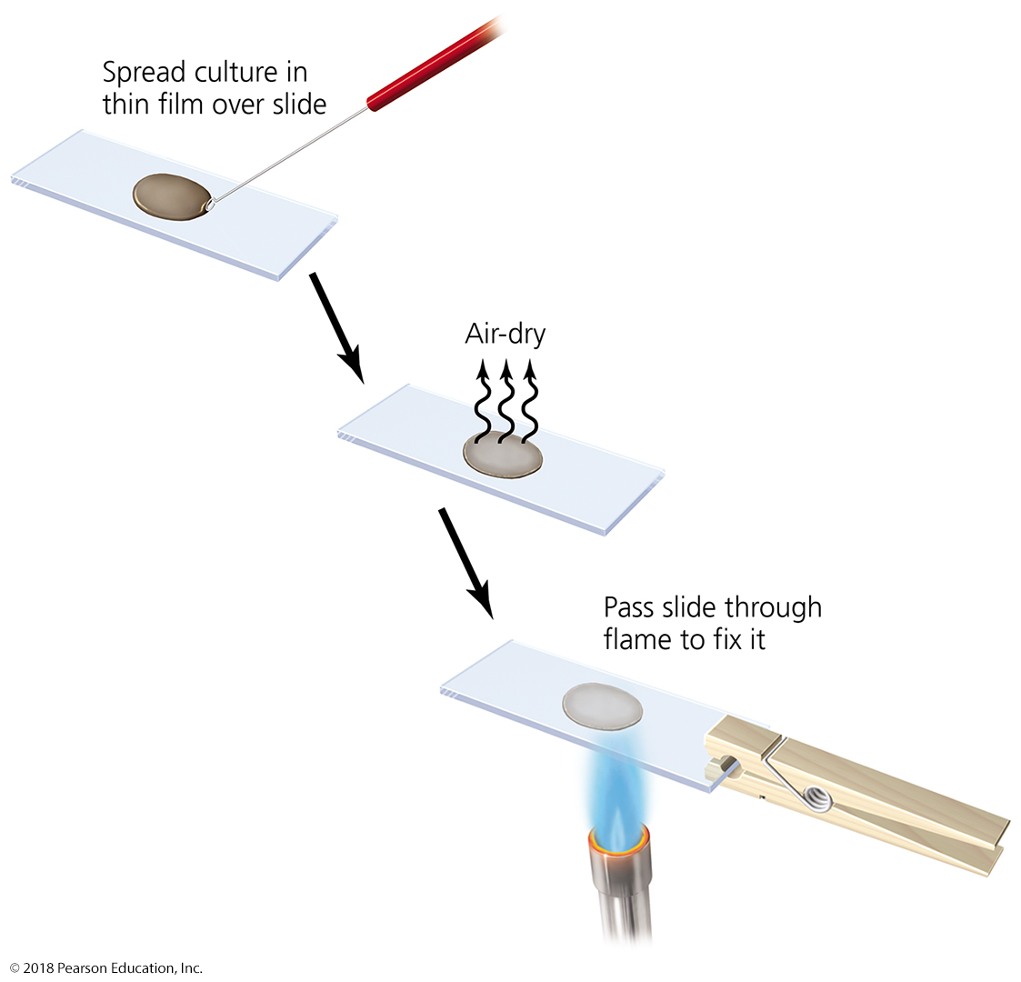
Preparing a specimen for staining.
Notes:
29

Slide 30
Staining
Principles of Staining
Dyes used as stains are usually salts (dissolve in water)
Chromophore is the colored portion of the dye
Acidic dyes
Negatively charged
Stains alkaline structures (positively charged - histones)
Basic dyes
Positively charged
stain acidic structures (negatively charged)
More commonly used since most biomolecules are negatively charged and thus are acidic
What is the nature of the interaction of stain with cellular components? Covalent or ionic?

Slide 31
Types of Staining – SUMMARY SLIDE
Simple Stains
Involve soaking the specimen in one stain
Differential Stains
Uses multiple stains (two, usually)
Gram stain
Distinguish Gram positive and Gram negative cells
Acid-fast stain
Stains Mycobacterium and Nocardia (waxy lipid in cell walls)
Endospore stain
Endospore walls are impermeable to many chemicals, stain uses heat to drive the staining agent into endospore
Histological stain
Used to visualize things like fungi and cancer cells in tissue samples
Special Stains
Negative stain (or capsular stain)
Uses acidic dye – repelled by negative charges on surface of cell
Flagellar stain
Increases diameter of flagella – allows them to be seen
Notes:
31

Slide 32
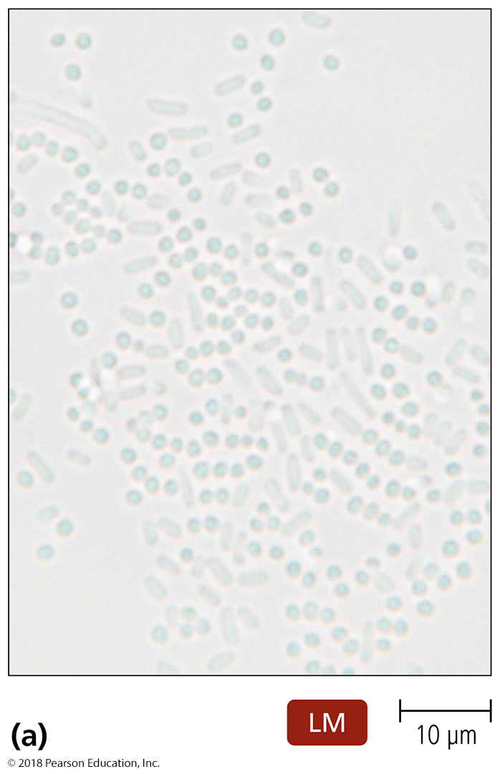
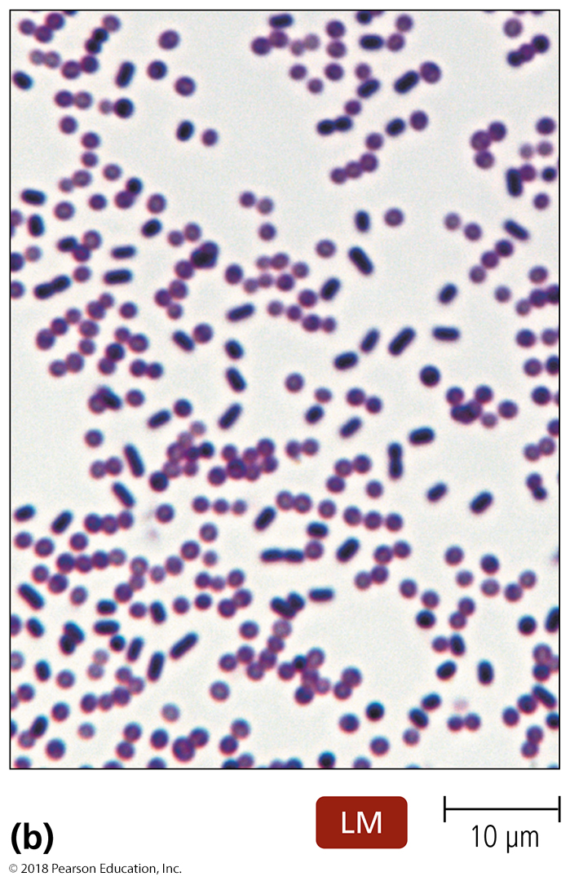
Simple Staining
Composed of single basic dye
Crystal violet, safranin, methylene blue
Used to determine size, shape, arrangement, viability, or the presence, of cells

Slide 33
Differential Staining – SUMMARY SLIDE
Uses more than one dye (most often, two)
Used to distinguish between different cells, chemicals, or structures
Common differential stains include:
Gram stain
Acid-fast stain
Endospore stain
Histological stains

Slide 34
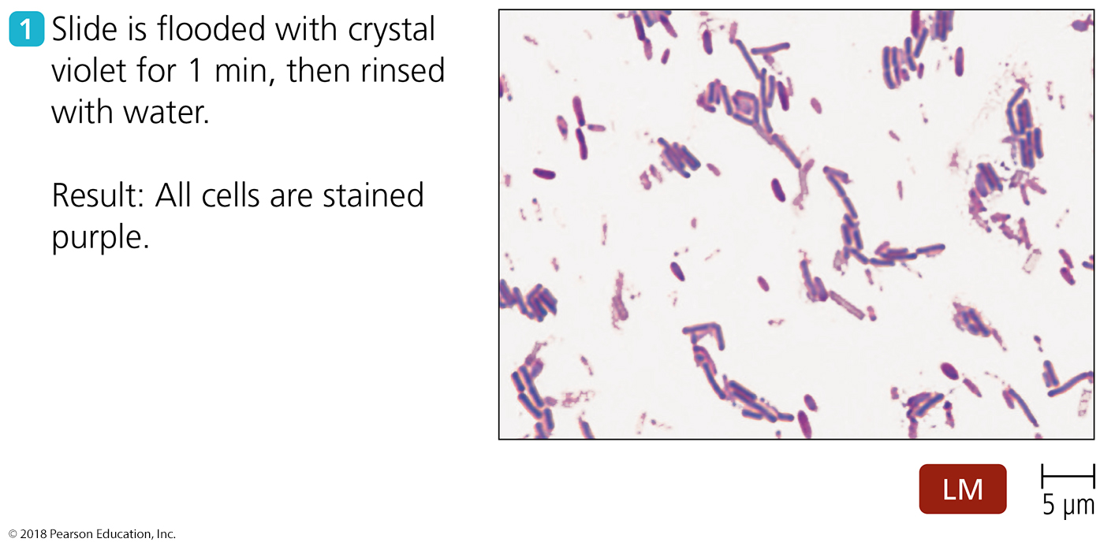
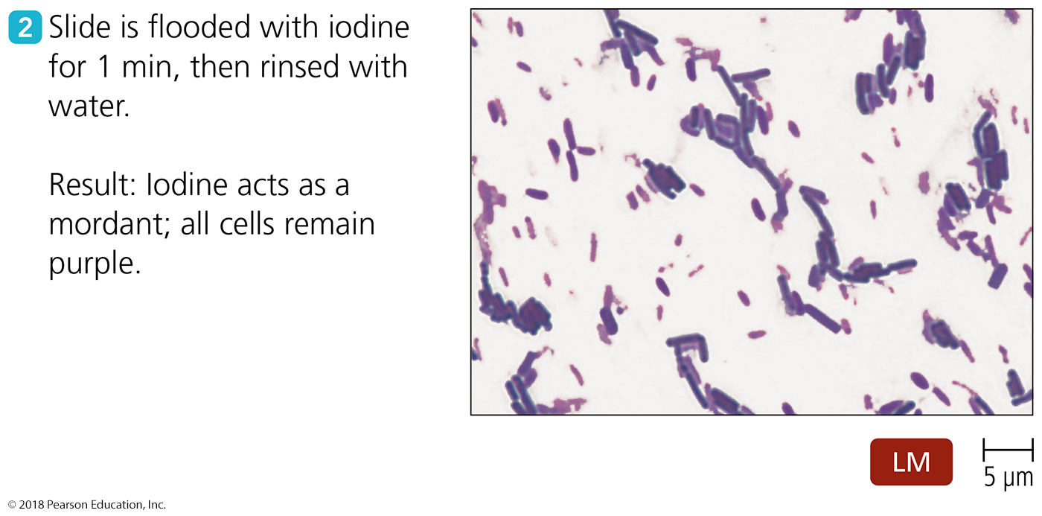
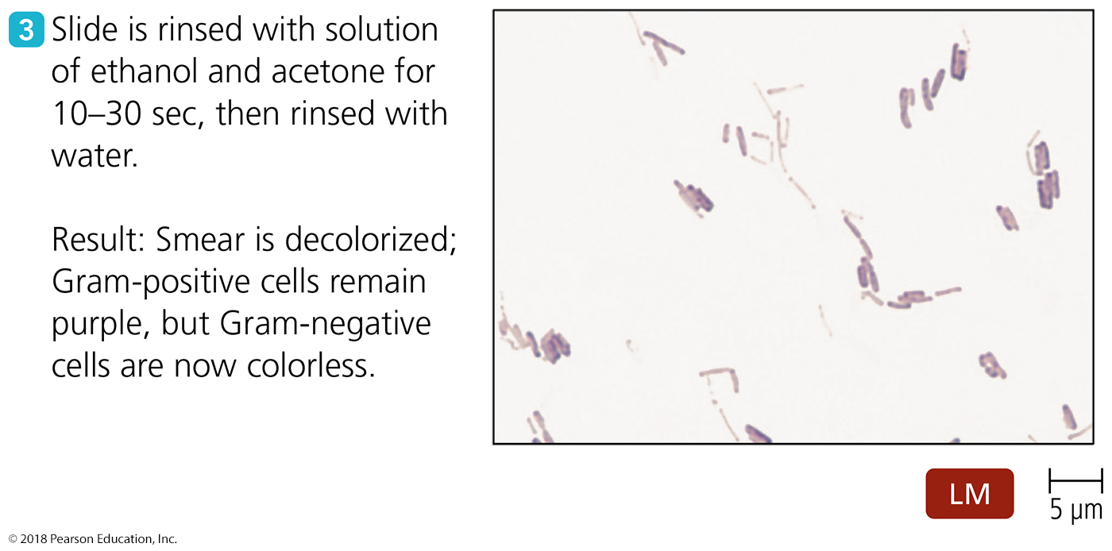
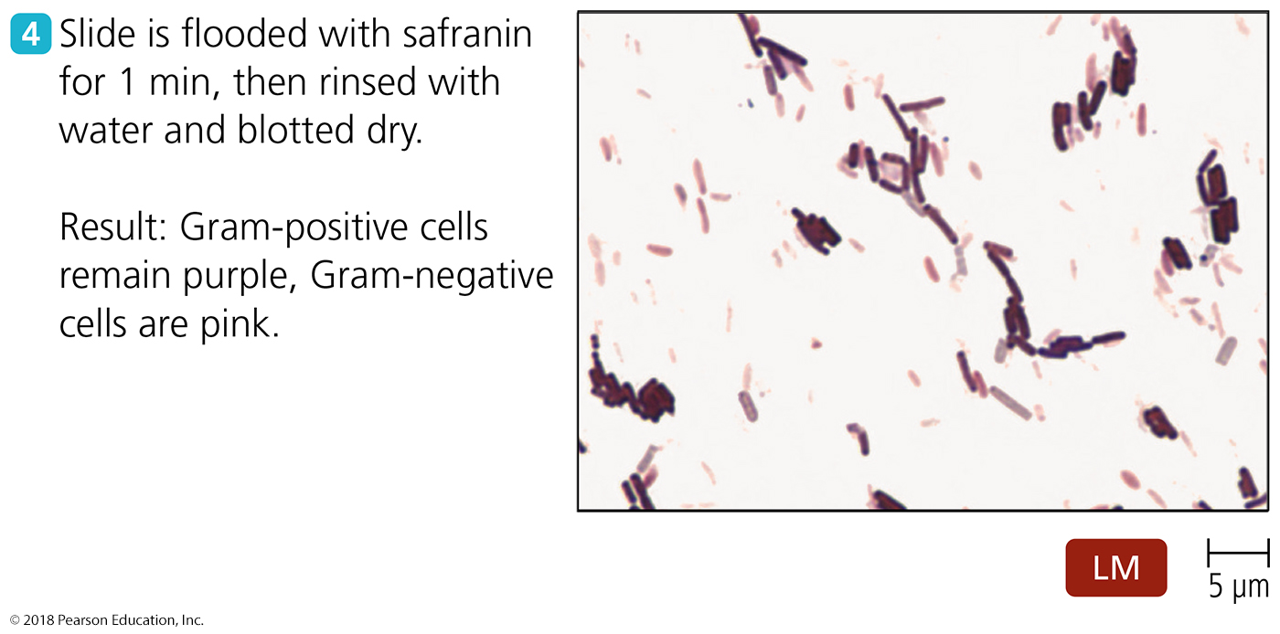
Figure 4.15 The Gram staining procedure.
Notes:
34

Slide 35
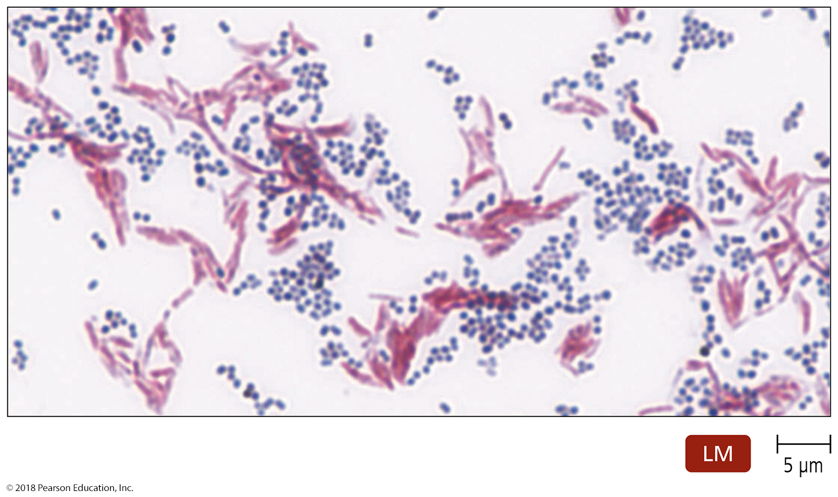
Figure 4.16 Ziehl-Neelsen acid-fast stain.
Notes:
35

Slide 36
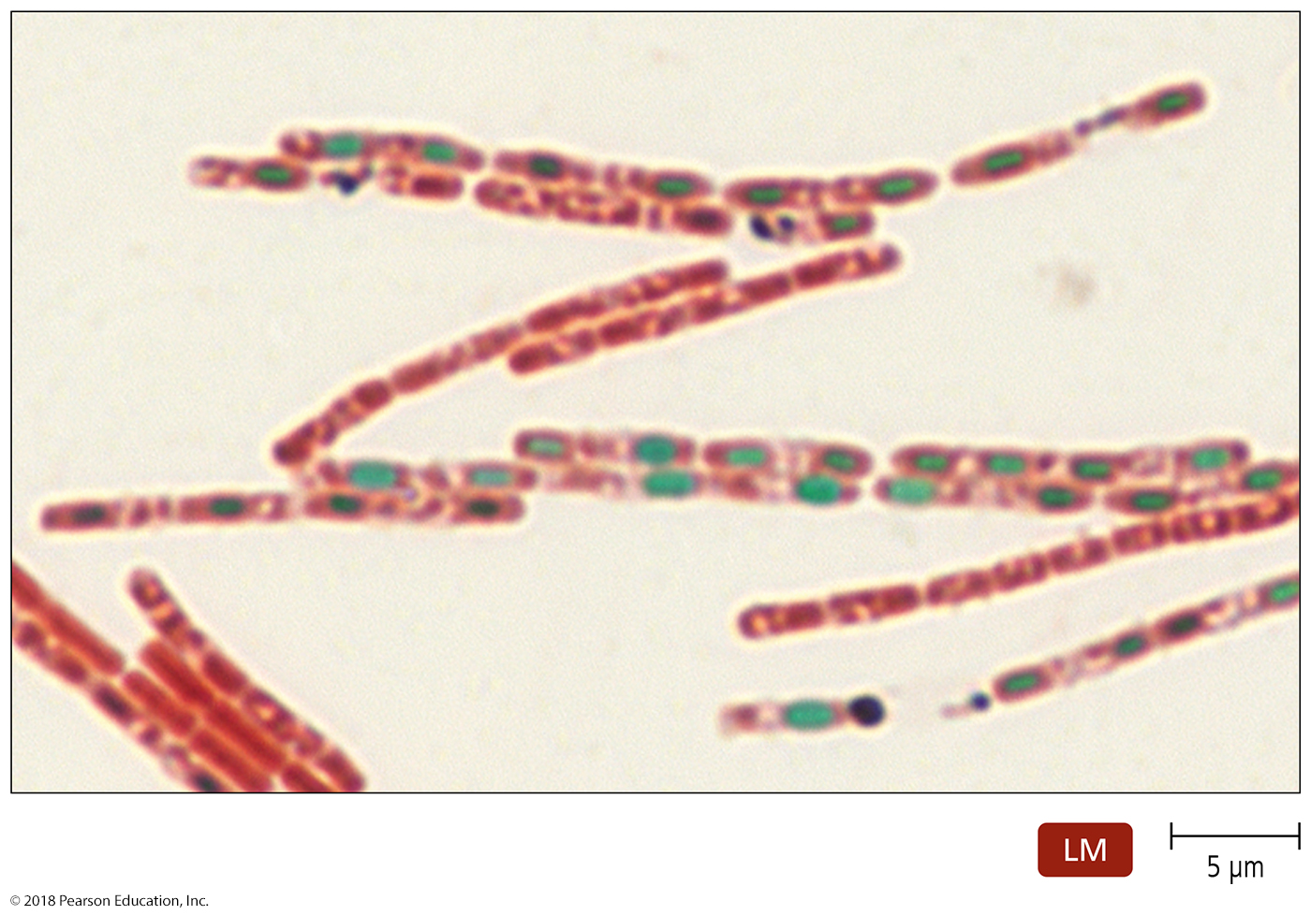
Endospore stain of Bacillus anthracis.
Notes:
36

Slide 37
Special staining – SUMMARY SLIDE
Simple stains used to identify specific microbial structures that are not easily visualized
Special stains include:
Negative stains – good for visualizing capsules
Flagellar stains – good for visualizing flagella
Fluorescent stains

Slide 38
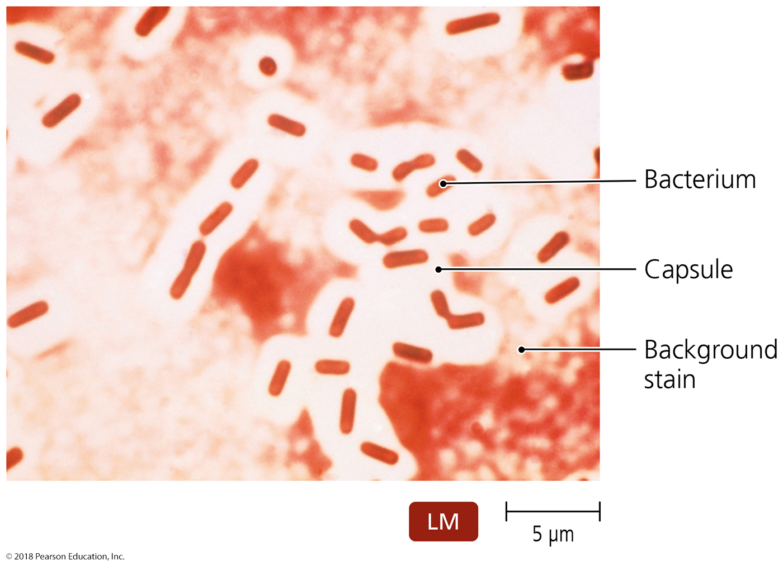
Negative (capsule) stain of Klebsiella pneumoniae.
Notes:
38

Slide 39
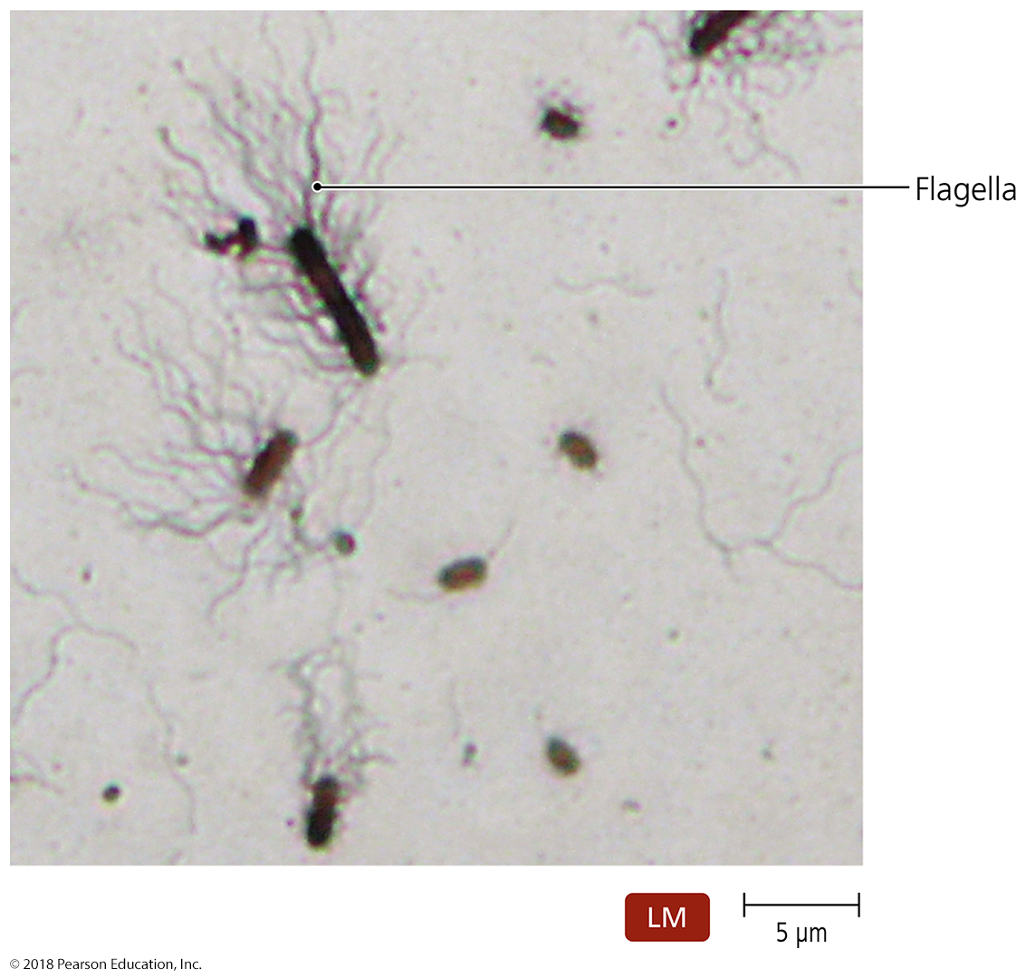
Figure 4.19 Flagellar stain of Proteus vulgaris.
Notes:
39

Slide 40
Table 4.3 Some Stains Used for Light Microscopy
Notes:
40

Slide 41
Histological stains
Used to identify pathogens in animal tissues (medical/veterinary)
Two popular stains for histological specimens
Gomori methenamine silver (GMS)
Presence of fungi and carbohydrates in tissues
Hematoxylin and eosin (HE)
Presence of cancer cells
Notes:
41

