Slide 1
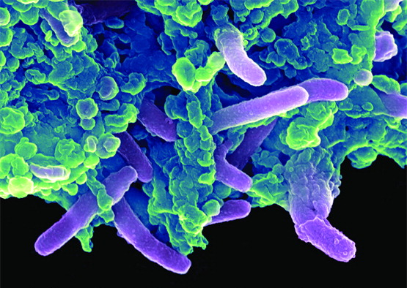
Chapter 3
Cell Structure and Function

Slide 2
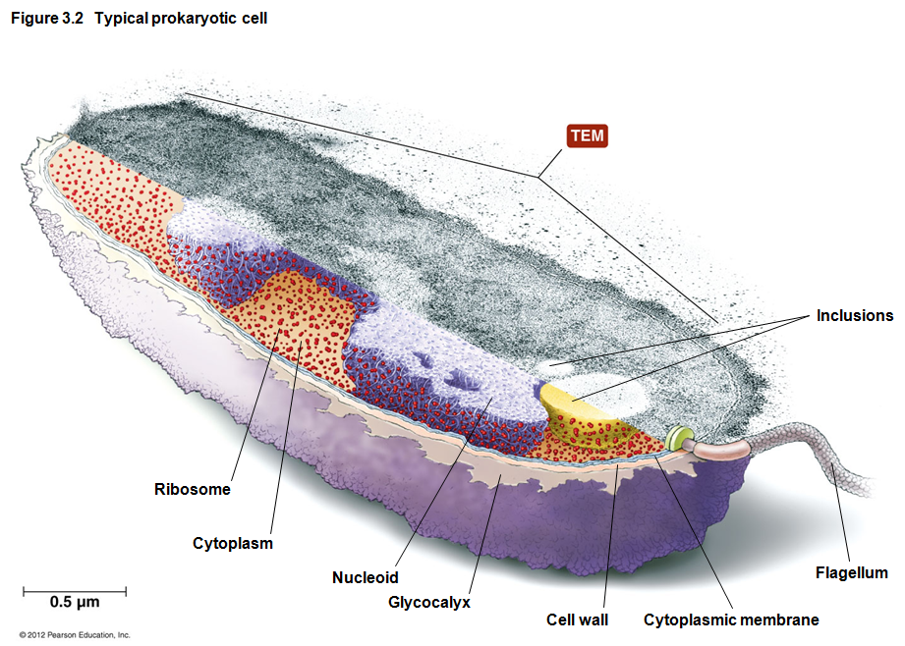
Prokaryotic vs. Eukaryotic Cells: To Review on your own
Prokaryotes
NOT a taxonomic classification
Only descriptive because of anatomic similarities
Lack nucleus
Lack various internal structures bound with phospholipid membranes
Are small
~1.0 µm in diameter
Includes:
Bacteria
Archaea
© 2012 Pearson Education Inc.
Notes:
2

Slide 3
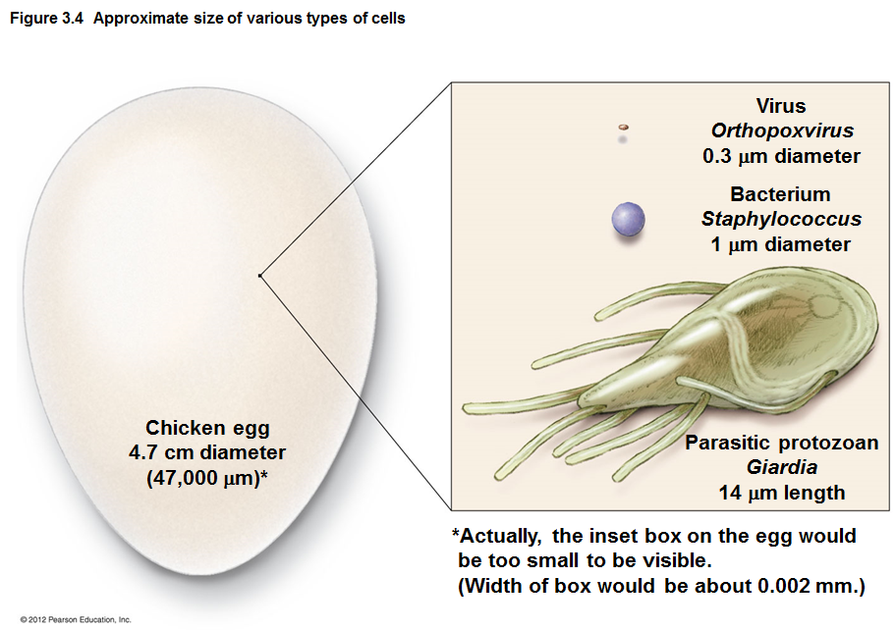
Notes:
3

Slide 4
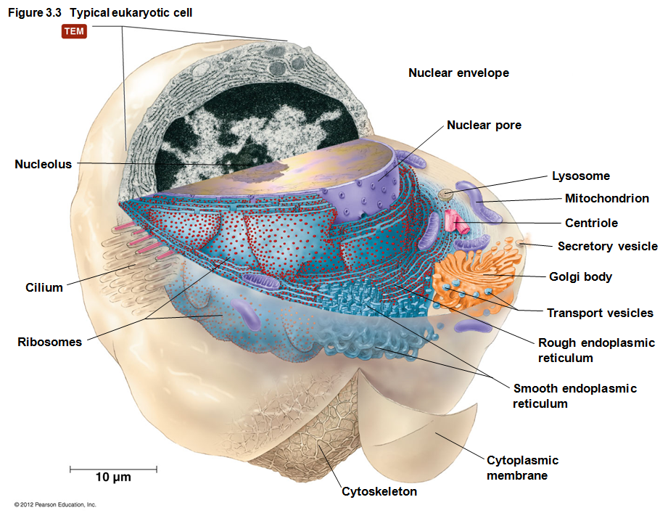
Prokaryotic vs. Eukaryotic Cells: To review on your own
Eukaryotes
Have nucleus
Have internal membrane-bound organelles
Are larger
10–100 µm
Have more complex structure
Includes:
Algae
Protozoa
Fungi
Animals
Plants
Notes:
4

Slide 5
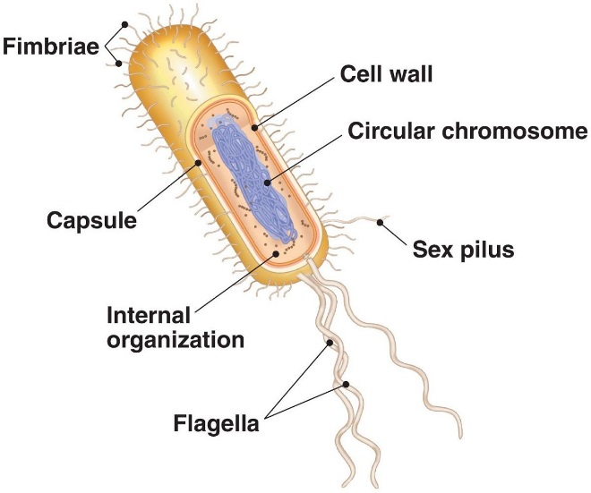
SUMMARY SLIDE - Anatomy of Bacterial Cells
External structures
Glycocalyx – capsule or slime layer
involved in protection (environment, antibiotics, immune system)
Motile elements – fimbriae, flagella, pili
Cell wall
attachment, osmotic protection, chemical protection
Membrane structure
Plasma membrane – lipids, proteins - selective entry
Internal structures
Nucleoid – DNA for gene expression, fission or endospore formation
Inclusions – banked chemicals
© 2012 Pearson Education Inc.
Notes:
5

Slide 6
External Structures of Bacterial Cells
Glycocalyces
Glycocalyx - gelatinous, sticky substance surrounding the outside of the cell
Two Types of Glycocalyces
Capsule
Composed of organized repeating units of organic chemicals
Firmly attached to cell surface
May prevent bacteria from being recognized by host
Slime layer
Loosely attached to cell surface
Water soluble
Sticky layer allows prokaryotes to reversibly attach to surfaces
Can help to form biofilm
© 2012 Pearson Education Inc.
Notes:
6

Slide 7
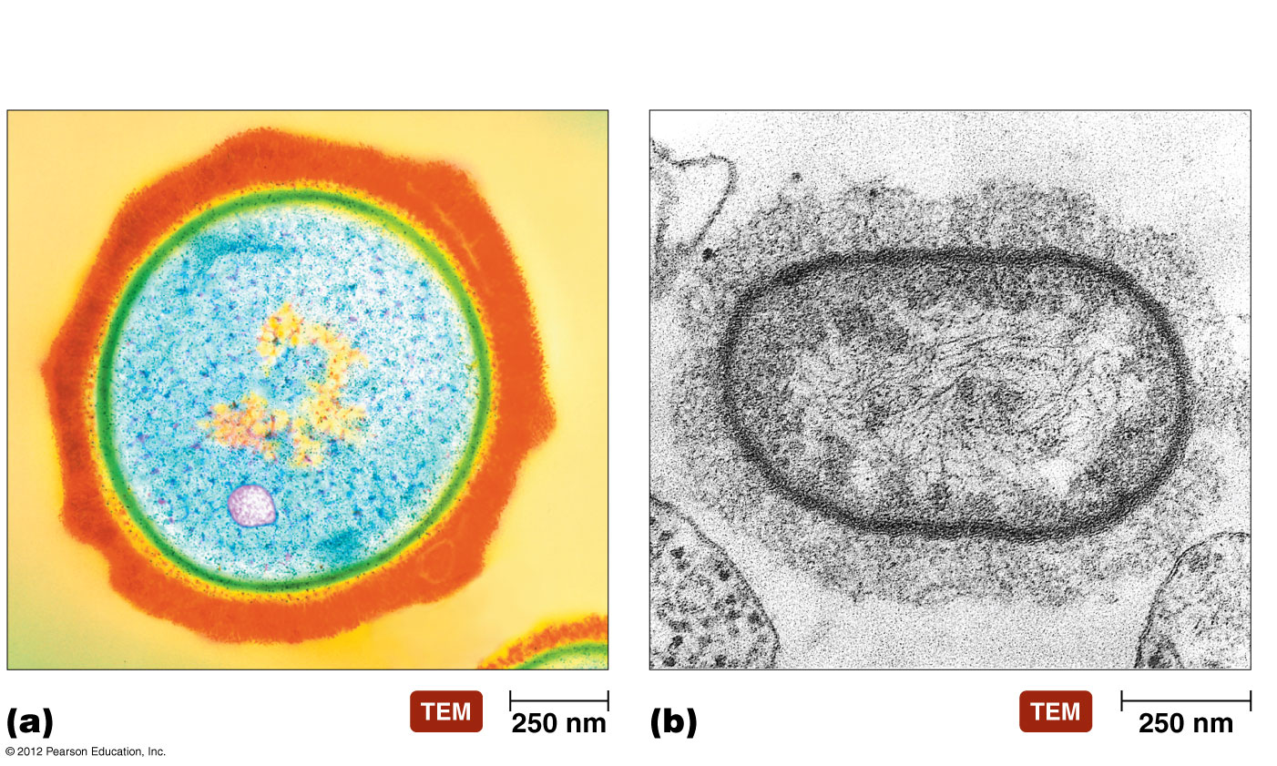
Glycocalyces
Glycocalyx (capsule)
Glycocalyx (slime layer)
Notes:
7

Slide 8
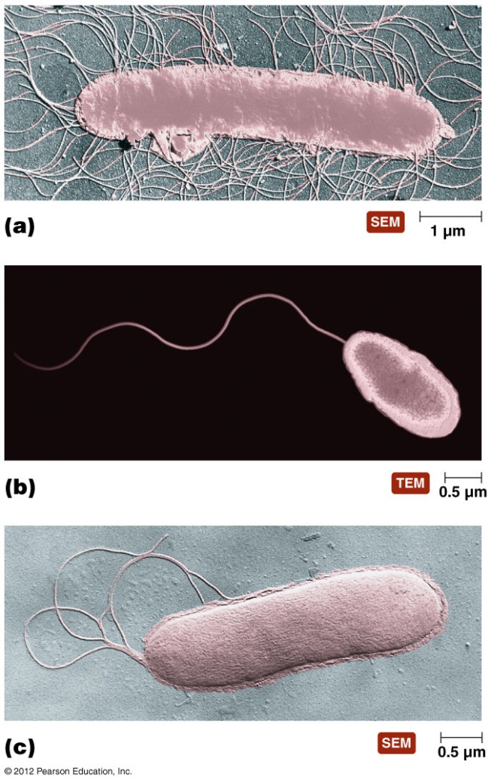
Flagella (Flagellum singular)
Are responsible for movement
Have long structures that extend beyond cell surface
Are not present on all bacteria
Are present in different arrangements in various bacteria:
Notes:
8

Slide 9
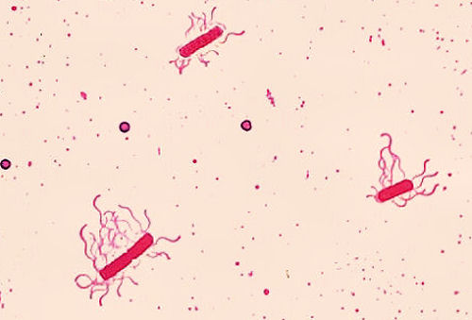
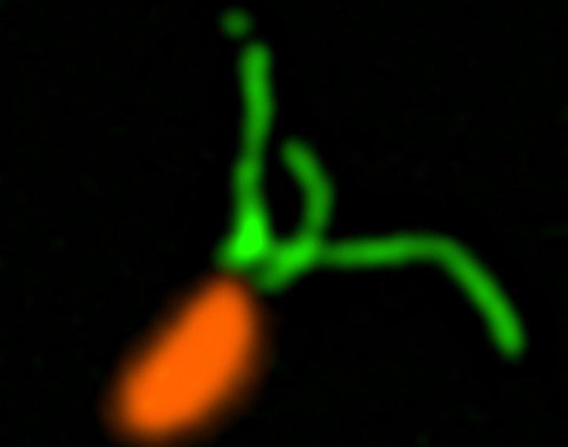
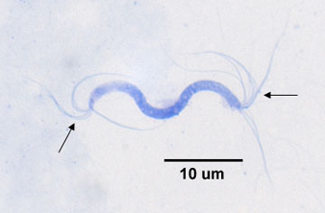
Learn to distinguish various flagellar patterns!

Slide 10
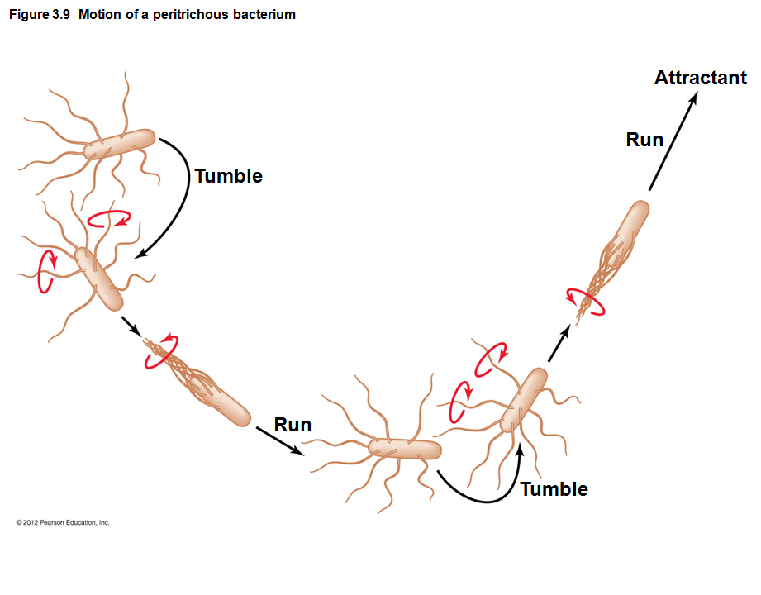
Function of Flagella
Long-range movement
Rotation propels bacterium through environment, counterclockwise or clockwise
Bacteria move in response to stimuli
Runs
toward or away
Tumbles
direction change
© 2012 Pearson Education Inc.
Notes:
10

Slide 11
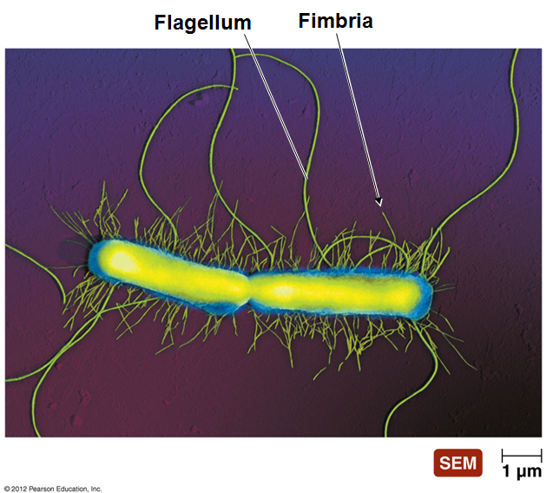
Fimbriae (Fimbria single)
Sticky, bristlelike projections (~ Velcro)
Shorter and FAR MORE
NUMEROUS than flagella and pili
Used by bacteria to adhere to:
Substances in the environment
to one another
to hosts – this is the primary
virulence factor for most
pathogens!
Serve an important
function in biofilms
and in conjugation
© 2012 Pearson Education Inc.
Notes:
11

Slide 12
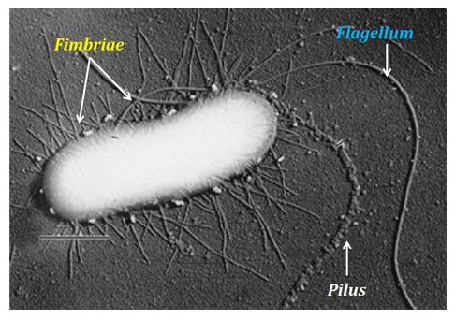
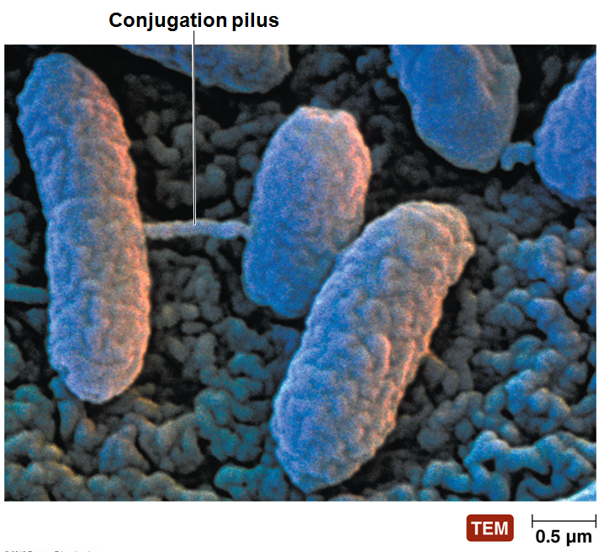
Pilus (pili, plural)
Special type of fimbria
Multiple fimbriae fuse and
extend to form a tube
Also known as conjugation pili
Longer than other fimbriae but shorter than flagella
Bacteria typically have only one or two per cell
Mediates conjugation - the transfer of DNA from one cell to another
Formed under duress
when neighboring (crowded)
bacteria sense each other
and may need to “steal”
genes from one another to
survive
© 2012 Pearson Education Inc.
Notes:
12

Slide 13
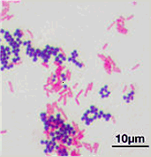
Bacterial Cell Walls, #1
Provide structure and shape and protect cell from osmotic forces
Think of an Ace bandage surrounding a water balloon
Give many bacterial cells characteristic shapes
coccus/cocci round shape
bacillus/bacilli rod shape
strepto- in chains
staphylo- in clusters
Notes:
13

Slide 14
Bacterial Cell Walls, #2
Composed of many layers of sheets of peptidoglycan in most species
Disrupting the cell wall of bacteria make them very susceptible to osmolysis and easier to kill
many commonly used antibiotics disrupt synthesis of the cell wall before it is built
an enzyme in our mucous fluids called lysozyme digests the cell well after it is built)
There are two basic types of bacterial cell walls found in most bacteria that cause disease
Gram-positive
Gram-negative
Notes:
14

Slide 15
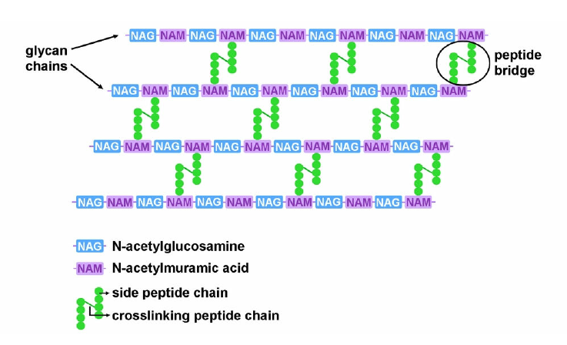
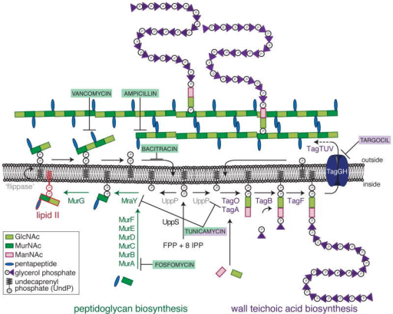
Peptidoglycan
Unbranched polysaccharide synthesized on outside surface of cytoplasmic or inner membrane
Monomer is disaccharide with pentapeptide
Analogous to spider silk outside of cell membrane
Polysaccharides connected together by crosslinking the pentapeptides
Analagous to fixing runs in nylons
Without crosslinking, molecules can slip through into cells, and osmotic forces can rupture bacterial membranes easily
Many antibiotics interfere with this multi-step process
Notes:
15

Slide 16
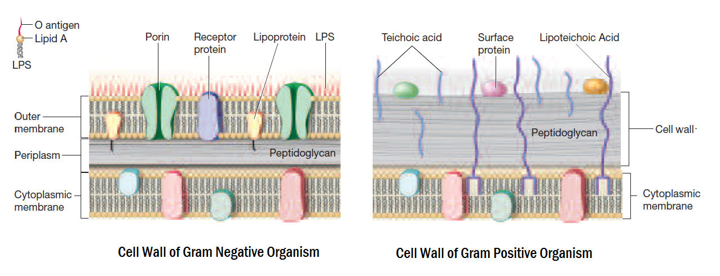
Gram-positive vs. Gram-negative Cell Walls
Both have cytoplasmic membrane
Gram-positive (more genetically diverse) have MUCH more peptidoglycan (many layers) but no outer membrane
Need teichoic acids to keep the many layers “stuck together”
Gram-negative (less genetically diverse) have MUCH less peptidoglycan (few layers), but surround that with an outer membrane
Extra membrane keeps out many antibiotics, bile salts, and contains virulence factors but makes bacteria more susceptible to osmotic effects
© 2012 Pearson Education Inc.
Notes:
16

Slide 17
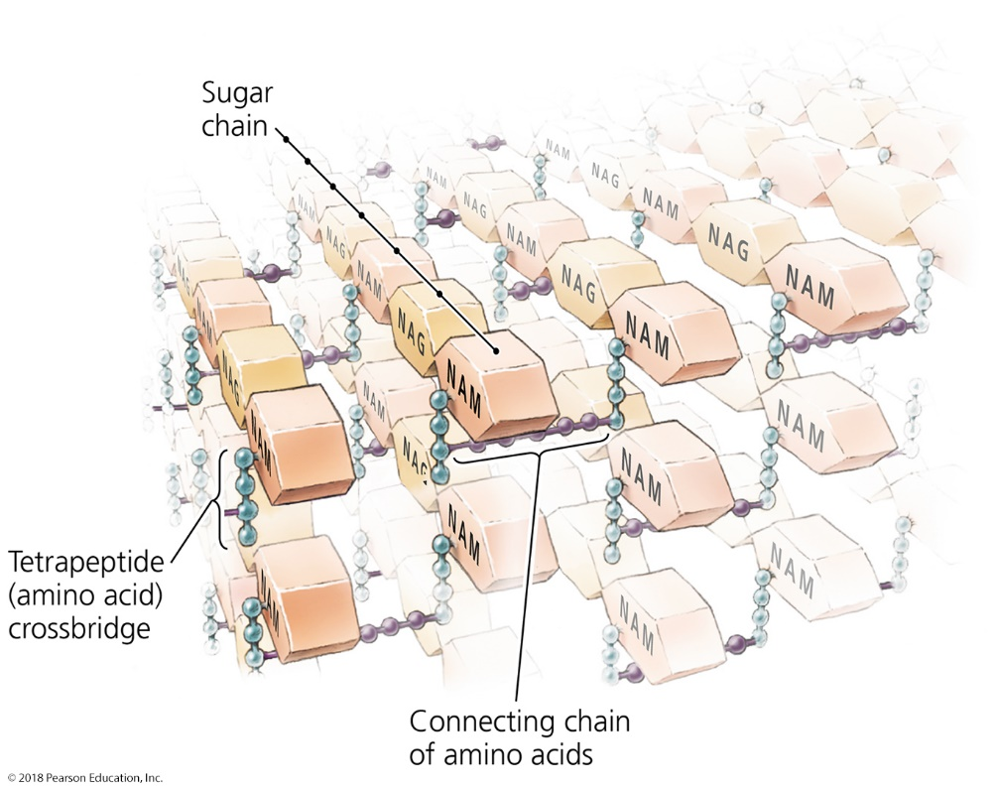
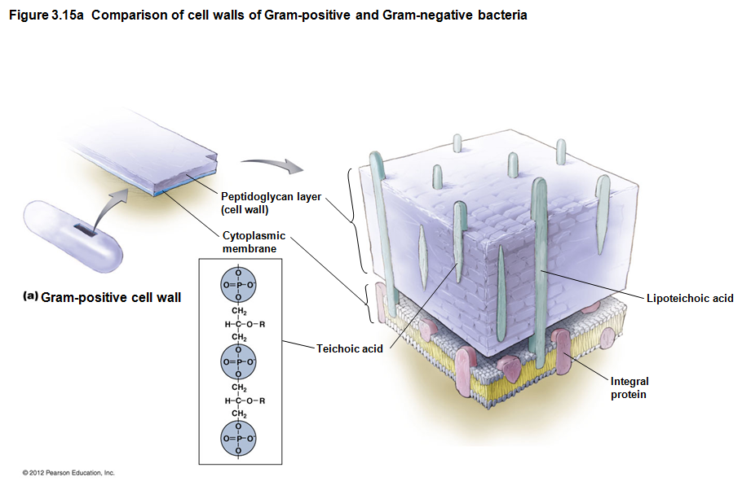
Gram-Positive Bacterial Cell Walls
Relatively thick layer of peptidoglycan (to make up for no outer membrane)
Contain unique polyalcohols called teichoic acids to anchor the many layers together
Appear purple following Gram staining procedure – dye trapped
In acid-fast bacteria, up to 60% of the cell wall contains waxy, highly hydrophobic mycolic acids
helps cells survive desiccation and prevent entry of almost all antibiotics
Notes:
17

Slide 18
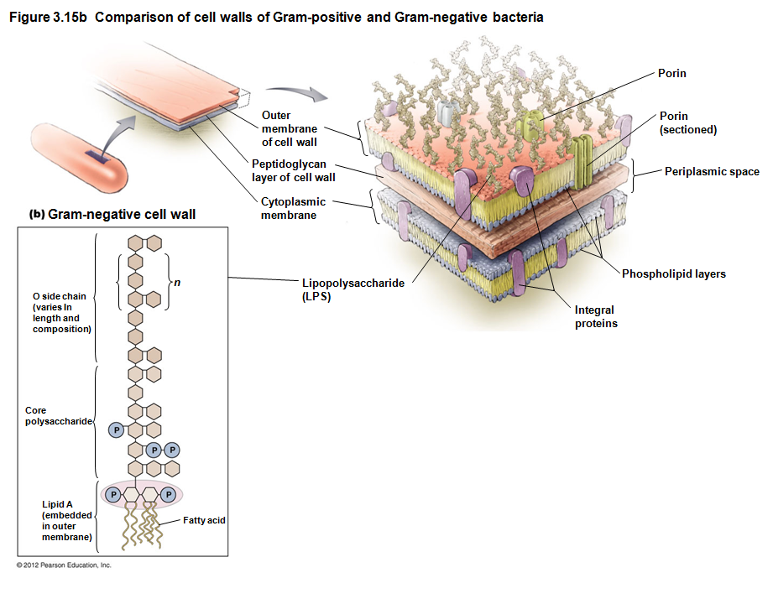
Gram-Negative Bacterial Cell Walls
Have only a thin layer of peptidoglycan
Outer membrane (outside the peptidoglycan) contains phospholipids, proteins, and lipopolysaccharide (LPS)
Appears pink following Gram staining procedure
purple dye easily exits through thin peptidoglycan
Notes:
18

Slide 19
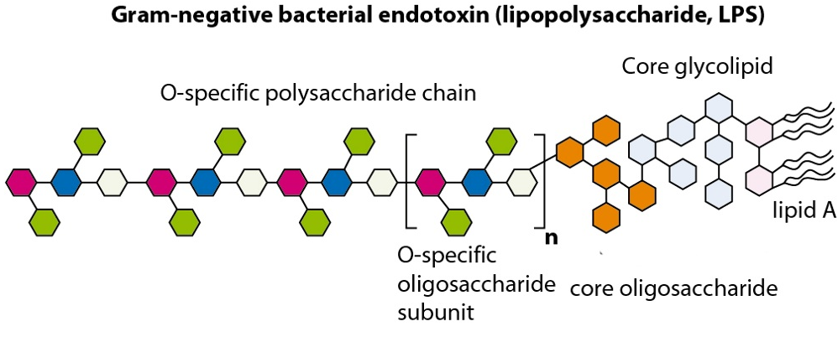
Lipopolysaccharide
Component of outer membrane of gram-negative bacteria
Assists in attaching to other cells or in resisting antimicrobial drugs
This is the primary component of gram-negative bacteria recognized by our immune system
Some variations of LPS are more virulent because they trigger the immune response better
Notes:
19

Slide 20
Lipopolysaccharide
LPS can complicate the treatment of disease
If one kills too make gram-negative bacteria at one:
Many fragments of outer membrane are released per bacterium
The immune system sees many small “bacteria” instead of a single large “bacteria”
The innate immune system overreacts (believing that are 10-100x more bacteria than there actually are)
The innate immune system initiates too strong of a systemic response
The multi-organ shutdown from the protective response leads to septic shock
Notes:
20

Slide 21
Bacteria Without Cell Walls
A few bacteria lack peptidoglycan cell walls
Often mistaken for viruses due to small size and lack of cell wall (e.g. mycoplasma)
Tend to have highly variable morphologies, making their microscopic identification difficult.
Penicillins, cephalosporins, and lysozyme do not inhibit these bacteria
Why?

Slide 22
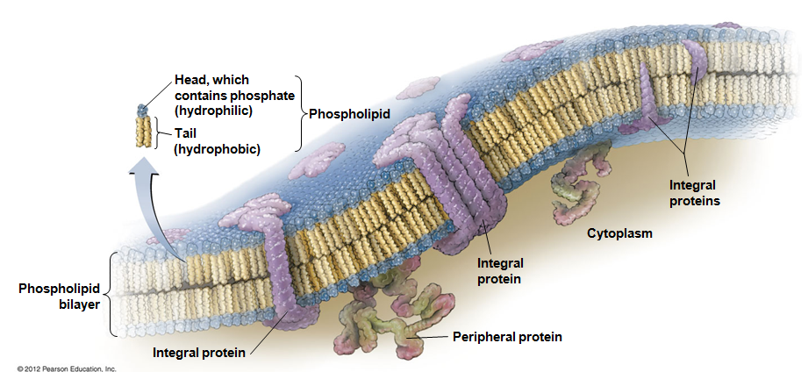
Bacterial Cytoplasmic Membranes
Structure
Referred to as phospholipid bilayer
Composed of lipids and associated proteins
Responsible for importing nutrients (active transport) and exporting waste, enzymes or exotoxins
Susceptible to osmolysis and plasmolysis
Notes:
22

Slide 23
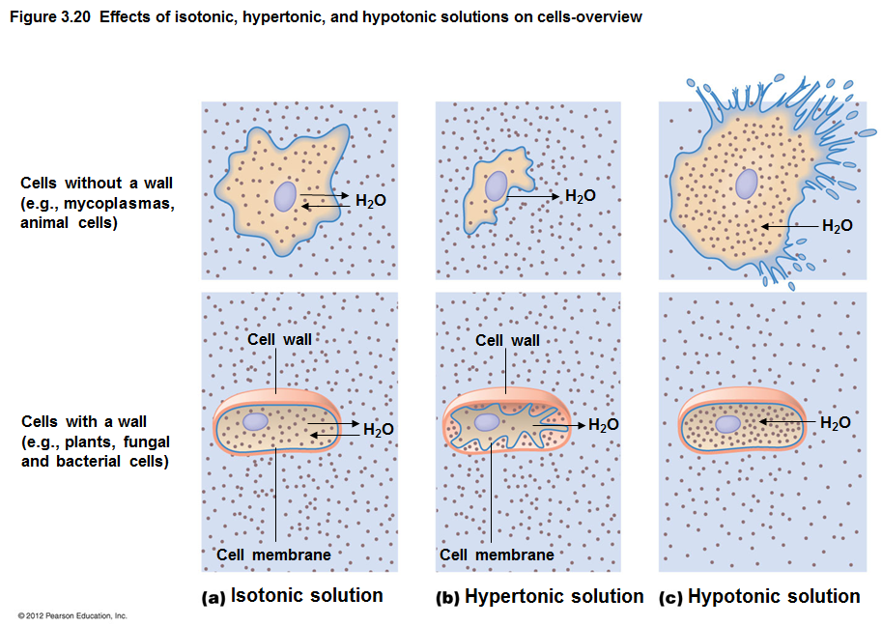
Osmosis Review
Osmolysis or plasmolysis?
Which hinders cells? Which kills cells? Why?
Notes:
23

Slide 24
Cytoplasm of Bacteria
Cytosol – Liquid portion of cytoplasm
Inclusions – May include reserve deposits of chemicals
Stored for a future when nutrients are low
Specific inclusion bodies is diagnostic for some pathogenic bacteria
Endospores – Unique structures produced by some bacteria that are a defensive strategy against unfavorable conditions (e.g., oxygen presence for obligate anaerobes; UV resistance)
Ribosomes - Sites of protein synthesis
Cytoskeleton – Helps to form the cell’s basic shape
Notes:
24

Slide 25
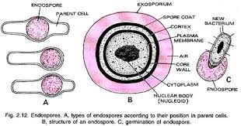
About endospores
Clostridium and Bacillus species are most commonly known endospore-forming bacteria
Endospore-forming bacteria spontaneously make endospores (you never know when disaster will strike)
Endospores are VERY HARD to destroy
endospore-contaminated food MUST be thrown away and destroyed
Botulism-tainted food, anthrax-diseased cattle
B. anthracis was weaponized because of its spore-forming ability
Endospores form as a highly dense structure within the parental bacteria; a “new” bacterium hibernated inside a spore coat
After “hibernation”, the bacterium “hatches” from the spore coat
Notes:
25

Slide 26
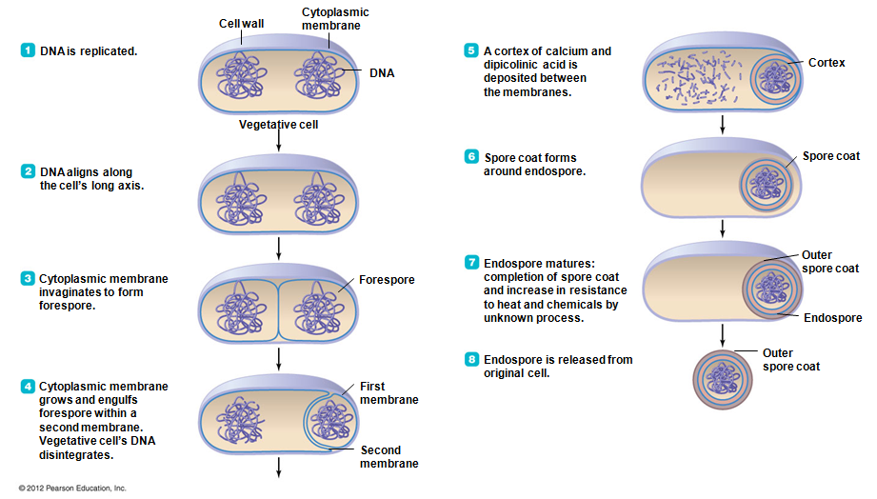
How Endospores Form
Notes:
26

Slide 27
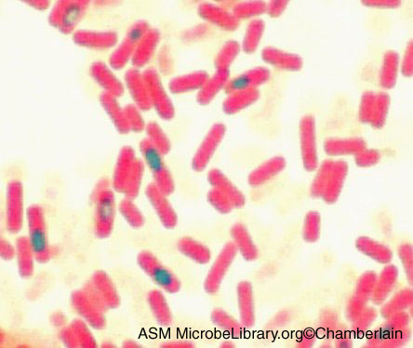
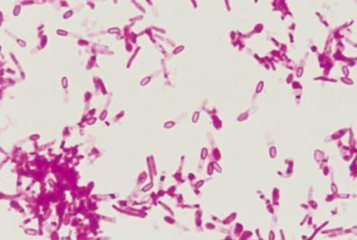
Can you identify endospores?
Endospores can be identified with a special stain “endospore stain”
Endospores can also be less stringently identified by the lack of staining within a cell
Notes:
27

Slide 28
SUMMARY SLIDE - Anatomy of Archaeal Cells
External structures
Glycocalyx – involved in protection, biofilm formation
Motile/attachment elements
Cell wall – different from bacterial cell walls
Membrane structure
Plasma membrane – lipids, proteins - selective entry
Internal structures
Nucleoid – DNA for gene expression and fission
Inclusions – banked chemicals
Eukaryote-like ribosomes
© 2012 Pearson Education Inc.
Notes:
28

Slide 29
Eukaryotes

Slide 30
SUMMARY SLIDE - Anatomy of Eukaryotic Cells
External structures
Glycocalyx – chemically complex, involved in protection
Motile/attachment elements – cilia, flagella, pseudopods
Cell wall – only in immobile eukaryotes
Membrane structure
Plasma membrane – lipids, proteins - selective entry
Internal structures
Ribosomes, cytoskeleton, centrioles
Nucleus
Endoplasmic reticulum (SER, RER)
Golgi Apparatus
Vesicular organelles (lysosome, peroxisome)
“prokaryotic” organelles – mitochondria, chloroplasts
© 2012 Pearson Education Inc.
Notes:
30

Slide 31
Eukaryotic Cell Walls
Fungi, algae, plants, and some protozoa have cell walls
Usually immobile creatures, as cell wall tends to be rigid
Composed of various polysaccharides
Plant cell walls composed of cellulose
Fungal cell walls composed of cellulose, chitin, and/or glucomannan
Algal cell walls composed of a variety of polysaccharides
© 2012 Pearson Education Inc.
Notes:
31

Slide 32
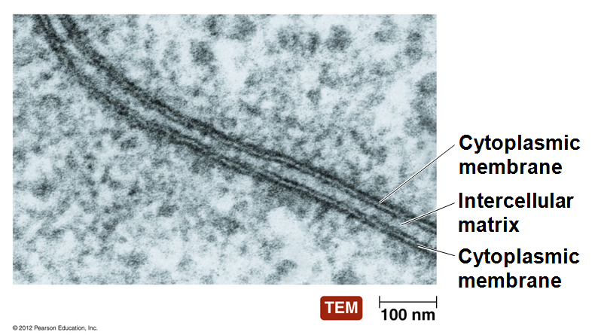
Eukaryotic Cytoplasmic Membranes
All eukaryotic cells have cytoplasmic membrane
Are a fluid mosaic of phospholipids and proteins
Contain steroid lipids to prevent clustering of membrane components (“fluidity”)
cholesterol in animals, ergosterol in fungi/protozoa, phytosterol in plants
Contain regions of lipids and proteins called membrane rafts – for signal transduction
Controls movement of molecules into and out of cell
Notes:
32

Slide 33
Figure 3.30 Endocytosis – Review on your own
Endocytosis is used by eukaryotes to ingest large objects easily
Endocytosed object (in a vesicle) is then processed by fusion with a lysosome or peroxisome
Digestive/destructive enzymes are kept within the cell instead of spewed into the outside world
reuse/recycle - more energy efficient
Pseudopodium
Notes:
33

Slide 34
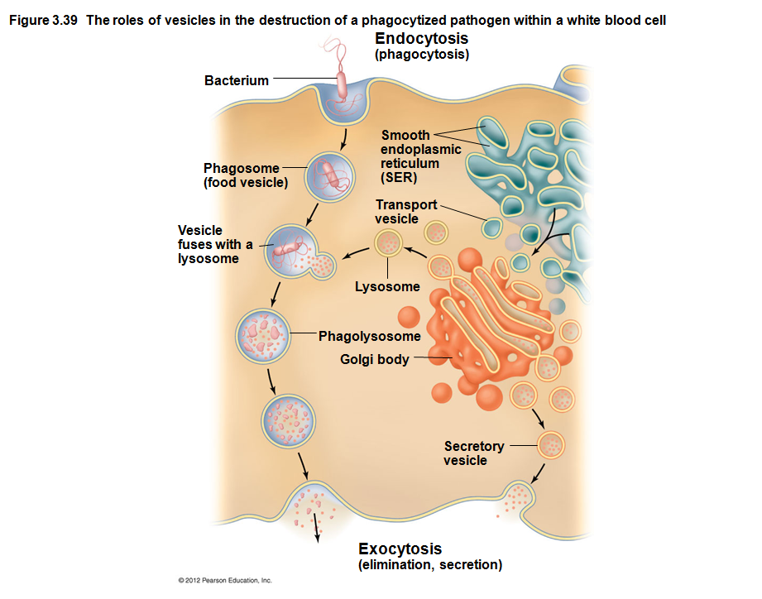
Endocytosis and use of lysosomes are critical to remove pathogens from body tissues
Notes:
34

Slide 35
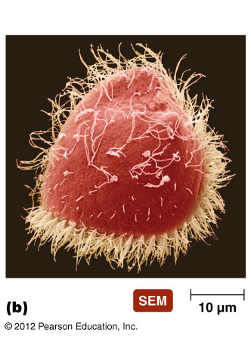
Eukaryotic Cilia
Used for motion, not attachment!
Shorter and more numerous than flagella
Coordinated beating propels cells through their environment
Also used to move substances past the surface of the cell (expel wastes, dust off pathogens)
© 2012 Pearson Education Inc.
Notes:
35

Slide 36
Cytoplasm of Eukaryotes
Other Nonmembranous Organelles
Ribosomes
Larger than bacterial ribosomes (80S versus 70S)
Similar in size and composition to archaeal ribosomes
Composed of 60S and 40S subunits
Cytoskeleton
Extensive network of fibers and tubules
Anchors organelles
Produces basic shape of the cell
Made up of tubulin microtubules, actin microfilaments, and intermediate filaments
© 2012 Pearson Education Inc.
Notes:
36

Slide 37
Cytoplasm of Eukaryotes – to review on your own
Other Nonmembranous Organelles
Centrioles and centrosome
Recall: mitosis is nuclear division, not cellular division
Need special organelles for nuclear division
Centrioles play a role in mitosis, cytokinesis, and formation of flagella and cilia
Centrosome is region of cytoplasm where centrioles are found
© 2012 Pearson Education Inc.
Notes:
37

Slide 38
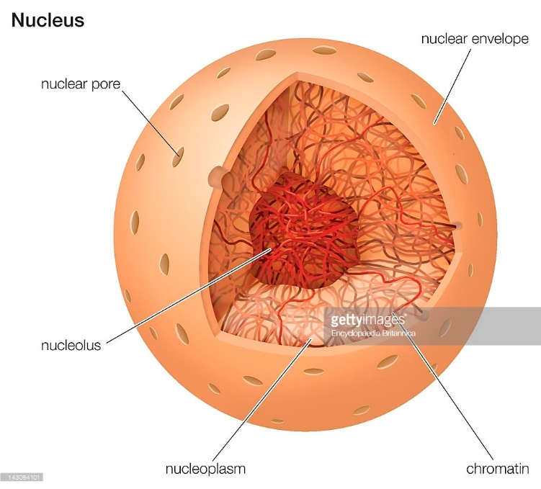
Cytoplasm of Eukaryotes – to review on your own
Membranous Organelles
Nucleus
Often largest organelle in cell
Contains the cell’s DNA
Nucleoplasm
Contains chromatin, some histones
Nucleoli present in nucleoplasm; rRNA synthesized in nucleoli
Surrounded by nuclear envelope – keeps DNA contained, and shields nucleus from viral intrusion
Nuclear pores allow small molecules (proteins, biomolecules) to move in and out
© 2012 Pearson Education Inc.
Notes:
38

Slide 39
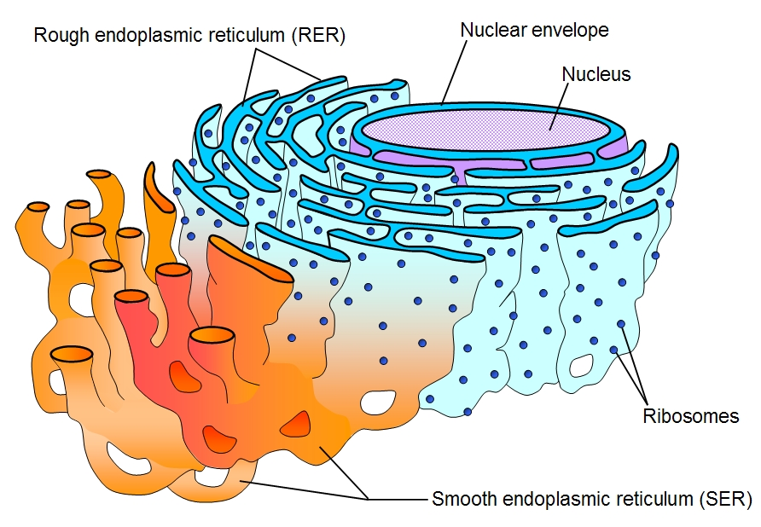
Cytoplasm of Eukaryotes – to review on your own
Membranous Organelles
Endoplasmic reticulum
Netlike arrangement of
flattened, hollow tubules
continuous with nuclear
envelope
Two forms
Smooth endoplasmic reticulum (SER)
Tubular
Lipid and glucose synthesis
Rough endoplasmic reticulum (RER)
Pancake-like, ribosomes attached on outside
Membrane, vesicular, or secreted protein synthesis
Protein modification, and transport
© 2012 Pearson Education Inc.
Notes:
39

Slide 40
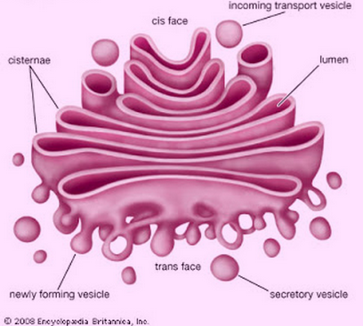
Cytoplasm of Eukaryotes – to review on your own
Membranous Organelles
Golgi body/Golgi apparatus
“Amazon”/ “Post Office”
Flattened hollow sacs
Receives, processes, and packages large molecules from RER for export from cell or final destination
Packages molecules in secretory vesicles that fuse to plasma membrane
Not in all eukaryotic cells
© 2012 Pearson Education Inc.
Notes:
40

Slide 41
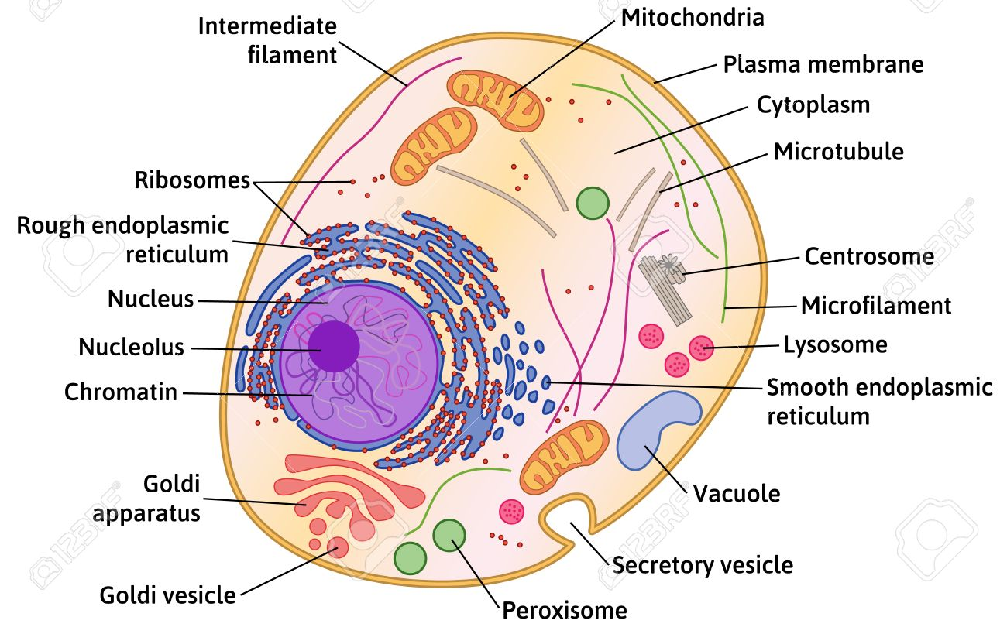
Cytoplasm of Eukaryotes – to review on your own
Vesicular Organelles
Lysosomes, peroxisomes, vacuoles, and vesicles
Visually indistinguishable; only differentiated biochemically
Vesicles may store nutrients in cell
Exocytosis - used to “spit out” waste or digestive enzymes (fungi)
Lysosomes contain catabolic enzymes – chop up particles
Peroxisomes contain enzymes that chemically destroy poisonous wastes (oxidation – burn instead of chop up)
Peroxisomes are “not seen” in plants
© 2012 Pearson Education Inc.
Notes:
41

Slide 42
Endocytosis and use of lysosomes are critical to remove pathogens from body tissues
Notes:
42

Slide 43
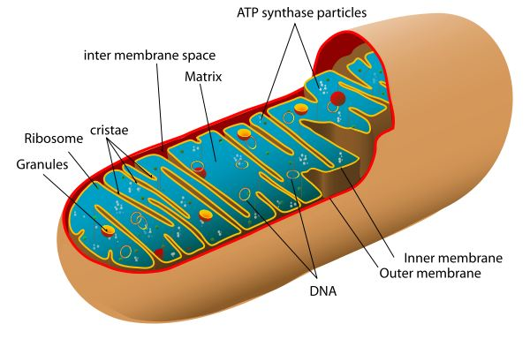
Cytoplasm of Eukaryotes – to review on your own
Membranous Organelles
Mitochondria
Have two membranes composed of phospholipid bilayer
Produce ~90-95% of cell’s ATP (because of oxidative phosphorylation)
Interior matrix contains 70S ribosomes and mitochondrial DNA
Mitochondrial ribosomes resemble bacterial ribosomes
Most toxicity of antibacterial antibiotics in humans is due to their inhibition of mitochondrial ribosomes
© 2012 Pearson Education Inc.
Notes:
43

Slide 44
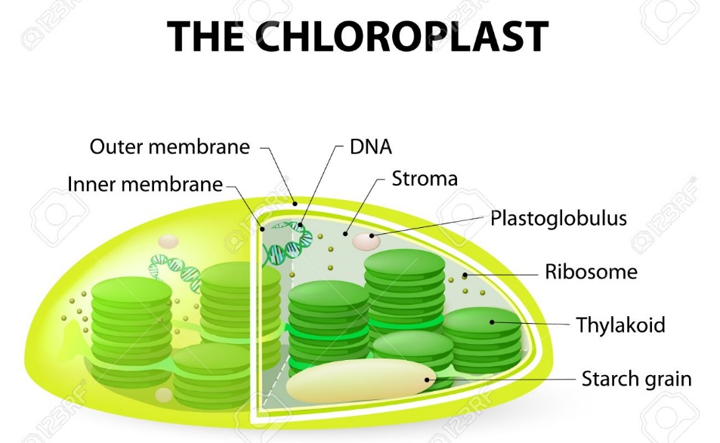
Cytoplasm of Eukaryotes – to review on your own
Membranous Organelles
Chloroplasts
Light-harvesting
structures found in
plants and photosynthetic
protozoa (algae, euglena)
Structures vary considerably
Two phospholipid bilayer membranes surround the chloroplast
Contains DNA, starch granules, 70S ribosomes, and thylakoid membranes
Chloroplast thylakoid complexes, ribosomes and DNA resemble those found in photosynthetic bacteria
© 2012 Pearson Education Inc.
Notes:
44

Slide 45
Endosymbiotic Theory
Eukaryotes formed from union of small aerobic bacterium with larger anaerobic archaean
Smaller prokaryotes were either pathogens or “trapped hostages”
Smaller cell lost ability to exist independently
Larger cell became dependent on smaller cell for aerobic ATP production (10-15X better than anaerobic ATP production)
Aerobic bacteria evolved into mitochondria
Ingested cyanobacteria evolved into chloroplasts
This mutualistic symbiosis has endured in nearly all eukaryotes for 2 billion years
Diplomonads and parabasalids lack mitochondria
© 2012 Pearson Education Inc.
Notes:
45

