Slide 1
Microbiology
Chapter 1
History of Microbiology

Slide 2
The Early Years of Microbiology
What Does Really Small Stuff Look Like?
Robert Hooke (1635-1703)
Mathematician, physicist, experimental technician
Created first single-lens microscope
Characterized “cells” from cavities in cork, microscopic fossils, and mold spore-forming bodies in 1665
Antoni van Leeuwenhoek (1632-1723)
Lensmaker (~glassblower), draper, and naturalist
What is the threadcount of this linen?
What is in a drop of “clear” rainwater?
What is in dental plaque?
Received most of the credit for the birth of microscopy and the discovery of microbes

Slide 3
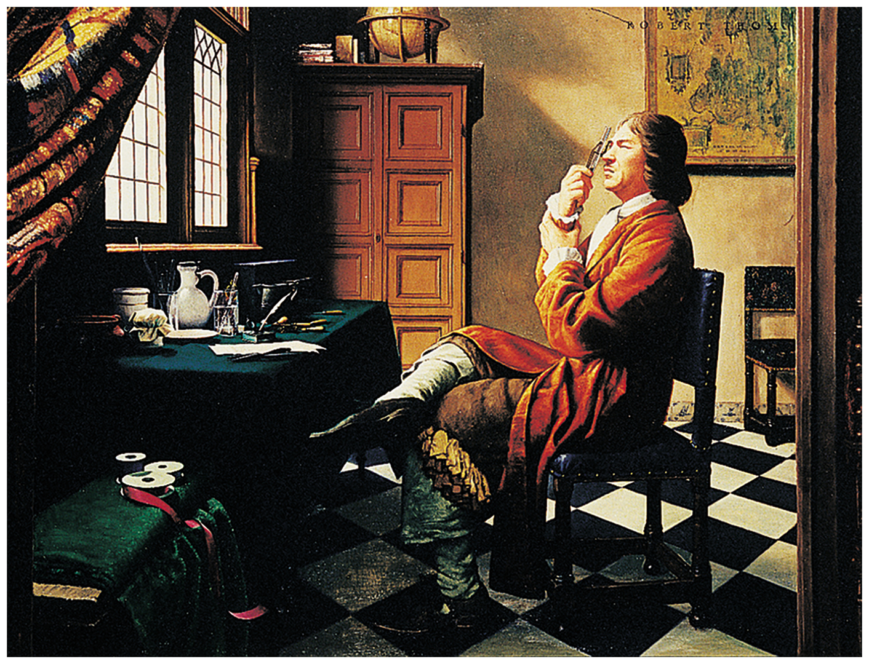
How did Antoni van Leeuwenhoek see small organisms – he “saw the light”!!
Notes:
3

Slide 4
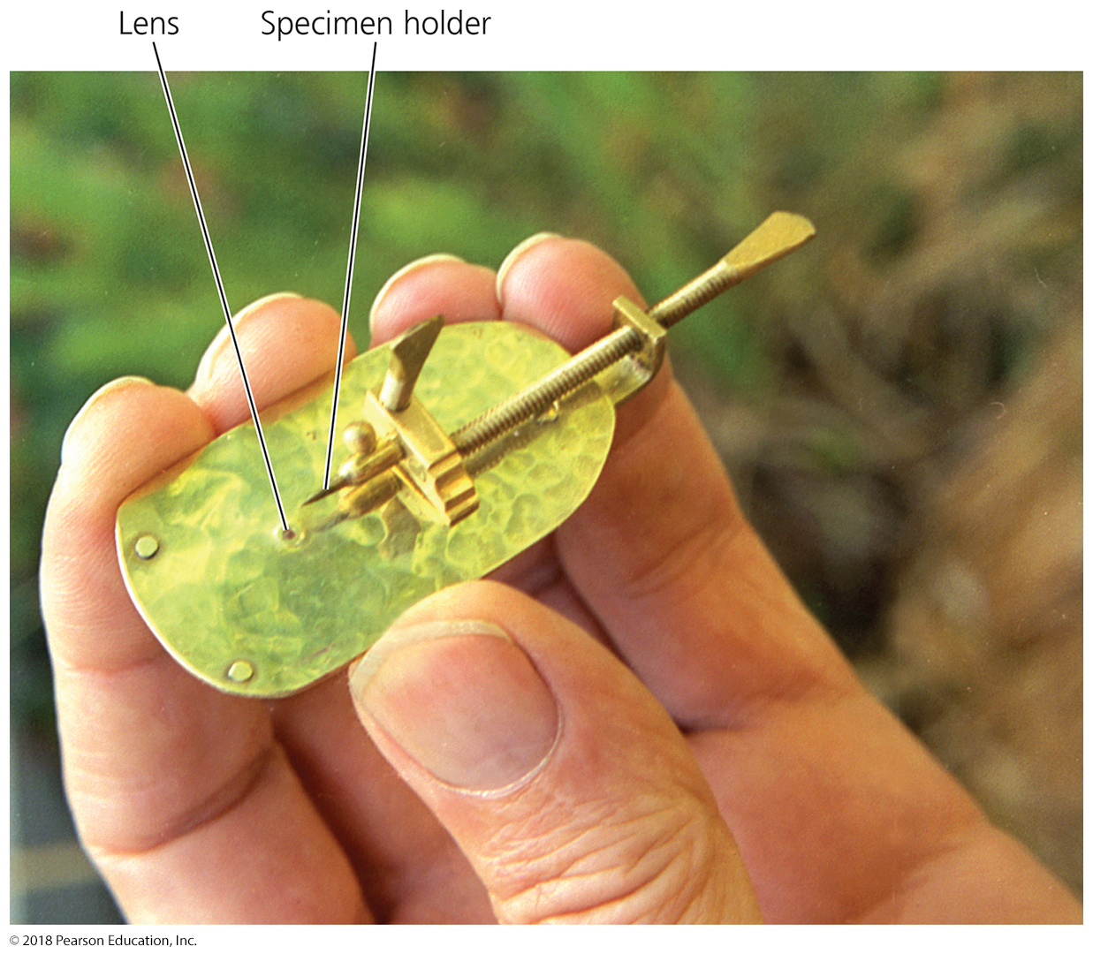
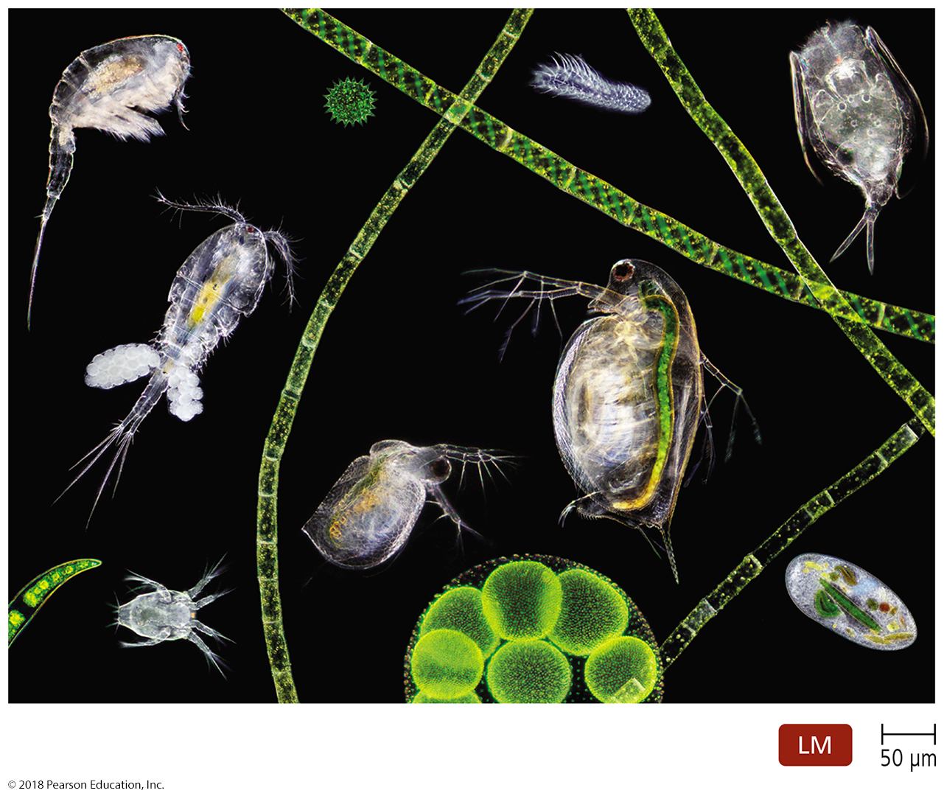
The Early Years of Microbiology
Leeuwenhoek’s microscopes
Began making and using simple “microscopes”
Often made a new “microscope” for each specimen (different objectives for different magnifications) – over 300 known
Examined water and visualized tiny animals, fungi, algae, and single-celled protozoa; “animalcules”
By end of 19th century, these organisms were called microorganisms.

Slide 5
SUMMARY SLIDE!
How Can Microbes Be Classified?
Millions of these things; very different from one another!
Need a way to organize them!
Carolus Linnaeus developed a taxonomic system for naming plants and animals and grouping similar organisms together.
Leeuwenhoek’s microorganisms are grouped into six categories:
Bacteria and Archaea
Fungi
Protozoa (Protists)
Algae
Small multicellular animals

Slide 6
How Can Microbes Be Classified?
Bacteria and Archaea
Unicellular and lack nuclei
Much smaller than eukaryotes
Found everywhere there is sufficient moisture; some isolated in extreme environments
Reproduce asexually
Most bacterial cell walls contain peptidoglycan
Some bacteria lack cell walls (mycoplasma).
Archaeal cell walls are composed of protein polymers rather than peptidoglycan or polysaccharide.

Slide 7
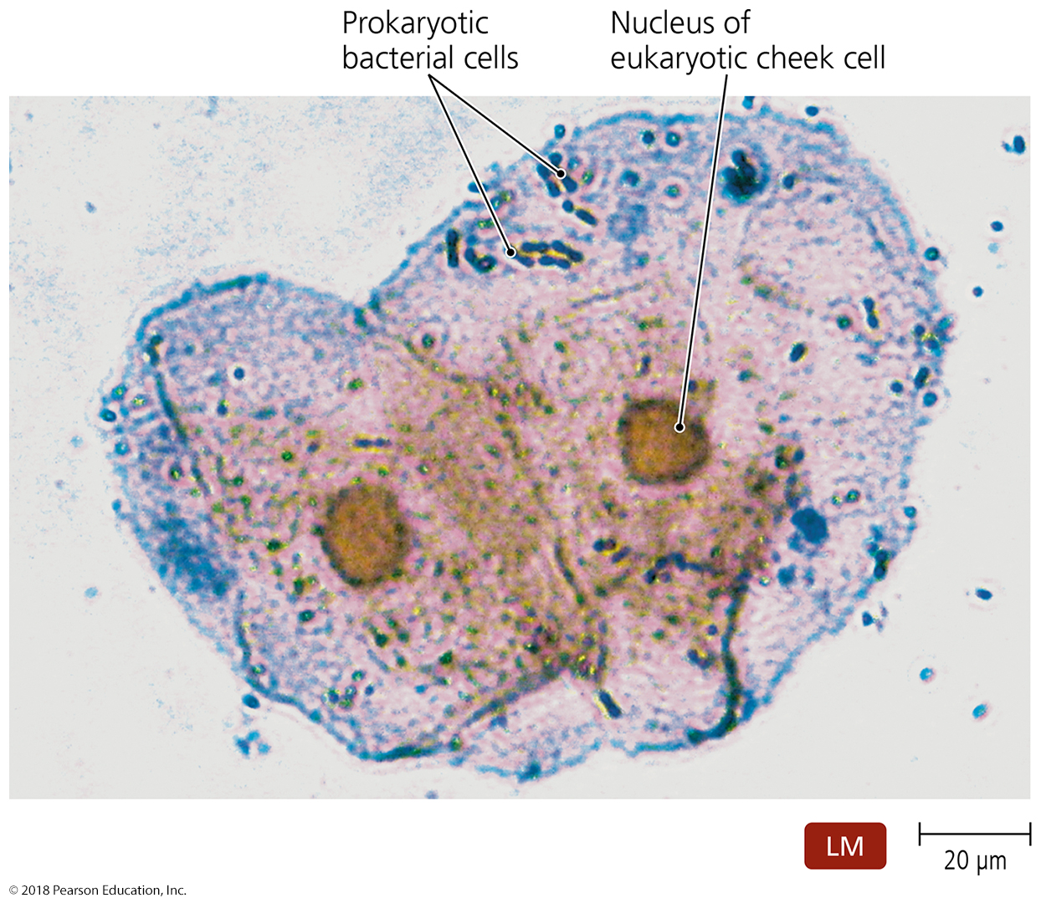
Figure 1.4 Cells of the bacterium Streptococcus (dark blue) and two human cheek cells.
Notes:
7

Slide 8
How Can Microbes Be Classified?
Fungi
Eukaryotic (have membrane-bound nucleus)
Obtains food by liquifying its surroundings
Possess cell walls made of polysaccharides and some protein
Include:
Mushrooms — sessile, multicellular; macroscopic, noninfectious (but intoxicating!)
Molds — sessile, multicellular (but fragments); grow as long filaments
Yeasts — mobile, unicellular (but clusters); reproduce asexually by budding
Dimorphic – switches between mold and yeast; common among infectious molds
stationary mold in the soil; mobile yeast to escape immune system

Slide 9
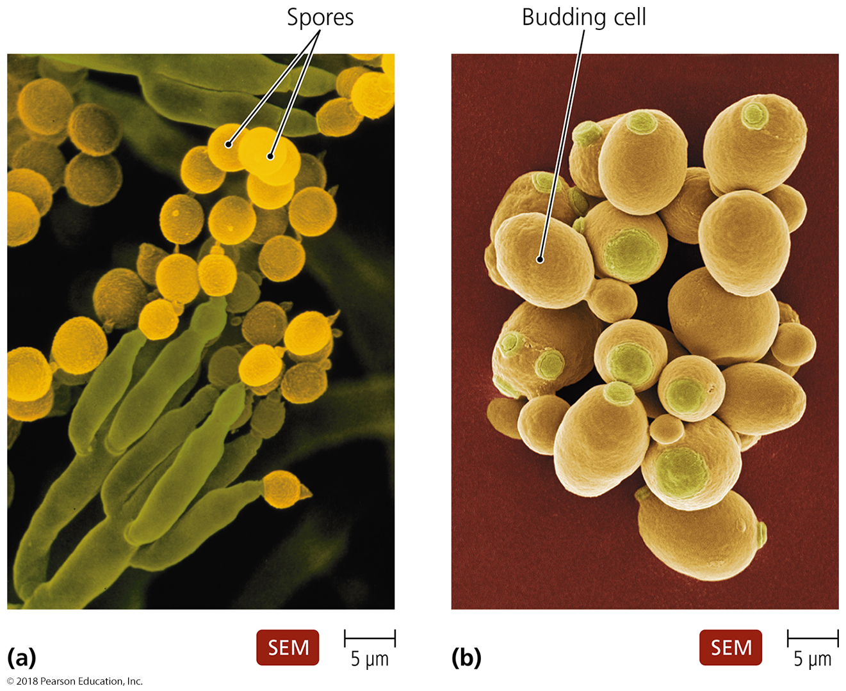
Molds vs. Yeast
Notes:
9

Slide 10
How Can Microbes Be Classified?
Protozoa
Now properly referred to as protists
Single-celled eukaryotes
Many are heterotrophic; some are autotropic
Most live freely in water; some live in animal hosts
Asexual (mostly) and sexual reproduction
Most are capable of locomotion by:
Pseudopods — cell extensions that stretch into the direction of travel (amoeba)
Cilia — numerous short protrusions that propel organisms through its environment (paramecium)
Flagella — extensions of a cell that are fewer, longer, and more whiplike than cilia (euglena)

Slide 11
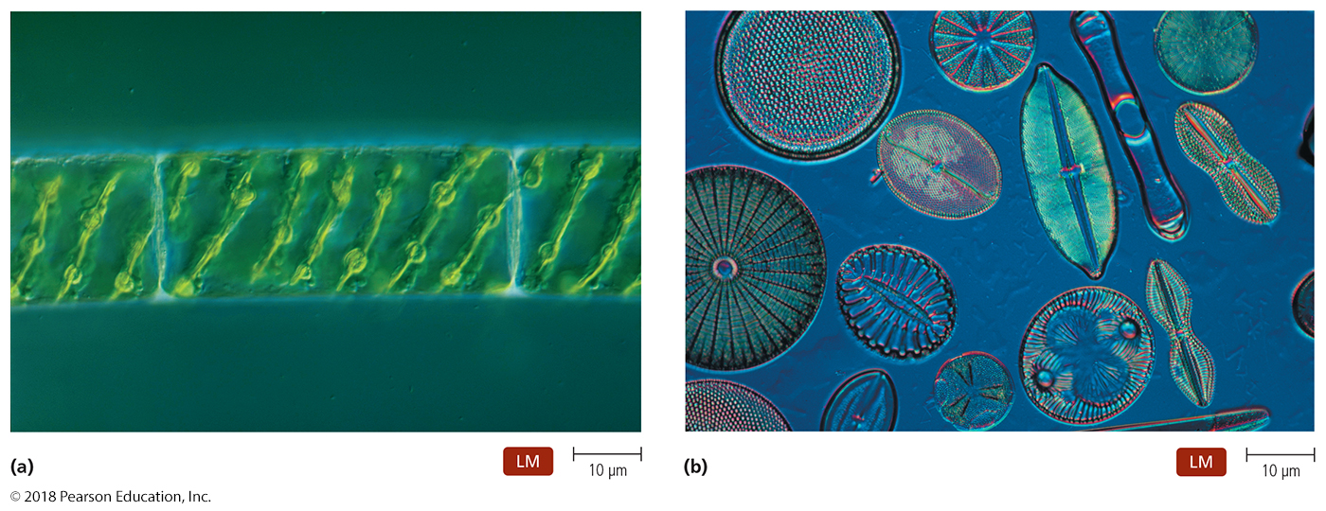
How Can Microbes Be Classified?
Algae
Unicellular or multicellular
Photosynthetic
Mostly asexual reproduction; Simple sexual reproductive structures (spores, differentiated filaments)
Red, green, and brown varieties
Green algae is precursor of green plants

Slide 12
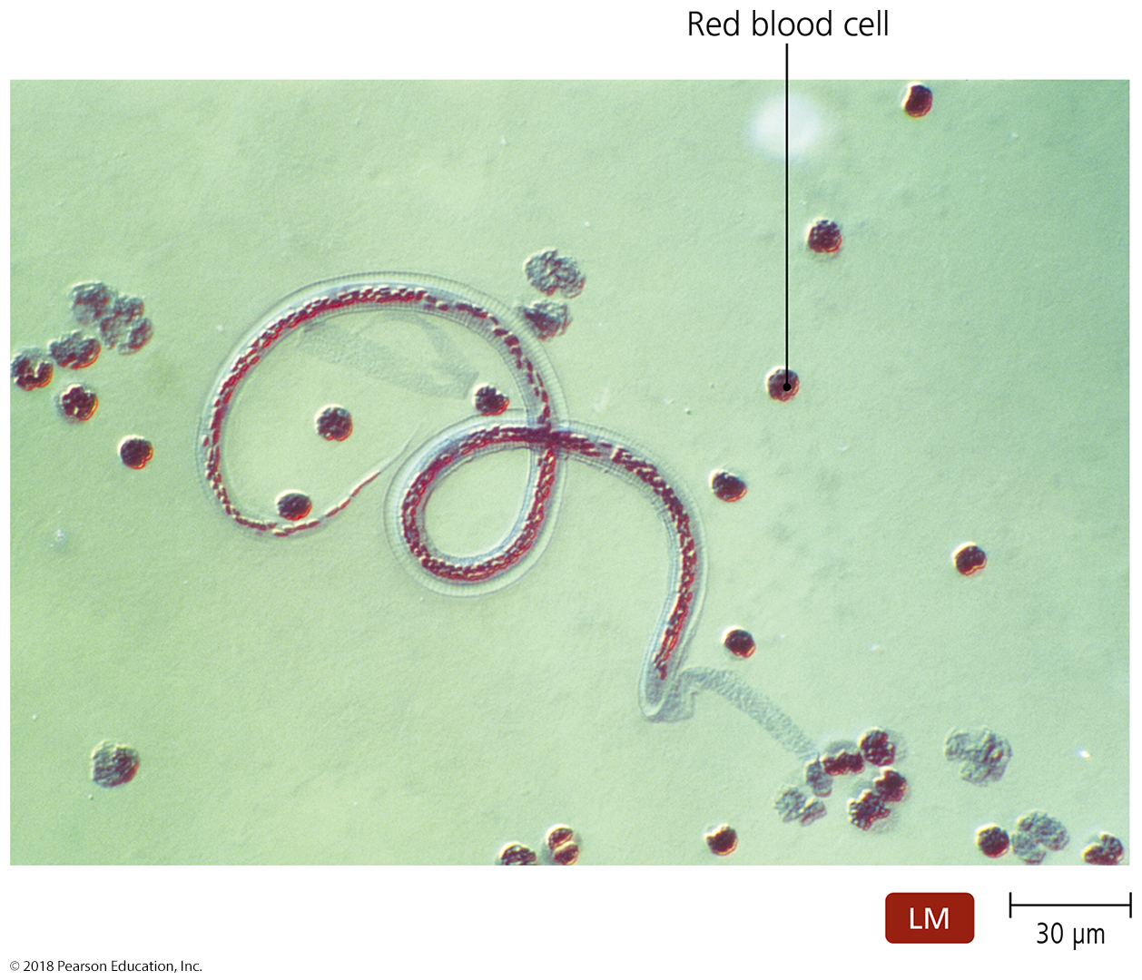
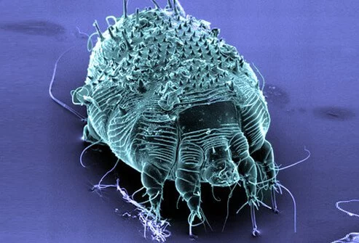
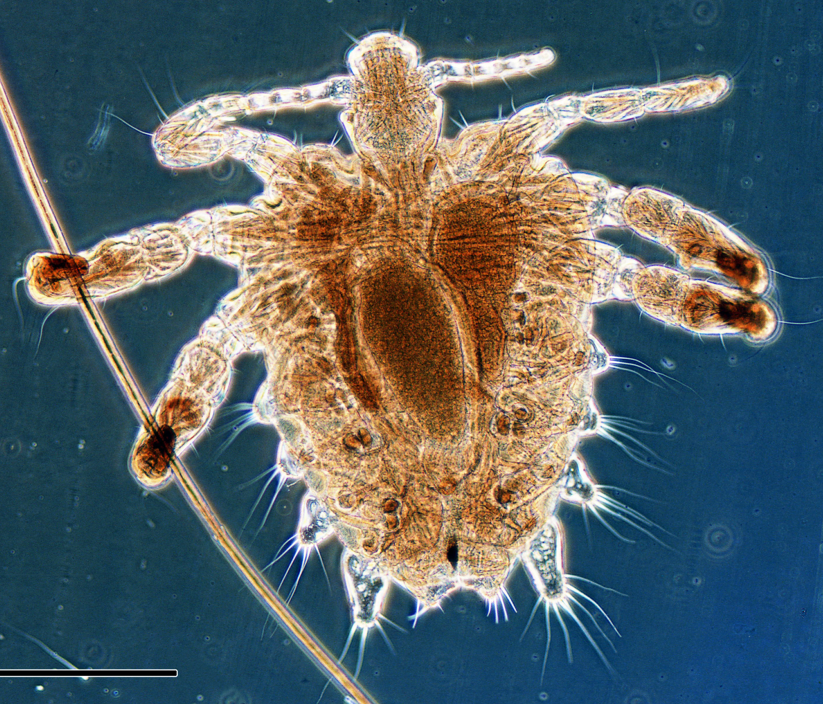
How Can Microbes Be Classified?
Small multicellular animals
Some directly cause disease themselves
Parasites – flatworms, flukes, or roundworms
Some carry disease and transmit to us through bites
Arthropods - Mites, ticks, mosquitoes, fleas, flies
Pubic louse
“crab”
scabies
helminth

Slide 13
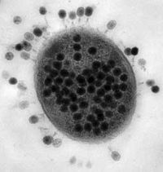
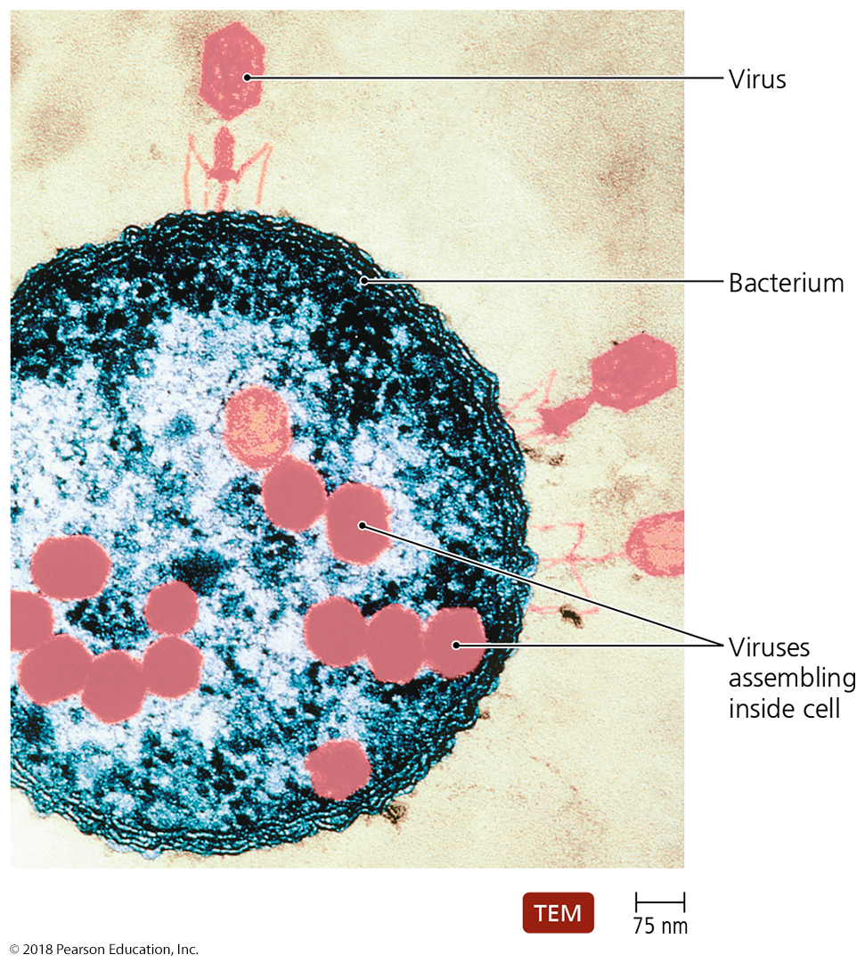
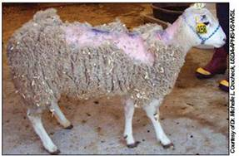
How Can Microbes Be Classified?
What von Leeuwenhoek could NOT see
Viruses – ebola, Hepatitis, HIV, measles, mumps
Virus-like particles – includes prion diseases (mad cow)
scrapie (~ mad cow)

Slide 14
SUMMARY SLIDE
Microbiology was validated as a science once people could do more than simply look at little critters (microbiological organisms, a.k.a. microbes)
Scientists searched for answers to four questions, of great importance to Renaissance people:
Is spontaneous generation of microbial life possible?
Do microbes make certain foods?
Do microbes cause disease (plague, cholera, smallpox)?
Can we prevent infection and disease?

Slide 15
Validating Microbiology
Does Microbial Life Spontaneously Generate?
Some philosophers and scientists of the past thought living things arose from three processes:
Asexual reproduction (green algae)
Sexual reproduction (animals, flowering plants)
Nonliving matter (microbes)
Aristotle proposed spontaneous generation.
He saw that living things can arise from nonliving matter.
The Renaissance fostered a need to understand things in a more “humanistic” fashion
Is there a understandable (nonreligious) reason?

Slide 16
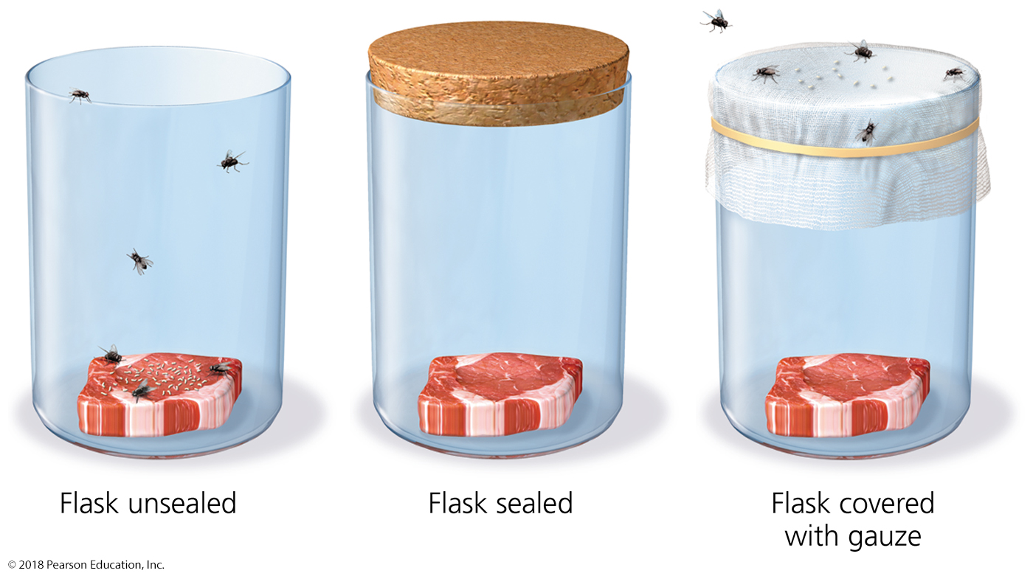
Validating Microbiology
Does Microbial Life Spontaneously Generate?
As meat decays in the wild, maggots are ALWAYS seen
Do maggots arise “spontaneously” from meat?
Francesco Redi’s experiments
When decaying meat was kept isolated from flies, maggots never developed (though mold and bacteria did).
Meat exposed to flies was soon infested.
As a result, scientists began to doubt Aristotle’s theory.

Slide 17
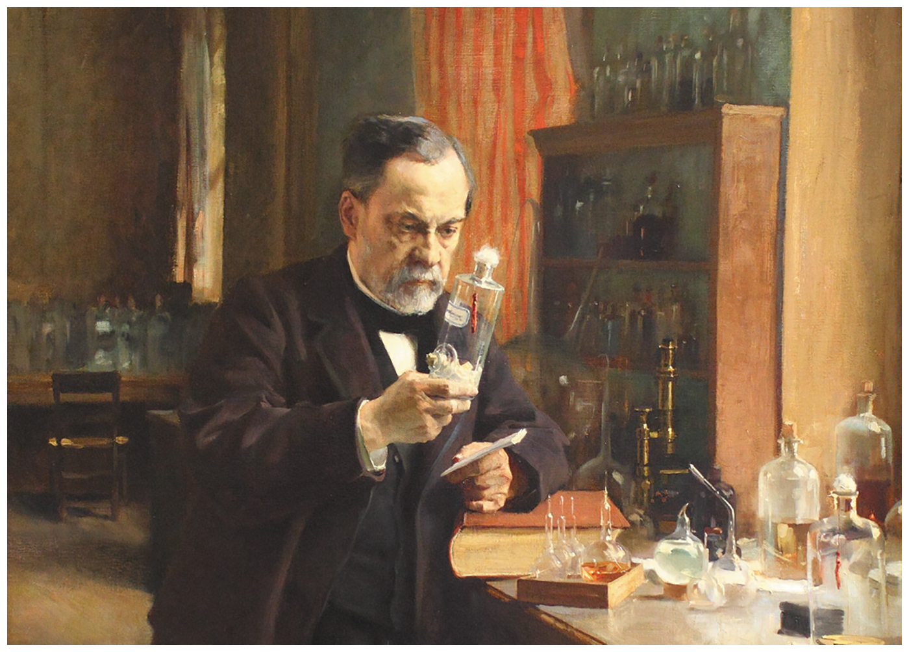
Figure 1.11 Louis Pasteur, the father of modern microbiology.
Notes:
17

Slide 18
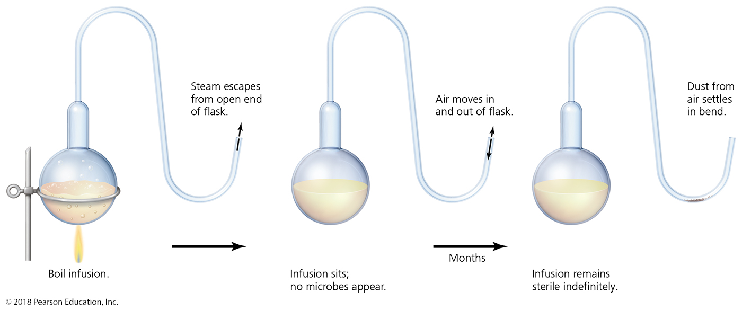
Validating Microbiology
Does Microbial Life Spontaneously Generate?
Louis Pasteur’s experiments
Performed experiments with “swan-necked” flasks
When the flasks remained upright, no microbial growth appeared (one flask on display in Paris has been sterile since 1862!)
When the flask was tilted, dust from the bend in the neck seeped back into the flask and made the infusion cloudy with microbes within a day.

Slide 19
Validating Microbiology – What causes disease?
Logically, something “clean” got “dirty”
Pasteur developed the germ theory of disease.
Pasteur established that things can become “sterile”
Sterile things can then become contaminated
He knew that “clean” things were less prone to developing microbes (handwashing, clotheswashing, dishwashing)
By proving that things start being sterile and then get contaminated, he allowed a rigorous framework to establish that “infectious disease” must be caused be contamination with germs.
Most deaths in the late 1800s were caused by various microbes (ex: pneumonia, diphtheria, meningitis) ; these disease-causing microbes are called pathogens.
Keeping things clean helps prevent spoilage/disease!

Slide 20
Notable contributions to preventing infection spread
Ignaz Semmelweis - introduced handwashing between patients for doctors (was ridiculed for this)
Joseph Lister’s antiseptic technique in surgery – spraying skin (was ultimately praised for this)
Florence Nightingale – hygiene, aseptic technique in nursing
John Snow—infection control and epidemiology
Stopped spread of cholera
Edward Jenner’s vaccine—field of immunology
Eradication of smallpox, polio, measles, pertussis
Paul Ehrlich’s “magic bullets”—field of chemotherapy
Antibiotics and microorganism-specific compounds

Slide 21
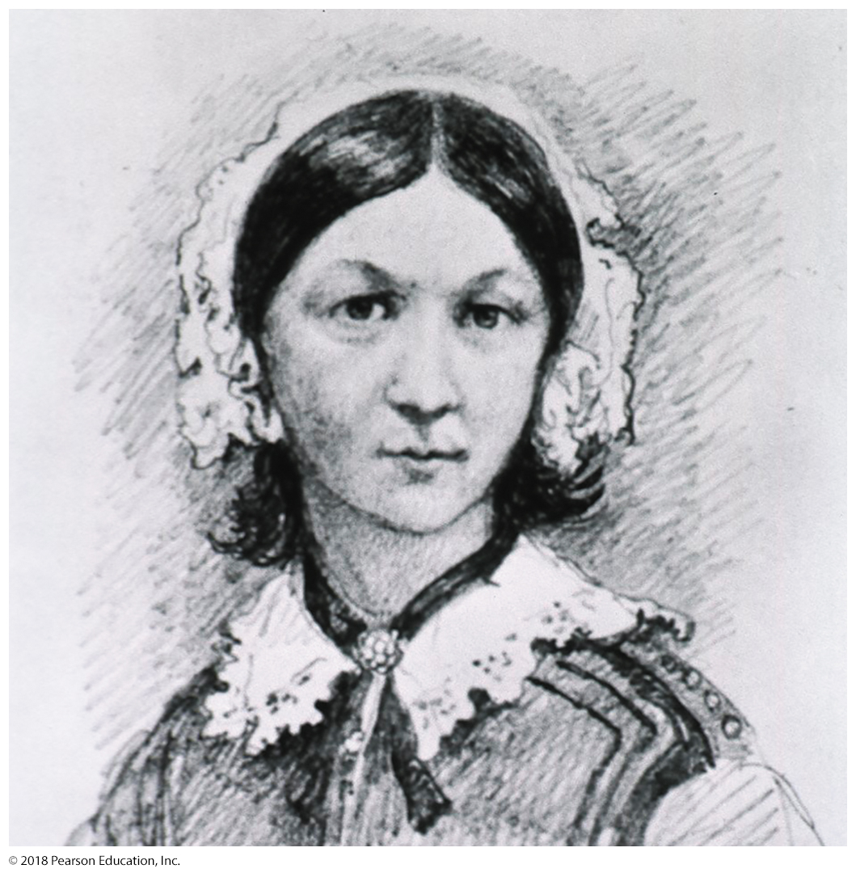
Figure 1.18 Florence Nightingale.
Notes:
21

Slide 22
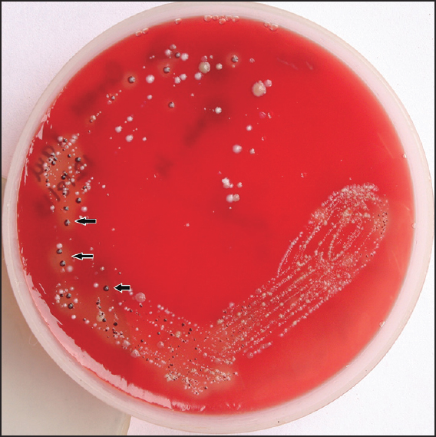
Validating Microbiology – What causes disease?
The problem:
These microbes were isolated from the mouth of someone with gingivitis (or insert disease here).
Which microbe is causing gingivitis?
Do any of these microbes cause tooth decay?
Do any of these microbes cause bad breath?
Do any of these microbes cause pneumonia?
Do any of these microbes cause strep throat?

Slide 23
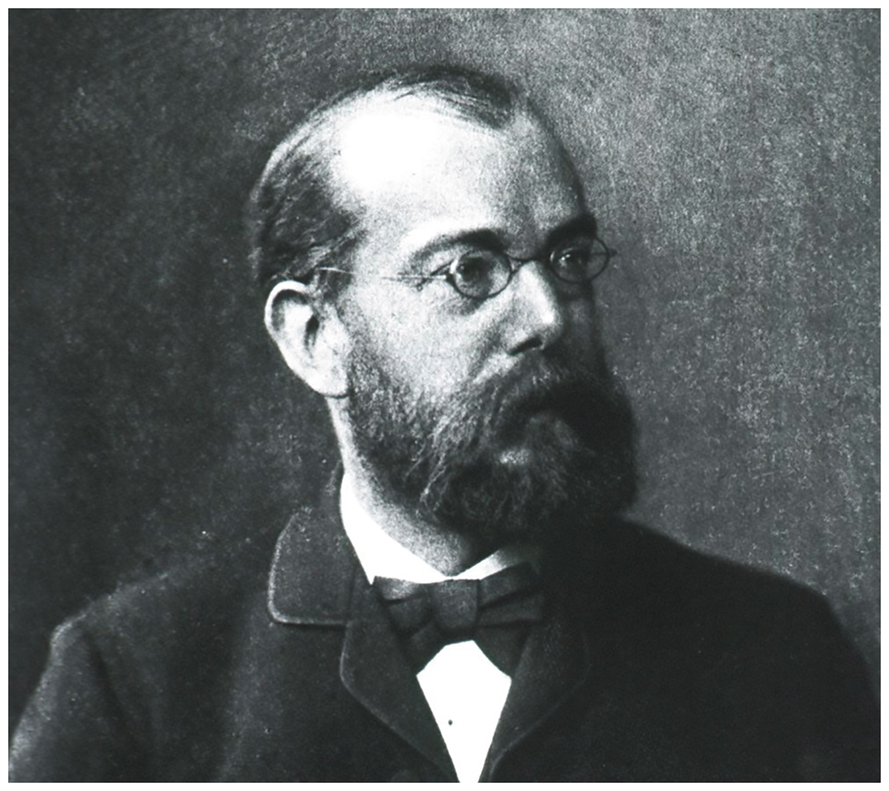
Validating Microbiology – What causes disease?
Robert Koch
Robert Koch studied causative agents of disease (etiology).
He established the first protocol for proving that a specific pathogen causes a specific disease
called Kock’s postulates
Isolated the bacterium that causes anthrax
Later, he isolated the bacterium that causes tuberculosis

Slide 24
Validating Microbiology – What causes disease?
Koch’s postulates
The same suspected causative agent must be found in every person afflicted with the disease, and must be absent from healthy hosts.
This agent must be isolated and grown outside the host.
When this agent is introduced to a healthy host, the new host must get the same disease as the original host.
The agent found in and isolated from the new diseased experimental hosts must be the same agent as that isolated from the original host.
What diseases do not obey Koch’s postulates?

Slide 25
Validating Microbiology – What causes disease?
Koch’s experiments focused on studying pathogens OUTSIDE of their diseased hosts
We rely on his developments even today!
Simple staining techniques
First photomicrograph of bacteria
First photograph of bacteria in diseased tissue
Techniques for estimating bacterial number in a solution
Use of steam to sterilize growth media
Use of Petri dishes
Laboratory techniques to transfer bacteria
Different bacteria as distinct species

Slide 26
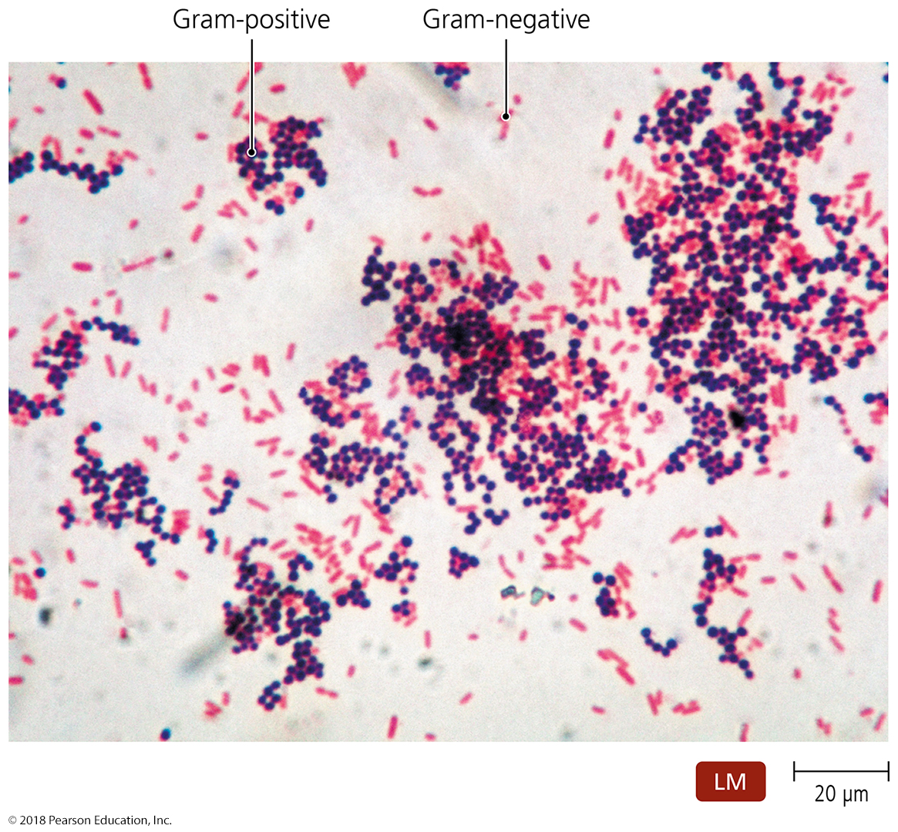
The Golden Age of Microbiology
Staining Techniques
Gram’s stain
The most widely used staining technique
One of the first steps to identify a bacterium

Slide 27
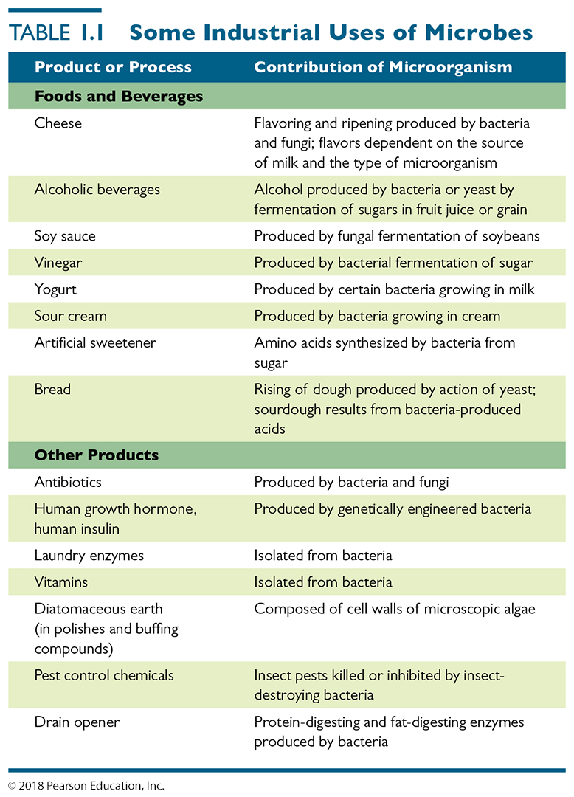
WE USE MICROBES IN REAL LIFE AND IN SOCIETY
Many of our favorite food products, some used for thousands of years, are made by microbial action (fermentation)
Many more recent products come directly from microbes
Notes:
27

Slide 28
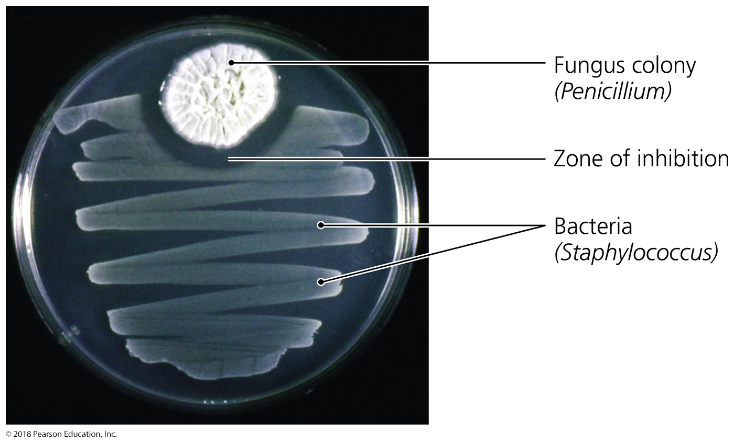
Figure 1.20 The effects of penicillin on a bacterial “lawn” in a Petri dish.
Discovery of antibiotics (Fleming, Waksman, others)
Notes:
28

Slide 29
What Role Do Microorganisms Play in the Environment?
Causation of disease to animals, plants, and even other microbes
Decomposers recycle chemicals such as carbon, nitrogen, and sulfur to nurture producers and “perpetuate” the food chain
Bioremediation uses living bacteria, fungi, and algae to detoxify polluted environments.

