Slide 1
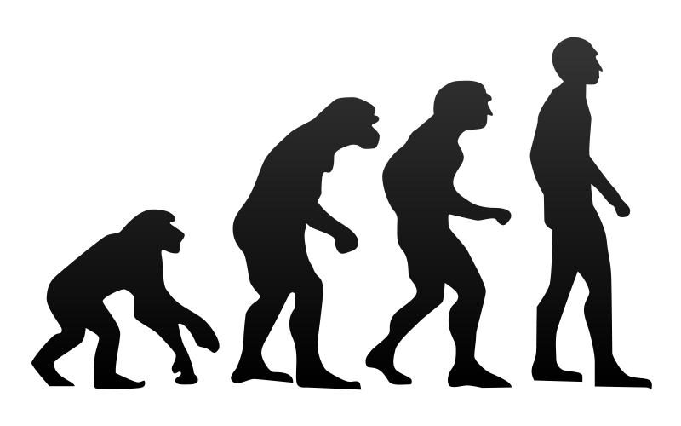
Chapter 18 Evolution
General Biology I
BSC 2010
Caption: Human Evolution (c) Tkgd2007, Public domain

Slide 2
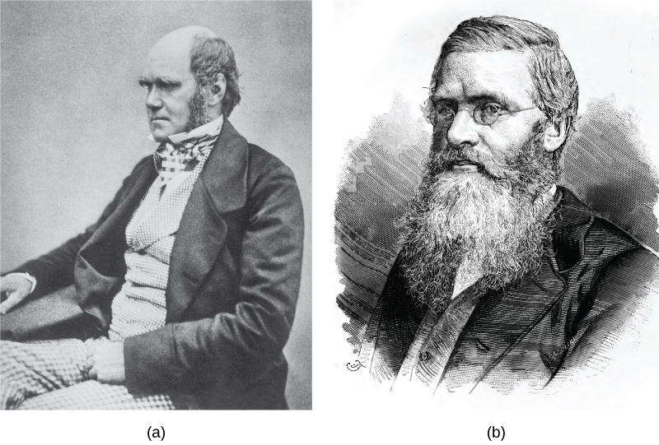
Evolution – how species change over time
Species (the makeup of a population)evolves
individuals do not evolve, and live only a short time
Evolution does not explain the origin of life, only how life changes its form over the eons
Charles Darwin and Alfred Wallace – “father” of evolution
Download for free at http://cnx.org/contents/185cbf87-c72e-48f5-b51e-f14f21b5eabd@10.61

Slide 3
What is natural selection?
4 principles that support natural selection:
More offspring are produced than are able to survive
A “testing” event removes individuals without a sufficiently robust makeup; this changes the overall appearance of the population
Parents pass traits to their offspring
Offspring vary from each other

Slide 4
Surviving natural selection
Natural selection can only take place if there is variation in a population
Genetic Mutation
Errors naturally occur during DNA synthesis and from “life”
DNA polymerase errors
Hydrolysis of nucleotides
Radiation of nucleotides
Genetic diversity
Arises by sexual reproduction
Sexual reproduction allows mixing of haploid alleles through a population
Diploid state allows good genes to remain and “experimental” variants to be “tested out”
Genetic recombination (crossover) mixes mutations among alleles to create new allelic combinations and optimize diversity

Slide 5
Genetic diversity caused by mutation can have 3 outcomes
Mutation could lead to an adaptation causing that individual to be more fit, more successful at reproduction and therefore passing that trait (i.e. sharper vision, better hearing, more ingenuity)
Mutation could lead to adaptation causing that individual to be less fit, less successful at survival and reproduction (i.e., reduced sense of smell, inability to process certain sugars)
Or, mutation could lead to a neutral adaptation – doesn’t make the individual more or less fit (in current society, ability to make freckles, baldness, left-handedness or right-handedness)
Fitness = reproductive success, continuation of the species
Animals AND humans choose “the best partner” to have the most fit children
Whether or not a new trait is favorable depends on the environment at that time
The environment is constantly changing, what is a favorable trait now may not be in the future
E.g., a higher body temperature will help one preserve water by sweating less in hot weather, but will make it harder to stay warm in cooler climate

Slide 6
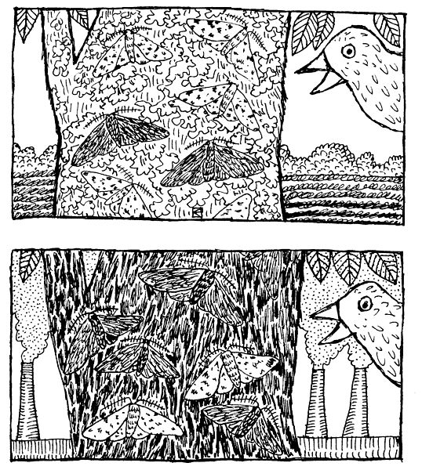
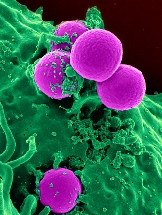
Macroevolution vs. microevolution
Sometimes we cannot see this in our lifetime (macroevolution – change of humans into bipedals from knuckle-walkers)
Sometimes we can (microevolution)
Examples: peppered moths, MRSA, round-up resistant weeds
Caption: Peppered Moths (c) Khaydock, Public domain

Slide 7
Combinatorial Advantage of Diploids
Diploids can have different alleles for a given trait
Some alleles are deficient in a function but “luckily” give a new (unexpected or unpredictable) advantage elsewhere
In some situations, heterozygotes have the best fitness (called heterozygote advantage or superdominance)
Heterozygote carriers of sickle-cell anemia have hemoglobin that aggregates just enough to make blood cells unsuitable for malaria to grow in them
Heterozygotes carriers of cystic fibrosis have enough defective chloride transporters that cholera toxin binds to the “decoy” receptors and cannot force tissues to release large amounts of water
Heterozygote carriers of Tay-Sachs disease have enough ganglioside on their plasma membranes that macrophages are more resistant to tuberculosis infection
Some carriers of X-linked color blindness may have an ability to discriminate subtle differences in oranges and reds relative to thos with normal vision

Slide 8
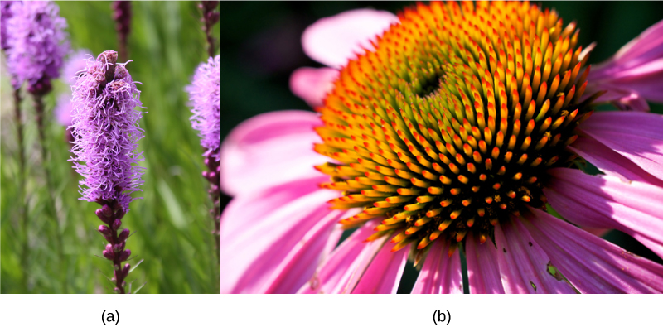
Divergent Evolution
The evolution of species has lead to enormous variation in form and function
Flower structure (fruits, grains, vegetables, ornamentals
Optimize appearance for “picky” shoppers (read: pollinators)
Download for free at http://cnx.org/contents/185cbf87-c72e-48f5-b51e-f14f21b5eabd@10.61

Slide 9
Convergent Evolution
Independently, similar phenotypes will evolve in distantly related species due to the same evolutionary pressures
Convergent evolution
Wings of a bird, of a bat, and wings of dragonfly
Eye of octopus and eye of vertebrate\
Live-bearing young in most mammals and some sharks
Analogous structures

Slide 10
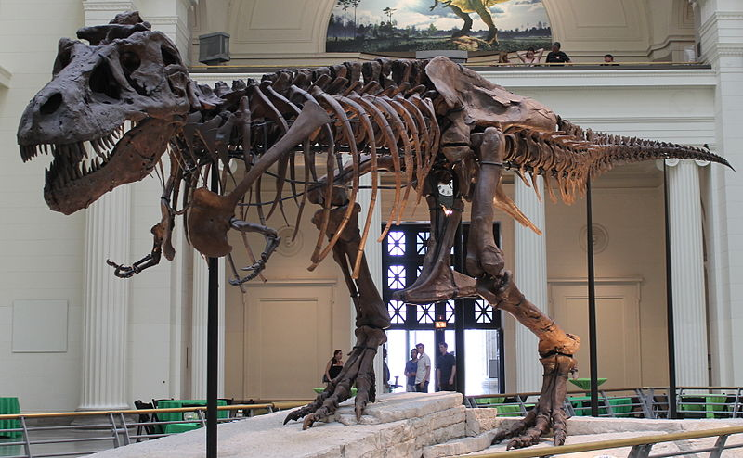
Evidence For Evolution
Fossil record – shows how species have changed over time
How are fossils aged?
measuring a variety of radioactive isotypes in nearby rocks with known half lives
Depth placement of bones – older bones are deeper as they were buried longer ago
Caption: Sues Skeleton (c) Connie Ma, Public domain

Slide 11
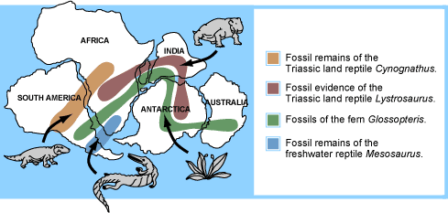
Biogeography and Evolution
As a species evolves, one can see a change in where its bones are found
Biogeography – geographical restriction of where a species is located
Biogeography in action – humans migrated multiple times “out of Africa” ( in search of more food)

Slide 12
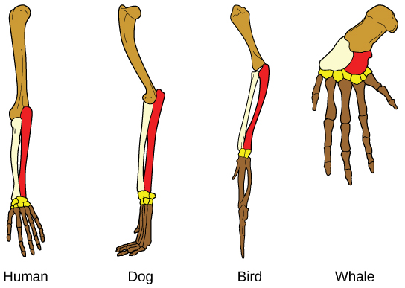
Conserved Anatomy after Diversity
Homologous structures – structures that have changed in size and function but are from common ancestor
Vestigial structures – unused structures left over from common ancestor
Ex: tails in humans, thumbs in dogs and cats, pelvis in whales
Download for free at http://cnx.org/contents/185cbf87-c72e-48f5-b51e-f14f21b5eabd@10.61

Slide 13
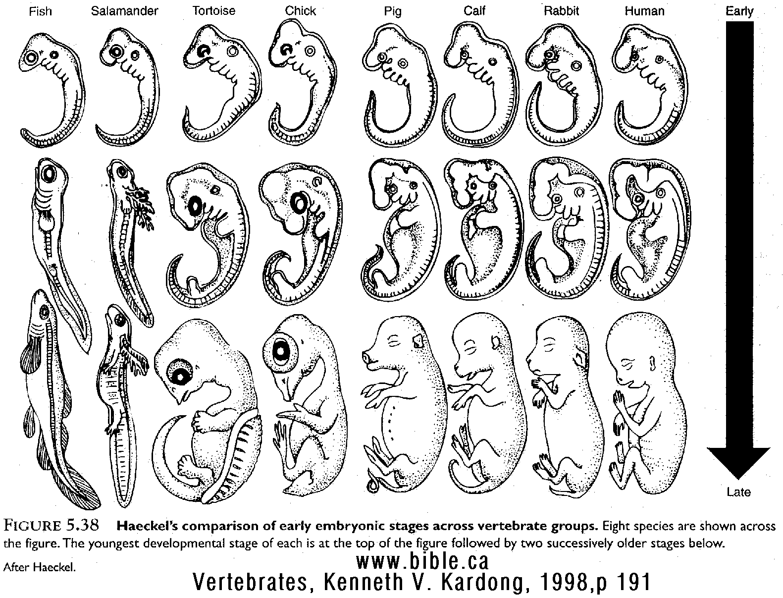
Conserved embryological development
Ontogeny – the development of an organism from conception to birth
All vertebrates develop gill slits and a tail; some lose them and some keep them
Similar species look similar for longer periods during the fetal stages
Compare:
tortoise + chick
pig + calf
rabbit + human

Slide 14
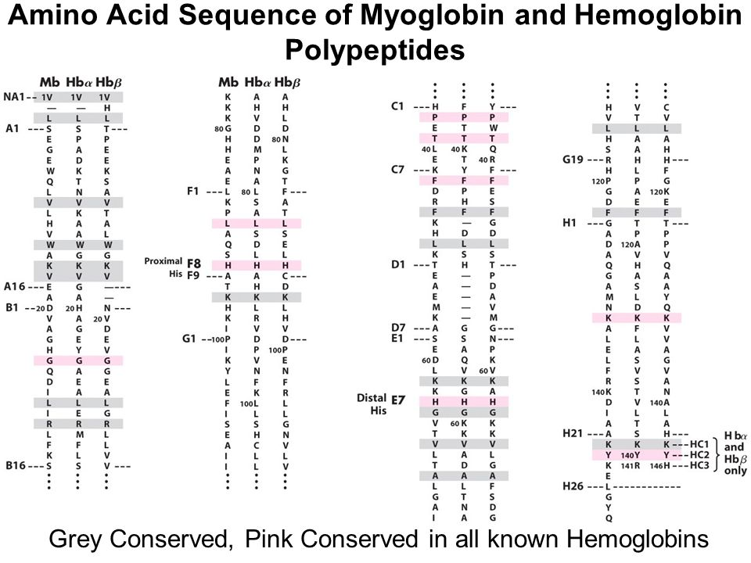
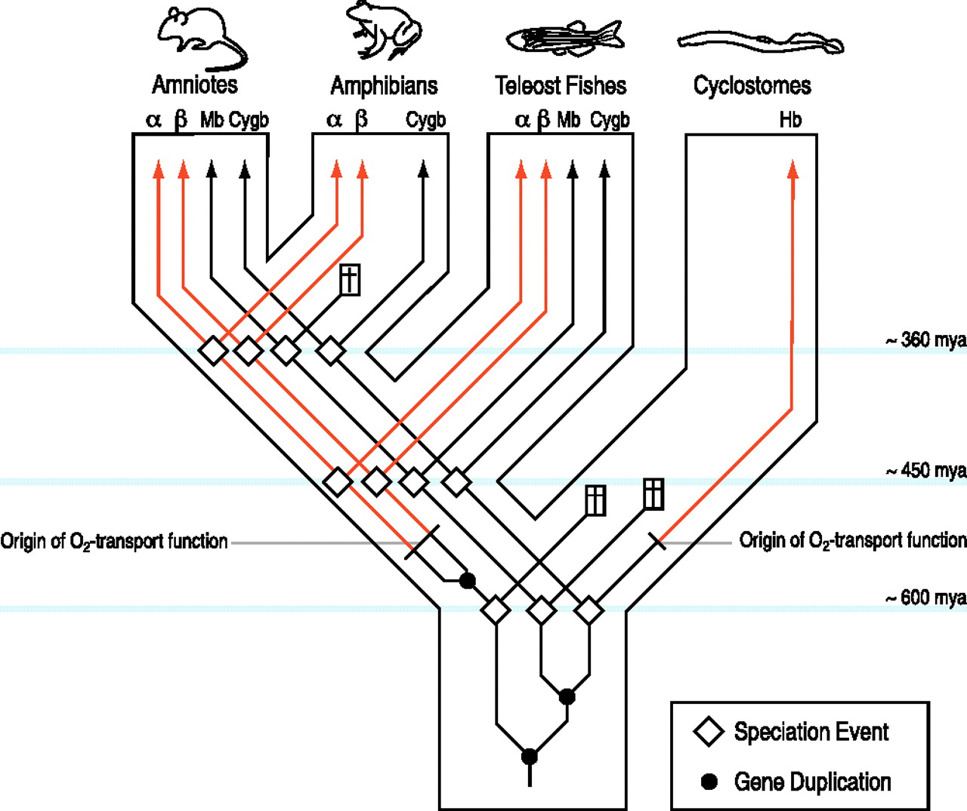
Genetics and Evolution
Molecular biology and molecular evolution
Analyze and find similarities among proteins with related functions (below, oxygen storage and transport is followed)
Patterns of similar amino acids often imply an evolutionary ancestor (iron/heme binding – cytochrome C uses heme)

Slide 15
Misconceptions of Evolution
These are wrong!:
Evolution is just a “theory”, they don’t really know
we just went through many line to show how things change over time but show their relationships to each other
Individuals evolve
We cannot change our gene sequence as we live. Mutations and variations are passed to children, and those with the right variations are allowed to survive and change further
Evolution explains the origin of life
Evolution only explains how different species from a single species. It cannot explain how that original single species came into existence
Organisms evolve with a purpose
Mutation is random and not “planned” or “engineered” to occur to specific genes. Purpose implies a plan or strategy. There is not strategy in random changes that survive. Also, one does not know what the next challenge is: why plan for a contingency that may not occur, or what if an event happens that you are not prepared for (FAR more common)

Slide 16
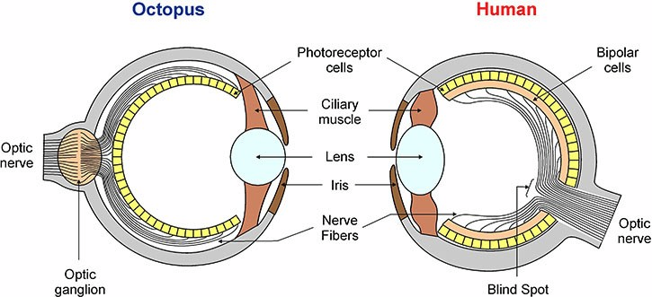
Perfection in Evolution – not possible
Evolution does not lead to perfection, it leads to what works in that environment at that time
Example – the octopus eye and the vertebrate eye look similar but are organized slightly differently. The octopus lens moves in an out, instead of being squished or pulled in vertebrates. Also, because photoreceptors are found “behind” the optic nerve in vertebrates but “in front of” the optic nerve in octopi, the blind spot in vertebrate vision is absent in octopi. Their eyes are “better”-designed!

Slide 17
How does speciation occur?
It occurs when…
When groups become isolated geographically for long period of time
Changes (mutations) in each group over time lead to the groups no longer being reproductively compatible
(chromosome translocations, sperm-egg interactions
Sometimes you can get gene flow into an area – all of a sudden something that is isolating 2 groups is removed
Flooding on lakes that separated African cichlids for millions of years can rejoin the separated populations
A second migration from Africa brought “modern” Homo sapiens in contact with European/Middle eastern Neaderthals and East Asian Denisovans

Slide 18
Artificial vs Natural Selection
We’ve been talking about natural selection
No individuals are favored to survive
e.g. we intend to kill all bacteria with antibiotics but get MDR strains
e.g. The ice age will freeze “everyone”. Only those who are “lucky” (they have cold-tolerant phenotypes) will survive
Artificial selection is when we choose who breeds
Humans have been doing this for years
Crops – bigger corn, larger apples
Domesticated animals – fatter pigs, hunting dogs
We have chosen the phenotypes we want and continually breed those individuals that have those phenotypes

