Slide 1
BIOLOGY
Chapter 15 GENES AND PROTEINS
PowerPoint Image Slideshow

Slide 2
From genes to proteins
Genes are regions of DNA that specify the sequence of amino acids to incorporate into a protein of a given function
~ genotype
Proteins are responsible for orchestrating almost every function of the cell (think about enzymes)
~ phenotype

Slide 3
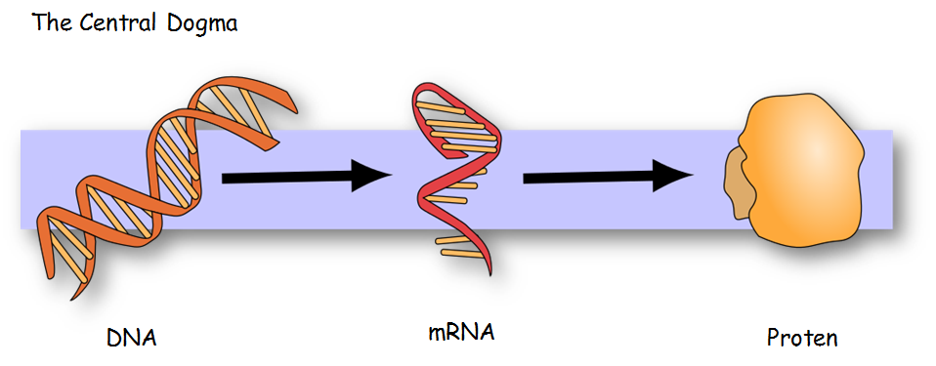
How does information flow from DNA to proteins? Through a transient copy of that region of the genome called mRNA
This information flow is called the Central Dogma of Gene expression
Caption: MolbioHeader (c) Squidonius, Public domain

Slide 4
Steps to execute the Central Dogma
Transcription (DNA → mRNA)
Translation (mRNA → Protein)
Caption: Genetic Code (c) Madprime, Public domain

Slide 5
Transcription and translation
So DNA RNA Protein
Instructions on DNA are “read” by RNA polymerase (3’ to 5’) to “write” a complimentary piece of mRNA (5’to3’).This is TRANSCRIPTION.
Ribosomes are later able to read the genetic information inscribed on a strand of messenger RNA and use this information to string amino acids together into a protein. This is TRANSLATION.
The overall process is referred to as expression of the gene. (The gene is the piece of DNA that started all of this).
Figure 15.3
Download for free at http://cnx.org/contents/185cbf87-c72e-48f5-b51e-f14f21b5eabd@10.61

Slide 6
TRANSCRIPTON IN Prokaryotes
Steps of Transcription:
Initiation
The promotor is a piece of DNA upstream that indicates where the RNA polymerase should bind and start
Activity of most promoters are always regulated by environmental variables (food, nutrients, water, etc.)
Elongation
RNA polymerase adds complimentary nucleotides (A, U, C, G) based on the template sequence (complement of the coding strand) to make the mRNA
Termination
Polymerase drops off of DNA, and RNA is released

Slide 7
Transcription
Start Site
So How does Transcription begin? (called Initiation)
The enzyme RNA Polymerase (RNA pol II in Eukaryotes) must find the promoter site for the gene. This is a piece of DNA ahead of the where the transcription of the mRNA starts.
Specifically, the σ subunit of RNA pol finds and binds a conserved sequence (the TATA box).
The σ subunit dissociates from the RNA polymerase after transcription has been initiated at the START SITE
(all of this happens In the nucleus)
Download for free at http://cnx.org/contents/185cbf87-c72e-48f5-b51e-f14f21b5eabd@10.61

Slide 8
Figure 15.8 transcription continues
During elongation, the prokaryotic RNA polymerase tracks along the DNA template, synthesizes mRNA in the 5' to 3' direction, and unwinds and rewinds the DNA as it is read.
So DNA is read 3’ to 5’ (as in replication)
And the mRNA is written 5’ to 3’
Download for free at http://cnx.org/contents/185cbf87-c72e-48f5-b51e-f14f21b5eabd@10.61

Slide 9
TEST YOUR KNOWLEDGE
If RNA polymerase reads the sequence 3’ATCTTA5’, which of the following sequences will it make?
5’GACUUA3’
5’UAGAAU3’
5’TAGAAU3’
5’CAGTTC3’
5’TUGUUG3’
Notes:
Bloom’s level: Application

Slide 10
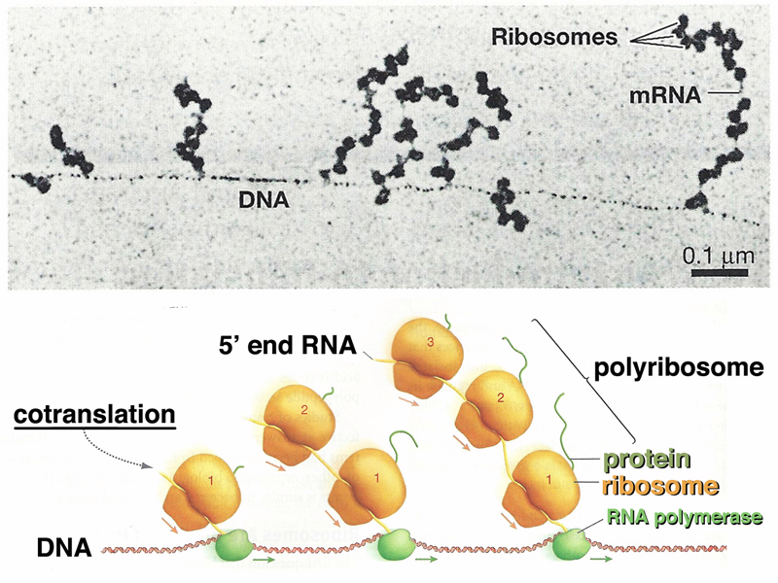
TRANSCRIPTON IN Prokaryotes
Since there is no nuclear membrane in prokaryotes, there is no separation of the transcription and translation process.
A ribosome will go ahead and grab onto the growing mRNA to start translation

Slide 11
Figure 15.9
Transcription in Prokaryotes is
IMMEDIATELY followed by
Translation.
Multiple polymerases can transcribe a single bacterial gene while numerous ribosomes concurrently translate the mRNA transcripts into polypeptides. In this way, a specific protein can rapidly reach a high concentration in the bacterial cell.
This is not how we (Eukarotes) do things.
Download for free at http://cnx.org/contents/185cbf87-c72e-48f5-b51e-f14f21b5eabd@10.61

Slide 12
PROCESSING/TRANSPORT OF TRANSCRIPTS
Eukaryotic genes are split into pieces to facilitate genomic diversity when mixing copies of genes up.
this is why the diploid nature of eukaryotes is so useful!
mRNA must leave the nucleus for proteins to be made
Prokaryotic genes are organized into functional groups, and are expressed coordinately in groups.
There is no nucleus to leave (no membrane in nucleoid) so translation can (and does) occur as the gene is being transcribed
Download for free at http://cnx.org/contents/185cbf87-c72e-48f5-b51e-f14f21b5eabd@10.61

Slide 13
TRAnsCRIPTION IN Eukaryotes
Transcription and Translation separated by nuclear membrane in eukaryotes; this slightly complicates the process
Initiation
Promotors are much more complex than prokaryotic promotors
not all regulatory regions are immediately upstream of the gene sequence)
Eukaryotes have 3 RNA polymerases (RNA Polymerase I, II, III)
Prokaryotes have only one
Transcription factors are needed
Elongation
Termination
mRNA is released, but must be modified (processed)
RNA processing usually starts during elongation
Export of ONLY PROCESSED mRNA to cytoplasm
mRNA must cross nuclear membrane for translation, which occurs only in the cytoplasm

Slide 14
Eukaryotic transcription INITIATION
In Eukaryotes, Initiation requires multiple factors binding to the promoter site. When they all arrive there, they “call in” RNA pol 2 to land at the promoter.
When all factors have arrived, the group is called the transcription initiation complex.
This makes Eukaryotic transcription a more complex and controlled process, as it should be.
What could go wrong with your body if Genes are transcribed by accident?
Figure 15.10
Download for free at http://cnx.org/contents/185cbf87-c72e-48f5-b51e-f14f21b5eabd@10.61

Slide 15
PROCESSing EUKARYOTIC messenger rna
In Eukaryotes, the newly made mRNA is not ready to leave the nucleus and be translated. It must get…
A 5’ Guanine Cap
A 3’ Poly-Adenine Tail
Proper Splicing
immature
(Introns removed)
Mature
Figure 15.11
Eukaryotic mRNA contains introns that must be spliced out. A 5' cap and 3' poly-A tail are also added. The untranslated regions control translational efficiency and lifetime of the mRNA
Download for free at http://cnx.org/contents/185cbf87-c72e-48f5-b51e-f14f21b5eabd@10.61

Slide 16
MESSENGER RNA SPLICING - Figure 15.13
Pre-mRNA splicing involves the precise removal of introns from the primary RNA transcript. The splicing process is catalyzed by protein complexes called spliceosomes that are composed of proteins and RNA molecules called snRNAs. Spliceosomes recognize sequences at the 5' and 3' end of the intron.
NOTE that the region being cut out could be of ANY length. It may even contain exons!!!! However, most RNAs when transcribed have nearly all of their exons present in the final mRNA molecule
Download for free at http://cnx.org/contents/185cbf87-c72e-48f5-b51e-f14f21b5eabd@10.61

Slide 17
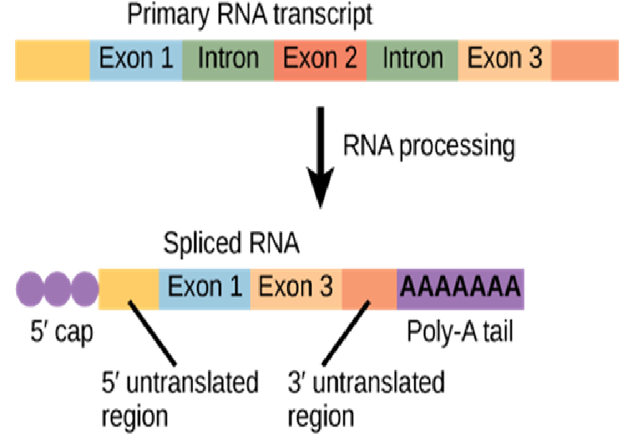
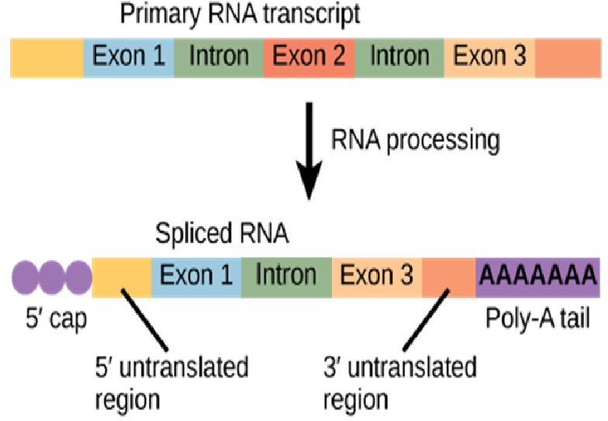
Alternative splicing
With Alternative Splicing, the standard (keep all exons and remove all introns) is disobeyed to get new and interesting mRNAs made.
You can exclude an Exon You can retain an Intron
Alternative Splicing enables eukaryotes to have one gene code for different mRNAs (thus different proteins) at different times.
In humans, it enables only ~20,000 genes to code for over 80,000 mRNAs
Very useful for Evolution. Responsible for some genetic disease as well.
Download for free at http://cnx.org/contents/185cbf87-c72e-48f5-b51e-f14f21b5eabd@10.61

Slide 18
RNA TRANSLATION and the Genetic code
The DNA sequence (and thus the RNA sequence) will determine the amino acid sequence and therefore, will determine the function of the protein
Every 3 nucleotides on the mRNA codes for an amino acid
Codon
The “matrix” that allows codons to “equate” to specific amino acids is called the genetic code
The genetic code is (nearly) universal
This means that from bacteria to us – 4 nucleotides (A, T, C, G) code for 20 amino acids
The sequence of those nucleotides in genes is what make a bacteria DIFFERENT from us
Only mitochondria and chloroplasts of certain species use a slightly modified genetic code (perhaps to “force” the mitochondria or chloroplast to remain within the cell as ransom)

Slide 19
RNA TRANSLATION
3 Steps of Translation:
Initiation
mRNA attaches to the smaller subunit of the ribosome
The mRNA is “scanned” through the 5’ untranslated region until an AUG is encountered
AUG is the start codon – a tRNA with the appropriate anticodon (which is what?) attaches
The larger subunit of the ribosome then comes in
Elongation
tRNAs move in with the appropriate amino acid, the amino acid chain grows using peptidyl transferase
Termination
Stop codon is reached
The amino acid chain then is ejected from the ribosome
In eukaryotes, the amino acid chain moves into the endoplasmic reticulum to be further processed if it is a excreted, membrane, or endosomal protein

Slide 20
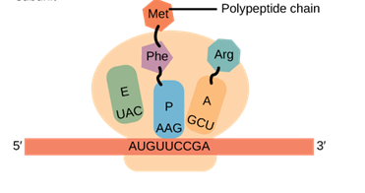
translation
The mRNA sequence determines the amino acid order.
The bases in mRNA are read by the ribosome in 3 letter chunks called Codons
For example, the codon AUG tells the ribosome the amino acid known as methionine should be put into the string of amino acids. This codon is also called the start codon because it dictates to the ribosome to start reading the mRNA there and start making a protein.
The mRNA 5’ AUGUUCCGAAUUGUUUCUUAA 3’ would be read
by a ribosome to make a protein with the sequence …
Met - Phe - Arg - Ile - Val - Ser
…and then it would stop
because it found a STOP Codon

Slide 21
translation
Transfer RNA (tRNA)
This is a space-filling model of a tRNA molecule.
tRNAs add the amino acid (phenylalanine in this case) to a growing polypeptide chain.
The anticodon AAG binds the Codon UUC on the mRNA. The amino acid phenylalanine is attached to the other end of the tRNA.
This is how phenylalalnine is incorporated into a protein when the UUC codon is encountered
Figure 15.14
Download for free at http://cnx.org/contents/185cbf87-c72e-48f5-b51e-f14f21b5eabd@10.61

Slide 22
Amino acids linked to one another
Figure 15.15
In the Ribosome a peptide bond is made to link the carboxyl end of one amino acid with the amino end of another, expelling one water molecule.
(a dehydration synthesis reaction)
Download for free at http://cnx.org/contents/185cbf87-c72e-48f5-b51e-f14f21b5eabd@10.61

Slide 23
Figure 15.16
Translation begins when an initiator tRNA anticodon recognizes a codon on mRNA. The large ribosomal subunit joins the small subunit, and a second tRNA is recruited. As the mRNA moves relative to the ribosome, the polypeptide chain is formed.
Watch this video on Eukaryotic Transcription and Translation:
https://www.youtube.com/watch?v=gG7uCskUOrA
Watch this video on Prokaryotic Transcription and Translation:
https://www.youtube.com/watch?v=1b-bRVgqof0
Watch this video on the Lac Operon that shows gene regulation: https://www.youtube.com/watch?v=oBwtxdI1zvk
Download for free at http://cnx.org/contents/185cbf87-c72e-48f5-b51e-f14f21b5eabd@10.61

Slide 24
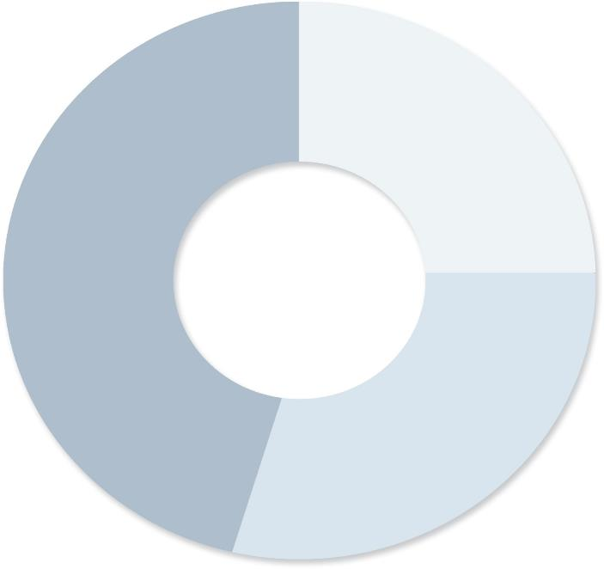
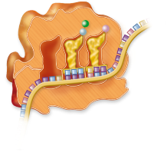
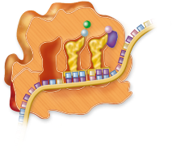
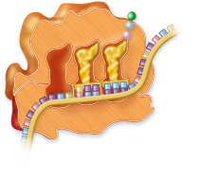
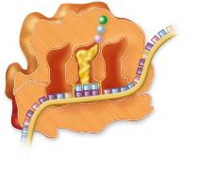
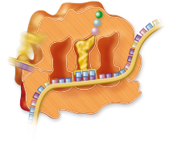
Elongation
3′
GDP
+
P_{i}
Elongation
factor
E
P
A
Elongation
factor
5′
GTP
3′
3′
2. Peptide bond formation
1. Matching tRNA anticodon with mRNA codon
E
P
A
E
P
A
5′
5′
Sectioned ribosome
3. Translocation of the ribosome
GTP
GTP
Next round
Elongation
factor
Elongation
factor
Growing
polypeptide
GDP
“Ejected” tRNA
+ P_{i}
3′
3′
E
P
A
A
E
P
5′
5′
Copyright © The McGraw-Hill Companies, Inc. Permission required for reproduction or display.

Slide 25
A PROTEIN IS MADE
Over and over again,…
tRNAs enter the A site bringing in new amino acids
tRNAs enter the P site to have their amino acids linked to those in the A site
Uncharged tRNAs enter the E site only to be kicked out of the ribosome
With time the growing polypeptide chain (the protein) is made, until a stop codon is encountered
Entry of a release factor into the A site terminates translation and the ribosome falls apart, releasing the new protein
Download for free at http://cnx.org/contents/185cbf87-c72e-48f5-b51e-f14f21b5eabd@10.61

Slide 26
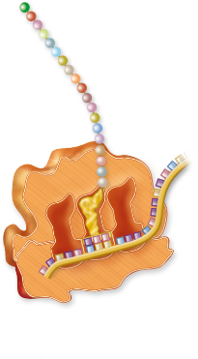
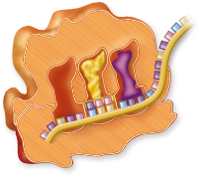
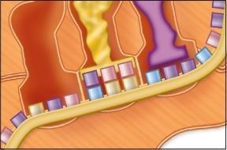
Copyright © The McGraw-Hill Companies, Inc. Permission required for reproduction or display.
Termination
Polypeptide
chain releases
Dissociation
Release
factor
3′
5′
3′
5′
Sectioned
ribosome
C
C
U
A
A
A
G
G
U
A
P
E

Slide 27
Overview for Eukaryotic Cells

Slide 29
Mutations: when things go wrong
Figure 15.5
The deletion of two nucleotides shifts the reading frame of an mRNA and changes the entire protein message, creating a nonfunctional protein or terminating protein synthesis altogether.
Download for free at http://cnx.org/contents/185cbf87-c72e-48f5-b51e-f14f21b5eabd@10.61

