Slide 1
DNA Structure, Replication
Objectives:
Illustrate the scientific experiments that demonstrated that DNA is the genetic material
Appreciate the structure of DNA and its implications
Learn about DNA replication and understand its unusual features
Larn about the major mechanism used to repair DNA mutations

Slide 2
The establishment of DNA as genetic material
It took almost 100 years to demonstrate that DNA was the genetic material.
Much of that time was spent trying to convince stubborn scientists that “boring” DNA and not “exciting” protein was responsible for storing traits.

Slide 3
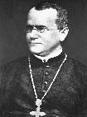
The establishment of DNA as genetic material
1866 – Gregor Mendel established the dominant/recessive model of traits and the segregation and random pairing of traits as a model of inheritance.
He had NO IDEA what actually possessed the traits that were faithfully carried from generation to generation.

Slide 4
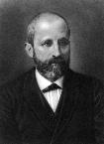
The establishment of DNA as genetic material
1869 –Friedrich Miescher isolated cellular nuclei and identified a molecule called “nuclein” that contained deoxyribose, weakly acidic phosphate, and minor levels of other biomolecules that were thought to be contaminants.
One of these “contaminants” were nucleotide bases, that were characterized soon afterward.

Slide 5
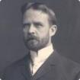
The establishment of DNA as genetic material
1910 – Thomas Hunt Morgan established that chromosomes (units observed during cellular division) carried the inherited traits by studying the fruit chromosomes of fruit flies. He also established the concepts of gene linkage and genetic crossover (recombination)
He did not know what biochemicals made up chromosomes in intact cells (they knew chromosomes outside of cells contained DNA)

Slide 6
The establishment of DNA as genetic material
1923 – agents that chemically bind to DNA (by then it was called deoxyribonucleic acid) in live cells demonstrated that DNA is found in the nucleus and is found only within chromosomes
However, there is nearly equal levels of protein in nuclei.
It was still heavily debated what biochemical carried inheritable genetic material

Slide 7
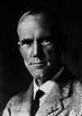
The establishment of DNA as genetic material
1927 – Frederick Griffith - after characterizing wild-type virulent S strains of streptococcus pneumonia (that kill mice) and spontaneously appearing non-virulent R strains that do not convert back to S in the laboratory (that do not kill mice), it was discovered that a combination of dead S strain debris (that also does not kill mice) and intact R strain killed mice; the bacteria isolated from the dead mice “transformed” back to the S strain!
What was that “transforming agent” in the S strain debris???

Slide 8
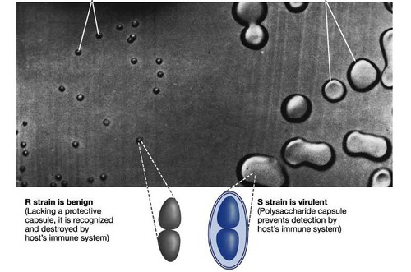
Frederick Griffith – 1928
Studied Streptococcus pneumoniae, a pathogenic bacterium causing pneumonia
2 strains of Streptococcus
  S strain is virulent
  R strain is nonvirulent
http://o.quizlet.com/i/GEJK81oHlTEYutTzmSQK6Q.jpg

Slide 9
Griffith’s Experiment
Griffith infected mice with these strains hoping to understand the difference between the strains

Slide 10



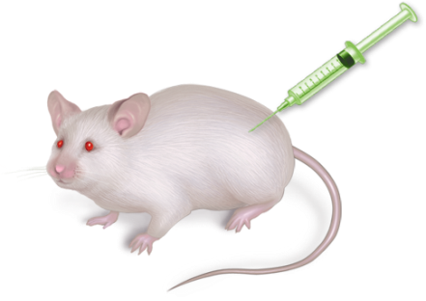
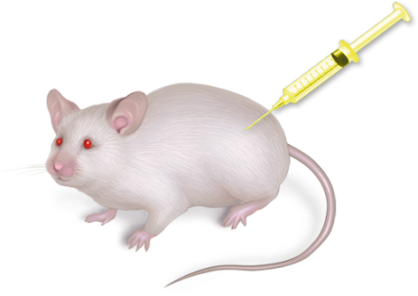
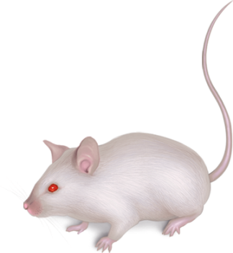
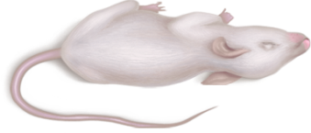
Griffith’s Experiment
Live Virulent
Strain of S. pneumoniae
Live Nonvirulent
Strain of
S. pneumoniae
Polysaccharide
coat
Mice die
Mice live
a.
b.
Copyright © The McGraw-Hill Companies, Inc. Permission required for reproduction or display.

Slide 11



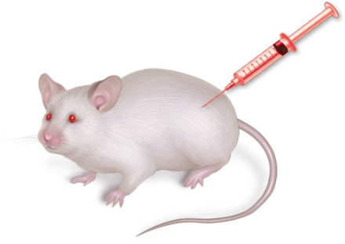
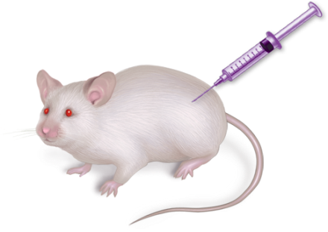
Griffith’s Experiment
Heat-killed Virulent
Strain of S. pneumoniae
Mixture of Heat-killed Virulent
and Live Nonvirulent
Strains of S. pneumoniae
+
Mice die
Mice live
Their lungs contain live
pathogenic strain of
S. pneumoniae
c.
d.
Copyright © The McGraw-Hill Companies, Inc. Permission required for reproduction or display.

Slide 12
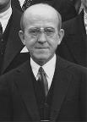

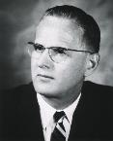
The establishment of DNA as genetic material
1944 – Oswald Avery, Colin MacLeod and Maclyn McCarty purified the substance in the S strain debris that transformed R strain back into the S strain. It was insensitive to protease, and RNAse, but sensitive to DNAse. The transformation could be done in the test tube with DNA alone and Strain R, and did not need to be mixed in an intact animal.
Some scientists still believed that minor protease-resistant contaminants in the S strain DNA were responsible for transforming the bacteria!

Slide 13
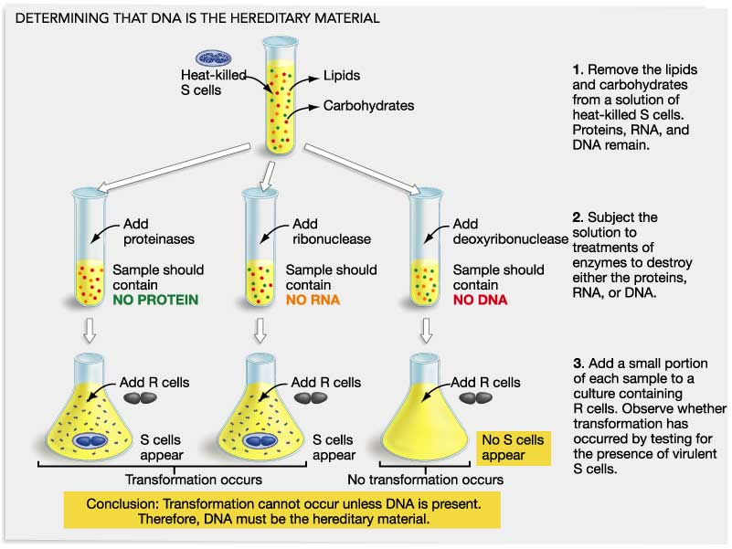
Avery, MacLeod, & McCarty – 1944
Repeated Griffith’s experiment using purified cell extracts
http://biology.kenyon.edu/courses/biol114/KH_lecture_images/How_DNA_works/FG11_02.JPG

Slide 14
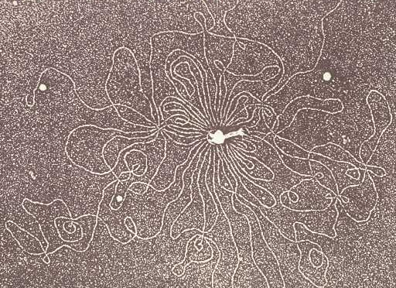
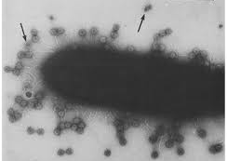
Disproving Stubborn Scientists
Let’s shift to viral infection systems, as this is where the final proof laid that only DNA passes genetic information
1939 – the electron microscope was invented
Viruses were finally visualized and thus “proven” to exist.
It was observed that phage on the bacterial surface lost some of their density when they infected cells, injecting some substance into the cells.

Slide 15
Disproving Stubborn Scientists
It was established that phosphorous is rarely observed in bacterial proteins, and that sulfur is never observed in DNA.
This, with a viral infection experiment, was the key in proving that DNA was solely responsible for storing and transmitting hereditary information
This experiment was done, finally, in 1952.

Slide 16
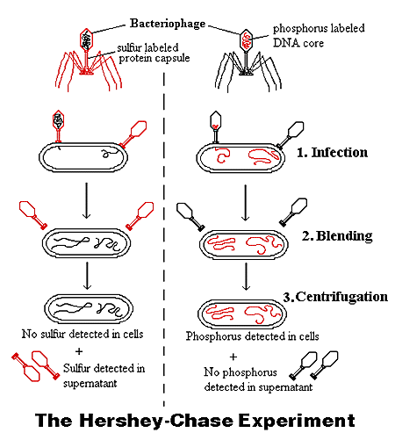
Disproving Stubborn Scientists
Phage grown in radioactive sulfur OR radioactive phosphorous were generated. The two phage groups were added to fresh bacteria. Before virus replication can occur (less than 20 minutes), the solution was blended in a blender to separate phase from the bacteria.

Slide 17
Disproving Stubborn Scientists
The mixtures were then centrifuged to separate large stuff (bacteria) from small stuff (phage).
Radioactivity was counted in the bacterial pellet and the phage - containing supernatant.
No sulfur was transferred to the cell, but all of the phosphorous was transferred.

Slide 18
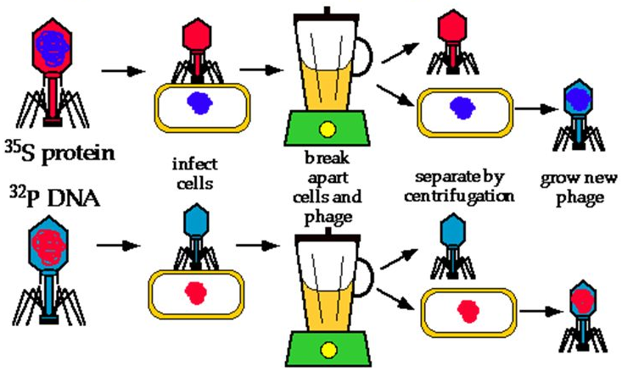
Disproving Stubborn Scientists
The bacteria containing the radioactive phosphorous (that was needed to make new phage) was then allowed to grow for another 30 minutes (so new phage would erupt from the bacteria), and radioactivity counted in the pellet and the supernatant again.

Slide 19
Disproving Stubborn Scientists
Radioactive phosphorous was found in the supernatant once more. This demonstrated that the material that was passed into the cell was repackaged into new phage.

Slide 20
The Age of DNA
Information about the chemical nature of DNA was progressively collected since the 1910s
Chargaff’s rules (1947 through 1952) the amount of G equals that amount of C in most biological systems. The amount of A also equaled the amount of T in most biological systems
Rosalind Franklin and Maurice Wilkins (1951) obtained crystallographic images of natural DNA and concluded that “DNA strands formed helical coils of 2-4 nucleotides per turn, with the phosphate groups on the outside of the coil”

Slide 21
Representation of Chargaff’s Data Table (1952)
http://en.wikipedia.org/wiki/Chargaff%27s_rules
Organism | %A | %G | %C | %T | A/T | G/C | %GC | %AT
φX174 | 24.0 | 23.3 | 21.5 | 31.2 | 0.77 | 1.08 | 44.8 | 55.2
Maize | 26.8 | 22.8 | 23.2 | 27.2 | 0.99 | 0.98 | 46.1 | 54.0
Octopus | 33.2 | 17.6 | 17.6 | 31.6 | 1.05 | 1.00 | 35.2 | 64.8
Chicken | 28.0 | 22.0 | 21.6 | 28.4 | 0.99 | 1.02 | 43.7 | 56.4
Rat | 28.6 | 21.4 | 20.5 | 28.4 | 1.01 | 1.00 | 42.9 | 57.0
Human | 29.3 | 20.7 | 20.0 | 30.0 | 0.98 | 1.04 | 40.7 | 59.3
Grasshopper | 29.3 | 20.5 | 20.7 | 29.3 | 1.00 | 0.99 | 41.2 | 58.6
Sea Urchin | 32.8 | 17.7 | 17.3 | 32.1 | 1.02 | 1.02 | 35.0 | 64.9
Wheat | 27.3 | 22.7 | 22.8 | 27.1 | 1.01 | 1.00 | 45.5 | 54.4
Yeast | 31.3 | 18.7 | 17.1 | 32.9 | 0.95 | 1.09 | 35.8 | 64.4
E. coli | 24.7 | 26.0 | 25.7 | 23.6 | 1.05 | 1.01 | 51.7 | 48.3

Slide 22
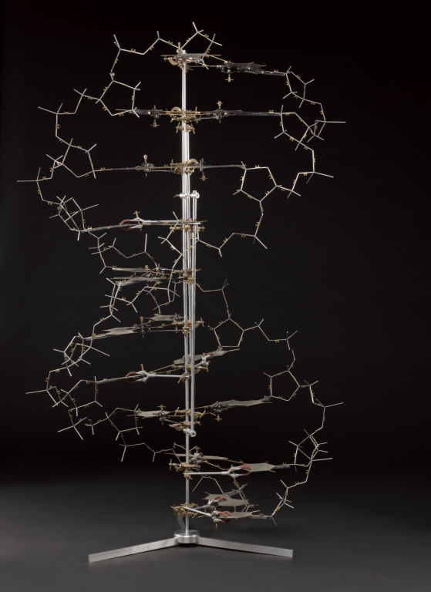
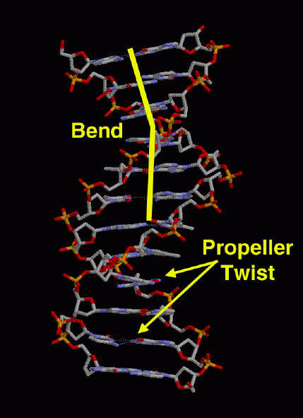
The Age of DNA
1953 - Watson and Crick assembled the data of many other scientists and created the correct structural model of DNA.
No one could synthesize DNA until the 1960s, and could not obtain an atomic structure until 1979, so a model was the best they could do).
It took scientists about 5-10 years to generally believe their model.
Model of d(CGCGAATTCGCG) established by crystallography (1980, 1981)
Model proposed by Watson and Crick

Slide 23
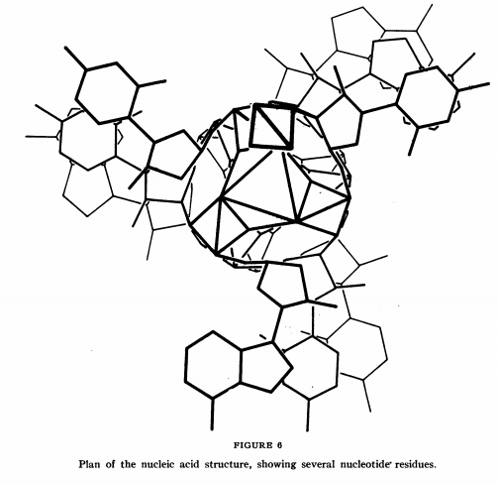
The Age of DNA
1953 - Linus Pauling (who proposed the structure of the α-helix in 1951 before it was proven with the crystal structure of myoglobin and hemoglobin in 1960) also proposed a model of DNA in 1953; his proposal led to Watson and Crick’s development of their model with data Pauling had no access to.
Unsurprisingly, Pauling’s model was ultimately proven wrong.
Model proposed by Watson and Crick
Model proposed by Linus Pauling

Slide 24

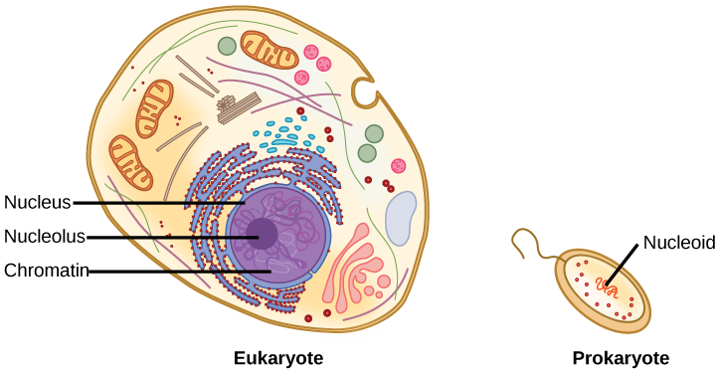
Figure 14.10
Where do organisms keep their DNA?
Download for free at http://cnx.org/contents/185cbf87-c72e-48f5-b51e-f14f21b5eabd@10.61
A eukaryote contains a well-defined nucleus and big linear chromosomes.
BUT in prokaryotes, the chromosome is relatively small, circular and lies in the cytoplasm in an area called the nucleoid.

Slide 25
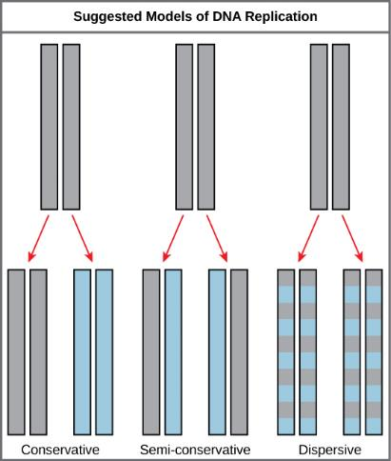
Figure 14.12
So, how does DNA copy itself?
The experiment to test this “proved” Watson and Crick’s model, and disproved other DNA structural models
Whena cell divides to make copies of itself (like when a cut heals), the DNA must copy itself.
The three models of how DNA replication could work were initially proposed:
In this figure, GREY indicates the exact original DNA strands from the original “parent” cell, while BLUE indicates newly made DNA
Download for free at http://cnx.org/contents/185cbf87-c72e-48f5-b51e-f14f21b5eabd@10.61

Slide 26
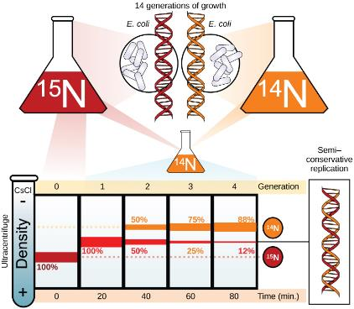
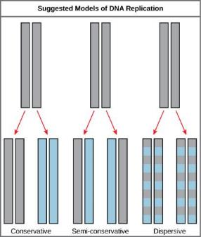
Figure 14.13
Meselson and Stahl demonstrated with an (heavier) isotope of nitrogen that cells made by cell division carry 50% of the exact original (heavier) DNA from their parent cell and 50% new (lighter) DNA copied from the original DNA.
Download for free at http://cnx.org/contents/185cbf87-c72e-48f5-b51e-f14f21b5eabd@10.61
Thus, the semi-conservative model was shown to be correct.
Meselson and Stahl experimented with E. coli grown first in heavy nitrogen (¹⁵N) then in ¹⁴N. DNA grown in ¹⁵N (red band) is heavier than DNA grown in ¹⁴N (orange band), and sediments to a lower level in cesium chloride solution in an ultracentrifuge. When DNA grown in ¹⁵N is switched to media containing ¹⁴N, after one round of cell division the DNA sediments halfway between the ¹⁵N and ¹⁴N levels, indicating that it now contains fifty percent ¹⁴N. In subsequent cell divisions, an increasing amount of DNA contains ¹⁴N only. This data supports the semi-conservative replication model. (credit: modification of work by Mariana Ruiz Villareal)

Slide 27
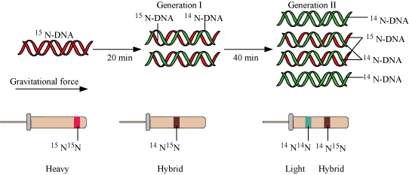
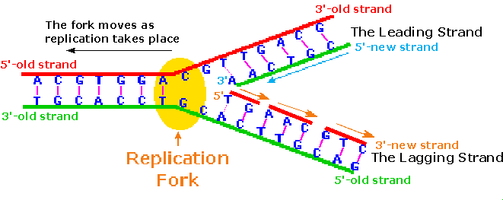
DNA Replication
Because the sequence of the reference strand guarantees the sequence of the complement strand, duplication of both strands of DNA results in two identical molecules that are identical to the original strand (replication errors notwithstanding)
Each template strand is separated to make a new complementary strand. Thus, of the two new DNA double-helices, one strand is older than the other strand – this is called semiconservative replication, and was proven by using ‘heavy nitrogen” to build the first strand, and “light” nitrogen to build the other strands.

Slide 28
Composition of Nucleic Acids
DNA is a linear polymer. Each monomer of the polymer is called a nucleotide. Each nucleotide is composed of a nucleotide base, a ribose (sugar), and phosphate groups.
adenine
5’
(deoxy)adenosine triphosphate
Tri-phosphate
4’
1’
3’
2’
(deoxy)ribose

Slide 29
RNA vs. DNA (cellular)
Only DNA stores information
DNA molecules are usually much longer than RNA molecules
RNA is far more unstable chemically in cells
RNA incorporates U instead of T into its sequences
DNA is almost always double-stranded; RNA is almost always single stranded
RNA is made with ribose; DNA with deoxyribose

Slide 30
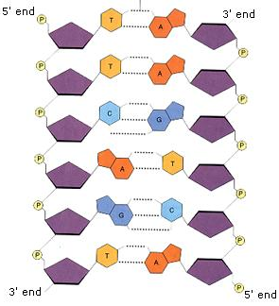
The DNA Double Helix
DNA is a polarized polymer. Most activities progress from 5’ to 3’
The two polarized helices wind around each other in an antiparallel orientation to form the double helix
Interaction is through the nucleotide bases and their complementarity
5’ end
3’ end
new nucleotides
added only here

Slide 31
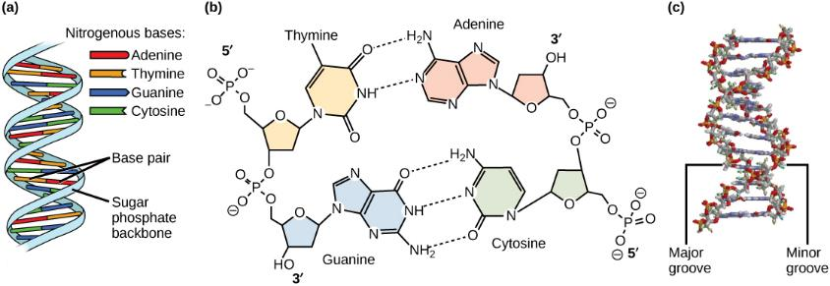
Figure 14.7
The bases of one strand bind to the bases of another (in DNA)
A H-bonds to T (in DNA) or to U (in RNA). C H-bonds just to G.
The 5’C of one sugar attaches to the 3’C of the next sugar by a phosphate (phosphodiester bond). This establishes the sugar phosphate backbone of a single strand of DNA.
Hydrogen bonds link one DNA strand to another via their bases.
Notice: the strands have opposite (antiparallel) direction. 5’ to 3’ vs 3’ to 5’
Download for free at http://cnx.org/contents/185cbf87-c72e-48f5-b51e-f14f21b5eabd@10.61

Slide 32
Base pairings as locks and keys
The lock and key works only when:
ALL partial positive and partial negative charges match up as the nucleotide bases approach each other
The same distance is obtained between the two sugars (R groups) on either side of the base pair for all base pairs in the helix
δ−
δ+
δ−
δ−
δ+
δ−

Slide 33
Why A pairs with only T in DNA

Slide 34
Why T pairs with only A in DNA

Slide 35
Why G pairs with only C in DNA

Slide 36
Why C pairs with only G in DNA

Slide 37
Complementarity test
If a strand of DNA had the sequence 5’- AGTCCA- 3’, which of the following would be the complementary DNA strand?
    3’- CATGGT- 5’
    3’- TCAGGT- 5’
    3’- TCAAAU- 5’
    3’- AGTCCA- 5’
    3’- GGTTCA- 5’
Notes:
Bloom’s level: Application,

Slide 38
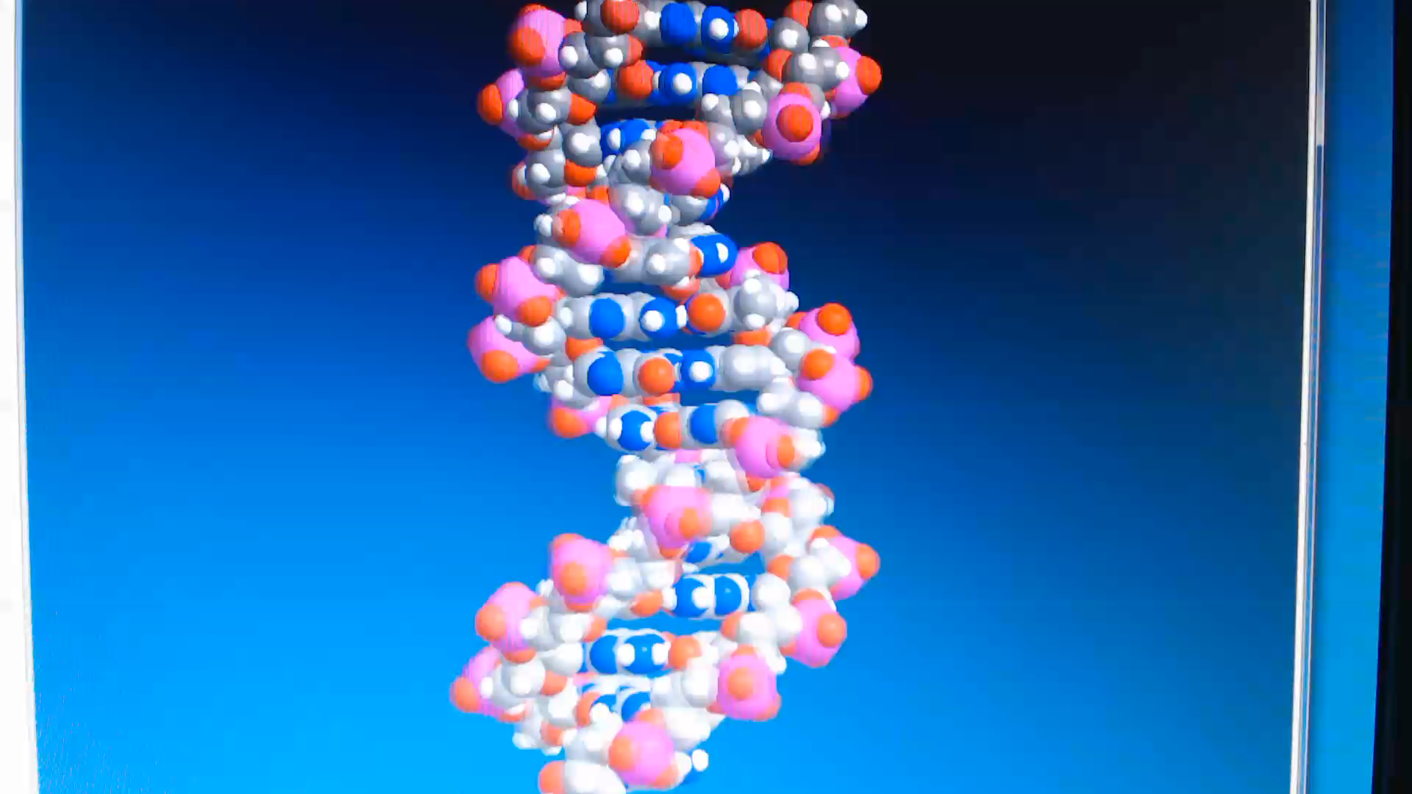
Multimedia time!
Watch this video about the structure of DNA
Understand template strand (the one we are using) vs. complementary strand (the other strand)
Guess who the speaker in the video is?

Slide 39
What use is dna anyway?
DNA can be used to copy itself
So cells can make copies of themselves &
So organisms can pass on some of their DNA to offspring
The complementarity of strands allows one strand to be used to make another
DNA copying is called DNA Replication
But what use is just copying a plan if you don’t use it? None!
So how is DNA used?....
DNA is used to make messenger RNA (transcription)
Messenger RNA is used by Ribosomes to construct Protein (translation)
YOU ARE CONSTRUCTED FROM PROTEIN, SO THIS IS HOW YOU AND
ALL ORGANISMS ARE MADE (We’ll discuss how this happens next chapter)
The central dogma: dna RNA Protein

Slide 40
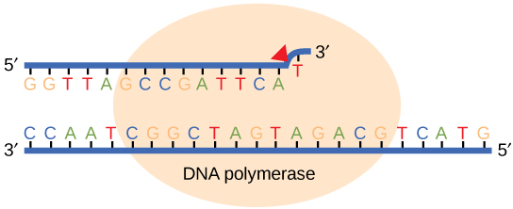
The Fussy DNA Polymerase
Like all enzymes, there is a very discriminating substrate preference, and a very strict chemistry that it will do. DNA polymerase is no different. It will recognize ONLY a free 3’ OH group on DNA whose template strand is separated from its original complementary strand. DNA polymerase will only add dATP, dCTP, dGTP or dTTP to that 3’ OH group. Therefore, by extending the 3’ of DNA, all DNA polymerases MUST synthesize DNA from the 5’ to the 3’ direction.

Slide 41
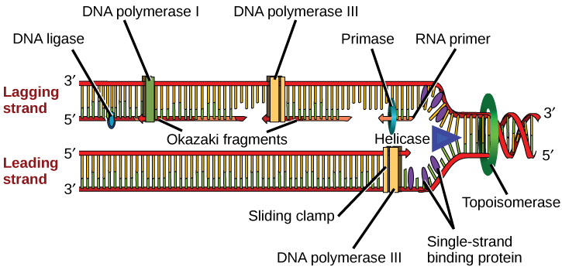
Figure 14.14
Download for free at http://cnx.org/contents/185cbf87-c72e-48f5-b51e-f14f21b5eabd@10.61
These are the PROKARYOTIC enzymes of DNA replication
A replication fork is formed when helicase separates the DNA strands at the origin of replication.
Primase synthesizes an RNA primer. So a bit of RNA must be made in order to copy DNA!!
DNA polymerase III uses this primer to synthesize complimentary “new” DNA strands to the original “template” strands.
On the leading strand, DNA is synthesized easily and continuously, whereas on the lagging strand, DNA is synthesized in short stretches called Okazaki fragments.
DNA polymerase I replaces the RNA primer with DNA.
DNA ligase seals the gaps between the Okazaki fragments, joining the fragments into a single DNA molecule.
(credit: modification of work by Mariana Ruiz Villareal)

Slide 42
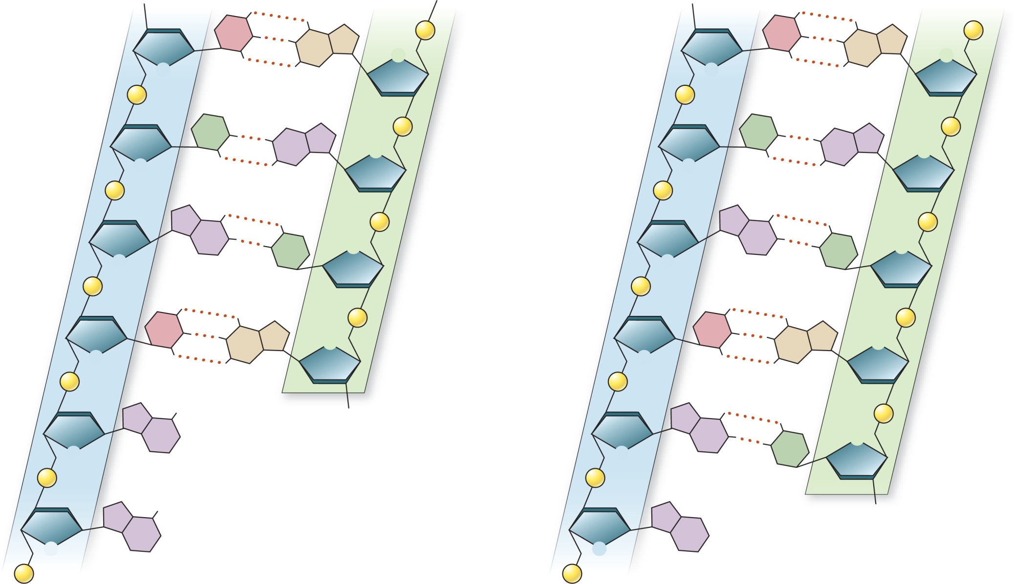



Copyright © The McGraw-Hill Companies, Inc. Permission required for reproduction or display.
Template Strand
New Strand
Template Strand
New Strand
HO
3′
5′
HO
3′
5′
C
G
P
C
P
O
G
O
Sugar–
phosphate
backbone
O
O
P
P
T
P
T
P
A
O
A
O
O
O
P
P
A
P
A
P
T
O
DNA polymerase III
T
O
O
O
P
P
C
P
C
P
O
G
O
G
O
O
P
P
3′
OH
P
P
P
A
A
T
O
Pyrophosphate
O
T
P
P
P
O
P
O
P
3′
OH
A
A
O
O
P
OH
P
5′
5′

Slide 43
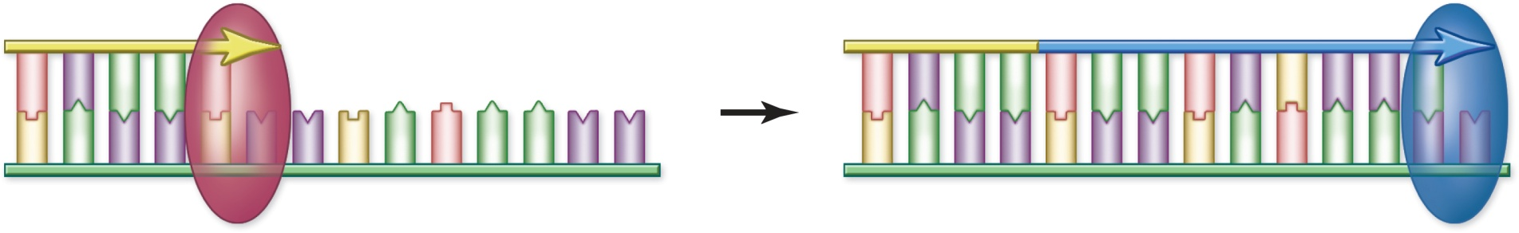
Copyright © The McGraw-Hill Companies, Inc. Permission required for reproduction or display.
5 
5 
3 
3 
5 
3 
5 
RNA polymerase makes primer
DNA polymerase extends primer
DNA polymerase
  Matches existing DNA bases with complementary nucleotides and links them
  All have several common features
    Add new bases to 3′ end of existing strands
    Synthesize in 5′-to-3′ direction
    Requires a primer of RNA

Slide 44
Complementarity of bases makes it happen
Old Strands (template strands)
are used to make complementary New Strands.
The Replication process relies upon available 3’ ends for Primase to grab onto and for DNA pol III to begin building new strands.
The LEADING strand has a 3’ end easily available for Primase to grab and start by making an RNA primer. DNA pol III then completes the new strand.
(DNA pol III does most of the work of building new strands)
BUT the LAGGING does not have a free and available 3’ end at first, so the strands must be separated to open the replication fork further to make one available. Then Primase can get start the process working “backwards” from the replication fork.
Download for free at http://cnx.org/contents/185cbf87-c72e-48f5-b51e-f14f21b5eabd@10.61

Slide 45
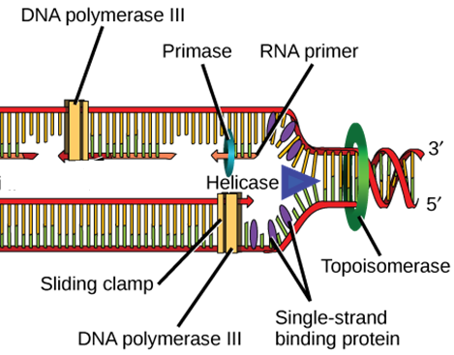
DNA replication
Topoisomerase/DNA Gyrase helps avoid Supercoiling ahead of the Replication fork
Single Stranded Binding
Proteins (SSBs) keep the
Two single strands from
rebinding to each other
Download for free at http://cnx.org/contents/185cbf87-c72e-48f5-b51e-f14f21b5eabd@10.61

Slide 46

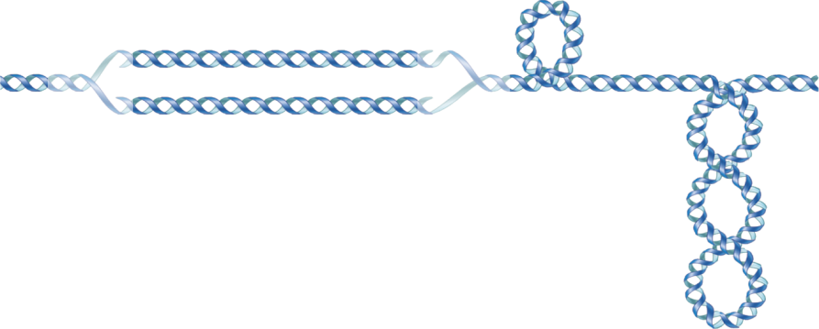



Copyright © The McGraw-Hill Companies, Inc. Permission required for reproduction or display.
Supercoiling
Replisomes
No Supercoiling
Replisomes
DNA gyrase
Unwinding DNA causes torsional strain
  Helicases – use energy from ATP to unwind DNA
  Single-strand-binding proteins (SSBs) coat strands to keep them apart
  Topoisomerase prevent supercoiling
    DNA gyrase is used in replication

Slide 47
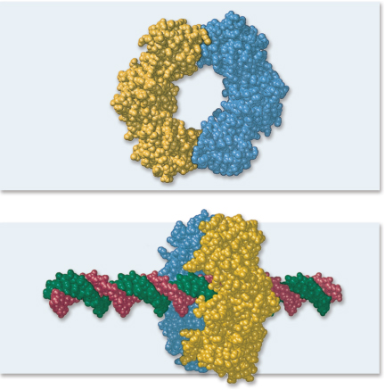
Leading-strand synthesis
  Single priming event
  Strand extended by DNA pol III
    Processivity – β subunit forms “sliding clamp” to keep it attached
Copyright © The McGraw-Hill Companies, Inc. Permission required for reproduction or display.
a.
b.
a-b: From Biochemistry by Stryer. © 1975, 1981, 1988, 1995 by Lupert Stryer. Used with permission of W.H. Freeman and Company

Slide 48
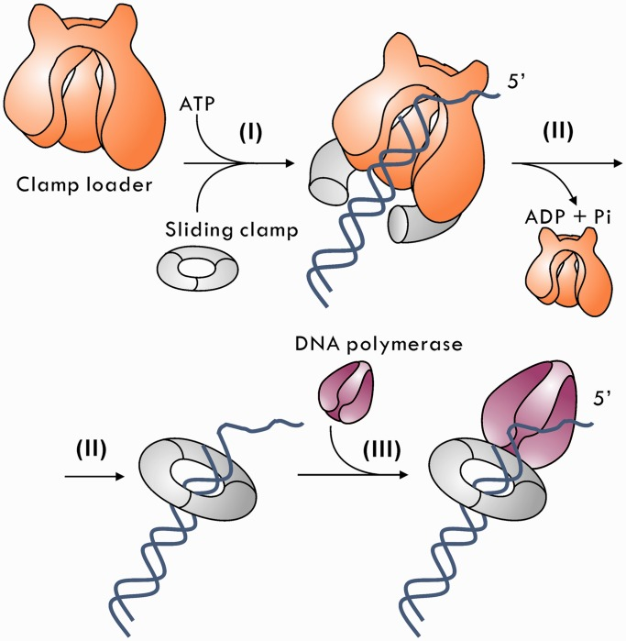
Keeping the DNA Polymerase Focused on its Goal
Here, the eukaryotic system is discussed
Each polymerase is involved in the synthesis of up to 25,000 nucleotides on the leading strand, and only 200 on the lagging strand. However, in vitro polymerases fall off of DNA before these limits are reached. DNA Polymerase α – starts DNA replication (recognizes the RNA primer 3’ OH), falls off very quickly (about 20 nucleotides), no proofreading ability
DNA Polymerase δ – used for synthesizing Okazaki fragments (high turnover at replication fork); needs a DNA clamp (PCNA) and a clamp loader (RF-C) to remain bound to DNA; proofreading activity
DNA Polymerase ε – used for synthesizing leading strand; needs PCNA and RF-C to remain bound to DNA; proofreading activity

Slide 49
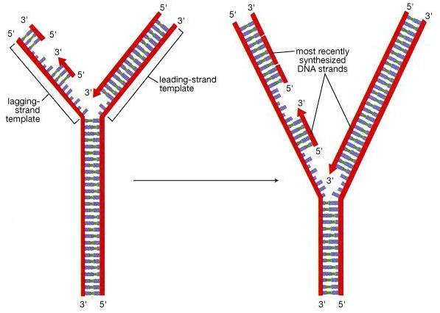
Fussy Polymerases and Anti-parallel DNA strands
How does DNA replication occur on both strands of an anti-parallel double-helix if both enzymes must go in opposite directions?
As DNA is unzipped, one strand can be made continuously (the leading strand), and the other strand (the lagging strand) must be made in pieces (Okazaki fragments), as ssDNA regions open up
A new Okazaki fragment is made every 100-200 nt in eukaryotes (every 1000-2000 nt in prokaryotes)

Slide 50
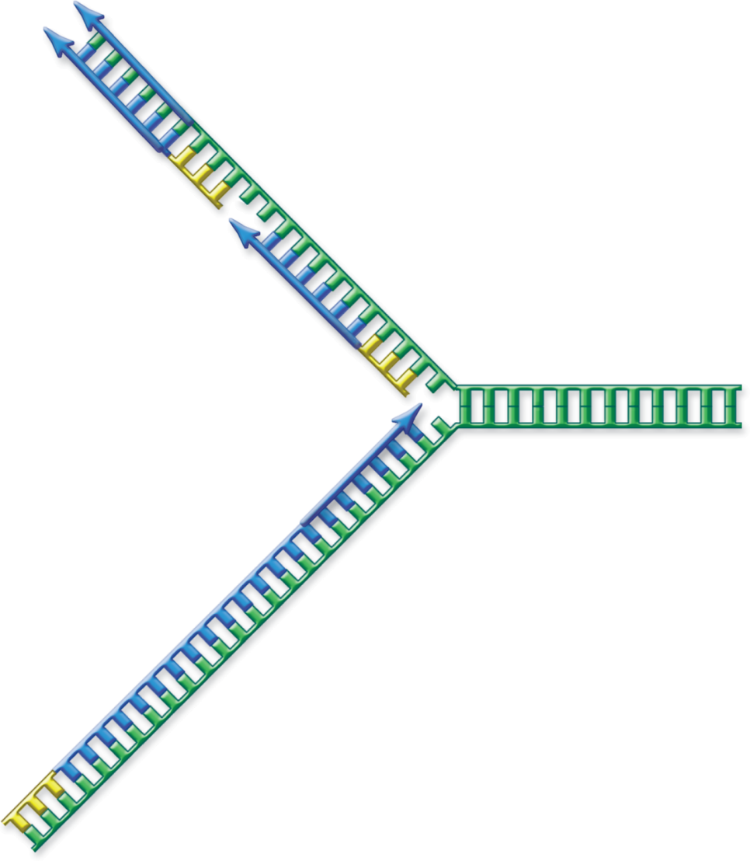
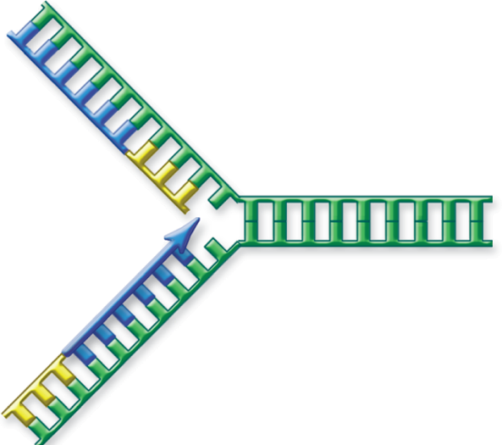

Copyright © The McGraw-Hill Companies, Inc. Permission required for reproduction or display.
5′
3′
First RNA
primer
Lagging strand
(discontinuous)
5′
3′
Open helix and
replicate further
Open helix
and replicate
Second RNA primer
5′
3′
3′
3′
5′
5′
RNA primer
5′
3′
Leading strand
(continuous)
RNA primer
5′
3′

Slide 51
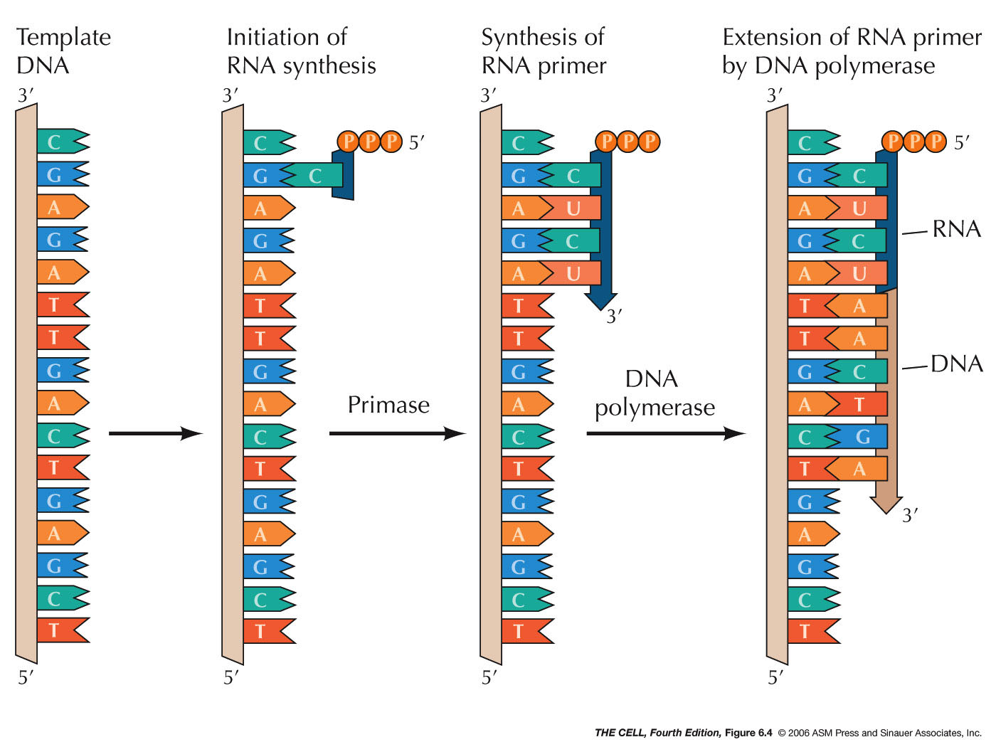
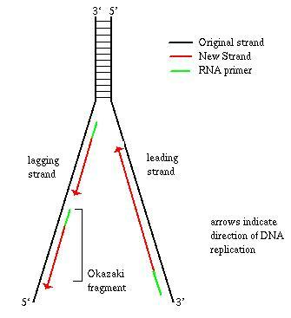
Beginning DNA polymerization
DNA polymerase MUST have a 3’ OH group to begin synthesis.
Freshly opened up DNA has no complement strand, so a short strand (4-10 nt) is made out of RNA by an enzyme called primase. Primase is related to RNA Polymerase.

Slide 52
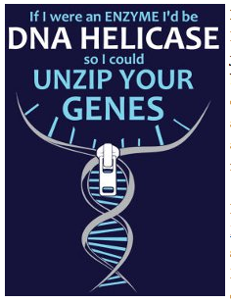
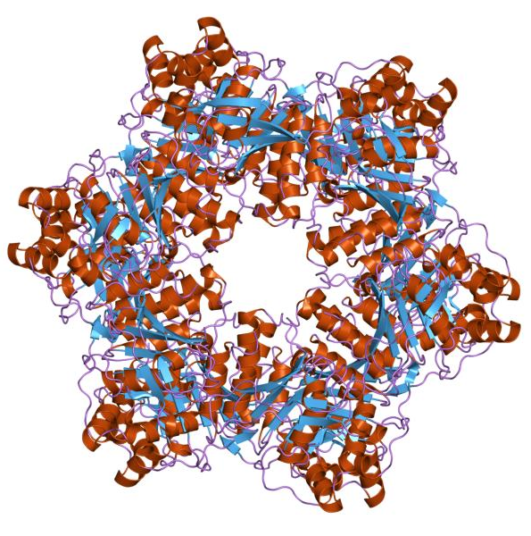
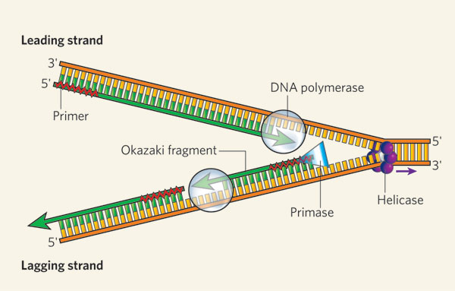
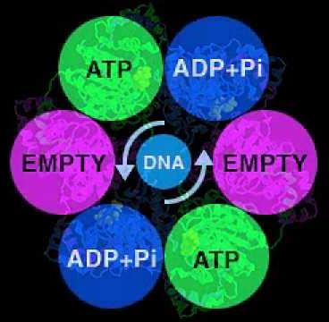
Unwinding DNA for duplication
ATP is expended to break the hydrogen bonding network between the nucleotide base pairs. This enzyme is called a helicase

Slide 53
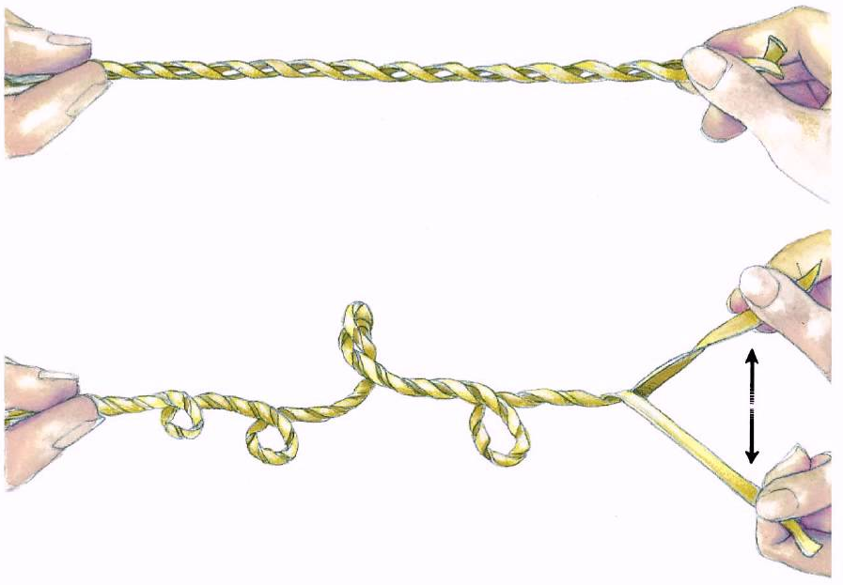
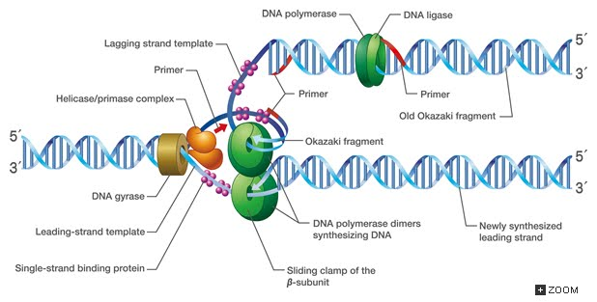
Untangling DNA
Dehybridizing DNA in cells causes supercoiling of upstream DNA because the DNA itself is helical. Gyrase (Topoisomerase II) sits upstream of the helicase and relieves the supercoiling by nicking one strand to allow the DNA to “relieve stress”. It then fixes the nick before moving forward to allow the helicase to open up the two strands.

Slide 54
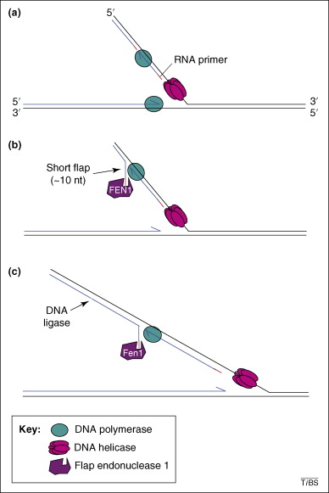
Tying up Loose Ends
The RNA primers need to be removed and the Okazaki fragments need to be assembled into one long strand of DNA to finish DNA synthesis and have stable DNA.
DNA polymerase “bumps out” the downstream RNA primer
This leaves a “flap” of RNA primer.
A flap endonuclease removes this flap.
The clamp stops at the nick; the stalled polymerase falls off
Finally, DNA ligase stitches the two DNA fragments together.
Trinucleotide repeats can inhibit this process and lead to trinucleotide polymorphisms in DNA (Fragile X Syndrome, Huntington’s Chorea, Friedreich’s ataxia)

Slide 55

Putting it all together: the replisome
Open the double helix (helicase)
DNA is unwound (topoisomerase; gyrase) to relieve upstream tensions
An RNA primer (short complementary sequence) is made on each single helix to start making a new helix (primase)
DNA is created in the 5’-3’ direction (polymerase III). A clamp loader loads a clamp that keeps DNA polymerases on DNA.
RNA primers are destroyed, and DNA pieces from the same helix are stitched together (ligase)
See a (mostly) integrative video here (I am not speaking!):
http://www.youtube.com/watch?v=yqESR7E4b_8 (start at 1:42)

Slide 56

Replication fork
Copyright © The McGraw-Hill Companies, Inc. Permission required for reproduction or display.
New bases
β clamp (sliding clamp)
Leading strand
Single-strand binding
3 
proteins (SSB)
5 
Clamp loader
DNA gyrase
Open β clamp
5 
3 
Parent
DNA
Helicase
DNA
Lagging strand
Primase
polymerase III
Okazaki fragment
New bases
3 
DNA
5 
polymerase I
DNA ligase
RNA primer

Slide 57

Prokaryotic DNA replication
Remember that prokaryotes have 1 circular chromosome
Have 1 origin of replication

Slide 58






Copyright © The McGraw-Hill Companies, Inc. Permission required for reproduction or display.
Replisome
Origin
Termination
Termination
Replisome
Origin
Termination
Termination
Termination
Origin
Origin
Origin

Slide 59


Copyright © The McGraw-Hill Companies, Inc. Permission required for reproduction or display.
Replication first round
5´
3´
The problem with replicating linear DNA: how does one copy the 5’ ends????
3´
5´
Leading strand (no problem)
Lagging strand (problem at the end)
5´
3´
3´
5´
Last primer
Origin
3´
Primer removal
Leading
strand
5´
5´
Lagging
strand
3´
Removed primer
cannot be replaced
Replication second round
5´
3´
3´
5´
5´
3´
3´
5´
Shortened template

Slide 60

Figure 14.15
The ends of linear Eukaryotic chromosomes are maintained by the action of the telomerase enzyme.
Without telomerase, the ends of DNA are shortened with each duplication, and eventually genes will “fall off the deep end”

Slide 61
The DNA needs to be proofread after replication, mistakes can be made.
Mismatch repair – wrong nucleotide is replaced
Excision repair - excise a fragment of DNA to be repaired
If the DNA is too damaged, the process might be aborted and the cell might undergo apoptosis. If not, the mistake leads to a mutation.
Mutations don’t only occur during replication. Sometimes spontaneous mutations can arise.
Point mutations – silent, missense, nonsense
Frameshift mutations – insertions or deletions

Slide 62


Slide 63

Figure 14.19
Nucleotide excision repairs thymine dimers. When exposed to UV, thymines lying adjacent to each other can form thymine dimers. In normal cells, they are excised and replaced.
Download for free at http://cnx.org/contents/185cbf87-c72e-48f5-b51e-f14f21b5eabd@10.61

Slide 64

How do mutations alter gene function?
Most genes code for proteins with specific biochemical functions; those functions are dependant on the interaction between up to thousands of amino acids, many at-a-time with each other
Because of the genetic code, a change in a nucleotide can change the amino acid inserted into a given protein (The ribosome just reads what is on the “teleprompter”)

Slide 65

Repair of altered DNA – Base Excision repair
DNA helical structure changes with:
    Mismatched nucleotides
    Crosslinked nucleotides
    Intercalated polyaromatic hydrocarbons
    Missing nucleotide bases
The cell does not care how the DNA was damaged; it only cares to make a normal double helix again
While repairing the DNA double-helix, DNA synthesis or RNA transcription is prevented from occurring in this region of DNA
Repair involves removing “bad” bases (base excision repair). If a single nucleotide or abasic sugar can be removed, it is removed, and a proper nucleotide added in by DNA polymerase β (a special subtype used for DNA repair) and nicks are sealed with DNA ligase.

Slide 66

Repair of altered DNA – Nucleotide Excision Repair
DNA helical structure changes with:
    Mismatched nucleotides
    Crosslinked nucleotides
    Intercalated polyaromatic hydrocarbons
    Missing nucleotide bases
The cell does not care how the DNA was damaged; it only cares to make a normal double helix again
This repair pathway can be used even if only a single nucleotide is damaged, as it is more “readily available” - RNA polymerase can find it while transcribing DNA or “scanning complexes” can find the damage in silent DNA
Especially if more than one base pair is damaged (pyrimidine dimers), then removal of several nucleotides becomes necessary.
The proper nucleotides are added in by DNA polymerase δ, RF-C, and PCNA, and nicks are sealed with DNA ligase.

Slide 67

(Sanger) Sequencing reaction
DNA polymerase allowed to start on a template sequence (to be read) with a primer (to start the sequencing reaction) and dNTPs to make long DNA
Small amount of fluorescently labeled ddNTPs (2’ and 3’ H group) added to end sequencing (why?) randomly throughout template
DNA is resolved by polyacrylamide gel electrophoresis to separate each terminated DNA strand
Laser scanning of each gel lane will show a panel of colored fluorescent bands, each corresponding to a given nucleotide at a given distance (nucleotide position) from the primer
The fluorescent trace is digitally recorded and interpreted, and the resulting sequence submitted to the researcher

Slide 68

Real-World Fragment Separation
A gel is made of agarose (anywhere from 0.7% - 4.0%; very porous or very congested) so that DNA (300 – 20000 bp) migrates through the matrix in an ordered fashion
Gels can also be made of polyacrylamide; these can resolve DNA of 10-1000 bp
DNA has the same charge density per monomer size, so the migration speed is inversely proportional to the size of the DNA (passing through the pores)
Smaller DNA gets through the pores faster, and so migrates faster and further
Larger DNA is trapped by agarose more easily, and so migrates slower

Slide 69

DNA Fragment Identification
Once DNA has “run” long enough, the gel is stopped and visualized
The gel is “stained” with fluorescent DNA intercalating agents (ethidium bromide is most popular and cheapest, but is mutagenic, so other s are used (e.g., SYBR green)
Many biologists stain the gel beforehand, instead of staining it afterward (this allows one to visualize the gel at many different points and continue resolving; the dye runs out of the gel eventually though(see bottom of both gels)
DNA size standards are added to gauge the size of DNA fragments

Slide 70

(Sanger) Sequencing Reaction
DNA polymerase allowed to start on a template sequence (to be read) with a primer (to start the sequencing reaction) and dNTPs to make long DNA
Small amount of fluorescently labeled ddNTPs (2’ and 3’ H group) added to end sequencing (why?) randomly throughout template
DNA is resolved by polyacrylamide gel electrophoresis to separate each terminated DNA strand
Laser scanning of each gel lane will show a panel of colored fluorescent bands, each corresponding to a given nucleotide at a given distance (nucleotide position) from the primer
The fluorescent trace is digitally recorded and interpreted, and the resulting sequence submitted to the researcher

Slide 71


Sequencing reaction
DNA polymerase allowed to start on a template sequence (to be read) with a primer (to start the sequencing reaction) and dNTPs to make long DNA
Small amount of fluorescently labeled ddNTPs (2’ and 3’ H group) added to end sequencing (why?) randomly throughout template
DNA is resolved by polyacrylamide gel electrophoresis to separate each terminated DNA strand
Laser scanning of each gel lane will show a panel of colored fluorescent bands, each corresponding to a given nucleotide at a given position from the primer
The fluorescent trace is digitally recorded and interpreted, and the resulting sequence submitted to the researcher

Slide 72
Limits of Sequencing reaction
Long pieces of DNA migrate very close to each other. The computer tries to read these sequences by spreading them out but garbles them. Current limits are 700-1100 bp, but are often less with difficult templates or suboptimal primers.

Slide 73


How is information stored in DNA?
The nucleotide sequence can be read letter-by-letter
  Requires opening of double-stranded DNA (dsDNA)
  Necessary for replication, transcription and translation
The base-pairs can be read pair-by-pair
  No DNA unwinding is needed, though dsDNA may be distorted
  The pair can be “read” in either the major groove or the minor groove

Slide 74
Reading the Nucleotide Sequence
Charge complementarity:
  forces A to hybridize with T only
  forces T to hybridize with A only
  forces G to hybridize with C only
  forces C to hybridize with G only
the sequence of the reference strand guarantees the sequence of the complement strand

Slide 75

Reading the Base Pair
Each DNA pair has a unique partial charge signature; proteins that interact with intact DNA recognize these patterns
H
H
H
H

