Slide 1
Chapter 13: Modern Understanding of Inheritance 13.2 Only: Chromosomal Basis of Inherited Disorders
General Biology I
BSC 2010
Download for free at http://cnx.org/contents/185cbf87-c72e-48f5-b51e-f14f21b5eabd@10.61

Slide 2
A karyotype is the number and appearance of chromosomes, and includes their length, banding pattern, and centromere position
Autosomes: Chromosomes 1-22, non-sex chromosomes
Both men and women have a pair of each
Sex chromosomes: Chromosome pair 23; XX (women) or XY (men)
The short arm is abbreviated p (for “petite”), whereas the long arm is abbreviated q (because it follows “p” alphabetically)
This karyotype is of a female human. Notice that homologous chromosomes are the same size, and have the same centromere positions and banding patterns. A human male would have an XY chromosome pair instead of the XX pair shown. (credit: Andreas Blozer et al)
Download for free at http://cnx.org/contents/185cbf87-c72e-48f5-b51e-f14f21b5eabd@10.61

Slide 3
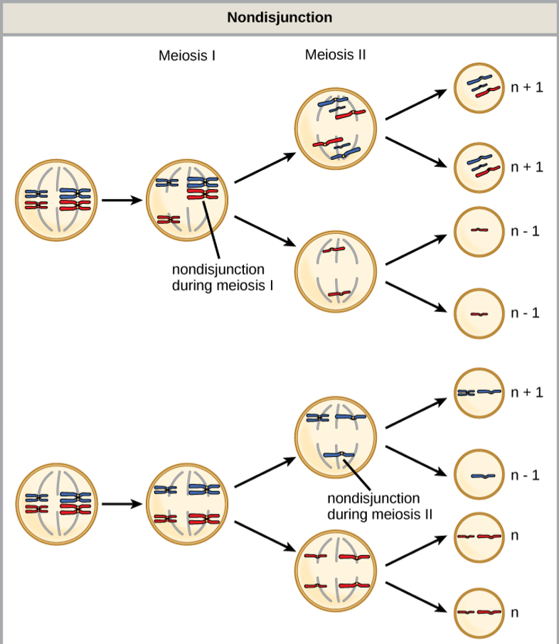
Disorders in Chromosome Number
Nondisjunction occurs when homologous chromosomes or sister chromatids fail to separate during meiosis, resulting in an abnormal chromosome number.
Nondisjunction may occur during meiosis I or meiosis II.
Download for free at http://cnx.org/contents/185cbf87-c72e-48f5-b51e-f14f21b5eabd@10.61

Slide 4
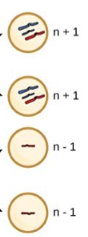
Disorders in Chromosome Number
Euploid: organisms with the correct number of chromosomes for their species
Aneuploid: individual with an error in chromosome number
Monosomy: loss of one chromosome
Trisomy: gain of one chromosome
Download for free at http://cnx.org/contents/185cbf87-c72e-48f5-b51e-f14f21b5eabd@10.61

Slide 5
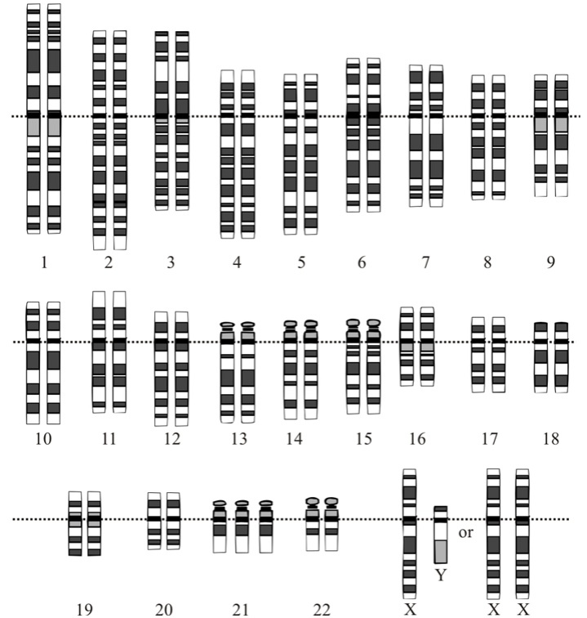
Disorders in Chromosome Number
Gene Dosage: amount of a gene product produced
Monosomy = lower gene dose
Monosomatic human zygotes fail to develop to birth, lack essential genes that must be present in two copies to give proper phenotype
Trisomy = extra gene dose
Trisomy exists in humans for chromosomes 13, 15, 18, 21 and 22
Trisomy 21: down syndrome
Trisomy 21
Caption: Karyotype (c) Wikipedia, Public domain

Slide 6
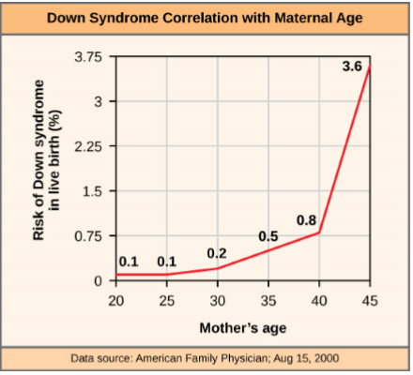
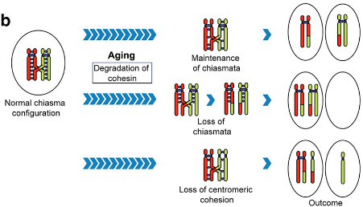
Disorders in Chromosome Number
Why does the incidence of having a fetus with trisomy 21 increases dramatically with maternal age?
Oocyte DNA held in Prophase I for decades
Synaptonemal complex begins to break down over decades
Proper segregation of homologous chromosomes cannot occur if tetrad falls apart before metaphase I
The incidence of having a fetus with trisomy 21 increases dramatically with maternal age.
Download for free at http://cnx.org/contents/185cbf87-c72e-48f5-b51e-f14f21b5eabd@10.61

Slide 7
Polyploid: individual with more than the correct number of chromosome sets
As with many polyploid plants, this triploid orange daylily (Hemerocallis fulva) is particularly large and robust, and grows flowers with triple the number of petals of its diploid counterparts. (credit: Steve Karg)
Download for free at http://cnx.org/contents/185cbf87-c72e-48f5-b51e-f14f21b5eabd@10.61

Slide 9
Errors in Sex Chromosome Number
Poly-X: XXX, phenotypically female, developmental delays, reduced fertility
Klinefelter: XXY, phenotypically male, small testes, enlarged breasts and reduced body hair
Monosomy: XO, phenotypically female, short statue, webbed skin in neck, sterile

Slide 10
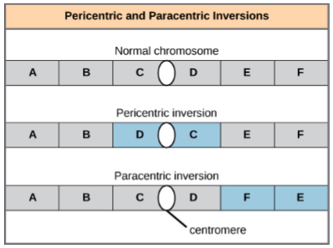
Chromosome inversion: detachment, 180°rotation, and reinsertion of part of a chromosome
Download for free at http://cnx.org/contents/185cbf87-c72e-48f5-b51e-f14f21b5eabd@10.61

Slide 11
A reciprocal translocation occurs when a segment of DNA is transferred from one chromosome to another, nonhomologous chromosome.
(credit: modification of work by National Human Genome Research/USA)
Download for free at http://cnx.org/contents/185cbf87-c72e-48f5-b51e-f14f21b5eabd@10.61

