Slide 1
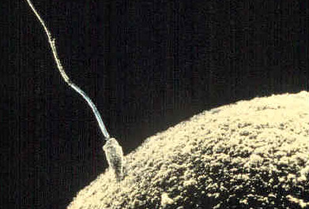
Chapter 11 meiosis
General Biology I
BSC 2010
Caption: Sperm-egg (c) unknown, Public domain

Slide 2
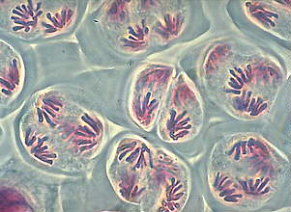
introduction
Mitosis creates many genetically identical cells
Asexual reproduction of unicellular organisms.
Growth, development, repair and regeneration in multicellular organisms.
Meiosis produces gametes for sexual reproduction resulting in offspring that are INTENTIONALLY genetically different from parents and each other.

Slide 3
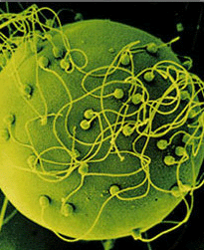
introduction
Sexual reproduction contributes to genetic variation
Gametes from each parent contain one set of chromosomes
each pair of chromosomes in somatic tissues are split!
Gametes fuse to produce a single cell, the zygote, with two sets of chromosomes
New pairs of chromosomes form compared to each parent
Offspring are genetically different from parents and each other, even before mutations

Slide 4
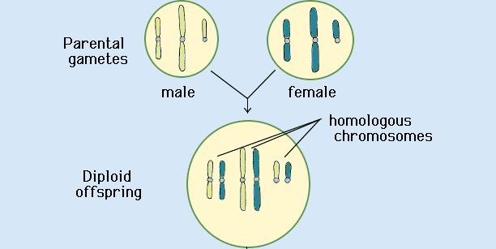
11.1 the process of meiosis
Fertilization is the process in which gametes from two parents unite.
Gametes (haploid cells) contain one homolog of each pair (n or n’)
When haploid gametes fuse in fertilization, they create a diploid (2n = n+n’) zygote
http://faculty.abe.ufl.edu/~chyn/age2062/lect/lect_08/12_25.GIF

Slide 5
HUMANS: Sperm + Ovum = FERTILIZED EGG EUKARYOTES: GAMETE + GAMETE = Zygote
haploid (1n) sperm
diploid zygote (2n = n+n’)
haploid (1n’) ovum

Slide 6
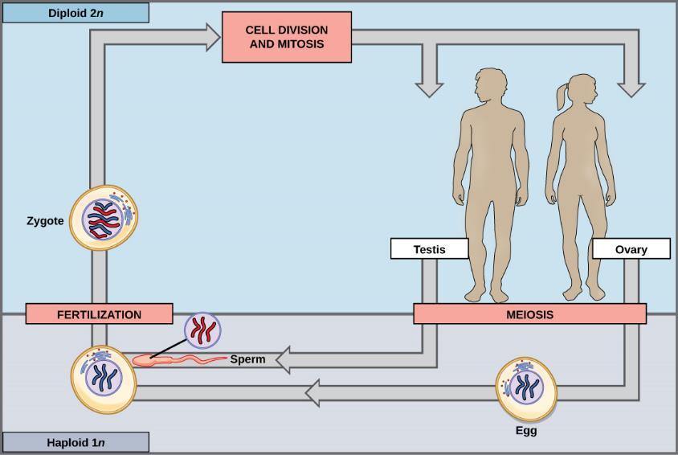
Download for free at http://cnx.org/contents/185cbf87-c72e-48f5-b51e-f14f21b5eabd@10.61

Slide 7
11.2 sexual reproduction
Fungi, such as black bread mold (Rhizopus nigricans) and the yeast that make beer, bread and wine, have haploid-dominant life cycles. The haploid multicellular stage of opposite mating types (a and α, a and A, + and -, etc.) produces specialized haploid cells (~ gametes) by mitosis that fuse to form a diploid zygote. This zygote undergoes meiosis almost immediately to produce haploid spores. Each spore gives rise to a multicellular haploid organism by mitosis.

Slide 8
In diploid (2n) multicellular organisms, somatic cells (non-gametes) each contain two sets of chromosomes
For each pair of chromosomes, each parent contributes one homolog
Have corresponding genes in exactly the same places but might have different versions of those genes (alleles)
The two sets of chromosomes are called a pair of homologous chromosomes

Slide 9
Functions of meiosis:
produce gametes
reduce chromosome number by half (from n+n’ to either n or n’)
ensure each gamete gets a complete set of chromosomes (one of each pair)
Mitosis ensures each cell gets a sister chromatid
Meiosis I ensures each cell gets a homologous chromosome
promote genetic diversity of products

Slide 10
In this example, this organism has 4 chromosomes (2 homologous pairs)
red chromosomes from mom
grey chromosomes from dad
The diploid chromosome number is 4.
The haploid chromosome number is 2

Slide 11
Remember that every time ANY cell divides, the DNA will replicate beforehand
In mitosis, there is only one division, and sister chromatids are separated
But in order to get down to a haploid # of chromosomes in meiosis, there must be 2 divisions
In Meiosis I, the homologous chromosomes are separated.
The number of chromosomes are reduced in half.
In Meiosis II, the sister chromatids are separated.
The final products are four haploid gametes (n).

Slide 12
Download for free at http://cnx.org/contents/185cbf87-c72e-48f5-b51e-f14f21b5eabd@10.61
Early in prophase I, homologous chromosomes “find” each other and come together to form a synapse.
The homologous chromosomes are bound tightly together and in perfect alignment by a protein lattice called a synaptonemal complex (because homologous chromosomes have no centromere) and by cohesin proteins at the centromere (these hold together sister chromatids).
During this time, crossing over (DNA strands swap between between occurs homologous chromosomes.

Slide 13
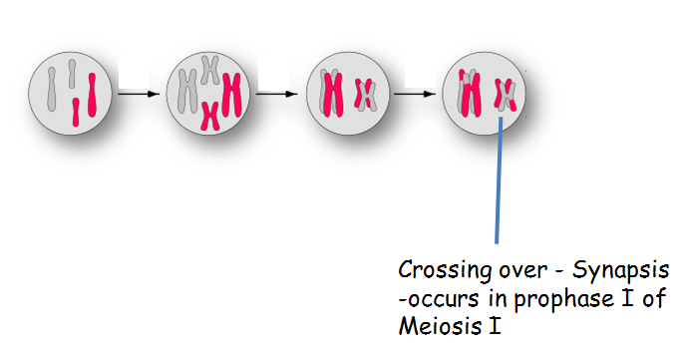
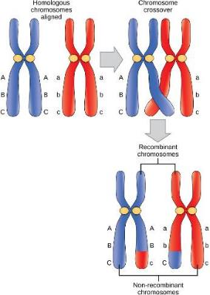
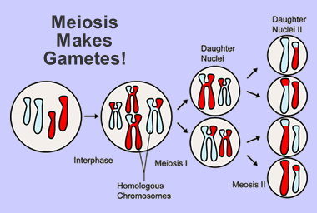
Download for free at http://cnx.org/contents/185cbf87-c72e-48f5-b51e-f14f21b5eabd@10.61

Slide 14
Meiosis
DNA replicates (chromosome # doubled)
Meiosis I
Stages:
Prophase I – synapses form as chromosomes condense and look for each other
Metaphase I – homologous chromosome pairs line up (4 chromosomes)
Anaphase I – homologous chromosomes separate
Telophase I
Results in 2 nuclei, each with haploid content of sister chromatids
Cytokinesis usually occurs (not in human females – oocyte ejects nucleus as a polar body!) and meiosis usually immediately continues
Meiosis II
Stages
Prophase II (chromosomes are usually still condensed if there was no pause)
Metaphase II
Anaphase II – sister chromatids seperate
Telophase II
Results in 4 cells, haploid number, one of two sister chromatids for each homologous pair in every cell

Slide 15
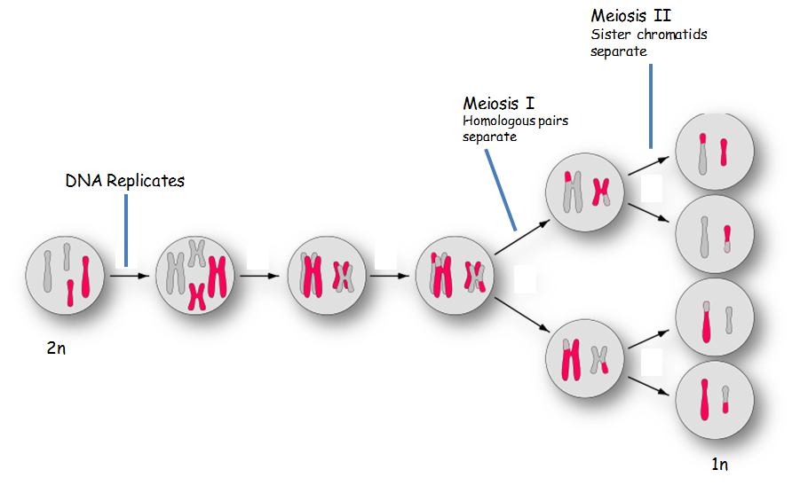

Slide 16
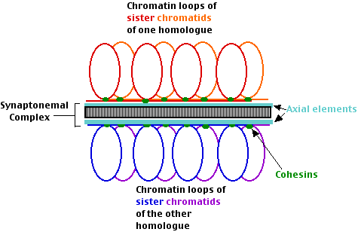
11.1 the process of meiosis
In Prophase I, synapsis occurs:
Two homologs join together, held together by protein complex
Resulting tetrad consists of two homologous chromosomes, each with two sister chromatids
http://users.rcn.com/jkimball.ma.ultranet/BiologyPages/S/SC_schematic.gif

Slide 17
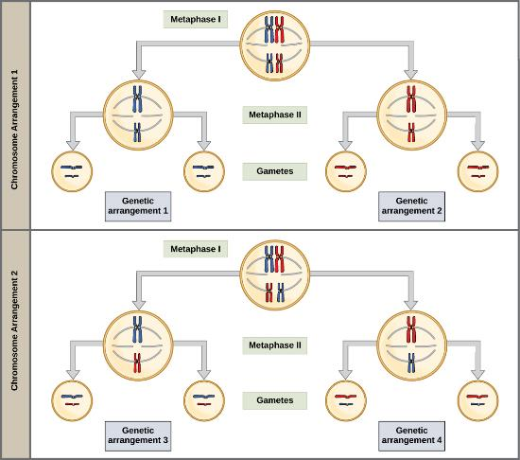
Random and Independent Assortment of tetrads after Metaphase I of
Meiosis I
Each tetrad (of sister chromatid + homologous chromosomes) aligns randomly at the metaphase plate
For 2 chromosomes, 1^{M} and 2^{M}, or 1^{D} and 2^{D}, or 1^{M} and 2^{D}, or 1^{D} and 2^{M}, all have an equal chance of aligning to the same centrosome.
Each cell undergoing meiosis will have a random alignment
2² = 4 different combinations
Download for free at http://cnx.org/contents/185cbf87-c72e-48f5-b51e-f14f21b5eabd@10.61
Random, independent assortment during metaphase I can be demonstrated by considering a cell with a set of two chromosomes (n = 2). In this case, there are two possible arrangements at the equatorial plane in metaphase I. The total possible number of different gametes is 2n, where n equals the number of chromosomes in a set. In this example, there are 2² = four possible genetic combinations for the gametes.
With n = 23 in human cells, there are 2²³ = over 8 million possible combinations of paternal or maternal chromosomes. Excluding additional variation from crossing over, there are at over 64 trillion combination of fertilized eggs possible from two human parents!

Slide 18
Anaphase I and II
The process of chromosome alignment differs between meiosis I and meiosis II. In prometaphase I, microtubules attach to the fused kinetochores of homologous chromosomes (which are opposite each other), and the homologous chromosomes are arranged at the midpoint of the cell in metaphase I. In anaphase I, the homologous chromosomes are separated. In prometaphase II, microtubules attach to the kinetochores of sister chromatids, and the sister chromatids are arranged at the midpoint of the cells in metaphase II. In anaphase II, the sister chromatids are separated.

Slide 19
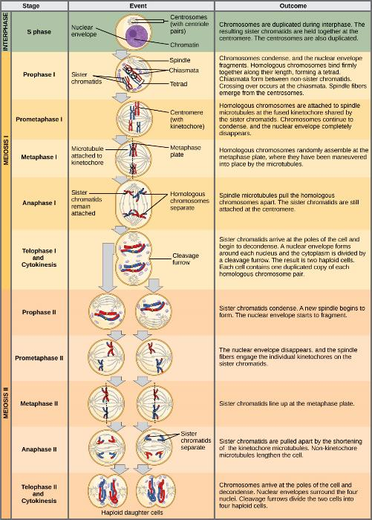
Meiosis I: creation of haploid cells from diploid cell
Download for free at http://cnx.org/contents/185cbf87-c72e-48f5-b51e-f14f21b5eabd@10.61

Slide 20
Meiosis II – resembles mitosis, except it occurs with only haploid content of genetic information
Download for free at http://cnx.org/contents/185cbf87-c72e-48f5-b51e-f14f21b5eabd@10.61

Slide 21
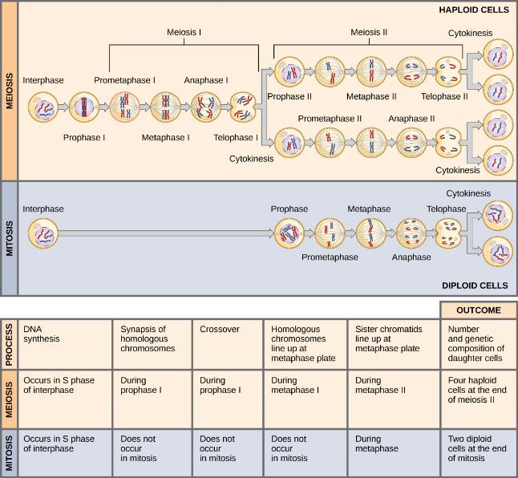
Meiosis vs mitosis
Download for free at http://cnx.org/contents/185cbf87-c72e-48f5-b51e-f14f21b5eabd@10.61

Slide 24
Oogenesis and Spermatogenesis in humans – to be studied in lab!
Oogenesis – meiosis that leads to egg production
Results – 1 usable egg
First nucleus lost as polar body after Telophase I
Second nucleus lost after fertilization after telophase II
Spermatogenesis – meiosis that leads to sperm production
Results – 4 usable sperm

Slide 25
Oogenesis
4 cells, but only 1 egg
that can be fertilized
Present at mother’s birth
Paused at prophase I until menstrual cycle
Termed a primary oocyte until ovulation
1 or (rarely) 2 released during menstrual cycle
Commence upon ovulation
First polar body discarded
Re-paused at metaphase II until fertilization;
Released from ovary as secondary oocyte
Immediately after fertilization, meiosis II finishes, and becomes a mature ovum
sperm nuclei fuses with final, retained nucleus; second polar body discarded
becomes a fertilized egg
Caption: Gray5 (c) Henry Carter, Public domain

Slide 26
Spermatogenesis
Each stage is formed continuously, without pauses to meiosis
“stem cell”: spermatogonium
Before Meiosis I: primary spermatocyte
After Meiosis I: secondary spermatocyte
After meiosis II: spermatid
After maturation: spermatozoa (mature sperm)
4 sperm cells that can fertilize eggs
Download for free at http://cnx.org/contents/185cbf87-c72e-48f5-b51e-f14f21b5eabd@10.61

Slide 27
nondisjunction
Errors that occur in normal chromosome splitting (disjunction) during meiosis
Many cases of spontaneous abortions are due to abnormalities form genetic imbalance from nondisjunction; these mostly occur in first trimester
Caption: Mitotic Disjunction (c) Wpeissner, Public domain

Slide 28
nondisjunction
Errors can occur in chromosome splitting during meiosis I (right) and during meiosis II (left)
more common in women than in men (due to long pauses in meiosis in oogenesis vs. spermatogenesis)
Errors in meiosis I result in ALL gametes being genetically imbalanced
Errors in meiosis II result in HALF of gametes being genetically imbalanced
Fusion with (normal) sperm result in aneuploidy (either 3 or 1) state for a chromosome – most embryos/feti are inviable b/c genetic imbalance of thousands of genes
Caption: Nondisjunction Diagrams (c) Tweety207, Public domain

