Slide 1
Chapter 10 Cell Division
General Biology I
BSC 2010
Download for free at http://cnx.org/contents/185cbf87-c72e-48f5-b51e-f14f21b5eabd@10.61

Slide 2
Cell division
The cell is a basic unit of life.
All living organisms are composed of one of more cells.
Cells comes from pre-existing cells.
Cell division in unicellular organisms is for reproduction.
Cell division in multicellular organisms is for growth, development, regeneration, and repair.

Slide 3
Cell division
A sea urchin begins life as a single cell that
divides to form two cells, visible by scanning electron microscopy. After four rounds of cell division,
there are 16 cells, as seen in this SEM image. After many rounds of cell division, the individual develops into a complex, multicellular organism, as seen in this
mature sea urchin.
Download for free at http://cnx.org/contents/185cbf87-c72e-48f5-b51e-f14f21b5eabd@10.61

Slide 4
Before division can happen, the cell must get the proper signal and the DNA has to replicate to make a replicate chromosome

Slide 5
Prokaryotic chromosome
Prokaryotes, including bacteria and archaea, have a single, circular chromosome located in a central region called the nucleoid.
Download for free at http://cnx.org/contents/185cbf87-c72e-48f5-b51e-f14f21b5eabd@10.61

Slide 6
Bacterial Binary Fission – since bacteria only have 1 circular chromosome, their division is less complicated than ours
Caption: Binary Fission (c) Ecoddington14, Public domain

Slide 7
Eukaryotic cells have multiple chromosomes
Eukaryotic cells have homologous pairs
Eukaryotic cells have linear chromosomes
Depending on the species, the number can range from a couple to hundreds
Humans have 46 chromosomes (usually defined as 22 autologous pairs and 1 pair of sex chromosomes)
Therefore, division is more complicated – have to keep track of the chromosomes so they end up in the right place
2 types of division with eukaryotes we will talk about:
Mitosis – growth and repair – identical DNA
Meiosis – to make gametes – shuffle DNA

Slide 8
Human chromosomes
Humans have 46 chromosomes in 23 nearly identical pairs
Every species can have a different number of chromosomes
Download for free at http://cnx.org/contents/185cbf87-c72e-48f5-b51e-f14f21b5eabd@10.61

Slide 9
Human chromosomes
Particular array of chromosomes in an individual organism is called karyotype.
Humans are diploid (2n)
2 complete sets of chromosomes
46 total chromosomes
Haploid (n): 1 set of chromosomes
Gametes, some fungi, and some algae exist in this form
Pairs of chromosomes are homologous
Have the same genes, just might have different versions (alleles) of that gene
Example: the two chromosome #3’s are homologous, or the two chromosome #18’s are homologous
(each pair is 99+% identical; thus differences are less than 1%)

Slide 10
Chromosomes Composition
Over 2 meters of DNA inside a diploid human nucleus.
When the cell is going about its normal function, the DNA is not condensed
When the cell is getting ready to divide, it will STOP its normal function and condense its DNA (making chromosomes visible under the light microscope)
Chromosomes are composed of chromatin – complex of TIGHTLY PACKED DNA and protein
Typical human chromosome 140 million nucleotides long

Slide 11
Chromosomes organization
Levels of Chromatin Organization:
Chromatin is organized to help form the proper structure
From naked DNA to Chromosomes
Naked DNA – form that is copied and transcribed
Nucleosome – ball of DNA wrapped around histone proteins – form that is stored and protected
Chromatin Loops – loops away from chromatin for gene expression
Chromosome – package of many genes

Slide 12
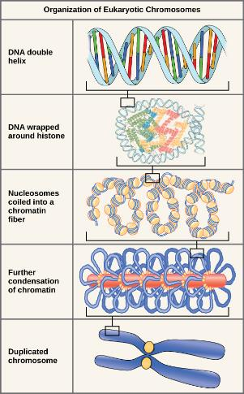
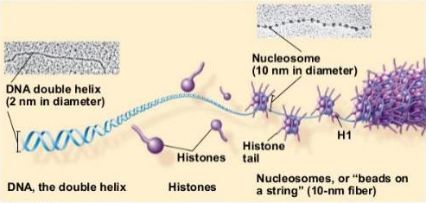
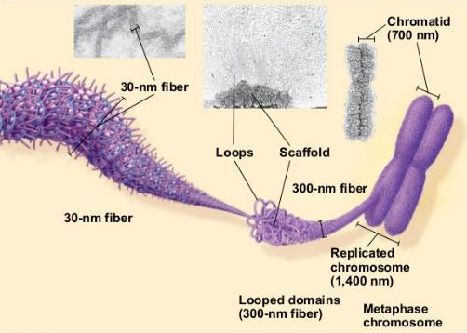
Download for free at http://cnx.org/contents/185cbf87-c72e-48f5-b51e-f14f21b5eabd@10.61

Slide 13
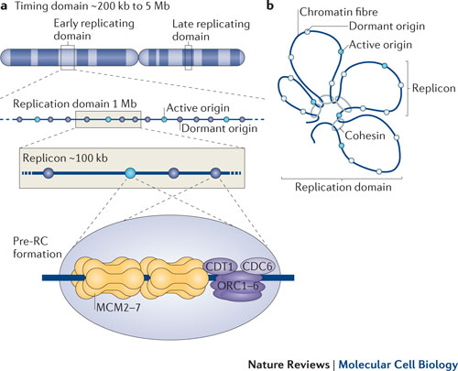
REPLICATION OF ChromosomeS
Before replication: each chromosome composed of a single DNA molecule
DNA must make a copy of itself
After replication: each chromosome composed of 2 identical DNA molecules
Identical copies are held together by cohesin proteins
Visible as 2 strands held together as chromosome becomes more condensed
One chromosome composed of 2 sister chromatids joined at centromere

Slide 14
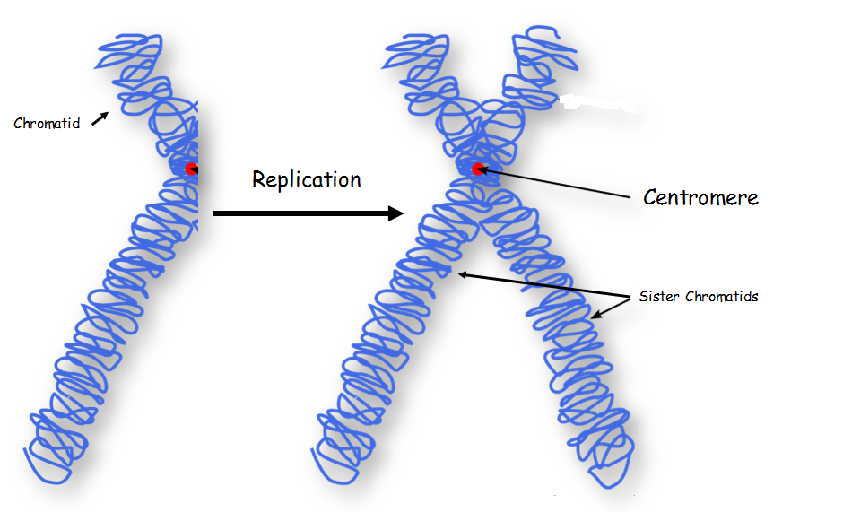

Slide 15
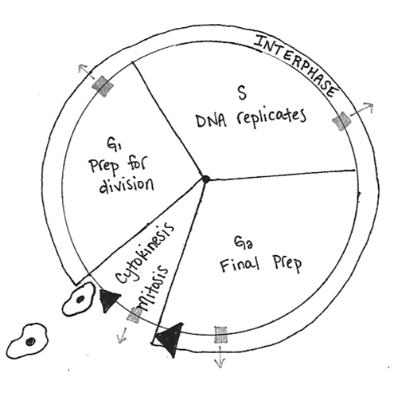
The cell cycle
The cell cycle consists of 2 stages: interphase and the mitotic phase.
During interphase, the cell grows and the nuclear DNA is duplicated.
Interphase is followed by the mitotic phase.
During the mitotic phase, the duplicated chromosomes are segregated and distributed into daughter nuclei.
The cytoplasm is usually divided as well (cytokinesis), resulting in two daughter cells.

Slide 16
Eukaryotic Cell Division
The eukaryotic cell cycle has two phases:
Interphase (Between cell divisions)
Cell is being a cell, performing its usual functions
Cell nucleus is visible
Cell metabolic functions, including DNA replication, occur
Begins after cytokinesis and ends when mitosis starts
Mitosis/cytokinesis:
Normal cell function stops because migrating DNA safely is priority
Eukaryotic nuclear division (mitosis) and cell division (cytokinesis)

Slide 17
Eukaryotic Cell Cycle
G₁ (gap phase 1)
Primary growth phase, longest phase
S (synthesis)
Replication of DNA
G₂ (gap phase 2)
Organelles replicate, microtubules
organize; prepare for mitosis
M (mitosis) – Nuclear division
Subdivided into 5 phases
C (cytokinesis) – Cytoplasmic division
Separation of 2 new cells
Interphase

Slide 18
Duration of Cell Cycle
Most variation in the length of the cell cycle between organisms or cell types occurs in G₁
Cells often pause in G₁ before DNA replication and enter a resting state called G₀
Resting phase G₀ – cells spend more or less time here before resuming cell division.
This is when a cell is being a cell
Can range from hours to decades depending on cell type
Most nerve cells remain there permanently – that is why damage to nerve cells is permanent
Liver cells can resume G₁ phase in response to factors released during injury

Slide 19
The Cell Cycle - Mitosis
Mitosis produces genetically-identical daughter nuclei
Mitosis is followed by cytokinesis which splits the cytoplasm into two daughter cells
4 main stages of mitosis:
Prophase – chromosomes condense; nuclear membrane dissolves
Prometaphase – centrosomes push away from each other; attach to centromeres
Metaphase – chromosomes align
Anaphase – chromosomes separate and migrate
Telophase – after nuclear membrane reforms, chromosomes relax

Slide 20
The Cell Cycle - Mitosis
Prophase:
Chromosomes condense and become visible
Chromosomes appear as two sister chromatids held together at the centromere
Nuclear envelope breaks down
Mitotic spindle begins to form
2 centrioles move to opposite poles forming spindle apparatus (no centrioles in plants)
Asters – radial array of microtubules in animals (not plants)

Slide 21
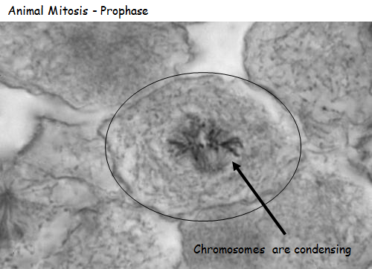
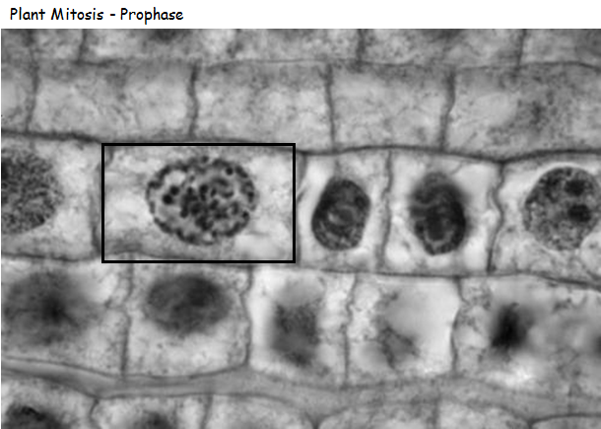

Slide 22
During prometaphase, mitotic spindle microtubules from opposite poles attach to each sister chromatid at the kinetochore.
Because sister chromatids are still attached to each other, the result is a tug of war between the two poles at the “equator”
In anaphase, the connection between the sister chromatids breaks down, and the microtubules pull the chromosomes toward opposite poles.
Download for free at http://cnx.org/contents/185cbf87-c72e-48f5-b51e-f14f21b5eabd@10.61

Slide 23
The Cell Cycle - Mitosis
Metaphase:
Alignment of chromosomes along metaphase plate
Not an actual structure; it is the midway between two centrioles pulling equally at chromosomes
Future axis of cell division

Slide 24
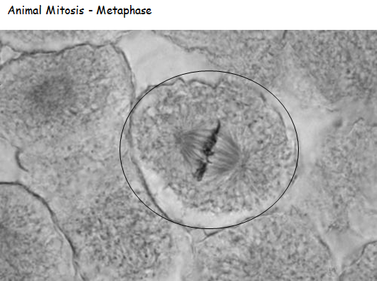
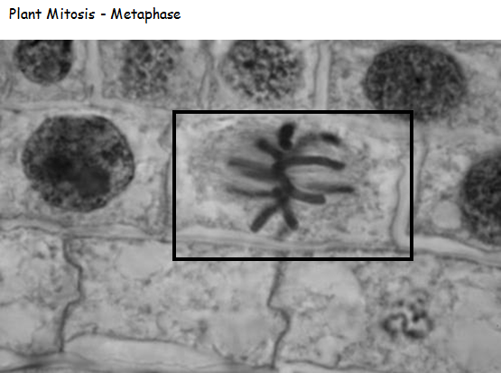

Slide 25
The Cell Cycle - Mitosis
Anaphase:
Begins when centromeres split
Removal of cohesin proteins from all chromosomes
Sister chromatids pulled to opposite poles

Slide 26
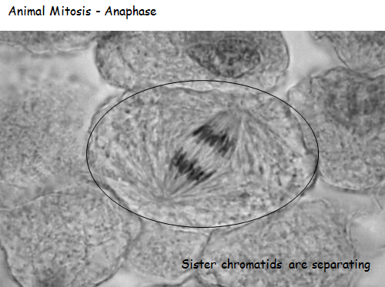
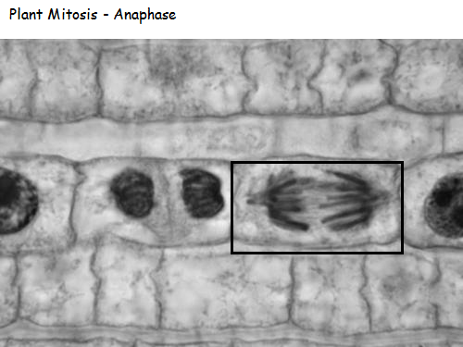

Slide 27
The Cell Cycle - Mitosis
Telophase:
Chromosomes are clustered at opposite poles
Nuclear envelopes re-forms around chromosomes
Chromosomes begin to uncoil and decondense once nucleus is there to trap them
Nucleolus reappears in each new nucleus
Golgi complex and ER re-form

Slide 28
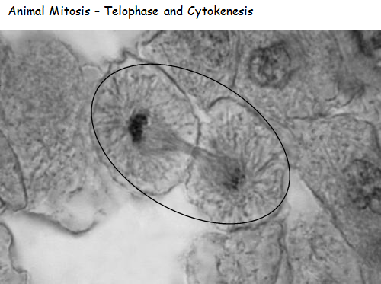
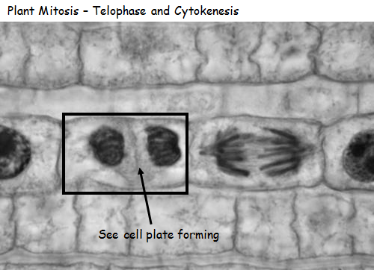

Slide 29
The Cell Cycle - cytokinesis
Often immediately follows telophase or begins at the same time as telophase
Cytokinesis is the stage in which two daughter cells are formed from the original one
After cytokinesis, cells re-enter interphase.
Animals:
Proteins pinch the original cell into two new cells

Slide 30
The Cell Cycle - cytokinesis
Cytokinesis in Plants:
Starts with vesicles forming the cell plate (segments of cell wall within vesicles)
This results in a new cell wall being formed between the cells forming daughter cells.
The cell wall is made from cellulose
Vesicles of cell plate fuse with each other and with membrane at equator and effectively split the cells

Slide 32
Control of the Cell Cycle
Cell division is a tightly controlled process
Normal cells halt at checkpoints
Proteins survey the condition of the cell
Cell must pass the survey to proceed with cell division
3 checkpoints: G₁,G₂, and metaphase

Slide 33
Control of the Cell Cycle

Slide 34
Control of the Cell Cycle
3 Checkpoints:
G₁/S checkpoint
Cell “decides” whether or not to divide
Enough nutrients? Mitotic signals?
G₂/M checkpoint
Cell makes a commitment to mitosis
Assesses success of DNA replication; fixes errors if necessary
Can stall the cycle if DNA has not been accurately replicated.
Late metaphase (spindle) checkpoint
Cell ensures that all chromosomes are attached to the spindle
Or else, both sister chromatids could go the same way – genetic imbalance – PROBLEMS!

Slide 35
Control of the Cell Cycle
There are two groups of intracellular molecules that regulate the cell cycle.
These molecules can either promote progress of the cell to the next phase (positive regulation) or halt the cell cycle (negative regulation).
These molecules can either act individually or in partnership with other molecules.
Deficiency or non-functioning of a single regulator may or may not affect the control of cell cycle.
Many redundancies exist to ensure mutation does not prevent cell cycle progression or its regulation!

Slide 36
POSITIVE REGULATION
Cyclin-dependent kinases (Cdk’s) are protein kinases that when fully activated, can phosphorylate and thus activate other proteins that advance the cell cycle past a checkpoint.
To become fully activated, a Cdk must bind to a cyclin protein and then be phosphorylated by another kinase.

Slide 37
Negative regulation – checkpoint inhibitors
The best understood are retinoblastoma protein (Rb), p53 and p21.
Rb, p53, and p21 act primarily at the G1 check point..
P53 detects damage DNA and recruits enzymes to repair DNA. If DNA cannot be repaired, it will trigger apoptosis (cell death) hence preventing duplication of damaged DNA.
Increasing of p53 results in production of p21 which in turn binds and inhibits the CDK/cyclin complexes. Ultimately, the cell cycle will not proceed.

Slide 38
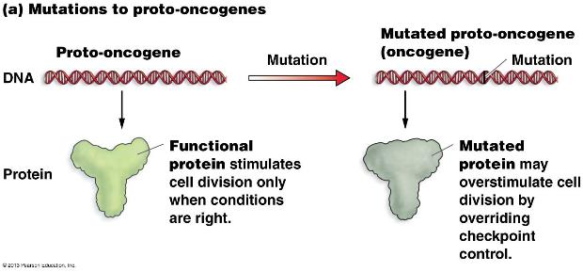
Cancer and the cell cycle
Proto-oncogenes: genes that code for the positive cell cycle control proteins
When proto-oncogenes mutate, they become oncogenes
Their proteins no longer properly regulate cell division
They usually overstimulate cell division even though it is not supposed to.

Slide 39
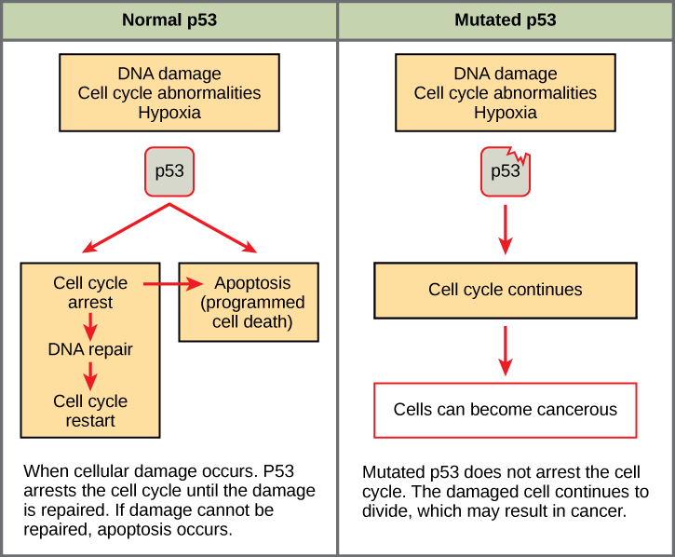
cancer and the cell cycle
Tumor suppressor genes: genes for proteins that stop cell division if conditions are not favorable (negative regulator)
Rb, p53, and p21 are tumor suppressor genes
When mutated, can allow cells to override checkpoints

Slide 40
Control of the Cell Cycle

