Slide 1

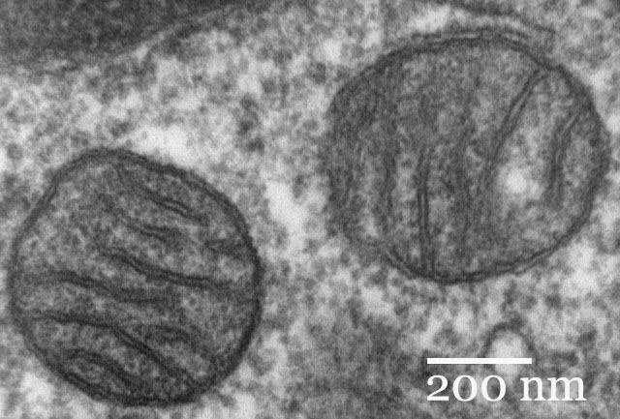
Chapter 7
Cellular Respiration
General Biology I
BSC 2010
Insert photo here representing
chapter
Caption: Mitochondria mammalian lung (c) Louisa Howard, Public domain

Slide 2
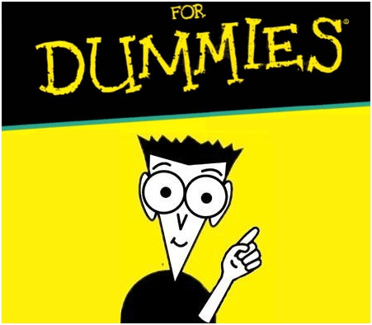
The Chemistry of Cellular Respiration
We burn glucose “with oxygen”
We get energy for life from the burn
We release carbon dioxide and water

Slide 3




How we burn organic molecules
Burning is oxidation. We oxidize organic chemicals by going through known functional groups
:
:
oxidation
$$⇌$$
:
:
reduction
:
Isoelectronic rearrangement
to release gas
ethane
“natural gas”
14 electrons
Ethylene
“fruit ripener”
12 electrons
Carbon dioxide (16 electrons)
Methane (8 electrons)
1 carbon converted to CO₂
2 H’s and 2
e⁻’s removed
oxidation
hydration
:
oxidation
$$⇌$$
$$⇌$$
:
$$⇌$$
reduction
dehydration
reduction
ethanol
“elixir of life”
20 electrons
:
:
Acetaldehyde
“hangover”
18 electrons
ethanediol
(unstable)
26 electrons
Acetic acid
“marinade”
24 electrons
water (H and OH) added to the double bond;
double bond hydrated
Add 8 electrons
2 H’s and 2
e⁻’s removed
water (H and OH) added to the double bond;
double bond hydrated
Add 8 electrons
2 H’s and 2
e⁻’s removed

Slide 4
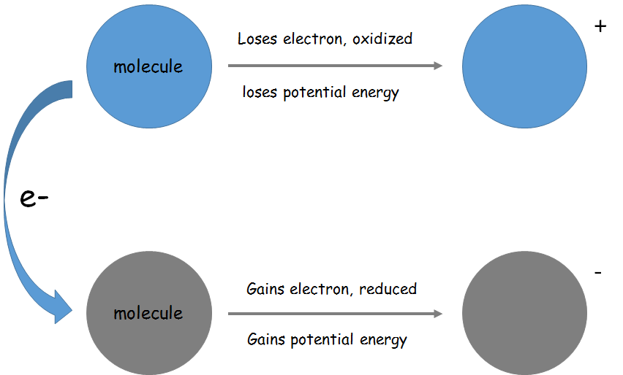
Electrons and Energy
REDOX Reactions
    Reduced – molecule gains an electron
    Oxidized – molecule loses an electron
This MUST be done in cells with redox cofactors called electron carriers

Slide 5
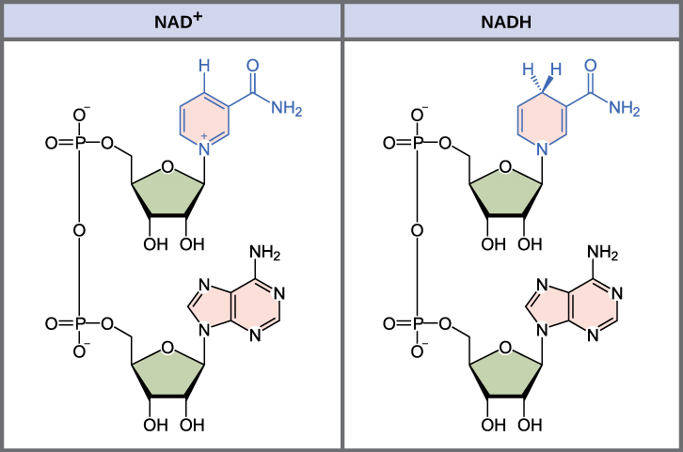
Electron Carriers
These molecules are especially “designed” to gain or lose electrons easily (both states are stabilized by aromaticity) and so catalyze the transport of electrons from various metabolites to the ATP generation complex
    Examples: NAD+ , NADP+, and FAD

Slide 6
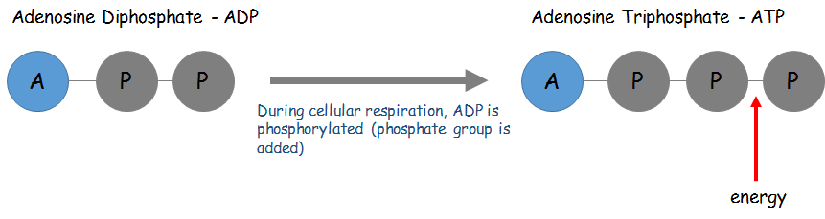
ATP
We do not use electrons from metabolites for energy directly
ATP is the energy currency of the cell
  We take in food, the energy in the bonds of those food molecules is released and transformed into the bonds of the ATP molecule
      This transformation process happens during cellular respiration
      ADP is phosphorylated – now there is more energy in the bonds of the ATP molecule
        Substrate level phosphorylation and oxidative phosphorylation
        The energy in the ATP molecule that was stored by bond formation from ADP in cellular respiration is directly used by the cell

Slide 7
Transformed During:
Food
Energy
Electron transport chain
ATP
Oxidative phosphorylation
(OXYGEN GAS USE)
Glycolysis
Fermentation
(quick pyruvate oxidation)
Krebs cycle
(slower pyruvate oxidation)
NO OXYGEN USE

Slide 8
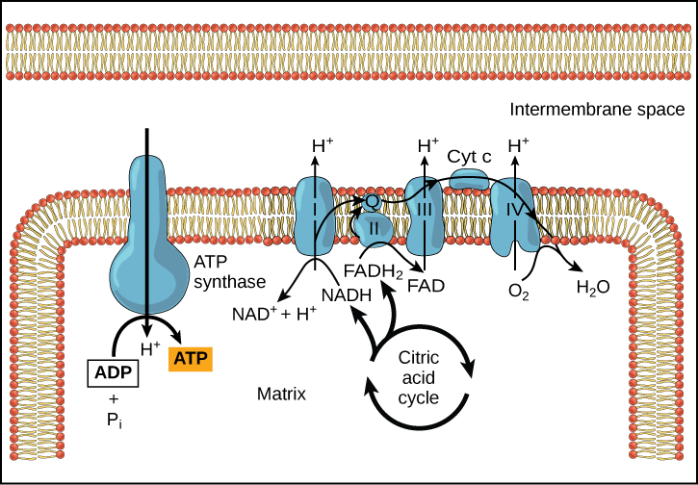
Steps of Cellular Respiration
Anaerobic Respiration – does not use oxygen
    Glycolysis – generate pyruvate, NADH from NAD+, and 2 H⁺
    Fermentation – reduce pyruvate to lactate to recycle NADH, reabsorb H⁺, and allow cell to burn more sugar (in animals and bacteria; yeast instead generate acetaldehyde and reduce that to ethanol)
      Lactic acid “burn” of muscles – muscles run out
      of oxygen and turn pyruvate into lactate
Aerobic Respiration – uses oxygen
    Glycolysis
    Pyruvate oxidation to Acetyl-CoenzymeA
    Krebs (Citric Acid) Cycle
      3x NADH and 3x H⁺ generated from NAD⁺ during
      Krebs cycle in mitochondrial matrix
    Electron Transport Chain
      Absorbs electrons by converting NADH back to NAD⁺ and H⁺
      H⁺ actively exported from mitochondrial matrix as electrons migrate through the chain
    Oxidative phosphorylation
      Oxygen gas accepts electrons to become water, sucking up even more H⁺ from the matrix the process
      Concentration of H⁺ in inner membrane space creates a H⁺ gradient (BATTERY; GREAT potential energy)
      Gradient is used to create ATP, and import pyruvate from cytosol
    Results in complete oxidation of glucose, produces 5x more ATP than anaerobic respiration of glucose to pyruvate (Do you see why original archaeal cell kept mitochondria in endosymbiotic theory???)

Slide 9
1. Glycolysis
Glycolysis
    All organisms do glycolysis, despite whether they use oxygen or not
    Happens in the cytosol
    10 steps; goes quickly
    Cancers often hyper-expresses these pathways, and ignores oxidative phosphorylation because it is slower.
    Needs 2 ATP to jump start the process, but produces 4 ATP
    Results in the net production of 2 ATP
    Start with glucose (6C), end with 2 molecules of pyruvate (3C)
    Pyruvate then imported into mitochondria (using H+ battery)

Slide 10
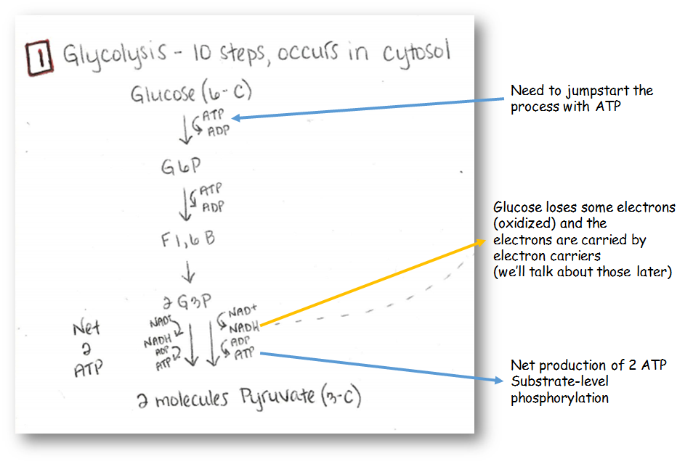

Slide 11
Glycolysis happens in the cytosol
Archaea did this before mitochondria came about
In bacteria utilizing aerobic cellular respiration, the rest of the processes will just happen in the cell
In eukaryotes, the pyruvate molecules move into the mitochondria (using H+ gradient)

Slide 12
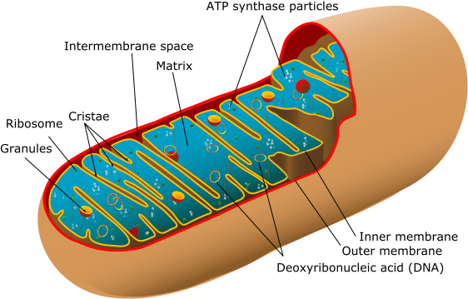
Mitochondria
Caption: Animal Mitochondrion Diagram (c) LadyofHats, Public domain

Slide 13
2. Pyruvate Oxidation
Pyruvate Oxidation
    Happens in mitochondrial matrix
    2 molecules of pyruvate (3C) are oxidized
    Decarboxylation
        Some carbon is lost (results in production of CO₂)
    Start with 2 molecules pyruvate (3C)
    Ends with 2 molecules Acetyl-Coenzyme A (2C), 2 NADH’s, and 2 H⁺
    Coenzyme A (CoA) “activates” the acetyl group in order to merge into the Krebs cycle

Slide 14
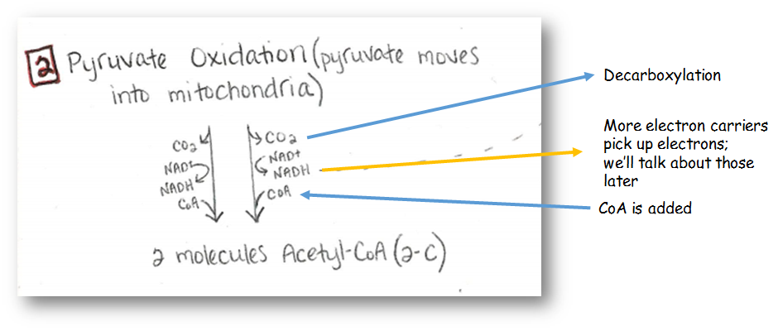

Slide 15
3. Citric Acid Cycle (Krebs cycle)
Citric Acid Cycle
    Happens in the mitochondrial matrix
    8 steps
    For every glucose molecule, there are 2 turns of the citric acid cycle
    At the end of the citric acid cycle, the glucose molecule has been completely oxidized
    More decarboxylation
    Produces 1 GTP per cycle (2 per glucose molecule)

Slide 16
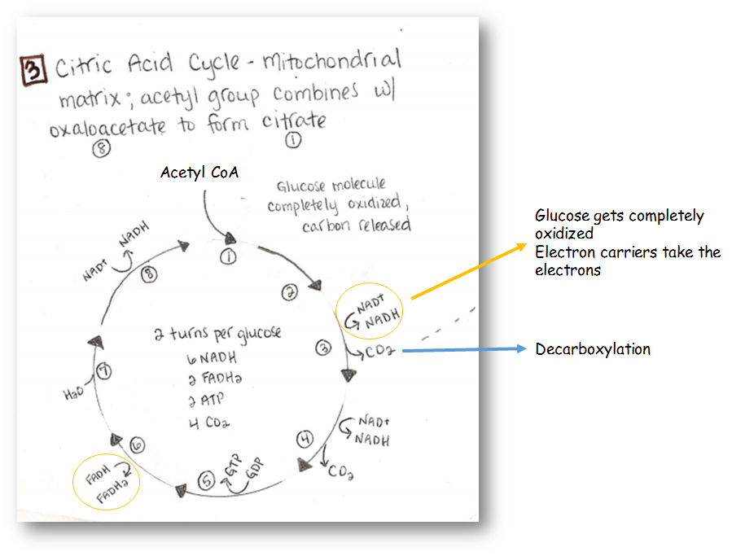

Slide 17
4. Oxidative Phosphorylation via the Electron Transport Chain (ETC)
Happens within the inner mitochondrial membrane (MUCH LARGER than the outer mitochondrial membrane)
Electron carriers (NAD+) that have been reduced (to NADH) during glycolysis, pyruvate oxidation and the Krebs cycle migrate to the membrane to become oxidized, and thus recycled
Electrons and hydrogen ions are deposited into the electron transport chain (ETC) as NADH and FADH₂ are oxidized
Electrons are carried from complex to complex, absorbing hydrogen ions from the matrix and depositing them into the inter-membrane space, creating a large hydrogen ion gradient
Oxygen gas (O₂) is the final electron acceptor in the ETC. It eventually reduces to two H₂O molecules, absorbing four hydrogen ions in the process.
H⁺
H⁺
H⁺
H⁺
H⁺
H⁺
H⁺
H⁺
H⁺
H⁺
H⁺
C•Fe²⁺
H⁺
H⁺
inter-
membrane
space
H⁺
C•Fe²⁺
H⁺
H⁺
H⁺
H⁺
H⁺
H⁺
H⁺
H⁺
C•Fe³⁺
C•Fe³⁺
H⁺
H⁺
H⁺
Q
Q
inner
membrane
QH₂
QH₂
H⁺
FAD
FADH₂
H⁺
matrix
NADH
H⁺
NAD⁺
H₂O
½ O₂
+ 2 H⁺

Slide 18
4. Oxidative Phosphorylation via the Electron Transport Chain (ETC)
Overall, NAD+ and FAD are regenerated, O₂ gets reduced to water, and large quantities of H⁺ ions are being pumped into the inner membrane space
  This creates a proton gradient – lots of potential energy
  Protons can only escape through ATP synthase
    Chemiosmosis – H+ is allowed to travel down its concentration gradient back into the matrix, but “at a cost”
    Results in a lot of production of ATP from ADP in exchange for diffusing the H⁺ gradient
H⁺
H⁺
H⁺
H⁺
H⁺
H⁺
H⁺
H⁺
H⁺
H⁺
H⁺
H⁺
H⁺
H⁺
H⁺
H⁺
inter-
membrane
space
H⁺
H⁺
C•Fe²⁺
C•Fe²⁺
H⁺
H⁺
H⁺
H⁺
H⁺
H⁺
H⁺
C•Fe³⁺
C•Fe³⁺
Q
Q
inner
membrane
QH₂
QH₂
H⁺
FAD
FADH₂
H⁺
matrix
NADH
H⁺
NAD⁺
H₂O
½ O₂
+ 2 H⁺
ADP
+ P_{i}
H⁺
3 ATP

Slide 19
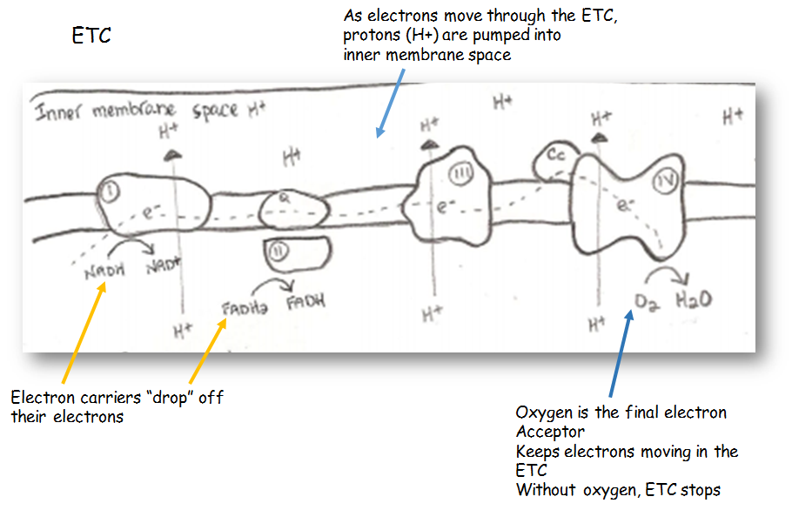

Slide 20
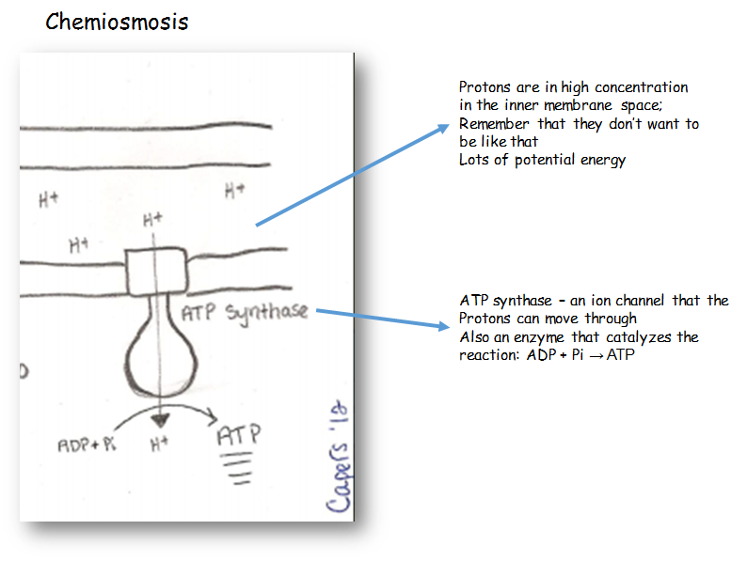

Slide 21
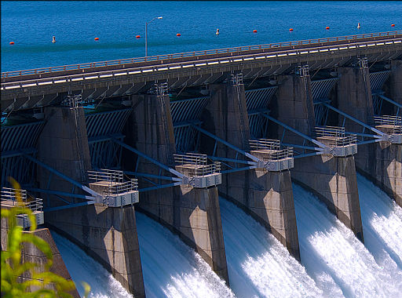
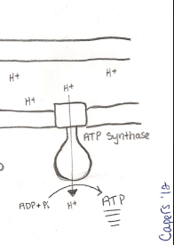
The proton gradient is like having water behind a dam, LOTS of potential energy
Caption: Open flood gates – Beaver Lake Dam (c) Doug Wertman, Public domain

Slide 22
ATP Yield
When a glucose is oxidized in aerobic respiration, ~32-36 ATP are generated in the mitochondrion (only 2 are generated during glycolysis in the cytosol)
    Not all of the energy in the glucose molecule is converted to ATP
    In the process, some of the energy is lost as heat
    The ATP will be immediately used by the cell. Have to continually produce ATP even when at rest (our cells are never “at rest”)

Slide 23
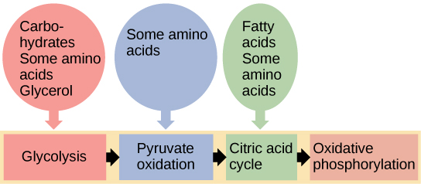
Glucose is not the only energy source
    Glucose is simply the most preferred system
    Other sugars can enter in different steps of glycolysis
    Several amino acids can enter at the citric acid cycle
    Lipids can also enter in at different spots during the process, usually at Acetyl-CoA
Download for free at http://cnx.org/contents/185cbf87-c72e-48f5-b51e-f14f21b5eabd@10.61

Slide 24
What happens when oxygen is not available?
Anaerobic Respiration
    Glycolysis
        Produces 2 ATP
        Electron carriers are reduced from NAD⁺ to NADH, but there is no electron transport in the cytosol to turn the NADH back to NAD⁺, and mitochondrial ETC is not available (lack of O₂)
    Fermentation (lactic acid fermentation, alcohol fermentation)
        Purpose of this is to recycle/oxidize the electron carriers (NADH to NAD⁺) so that they can be used again rapidly in glycolysis
        Results in pyruvate reduction into lactate
        In yeast, pyruvate is decarboxylated to acetaldehyde, which is reduced to ethanol
  Whole process only results in 2 ATP

Slide 25
Who uses it?
    Some bacteria, yeast
    In animals, it can happen in our muscle cells when oxygen is low (part of fight and flight response)
    Cancer – Krebs cycle is too slow, and cancer needs to grow fast, so they express more glycolysis enzymes and no Krebs cycle enzymes
A multicellular plant or animal has to use aerobic respiration – we need all the ATP we can get!

Slide 26
NAD⁺, converted to NADH for glycolysis, MUST be regenerated to allow cells to produce more ATP.
If the mitochondria cannot recreate NAD⁺ from NADH fast enough (usually because there is not enough O₂), fermentation occurs to recycle NADH.
When there is enough O₂, mitochondria simultaneously regenerate NAD⁺ and generate ATP for cellular life
in cells
in mitochondria
2 ADP
2 ATP
sugars
2 pyruvate
2 pyruvate
6 CO₂
2 NAD⁺
2 NADH
6 NAD⁺
6 NADH
2 lactate
or
2 ethanol
2 pyruvate
or
2 ethanal
H₂O
ATP
1/2 O₂
ADP

