Slide 1
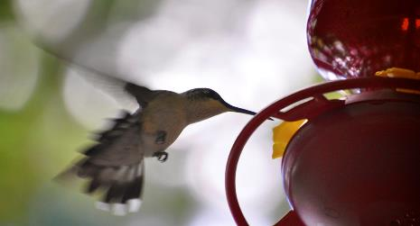
Chapter 6
Metabolism
Download for free at http://cnx.org/contents/185cbf87-c72e-48f5-b51e-f14f21b5eabd@10.61
Caption: Mitochondria, Mammalian Lung - TEM (c)Louisa
Howard, Public domain

Slide 2
The NEED FOR ENERGY AND MOVING IT AROUND!
Every task performed by living things requires energy
Cells constantly need energy
Keeps biochemical processes happening in order
Biology needs ORDER!
Chaos = Death

Slide 3
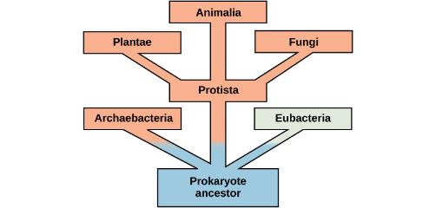
Metabolism – all of the chemical reactions that take place inside cells
Anabolic Reactions
These reactions use energy and build molecules
Catabolic Reactions
Some of these reactions release energy by breaking down molecules
Evolution of Metabolic Pathways: eukaryotes tend to build large molecules more than prokaryotes do
Download for free at http://cnx.org/contents/185cbf87-c72e-48f5-b51e-f14f21b5eabd@10.61

Slide 4
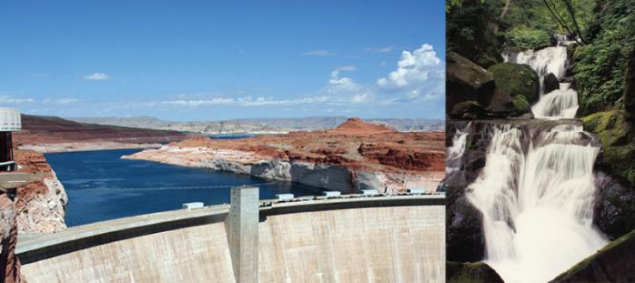
Two main types of energy for biological systems
Potential energy – potential to do work; STORED energy
Ion gradients, fats, carbohydrates, ATP,
Kinetic energy – energy ; energy IN MOTION
Oxidative phosphorylation; photosynthesis, glycolysis, β-oxidation/synthesis of fats
Download for free at http://cnx.org/contents/185cbf87-c72e-48f5-b51e-f14f21b5eabd@10.61

Slide 5
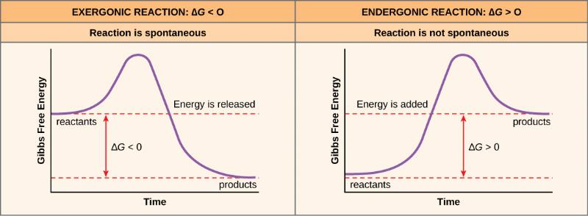
Some money is easy to earn, some money is hard to earn
Endergonic reactions – energy in
Many energy-storing molecules are made with endergonic reactions
Some energy-generating reactions are intentionally endergonic – “money is invested for much more money later on”
Exergonic reactions – energy out
Most energy-generating reactions are intentionally exergonic reactions

Slide 6
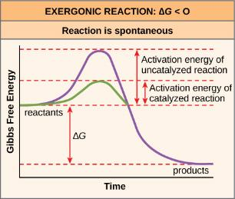
Activation energy
Input of energy to get reaction started
“friction” that must be overcome to “get the wheel rolling”
A catalyst is needed to lower this activation energy
Our reactions must be catalyzed for life to occur
Catalysts “grease the wheel”, or the road!!!
Enzymes catalyze nearly all biological reactions
Without functioning enzymes, our chemical reactions would not happen efficiently or at all
How enzymes work, watch this video:
https://www.youtube.com/watch?v=qgVFkRn8f10 or
https://www.youtube.com/watch?v=rlH1ym916Fo
Download for free at http://cnx.org/contents/185cbf87-c72e-48f5-b51e-f14f21b5eabd@10.61

Slide 7
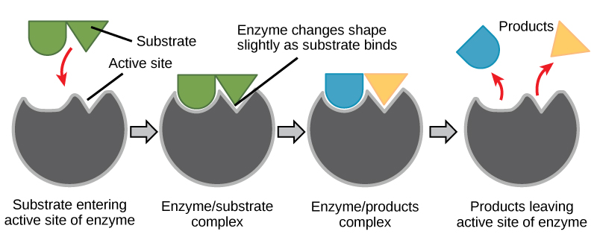
How Enzymes work: induced fit: the lock fits the key, then warps it to break the key easily!!
Download for free at http://cnx.org/contents/185cbf87-c72e-48f5-b51e-f14f21b5eabd@10.61

Slide 8
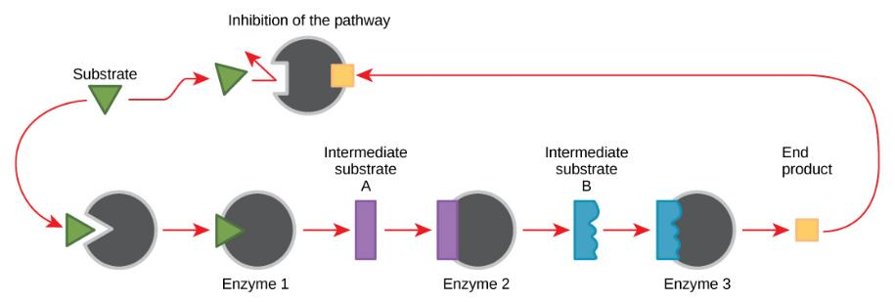
Feedback inhibition
A product that is too excessive will “turn off” the pathway by inhibiting the first or slowest enzyme, and therefore allow the product numbers to slowly decline as they get used up.

Slide 9
The Laws of Thermodynamics (Energy flow through a system)
The First Law of Thermodynamics (paraphrased)
Energy cannot be created nor destroyed, it will just change form
The Second Law of Thermodynamics (paraphrased)
As energy changes form, some of it will be lost as an unusable form

Slide 10
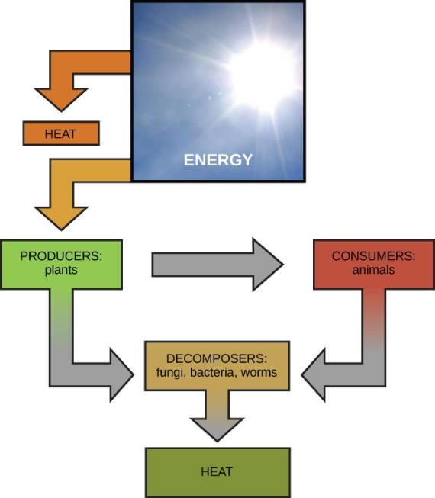
Download for free at http://cnx.org/contents/185cbf87-c72e-48f5-b51e-f14f21b5eabd@10.61

Slide 11
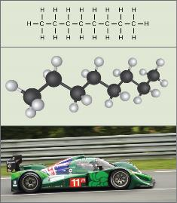
Chemical energy is stored as potential energy in bonds of molecules
Metabolism of Carbohydrates:
Photosynthesis
Anabolic reaction that is endergonic (energy in, energy from the sun is transformed into bonds in sugar molecule)
Cellular Respiration
Catabolic reaction that is exergonic (sugar is broken down and energy is released), the energy from this results in:
Anabolic reaction that is endergonic (that energy is put into the bonds of an ATP molecule, that ATP molecule can now be used by the cell for energy)
Download for free at http://cnx.org/contents/185cbf87-c72e-48f5-b51e-f14f21b5eabd@10.61

Slide 12
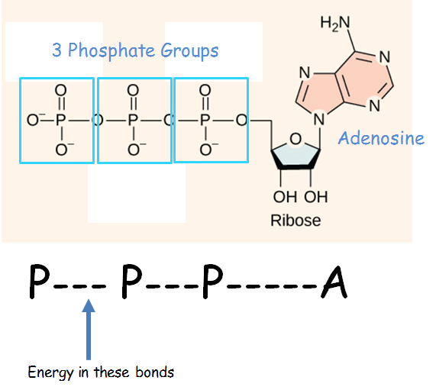
Biological energy: What is ATP?
Adenosine Triphosphate - ATP

Slide 13
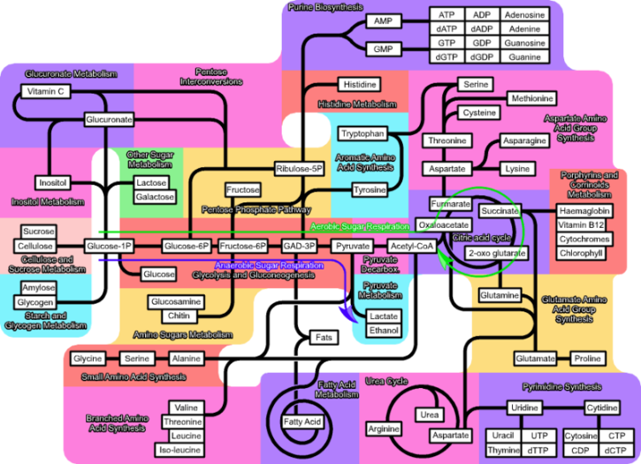
Cellular Metabolism is far more complicated – don’t need to know all of this!

Slide 14
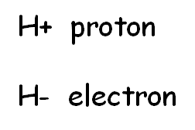
Redox Reactions
We can only get energy from sugar by burning (oxidizing) it!
Plants can only “make” energy by reducing CO₂ into sugars
With reactions of photosynthesis and cellular respiration, we are going to be following the electrons
That will allow us to see the transformation of the energy
Remember, we have to get the energy from the sun transformed to ATP so our cells can use that energy
REDOX reactions
Reduced – molecule gains electrons and hydrogens (becomes more negative)
Oxidized – molecule loses electrons and hydrogens
Remember this: OIL RIG
“oxidized it loses, reduced it gains”

