Slide 1
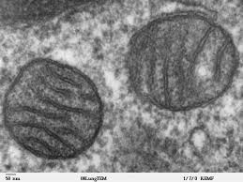
Chapter 5
Structure and Function of Plasma Membranes
Caption: Mitochondria, Mammalian Lung - TEM (c)Louisa
Howard, Public domain

Slide 2
Learning Objectives
The Structure of Membranes
Describe the components of biological membranes.
Explain the fluid mosaic model of membrane structure.
Phospholipids: The Membrane’s Foundation
Recall the different components of phospholipids.
Recall how membranes form spontaneously.
Describe the factors involved in membrane fluidity.

Slide 3
Figure 5.2
Download for free at http://cnx.org/contents/185cbf87-c72e-48f5-b51e-f14f21b5eabd@10.61
The fluid mosaic model of the plasma membrane describes the plasma membrane as a combination of phospholipids, cholesterol, and proteins (mosaic).
Lipids and protein move about the surface of the membrane freely (fluid)
Carbohydrates attached to lipids (glycolipids) and to proteins (glycoproteins) extend from the outward-facing surface of the membrane.

Slide 4
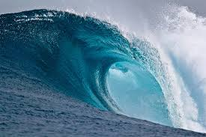
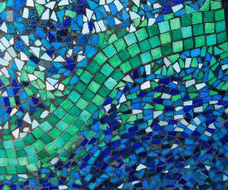
Membrane Structure
Phospholipids arranged in a bilayer (they are the water).
Globular proteins inserted in the lipid bilayer (they are the surfer, or the boat).
Fluid mosaic model
Fluid Mosaic
Caption: Large Breaking Wave (c)NOAA, Public domain
Caption: Mosaic Patterns (c)Ali Harrison,
Public domain

Slide 5
Membrane Structure
Cellular membranes have 4 components
Phospholipid bilayer
Flexible matrix, barrier to permeability
Transmembrane proteins
Integral membrane proteins
Interior protein network
Peripheral or Intracellular membrane proteins
Cell surface markers
Glycoproteins and glycolipids

Slide 6
Figure 5.7
Download for free at http://cnx.org/contents/185cbf87-c72e-48f5-b51e-f14f21b5eabd@10.61
The exterior surface of the plasma membrane is not identical to the interior surface of the same membrane.
Communication with tissues vs. intracellular needs
Are your outdoor things similar to your indoor things?

Slide 7
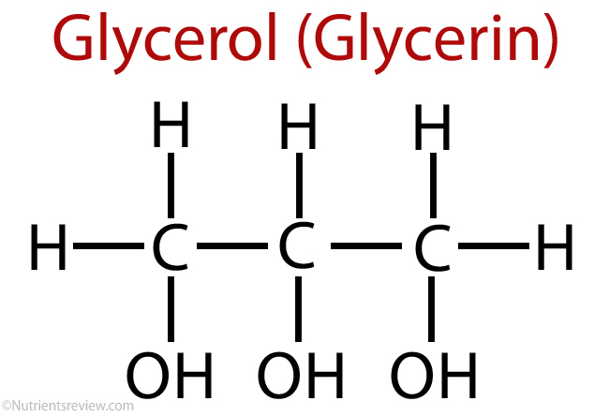
Phospholipids
Structure consists of
Glycerol – a 3-carbon tri-alcohol
2 fatty acids attached to the glycerol
Nonpolar and hydrophobic (“water-fearing”)
Phosphate group attached to the glycerol
Polar and hydrophilic (“water-loving”)
Spontaneously forms a bilayer to hide fatty acids from water
Fatty acids are on the inside
Phosphate groups are on both surfaces

Slide 8
Figure 5.3
This phospholipid molecule is composed of a hydrophilic head and two hydrophobic tails.
The hydrophilic head group consists of a phosphate-containing group attached to a glycerol molecule.
The hydrophobic tails, each containing either a saturated or an unsaturated fatty acid (usually one of each), are long hydrocarbon chains.
Download for free at http://cnx.org/contents/185cbf87-c7
2e-48f5-b51e-f14f21b5eabd@10.61

Slide 9
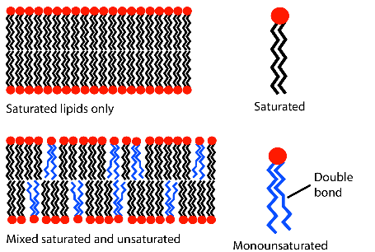
Environmental influences on membrane fluidity
Saturated fatty acids: makes membrane less fluid than unsaturated fatty acids – useful for “firmer” structure and better molecular retention, BUT…
Unsaturated fatty acids: makes membrane sufficiently fluid to allow protein motion and cell membrane-based signaling
“Kinks” introduced by the double bonds force spreading of lipids
keeps them from packing too close together
Warm temperatures make membrane more fluid than cold
Cold tolerance in bacteria due to unsaturated fatty acids
(this is why polyunsaturated fatty acids like ω-3’s are co common in cold-water krill and fish)
Viscous – saturated,
well-packed hydrocarbon tails
Fluid – unsaturated, unpacked hydrocarbon tails with kinks
Caption: Lipid Unsaturation Effect (c)MDougM, Public domain

Slide 10
Figure 5.4
In an aqueous solution, phospholipids tend to arrange themselves with their polar heads facing outward and their hydrophobic tails facing inward.
Membranes form because of the hydrophobic effect – oily parts make bilayer to hide from water on either side
Download for free at http://cnx.org/contents/185cbf87-c7
2e-48f5-b51e-f14f21b5eabd@10.61
Credit: modification of work by Mariana Ruiz Villareal

Slide 11
Learning Objectives
Proteins: Multifunctional Components
Describe the functions of membrane proteins.
Discuss how proteins can associate with the membrane.
Describe a transmembrane domain.
Passive Transport Across Membranes
Compare simple diffusion and facilitated diffusion.
Differentiate between channel proteins and carrier proteins.
Predict the direction of water movement by osmosis.

Slide 12
Membrane Proteins
Various functions:
Transporters
Enzymes
Cell-surface receptors
Cell-surface identity markers
Cell-to-cell adhesion proteins
Attachments to the cytoskeleton

Slide 13
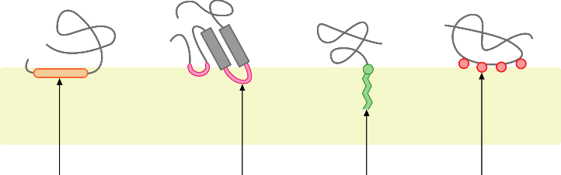
Membrane Proteins
Diverse functions arise from the diverse structures of membrane proteins
Peripheral proteins
Anchoring molecules attach membrane protein to surface
They do NOT go through the entire bilayer
Different peripheral proteins
Caption: Monotopic Membrane Protein (c)Foobar, Public domain

Slide 14
Membrane Proteins
Integral membrane proteins
Completely span the lipid bilayer (transmembrane proteins)
Nonpolar, hydrophobic regions of protein within the interior of bilayer
Polar regions of the protein protrude from both sides of the bilayer
The transmembrane domain is a segment of hydrophobic amino acids that spans the lipid bilayer arranged in an α-helix

Slide 15
Figure 5.5
Download for free at http://cnx.org/contents/185cbf87-c72e-48f5-b51e-f14f21b
5eabd@10.61
Credit: “Foobar”/Wikimedia Commons
Integral membrane proteins have one or more α-helices that span the membrane (examples 1 and 2), or they may have β-sheets that span the membrane in a can-like form (example 3).

Slide 16
Figure 5.6
HIV binds to the CD4 receptor, a glycoprotein on the surfaces of T cells.
Download for free at http://cnx.org/contents/185cbf87-c7
2e-48f5-b51e-f14f21b5eabd@10.61
Credit: modification of work by NIH, NIAID

Slide 17
Proteins need only a single transmembrane domain to be anchored in the membrane, but they often have more than one such domain.
Pores
Extensive nonpolar regions within a transmembrane protein can create a pore (a hole) through the membrane
Cylinder of β sheets in the protein secondary structure (β-barrel)
Interior is polar and allows water and small polar molecules to pass through the membrane

Slide 18
Passive Transport

Slide 19
Passive Transport
Passive Transportation: DOES NOT require energy, goes with the concentration gradient
Diffusion
Facilitated Diffusion
Channel Proteins
Ion Channels
Gated Channel
Carrier proteins
Osmosis

Slide 20
Figure 5.8
Download for free at http://cnx.org/contents/185cbf87-c72e-48f5-b51e-f14f21b5eabd@10.61
Credit: modification of work by Mariana Ruiz Villareal
Diffusion through a permeable membrane moves a substance from an area of high concentration (extracellular fluid, in this case) down its concentration gradient (into the cytoplasm, in this case) where the concentration is low. Molecules can migrate back, but more are coming in than going out.
This will continue until the concentration is the same in all regions, and equal numbers are going in and out (equilibrium).

Slide 21
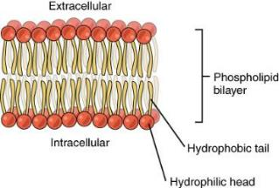
Membrane is Selectively Permeable
A major barrier to crossing a biological membrane is the hydrophobic interior that repels polar molecules but not nonpolar molecules
Nonpolar molecules will move until the concentration is equal on both sides
Limited permeability to small polar molecules
Very limited permeability to larger polar molecules and ions
Caption: 0302 Phospholipid Bilayer (c)OpenStax,
Public domain

Slide 22
Membrane is Selectively Permeable
Facilitated Diffusion:
Molecules that cannot cross membrane easily may move through proteins much faster
Move from higher to lower concentration (passive, no energy!)
Channel proteins
Hydrophilic channel when open (they are regulated)
Example: Ion Channels
Carrier proteins
Bind specifically to molecules they assist

Slide 23
Channel Proteins
Ion Channels
Allow the passage of ions
Gated channels: open or close in response to stimulus (chemical or electrical)
3 conditions determine direction
Relative concentration on either side of membrane
Voltage differences across membrane
Gated channels: channel open or closed

Slide 24
Figure 5.9
Download for free at http://cnx.org/contents/185cbf
87-c72e-48f5-b51e-f14f21b5eabd@10.61
Credit: modification of work by Mariana Ruiz Villareal
Facilitated transport moves substances down their concentration gradients. They may cross the plasma membrane with the aid of channel proteins. They are usually selective for specific solutes to prevent everything from leaking through

Slide 25
Carrier Proteins
Help transport ions and some sugars and amino acids
Requires a concentration difference across the membrane
Must bind to the molecule they transport
Saturation: rate of transport limited by number of transporters
Think people exiting a classroom through only 2 doors versus one door.

Slide 26
Figure 5.10
Download for free at http://cnx.org/contents/185cbf87-c72e-48f5-b51e-f14f21b5eabd@10.61
Credit: modification of work by Mariana Ruiz Villareal
Some substances are able to move down their concentration gradient across the plasma membrane with the aid of carrier proteins.
Carrier proteins change shape as they move molecules across the membrane.

Slide 27
Osmosis
Cytoplasm of the cell is an aqueous solution
Water is solvent
Dissolved substances are solutes
Osmosis – net diffusion of water across a membrane toward a higher solute concentration
Water moves from “pure” to “less pure”
Water moves to dilute a concentrated source of solute

Slide 28
Figure 5.11
Download for free at http://cnx.org/contents/185cbf87-c72e-48f5-b51e-f14f21b5eabd@10.61
In osmosis, water always moves from an area of higher water concentration (more pure; less solute) to one of lower concentration (less pure; more solute). Water acts to dilute solutes.
In the diagram shown, the solute cannot pass through the selectively permeable membrane, but the water can.
Could this be used to concentrate solutions????

Slide 29
Osmotic Concentration
When 2 solutions have different osmotic concentrations…
The Hypertonic Solution has a higher solute concentration
The Hypotonic Solution has a lower solute concentration
When two solutions have the same osmotic concentration, the solutions are isotonic
Aquaporins facilitate osmosis, by allowing water to equilibrate at a defined maximal rate

Slide 30
Figure 5.12
Download for free at http://cnx.org/contents/185cbf87-c72e-48f5-b51e-f14f21b5eabd@10.61
Credit: Mariana Ruiz Villareal
Osmotic pressure changes the shape of red blood cells in hypertonic, isotonic, and hypotonic solutions.

Slide 31
Figure 5.13
Download for free at http://cnx.org/contents/185cbf87-c72e-48f5-b51e-f14f21b5eabd@10.61
Credit: modification of work by Mariana Ruiz Villareal
The turgor pressure within a plant cell depends on the tonicity of the solution that it is bathed in.
Vacuoles act as osmotic buffers to release water for plant when water dried out but absorb water when water is too diluted.

Slide 32
Osmotic Pressure
Force needed to stop osmotic flow
Cell in a hypotonic solution gains water causing cell to swell – creates pressure
If membrane strong enough, cell reaches counterbalance of osmotic pressure driving water in with hydrostatic pressure driving water out
Cell wall of prokaryotes, fungi, plants, protists
If membrane and cell wall is not strong, the cell may burst under hypotonic conditions
Cell walls destabilized with penicillins or lysozyme are much more susceptible
Animal cells must be in isotonic environments

Slide 33
Maintaining Osmotic Balance
Some cells use extrusion in which water is ejected through contractile vacuoles
Isosmotic regulation involves keeping cells isotonic with their environment
Marine organisms adjust internal concentration to match sea water
Terrestrial animals circulate isotonic fluid
Plant cells use turgor pressure to push the cell membrane against the cell wall and keep the cell rigid

Slide 34
Figure 5.14
Download for free at http://cnx.org/contents/185cbf87-c72e-48f5-b51e-f14f21b5eabd@10.61
Credit: Victor M. Vicente Selvas
Without adequate water, the plant on the left has lost turgor pressure, visible in its wilting; the turgor pressure is restored by watering it (right).

Slide 35
Figure 5.15
Download for free at http://cnx.org/contents/185cbf87-c72e-48f5-b51e-f14f21b5eabd@10.61
Credit: modification of work by NIH; scale-bar data from Matt Russell
A paramecium’s contractile vacuole, here visualized using bright field light microscopy at 480x magnification, continuously pumps water out of the organism’s body to keep it from bursting in a hypotonic medium.

Slide 36
Learning Objectives
Active Transport Across Membranes
Differentiate between active transport and diffusion.
Describe the function of the Na+/K+ pump.
Explain the energetics of coupled transport.
Bulk Transport by Endocytosis and Exocytosis
Distinguish between endocytosis and exocytosis.
Describe how endocytosis can be specific.

Slide 37
Active Transport

Slide 38
Active Transport
Active Transportation: requires energy, against concentration gradient
Uniport, symport, antiport
Na⁺–K⁺ Pump
Coupled Transport

Slide 39
Active Transport
Requires Energy: ATP is used directly or indirectly to fuel active transport
Moves substances from low to high concentration
Requires the use of highly selective carrier proteins

Slide 40
Figure 5.16
Download for free at http://cnx.org/contents/185cbf87-c72e-48f5-b51e-f1
4f21b5eabd@10.61
Credit: “Synaptitude”/Wikimedia Commons
Potassium ions “really want” to get to the left, both by concentration and by a net charge at the membrane.
Being held back, it creates a gradient, and can be used as a source of energy
Electrochemical gradients arise from the combined effects of concentration gradients and electrical gradients.

Slide 41
Active Transport
Carrier proteins used in active transport include
Uniporters: move one molecule at a time
Symporters: move two molecules in the same direction
Antiporters: move two molecules in opposite directions
Terms can also be used to describe facilitated diffusion carriers (when no energy required)

Slide 42
Figure 5.17
Download for free at http://cnx.org/contents/185cbf87-c72e-48f5-b51e-f14f21b5eabd@10.61
Credit: modification of work by “Lupask”/Wikimedia Commons
A uniporter carries one molecule or ion.
A symporter carries two different molecules or ions, both in the same direction.
An antiporter also carries two different molecules or ions, but in different directions.

Slide 43
Figure 5.18
Download for free at http://cnx.org/contents/185cbf87-c72e-48f5-b51e-f14f21b5eabd@10.61
Credit: modification of work by Mariana Ruiz Villareal
Primary active transport moves ions across a membrane, creating an electrochemical gradient (electrogenic transport).

Slide 44
Figure 5.19
Download for free at http://cnx.org/contents/185cbf87-c72e-48f5-b51e-f14f21b5eabd@10.61
Credit: modification of work by Mariana Ruiz Villareal
An electrochemical gradient, created by primary active transport, can move other substances against their concentration gradients, a process called co-transport or secondary active transport.

Slide 45
Active Transport
Sodium–Potassium (Na⁺–K⁺) Pump:
Direct use of ATP for active transport
Antiporter moves…
3 Na⁺ out of the cell
2 K⁺ into the cell
Both go against their concentration gradient
ATP energy changes conformation of carrier protein
convinces both ions to bind, and traps the easy escape

Slide 46
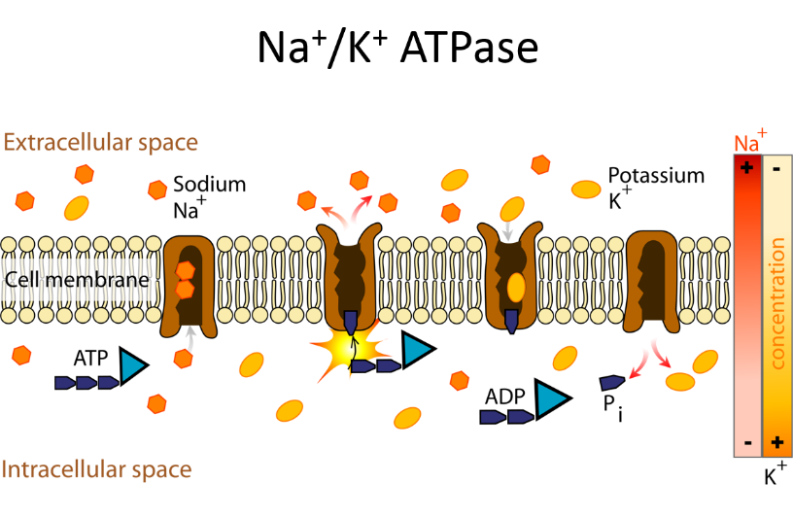
Antiporter
Download for free at http://cnx.org/contents/185cbf87-c72e-48f5-b51e-f14f21b5eabd@10.61

Slide 47
Active Transport
Coupled Transport:
Uses ATP indirectly; uses Symporter
Molecules moved against their concentration gradient using energy stored in a gradient of a different molecule
Sodium-Glucose Symporter:
Captures the energy from Na⁺ diffusion to move glucose against a concentration gradient

Slide 48
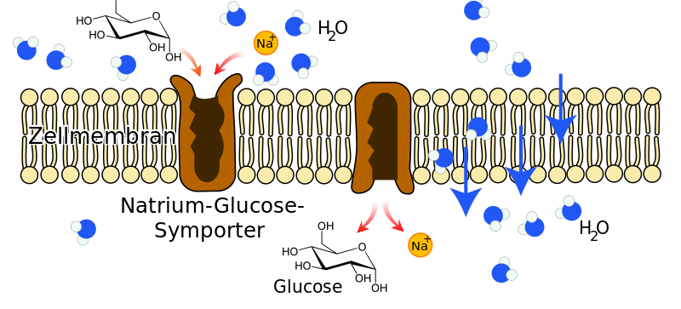
Na⁺ - Glucose Symporter
Caption: Na-Glucose-Symporter (c)Furfur, Public domain

Slide 49
Bulk Transport
Endocytosis
Movement of substances into the cell
Phagocytosis – cell takes in particulate matter
Pinocytosis – cell takes in only fluid
Receptor-mediated endocytosis – specific molecules are taken in after they bind to a receptor, formation of clathrin-coated pits and vesicles
Exocytosis
Movement of substances out of cell
Requires energy

Slide 50
Figure 5.20
In phagocytosis, the cell membrane surrounds the particle and engulfs it.
Download for free at http://cnx.org/contents/185cbf87-c72e-48
f5-b51e-f14f21b5eabd@10.61
Credit: Mariana Ruiz Villareal

Slide 51
Figure 5.21
In pinocytosis, the cell membrane invaginates, surrounds a small volume of fluid, and pinches off.
Download for free at http://cnx.org/contents/185cbf87-c72e-4
8f5-b51e-f14f21b5eabd@10.61
Credit: Mariana Ruiz Villareal

Slide 52
Figure 5.22
In receptor-mediated endocytosis, uptake of substances by the cell is targeted to a single type of substance that binds to the receptor on the external surface of the cell membrane.
Download for free at http://cnx.org/contents/185cbf87-c
72e-48f5-b51e-f14f21b5eabd@10.61
Credit: modification of work by Mariana Ruiz Villareal

Slide 53
Figure 5.23
In exocytosis, vesicles containing substances fuse with the plasma membrane. The contents are then released to the exterior of the cell.
Download for free at http://cnx.org/contents/185cbf87-c72e-48f5-b51e-f14f21b5eabd@10.61
credit: modification of work by Mariana Ruiz Villareal

