Slide 1
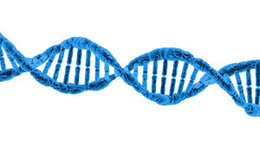
Chapter 3 Macromolecules
General Biology I
BSC 2010
Caption: DNA Structure (c)Pixabay, Public domain

Slide 2
Types of Macromolecules
Monomer – small, similar chemical subunits
Polymer – built by linking monomers
Monomers
Polymers

Slide 3
Types of Macromolecules
Macromolecules: large biological molecules
Proteins: polymers of amino acids monomers
Carbohydrates: polymers of monosaccharides
3. Nucleic acids: polymers of nucleotides
4. Lipids: aren’t built of monomers but form large complexes considered macromolecules

Slide 4
Building Macromolecules
Dehydration Synthesis
Formation of large molecules by the removal of water
Monomers are joined to form polymers
Monomers
Polymer
Caption: Dehydration Synthesis and Hydrolysis (c) OpenStax College, Public domain

Slide 5
Breaking Macromolecules
Hydrolysis
Breakdown of large molecules by the addition of water (hydro=water, lysis=break)
Polymers are broken down to monomers
Polymer
Monomers
Caption: Dehydration Synthesis and Hydrolysis (c) OpenStax College, Public domain

Slide 6
Carbohydrates
Molecules with a 1:2:1 ratio of carbon, hydrogen, oxygen
Empirical formula (CH₂O)_{n}
C-H covalent bonds hold a lot of energy and are quickly broken down
Carbohydrates are good energy storage molecules
Examples: starch, glycogen, glucose

Slide 7
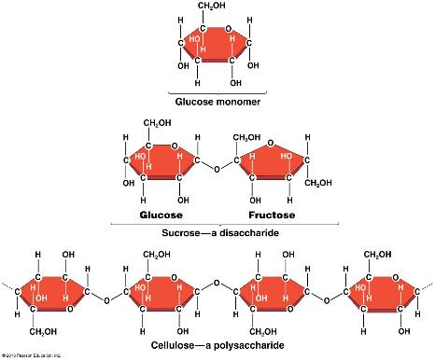
Carbohydrates
Three Major Groups:
Monosaccharaides
Disaccharides
Polysaccharides
Know definition, example, functions, and how they form for each.
Example: Starch is an energy storage molecule that is formed of glucose molecules linked by covalent bonds through dehydration synthesis.

Slide 8
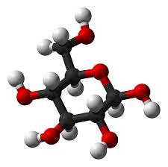
Monosaccharides
Simplest carbohydrate
6 carbon sugars play important roles
Glucose C₆H₁₂O₆
Glucose (C₆H₁₂O₆)
Caption: Alpha–D-glucose (c)Ben Mills, Public domain

Slide 9
Monosaccharides
Examples of Monosaccharides:
Glucose
Fructose is a structural isomer of glucose
Galactose is a stereoisomer of glucose – used for structural needs
Ribose is a chemically different sugar - used for nucleic acids
Enzymes that act on different sugars can distinguish structural and stereoisomers of this basic six-carbon skeleton

Slide 10
Monosaccharides are classified based on the position of their carbonyl group and the number of carbons in the backbone.
Trioses, pentoses, and hexoses have three, five, and six carbon backbones, respectively.
Download for free at http://cnx.org/contents/185cbf87-c72e-48f5-b5
1e-f14f21b5eabd@10.61

Slide 12
Five and six carbon monosaccharides exist in equilibrium between linear and ring forms. When the ring forms, the side chain it closes on is locked into an α or β position.
Fructose and ribose also form rings, although they form five-membered rings as opposed to the six-membered ring of glucose.
Download for free at http://cnx.org/contents/185cbf87-c72e-48f5-b51e-f14
f21b5eabd@10.61

Slide 13
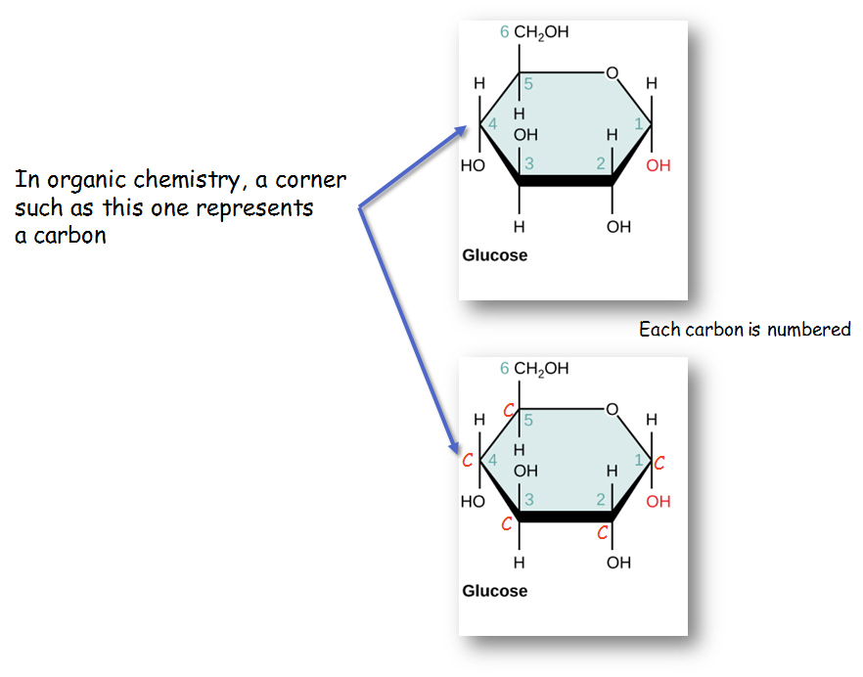
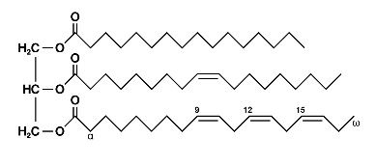
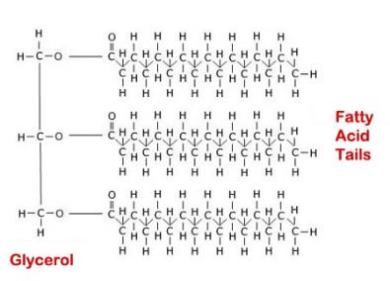

Slide 14
Disaccharides
2 monosaccharides linked together by dehydration synthesis
Used for sugar transport or energy storage
Examples: sucrose, lactose, maltose

Slide 15
Sucrose is formed when a monomer of glucose and a monomer of fructose are joined in a dehydration reaction to form a glycosidic bond. In the process, a water molecule is lost. By convention, the carbon atoms in a monosaccharide are numbered from the terminal carbon closest to the carbonyl group. In sucrose, a glycosidic linkage is formed between carbon 1 in glucose and carbon 2 in fructose.
Download for free at http://cnx.org/contents/185cbf87-c72e-48f5-b51e-f
14f21b5eabd@10.61

Slide 16
Polysaccharides
Long chains of monosaccharides
Linked through dehydration synthesis
Four major classes:
Starch: energy storage in plants (rice, pasta, potatoes)
Glycogen: short term energy storage in animals
Cellulose: structural molecule of plants (dietary fiber: this is why fiber is listed under the carbohydrate section of food label).
Chitin: structural support in insects, arthropods (exoskeleton), fungal cell walls

Slide 17
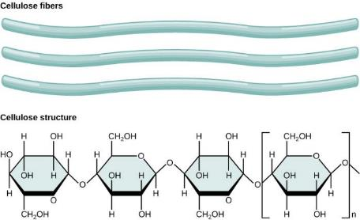
Note the parallel array of monomeric sugars
note the anti parallel array of monomeric sugars
Download for free at http://cnx.org/contents/185cbf87-c7
2e-48f5-b51e-f14f21b5eabd@10.61

Slide 18
Download for free at http://cnx.org/contents/185cbf87-c72e-48f5-b
51e-f14f21b5eabd@10.61
Credit: Louise Docker
Insects have a hard outer exoskeleton made of chitin, a type of polysaccharide (like cellulose, but made of glucosamine instead of glucose).

Slide 19
Carbohydrates:
Monomer – monosaccharides
Covalent bond name – glycosidic linkage

Slide 20
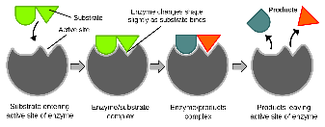
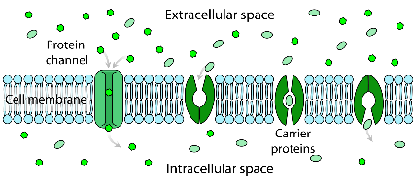
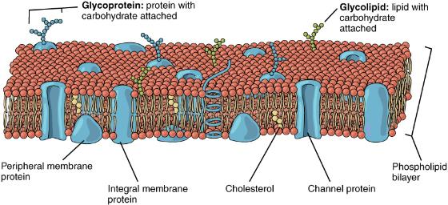
Proteins
Protein functions include:
1. Enzyme catalysis
2. Defense
3. Transport
4. Support
5. Motion
6. Regulation
7. Storage

Slide 21
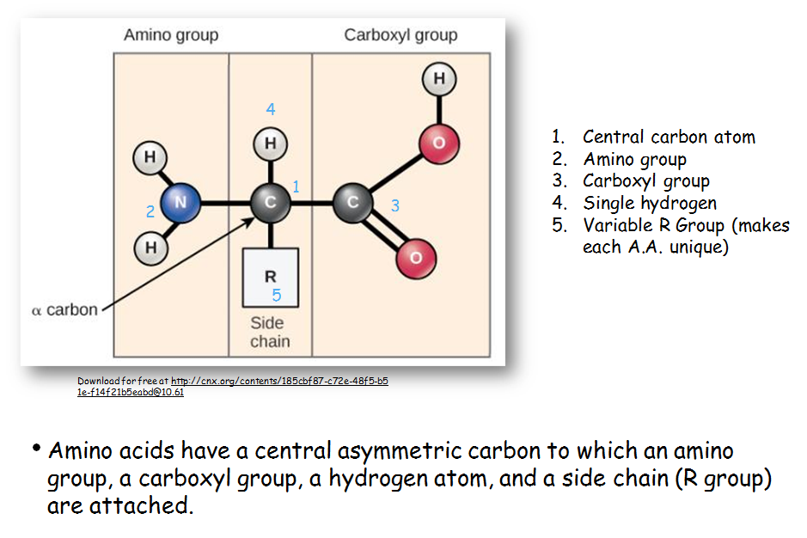

Slide 22
There are 20 common amino acids commonly found in proteins, each with a different R group (blue box) that determines its chemical nature.
You do not have to memorize all 20 individual amino acids
You need to know that some are:
Nonpolar
Polar uncharged
Polar charged
Download for free at http://cnx.org/contents/185cbf87-c72e-48f5-b51e-f14f21b5eab
d@10.61

Slide 23
Download for free at http://cnx.org/contents/185cbf87-c72e-48f5-b51e-f14f2
1b5eabd@10.61
Peptide bond formation is a dehydration synthesis reaction. The carboxyl group of one amino acid is linked to the amino group of the incoming amino acid. In the process, a molecule of water is released.

Slide 24
Proteins
Proteins are polymers made of Amino Acid monomers
There are 20 amino acids
Combinations of these 20 AA make up long chains from 2 to over 5,000 or more AA in length
Each chain is a polypeptide
AA link together by a peptide bond to form the long chain polymers of proteins

Slide 25
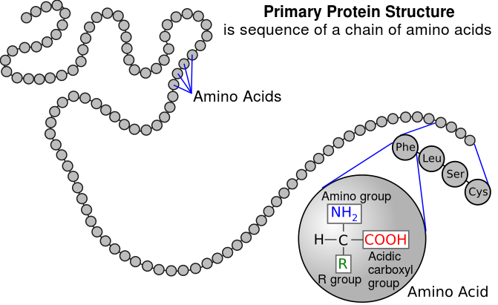
4 Levels of Protein Structure
Primary structure: sequence of amino acids
Amino acids linked by peptide bonds
Millions of different proteins made from the 20 A.A.
A.A. sequence: amino acids given 3 or 1 letter abbreviation
Caption: Primary Protein Structure (c) National Human Genome Research Institute, Public domain

Slide 26
Secondary Protein Structure
Download for free at http://cnx.org/contents/185cbf87-c72e-48f5-b51e-f14f2
1b5eabd@10.61
The α-helix and β-pleated sheet are secondary structures of proteins that form because of hydrogen bonding between carbonyl and amino groups in the peptide backbone. Certain amino acids have a propensity to form an α-helix, while others have a propensity to form a β-pleated sheet.

Slide 27
Download for free at http://cnx.org/contents/185cbf87-c72e-48f5-b51e-f14f21b5eabd@10.61
The tertiary structure of proteins is determined by a variety of chemical interactions. These include hydrophobic interactions, ionic bonding, hydrogen bonding and disulfide linkages. The final level of structure for proteins that consists of only a single polypeptide chain.

Slide 28
Quaternary structure: arrangement of individual chains (subunits) in a protein with 2 or more polypeptide chains.
Caption: Main Protein Structure Levels
(c)LadyofHats, Public domain

Slide 29
The four levels of protein structure can be observed in these illustrations. (credit: modification of work by National Human Genome Research Institute)
Know the names of all four levels
Download for free at http://cnx.org/contents/185cbf87-c72e-48f5-b5
1e-f14f21b5eabd@10.61

Slide 30
Additional Structural Characteristics
Domains
Functional units within a larger structure
Often each tertiary structure has its own single domain
Most proteins made of multiple domains that perform different parts of the protein’s function
Example: enzyme’s active site
Example: bind substrate
Example: anchor to membrane, actin, DNA

Slide 31
Chaperones
Chaperone proteins: help proteins fold correctly or keep folded properly
Deficiencies in chaperone proteins implicated in certain diseases
Cystic fibrosis is a hereditary disorder
In some individuals, protein appears to have correct amino acid sequence but fails to fold

Slide 32
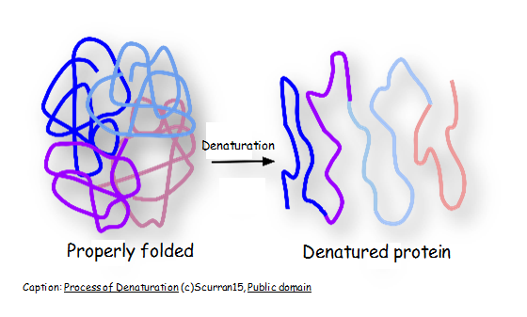
Denaturation
Denature: Protein loses structure and function
Due to environmental conditions
pH
Temperature
Ionic concentration of solution
Sometimes reversible; usually not
Think fried eggs, yogurt

Slide 33
Dissociation
Subunits may be dissociated without losing their individual tertiary structure
Hemoglobin
Caption: 1904 Hemoglobin (c)OpenStax College, Public domain

Slide 34
Proteins
Monomer – amino acids
Covalent bond – peptide bond

Slide 35
Nucleic Acids
Polymer: nucleic acids
Monomers: nucleotides
Nucleotide: sugar + phosphate + nitrogenous base
Sugar is deoxyribose in DNA or ribose in RNA
Caption: DNA Nucleotides (c) OpenStax College, Public domain

Slide 36
Nitrogeneous bases in Nucleotides
A nucleotide is made up of three components:
A nitrogenous base (A, T, G, C, U)
A pentose sugar
One or more phosphate groups.
Carbon residues in the pentose are numbered 1′ through 5′ (the prime distinguishes these residues from those in the base, which are numbered without using a prime notation).
Bases can be divided into two categories:
Purines have a double ring structure
Pyrimidines have a single ring.

Slide 37
Sugars in Nucleotides
Two types of pentose are found in nucleotides, deoxyribose (found in DNA) and ribose (found in RNA). Deoxyribose is similar in structure to ribose, but it has an H instead of an OH at the 2′ position.
RNA!!!!!

Slide 38
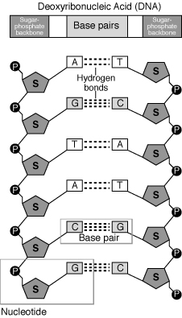
Caption: Nucleotide (c) Mirmillon, Public domain

Slide 39
Download for free at http://cnx.org/contents/185cbf87-c72e-48f5-b51e-f14f21b5eabd@10.61
In a double stranded DNA molecule, the two strands run antiparallel to one another so that one strand runs 5′ to 3′ and the other 3′ to 5′.
The phosphate backbone is located on the outside, and the bases are in the middle, aligned like stairs stacked on top of one another along a spiral staircase.
Adenine forms hydrogen bonds (or base pairs) with thymine, and guanine base pairs with cytosine.

Slide 40
Deoxyribonucleic Acid (DNA)
Genes: Encodes information for amino acid sequence of proteins
Sequence of bases (A, T, C, G)
Double helix
Base-pairing rules
A with T (or U in RNA)
C with G
DNA Strand 1: T T A C G G A T C
DNA Strand 2: _ _ _ _ _ _ _ _ _

Slide 41
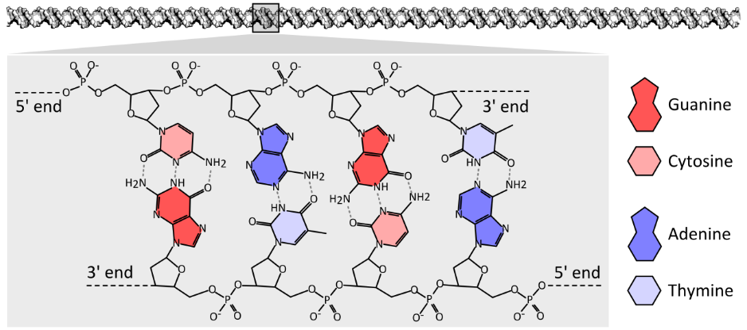
C
T
A
G
G
A
T
C
Caption: The Chemical Structure of a Four Base Pair Fragment of a DNA Double Helix (c)Thomas Shafee, Public domain
Nucleotides: sugar + phosphate + nitrogenous base
Nitrogenous bases include
Purines: adenine and guanine
Pyrimidines: thymine, cytosine, uracil (RNA only)

Slide 42
Ribonucleic Acid (RNA)
RNA similar to DNA except
Contains ribose instead of deoxyribose
Contains uracil instead of thymine
Single stranded
RNA plays many roles in the cell
Messenger RNA (mRNA): DNA encodes the information to make proteins, mRNA relays this info to the structures that make proteins
DNA is protected from the protein production process
Ribosomal RNA (rRNA) and Transfer RNA (tRNA) also needed for protein production
Notes:
)

Slide 43
Download for free at http://cnx.org/contents/185cbf87-c72e-48f5-b51e-f14f21b5eabd@10.61
A ribosome has two parts: a large subunit and a small subunit.
The mRNA sits in between the two subunits, anchored and oriented by the small subunit.
A tRNA molecule recognizes a codon on the mRNA, binds to it by complementary base pairing, and adds the correct amino acid to the growing peptide chain.

Slide 44
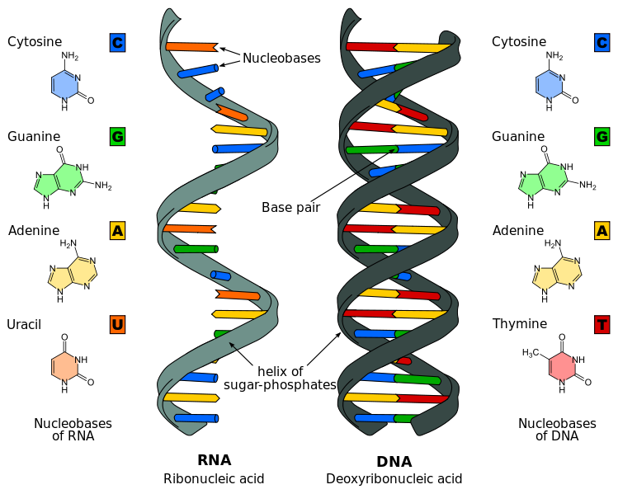
Caption: Difference in DNA and RNA (c)Sponk, Public domain

Slide 45
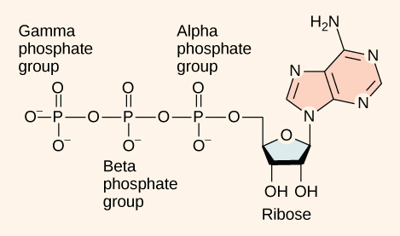
Other nucleotides
ATP Adenosine TriPhosphate
Primary energy currency of the cell
Caption: Figure 06 04 01 – Adenosine Triphosphate (c)CNX Openstax, Public domain
adenosine

Slide 46
Other nucleotides
GTP Guanosine TriPhosphate
Signal transduction activating molecule
NAD Nicotine Adenine Dinucleotide
Cofactor for oxidation/reduction reactions
FAD Flavin Adenine Dinucleotide
Cofactor for oxidation/reduction reactions

Slide 47
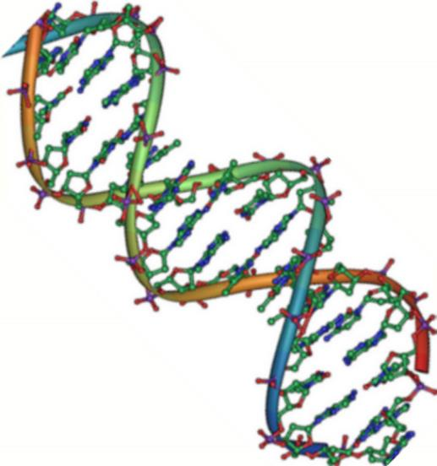
Nucleic Acids
Monomer – nucleotides (made up of phosphate group, sugar and nitrogeneous base)
Covalent bond linking one nucleotide to another – phosphodiester bond
Remember that hydrogen bonds hold the 2 strands of DNA together

Slide 48
Lipids
Group of nonpolar compounds
hydrophobic
insoluble in water
Not polymers
Examples: Fats, oils, waxes, cholesterol, hormones, some vitamins
Excellent for energy storage
Due to high number of C-H bonds

Slide 49
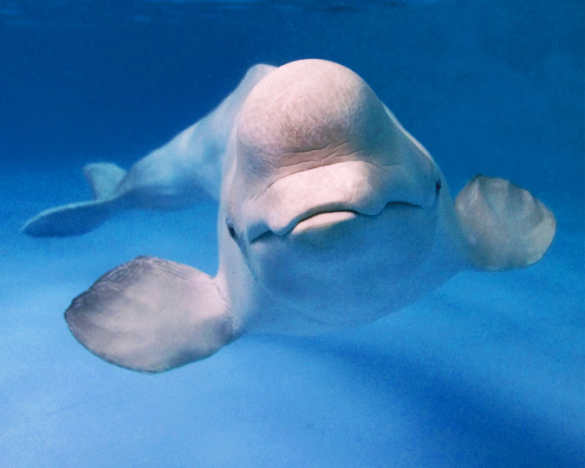
Caption: Premier Beluga (c) Premier, Public domain
Hydrophobic lipids in the blubber of aquatic mammals, such as this whale, protect them from the elements.

Slide 50
Lipids: Fats
Fatty acids
Saturated: no double bonds between carbon atoms
Higher melting point, usually animal origin
Solid at room temperature
Unsaturated: 1 or more double bonds
Low melting point, usually plant origin
Liquid at room temperature
Trans fats: produced industrially

Slide 51
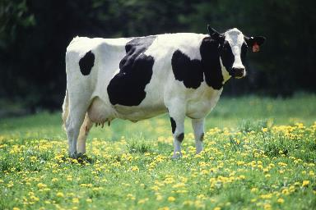
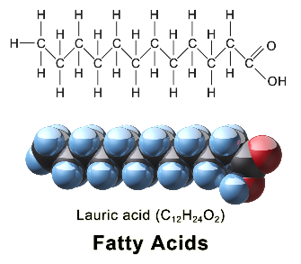
Saturated:
No double bonds
Solid at room temperature
Animal origin
Caption: Cow Female Black White
(c) Keith Weller, Public domain
Caption: Saturated Fatty Acid (c)BruceBlaus,
Public domain

Slide 52
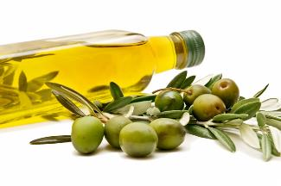
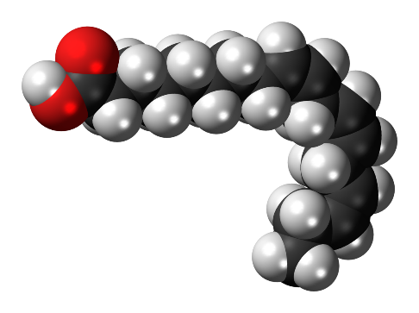
Unsaturated:
1 or more double bonds
Liquid at room temperature due to “kinks”
Plant origin
Caption: Extra Virgin Olive Oil (c)USDA, Public
domain
Caption:Alpha-Linolenic-acid-3D-spacefill (c) Jynto, Public
domain

Slide 53
Stearic acid is a common saturated fatty acid.
(No double bonds between carbon atoms)
Download for free at http://cnx.org/contents/185cbf87-c72e-48f5-b51e-f14f21b5eabd@10.61

Slide 54
Oleic acid is a common unsaturated fatty acid.
(One or more double bonds between carbon atoms)
Download for free at http://cnx.org/contents/185cbf87-c72e-48f5-b51e-f14f21b5eabd@10.61

Slide 55
Download for free at http://cnx.org/contents/185cbf87-c72e-48f5-b51ef14f21b5
eabd@10.61
Credit: Roger Griffith
Waxy coverings on some leaves are made of lipids.

Slide 56
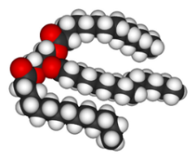
Lipids: Fats
Triglycerides
Composed of 1 glycerol and 3 fatty acids
Caption: Triglycerides (c)OpenStax College, Public domain
Caption: Trimyristin 3D (c)Wikimedia Commons, Public domain

Slide 57
Triacylglycerol is formed by the joining of three fatty acids to a glycerol backbone in a dehydration reaction. Three molecules of water are released in the process.
Download for free at http://cnx.org/contents/185cbf87-c72e-48f5-b51
e-f14f21b5eabd@10.61

Slide 58
A phospholipid is a molecule with two fatty acids and a modified phosphate group attached to a glycerol backbone.
The phosphate may be modified by the addition of charged or polar chemical groups (The R group).
Four chemical groups that may modify the phosphate (choline, ethanolamine, serine, and inositol), attach to the phosphate group at the position labeled R via the hydroxyl group indicated in green.
Download for free at http://cnx.org/contents/185cbf87-c72e-48f5-b51e
-f14f21b5eabd@10.61

Slide 59
Download for free at http://cnx.org/contents/185cbf87-c72e-48f5-b51e-f14f21b5eabd@10.61
The phospholipid bilayer is the major component of all cellular membranes. The hydrophilic head groups of the phospholipids face the aqueous solution. The hydrophobic tails are sequestered in the middle of the bilayer. This provides a continuous molecular interface separating the two aqueous regions so any molecule can contact the membrane (necessary to transport).

Slide 60
Steroids such as cholesterol and cortisol are composed of four fused hydrocarbon rings.
Cholesterol is mainly synthesized in the liver and is the precursor to many steroid hormones such as testosterone, cortisol, and estradiol
Cholesterol is also the precursor for digestive detergents called bile salts
Cholesterol is precursor to vitamin D and important in plasma membranes
Download for free at http://cnx.org/contents/185cbf87-c72e-48
f5-b51e-f14f21b5eabd@10.61

