Slide 1

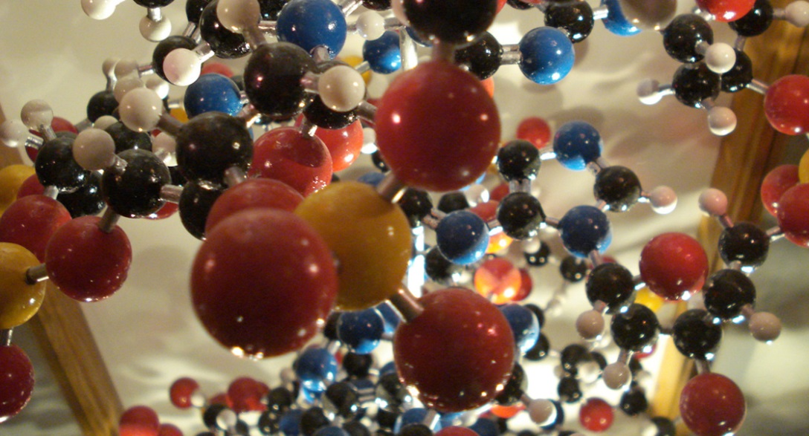
Chapter 2 - Chemistry
General Biology I
BSC 2010
Download for free at http://cnx.org/contents/185cbf87-c72e-48f5-b51e-f14f21b5eabd@10.61

Slide 2
Atoms are the Building Blocks
Atoms are the building blocks of molecules found in the universe—air, soil, water, rocks . . . and the macromolecules found in living things.
All biological processes follow the laws of physics and chemistry.
Therefore, it is important to understand some basic chemistry.

Slide 3
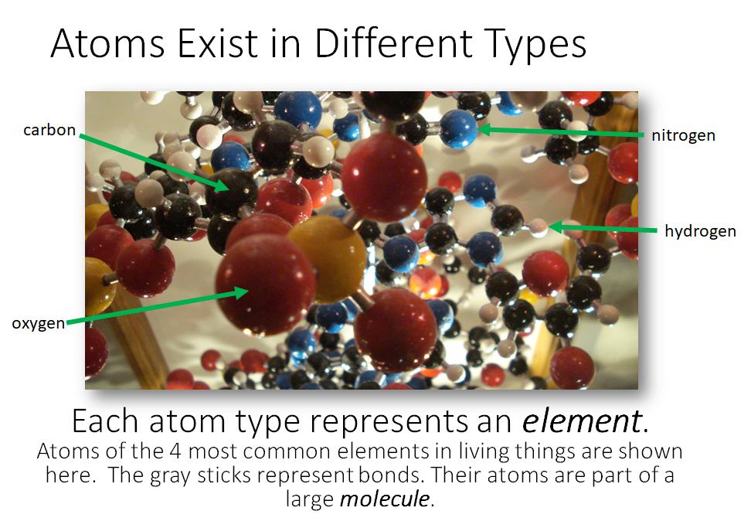
C
N
H
O

Slide 4
Matter
Matter is any substance that occupies space and has mass.
Each element is a specific form of matter with specific properties.
  The atoms of an element cannot be broken down into smaller parts by ordinary chemical reactions.
  There are over 100 known elements.
    Some are man-made.
    Some are unstable.
  Each element is designated by a chemical symbol.

Slide 5
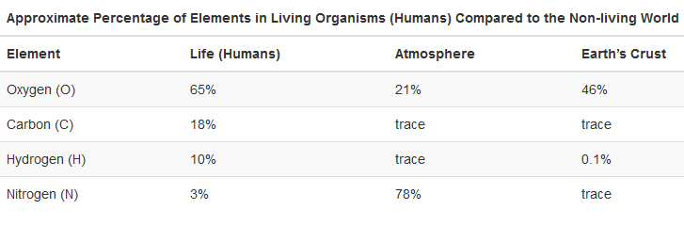
Download for free at http://cnx.org/contents/185cbf87-c72e-48f5-b51e-f14f21b5eabd@10.61

Slide 6
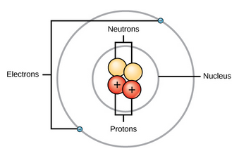
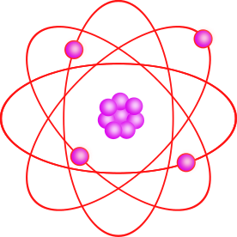
The Structure of an Atom
Download for free at http://cnx.org/contents/185cbf87-c72e-48f5-b51e-f14f21b5eabd@10.61
Caption: Atom Clipart violet (c) MarekM, Public domain
An atom is the smallest unit of an element.
The central atomic nucleus has protons and neutrons.
The outer region has the electrons.
Each type of atom has a specific number and arrangement of these subatomic particles (protons, neutrons, electrons).

Slide 7
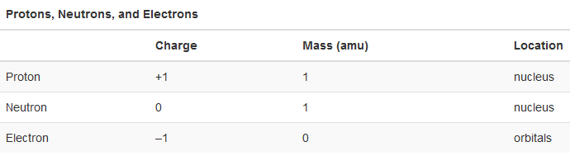
Particles in an atom have electric charges and masses.
Download for free at http://cnx.org/contents/185cbf87-c72e-48f5-b51e-f14f21b5eabd@10.61
Electrons contribute very little to an atom’s mass. So little, it is customary to ignore their mass.
Note: An “amu” (atomic mass unit) is sometimes referred to as a “dalton” to honor John Dalton’s work on atomic theory (1800s).
Remember “Dalton” because we use kilodaltons (kDa) frequently to describe the sizes of proteins

Slide 8
Atomic Number - # of protons
The atomic number is the number of protons in an atom.
Each element has a characteristic atomic number.
  Carbon atoms have an atomic number of 6.
  Hydrogen atoms have an atomic number of 1.
Atomic number cannot change without changing the atom to a different element!

Slide 9
Mass Number - # of protons + neutrons
The mass number is the number of protons and neutrons in the nucleus of an atom.
Mass number is an approximation of the atom’s mass, since it ignores the very tiny contribution of the electrons.
Note that neutron numbers can vary among atoms of an element, changing the overall mass number and creating an “isotope” for that element. The term “atomic mass” refers to the average mass number of naturally occurring atoms of an element on Earth.
Some isotopes are unstable, or “radioactive”. Their atoms decay.
Isotopes of same element – same # of protons, different # of neutrons

Slide 10
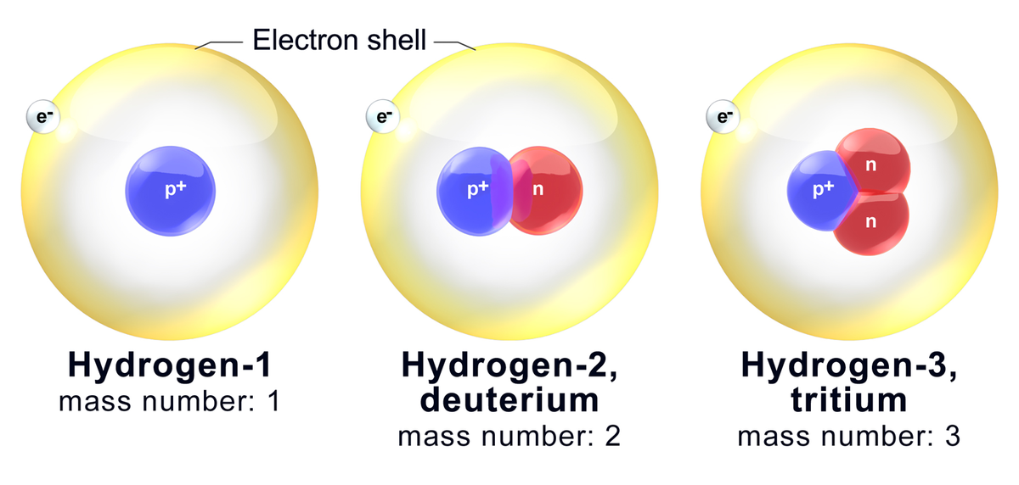
Isotopes of Hydrogen
Caption: Hydrogen Isotopes (c) BruceBlaus, Public domain

Slide 11
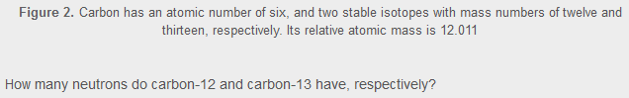
Two Nonradioactive Isotopes of Carbon
Mass number
read as:
“carbon-12”
¹²C
Chemical
symbol
¹³C
read as:
“carbon-13”
6
6
Atomic number (often not included)
Download for free at http://cnx.org/contents/185cbf87-c72e-48f5-b51e-f14f21b5eabd@10.61

Slide 12
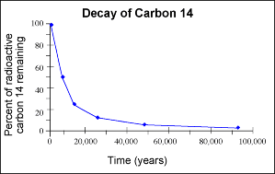
Radioisotopes
Further information:
  https://www.youtube.com/watch?v=cKJMk2Oiod0
  https://www.youtube.com/watch?v=s0TtHjuEE5Y
Every radioisotope has a half life – that half life can be measured, and never changes

Slide 13
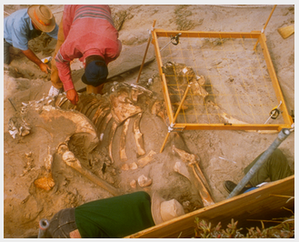
Using Radioactive Decay to Date Fossils and Rocks
¹²C has a radioisotope: ¹⁴C
  ¹⁴C is constantly made on our planet
  ¹⁴C is made when ¹⁴N within N₂ in our atmosphere is hit with cosmic rays and gains a neutron by fusing a proton and an electron
  Organisms take in ¹²C and ¹⁴C throughout their lifetime
  We all have the same amount of ¹⁴C in our bodies (about 1 part per trillion carbon atoms)….we are all slightly radioactive!
    0.01% of K in the body is the radioactive ⁴⁰K
  When an organism dies, it stops taking in carbon, including ¹⁴C
  The ¹⁴C that is in the body will begin to decay, then the level can be measured
Download for free at http://cnx.org/contents/185cbf87-c72e-48f5-b51e-f14f21b5eabd@10.61

Slide 14
Carbon Dating Video:
https://www.youtube.com/watch?v=2io5opwhQMQ
Fossils that might be older (let’s say million of years old) have to be aged using different elements found in the body (potassium for instance) that have longer half lives or by dating rocks and soil that are near the fossils, that contain material from outer space.

Slide 15
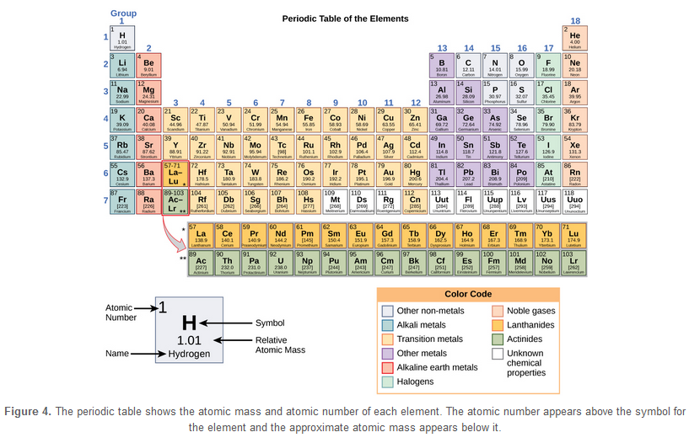
The Periodic Table of the Elements
Memorize the elements boxed in black: hydrogen, sodium, potassium, magnesium, calcium, iron, carbon, nitrogen, oxygen, phosphorous, sulfur, chlorine, and iodine

Slide 16
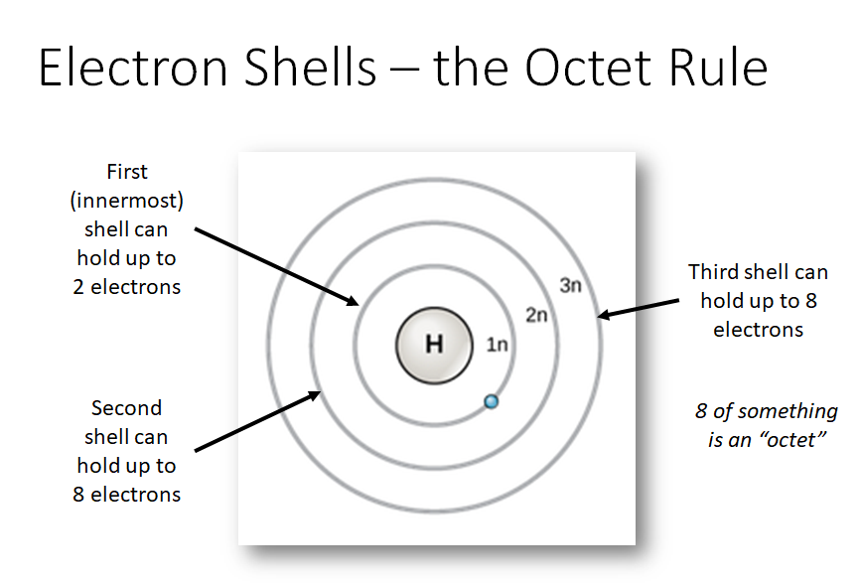
atoms interact with each other, or give/take electrons from one another to fill their shells or empty them completely
H obeys this rule

Slide 17
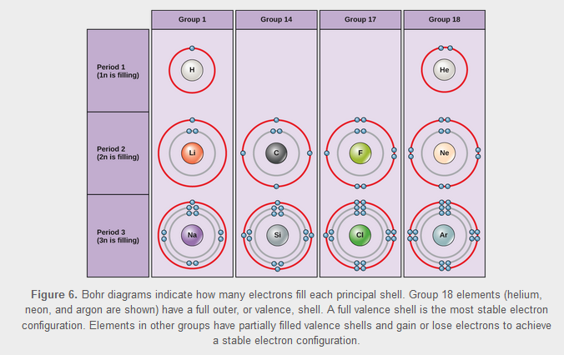
Electrons Fill the Innermost Shell First
The outermost shell is the valence shell.
Download for free at http://cnx.org/contents/185cbf87-c72e-48f5-b51e-f14f21b5eabd@10.61

Slide 18
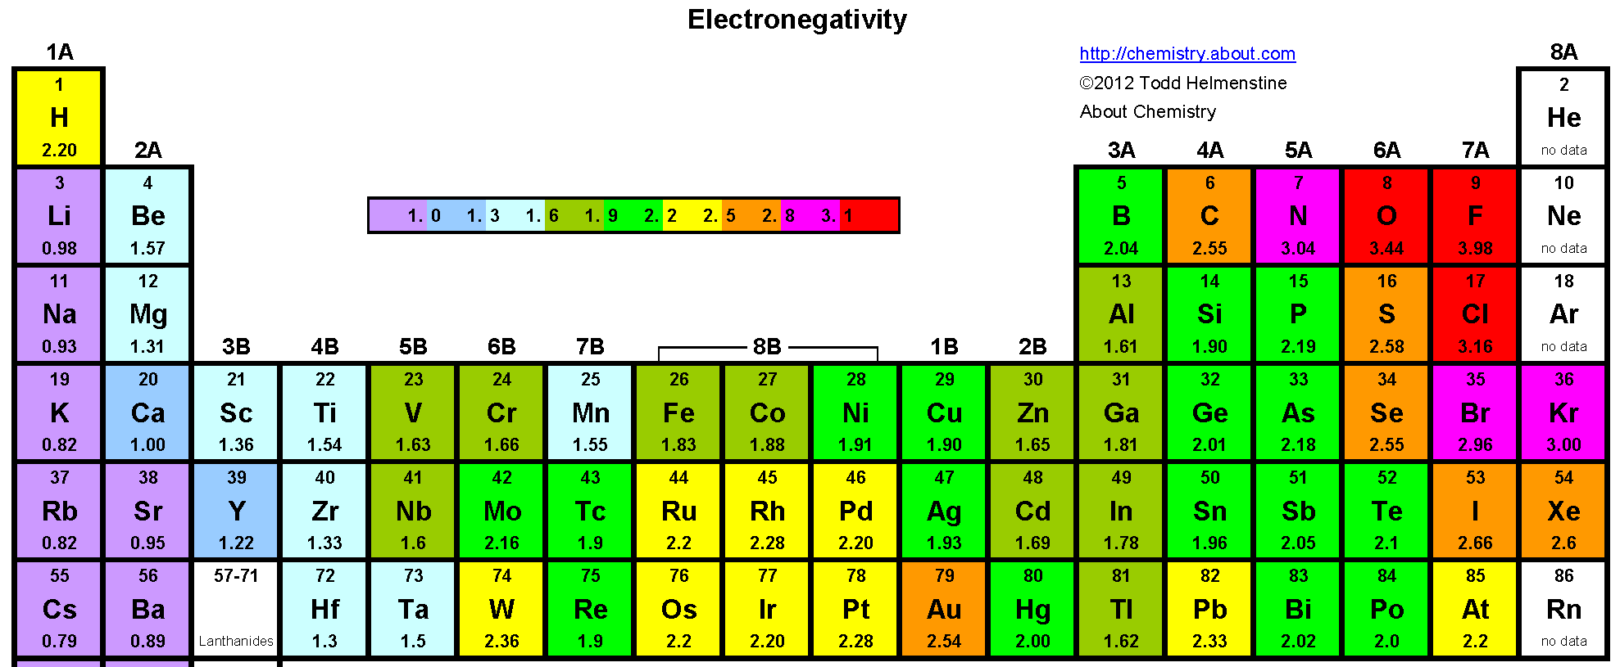
Atoms: neutral but incomplete!
A typical atom is “neutral” (has no overall charge) because the number of protons (+) matches the number of electrons (-).
  The equal numbers of plus and minus cancel each other.
  Because of the octet rule and because most atoms do not have filled electron shells, most atoms do not enjoy being isolated, and so interact with each other to satisfy their octet rules, forming molecules in the process
8 electrons in outer shell
3 electrons in outer shell
5 electrons in outer shell
7 electrons in outer shell
1 electron in outer shell
4 electrons in outer shell
6 electrons in outer shell
2 electrons in outer shell

Slide 19
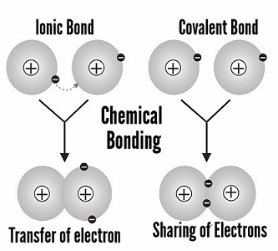
Neutral vs. Charged Atoms
Because atoms need to fill or empty their electron shells, they will either:
  give or take electrons from other atoms, or
  share electrons with other atoms
Atoms that gain or lose electrons become ions (charged particles).
  An extra electron results in an overall negative charge (anion).
  Loss of an electron results in an overall positive charge (cation).
  They gain or lose electrons to fill or empty shells
  For H: 1 to 0 electrons, 1 to 2 electrons
  For most other atoms: [1,2,3,4] to 0 electrons, [4,5,6,7] to 8 electrons)
Anions and cations attract each other in order to balance their opposite charges, forming an ionic bond between the ions. They separate “only in water”.
  Ex: Na⁺ + Cl⁻ = NaCl Ca²⁺ + 2OH⁻ = Ca(OH)₂

Slide 20
Which ions form?
What type of charges form on these atoms to become ions: H, K, Ca, Cl, Na, O?
What kind of ion do each above become – cation or anion?
8 electrons in outer shell
3 electrons in outer shell
5 electrons in outer shell
7 electrons in outer shell
1 electron in outer shell
4 electrons in outer shell
6 electrons in outer shell
2 electrons in outer shell

Slide 21

Ionic Bonds Have Transferred Electrons
Cation (+)
Anion (-)
sodium chloride
Opposite charges attract, holding the atoms together. An ionic bond holds atoms together through their charges
Download for free at http://cnx.org/contents/185cbf87-c72e-48f5-b51e-f14f21b5eabd@10.61

Slide 22
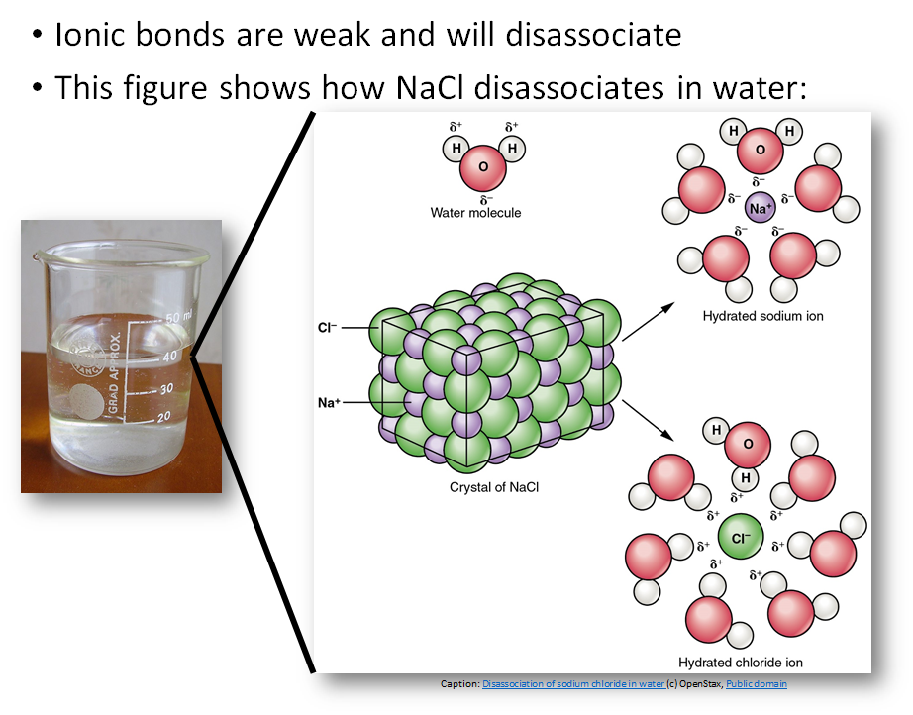

Slide 23
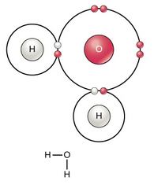
Atoms Can Bond Together to Make Molecules
The differences in chemical reactivity between the elements are based on the number and spatial distribution of an atom’s electrons.
Atoms that chemically react and bond to each other form molecules.
Molecules are simply two or more atoms chemically bonded together.
Sharing electrons plays a key role in forming these bonds.
Covalent bonds are NOT broken by dissolving in water (vs. ionic bonds)
Download for free at http://cnx.org/contents/185cbf87-c72e-48f5-b51e-f14f21b5eabd@10.61

Slide 24
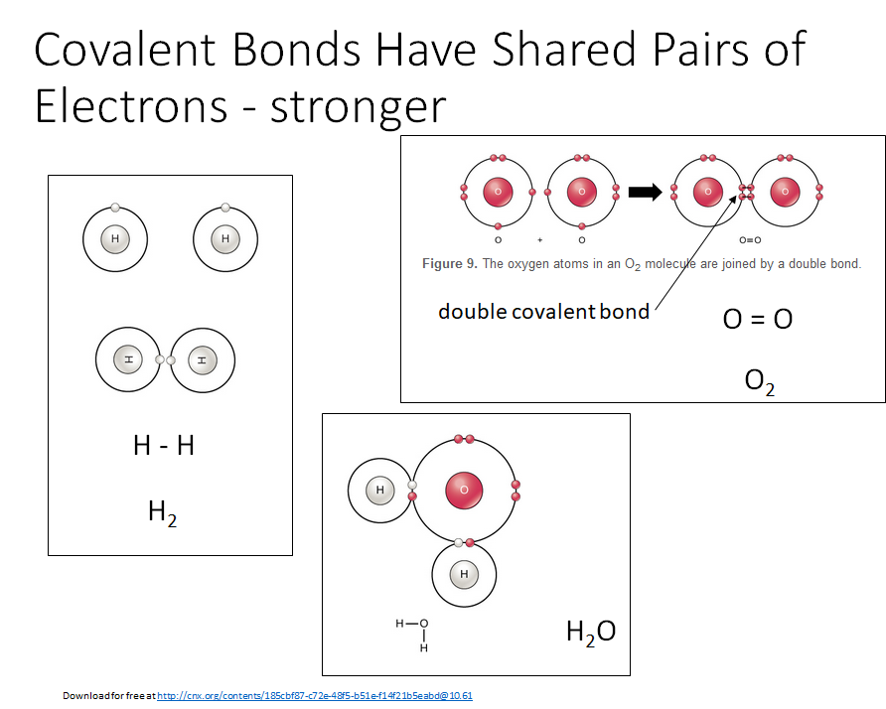

Slide 25
Sharing electrons to become neighbors
H and atoms near the upper-right part of the periodic table share valence electrons (C, N, O, P, S, Cl) instead of giving them or taking them completely
The atoms sharing electrons “always” remain next to each other; thus they are bonded to each other, forming a covalent bond.
The type of bond formed between two atoms is classified on how much time the electrons stay with one atom versus the other atom
  covalent bond - Share “evenly”
  hydrogen bond - Share “barely” – seen with hydrogen in biology – “hybrid” bond between two molecules
  ionic bond - Do not share at all – give and take electrons permanently

Slide 26
Electronegativity: predictor for bonding
Very “electronegative” atoms pull strongly on electrons.
  Tend to be in the upper-right part of the periodic table
  Non-metals
  N, O, F, Cl
Some atoms only have a moderate pull on electrons
  Also non-metals
  C, H, S, P
Metals do not hold onto electrons strongly – they are weakly electronegative
  The left three-fourths of the periodic table
  This is why most metals or alloys (combinations of metals) conduct electricity
Electronegative atoms do not share well with less electronegative atoms.
  Ionic bonds form between metals and non-metals because the electronegative atom (non-metal) pulls the electrons away, and the metal freely gives them up
  Covalent bonds form when the two atoms both want to pull on electrons, creating a “tug-of-war”

Slide 27
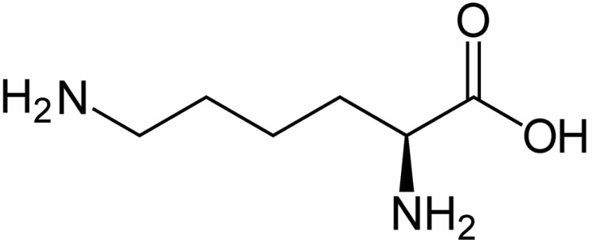
Covalent bonds sub-classified:
How many “tug-of-war”s are evenly matched?????? Not many…
If the two atoms have the same pull (C and C, C and H are the most common examples in biology), then the electrons will be evenly shared between the atom pairs.
  This results in a nonpolar covalent bond.
  Nonpolar covalent bonds are not chemically reactive, and are great in biology for energy storage and forming stable molecular backbones
Shorthand structure
Carbon atoms not labeled
Carbon bonds are “bent”
C-H bonds are left out
Structure of the amino acid arginine

Slide 28
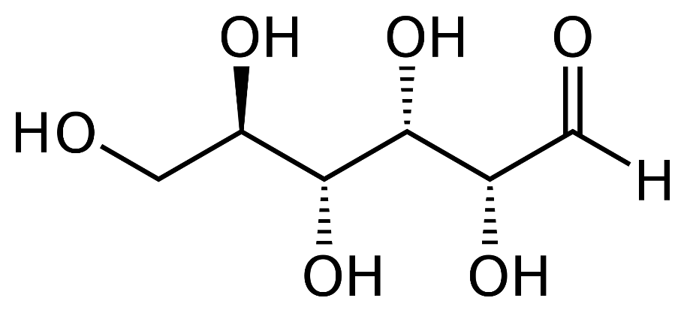
Covalent bonds sub-classified:
When electron charges are not evenly shared:
  The end of the bond with the more electronegative atom has a partial negative charge (the more electronegative atoms is labeled with δ⁻)
  The end of the bond with the less electronegative atom has a partial positive charge (the less electronegative atoms is labeled with δ⁺).
  This separation of partial charges creates a polar covalent bond. These are essential for chemical reactions to occur and thus for life to occur
Bonds between different atoms (C and N somewhat, C and O, more readily in biology) will not share electrons evenly. Electrons spend more time with the more electronegative atom than the less electronegative atom.
Bonds between either N and H and especially O and H in biology share electrons even less readily, especially because hydrogen has such a small atomic mass (1) compared to O (16) or N (14)
δ⁻
δ⁻
δ⁻
δ⁺
δ⁻
δ⁺
δ⁺
δ⁺
δ⁺
δ⁺
δ⁺
δ⁺
δ⁺
δ⁺
Structure of the sugar glucose
δ⁻
δ⁻
δ⁺

Slide 29
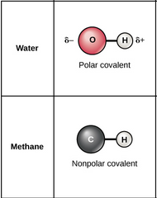
Nonpolar vs. Polar Covalent Bonds

Slide 30
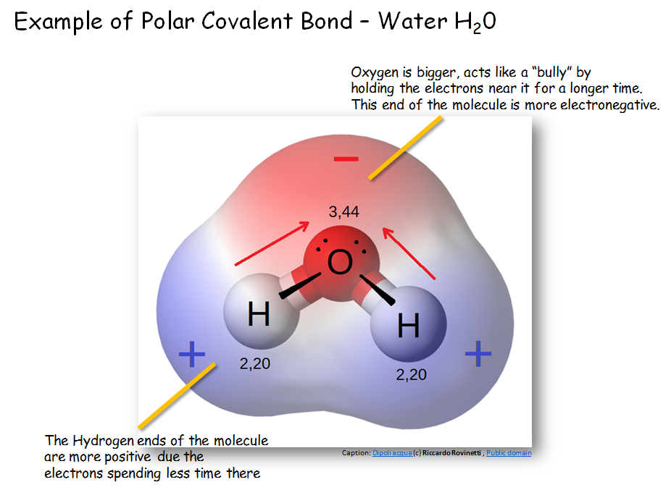

Slide 31
Polar Covalent Bonds and Polar Molecules
Except for lipids (see later) Most biological molecules have many polar covalent bonds.
If the polar bonds do not balance each other out, then the resulting molecule will have polarity – regions with partial positive (δ⁺) and partial negative (δ⁻) charges.

Slide 32

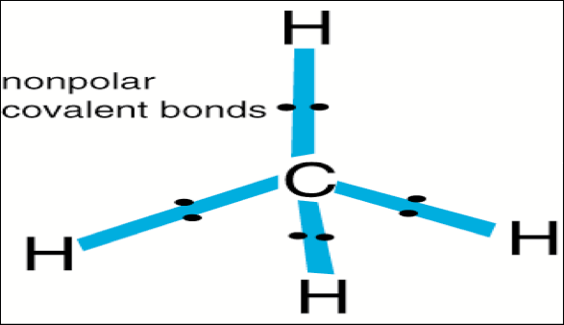
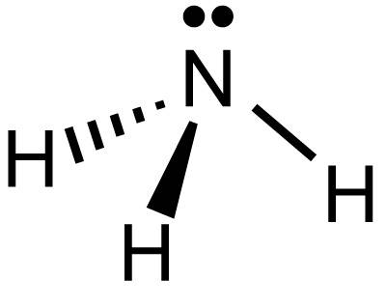
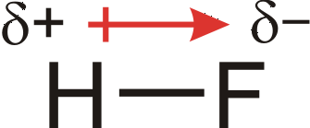
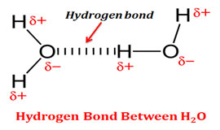
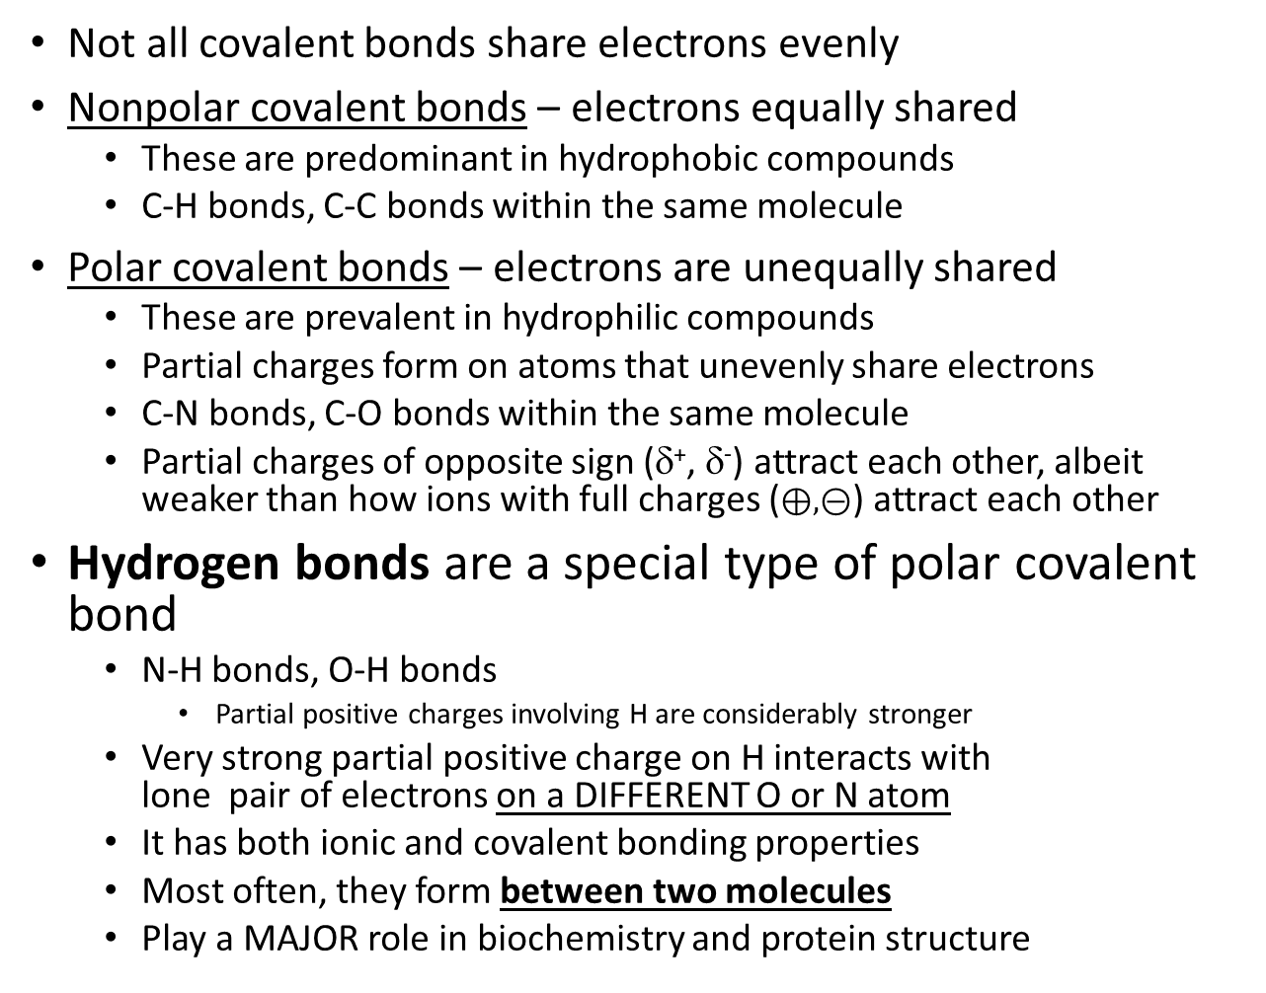
Flavors of Covalent Bonds
Not all covalent bonds share electrons evenly
Nonpolar covalent bonds – electrons equally shared
  These are predominant in hydrophobic compounds
  C-H bonds, C-C bonds within the same molecule
Polar covalent bonds – electrons are unequally shared
  These are prevalent in hydrophilic compounds
  Partial charges form on atoms that unevenly share electrons
  C-N bonds, C-O bonds within the same molecule
  Partial charges of opposite sign (δ⁺, δ⁻) attract each other, albeit weaker than how ions with full charges ($⊕, ⊝$) attract each other
Hydrogen bonds are a special type of polar covalent bond
  N-H bonds, O-H bonds
    Partial positive charges involving H are considerably stronger
  Very strong partial positive charge on H interacts with lone pair of electrons on a DIFFERENT O or N atom
  It has both ionic and covalent bonding properties
  Most often, they form between two molecules
  Play a MAJOR role in biochemistry and protein structure
:
:
:
:
:
:
:

Slide 33
Hydrogen Bonding Between Water Molecules Gives Water Properties Essential to Life
Water:
  is cohesive (bonds to itself).
    This results in surface tension.
  is adhesive (bonds to other charged materials).
    This permits capillary action.
  is less dense when frozen (solid ice floats in liquid water).
  has high specific heat capacity (it takes a lot of energy to cool it down or heat it up).
    1 calorie of energy will raise the temperature of 1 gram of water by 1 degree Celsius.
  has high heat of vaporization (which results in evaporative cooling removing a LOT of heat from the body).
  is an excellent solvent for hydrophilic materials.
    The charges of water can dissociate polar materials, and ionic materials like table salt.
    Hydrophobic materials like oil are nonpolar, have no charges, do not dissolve well in water, and will aggregate in water
      E.g., oil droplets, phospholipids into plasma membranes.

Slide 34
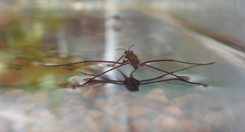
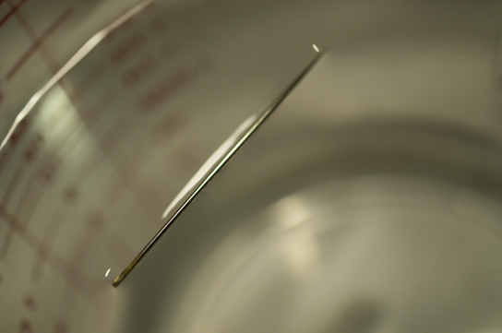
Hydrogen bonding results in surface tension;
This tension helps keep some thin things floating!
Download for free at http://cnx.org/contents/185cbf87-c72e-48f5-b51e-f14f21b5eabd@10.61

Slide 35
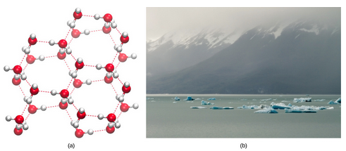
Hydrogen bonding makes ice less dense than liquid water
(nearly all solids sink in their liquid)
Download for free at http://cnx.org/contents/185cbf87-c72e-48f5-b51e-f14f21b5eabd@10.61

Slide 36
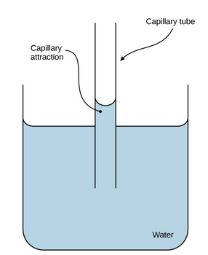
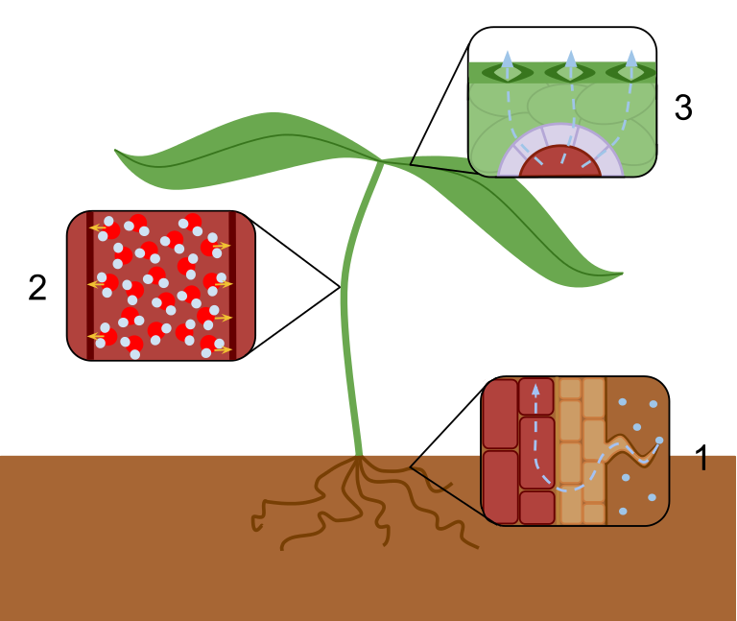
Hydrogen bonding results in capillary action
Download for free at http://cnx.org/contents/185cbf87-c72e-48f5-b51e-f14f21b5eabd@10.61
Caption: Transpiration Overview (c) Laurel Jules, Public domain

Slide 37
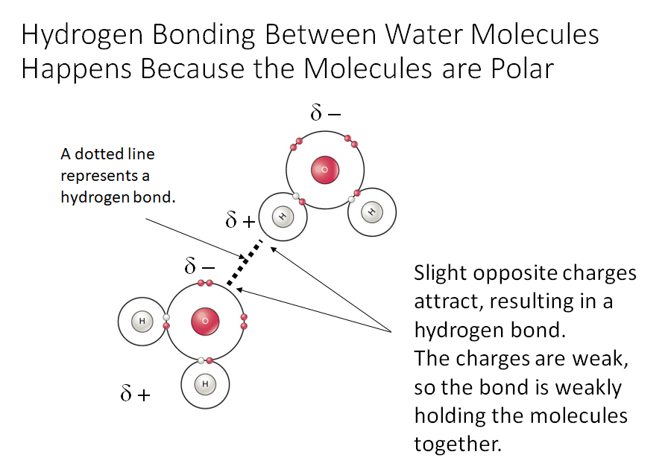

Slide 38
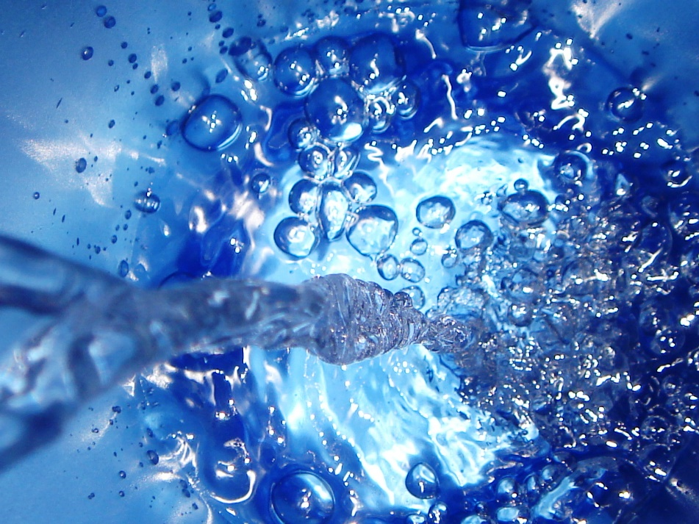
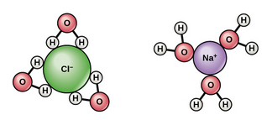
Hydrogen bonding makes water act as a solvent
Download for free at http://cnx.org/contents/185cbf87-c72e-48f5-b51e-f14f21b5eabd@10.61

Slide 39
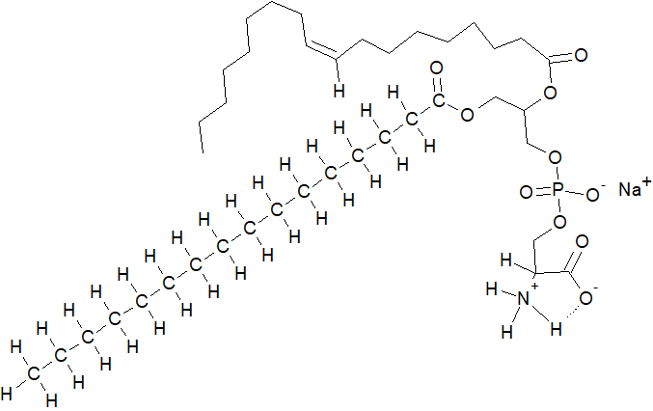
sodium palmitoyloleoylphosphatidylserine
Name the bonds:
δ⁻
δ⁺
δ⁻
δ⁺
δ⁻
δ⁺

Slide 40
Chemical Reactions:
Moving electrons and moving neighbors
A chemical reaction involves the migration of electrons (and any associated atoms) from one molecule to another
  Cl + e⁻ → Cl⁻
  H⁺ + OH⁻ → H₂O
In most of chemistry and nearly all of biology, biochemical reactions involve the breaking of old bonds and the formation of new covalent bonds between molecules. Atoms often move with these electrons from molecule to molecule
  CH₃CH₂OH + CH₃COOH ↔ CH₃COOCH₂CH₃ + HOH

Slide 41
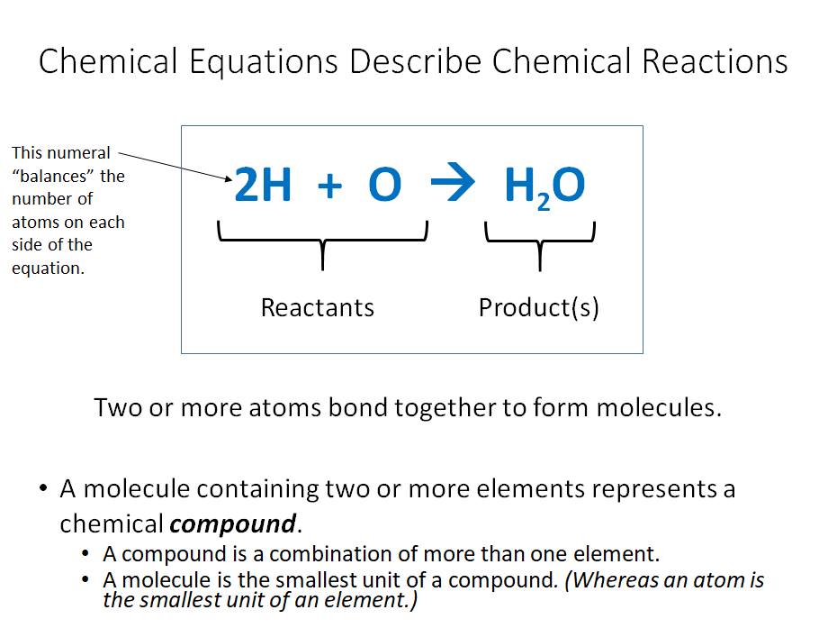

Slide 42
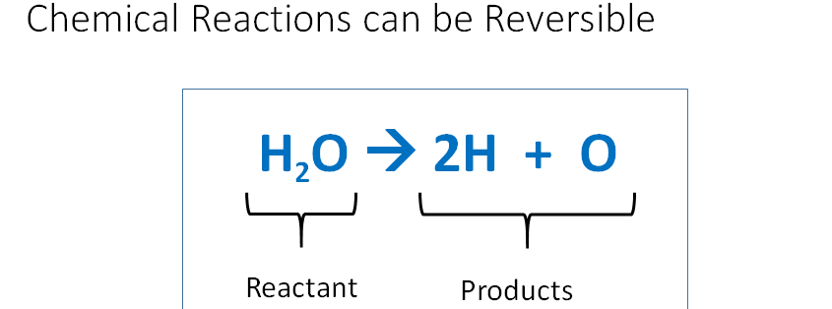
Reversible reactions
Biology depends on reactions being reversible
  Sugars → energy + CO₂ (everyone) and energy + CO₂ → sugars (plants, green algae, and some photosynthetic bacteria)
  Therefore, biologically, sugars ↔ energy + CO₂
  When sugar gone, amino acids are broken down for energy, and some amino acids we make from excess energy molecules
  Therefore, amino acids + H₂0 ↔ energy molecules + NH₃ (ammonia)

Slide 43


Equilibrium
Reversible reactions proceed in one direction or the other toward equilibrium (based on “the law of mass action”).
In human blood, excess hydrogen ions (generated through glycolysis) bind with bicarbonate to form carbonic acid and prevent acidification of the blood. Adding carbonic acid to the system (through CO₂ generation in watery tissues) would drive the reaction toward the left. Loss of carbonic acid (by expiration at the lungs) would drive the reaction to the right.
Does blood get more or less acidic after leaving the lungs??
Our body secretes large amounts of carbonate into our gut to neutralize stomach acid (HCl, which in water is H⁺ and Cl⁻) so it does not burn our intestines. What happens when our gut generates carbon dioxide from large amounts of acidity (e.g., digesting large meals) that it neutralizes??
Video: https://www.youtube.com/watch?v=X3VdcLD6h9w

Slide 44
pH, Buffers, Acids and Bases
A small number of water molecules (about 1 in 100 trillion) spontaneously come apart, generating hydrogen (cat)ions and hydroxide (an)ions.
H₂O → H⁺ + OH⁻
Hydrogen ions consist of naked protons (no electrons, no neutrons), and have a positive charge present on a very TINY particle.
That makes these little ions very reactive (like an angry Chihuahua)
thus we have the age-old term acid when referring to hydrogen cations and the molecules that release them easily.

Slide 45
Acid concentration and the pH concept
Because of the importance of H⁺ in chemistry and because its concentration can vary by factors of trillions depending on the molecule that releases H ⁺, a term called pH is used to describe the amount of acidity in a aqueous solution on a scale we can understand.
pH = -log(hydrogen ion concentration)
Most living things do best at near-neutral pH (6.0 - 8.0).
H⁺ concentration | log₁₀(concentration) | -log(concentration)
0.01M = 1×10⁻²M (full stomach acid) | -2 | 2
0.00001M = 1×10⁻⁵M | -5 | 5
0.0000000398M = 3.98×10⁻⁸M (empty stomach acid) | -7.4 | 7.4

Slide 46
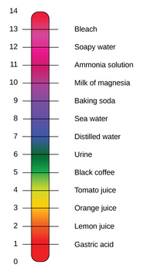
The pH Scale
pH is defined as the negative log of the hydrogen ion concentration.
Pure water has pH 7 (neutral), in the middle.
Acids are at lower pH numbers. (more hydrogen ions)
Bases are at higher pH numbers. (increased hydroxide concentrations create lower hydrogen ion levels )
H₂O ↔ H⁺ + OH⁻
This equation dictates that H⁺ concentrations less than 1×10⁻⁷ must be created by high OH⁻.
Download for free at http://cnx.org/contents/185cbf87-c72e-48f5-b51e-f14f21b5eabd@10.61

Slide 47

Buffers Maintain pH Homeostasis
H+ makes a solution acidic
H+ absorbed so the pH is re-reduced
Generation of CO₂ removes acidifying component
Human blood pH is maintained by the carbonic acid/ bicarbonate/CO₂ system shown above.
Buffers can absorb excess H⁺ or excess OH⁻, helping the system resist pH changes when acids of bases are added.
Download for free at http://cnx.org/contents/185cbf87-c72e-48f5-b51e-f14f21b5eabd@10.61

Slide 48
Carbon Chemistry
Molecules that contain carbon-hydrogen bonds are known as “organic” molecules.*
Organic Chemistry deals with the chemistry of molecules with carbon-hydrogen bonds in them.
We are carbon based beings.
The valence shell of carbon atoms have 4 missing electrons. This allows them to form 4 covalent bonds with other atoms. Such versatility makes them important building blocks for diverse chemistry and for life.
*Carbon Dioxide is “inorganic” because It does not have the carbon-hydrogen bonds characteristic of organic molecules.

Slide 49
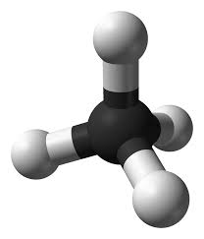
Carbon
Framework of organic compounds consists primarily of C bonded to other C, or N, O, P, S, or H
Carbon forms up to 4 covalent bonds
Methane (CH₄)
Caption: Ball-and-stick model of the methane molecule (c)Ben Mills, Public domain

Slide 50
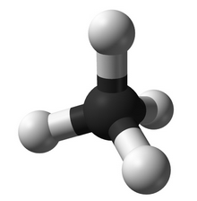
Hydrocarbons
a ball-and-stick model of methane
Hydrocarbons consist of only hydrogen and carbon.
They have many covalent bonds that store energy.
Many fuels, such as propane and octane, are hydrocarbons.
Fats contain a large portion that is hydrocarbon

Slide 51
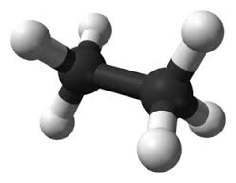
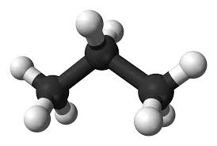
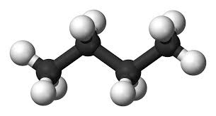
Hydrocarbons
Molecules consisting only of carbon and hydrogen
Nonpolar - most hydrocarbons (think oil/gas)
Functional groups add chemical properties (and polar covalent bonds) to hydrocarbons
Biological molecules are made from hydrocarbon frames, and have functional groups that can make the molecules polar
Ethane Propane Butane
Caption: Ball-and-stick model of the ethane molecule (c)Ben Mills, Public domain
Caption: Ball-and-stick model of the propane molecule (c)Ben Mills, Public domain
Caption: Ball-and-stick model of the butane molecule (c)Ben Mills and Jynto, Public domain

Slide 52
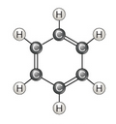

Hydrocarbons Can Form Rings and Chains
aromatic
Rings containing alternating single and double bonds
Flat, rigid structures
aliphatic
Non-aromatic structures; can be chains or rings
Flexible structures
Download for free at http://cnx.org/contents/185cbf87-c72e-48f5-b51e-f14f21b5eabd@10.61

Slide 53
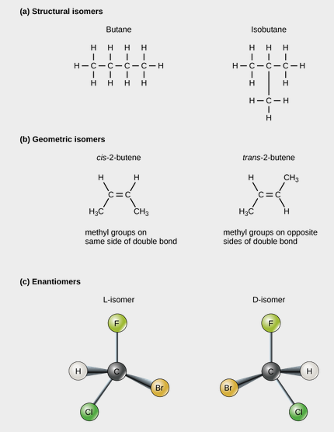
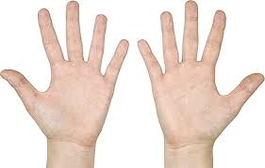
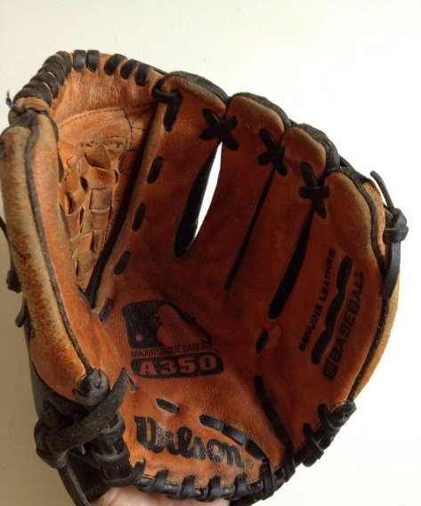
Isomers Use the Same Atoms To Make Different Shapes
This baseball glove fits only one hand. Which hand does it fit, and why?
If you can understand why, you understand the most important point about enantiomers!
Download for free at http://cnx.org/contents/185cbf87-c72e-48f5-b51e-f14f21b5eabd@10.61

Slide 54
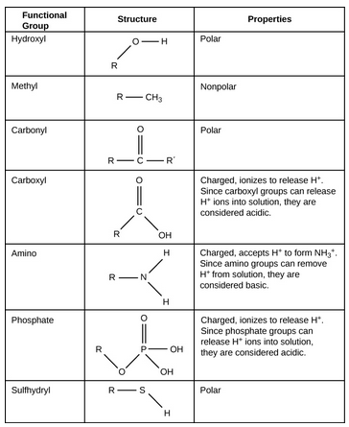
Functional Groups Can be Added to Hydrocarbon Frameworks to change the chemical properties of the compound
Ketone vs aldehyde:
Central C=O vs. terminal C=O
R is C; R’ is C R is C; R’ is H
Amine
Amine: nitrogen and only “plain” C
(R is C)
and generate OH- by consequence
Amide: amine group + carbonyl
(R is C=O)
R’ is N
Download for free at http://cnx.org/contents/185cbf87-c72e-48f5-b51e-f14f21b5eabd@10.61

Slide 55
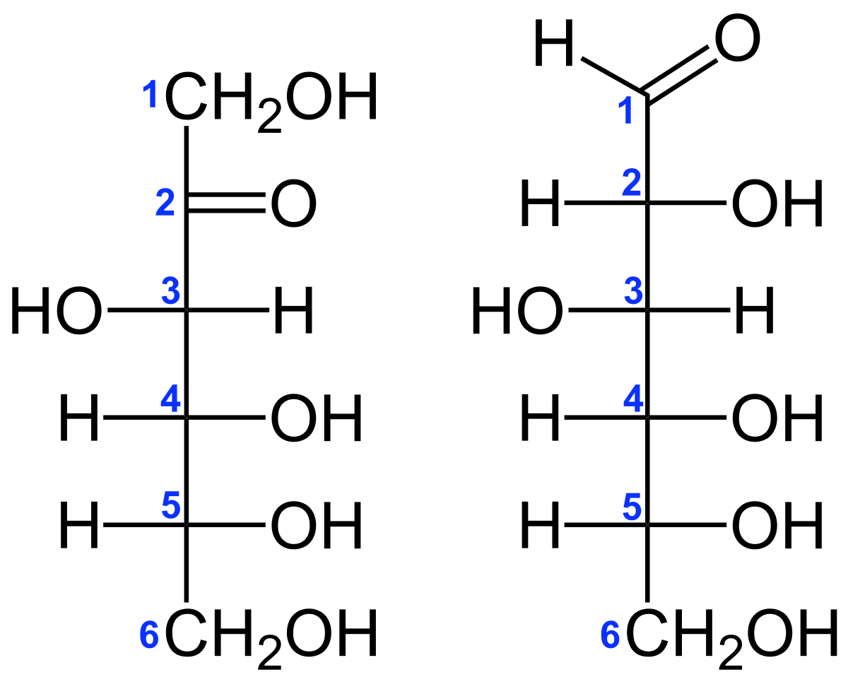

Functional Groups Can be Added to Hydrocarbon Frameworks to change the chemical properties of the compound
Ketone vs aldehyde:
Central C=O vs. terminal C=O
Amide: amino group + carbonyl
fructose:
Has the ketone group
Is a ketose sugar
glucose:
Has the aldehyde group
Is a aldose sugar
Download for free at http://cnx.org/contents/185cbf87-c72e-48f5-b51e-f14f21b5eabd@10.61

